Slide 1

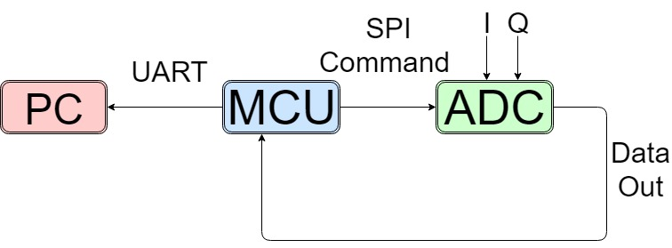
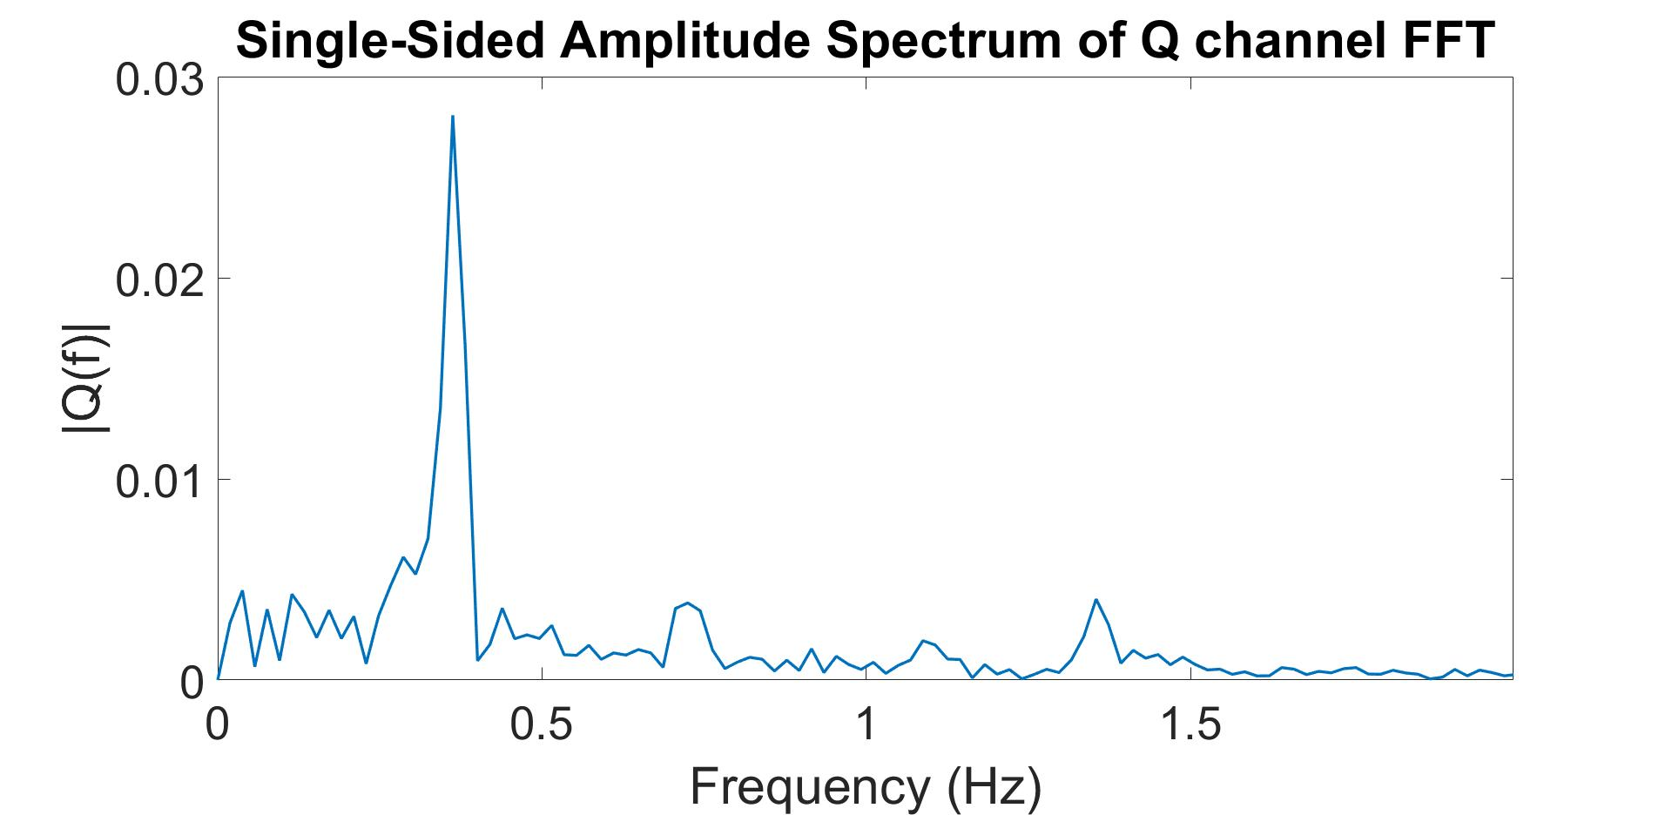
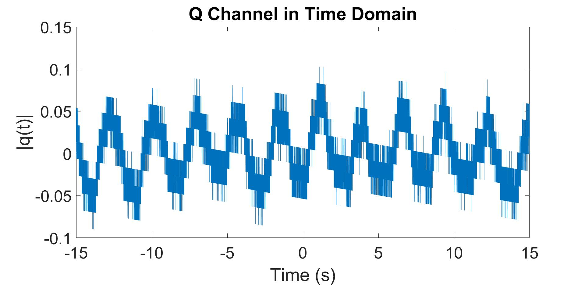
Non Contact Vital Signs Monitoring System
Alec Adamski, Rohan Iyengar, Kedar Manishankar, Sai Sathiesh Rajan
Georgia Institute of Technology
Introduction
Experiment
User Interface
Our team builds upon an existing practical, low-noise detection system that detects vital signs, in order to create a commercial product that is user friendly, can be accessed via a computer user interface (UI) and accurately displays heartbeat and respiration in real-time.
A microcontroller unit (MCU) samples the signal, and converts the incoming analog signal to digital for transmission to a computer
The raw digital data is processed to deconstruct the original signal into two separate signals
The computer UI provides necessary functionality to control the duration of recorded signal and display the incoming raw signal in real-time
Serial Peripheral Interface (SPI) is used to communicate between the MCU and the external ADC, and Universal Asynchronous receiver/transmitter (UART) is used to transmit the digital signal to the computer.
The two incoming signals are analyzed in the frequency domain for spikes representing respiration and heart rate
Using a peak detection algorithm, the respiration and heart rates can be determined
Precautions are taken to distinguish between the heart rate and the harmonics of the much stronger respiration signal
Two filters are generated based on the expected respiration and heart rates to clearly visualize each component
The Graphical User Interface (GUI) system is built in Python to run as a Windows application without network connectivity
The PC listens through UART communication to the experiment setup that is constantly transmitting data.
Through the first screen, the user can specify how long to measure their vitals signal for
Graphs of the user’s raw signal, heart rate signal, heart rate transient, respiration rate signal, and respiration rate transient are displayed
Future Work
Background
Extract both channels containing the quadrature signals from the Data Output register of the external ADC
Implement a commercial mobile application that accurately displays heartbeat and respiration in real-time
Improve the existing UI by using a web application without network connectivity or more professional C# framework.
Noncontact vital sign monitoring systems utilize radar signals to determine the frequency and transient
features of chest movements.
The current system setup uses a Doppler radar because of its better system complexity and high distance resolution, and has the capability to extract the frequency and transient vital sign signals
The most notable difference in design process is the noise suppression scheme to reduce the phase noise of the Doppler radar that has already been implemented
References
Z. Xia and Y. Zhang, “Dual-Carrier Noncontact Vital Sign Detection With a Noise Suppression Scheme Based on Phase-Locked Loop,” in IEEE Transactions on Microwave Theory and Techniques, vol. 64, no. 11, November 2016.
Silicon Labs, "EFM8 Busy Bee Family EFM8BB1 Data Sheet," in www.silabs.com. [Online].
Acknowledgements
Dr. Ying Zhang, Zongyang Xia

