Slide 1
Non Contact Vital Signs Monitoring System
Alec Adamski
Rohan Iyengar
Kedar Manishankar
Sai Sathiesh Rajan

Slide 2
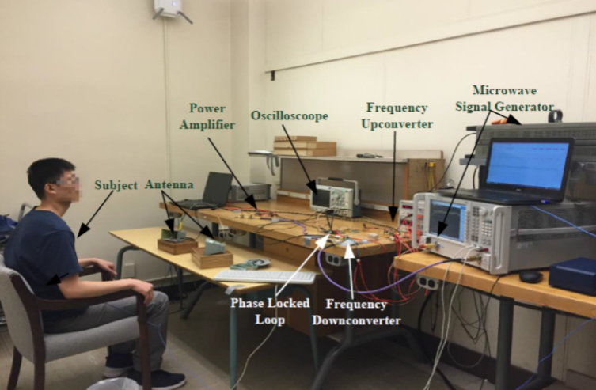
Project Description
Requesting $174.34 to build prototype
Samples and analyze analog signal containing respiration and heart rate
Display important data on computer UI and mobile app

Slide 3
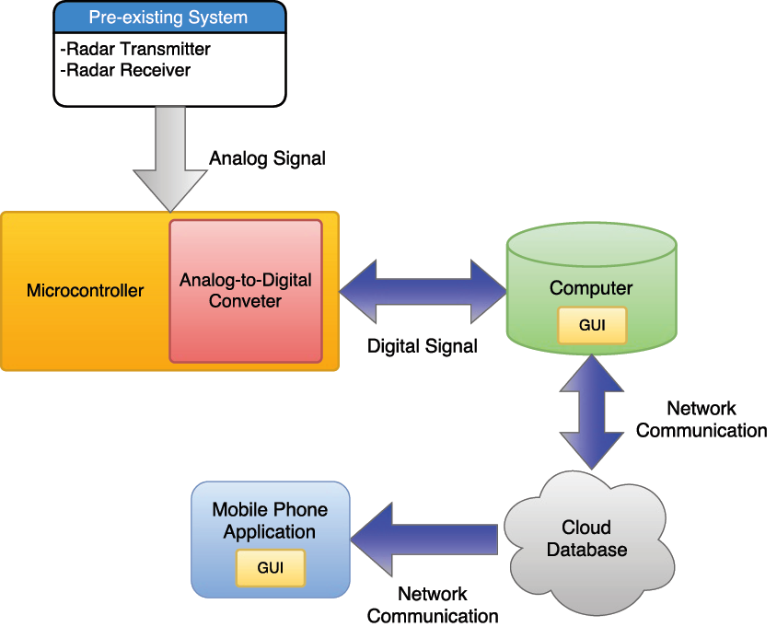
Planned Workflow
Pre-existing Doppler radar
Signal transmission via microcontroller
User controls sampling rate of analog input
Trigger contact system
Signal Deconstruction
Display information on computer UI
Data is stored in a database
Mobile app display

Slide 4
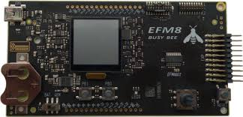
Required Technical Specifications
16 Bit resolution for ADC
External ADC evaluation board
2 Sampling Channels
1000 samples/second
UART MCU-computer connection
SMA female connector on ADC

Slide 5
Signal Processing
Variable Sampling Rate
Blind Signal Separation of the Input Signal
Independent Component Analysis
RELAX Algorithm
Signal Separation
Band Pass Filters
Track the individual signals

Slide 6
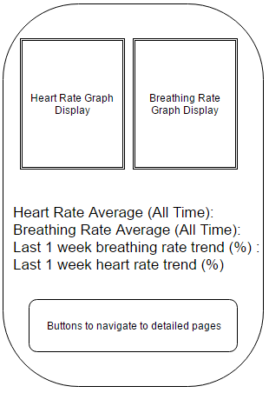
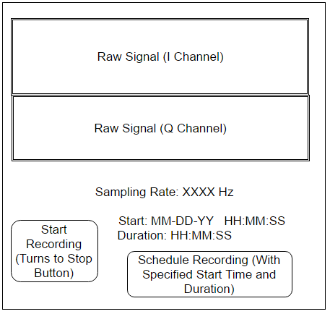
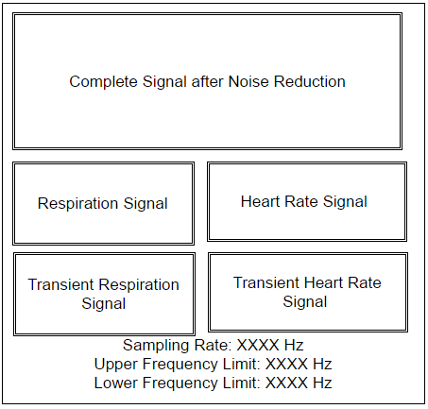
Database/Mobile App
Computer: Mobile:

Slide 7
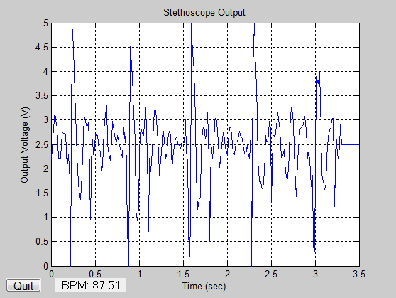
Constraints
Real time display
Delay will be introduced in order to sample and transmit data
Finite amount of data can be stored in the database for free
Wired transmission used to save time and avoid design expenditures into wireless protocol

Slide 8
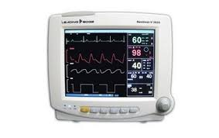
Marketing Analysis
Vital sign monitoring systems range from $1350 to $3895 depending on features and robustness
Our prototype will not be as expensive but will not have the same features

Slide 9
Demonstration
A user will be able to create a new account or add their health data to a precreated existing account.
Once the user is logged in, the raw signal data will be displayed on the screen. The user can set sampling rate and frequency range to analyze and then click a button to go to start recording.
The user views processed signal data like heartbeat and breathing rate on the computer interface to track the current sensor measurement. The transients will also be displayed on this screen.
After a brief delay of 1-2 seconds, can use the phone to access processed data with historical trends on the mobile application.

Slide 10
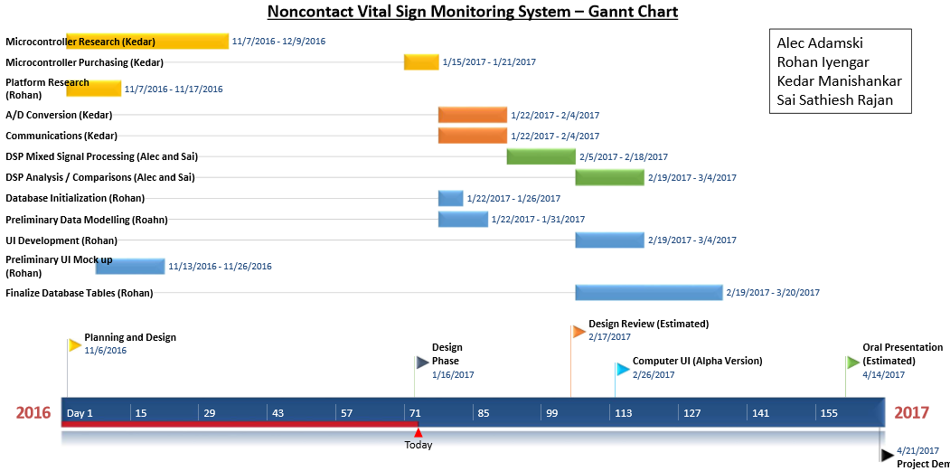
Schedule

Slide 11
Questions?

