Slide 1
Standardization of data.
Presented By: Rohan J. K. Sourav
Last Updated: July 6th,2021

Slide 2
Standardization & normalization.

Slide 3
Summary.
dd p mn s mn_s l_temp super_heat tt
Min. :-1.8859 Min. :-2.3573 Min. :-3.1875 Min. :-3.08360 Min. :-1.6435 Min. :-6.4412 Min. :-1.2084 Min. :-1.8835
1st Qu.:-0.7470 1st Qu.:-0.6672 1st Qu.:-0.7111 1st Qu.:-0.61908 1st Qu.:-0.6991 1st Qu.: 0.1342 1st Qu.:-0.3521 1st Qu.:-0.4594
Median :-0.1775 Median :-0.1039 Median :-0.5007 Median :-0.09097 Median :-0.2542 Median : 0.1712 Median :-0.2229 Median :-0.2220
Mean : 0.0000 Mean : 0.0000 Mean : 0.0000 Mean : 0.00000 Mean : 0.0000 Mean : 0.0000 Mean : 0.0000 Mean : 0.0000
3rd Qu.: 0.6767 3rd Qu.: 0.6473 3rd Qu.: 0.8967 3rd Qu.: 0.78921 3rd Qu.: 0.4451 3rd Qu.: 0.1712 3rd Qu.:-0.0613 3rd Qu.: 0.1170
Max. : 6.9406 Max. : 4.2152 Max. : 3.2814 Max. : 3.25372 Max. :12.1551 Max. : 0.5046 Max. : 7.7425 Max. : 4.8300
cs mcwf mould_level mcwd_temp new_var sczfr m_factor
Min. :-3.3707 Min. :-2.71787 Min. :-14.64393 Min. :-0.93133 Min. :-0.91127 Min. :-4.4955 Min. :-4.5086
1st Qu.:-0.8257 1st Qu.:-0.66204 1st Qu.: -0.32342 1st Qu.:-0.22758 1st Qu.:-0.24601 1st Qu.:-0.4569 1st Qu.:-0.4547
Median : 0.1029 Median :-0.06869 Median : 0.01873 Median :-0.04986 Median :-0.06063 Median : 0.1246 Median : 0.1247
Mean : 0.0000 Mean : 0.00000 Mean : 0.00000 Mean : 0.00000 Mean : 0.00000 Mean : 0.0000 Mean : 0.0000
3rd Qu.: 0.6876 3rd Qu.: 0.57835 3rd Qu.: 0.67495 3rd Qu.: 0.08639 3rd Qu.: 0.08529 3rd Qu.: 0.5892 3rd Qu.: 0.5888
Max. : 4.4708 Max. : 5.27078 Max. : 6.32485 Max. : 9.04444 Max. :11.15343 Max. : 4.7018 Max. : 4.7069

Slide 4
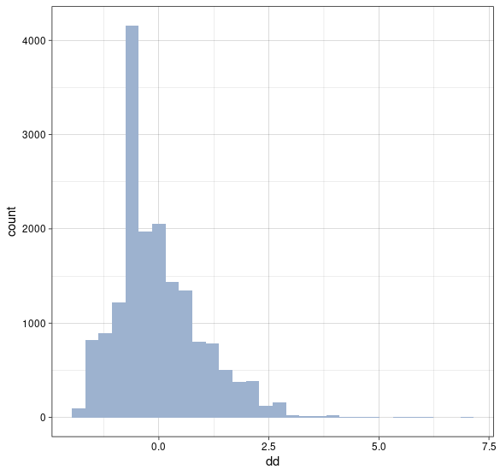
Diagonal difference

Slide 5
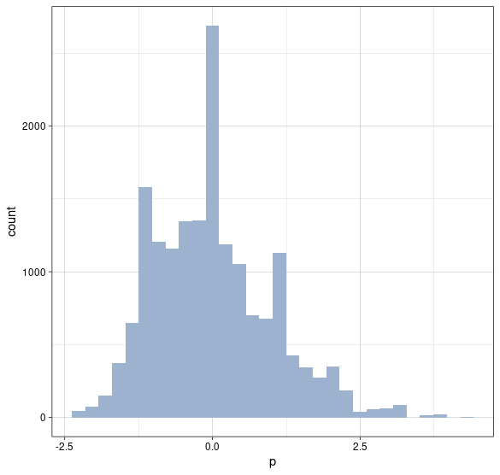
Phosphorus content

Slide 6
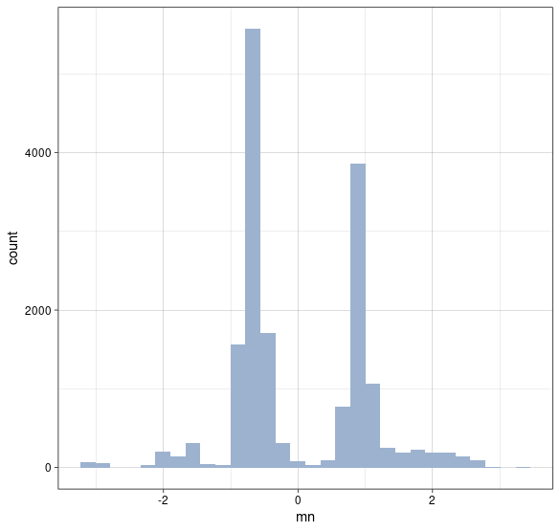
Manganese content

Slide 7
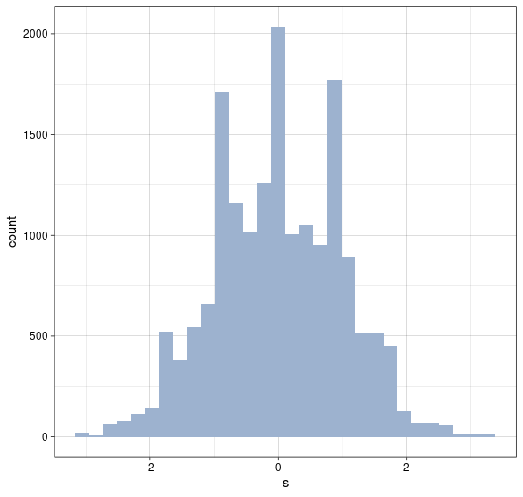
Sulphur content

Slide 8
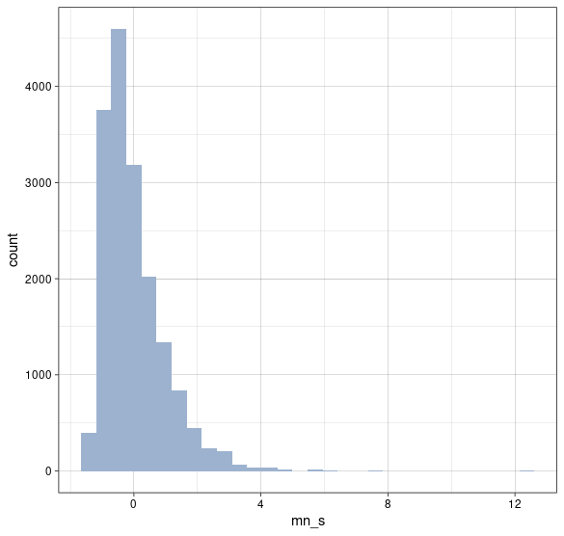
Mn/S ratio

Slide 9
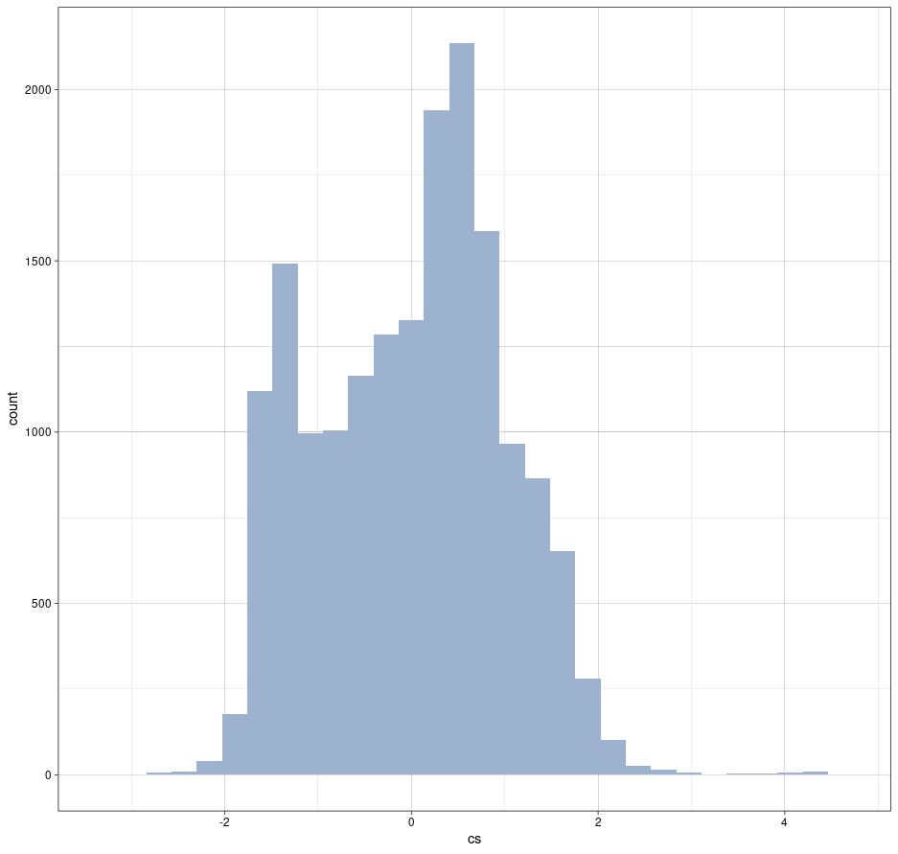
Casting speed

Slide 10
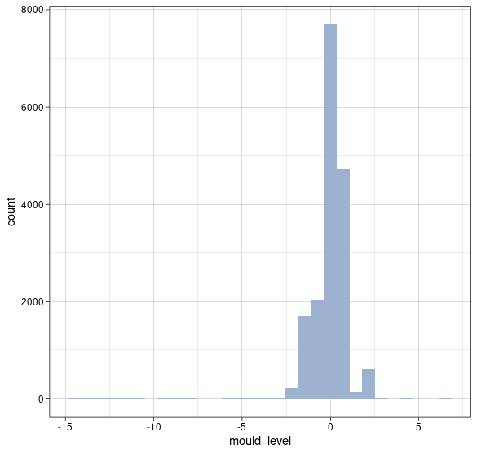
Mould level

Slide 11
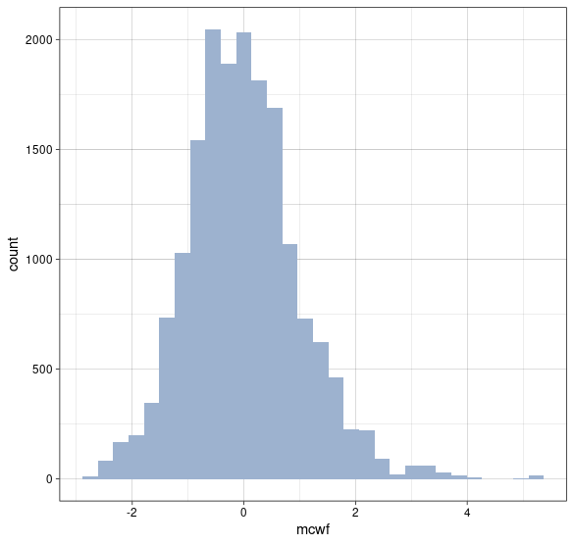
Mould cooling water flow rate

Slide 12
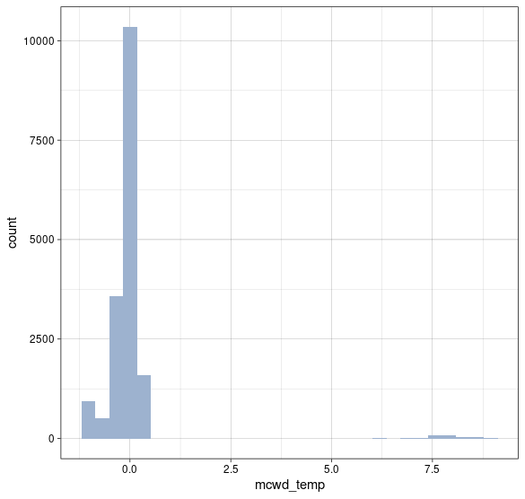
MCW delta temperature

Slide 13
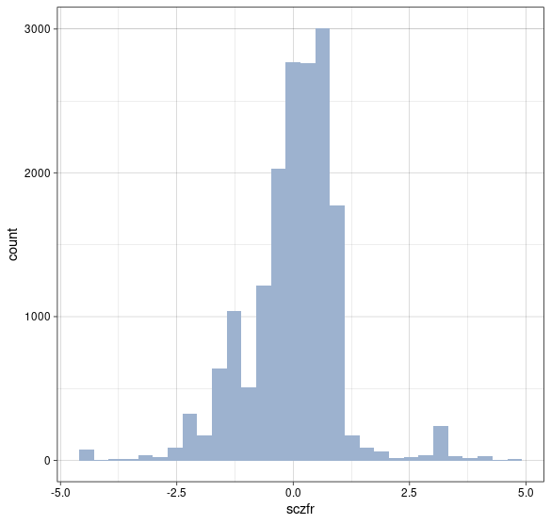
Sec cooling zone flow rate

Slide 14
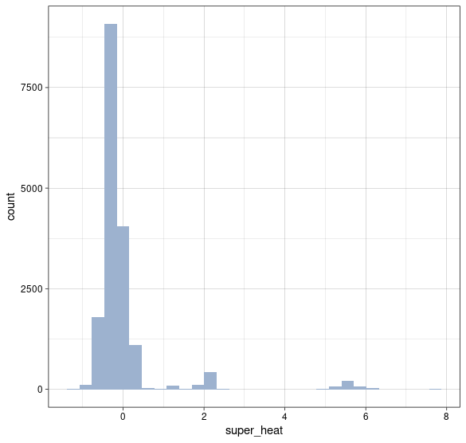
Superheat

Slide 15
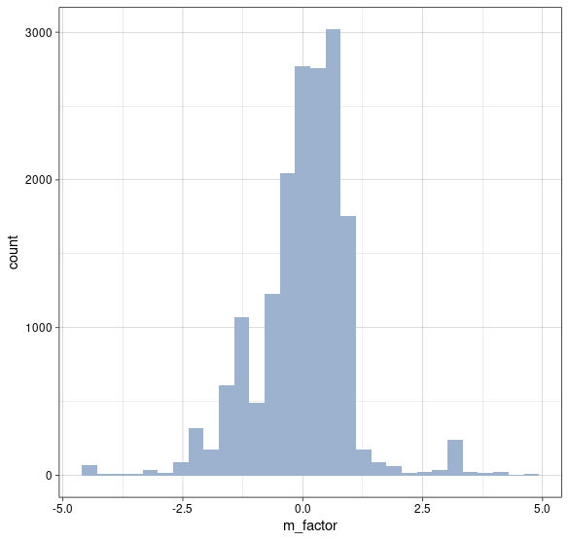
M fator

Slide 16
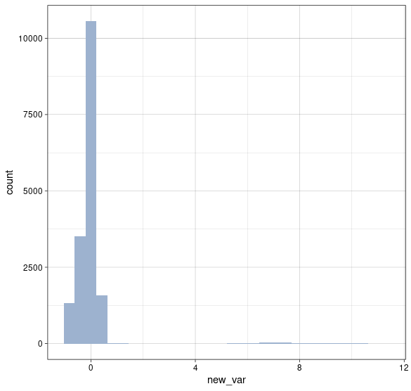
new_var

Slide 17
Correlation.

Slide 18
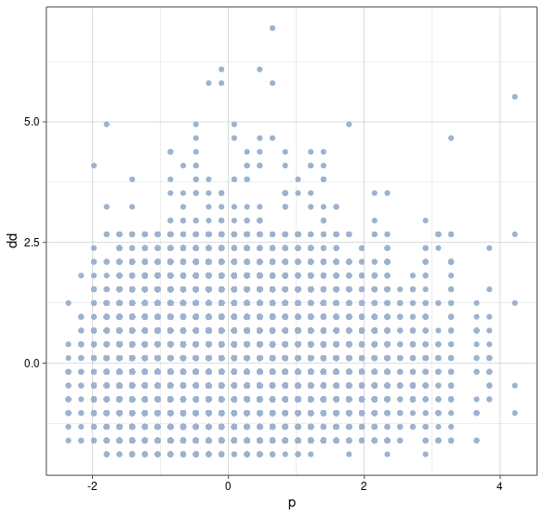
Between P content & DD

Slide 19
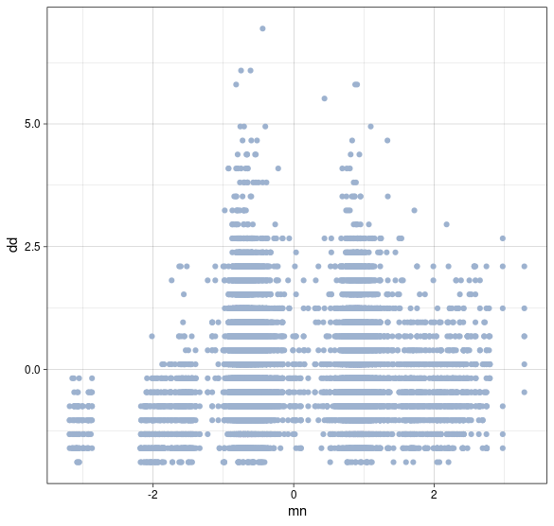
Between Mn content & DD

Slide 20
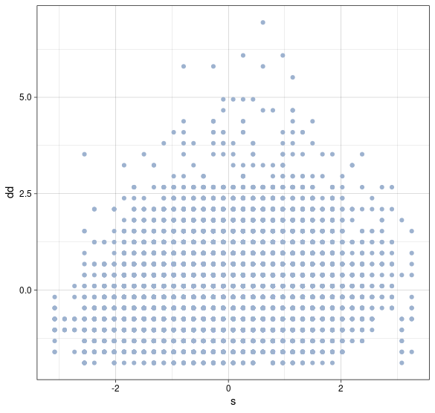
Between S content & DD

Slide 21
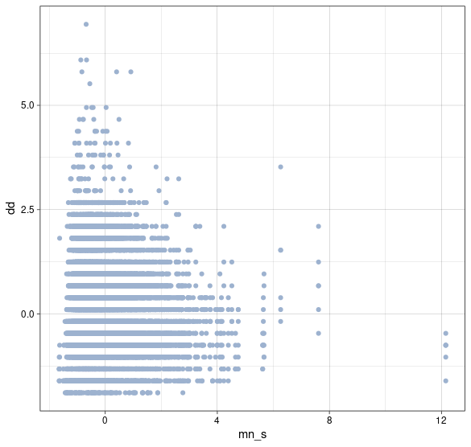
Between Mn/S ratio & DD

Slide 22
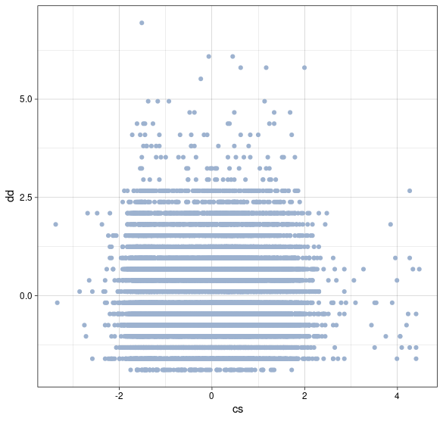
Between CS & DD

Slide 23
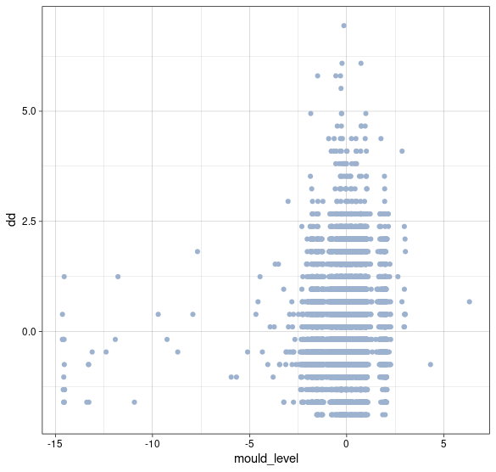
Between ML & DD

Slide 24
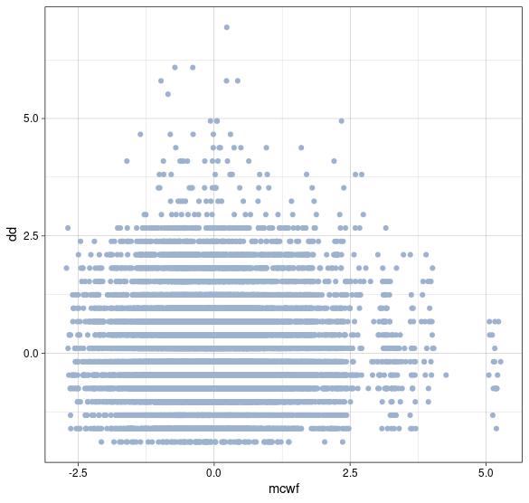
Between MCWF & DD

Slide 25
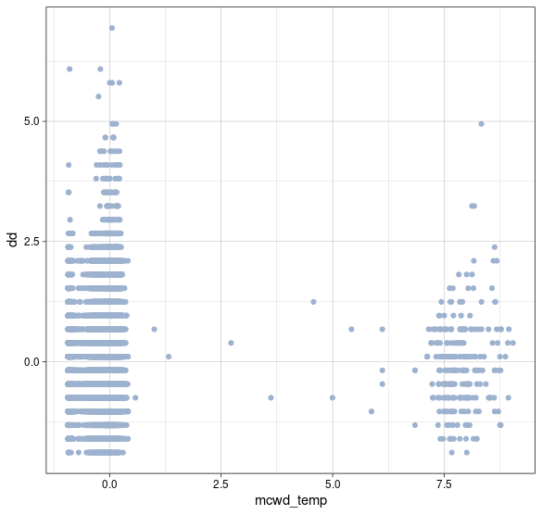
Between MCWDT & DD

Slide 26
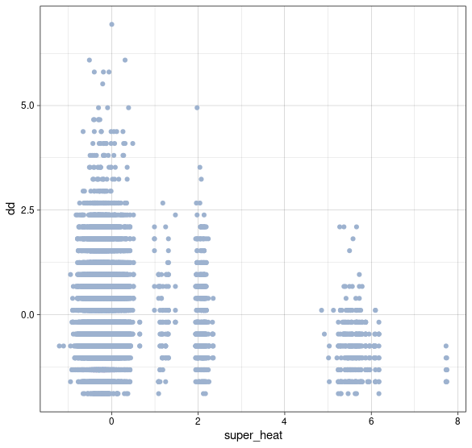
Between superheat & DD

Slide 27
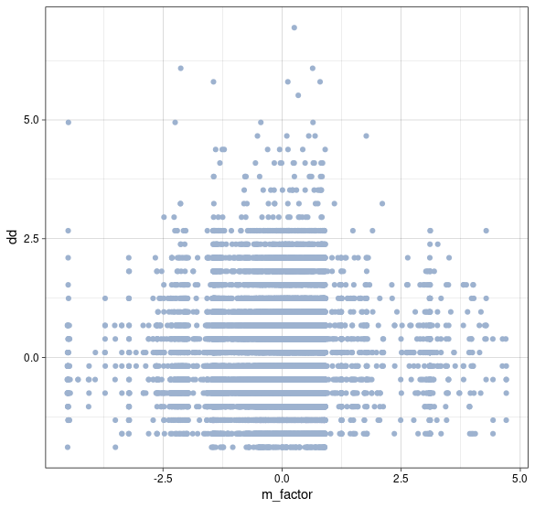
Between m factor & DD

Slide 28
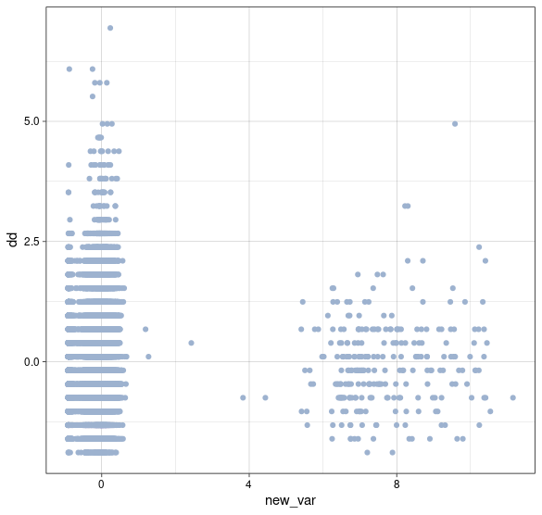
Between new_var & DD

