Slide 1
Statistical analysis
Presented By: Rohan J.
Last Updated: July 2th,2021

Slide 2
Statistical analysis of variables.

Slide 3
Table of Content
Analysis of individual variables & correlation
Analysis of variables.
Correlation with rhomboidity.
Conclusion.

Slide 4
Statistical analysis.

Slide 5
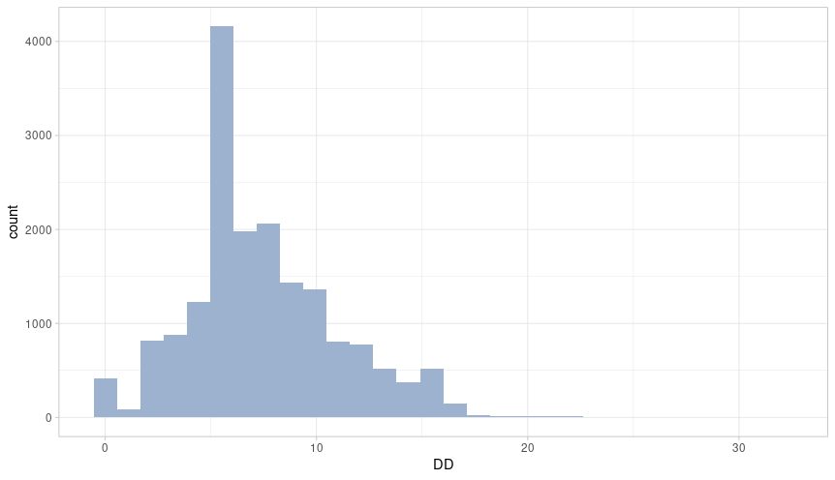
Diagonal difference
Mean = 7.452
Median = 7.000
Standard deviation = 3.6532

Slide 6
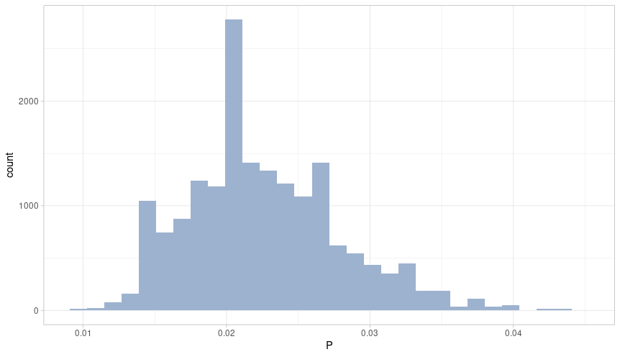
Phosphorus content
Mean = 0.022553349
Median = 0.0222000
Standard deviation = 0.00532604

Slide 7
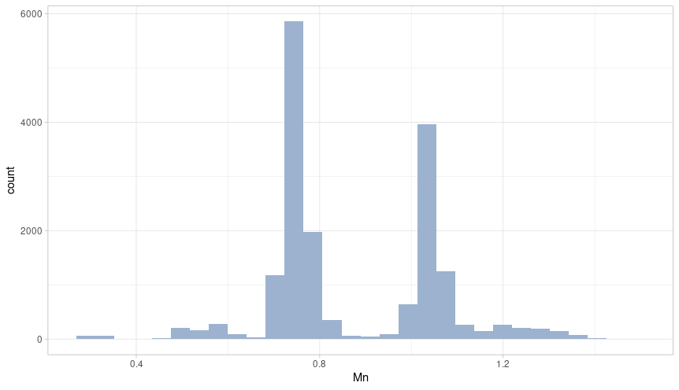
Manganese content
Mean = 0.872
Median = 0.779
Standard deviation = 0.1853034

Slide 8
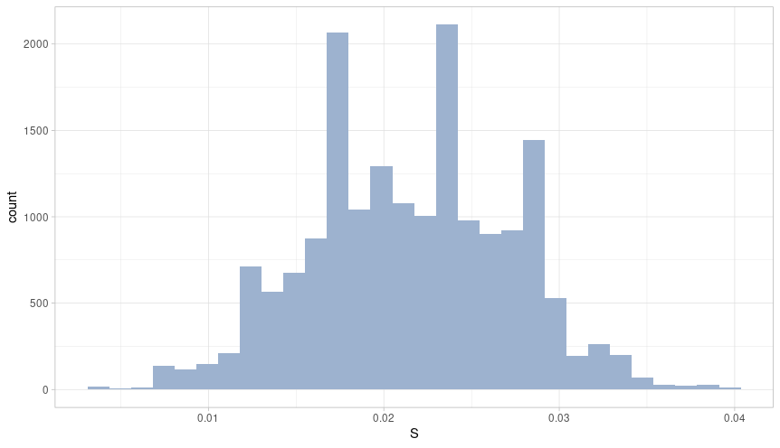
Sulphur content
Mean = 0.02151
Median = 0.02100
Standard deviation = 0.005681

Slide 9
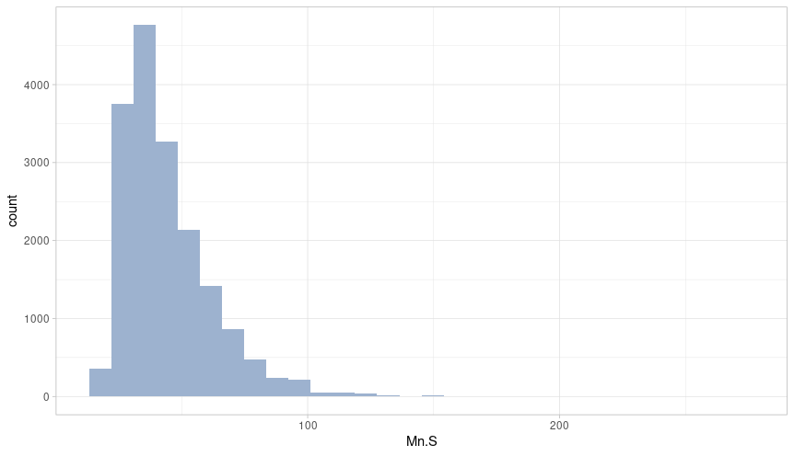
Mn/S ratio
Mean = 44.23
Median = 39.54
Standard deviation = 18.4387

Slide 10
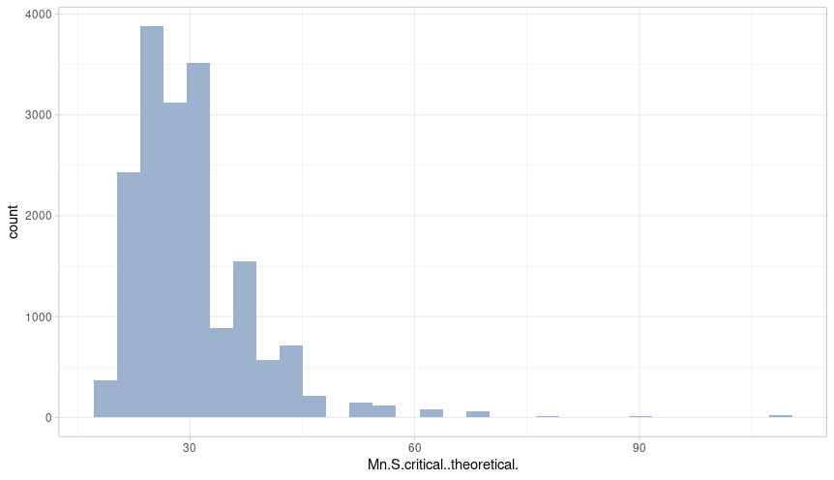
Mn/S critical ratio
Mean = 30.05
Median = 28.83
Standard deviation = 8.069874

Slide 11
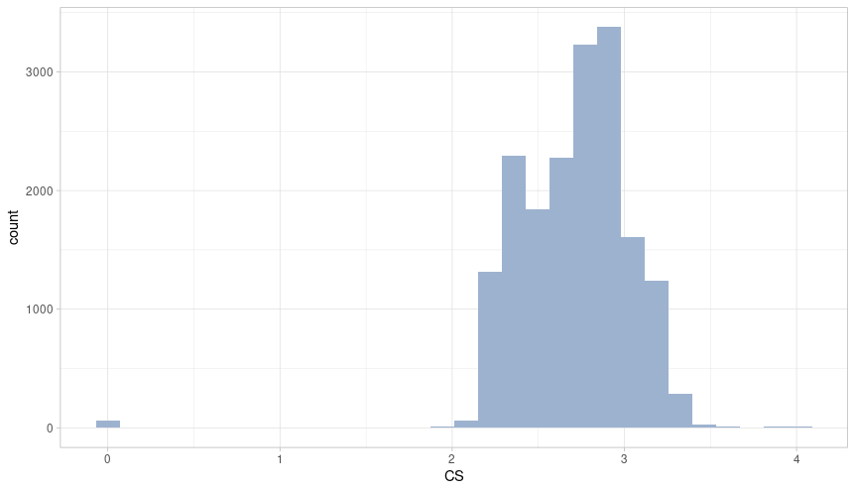
Casting speed
Mean = 2.711
Median = 2.750
Standard deviation = 0.333195

Slide 12
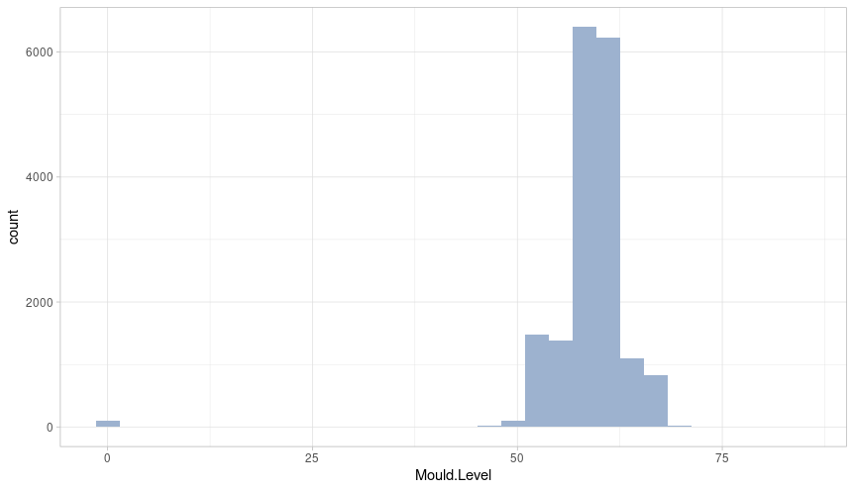
Mould level
Mean = 58.81
Median = 59.12
Standard deviation = 5.684378

Slide 13
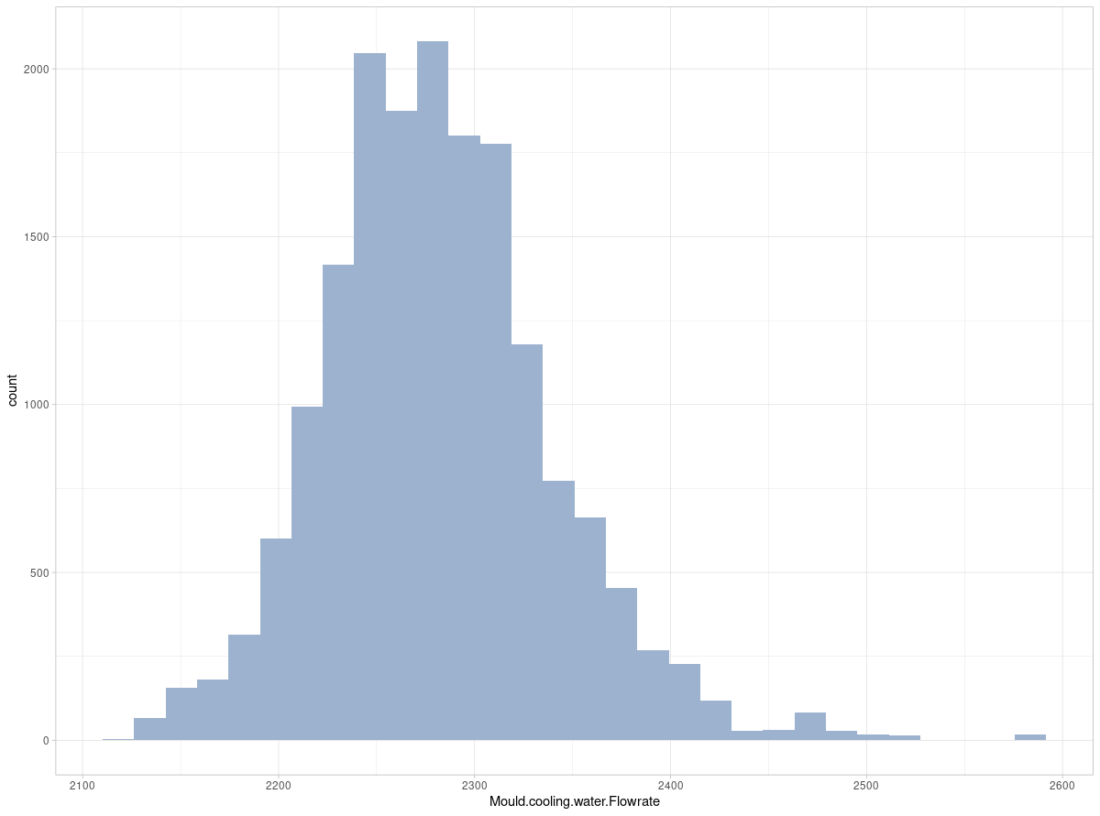
Mould cooling water flow rate
Mean = 2181.867
Median = 2277.855
Standard deviation = 58.25385

Slide 14
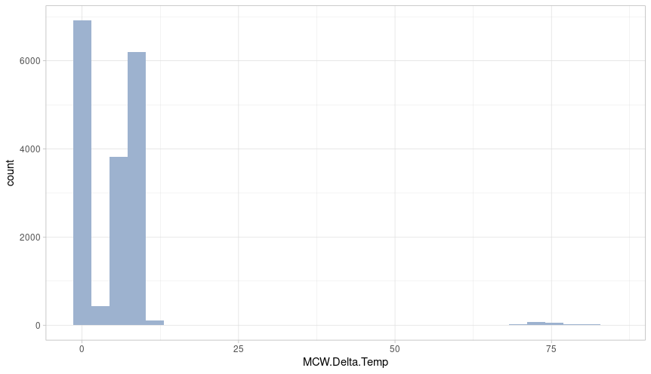
MCW delta temperature
Mean = 5.286
Median = 5.8500
Standard deviation = 8.2937

Slide 15
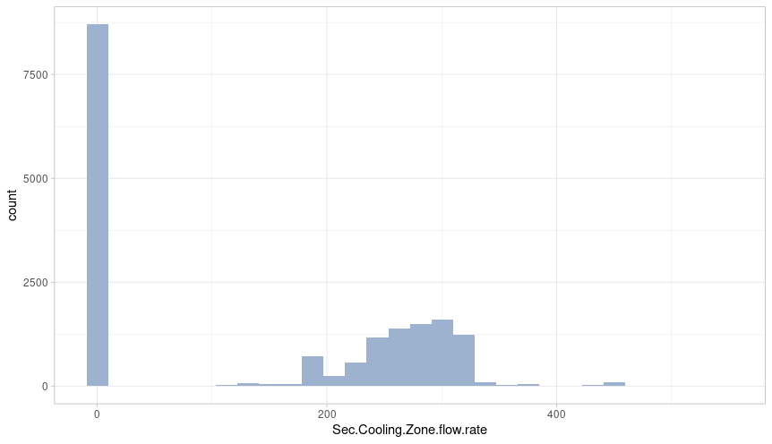
Sec cooling zone flow rate
Mean = 137.1
Median = 144.8
Standard deviation = 139.8454

Slide 16
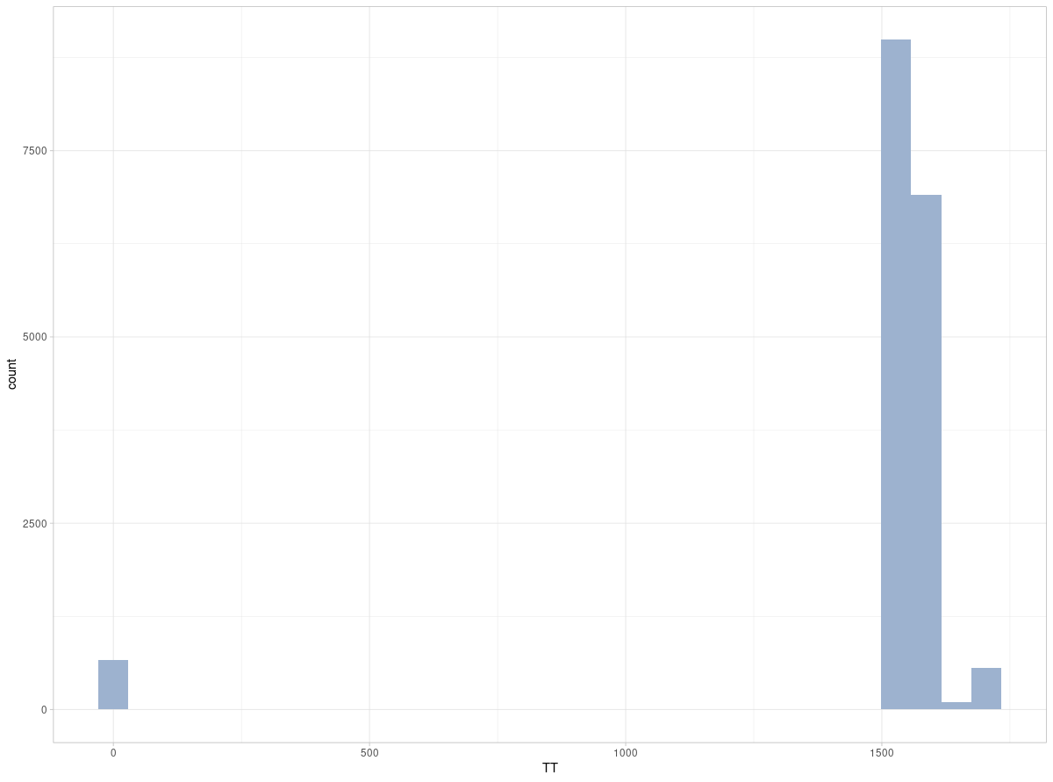
Tundish temperature
Mean = 1502.766
Median = 1555.000
Standard deviation = 301.1913

Slide 17
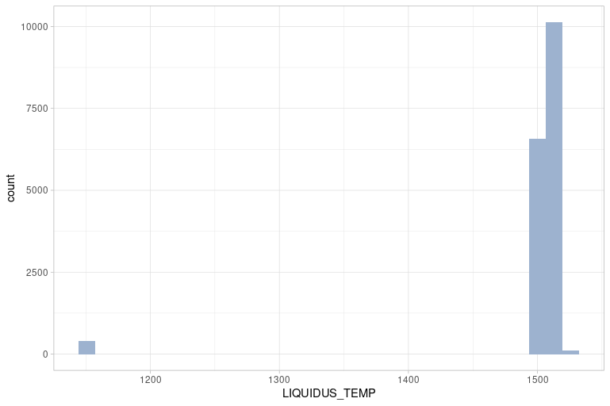
Liquidus temperature
Mean = 1499
Median = 1508
Standard deviation = 53.9894

Slide 18
Correlation.

Slide 19
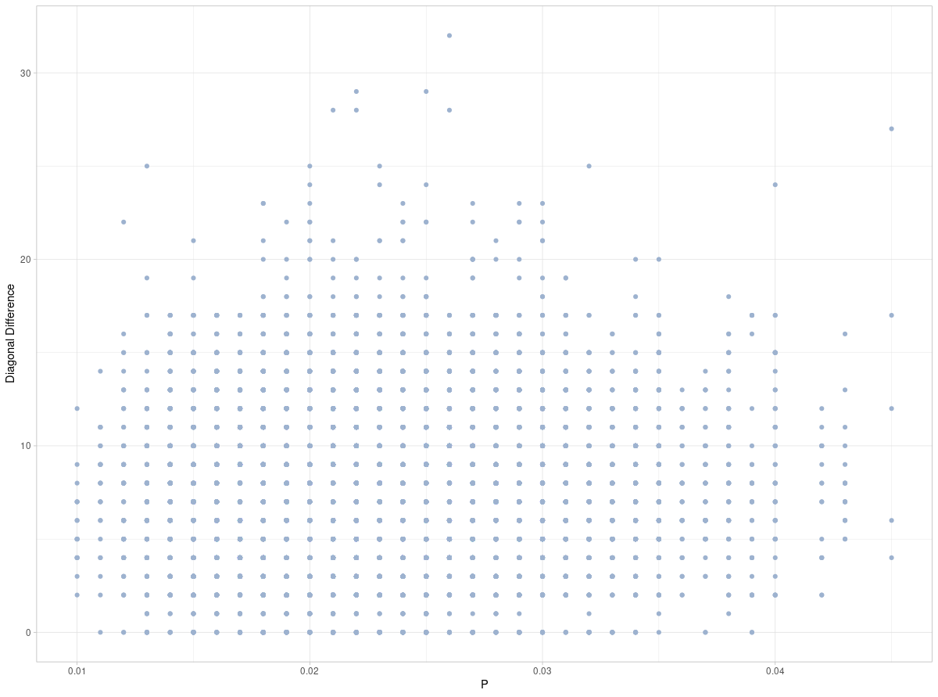
Between P content & DD

Slide 20
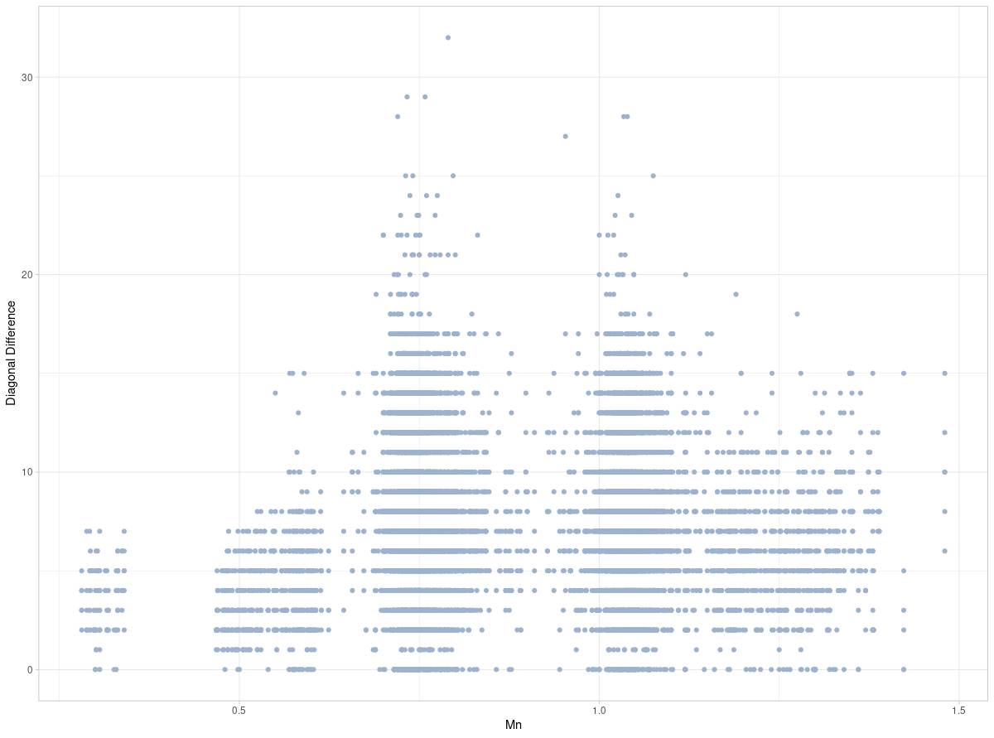
Between Mn content & DD

Slide 21
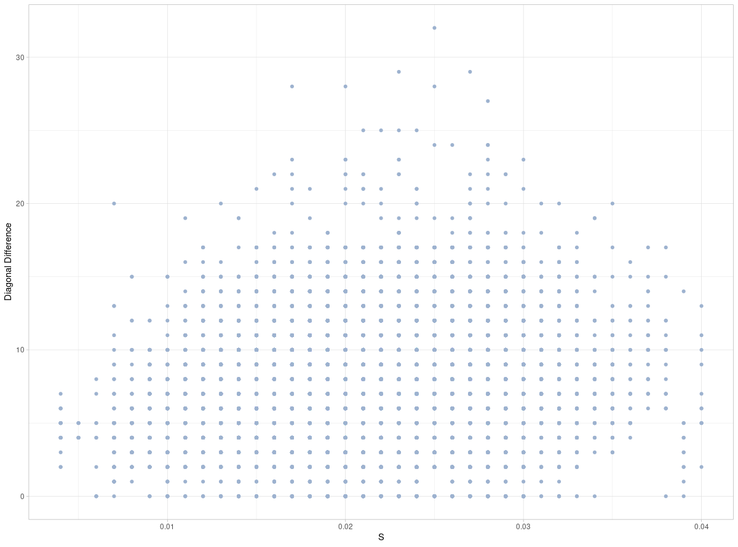
Between S content & DD

Slide 22
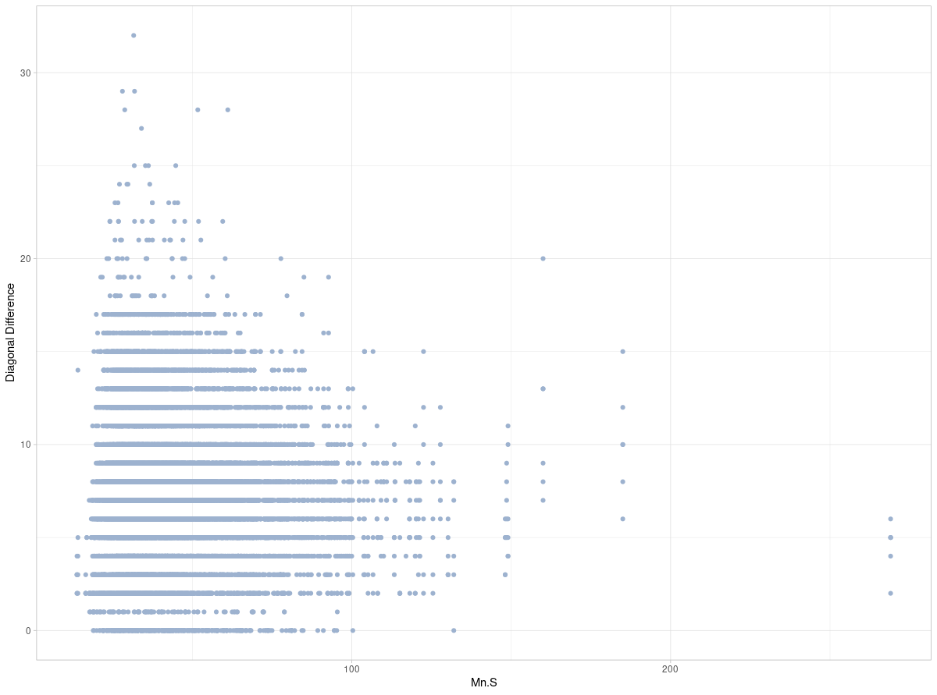
Between Mn/S ratio & DD

Slide 23
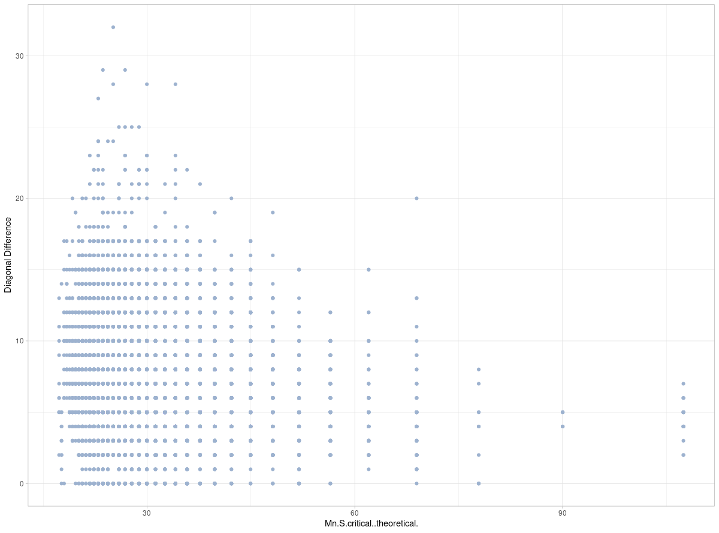
Between Mn/S critical & DD

Slide 24
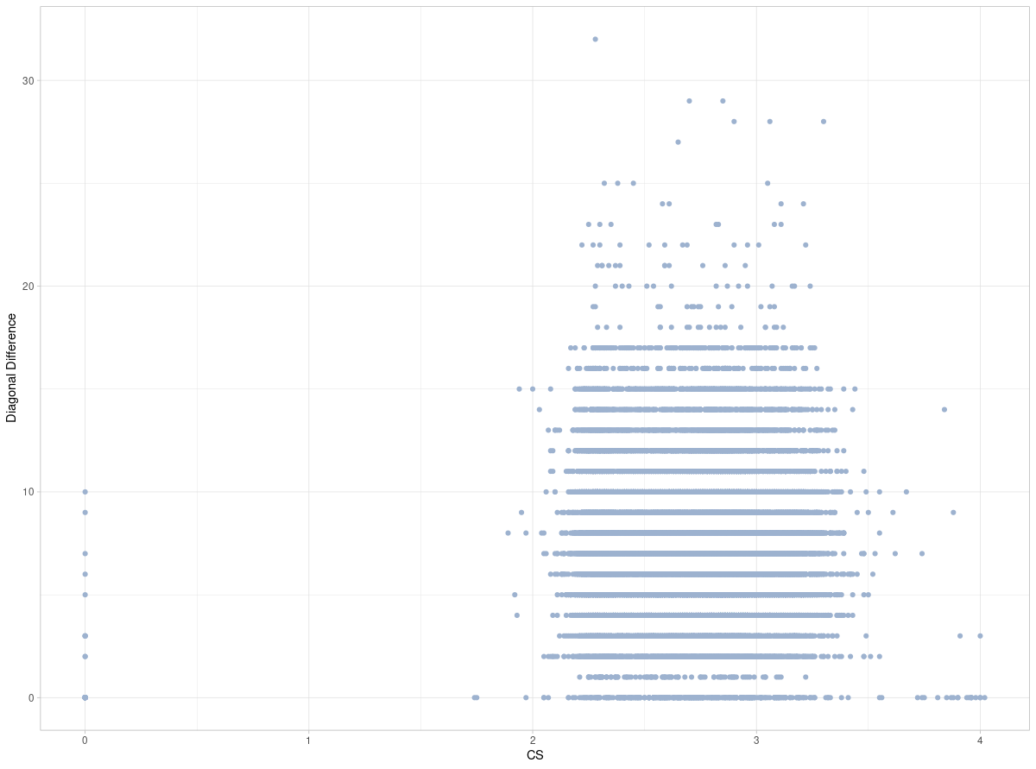
Between CS & DD

Slide 25
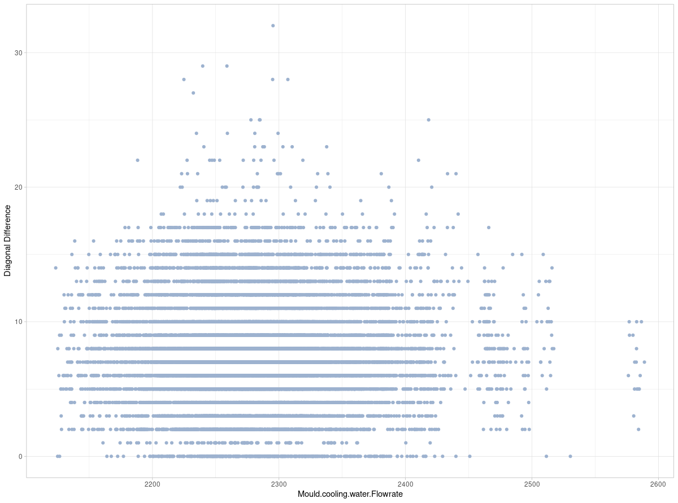
Between MCWF & DD

Slide 26
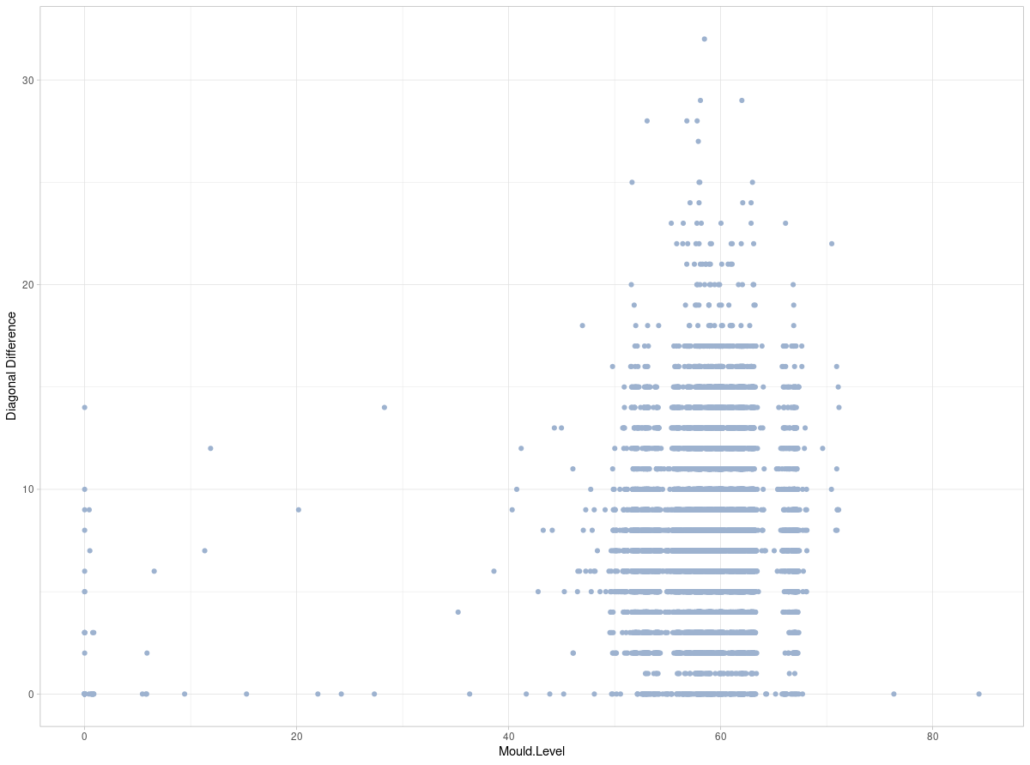
Between ML & DD

Slide 27
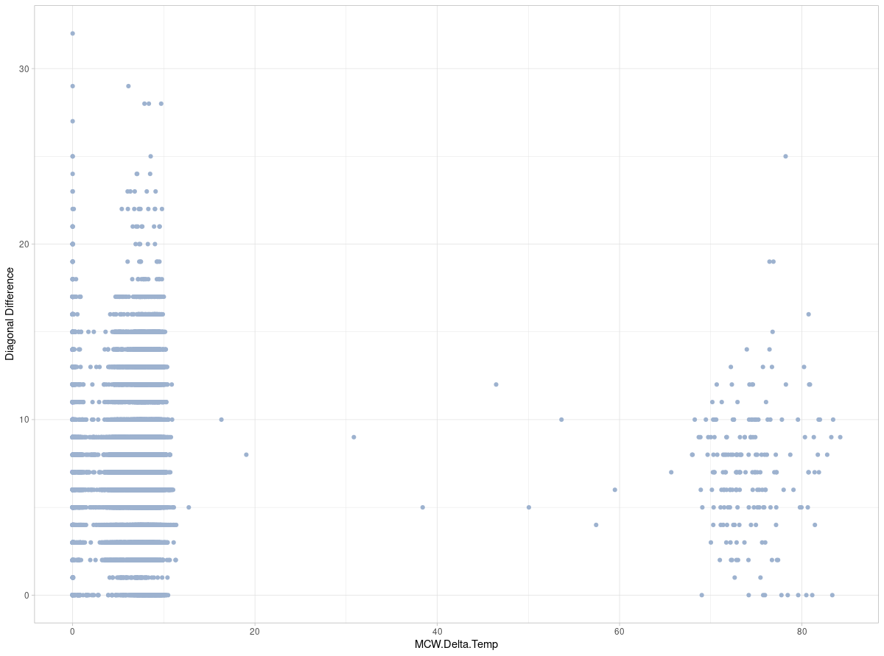
Between MCWDT & DD

Slide 28
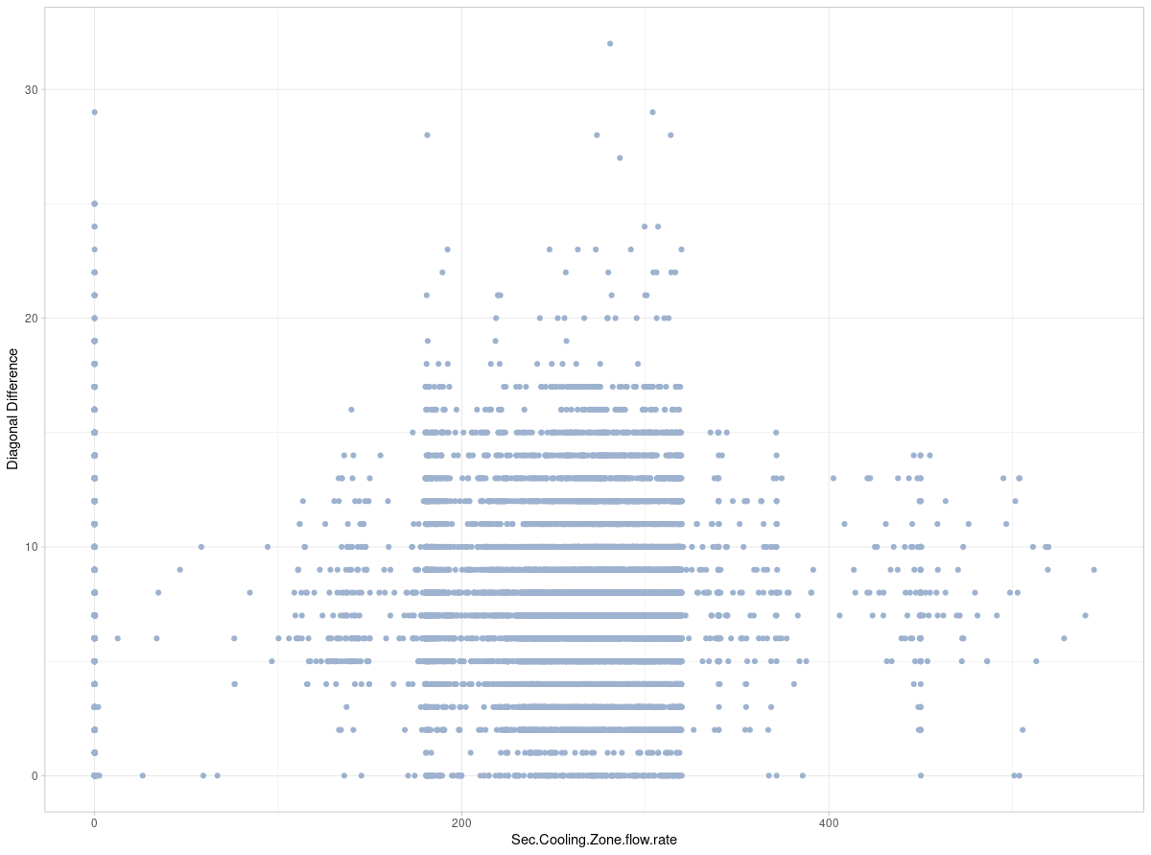
Between SCZFR & DD

Slide 29
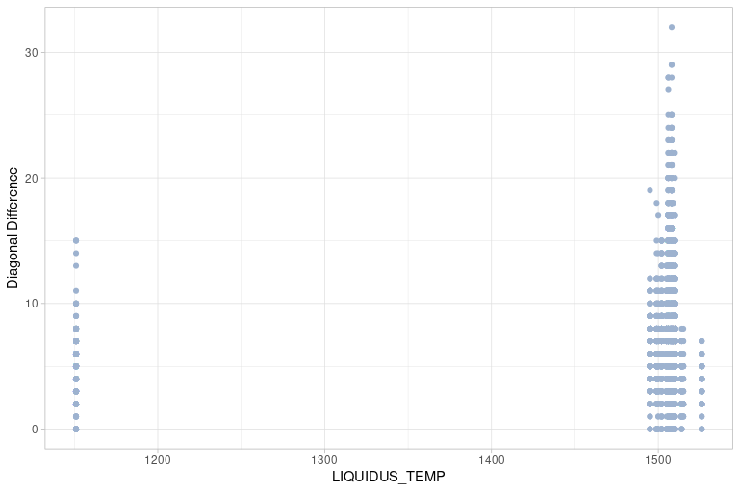
Between LT & DD

