Slide 1
Statistical analysis
Presented By: Rohan J. K. Sourav
Last Updated: July 6th,2021

Slide 2
Statistical analysis.

Slide 3
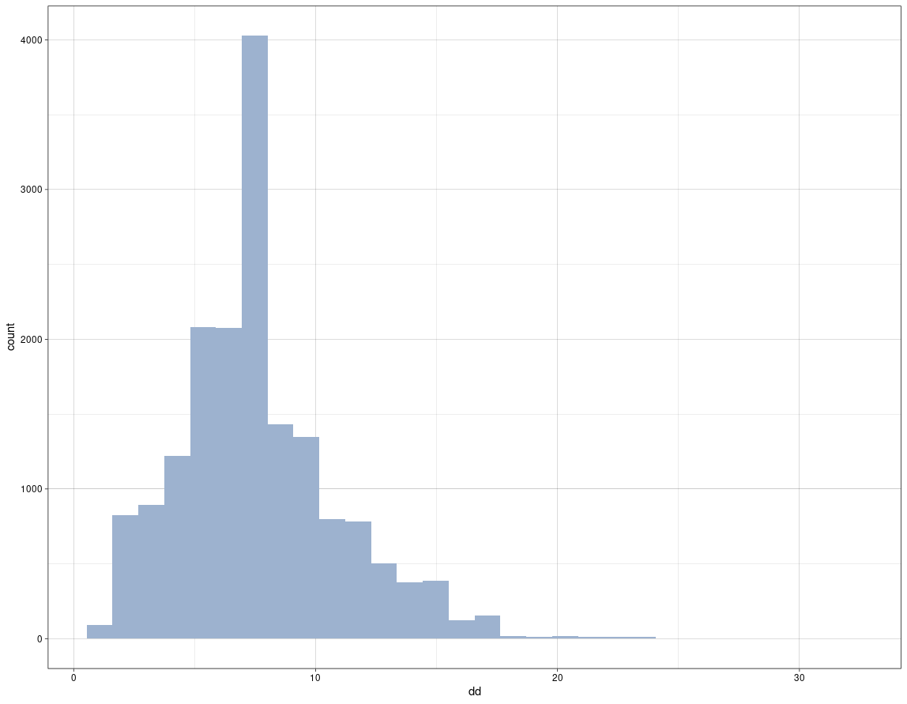
Diagonal difference
Mean = 7.623
Median = 7.000
Standard deviation = 3.5122

Slide 4
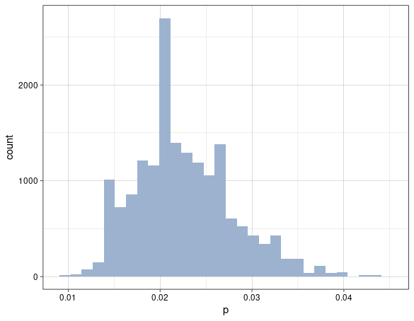
Phosphorus content
Mean = 0.02255
Median = 0.02220
Standard deviation = 0.005325

Slide 5
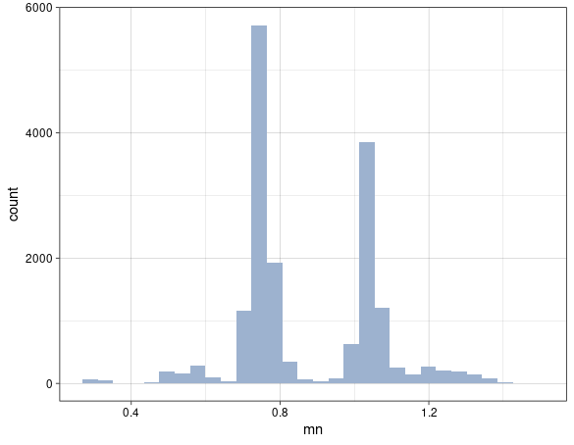
Manganese content
Mean = 0.8718
Median = 0.7790
Standard deviation = 0.18534

Slide 6
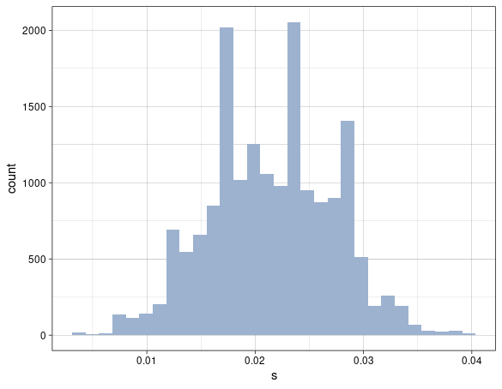
Sulphur content
Mean = 0.02152
Median = 0.02100
Standard deviation = 0.005681

Slide 7
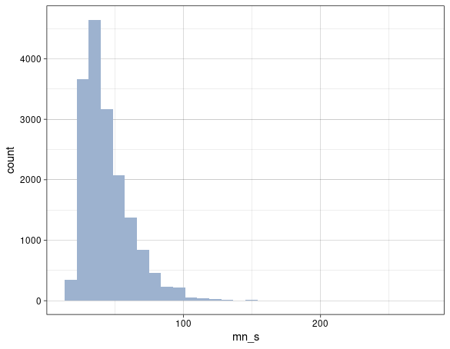
Mn/S ratio
Mean = 44.22
Median = 39.52
Standard deviation = 18.4927

Slide 8
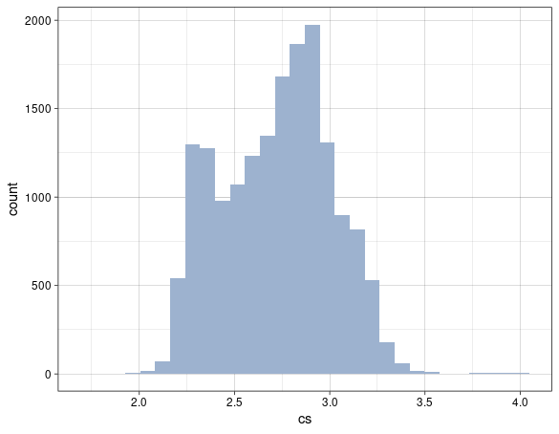
Casting speed
Mean = 2.720
Median = 2.750
Standard deviation = 0.29076

Slide 9
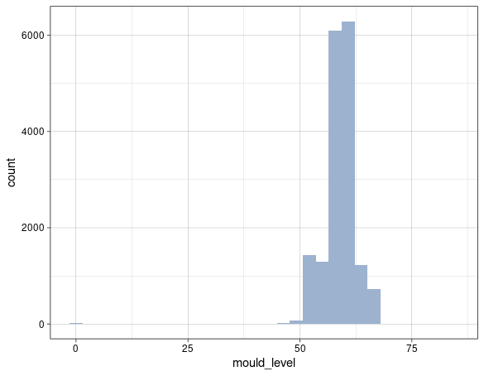
Mould level
Mean = 59.04
Median = 59.12
Standard deviation = 4.00405

Slide 10
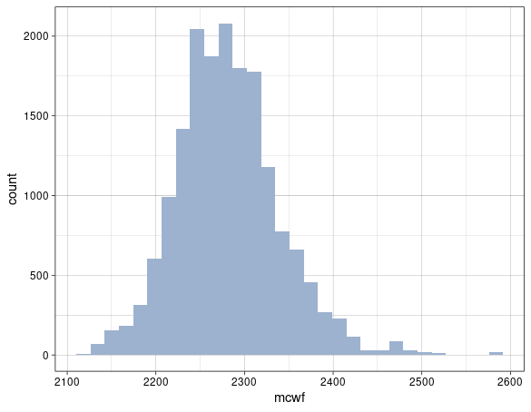
Mould cooling water flow rate
Mean = 2282
Median = 2278
Standard deviation = 58.2538

Slide 11
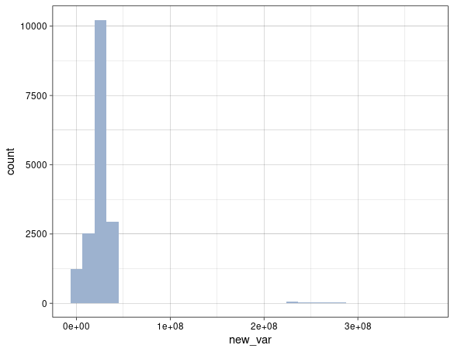
new_var
Mean = 28039355
Median = 26175761

Slide 12
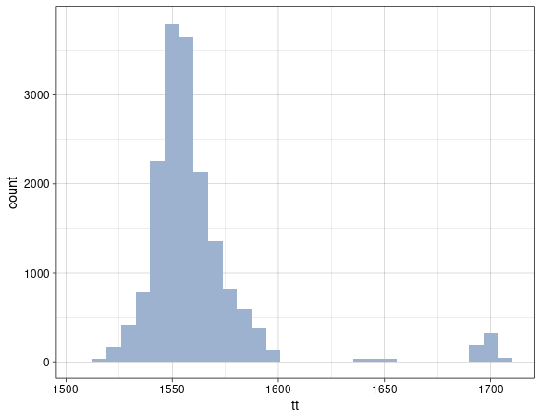
Tundish temperature
Mean = 1562
Median = 1555
Standard deviation = 29.493

Slide 13
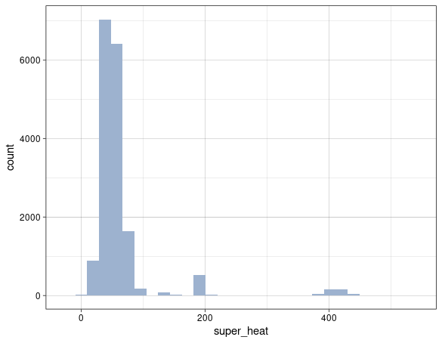
Superheat
Mean = 62.79
Median = 49.00
Standard deviation = 61.893

Slide 14
Correlation.

Slide 15
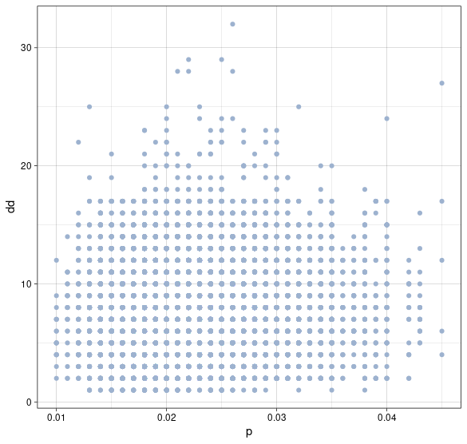
Between P content & DD

Slide 16
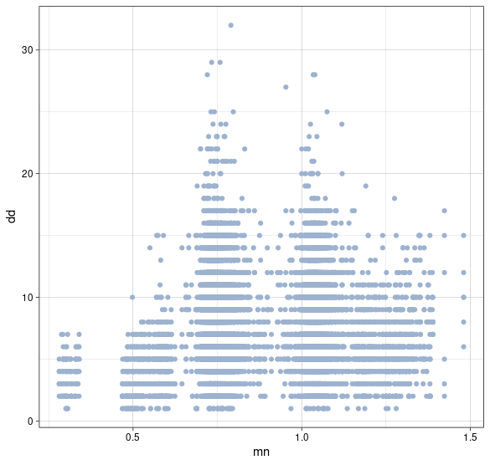
Between Mn content & DD

Slide 17
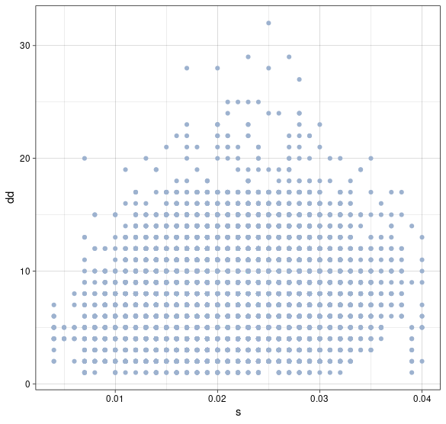
Between S content & DD

Slide 18
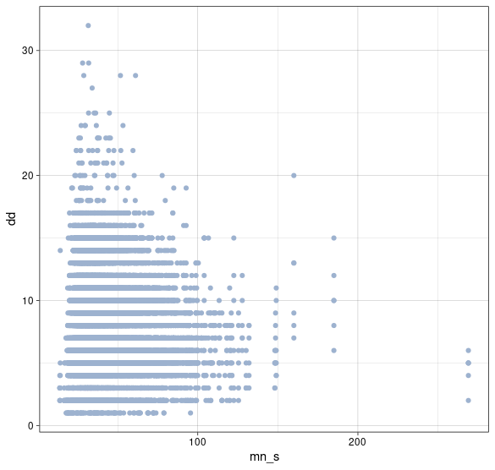
Between Mn/S ratio & DD

Slide 19
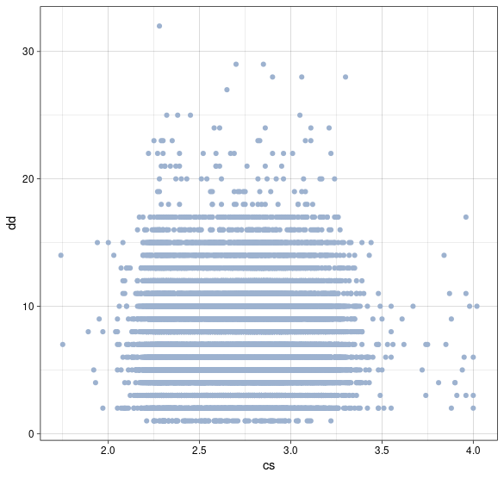
Between CS & DD

Slide 20
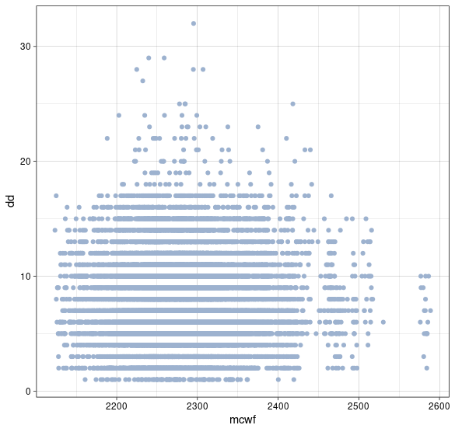
Between MCWF & DD

Slide 21
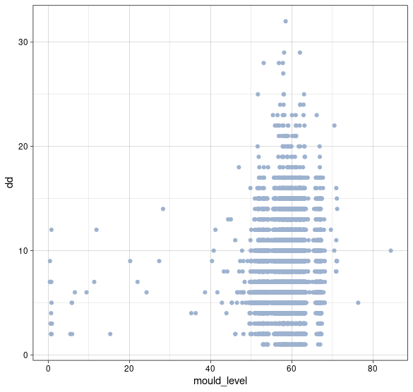
Between ML & DD

Slide 22
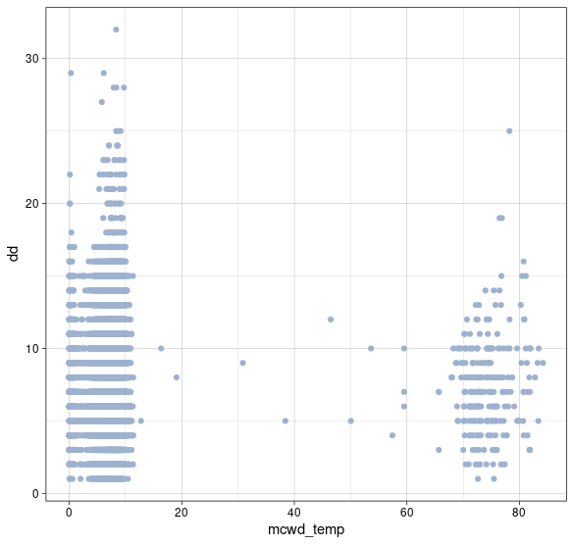
Between MCWDT & DD

Slide 23
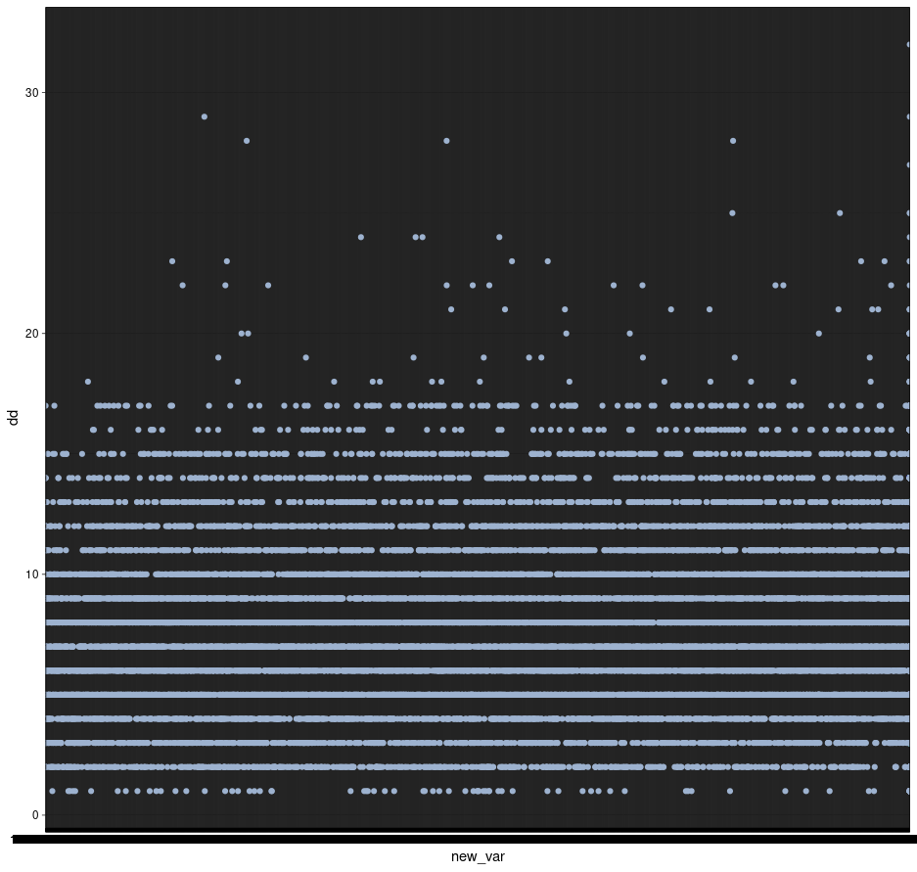
Between new_var & DD

Slide 24
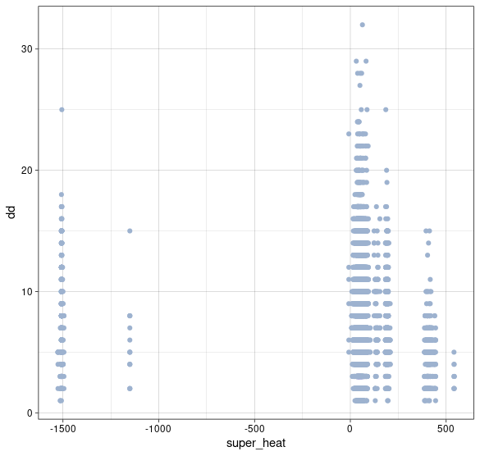
Between SF & DD

