Slide 1
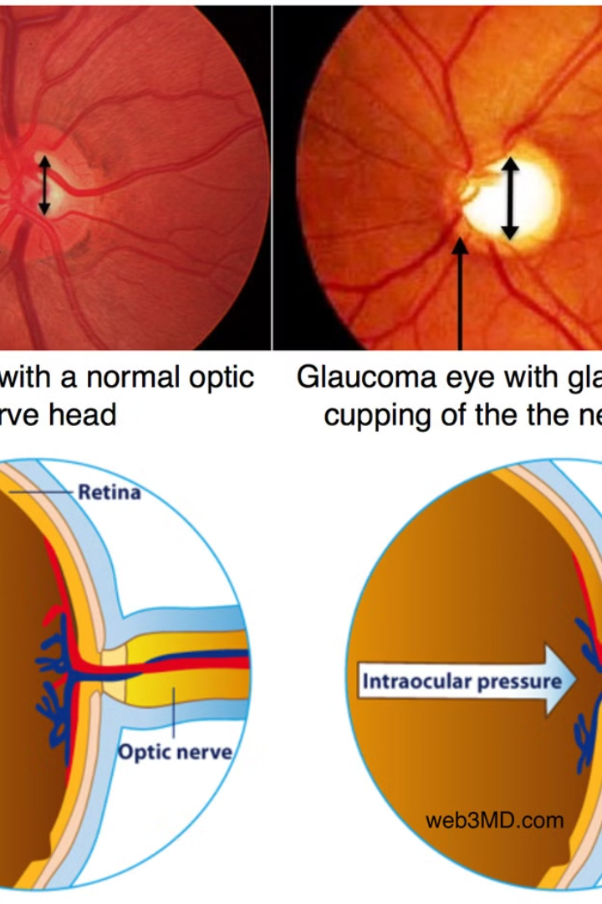

What is Glaucoma?
Glaucoma is a group of eye conditions that damage the optic nerve. The optic nerve is responsible for sending visual information from the eye to the brain. It's often linked to a buildup of pressure inside the eye, which can lead to potential vision loss or blindness if not treated.
Ra
by Rahul .

Slide 2
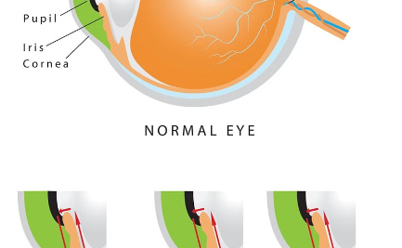
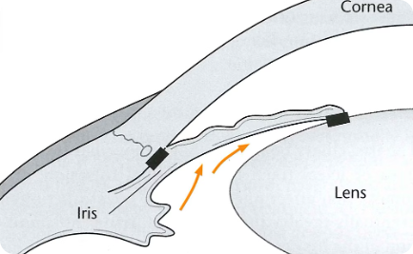
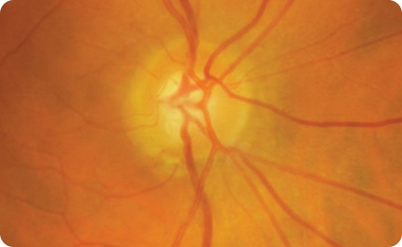
Types of Glaucoma
Primary Open-Angle Glaucoma
Angle-Closure Glaucoma
Normal-Tension Glaucoma
This type occurs when the iris becomes too close to the drainage angle in the eye. It may occur suddenly or gradually.
It's the most common type. It develops slowly, and there are no early symptoms. It can result in severe vision loss.
Also known as low-tension or normal-pressure glaucoma. It's a form of open-angle glaucoma with normal eye pressure.

Slide 3
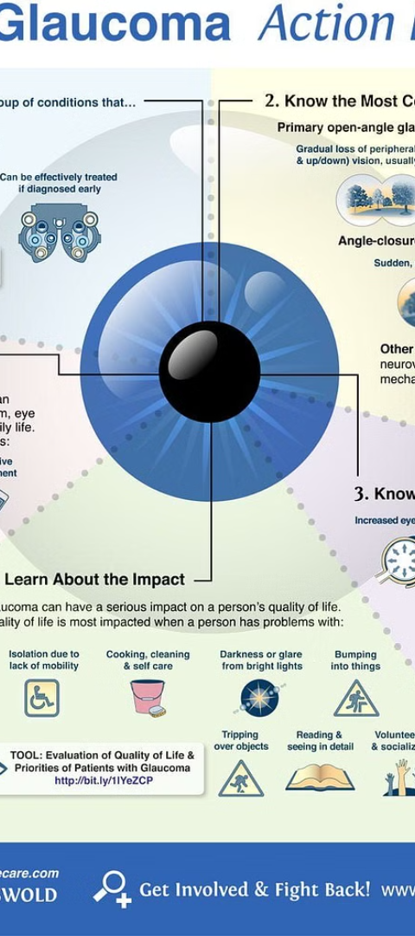
Causes and Risk Factors
1
Elevated Eye Pressure
2
Family History
High intraocular pressure is a significant risk factor for developing glaucoma.
Having a close relative with glaucoma increases the risk of developing the condition.
3
Aging
Advancing age is a major risk factor for glaucoma and becomes more common as people get older.

Slide 4
Symptoms and Diagnosis
Symptoms
Diagnosis
Eye pain or redness
Eye pressure measurement
Gradual loss of peripheral vision
Optic nerve evaluation
Blurred vision
Visual field test

Slide 5
Treatment Options
Medication
Surgery
Lifestyle Changes
Prescribed eye drops, oral medications, or laser treatments.
Trabeculectomy, drainage implants, or laser surgery.
Regular exercise, healthy diet, and reduced caffeine intake.

Slide 6

Lifestyle Changes to Manage Glaucoma
1
Regular Exercise
2
Healthy Diet
Physical activity can help lower eye pressure in some individuals.
Consuming nutrient-rich foods can aid in maintaining overall eye health.
3
Stress Management
Reducing stress can contribute to better eye health.

Slide 7



Complications of Glaucoma
Vision Loss
Blindness
Headaches
Gradual and irreversible damage to the optic nerve may result in loss of vision.
Advanced glaucoma can lead to partial or complete blindness.
Some individuals may experience headaches due to eye pressure.

Slide 8
Prevention and Early Detection
Regular Eye Exams
Eye Protection
Annual eye exams are essential for early detection and prevention of vision loss.
Using eye protection such as goggles or safety shields in high-risk environments.
Awareness
Spreading awareness about glaucoma and its risk factors is crucial in prevention.

