Slide 1

The Intrinsic Dimensionality of the Stock Market:
A Geometric Approach to Factor-Based Market Analysis
Rohan Kumar Mahato
220101088
Btech, CSE
Under Guidance of
- Prof. Benny George K
- Prof. Sriram Bhyravarapu

Slide 2
Agenda
Introduction & Motivation
Contributions, Highlights & Novelty
Mathematical Foundations
Data Collection & Preprocessing
Research Methodology
Full-Sample Empirical Results
Subperiod Analysis & Temporal Evolution
Market Insights
Scale, Extensibility & Predictive Potential
Why Data Till 2020? + Limitations
Conclusion, Future Work & Takeaways
Q&A

Slide 3
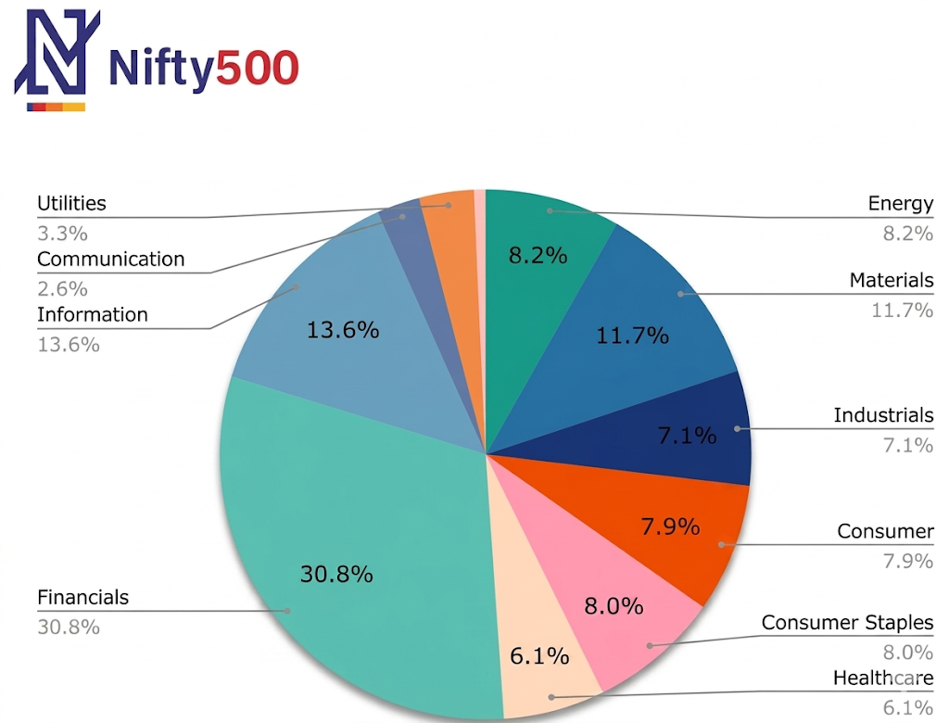
Introduction: The Indian equity Market landscape
One of the fastest-growing emerging equity markets
NSE has over 5,000 listed companies
NIFTY 500 covers approximately 93% of total market cap
Diverse sectoral representation: IT, Financials, Pharma, Industrials, etc.
Massive high-dimensional daily return data

Slide 4
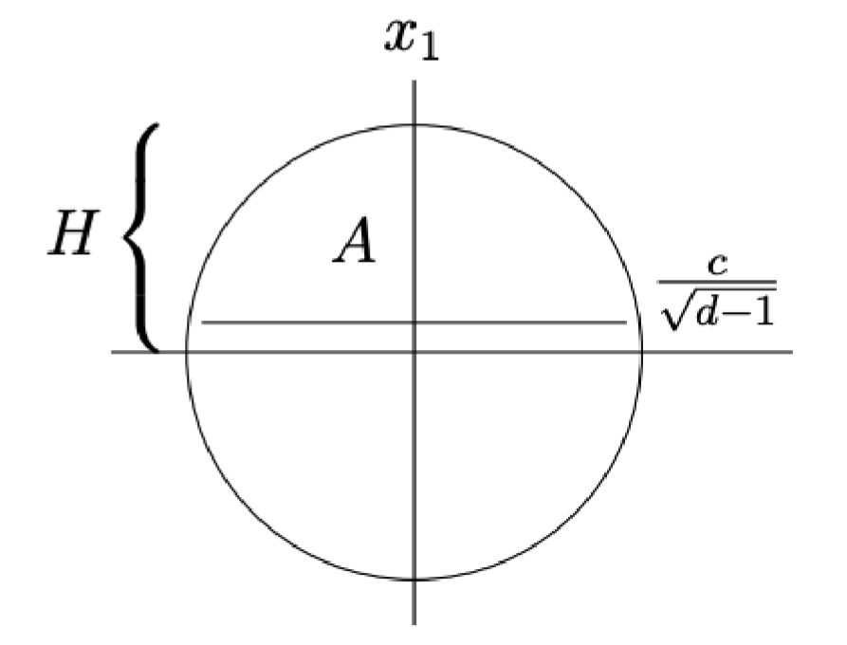
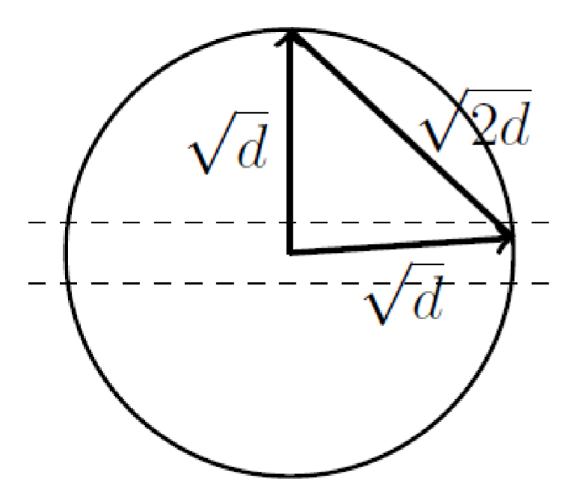
The Curse of Dimensionality in Financial Markets
For N ≈ 400 stocks: ~80,000 unique pairwise correlations
Distance concentration in high dimensions
Sample covariance matrices dominated by noise
Traditional statistical models frequently fail or overfit. Eg-
  Mean-Variance Optimization Markowitz Model
  Clustering Algorithms (e.g.-K-Means)
Surface area is at the equator
Everyone is perpendicular
Image ref. Foundations of Data Science (Blum, Hopcroft, and Kannan)

Slide 5
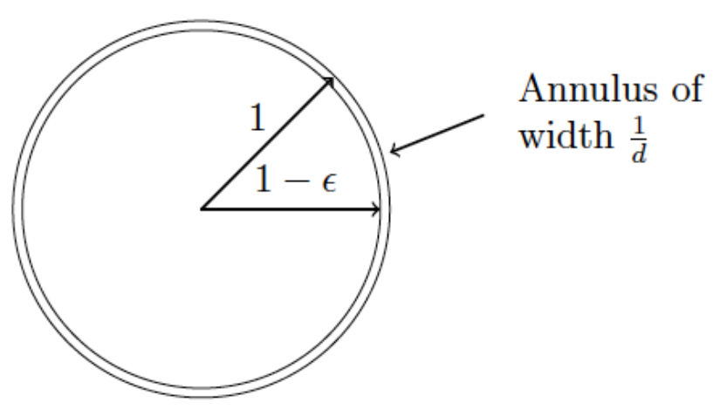
Geometric Perspective: Markets as High-Dimensional Objects
Each trading day treated as a vector in R^N
Market history forms a cloud of points in high-dimensional space
Gaussian Annulus Theorem (Thin Shell Phenomenon)
Real markets deviate significantly from pure randomness
Indicates presence of hidden low-dimensional structure
Gaussian Annulus theorem
Image ref. Foundations of Data Science (Blum, Hopcroft, and Kannan)

Slide 6
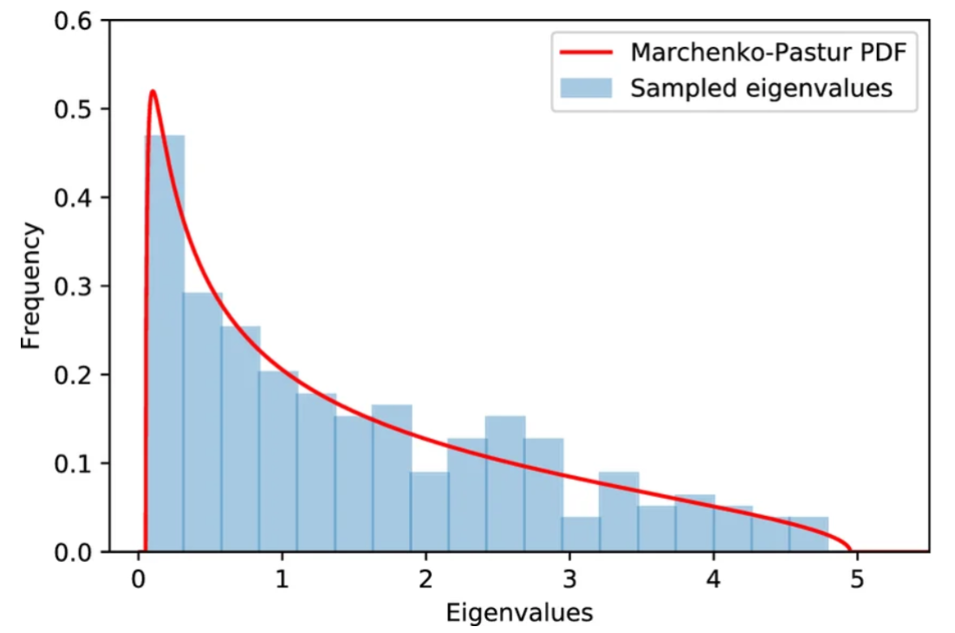
Motivation & Research Objectives
General RMT Visualization
Uncover the intrinsic dimensionality of the Indian equity market
Build low-rank factor models separating signal from noise
Analyze stability across frequencies and economic regimes
Provide strong sectoral interpretability
Derive practical insights for risk management and portfolio construction

Slide 7
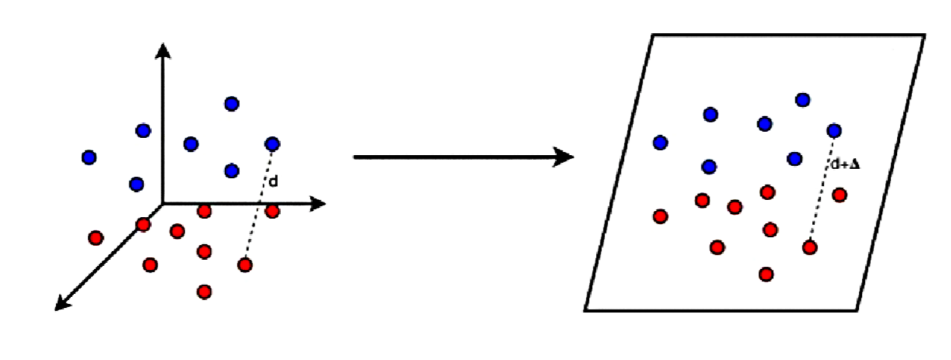
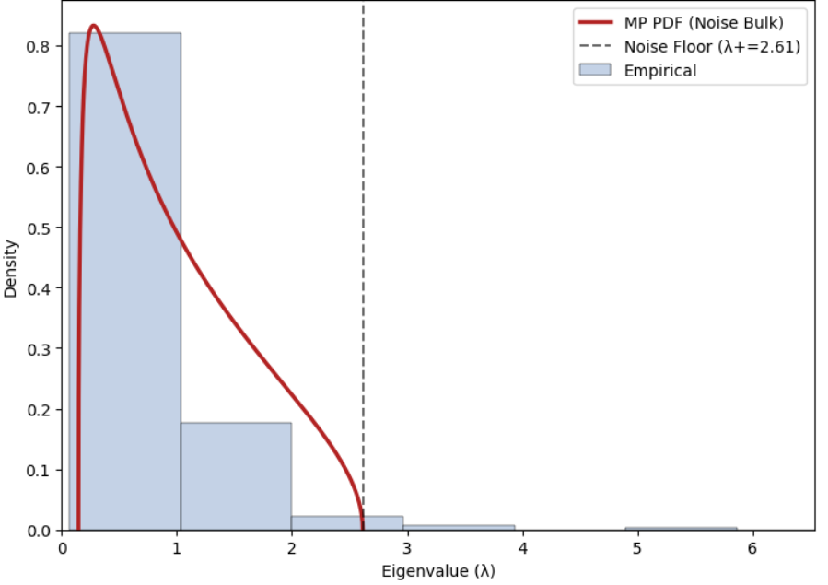
Main Contributions & Highlights
Johnson-Lindenstrauss Lemma
Geometric and Random Matrix Theory foundation
  Use of Principal Component Analysis (PCA) with Random Matrix Theory (RMT) and the Johnson-Lindenstrauss Lemma to provide mathematical guarantees that market structure is preserved during dimensionality reduction.
Fixed NIFTY 500 universe (378 stocks) - eliminates survivorship bias
Multi-frequency analysis: daily, weekly, and monthly returns
Temporal regime analysis across three economic subperiods
Sectoral dominance analysis using loading heatmaps
Demonstrates low intrinsic dimensionality with economic
meaning (Monthly data requires nearly 3x fewer
components)
Proved that market dimensionality is not constant, it collapses during systemic
shocks (2008, 2020) and expands during stable growth (2010–2015)
RMT comparision on our Dataset

Slide 8
Relation to Existing Literature
https://www.sciencedirect.com/science/article/pii/S0378437120305872
https://journals.aps.org/prl/abstract/10.1103/PhysRevLett.83.1467
Feature | Existing Literature ( Laloux 1999, Kumar 2020 ) | Our Study
Data Universe | Often relies on dynamic index constituents, introducing index-shuffling bias. | Fixed Universe: Tracks a static set of 378 stocks over 15 years to eliminate survivorship bias
Temporal Focus | Frequently provides a "static" snapshot of market structure. | Temporal Evolution: Isolates shifts across three 5-year economic regimes (2005–2020).
Return Horizon | Predominantly analyzes daily returns, which are dominated by microstructure noise. | Multi-Frequency: Compares Daily, Weekly, and Monthly horizons to uncover the "economic backbone"
Sectoral Insight | Identifies broad signal vs. noise without specific thematic evolution | Thematic Discovery: Quantifies shifting dominance, such as the 2020 Healthcare "Super-Factor".

Slide 9
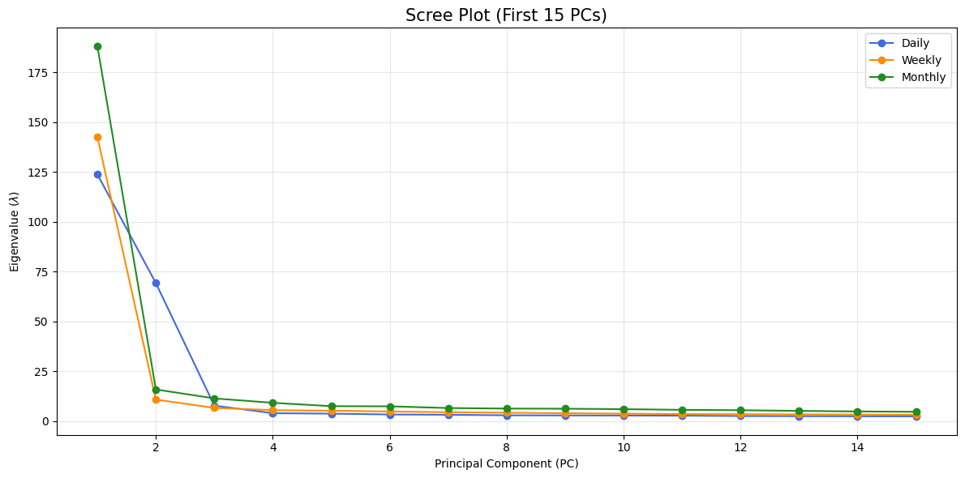
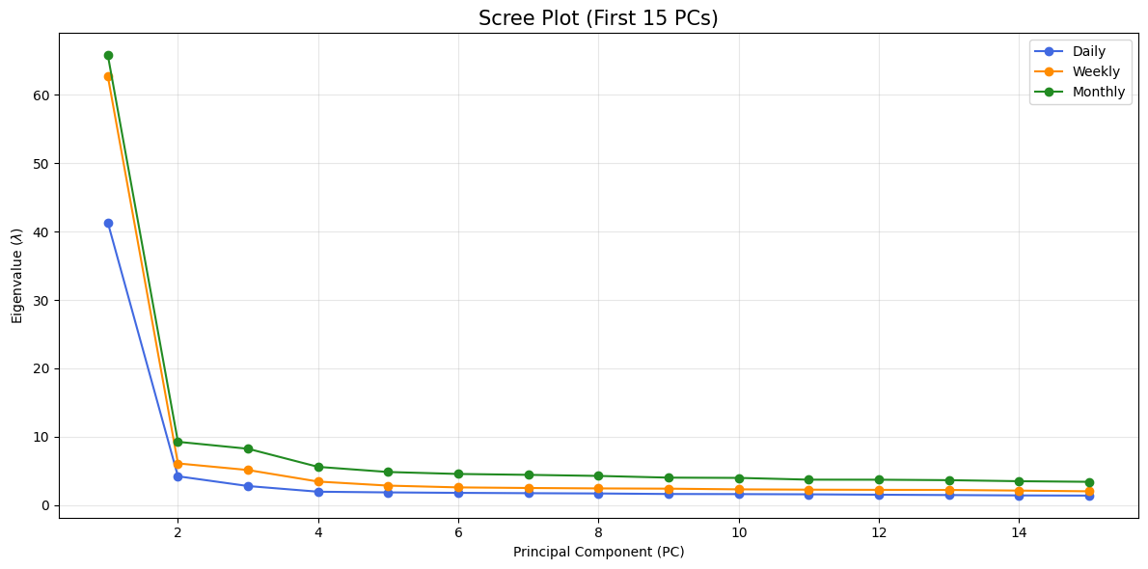
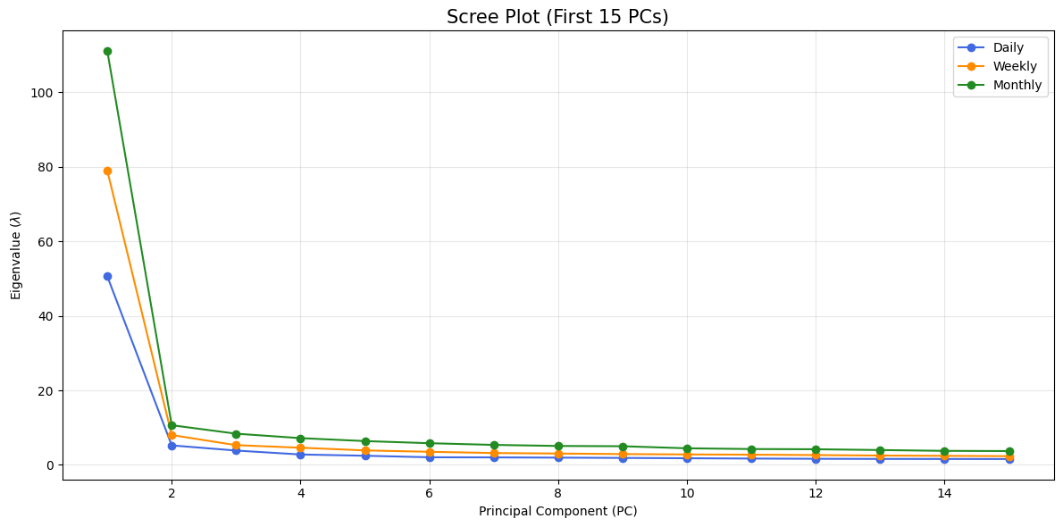
Why Our Work is Reliable ?
Random Matrix Theory (Marchenko-Pastur law) for signal-noise separation
Johnson-Lindenstrauss Lemma provides theoretical guarantees
Results consistent across frequencies and subperiods
Fixed universe + standardization reduces bias
Fully transparent and reproducible pipeline
2005-2010
2010-2015
2015-2020

Slide 10
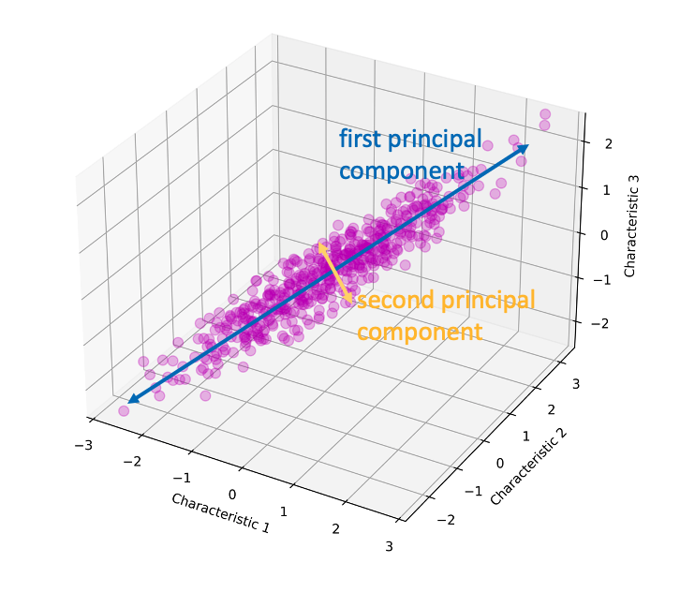
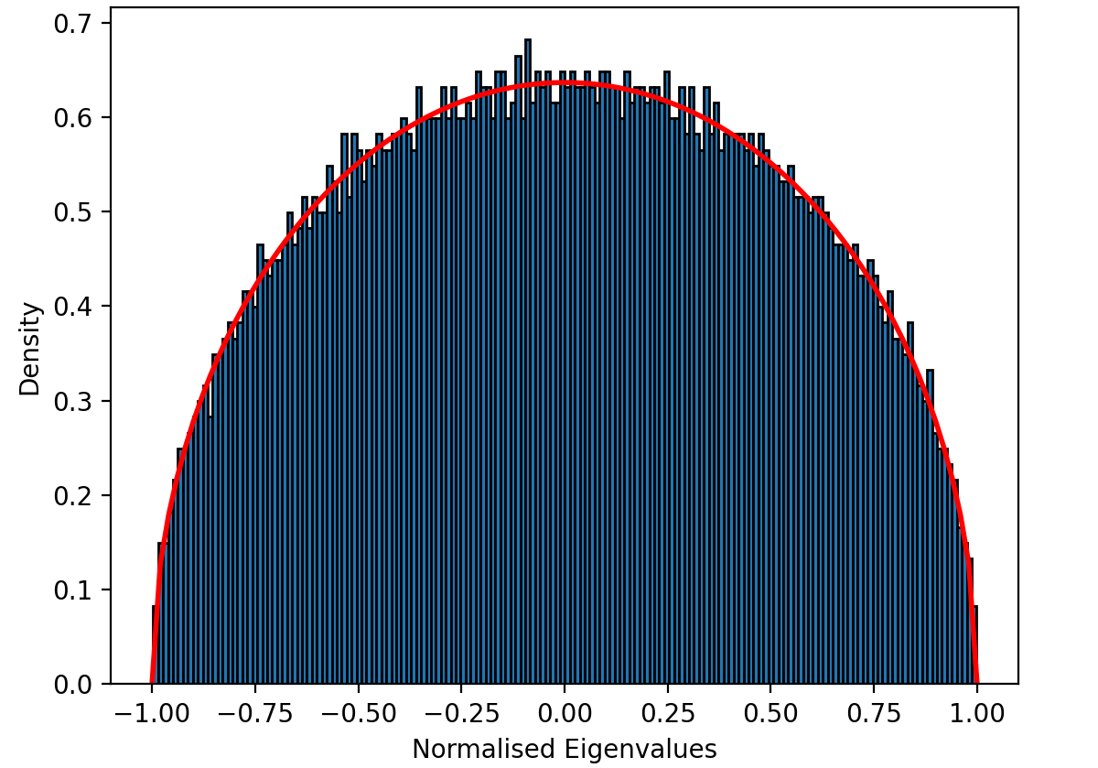
Connection to Random Matrix Theory
RMT distinguishes signal (large eigenvalues) from noise
PC1: Strong Market Factor
PC2–PC5: Sectoral and thematic rotation factors
PCA preferred due to variance maximization, orthogonality, and interpretability.
Image-1 ref.
Image-2 ref.

Slide 11


Data Collection – Fixed NIFTY 500 Universe
Based on NIFTY 500 membership as of end of 2004
Final cleaned universe: 378 stocks
Eliminates survivorship bias for reliable long-term analysis
Data collected using NSE & Yahoo Finance

Slide 12
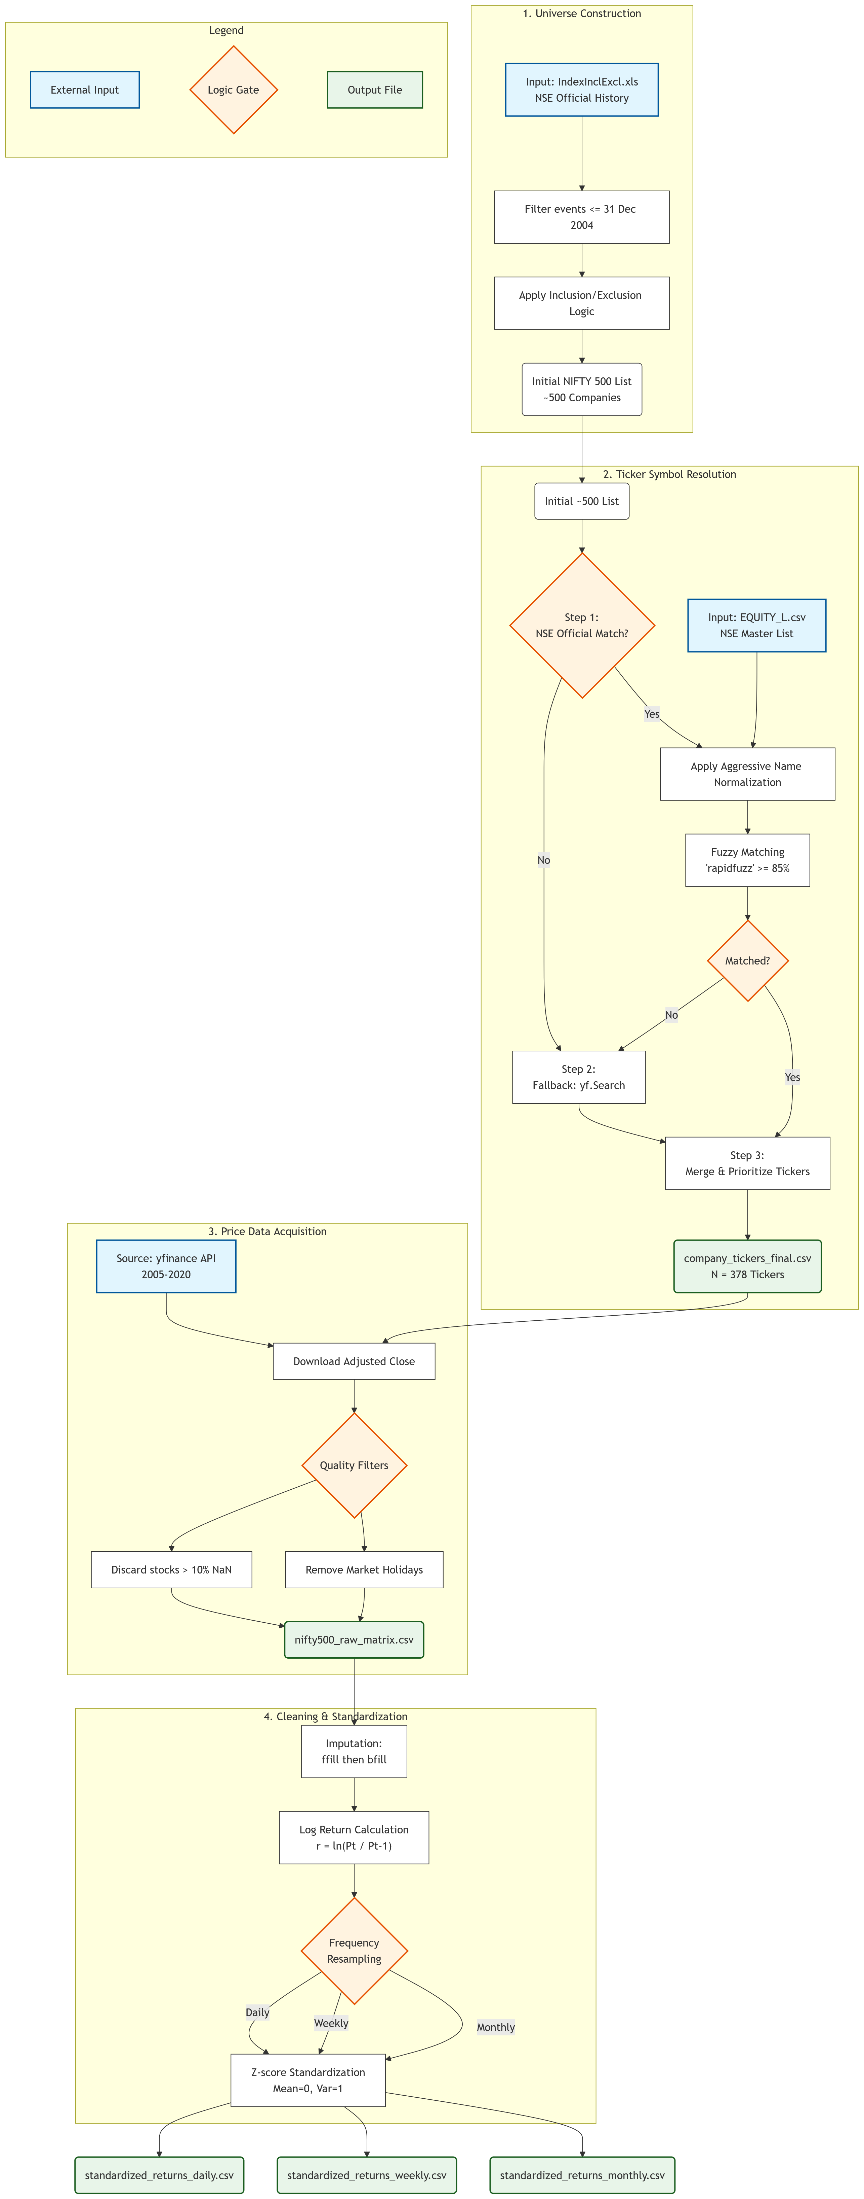
Preprocessing & Dataset Characteristics
Historical adjusted close prices from yfinance (2005–2020)
Missing value imputation using forward-fill + backward-fill
Return calculation at three frequencies: daily, weekly, monthly
Standardization applied to each stock individually
Final dataset: ~3,720 trading days × 378 stocks

Slide 13
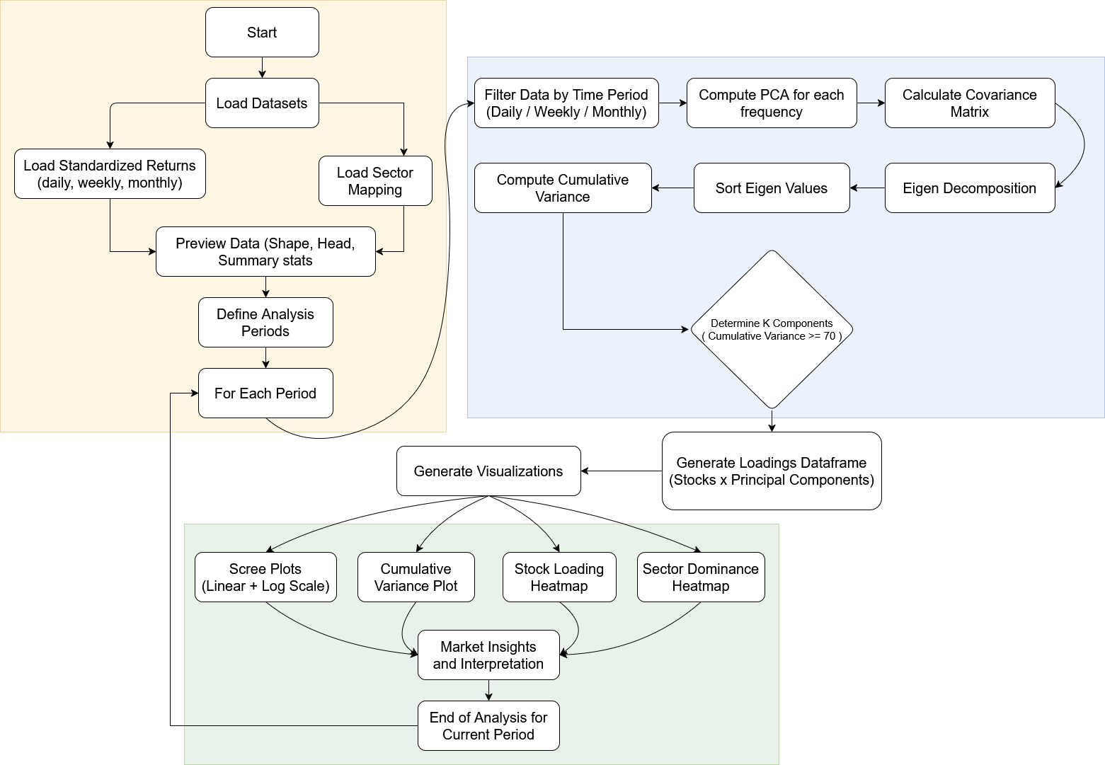
Research Methodology Overview

Slide 14
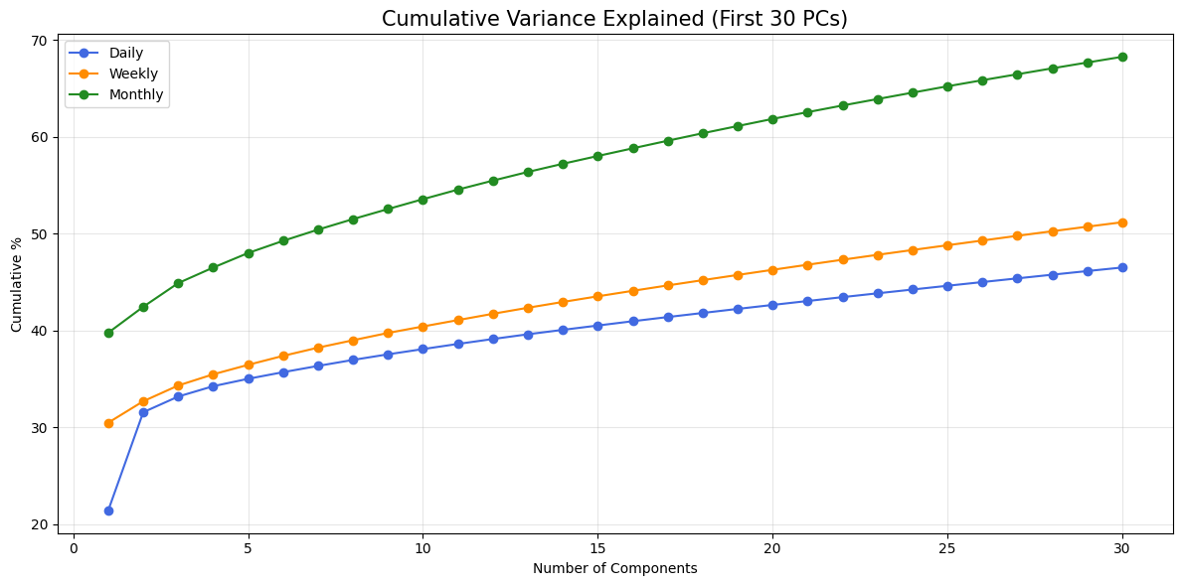
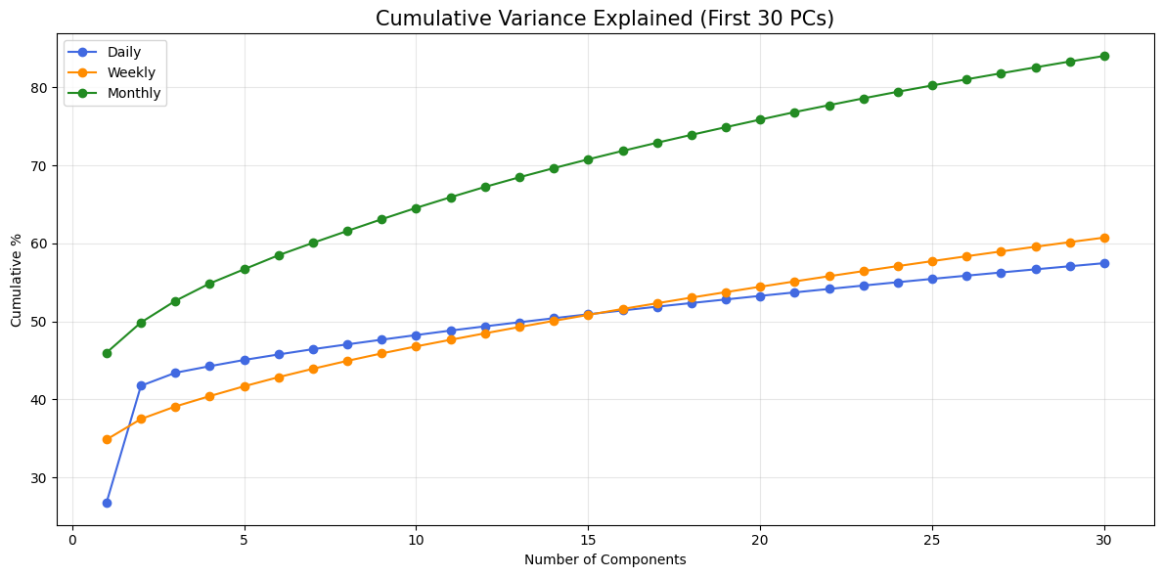
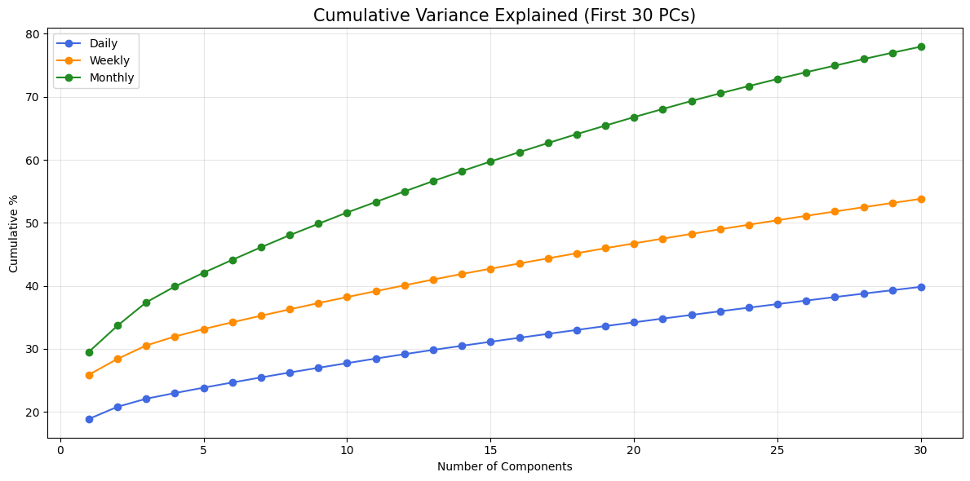
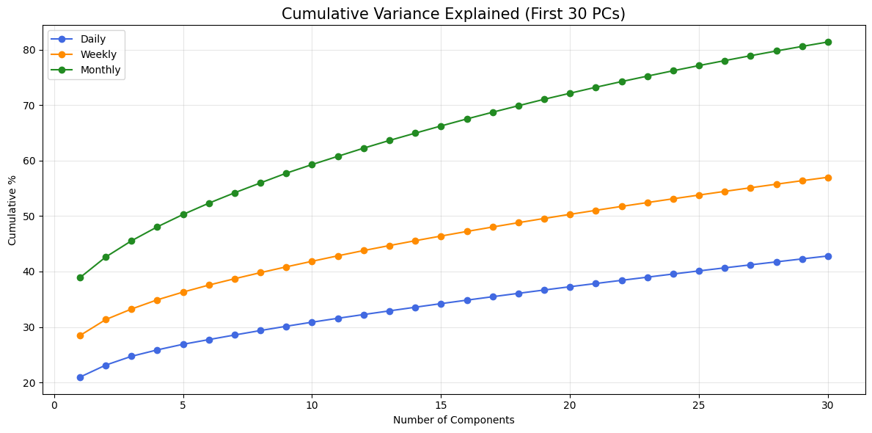

Full-sample Vs. Subperiod
Full Sample (2005–2020): Provides the long-term “geometric backbone” of the market, capturing stable patterns that persist beyond short-term fluctuations.
Global Eigenvectors: Represent the main underlying drivers of the market over time (e.g., GDP growth, interest rates) i.e the key forces shaping overall movement.
Subperiod Analysis (5-year blocks): Shows how market structure evolves, collapsing into unified, panic-driven behavior during crises and expanding into diverse sector trends during growth.
Fixed Universe (378 stocks): Ensures consistency, observed changes reflect real economic shifts, not changes in the stock sample.
WHY ?
2005-2020
2005-2010
2010-2015
2015-2020

Slide 15
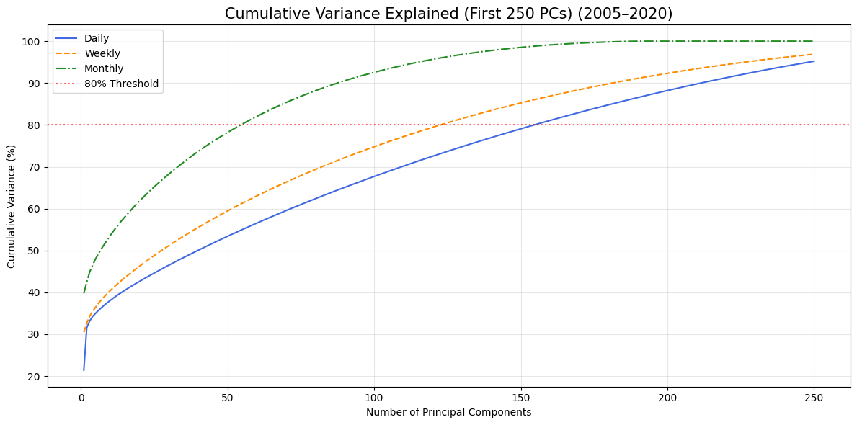
Full-sample Results: Intrinsic Dimensionality
How Many Forces Actually Drive 378 Stocks ?
The “Magic Number”: Even with 378 stocks, market behavior is driven by only ~50-60 core components, indicating strong underlying structure.
Signal vs. Noise: The majority of daily price changes are random noise, while only the top components capture meaningful economic signals relevant for investors.
Horizon Effect: Monthly data produces a clearer, more stable structure, whereas daily data is noisier due to short-term effects like panic trading and liquidity shocks.

Slide 16
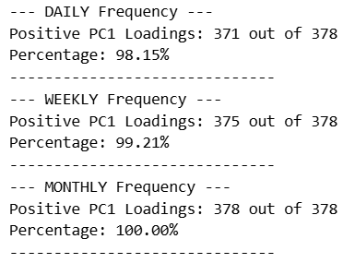
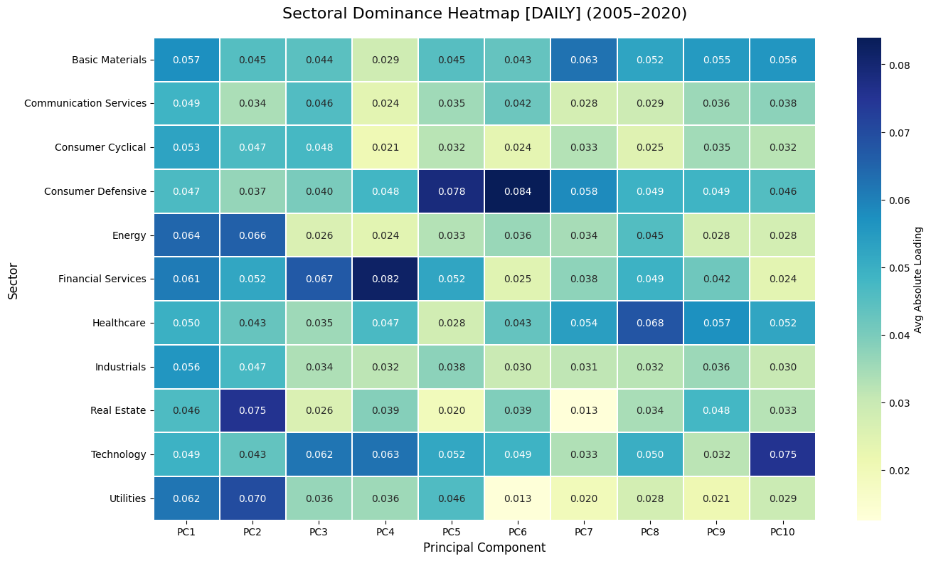
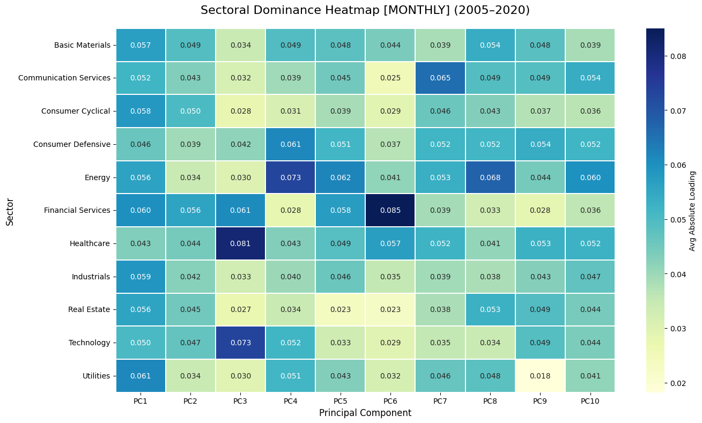
What do the components (pc1, pc2, pc3) represent?
The Hidden Drivers of the Full Sample ( 2005 – 2020 )
PC1 (Market Factor): A broad, universal factor with positive loadings across most stocks. It captures systemic risk and overall market direction, influenced by GDP growth, rupee movements, and global risk sentiment.
PC2 (Sectoral Rotations): Reflects the rotation between sectors, showing a contrast between cyclical sectors (Financials, Energy, Industrials) and defensive/growth sectors (IT, Pharmaceuticals)
.
PC3 (Thematic Clusters): Captures localized, sector-specific movements independent of the overall market, highlighting industry-level shocks or trends (e.g., Technology or Banking booms).

Slide 17
subperiod analysis: Market evolution
Three Regimes of the Indian Market ?
Period 1: 2005–2010 (Crisis Driven): Market dimensionality was at its lowest. During the 2008 GFC, stock differences vanished as PC1 became exceptionally dominant, reaching an eigenvalue of λ≈190 in monthly returns.
Period 2: 2010–2015 (Stabilization): This era saw the highest diversification. PC1 dominance dropped significantly (monthly eigenvalue fell to ≈65), allowing individual sector stories and domestic policy shifts to drive market variance.
Period 3: 2015–2020 (Reform & COVID): Market structure became highly "thematic". While the COVID shock caused a resurgence in PC1 (systemic panic), it also birthed clear "winner" factors in the Healthcare and IT sectors.
2005-2010
2010-2015
2015-2020

Slide 18
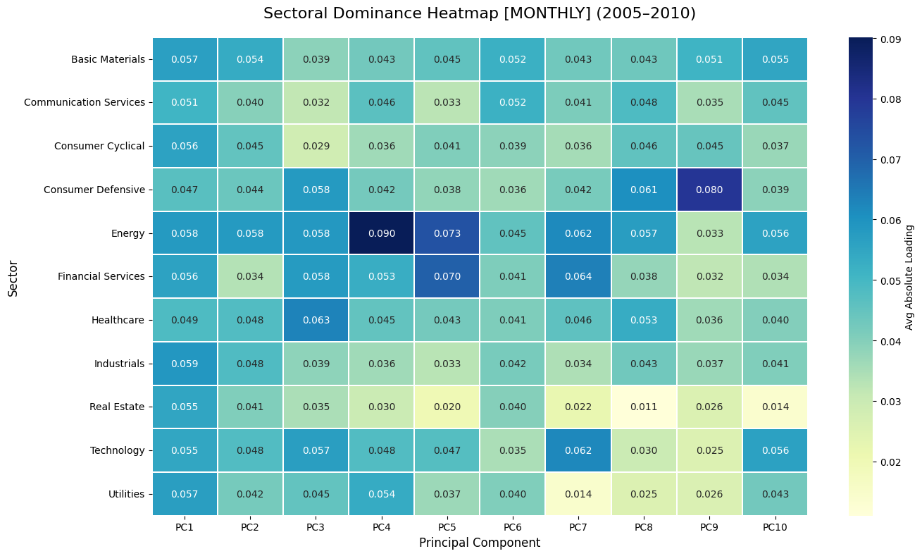
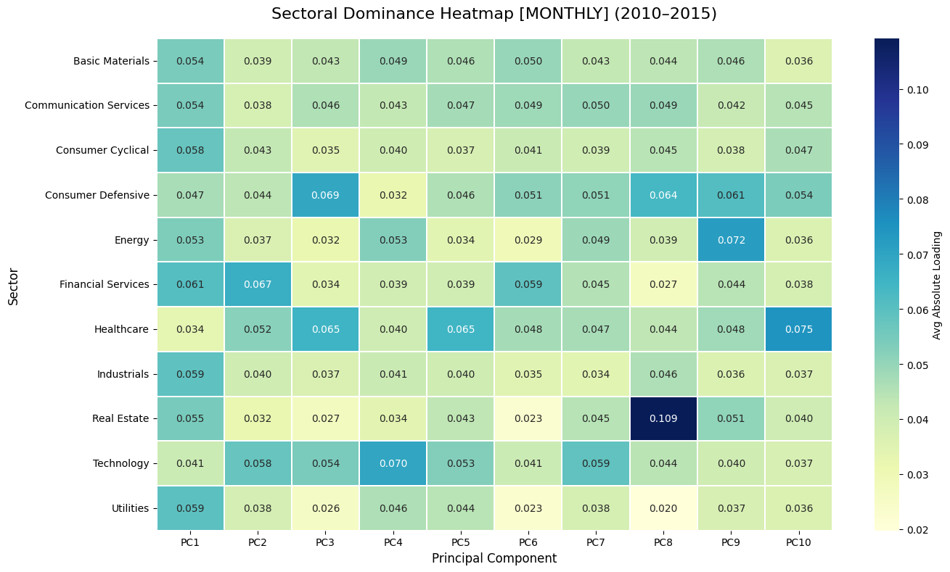
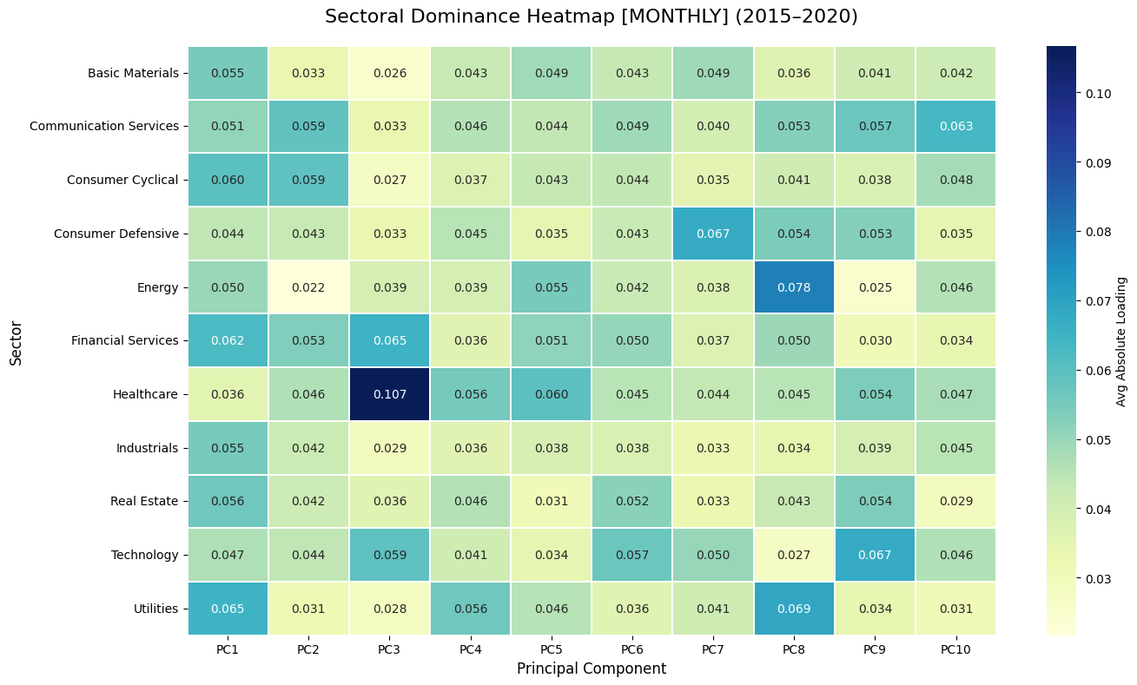
Pc1, pc2 and pc3 in subperiods
How the Core Factors Evolve Over Time ?
PC1 (Synchronization Pulse): Acts as a market-wide force during crises (2008, 2020), where all stocks move together. In stable periods (2010–2015), its influence weakens, indicating reduced market synchronization.
PC2 & PC3 (Industry Rotation):
Capture the shift in sector leadership over time:
- 2005–2010: Dominated by Financials, Energy and Industrials
- 2015–2020: Shift toward Healthcare, Technology and Financials
Emergence of New Factors: In 2015–2020, higher components (PC3/PC4) reveal a distinct Healthcare-driven factor, reflecting its role as a key structural driver and crisis hedge during the pandemic.

Slide 19
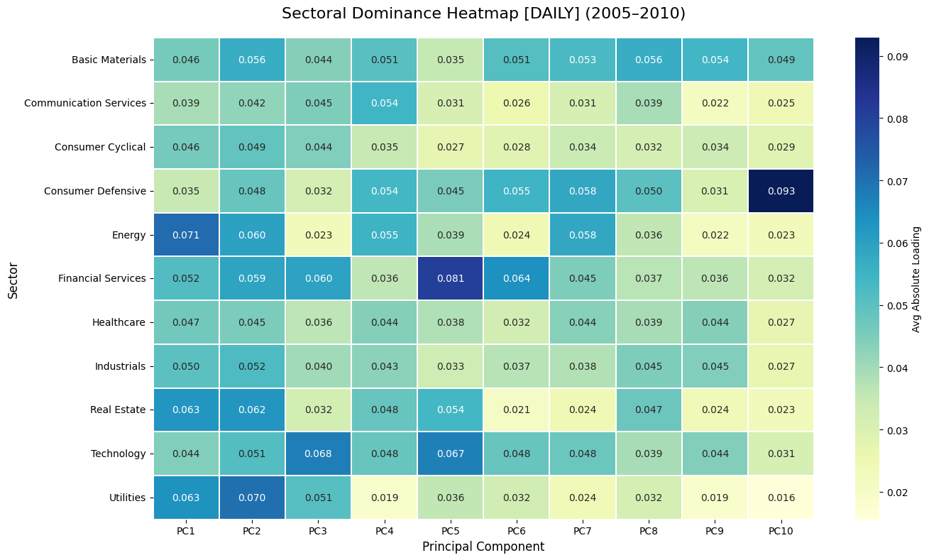
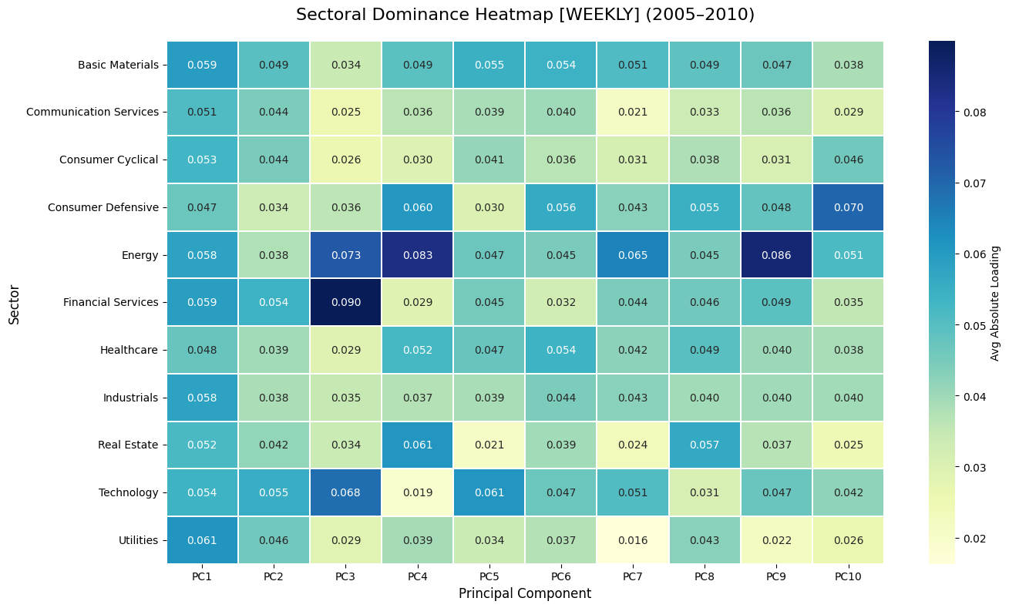
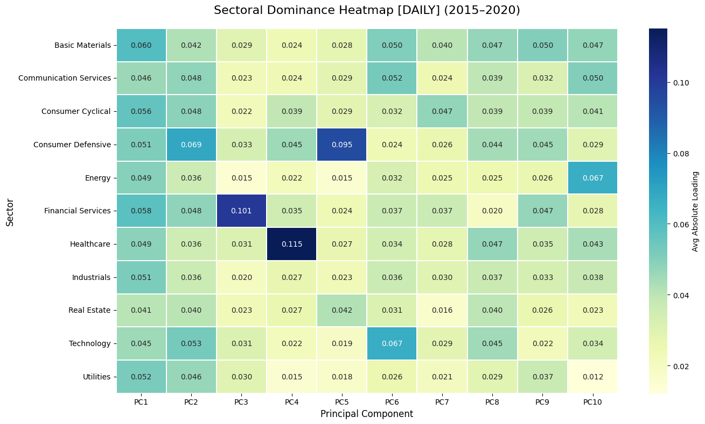
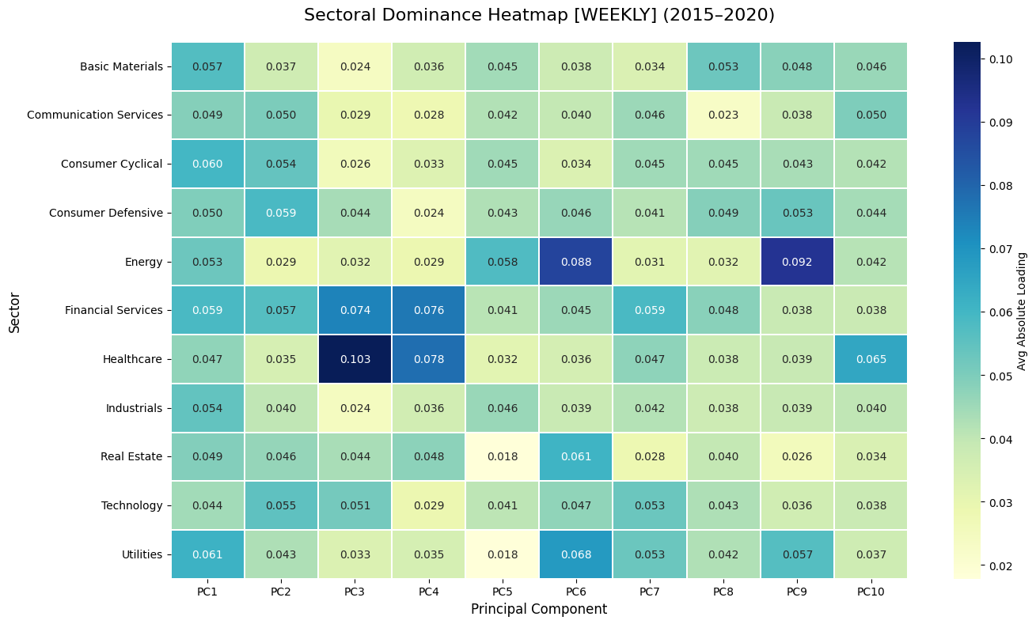
Multi-frequency sectoral evolution
How Frequency Reveals Structural Shifts ?
Daily (The “Noise Layer”): Dominated by short-term fluctuations and liquidity effects.
Weekly (Balanced View): Reduces noise and reveals clearer sector relationships. Offers a better signal-to-noise balance.
Monthly (Structural Signal): Filters out daily volatility to show true economic drivers. Highlights stable, long-term sector dependencies.

Slide 20
Key Market Insights & Robustness
Low Dimensionality: Just 15–30 monthly components capture 80% of total market variance.
Systemic Dominance: PC1 serves as a universal market factor, spiking during the 2008 and 2020 crises.
Horizon Clarity: Monthly returns filter out short-term noise to reveal the market’s underlying macroeconomic backbone.
Regime Shifts: Intrinsic dimensionality collapses during systemic shocks and expands during stable growth periods.
Sectoral Evolution: Market drivers keeps changing with subperiod.

Slide 21
Scale of This Study
15-Year Timeframe: Analysis covering January 2005 to December 2020.
Fixed Stock Universe: 378 tickers from the NIFTY 500 maintained throughout the study to ensure temporal consistency and avoid survivorship bias.
High Data Density: Total analysis of over 1.4 million individual data elements for the daily frequency alone.
Multi-Frequency Horizon: Comparison across Daily, Weekly, and Monthly return frequencies.
Temporal Segmentation: Detailed investigation of market evolution across 3 distinct five-year economic subperiods.

Slide 22
Extensibility of the Work
Extend dataset beyond 2020
Incorporate non-linear methods (autoencoders, VAEs)
Develop dynamic/time-varying factor models
Apply to other markets and asset classes

Slide 23
Predictive Potential – Can It Predict Future Prices?
Structural Insight, Not Point Prediction: Captures the market’s underlying structure and systemic risk, rather than forecasting exact price levels.
Early Warning Signals: Spikes in PC1 variance indicate rising systemic stress and potential market-wide instability.
Signal Extraction: Filters out short-term noise to reveal true economic relationships between assets.
Risk Regime Detection: Identifies crisis phases where markets move together and diversification breaks down.
Core Limitation: As a linear model, it may miss non-linear shocks and highlights patterns, not direct causation.

Slide 24
Why Dataset Only Till 2020?
Need for a clean, consistent 15-year window
Covers major economic regimes (crisis, recovery, pre-COVID)
Fixed-universe construction more reliable up to 2020, Extending beyond 2020 would require dropping many stocks, reducing reliability and comparability.

Slide 25
Limitations of the Study
Linearity Assumption: PCA is a linear model, so it may miss non-linear dynamics during extreme events or market panics.
Survivorship Bias: Using a fixed set of stocks (2005–2020) focuses on surviving firms, potentially overstating stability.
Latent Factors (Not Causal): Identifies where risk exists, but does not directly link it to external drivers (e.g., interest rates, policy).
Fixed Time Windows: Assumes stability within 5-year periods, while in reality market structure evolves continuously.

Slide 26
Conclusion & Main Takeaways
Indian equity market has low intrinsic dimensionality
Dominated by a strong market factor + few sectoral factors
Fixed-universe + multi-frequency + RMT approach is effective
Geometric perspective reveals hidden order in market data

Slide 27
Future Work & Thank You
Future Work:
Extend dataset to 2025 and beyond
Non-linear dimensionality reduction
Dynamic factor models and ML integration
Thank You!
I welcome your questions

