Slide 1
The Intrinsic Dimensionality of the Indian Stock Market: A Geometric Approach to Factor-Based Market Analysis
Rohan Kumar Mahato
220101088
Btech CSE 4th Yr
Under the Guidance of
Prof. Benny George K
Supervisor: Sriram Bhyravarapu

Slide 2
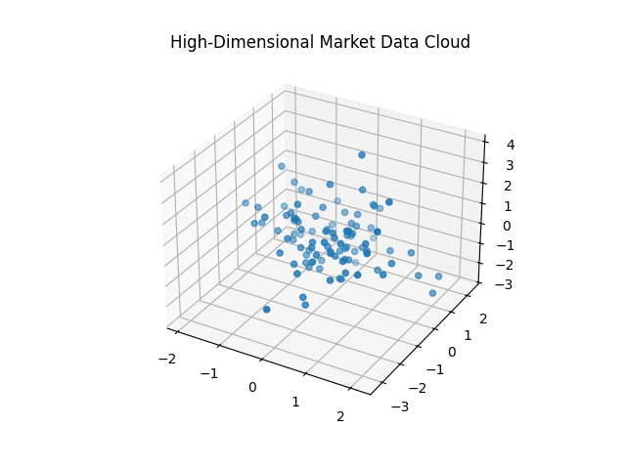
The Challenge of High-Dimensional Market Data
The Indian equity market (NIFTY 500) involves 500+ securities, creating a high-dimensional system.
Tracking co-movements is computationally intensive and prone to noise due to the 'curse of dimensionality.'
Difficulty in distinguishing signals from noise in vast data volumes.

Slide 3
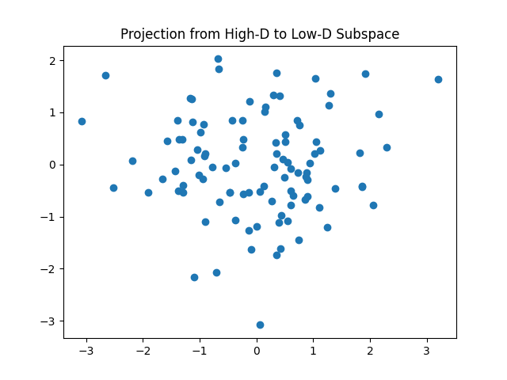
Core Problem and Goal
Central Problem: Analytical complexity (e.g portfolio optimization) in modeling 500+ stocks interactions.
Goal: Reduce dimensionality from hundreds of stocks to a small set of core underlying factors.
This enables efficient analysis of market drivers without losing key insights.

Slide 4

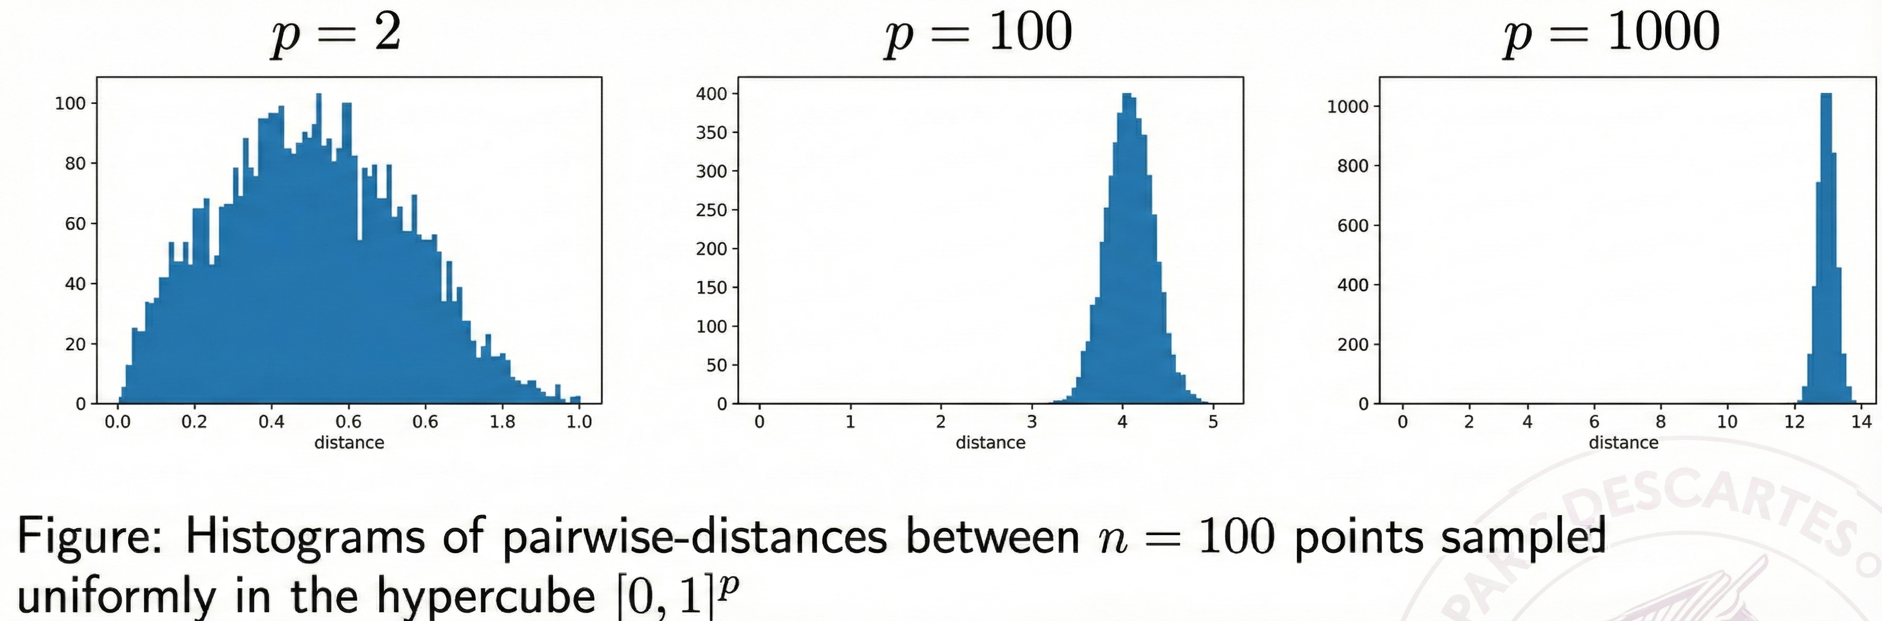
Evidence of Non-Random Structure
If returns were independent, distances would concentrate, and vectors would be near-orthogonal—contradicting observed trends like rallies (days moving together) and volatility clustering (periods of high vs. low variance).
Empirical structure suggests data lies in a low-dimensional subspace.
Equation for distance:
Src: https://web.lums.edu.pk/~imdad

Slide 5
Motivation to Study the Problem
High-dimensional markets overwhelm analysts, reduction simplifies modeling.
Geometric insights reveal why markets aren't random, enabling better signal detection.
Addresses real-world issues like computational inefficiency in large datasets.

Slide 6
Applications of the Approach
Efficient market explanation: Analyze via few factors (e.g., market factor, sector tensions).
Risk assessment and portfolio construction in reduced space.
Broader uses: Data compression, latent factor discovery in finance.

Slide 7
Domain Perspective – Geometric Approach
Study from a geometric lens: View market as points in high-D space, not just statistical data (variance and correlation).
Use properties like distance concentration and near-orthogonality to justify non-randomness.
Bridge geometry with finance for rigorous dimensionality reduction.

Slide 8
Why This Perspective?
Traditional stats overlook high-D quirks, geometry provides intuitive motivation.
Reveals intrinsic low-D structure, making analysis defensible and novel.
Aspect | Statistical View | Geometric View
Focus | Variance/Correlation | Subspaces/Distances
Insight | Factors | Low-D Manifold

Slide 9
Establishing the Background

Slide 10
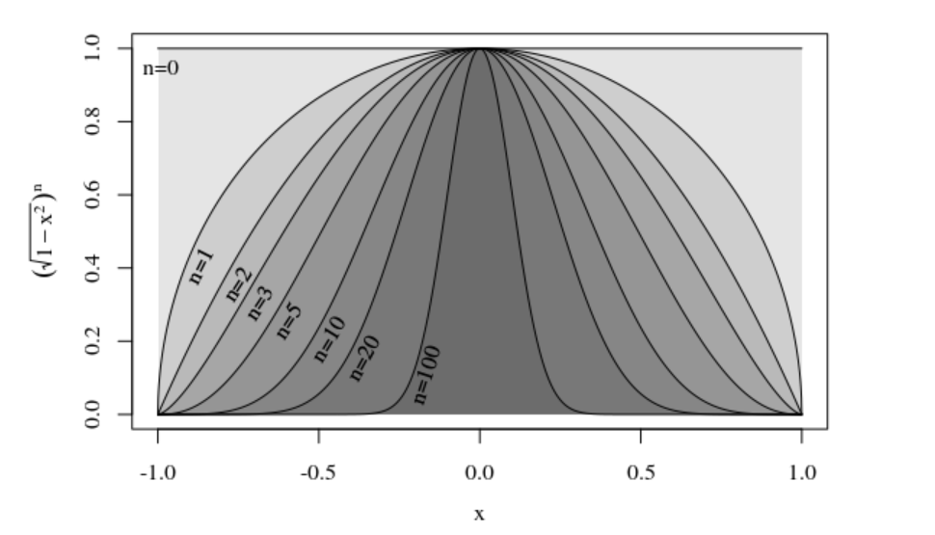
High-Dimensional Space – Introduction
Geometry in high-D is counter-intuitive: Distances similar, volume near surface/equator.
Beneficial: Explains why random market models fail, justifying reduction.
Img src: https://math.stackexchange.com/questions/15656/volumes-of-n-balls-what-is-so-special-about-n-5

Slide 11
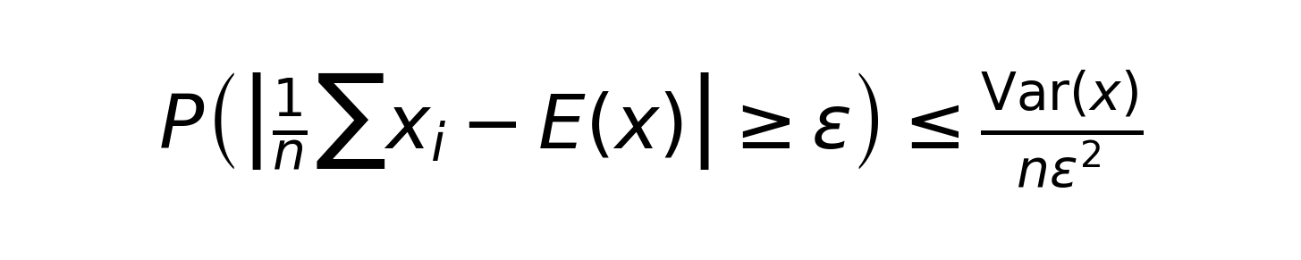
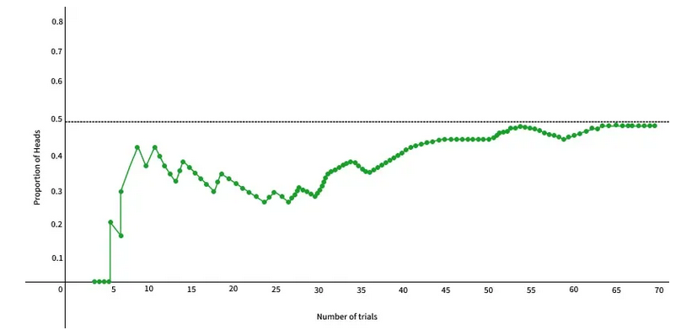
Law of Large Numbers
LLN: Averages converge, bounds via Chebyshev:
In markets: Distances concentrate in high-D random data.
Beneficial: Shows non-random markets must have low-D structure.

Slide 12
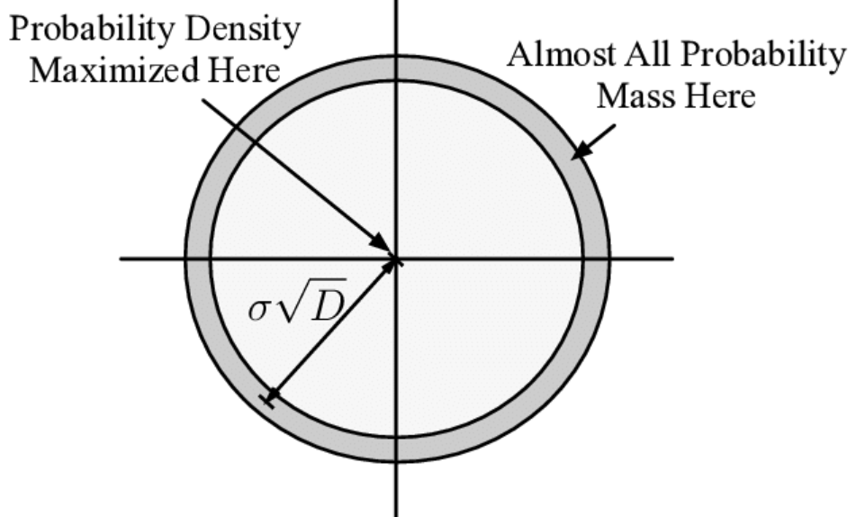
Geometry Properties
Shrinking by (1-ε) reduces volume by (1-ε)^d → thin shell.
Most volume in annulus near boundary.
Beneficial: Highlights curse of dimensionality in finance data.
  -> If we try to find 'similar days' using nearest-neighbor search in raw 500D space, the algorithm struggles because every day looks equally far apart (contrast loss). This motivates why we must reduce dimensions to find meaningful clusters."

Slide 13
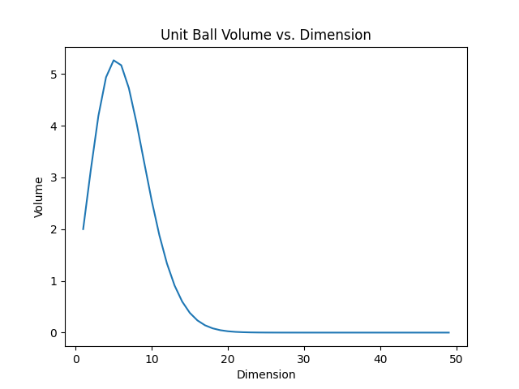
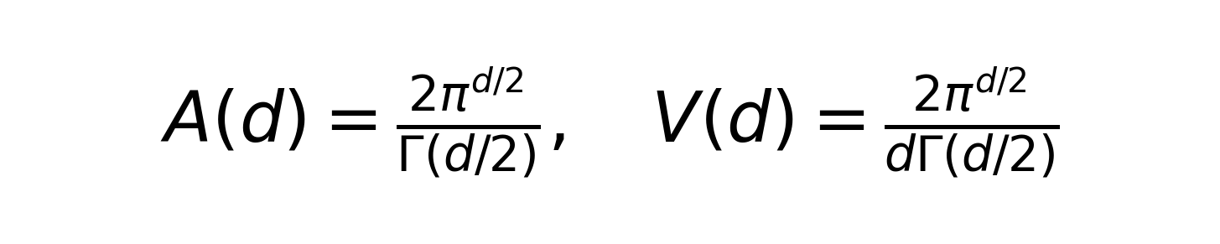
Volume and Surface Area
Unit ball:
Equator concentration: Mass where |x1| = O(1/√d).
Beneficial: Motivates why market data clusters in subspaces.

Slide 14
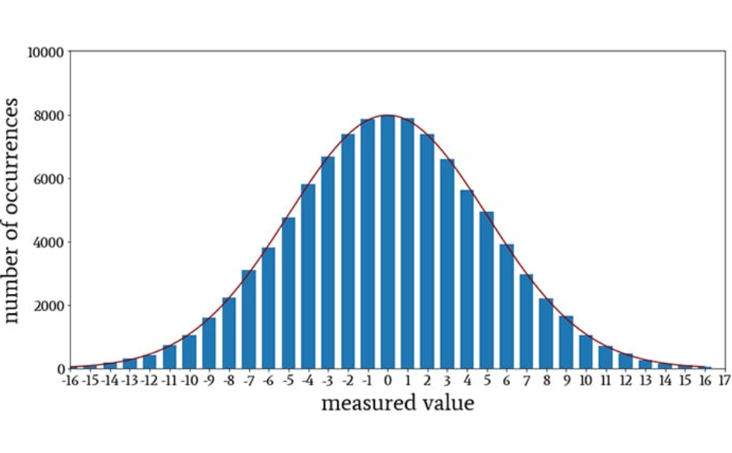
Sampling and Gaussians
Uniform sampling: Normalize Gaussian + scale by r^(d-1).
Gaussians: Mass in annulus ~σ√d.

Slide 15
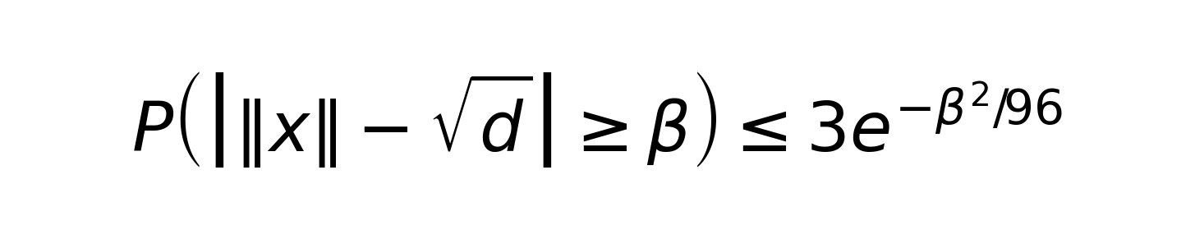
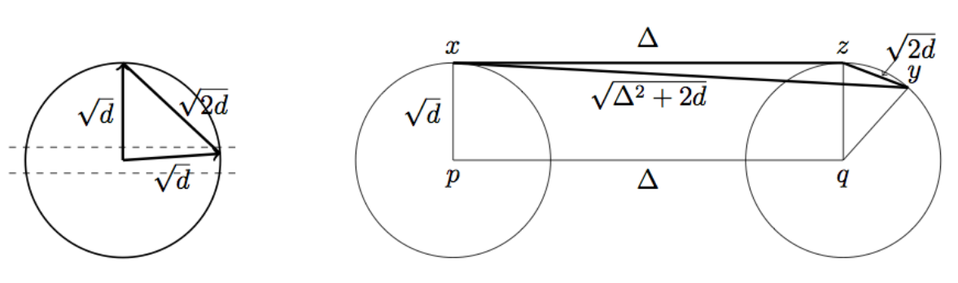
Gaussian Annulus Theorem
Theorem: For high-dimensional random vectors, the probability of falling outside a thin "shell" (annulus) drops exponentially.
Separating gaussian

Slide 16
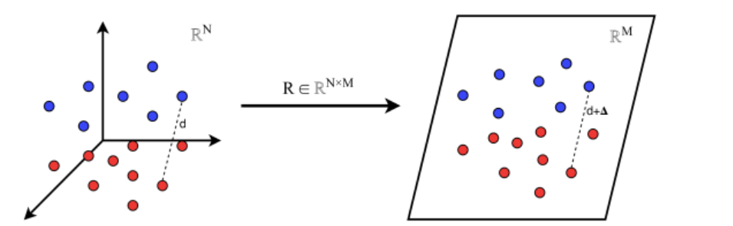
Random Projections and JL Lemma
Projections preserve norms/distances with high prob.
  The JL Lemma states: We don't even need to be careful while projecting high-dimensional data onto a random lower-dimensional subspace as the relative distances between points stay roughly the same.
JL: k ≥ O(ln n/ε²) preserves pairwise distances.
Beneficial: Theoretical basis for dimensionality reduction without loss.

Slide 17
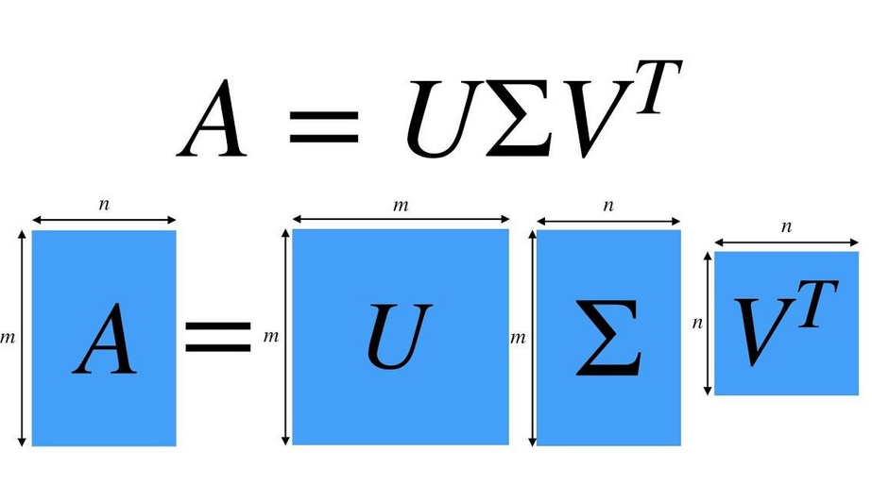
Best-Fit Subspaces and SVD
SVD: A = U D V^T finds best k-D subspace minimizing squared distances.
Beneficial: Core tool for market factorization.
-> A (The Data): This is your 10-year NIFTY 500 matrix (2500 days×500 stocks).
-> U (Left Singular Vectors): These represent the "Market Regimes" (patterns in time). They tell you when specific factors were active.
-> Σ (Singular Values): These are diagonal numbers representing the "Strength" of each factor. A large value means that factor explains a lot of market variance.
-> VT (Right Singular Vectors): These represent the "Factors" themselves (patterns in stocks). They tell you which stocks move together (e.g., a "Banking Sector" vector).

Slide 18
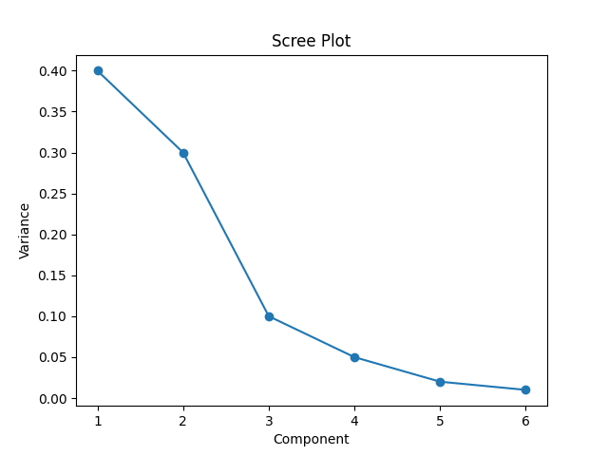
SVD Applications and Norms
Optimal Reduction: SVD guarantees the mathematically "best" rank-k approximation (Ak​) of the market matrix.
Error Control: This approximation minimizes the Frobenius Norm (total squared error), ensuring minimal information loss.
Factor Selection: The Scree Plot (right) identifies the "Elbow Point" to determine the optimal number of factors (k).
Beneficial: Enables efficient compression and analysis in finance.

Slide 19
Future Work

Slide 20
Data Collection and Preparation
Collect 10+ years of NIFTY 500 daily adjusted prices.
Transform to log-returns, standardize (Z-score).
Phase 2: Implement in Python, handle missing data.

Slide 21
Matrix Factorization and Intrinsic Dimension
Perform SVD/PCA on return matrix.
Use scree plot to find k (where it flattens).
Phase 2: Analyze components for economic interpretation.

Slide 22
Model Construction and Validation
Reduce to k-D model with top components.
Validate: Explain market variance, compare to benchmarks.
Phase 2: Test on out-of-sample data, explore factor interpretations (e.g., market vs. sectors).

Slide 23
Thank You

