Slide 1
Mobile Application Development
IS0325

Slide 2
App Functionality – Beyond UI

Slide 3
Learning Objective for the Chapter
Design and Implement long-running tasks using Threads, AsyncTask and Services.
Design and Implement Notifications.
Design and Implement components that respond to system events
Utilize telephony and SMS services.

Slide 4
Introduction
In previous chapter functional UI of an Android app was explored, where event handlers play a key role.
Event handlers provide a mechanism to implement UI – Specific app functionality like:
  What should happen when a button is tapped.
  Which activity should trigger when an action item is selected in an action bar or
  What should happen after a user has completed entering text into an edit text.
All these functionalities are part of event handing logic related to an app UI

Slide 5
Cont . . .
If functionalities that is beyond app UI needs to be supported like:
  Downloading files
  Playing audio
  Processing large data or
  Complex database queries.
Which happen behind the scenes and consume more time to execute.
Needs to be dealt differently

Slide 6
Cont . . .
As each app have single thread called main thread on which all
  Its components,
  Event callbacks
    Execute in a sequential manner.
If user interacts with an app while the main thread is busy running the previous functionality and
  If it takes more than 5s to respond, then Android runtime will popup the Application Not Responding (ANR) dialog
    Prompting the user to either close or wait for the app.
So an app functionality that takes more than 5s, should be taken as long running task and should be tackled by off loading it from main thread to make app responsive.

Slide 7
Cont . . .
There are several ways of offloading a long running task from the main thread like
  New thread to carry out task.
  API called AsyncTask, which enables to do multithreading.
  Service, used to carry out long running task.

Slide 8
Threads
In Android, working of threads is similar to that of java.
To create & start a new thread, Runnable (Thread) instance is created and override run( ) method which contains the functionality of offloading.
To start a thread, invoke start( ) method on the Runnable (Thread) instance.
Main thread needs to be held to access it from a non UI thread, which is done by using handler.
Handler is an object that always refers to the thread that created it.
Handler of the main thread allows other thread to post new tasks to the message queue maintained by the main thread.

Slide 9
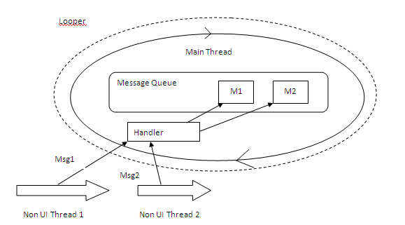
Fig: Handler and Looper

Slide 10
Cont . . .
Tasks are executed as first come first serve basis.
Once message queue is exhausted, the main thread waits for a new task in an endless loop, which is induced by a looper

Slide 11
AsyncTask
AsyncTask enables proper and easy use of the UI thread.
This class allows to perform background operations and publish results on the UI thread without having to manipulate threads and/or handlers.
AsyncTask has to deal with two key aspects:
  Execute the long-running task in the background
  Update the main thread as the task progresses / completes.

Slide 12
Cont . . .
To achieve this, AsyncTask class provides two key callback methods:
  doInBackground ( Params …. )
    Executed on a separate thread in the background, different from main thread
    Ideal place for long running tasks.
  onProgressUpdate(Progress...)
    Executed on main thread,
    Suited to update the progress of the background task on UI.
  This asynchronous communication between these methods is achieved through the publishProgress(Progress...) method call inside doInBackground ( Params …. )

Slide 13
Service
A Service is an application component that can perform long-running operations in the background and does not provide a user interface
States and Life – Cycle Methods
  Life cycle of a service (Fig) begins when a call to the startService() method is made in another component.
  This triggers the creation of service, and onCreate() method is called as a result.
  Service progresses to the running state via a call to the onStartCommand() and will remain in the same state untill a call to stopService() is made.
  If a service is stopped, it moves to destroyed state via a call to onDestroy()

Slide 14
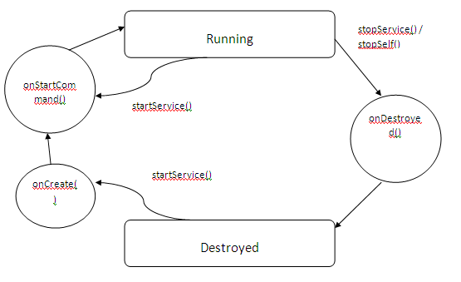
Fig: Services States and Life-Cycle Methods

Slide 15
Notifications
Notifications is a mechanism to inform a user about the occurrence of an event.
Event might be a as shown in fig.
Notifications can be a categorized as hardware and software.
Vibrating or flashing a LED fall under hardware notifications
Flashing message to a user in a non-intrusive manner is software notification.
Fig shows the notification shown in area and drawer

Slide 16
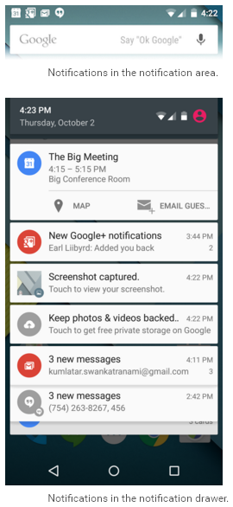

Slide 17
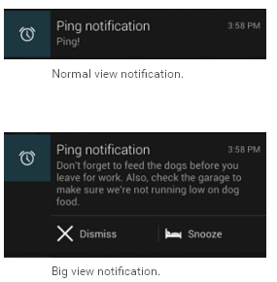
Cont . . .
Advantage of using notification is, it does not distract the user from the current task at hand.
But provides option to respond to the notification anytime.
Android provides two views of notification
  Normal and Big view as shown

Slide 18
Cont . . .
Implementing a notification starts with
  Creating the template of notification
  Defining the navigation from the notification
  Finally triggering it.

Slide 19
Intents and Intent Resolution
Intents play a very important role as binding agents in the decoupled architecture of android.
Intent is a messaging object which is used to request an action from another app component.
Intent can be explicit or implicit
Explicit Intent:
  Specify the activity required to respond to the intent by explicitly designating the target component.
  The developers of the applications have no idea of components names in other applications, so limited to be used within an application.
    Ex: Transferring internal messages

Slide 20
Cont . . .
Implicit Intent:
  Just declare intent and leave it to the platform to find an activity that can respond to the intent.
  Won’t specify the target component that should respond.
  Used for activating components of other applications
  Job of the platform to find suitable component to handle this intent

Slide 21
Broadcast Receivers
Broadcast Receivers simply respond to broadcast messages from other applications or from the system itself.
These messages are sometime called events or intents.
For example,
  Applications can also initiate broadcasts to let other applications know that some data has been downloaded to the device and is available for them to use
  So this is broadcast receiver who will intercept this communication and will initiate appropriate action.
There are following two important steps to make Broadcast Receiver works for the system broadcasted intents −
  Creating the Broadcast Receiver.
  Registering Broadcast Receiver

Slide 22
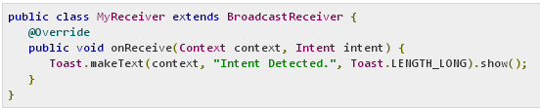
Cont . . .
Creating the Broadcast Receiver
  A broadcast receiver is implemented as a subclass of BroadcastReceiver class and overriding the onReceive() method where each message is received as a Intent object parameter.

Slide 23
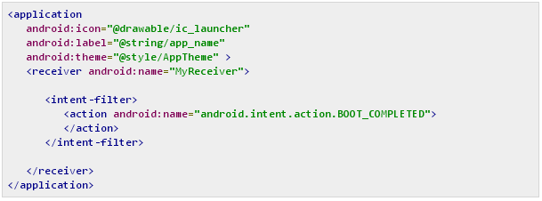
Cont . . .
Registering Broadcast Receiver
  An application listens for specific broadcast intents by registering a broadcast receiver in AndroidManifest.xml file.
  Consider we are going to register MyReceiver for system generated event ACTION_BOOT_COMPLETED which is fired by the system once the Android system has completed the boot process.
  Whenever the Android device gets booted, it will be intercepted by BroadcastReceiver MyReceiver and implemented logic inside onReceive() will be executed.

Slide 24
Telephony and SMS
Android provides TelephonyManager and SmsManager API’s to implement telephony and SMS related functionalities
Key features of TelephonyManager include
  Accessing network and device type information
  Retrieving information about phone states.
SmsManager provides methods to send and receive SMS
TelephonyManager is accessed through the telephony service provided by android as shown

Slide 25
Cont . . .
getSystemService( ) method is used to access telephony service.
Once TelephonyManager is accessed its getNetworkType( ) and getPhoneType( ) methods are used to access network and device type information.
tm.getPhoneType();
tm.getNetworkType();
This information may be crucial to apps that needs to determine the network and device type before executing a specific task.

Slide 26
Cont . . .
TelephonyManager can also be used to determine the state of a mobile device
Change in phone state is a system generated broadcast, which is fired with an intent containing extras, (Key – EXTRA_STATE) as shown below
Phone State EXTRA_STATE value
Phone Disconnected EXTRA_STATE_IDLE
Phone Answered EXTRA_STATE_OFFHOOK
Phone Ringing EXTRA_STATE_RINGING
To listen to these phone state changes, a broadcast receiver has to be implemented in the app

Slide 27
Cont . . .
When configuring intent filter of broadcast receiver in the app, built-in action string used is
android.intent.action.PHONE_STATE
App has to request READ_PHONE_STATE permission in the AndroidManifest.xml file to read the device state change as shown.
Or else the app will throw security exception and terminate.

Slide 28
Cont . . .
Another key aspect of telephony is to place a call.
To place a call, create an intent object with action Intent.ACTION_DIAL, as shown.
Intent makeCallIntent = new Intent (Intent.ACTION_DIAL);
makeCallIntent.setData(Uri.parse(“tel:”+phoneNumber));
startActivity (makeCallIntent)

Slide 29
Cont . . .
SmsManager provides methods to send and receive SMS.
To access the SmsManager, use the getDefault( ) method as shown.
To send a text message, the sendTextMessage ( ) method is used.
  First parameter is phone No. of destination
  Second parameter is SMS service center address
  Third parameter is the message to be sent
  Fourth and fifth parameters are pending intents to be broadcasted if message is successfully sent and delivered to recipient, respectively

Slide 30
Cont . . .
Other aspect of the SmsManager is to receive SMS
To receive an incoming SMS, a broadcast receiver has to be implemented in the app.
When configuring the intent filter of broadcast receiver in the app, the built-in action string used is android.provider.Telephony.SMS_RECEIVED
Also need to request RECEIVE_SMS and READ_SMS permissions for receiving and reading the SMS

Slide 31
Cont . . .
Each sms is received as a packet data unit (PDU)
If the message is too long, it is split into multiple PDU’s
These PDU’s can be obtained as an array of object from the intent in the onReceive( ) method of broadcast receiver.
To extract the message the createFromPDU( ) method of SmsMessage class is used
To extract the message body and the sender’s number, the getMessageBody( ) and getOriginatingAddress( ) methods are used

