Slide 1
Mobile Application Development
IS0325

Slide 2
App Data – Persistence and Access

Slide 3
Learning Objective for the Chapter
Identify various data persistence and access mechanism in a mobile app
Implement data persistence and access using flat files and shared preferences.
Construct and leverage relational database on devices using SQLite
Share app data with other apps using content providers

Slide 4
Introduction
Till now two aspects of mobile app development – UI and the long running tasks are completed.
In both cases, data was captured through user input and exchanged using intents.
These data are volatile and gets wiped off once the app is terminated by the user or android runtime.
But in some scenarios the app data needs to be stored permanently and retrieved when needed.
Data can be saved locally or remotely on the enterprise systems.
Because of limited storage space and network bandwidth, developers have to ensure that app data needs are optimally handled.

Slide 5
Cont . . .
Data can be primitive or complex in nature and can be stored on device in an unstructured or structured manner.
Android provides shared preferences framework to deal with primitive data .
Supports storage of unstructured data in flat files
Also provides SQLite database and API’s to deal with relational data.
It is developer responsibility to identify the data handling techniques based on app requirement.

Slide 6
Flat Files
Used to persist unstructured data – primitive and complex.
Act as an adhoc scribble pad for an app.
Android uses java I/O API to read and write flat files.
To make a user read and write text in a flat file on the device , two user defined methods are used in the activity -
  getFileContent( )
  writeToFile(Stringtext)
  getFileContent( ) method is invoked to fetch the content of a flat file, and populate the TextView.
  writeToFile(Stringtext) is used to save the text entered in the EditText into a flat file on click of the button

Slide 7
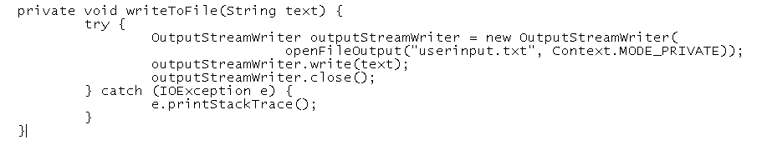
Cont . . .
openFileOutput( ) method is used to create and open a file named userinput.txt as shown
Second parameter indicates the permission on the file.
Can take different values such as MODE_APPEND (Opens file in append mode) and MODE_PRIVATE (erases previous data and writes afresh).
Using the write( ) method of outputStreamWriter, can write data into the file

Slide 8
Cont . . .
In android, data pertaining to any app is maintained in data\data\<package-name>folder.
This folder in turn has subfolders, like files subfolder to store flat files or databases subfolder to store relational database files.
getFileContent( ) – used to read data from the file
openFileInput( ) – used to open the userinput.txt file for reading.
readLine( ) of BufferedReader – used iteratively to read the lines inside the file.
append( ) of StringBuilder – used to cumulate each line read from the file

Slide 9
Shared Preferences
Shared Preferences is android’s simple and hassle-free solution to store primitive data in key-value pairs.
Key – value pairs are most often used to save user preferences such as ringtone, user-preferred app settings etc.
Shared Preferences Stores data in an XML file in the internal memory of the device.
Creation, storage and manipulation of the XML file are internally taken care by the SharedPreferences API

Slide 10
Cont . . .
To use shared preferences, a call to getSharedPreferences() method is made that returns a SharedPreference instance pointing to the file that contains the values of preferences.
SharedPreferences sharedpreferences =
getSharedPreferences(MyPREFERENCES, Context.MODE_PRIVATE);
  First parameter is the key
  Second parameter is the MODE

Slide 11
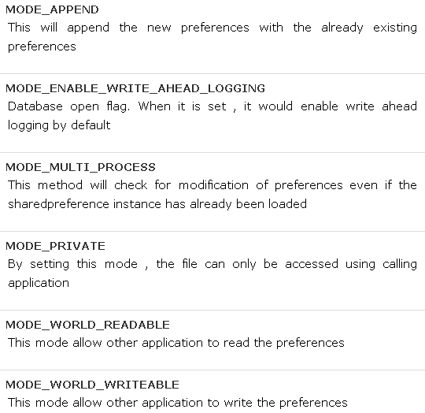
Cont . . .
Other modes available that can be used are

Slide 12

Cont . . .
Can save something in the sharedpreferences by using SharedPreferences.Editor class.
Will call the edit method of SharedPreference instance and will receive it in an editor object.
Its syntax is −
There are methods available in the editor class that allows manipulation of data inside shared preferences.
They are listed as follows:

Slide 13
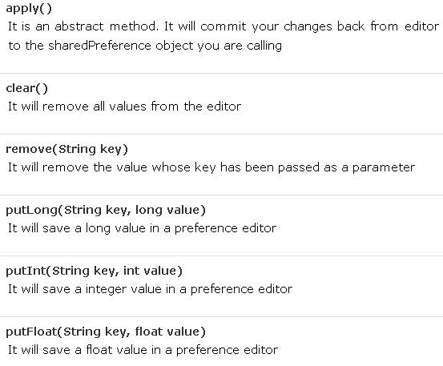
Cont . . .

Slide 14
Relational Data
Mobile apps need to store data in relational format due to the features the databases bring such as –
  Reduced data redundancy
  Atomicity
  Consistency
  Isolation
  Durability and
  Querying capabilities
Mobile databases have different challenges that a developer needs to be caution of.

Slide 15
Cont . . .
These databases have to be really light weight as devices have
  Low disk space
  Must utilize limited processing power to save system resources
  Should be resilient to work in an unfriendly environment where
    Power failure (due to unexpected battery outage) or
    Disk failure (due to device drop) may occur.
So android provides SQLite database and related API’s
SQLite is a popular, open source, RDBMS widely used in mobile platform like android, apple iOS, backberry.
Database is implemented in C and is very light, around 500KiB
The kibibyte is a multiple of the unit byte for quantities of digital information. The binary prefix kibi means 2¹⁰, or 1024, therefore a 1 kibibyte is 1024 bytes. The unit symbol for the kibibyte is KiB.

Slide 16
Cont . . .
SQLite database instance runs as part of the app with which it is associated.
  Implements most of the SQL standards
  Has weakly typed syntax
  Does not support referential integrity constraint, can be enforced using triggers.
  Does not support some form of alter statements.
Android app that intends to use database has to manage both the definition and manipulation aspects of data.
Includes creation of database and tables, and CRUD –
  Create, Retrieve, Update and Delete operations

Slide 17
Cont . . .
Data-related aspects have to be tightly coupled with the app functionalities.
Standard practice to organize the data definition and manipulation aspects using an adapter, which acts as
  a channel between relational database and other app components.
The main package is android.database.sqlite that contains the classes to manage own databases.
To create a database call the method openOrCreateDatabase with database name and mode as a parameter.

Slide 18
Cont . . .
It returns an instance of SQLite database which has to be received in the own object. Syntax
  SQLiteDatabase mydatabase = openOrCreateDatabase("your database name",MODE_PRIVATE,null);
Can create table or insert data into table using execSQL method defined in SQLiteDatabase class. Its syntax is given below
mydatabase.execSQL("CREATE TABLE IF NOT EXISTS TutorialsPoint(Username VARCHAR, Password VARCHAR);");
mydatabase.execSQL("INSERT INTO TutorialsPoint VALUES('admin', ‘admin');");

Slide 19
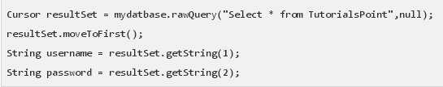
Cont . . .
Can retrieve anything from database using an object of the Cursor class.
Will call a method of this class called rawQuery and it will return a result set with the cursor pointing to the table
Can move the cursor forward and retrieve the data.

Slide 20
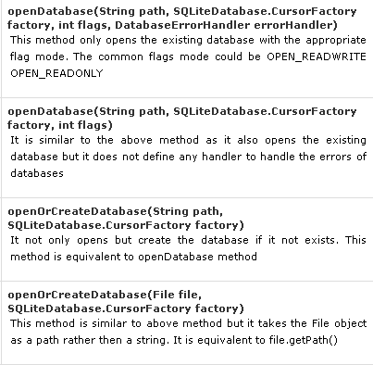
Database - Creation

Slide 21
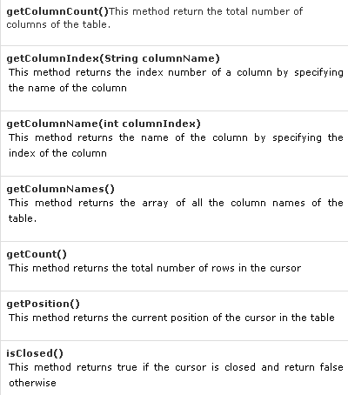
Database - Fetching

Slide 22
Data sharing across Apps
Android apps do not share their data with each other as a security measure.
There may be instances where an app has to share its data with other apps
Example:
  App needs to send an auto-generated SMS to the select few contacts,
  So it needs a mechanism to access contacts stored in the contacts app.
To achieve this android provides the content provider, which hides the implementation details of the data from other apps.

Slide 23
Cont . . .
Using content provider CRUD operations can be performed on data of other apps as a black box.
Android provides many
  In-built content providers using which the data of in built apps are made accessible.
  Can create custom content provider, so other app’s can access our app’s data.

Slide 24
In-built content providers
Android provides In-built content providers, so that a developer can conveniently access some commonly used data sets in their apps.
CalendarContract.CalenderColumns is used for accessing calendar related data.
MediaStore.Audio.AlbumColumns is used for accessing album data of an audio file.
All content providers expose their data sets to other apps using CONTENT_URI’s.
Apps accessing data set use the ContentResolver API which provides a mechanism to carry out CRUD operations on the content provider.

Slide 25
Custom Content Provider
When apps data needs to be exposed and to be accessed by other apps custom content provider are used.
Expose their data sets to other apps using unique strings known as CONTENT_URIs.
CONTENT_URIs is composed of three components –
  Scheme
  Authority
  Path

Slide 26
Cont . . .
Defined as scheme://authority/path.
  Scheme for content providers is always content.
  Authority is a unique string to identify the provider.
    Usual convention followed for defining an authority is <app_package_name>.<app_name>.<provider_name>
  Path refers to the name of the underlying table of the app database, or a specific functionality that is exposed using the CONTENT_URIs

