Slide 1
Mobile Application Development
IS0325

Slide 2
Graphics and Animation

Slide 3
Learning Objective for the Chapter
Design apps that adapt to multiple screen densities and sizes
Discover two-dimensional graphics types and capabilities
Illustrate animation types and capabilities
Apply graphics and animation capabilities to an app.

Slide 4
Introduction
Most popular mobile apps give awesome user experience – both on creative and functional fronts.
Graphics and animation are two key ingredients which makes an app lively and keep’s the user engaged.
From an end-users perspective, graphics enhances the visual quality of an app that results in the wow effect.
From a developer’s standpoint, graphics is all about understanding and dealing with the
  Screen size, resolution, orientation, colors, typography and
  Image formats to create a simple, clean and unique user interface with sound.

Slide 5
Cont . . .
Animations from an end-user’s perspective add zing to the app experience by augmenting tiny delights at multiple occasions.
From developer’s standpoint, animation is all about keeping the user engaged while something is being done in the background.
Example:
  Buffering a song.

Slide 6
Android Graphics
Key graphics capabilities of an android platform can be broadly categorized into the following:
Drawables and canvas:
  Drawables are 2D graphics components of android. Android also allows building custom 2D graphics using canvas.
Hardware acceleration:
  Hardware acceleration means using device’s graphical processing unit to render an app’s UI.
  Means a major performance boost for graphics intensive apps like gaming.
OpenGL:
  OpenGL ES is an open source 3D framework that is used by mobile platforms including Android to render 3D graphics.

Slide 7
Supporting Multiple Screens
Key concepts that impact the app UI –
  Screen density and screen size.
As the spectrum of devices sporting android, varies a lot in terms of screen densities and screen sizes.
It is important for developer to make sure the app UI adapts to these different devices.
Screen densities is defined as number of pixels per unit area of a screen, usually referred to as dots per inch (dpi)

Slide 8
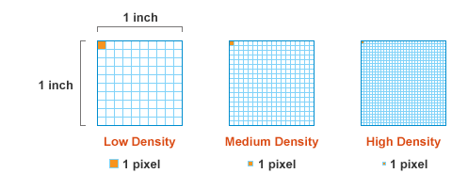
Cont . . .
Fig shows, the leftmost screen has the lowest density, because it has the least number of pixels in the same area compared to other two images.

Slide 9
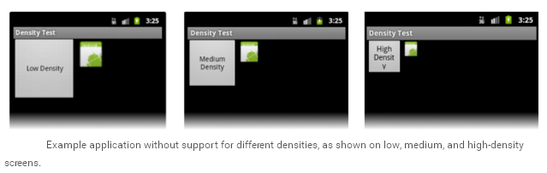
Cont . . .
Fig shows how different screen densities affect app UI
Image and button gets displayed in different sizes based on the screen density.

Slide 10
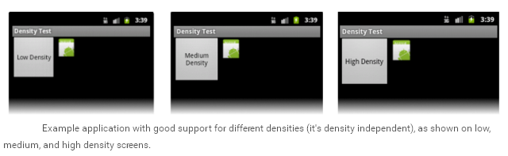
Cont . . .
Aim is to achieve same image size across different density screens so that the app UI looks homogeneous across devices as shown.

Slide 11

Cont . . .
A developer needs to handle images and views appropriately so that the app UI can adapt to multiple target devices.
Android has an in-built mechanism to automatically pick the appropriate image for a given screen density.
Android broadly categorizes the screen density into four categories – ldpi, mdpi, hdpi, xhdpi as shown

Slide 12
Cont . . .
To deal with views across multiple screen densities, it is recommended to use density independent pixels (dpi) as the dimension unit instead of using (px).
Android ensures that views get scaled up / down based on the screen densities.
Android provides three configuration qualifiers to deal with different screen sizes – sw<N>dp, w<N>dp, h<N>dp.
<N>dp represents screen dimension measured in dp

Slide 13
Drawables
Drawable is a visual resource that is typically referred to as something that can be drawn such as a 2D image or a shape.
Android supports various types of drawables.
Bitmap, a png image, is one of the simplest drawables used as app icon or a background image.
Shape drawable is another simple drawable that finds its use where geometric shapes are required.

Slide 14
Custom view and Canvas
When a new view is to be build from scratch or modify the behavior of existing views, then
  Own custom views needs to be created either by extending View class or existing views such as Edittext and Button
Custom views are provided with Canvas object to draw its UI
To draw anything on the screen, we need to call methods provided by Canvas.

Slide 15
Android Animations
Android Animations may be broadly categorized into two types –
  Frame-by-Frame
  Transition
Frame-by-Frame animation referred to as drawable animation, is the simplest types which shows multiple frames in quick succession to create animation effect.
Transition animation is a animation system where varying any property of an object over time, delivers an animated effect to the user.

Slide 16
Cont . . .
Android has two types of animation system –
  View animation – restricted only to animate android views
  Property animation – relatively new, more powerful and can animate any property of any object.

Slide 17
Drawable Animation
Drawable Animation is about showing drawable resources in quick succession one after the to produce an animated effect.
To create a drawable animation follow the steps –
  Prework steps include making / collecting the
    Drawable resources (images),
    Determining the sequence and their
    Individual duration.
  Compose the animation, which involves preparing an XML that lists drawable resources for each frame, their order and duration.
    <animation-list> tag is the root node, each <item> node defines a frame and its duration.
  Last step is realizing animation on the UI that involves associating.

Slide 18
View Animation
View animation is used to perform tweened animation on a view
  Tweening is the process of generating intermediate frames between two images to give the appearance that the first image evolves smoothly into the second image
Tweened animation helps in achieving simple transformation of a view based on four aspects –
  Position, rotation, size and transparency

Slide 19
Cont . . .
Pre-work step identifies the view to be animated, and the number, order and duration of transformations to be carried out on that view
Next compose the animation XML that has the animation instructions to define the type of transformation, timing and duration.

Slide 20
Property Animation
Allows animating any property of an object .
Property animation has no constraints compared to view animation.
Ex:
  Animating the background color of a layout is not possible using view animation but can be done using property animation.

