Slide 1
Python
Presenter : Pawan Dhail

Slide 2


Agenda
Introduction to Python & Syntax Basics with Operators
String manipulations – replace, join, split, reverse, upper & lower case conversions
Data Types
Lists
Tuples
Sets
Dictionary
Conditional Statements & Loops – while, for & nested
Classes & Objects - Inheritance
Reading Data from External Sources – XML, JSON, .CSV, Excel & Databases
Charting with Matplotlib

Slide 3
Python Overview

Slide 4

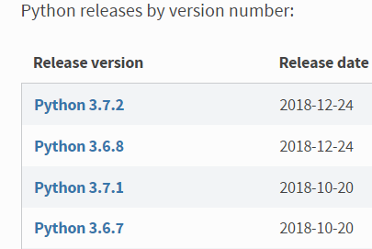


Python - Overview
Python is an interpreted, high-level, open-source and general-purpose programming language
Created by Guido van Rossum and first released in 1991
Python features a dynamic type system and automatic memory management. It supports multiple programming paradigms, including object-oriented, imperative, functional and procedural, and has a large and comprehensive standard library
Anaconda is a free and open-source distribution of the Python and R programming languages for scientific computing (data science, machine learning applications, large-scale data processing, predictive analytics, etc.), that aims to simplify package management and deployment.
Jupyter supports execution environments in several dozen languages. It refers to the three core programming languages - Julia, Python and R
Notes:
Python programmers are affectionately called Pythonistas

Slide 5
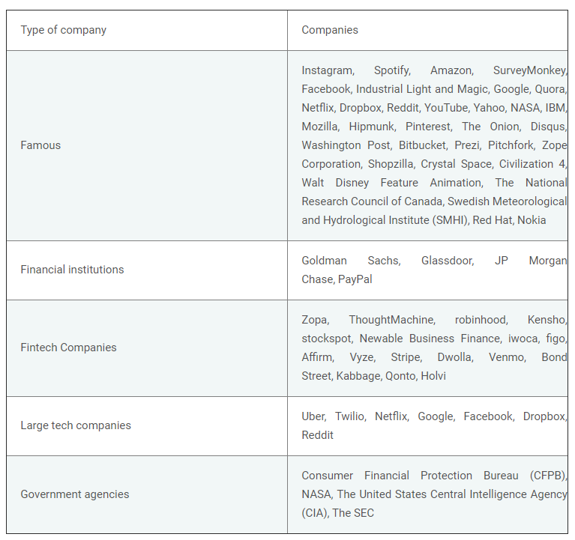
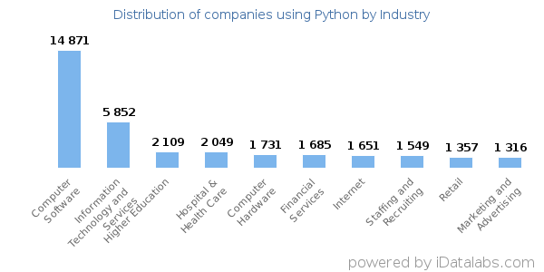
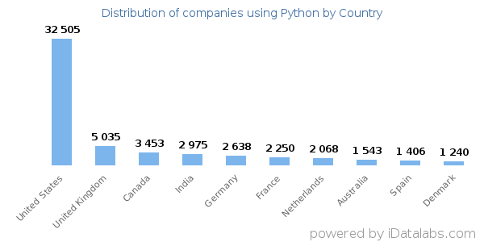
Python – in Industry
Notes:
https://webcase.studio/blog/10-famous-companies-use-python/
https://realpython.com/world-class-companies-using-python/
https://www.cleveroad.com/blog/discover-5-leading-companies-that-use-python-and-learn-does-it-fit-your-project
https://www.fullstackpython.com/companies-using-python.html
https://idatalabs.com/tech/products/python
==================================================================
Amazon – Amazon built the features connected with suggestions (e.g. recommended deals) using Python
To provide its customers with accurate recommendations, Amazon analyzes their buying habits and search patterns. That's possible due to their Python machine learning engine which interacts with company's database Hadoop. So, they combine and work together in order to achieve the most efficiency and accuracy in giving recommendations.
Python @ Netflix - https://talkpython.fm/episodes/transcript/16/python-at-Netflix
https://www.quora.com/What-are-some-amazing-projects-built-using-Python/answer/Ganesh-Kumar-M-4

Slide 6




Python – in Industry…
Following are few of the organizations using Python –
Amazon built the features connected with suggestions (e.g. recommended deals) using Python
Facebook uses Python for the applications connected with image-processing (e.g. image resizing)
Notes:
https://realpython.com/world-class-companies-using-python/
https://www.cleveroad.com/blog/discover-5-leading-companies-that-use-python-and-learn-does-it-fit-your-project
https://www.fullstackpython.com/companies-using-python.html
https://idatalabs.com/tech/products/python
==================================================================
Amazon – Amazon built the features connected with suggestions (e.g. recommended deals) using Python
To provide its customers with accurate recommendations, Amazon analyzes their buying habits and search patterns. That's possible due to their Python machine learning engine which interacts with company's database Hadoop. So, they combine and work together in order to achieve the most efficiency and accuracy in giving recommendations.
Python @ Netflix - https://talkpython.fm/episodes/transcript/16/python-at-Netflix
https://www.quora.com/What-are-some-amazing-projects-built-using-Python/answer/Ganesh-Kumar-M-4

Slide 7
Python – Syntax Basics

Slide 8
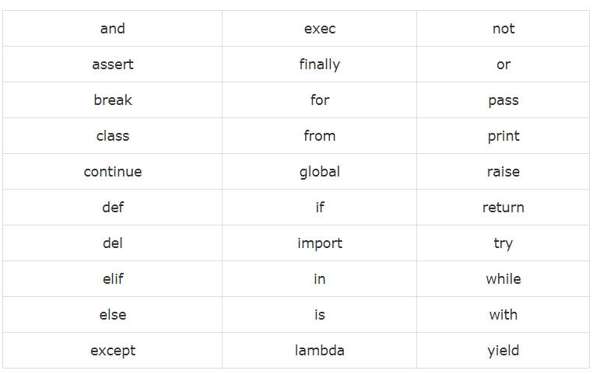
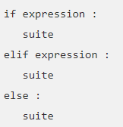
Python – Syntax & Basics
Python is case-sensitive in scripting
Punctuation-characters are not allowed within identifiers; such as - @, $ and %
Class names – starts with capital-alphabet, and identifiers with small-letters
_identifierName : private
__IdentifierName : strongly private
identifierName__ : langaue-defined special name
- hyphens & spaces not allowed
Reserved Keywords
No braces are allowed – for blocks of code, w.r.t
class
functions or
control-flow statements
*** Line indentations are rigidly enforced
Comments
# - single-line-of-code
‘’’ multiple-lines-of-code ‘’’
Python Suite – exhibited by using :
Multiple LoCs can exhibited by using ;

Slide 9
Python – Operators
Arithmetic Operators
Bitwise Operators
Operator | Operation | Example | Evaluates to...
** | Exponent | 2 ** 3 | 8
% | Modulus/remainder | 22 % 8 | 6
// | Integer division/floored quotient | 22 // 8 | 2
/ | Division | 22 / 8 | 2.75
* | Multiplication | 3 * 5 | 15
- | Subtraction | 5 - 2 | 3
+ | Addition | 2 + 2 | 4
Operator | Description | Syntax
& | Bitwise AND | x & y
| | Bitwise OR | x | y
~ | Bitwise NOT | ~x
^ | Bitwise XOR | x ^ y
>> | Bitwise right shift | x>>
<< | Bitwise left shift | x<<
Relational Operators
Identity Operators
Operator | Description | Syntax
> | Greater than: True if left operand is greater than the right | x > y
< | Less than: True if left operand is less than the right | x < y
== | Equal to: True if both operands are equal | x == y
!= | Not equal to - True if operands are not equal | x != y
>= | Greater than or equal to: True if left operand is greater than or equal to the right | x >= y
<= | Less than or equal to: True if left operand is less than or equal to the right | x <= y
is : True if the operands are identical
is not : True if the operands are not identical

Slide 10

Python – Operators
Quick Hands-on
Assignment Operators
Operator | Description | Syntax
₌ | Assign value of right side of expression to left side operand | x = y + z
₊₌ | Add AND: Add right side operand with left side operand and then assign to left operand | a+=b a=a+b
₋₌ | Subtract AND: Subtract right operand from left operand and then assign to left operand | a-=b a=a-b
_{*=} | Multiply AND: Multiply right operand with left operand and then assign to left operand | a*=b a=a*b
_{/=} | Divide AND: Divide left operand with right operand and then assign to left operand | a/=b a=a/b
_{%=} | Modulus AND: Takes modulus using left and right operands and assign result to left operand | a%=b a=a%b
_{//=} | Divide(floor) AND: Divide left operand with right operand and then assign the value(floor) to left operand | a//=b a=a//b
_{**=} | Exponent AND: Calculate exponent(raise power) value using operands and assign value to left operand | a**=b a=a**b
_{&=} | Performs Bitwise AND on operands and assign value to left operand | a&=b a=a&b
_{|=} | Performs Bitwise OR on operands and assign value to left operand | a|=b a=a|b
_{^=} | Performs Bitwise xOR on operands and assign value to left operand | a^=b a=a^b
_{>>=} | Performs Bitwise right shift on operands and assign value to left operand | a>>=b a=a>>b
_{<<=} | Performs Bitwise left shift on operands and assign value to left operand | a <<= b a= a << b
Example : ExerciseOperators_02.py
Notes:
ExerciseOperators_02.py
=================================
https://www.geeksforgeeks.org/basic-operators-python/
https://www.w3schools.com/python/python_operators.asp
https://www.tutorialspoint.com/python/python_basic_operators.htm

Slide 11
Python Data-Types

Slide 12
Python – Data Types
Data Types
Numbers
String
List
Tuple
Dictionary

Slide 13
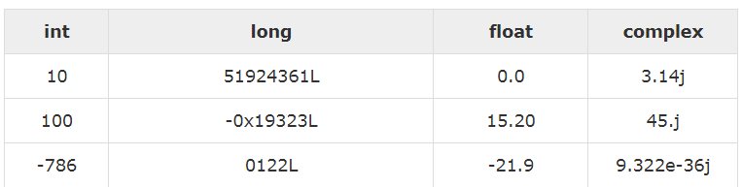
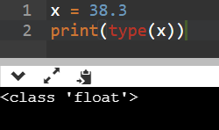
Python – Data Types : Numbers
Numeric types
int (signed integers)
long (long integers, they can also be represented in octal and hexadecimal)
float (floating point real values)
complex (complex numbers)
Numeric type conversions
Type int(x) : to convert x to a plain integer.
Type long(x) : to convert x to a long integer.
Type float(x) : to convert x to a floating-point number.
Type complex(x) : to convert x to a complex number with real part x and imaginary part zero.
Notes:
https://www.w3schools.com/python/python_numbers.asp
https://www.tutorialspoint.com/python/python_numbers.htm

Slide 14
Python – Data Types : Numbers…
Mathematical Functions
Random Functions
Function & Returns ( description )
abs(x)
The absolute value of x: the (positive) distance between x and zero.
cmp(x, y)
-1 if x < y, 0 if x == y, or 1 if x > y
exp(x)
The exponential of x: e^{x}
floor(x)
The floor of x: the largest integer not greater than x
log(x)
The natural logarithm of x, for x> 0
log10(x)
The base-10 logarithm of x for x> 0.
max(x1, x2,...)
The largest of its arguments: the value closest to positive infinity
min(x1, x2,...)
The smallest of its arguments: the value closest to negative infinity
pow(x, y)
The value of x**y.
sqrt(x)
The square root of x for x > 0
Function & Description
choice(seq)
A random item from a list, tuple, or string.
randrange ([start,] stop [,step])
A randomly selected element from range(start, stop, step)
random()
A random float r, such that 0 <= r and r < 1
shuffle(lst)
Randomizes the items of a list in place. Returns None.
uniform(x, y)
A random float r, such that x is <= r and r < y
cos(x)
Return the cosine of x radians.
hypot(x, y)
Return the Euclidean norm, sqrt(x*x + y*y).
sin(x)
Return the sine of x radians.
tan(x)
Return the tangent of x radians.
degrees(x)
Converts angle x from radians to degrees.
radians(x)
Converts angle x from degrees to radians.
Trigonometric Functions

Slide 15
Python – Data Types : Strings
varX = 'Hello World!'
print ("Updated String :- ", varX[:6] + 'Python‘)
Escape Characters
Backslash Notation | Description
\a | Bell or alert
\b | Backspace
\n | Newline
\r | Carriage return
\t | Tab
\v | Vertical tab
Operator | Description
+ | Concatenation - Adds values on either side of the operator
* | Repetition - Creates new strings, concatenating multiple copies of the same string
[ ] | Slice - Gives the character from the given index
[ : ] | Range Slice - Gives the characters from the given range
in | Membership - Returns true if a character exists in the given string
not in | Membership - Returns true if a character does not exist in the given string
String Operators

Slide 16
Python – Data Types : Strings…
String Manipulations by Functions
capitalize
count
endswith
find
index
join
lstrip & rstrip
replace
split
swapcase
upper & lower
Formatted Strings
Quick Hands-on
Example : StringOperators_03.py
Notes:
first ='Pawan' last = 'Dhail' message = first + ' [' + last + '] ' + 'is a coder' print(message) msg = f'{first} [{last}] is a coder' # Formatted Strings print(msg)

Slide 17
Lists
List is a collection which is ordered and changeable. Allows duplicate members.
List Creation
fruitList = [ "Apple", "Banana", "Cherry", "Grapes", "Guava", "Papaya“ ]
print(fruitList)
List Methods
Method | Description
append() | Adds an element at the end of the list
clear() | Removes all the elements from the list
copy() | Returns a copy of the list
count() | Returns the number of elements with the specified value
extend() | Add the elements of a list (or any iterable), to the end of the current list
index() | Returns the index of the first element with the specified value
insert() | Adds an element at the specified position
pop() | Removes the element at the specified position
remove() | Removes the item with the specified value
reverse() | Reverses the order of the list
sort() | Sorts the list
Quick Hands-on
ExerciseLists_04.py
Notes:
https://www.w3schools.com/python/python_lists.asp

Slide 18
Tuples
A tuple is a sequence of immutable Python objects; which are unchangeable. In Python tuples are written with round brackets.
Tuple Creation
fruitTuple = ( "Apple", "Banana", "Cherry", "Grapes", "Guava", "Papaya“ )
print(fruitTuple)
Tuple Methods
Method | Description
count() | Returns the number of times a specified value occurs in a tuple
index() | Searches the tuple for a specified value and returns the position of where it was found
Unpacking of a Tuples / List :
Coordinates = [1,2,3]
X, Y, Z = Coordinates
print(Y) ➔ 2
Quick Hands-on
ExerciseTuples_05.py

Slide 19
Sets
A set is a collection which is unordered and unindexed. In Python sets are written with curly brackets.
Set Creation
fruitSet = { "Apple", "Banana", "Cherry", "Grapes", "Guava", "Papaya“ }
print(fruitSet)
Set Methods
Method | Description
add() | Adds an element to the set
clear() | Removes all the elements from the set
copy() | Returns a copy of the set
difference() | Returns a set containing the difference between two or more sets
discard() | Remove the specified item
intersection() | Returns a set, that is the intersection of two other sets
isdisjoint() | Returns whether two sets have a intersection or not
issubset() | Returns whether another set contains this set or not
issuperset() | Returns whether this set contains another set or not
pop() | Removes an element from the set
remove() | Removes the specified element
union() | Return a set containing the union of sets
update() | Update the set with the union of this set and others
Quick Hands-on
ExerciseSets_06.py

Slide 20
Dictionary
A dictionary is a collection which is unordered, changeable and indexed. In Python dictionaries are written with curly brackets, and they have keys and values.
Dictionary Creation
carDictionary = {
"brand": "Ford",
"model": "Mustang",
"year": 1964
}
print( carDictionary )
Method | Description
clear() | Removes all the elements from the dictionary
copy() | Returns a copy of the dictionary
fromkeys() | Returns a dictionary with the specified keys and values
get() | Returns the value of the specified key
items() | Returns a list containing the a tuple for each key value pair
keys() | Returns a list containing the dictionary's keys
pop() | Removes the element with the specified key
popitem() | Removes the last inserted key-value pair
update() | Updates the dictionary with the specified key-value pairs
values() | Returns a list of all the values in the dictionary
Dictionary Methods
Quick Hands-on
ExerciseDictionary_07.py
Notes:
https://www.w3schools.com/python/python_dictionaries.asp

Slide 21
Python - Conditional Statements & Loopings

Slide 22
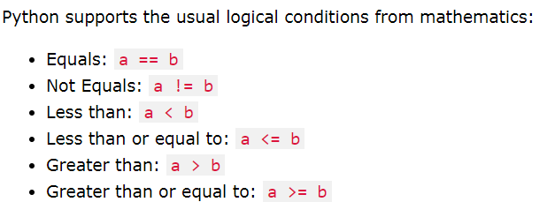
Conditional Statements : If , Else, Elif
Example : 01
a = 200 b = 33 if b > a: print("b is greater than a") elif a == b: print("a and b are equal") else: print("a is greater than b")
Example : 03
a = 200
b = 33
c = 500
if a > b and c > a:
print("Both conditions are True")
Example : 02
a = 430
b = 330
print("A is Greater than B ") if a > b else print(" a = b ") if a == b else print("B is Greater than A ")
Notes:
https://www.w3schools.com/python/python_conditions.asp

Slide 23

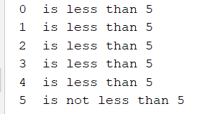
Python : Loops – while, for & nested
Python has two primitive loop commands
for loops
while loops
Example : for-loop
fruits = ['banana', 'apple', 'mango']
for index in range (len ( fruits ) ):
print ( 'Current fruit :', fruits[index] )
print “End-of-Program !"
Example : While-loop
count = 0
while count < 5:
print (count, " is less than 5" )
count = count + 1
else:
print (count, " is not less than 5" )
Sr.No. | Control Statement & Description
1 | break statement
 | Terminates the loop statement and transfers execution to the statement immediately following the loop.
2 | continue statement
 | Causes the loop to skip the remainder of its body and immediately retest its condition prior to reiterating.
3 | pass statement
 | The pass statement in Python is used when a statement is required syntactically but you do not want any command or code to execute.
Notes:
https://www.w3schools.com/python/python_while_loops.asp
https://www.w3schools.com/python/python_for_loops.asp

Slide 24

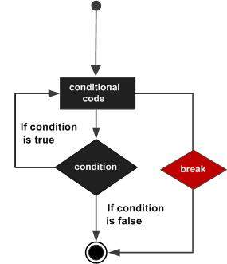
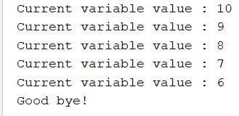
Python : Loops – while, for & nested
Break : Statement
for letter in 'Python':
if letter == 'h':
break
print ('Current Letter :', letter)
Example #1
var = 10
while var > 0:
print ('Current variable value :', var)
var = var -1
if var == 5:
break
print ("Good bye!")
Example #2
break terminates the current loop and resumes at the next statement.
break is used often, when some external condition is triggered and requires exit from a loop.
Can be used in both while and for loops.
*** If you are using nested loops, the break statement stops the execution of the innermost loop and start executing the next line of code after the
block.

Slide 25
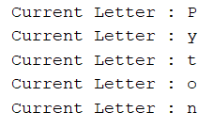
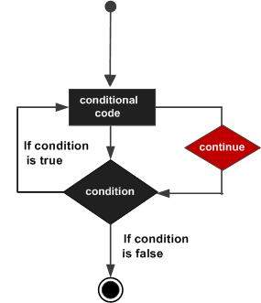
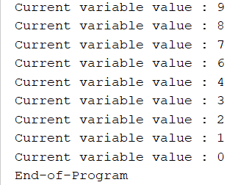
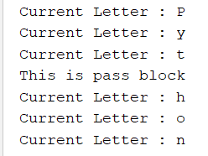
Python : Loops – while, for & nested
Example #1
Continue : Statement
for letter in 'Python':
if letter == 'h':
continue
print ('Current Letter :', letter)
Example #2
var = 10
while var > 0:
var = var -1
if var == 5:
continue
print ('Current variable value :', var)
print ("End-of-Program")
Pass : Statement
for letter in 'Python':
if letter == 'h':
pass
print ('This is pass block')
print ('Current Letter :', letter)
Example #3
Notes:
Nested Loop : https://www.tutorialspoint.com/python/python_nested_loops.htm
i = 2
while(i < 100):
j = 2 while(j <= (i/j)):
if not(i%j):
break
j = j + 1
if (j > i/j) :
print i, " is prime" i = i + 1 print "Good bye!"

Slide 26
Python – Classes
& Inheritance

Slide 27
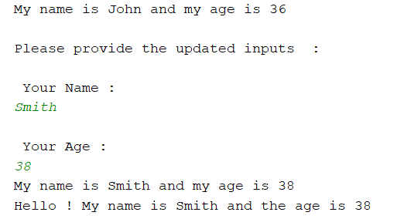
Python : Classes & Objects
Python is an object oriented programming language.
Almost everything in Python is an object, with its properties and methods.
A Class is like an object constructor, or a "blueprint" for creating objects.
Example : Class
class Person:
def __init__(this, name, age):
this.name = name
this.age = age
def myfunc(this):
print("My name is " + this.name + " and my age is " + str(this.age))
p1 = Person("John", 36)
p1.myfunc()
print("\nPlease provide the updated inputs : ")
print("\n Your Name : ")
x = input()
print("\n Your Age : ")
y = input()
p1.name = x
p1.age = y
p1.myfunc()
print("Hello ! My name is " + p1.name + " and the age is " + str(p1.age))
Class Creation
Object Creation
class MyClass:
x = 5
print (MyClass)
class MyClass:
x = 5
p1 = MyClass()
print (p1.x)
__init__() Function
All classes have a function called __init__(), which is always executed when the class is being initiated.
__init__() function is used to assign values to object properties
Notes:
https://www.w3schools.com/python/python_classes.asp

Slide 28
Functions
Function : Syntax
Function : Example #1
def changeme( mylist ) :
"This changes a passed list into this function"
mylist = [1,2,3,4];
mylist.append([5,6,7,8]);
print ("Values inside the function: ", mylist)
return
mylist = [10,20,30];
changeme( mylist );
print ("Values outside the function: ", mylist)
def functionname ( parameters ) :
"function_docstring"
function_suite
return [expression]
Lambda Functions : Syntax
Lambda functions are also called as anonymous because they are not declared in the standard manner by using the def keyword.
lambda [arg1 [,arg2,.....argn]] :expression
Lambda Function : Example #2
x = lambda a, b : a * b
print(x(5, 6))
30
Notes:
https://www.tutorialspoint.com/python/python_functions.htm

Slide 29
Python : Classes & Objects – Inheritance
Person
----------------------------------------------------
name :
age :
---------------------------------------------------
def __init__(self, , ) : // constructor
def showName(self):
def showAge(self):
Super Class
Student(Person)
---------------------------------------------------------------------------------------------------------------------------
def __init__(self, studentName, studentAge, studentId) : //super class constructor
Person.__init__(self, studentName, studentAge)
def getId(self):
Sub Class
Obj1 = Person()
Obj1.showAge()
Obj2 = Student()
Obj2.getId()
Notes:
https://www.javatpoint.com/inheritance-in-python
https://www.python-course.eu/python3_inheritance.php
https://www.python-course.eu/python3_multiple_inheritance.php

Slide 30
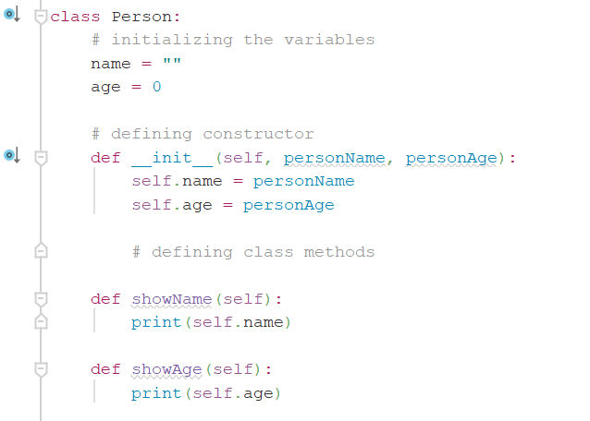
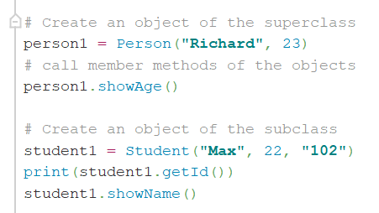

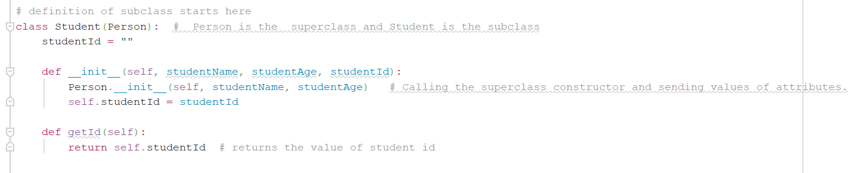
Python : Classes - Inheritance
Example : ExerciseInheri_02.py
Notes:
https://www.javatpoint.com/inheritance-in-python
https://www.python-course.eu/python3_inheritance.php
https://www.python-course.eu/python3_multiple_inheritance.php

Slide 31
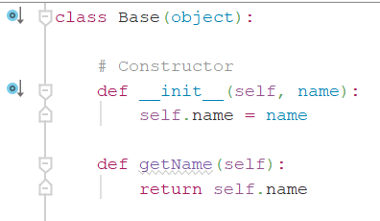

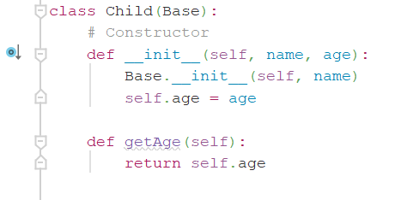

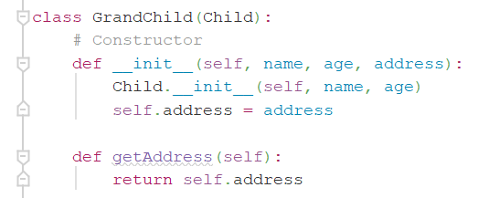
Python : Classes – Multi-level Inheritance
Example : ExerciseMultiLevelInheritence_03.py
Notes:
https://www.javatpoint.com/inheritance-in-python
https://www.python-course.eu/python3_inheritance.php
https://www.python-course.eu/python3_multiple_inheritance.php

Slide 32
Python – Reading Data from External Sources : XML , CSV, JSON, Excel & Databases

Slide 33
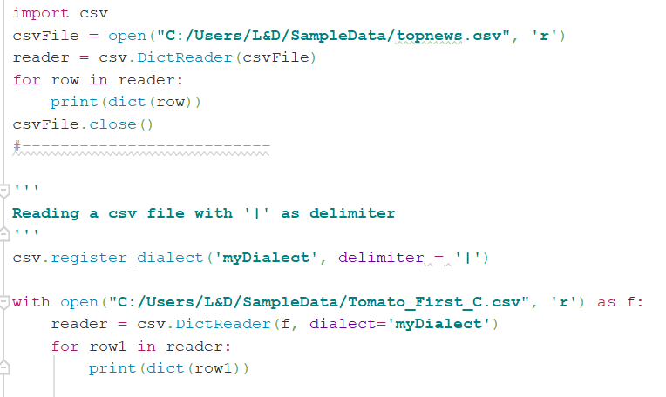
Reading Data from .CSV
To read a .csv file
Import the CSV package
Open the file with absolute path in ‘r’ mode
Read the file using csv.DictReader(), and with dialect for ‘|’ , ‘,’,
Iterate through the csv-reader object

Slide 34
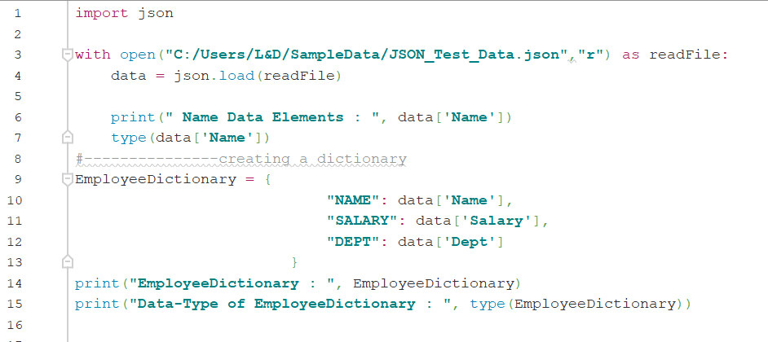
Reading Data from .JSON
To read a .json file
Import the json package
Open the file with absolute path in ‘r’ mode
Read the file using json.load()

Slide 35

Reading Data from .XML
XML Documents in Python can be read and parsed by using –
SAX API (Simple API for XML) - useful when xml documents are large or we have memory limitations, it
parses the file as it reads it from disk and the entire file is never stored in memory
DOM API (Document Object Model) – useful when the entire file is read into memory, and stored in a hierarchical
(tree-based) form to represent all the features of an XML document.
TIP
DOM approach is faster than SAX, when working with large files
DOM allows you to enable changes to the XML files, where as SAX exhibits the read-only approach
Exercise : readXMLExercise2.py
Notes:
https://www.tutorialspoint.com/python/python_xml_processing.htm
https://www.geeksforgeeks.org/xml-parsing-python/
readXMLExercise2.py

Slide 36
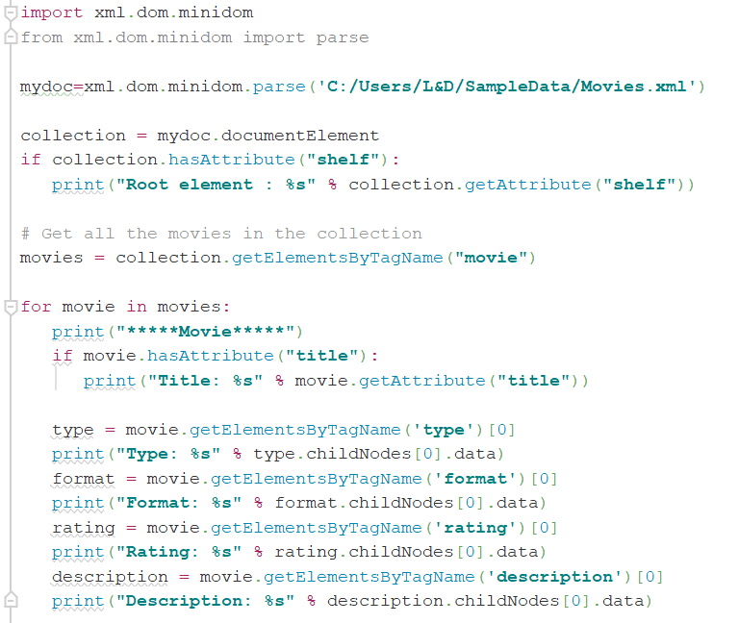
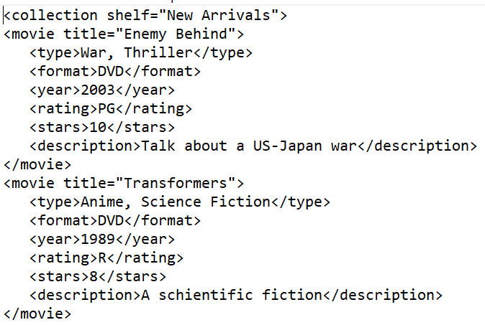
Reading Data from .XML …
DOM API method
Import xml.dom module
1.1) Use minidom object – which allows you to parse xml document thereby creating the DOM - Tree
Open XML document using minidom.parse()

Slide 37
Reading Data from .XML …
Load the entire collection of xml-elements in an object
Identifying and loading the Parent-Node from the collection-object
Traversing of collection object and printing the attribute values of respective tags

Slide 38
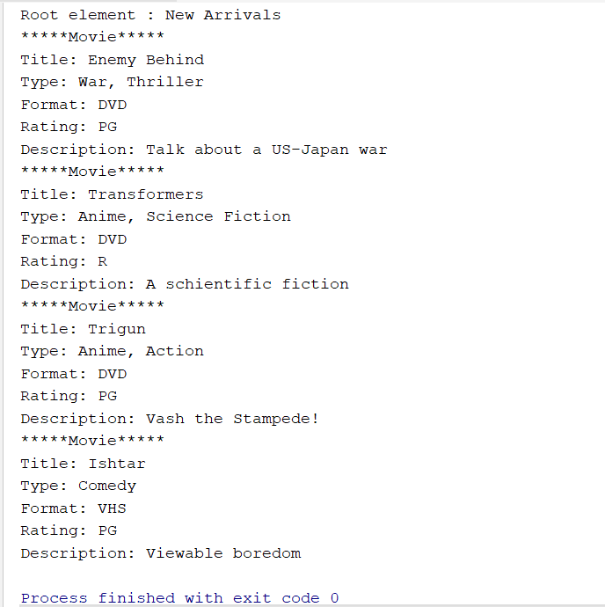
Reading Data from .XML …

Slide 39
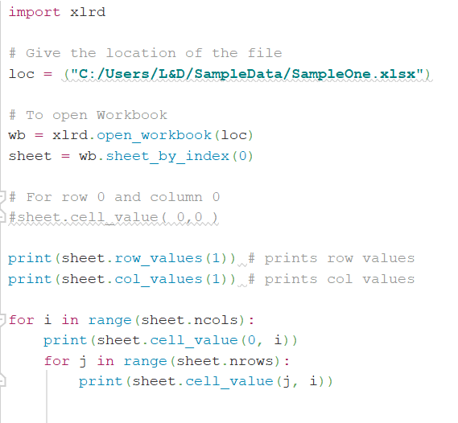
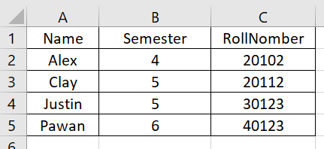
Reading Data from Excel
Excel Files can be read from Python by using the following modules –
xlrd : good for retrieving / reading content from spredsheets
openpyxl : good for reading and writing Excel (with extension xlsx/xlsm/xltx/xltm) files
xlrd
Example : readExcelExer1.py

Slide 40
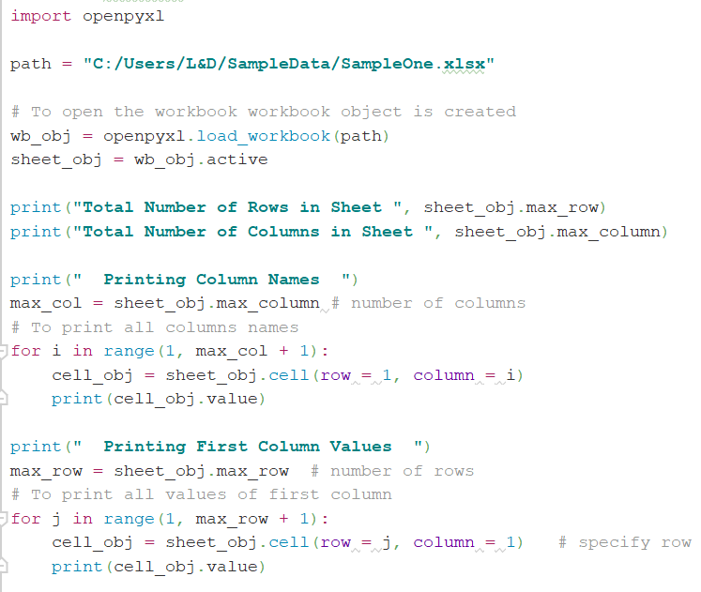
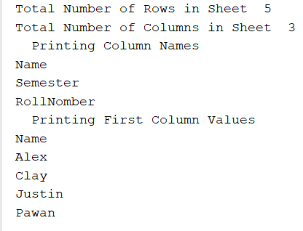
Reading Data from Excel…
0
1
openpyxl
1
Example : readExceltwo.py

Slide 41
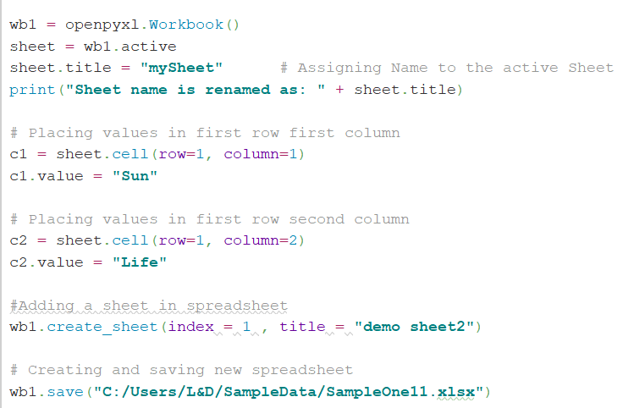
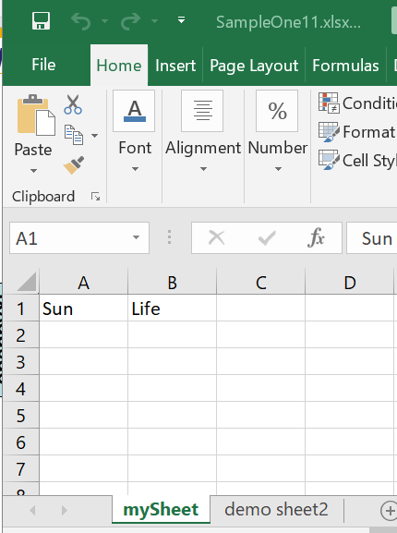
Writing Data into Excel
3
1
openpyxl
2
2
3
1
Example : readExceltwo.py

Slide 42
Reading Data from Database : MySQL
Python Database APIs support wide range of database servers, such as –
GadFly
mSQL
MySQL
PostgreSQL
Microsoft SQL Server 2000
Informix
Interbase
Oracle
Sybase
DB API provides a minimal standard for working with databases using Python structures and syntaxes –
Importing the API module : import mysql
Acquiring a connection with the database : mysql.connector.connect()
Issuing SQL statements and stored procedures : cursor.execute()
& fetch
Closing the connection : close()
Notes:
http://www.mysqltutorial.org/getting-started-mysql-python-connector/

Slide 43
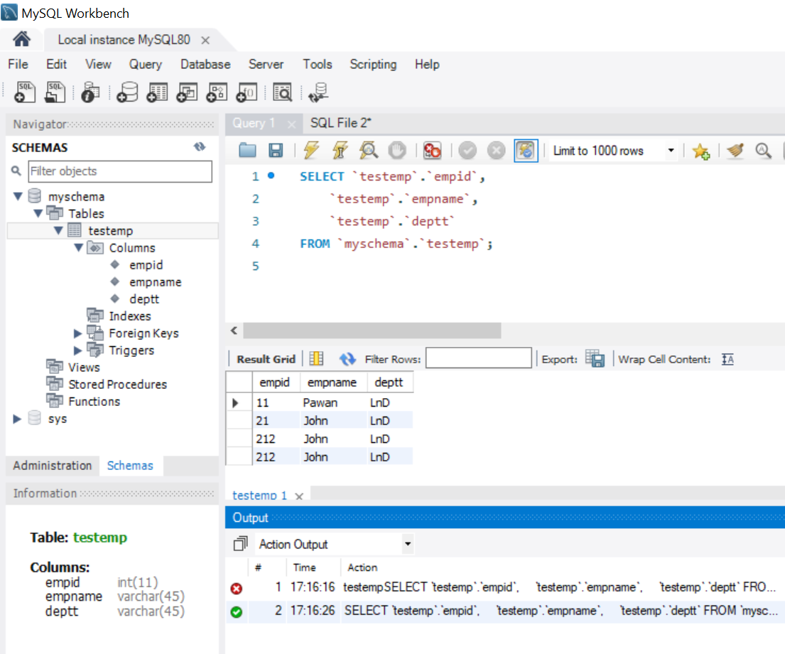
Reading Data from Database : MySQL…
MySQL DB :
testemp
Notes:
http://www.mysqltutorial.org/getting-started-mysql-python-connector/

Slide 44
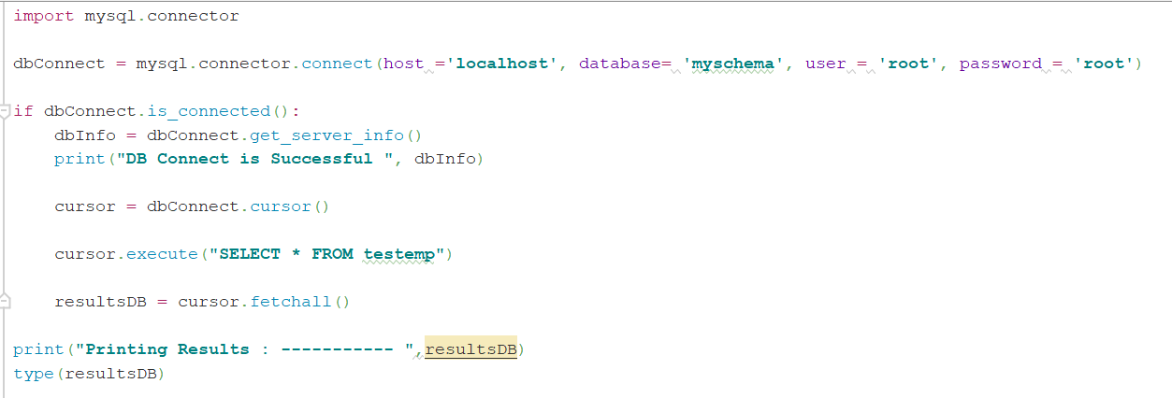
Reading Data from Database : MySQL… put result image
1
2
3
4
5
6
Example : mySQlConnectExercise.py
Notes:
#============================================== http://www.mysqltutorial.org/python-mysql/
mySQlConnectExercise.py

Slide 45
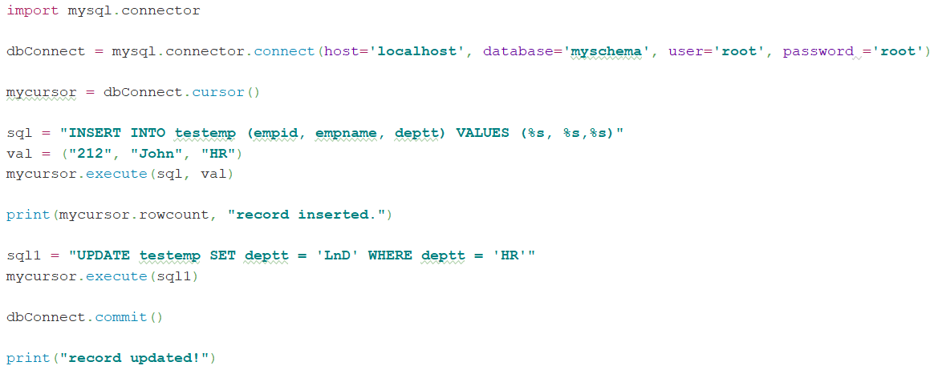
Insert & Update Records in Database : MySQL
1
2
Example : insertDBExer.py
Notes:
#============================================== http://www.mysqltutorial.org/python-mysql/

Slide 46
Python – Charting with Matplotlib

Slide 47
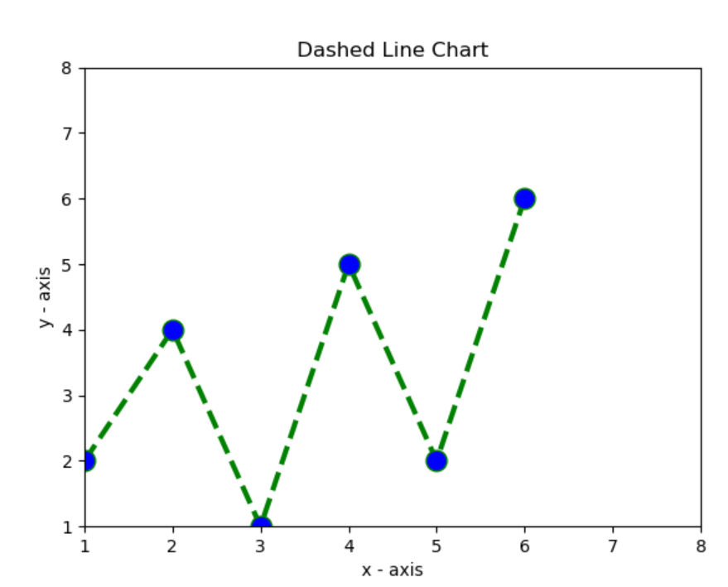
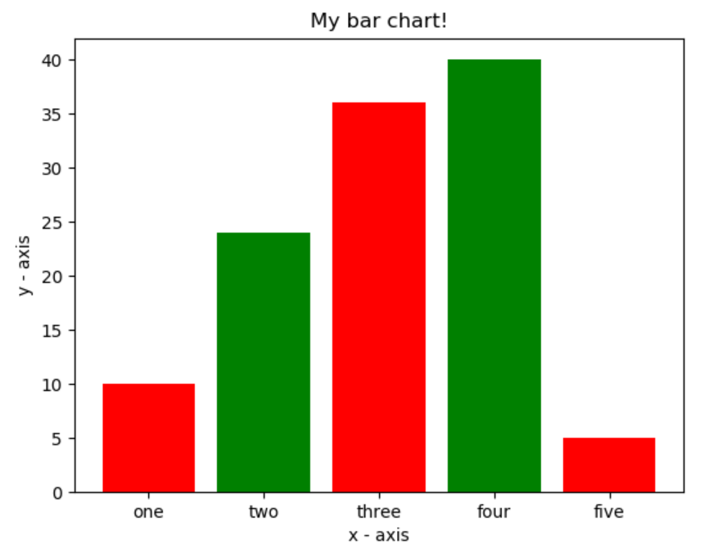
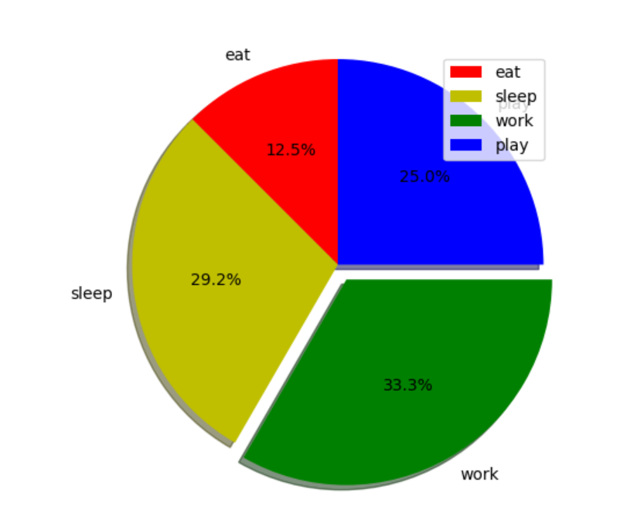
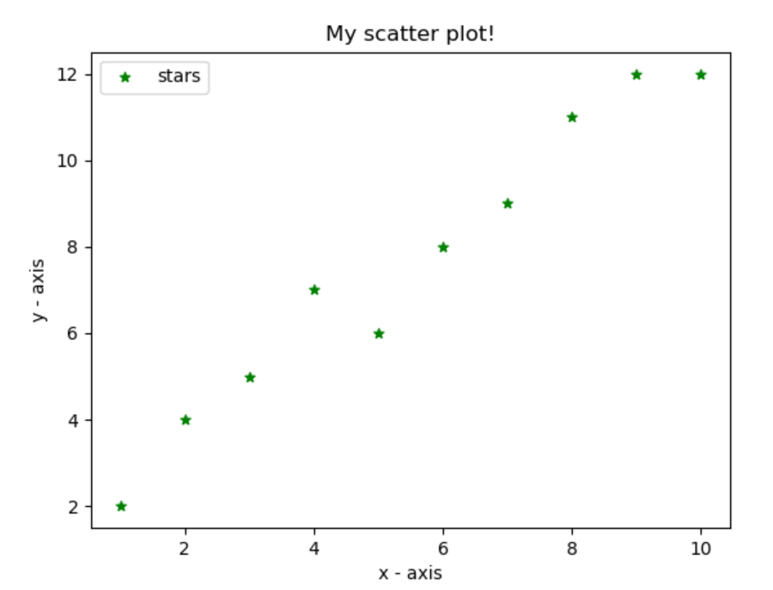
Charts Using Matplotlib
Line Graph
Bar Chart
Pie Chart
Scatter Chart
https://python-graph-gallery.com/all-charts/
https://seaborn.pydata.org/examples/
https://plot.ly/python/

Slide 48
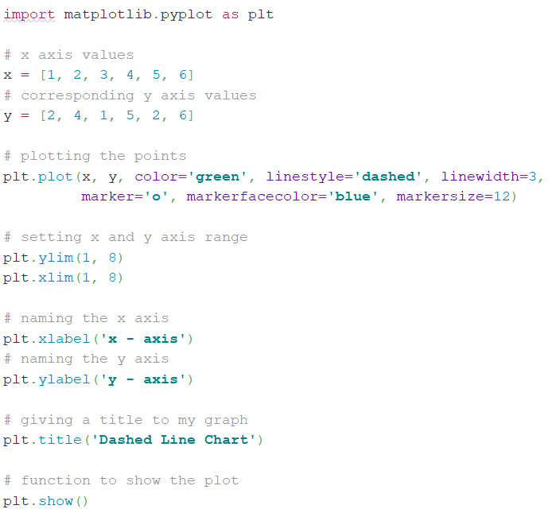
Python – Matplotlib
Line Chart
Import the module Matplotlib, and assign the object
Identify the dependent and independent variables; and their data-sets
Use the function plot() from matplotlib-object with subsidiary attributes
Notes:
ChartsExercise1

Slide 49
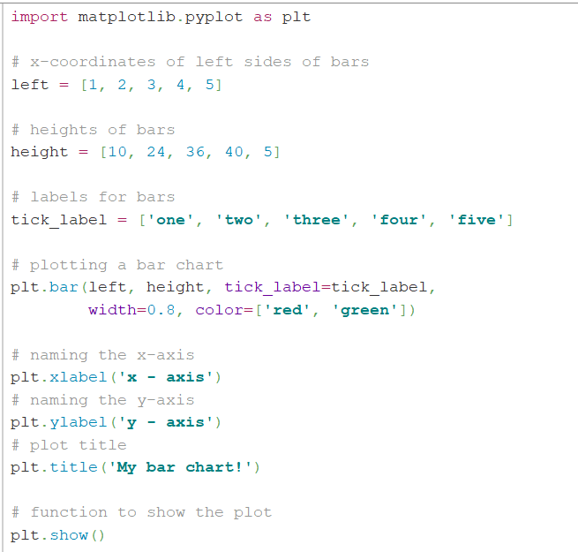
Python – Matplotlib
Bar Chart
Notes:
BarChartExer.py

Slide 50
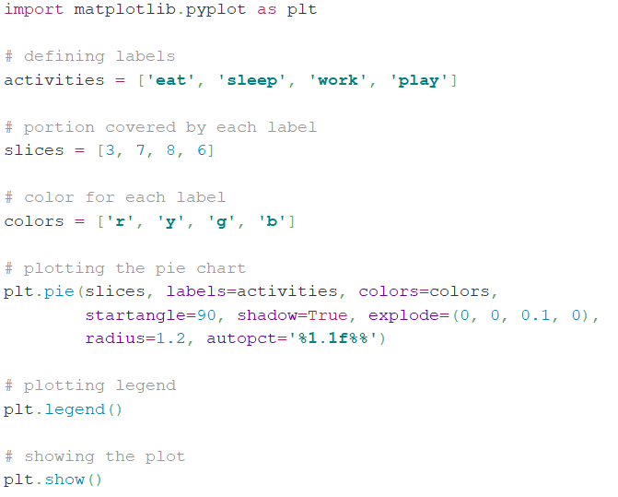
Python – Matplotlib
Pie Chart
Notes:
BarChartExer.py

Slide 51
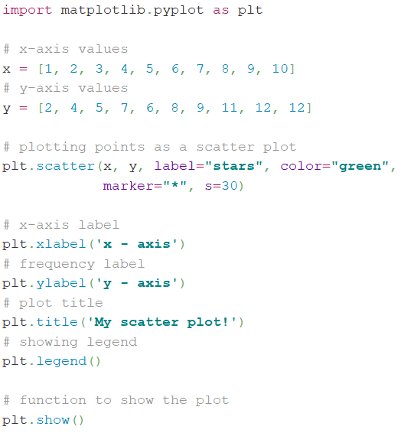
Python – Matplotlib
Scatter Chart
Notes:
BarChartExer.py

Slide 52
What have we covered.. Today !
Introduction to Python & Syntax Basics with Operators
String manipulations – replace, join, split, reverse, upper & lower case conversions
Data Types
Lists
Tuples
Sets
Dictionary
Conditional Statements & Loops – while, for & nested
Classes & Objects - Inheritance
Reading Data from External Sources – XML, JSON, .CSV, Excel & Databases
Charting with Matplotlib

Slide 53
THANK YOU

Slide 54
Template Revision History
Revision Number | Revision Date (DD-Mmm-YY) | Revision Description | Revised By | Rationale for Change
1.0 |  | Send revised module for approval | Pawan Dhail | Approved by Mrinal Benipuri
0.1 |  | Final module created

