Slide 1
Project 2- Chebyshev and evenly spaced interpolation of e^x on [-1,1]
By:Rohan Mankame

Slide 2
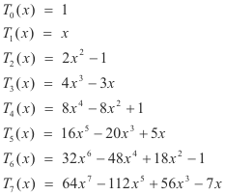
Chebyshev interpolation
Chebyshev polynomial interpolation is a method of approximating a function using a polynomial that passes through a set of Chebyshev points. Chebyshev points are a set of nodes on the interval [−1,1]
General form:

Slide 3
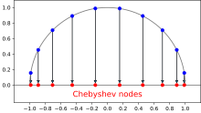
Here you can see how the nodes are distributed rather then evenly spaced on the interval.

Slide 4

For positive integer n the Chebyshev nodes in the interval (-1,1) are…
Chebyshev polynomial of degree n ≥= 0 is defined as:
Tn(x) = cos (n*arccosx) , x ∈ [−1,1]
To use Chebyshev polynomial interpolation, we first need to create a set of Chebyshev points, to do this I have used the formula
From this we can get the x values of the nodes.
(k or Tn is iteration , and n is num of nodes)

Slide 5
Steps for Chebyshev
Create spaced nodes, using x= cos((2K-1)*pi/(2(n)))
Create a Chebyshev interpolation formula to make polynomial, matlab has built-in-function to construct polynomials of degree n using polyfit(x,f(x),n)
Let P = polyfit(x,f(x),n), now we use P to approximate the function over our interval
Produce plots of F(x) and P(x)

Slide 6
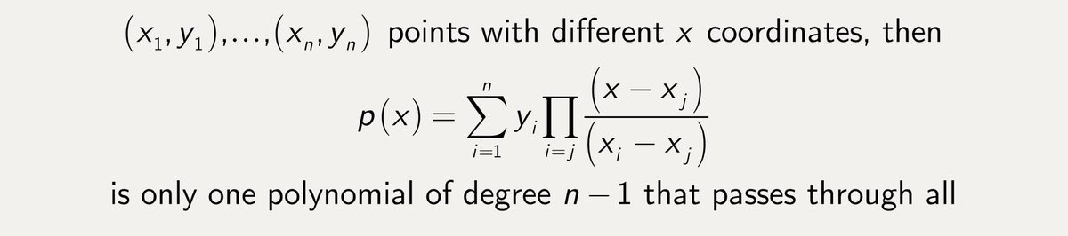
Evenly spaced interpolation
Evenly spaced polynomial interpolation is a method of approximating a function using a polynomial that passes through a set of evenly spaced points. The polynomial is constructed using the Lagrange interpolation formula.

Slide 7
Steps for evenly spaced
Create evenly spaced points, using x=linespace(-1,1,2000)
Create a Lagrange interpolation formula to make polynomial, matlab has built-in-function to construct polynomials of degree n using polyfit(x,f(x),n)
Let P = polyfit(x,f(x),n), now we use P to approximate the function over our interval
Produce plots of F(x) and P(x)

Slide 8

Error of Chebyshev polynomials and evenly spaced polynomial in interval [-1,1]
To get the error bound in Chebyshev and evenly spaced interpolation we will simply take the absolute value of F(x)-P(n-1)(x).
We will compute these points using the steps shown in each case and plot the error.

Slide 9
Built-in functions in mathlab
linespace(-1,1,2000) – creates linearly spaced values (2000 values)
polyfit(x,f(x),n) – find coefficients of P(x) of degree n that fits F(x) data
polyval(P,x)- evaluates polynomial for given set of x values

Slide 10
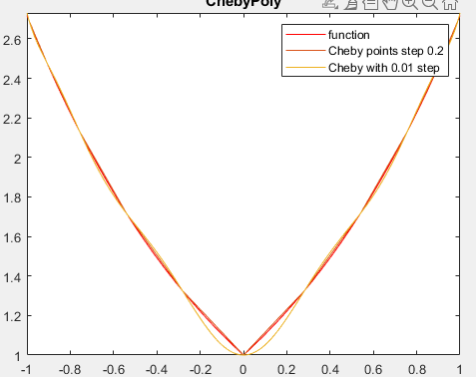
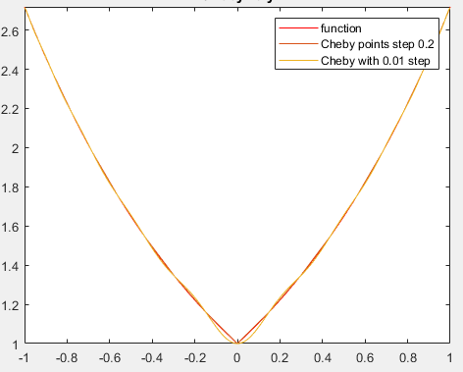
Chebyshev interpolation
N=20
N=10

Slide 11
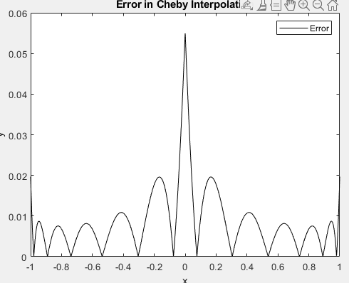
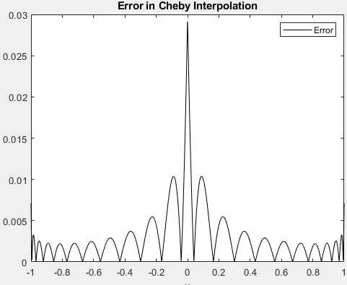
Chebyshev interpolation error
N=10
N=20

Slide 12
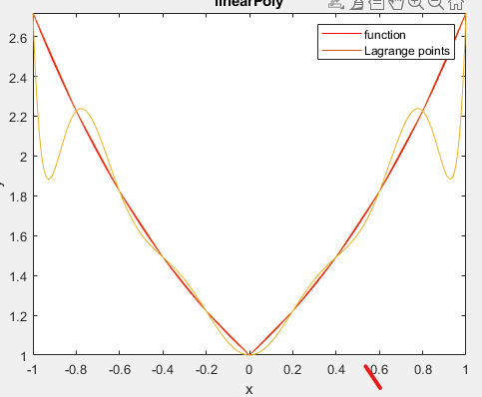
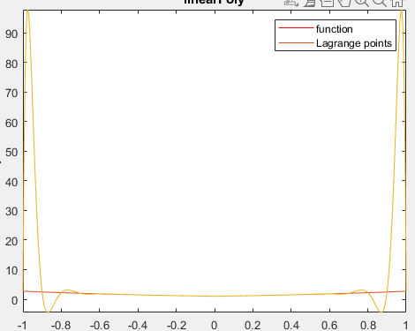
Evenly spaced interpolation
N=10
N=20

Slide 13
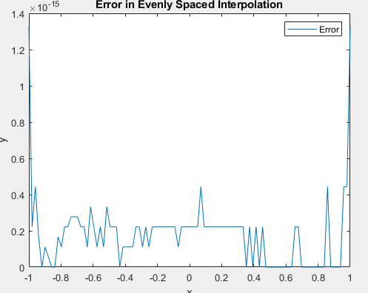
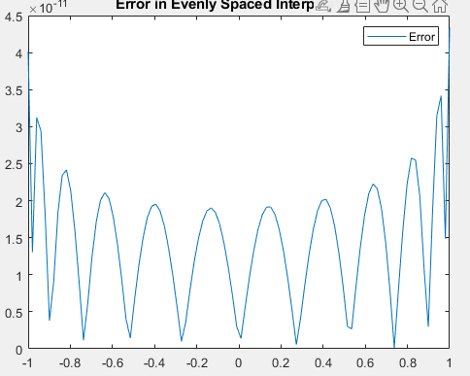
Evenly spaced interpolation error
N=10
N=20

Slide 14
Demo

Slide 15
Results- Chebyshev error
The error is large for most values of x, but it decreases as x approaches the ends of the interval.
As the value of n increases the error towards the center of the interval is large however, the errors towards the ends go to 0. Therefore, as degree of n increases the error minimizes

Slide 16
Results- error evenly spaced
The error is small for most values of x, but it increases as x approaches the ends of the interval.
As the value of n increases the error towards the center of the interval is extremely small however, the errors towards the ends go to infinity.

Slide 17
End
Thank you for watching my presentation!

