Slide 1
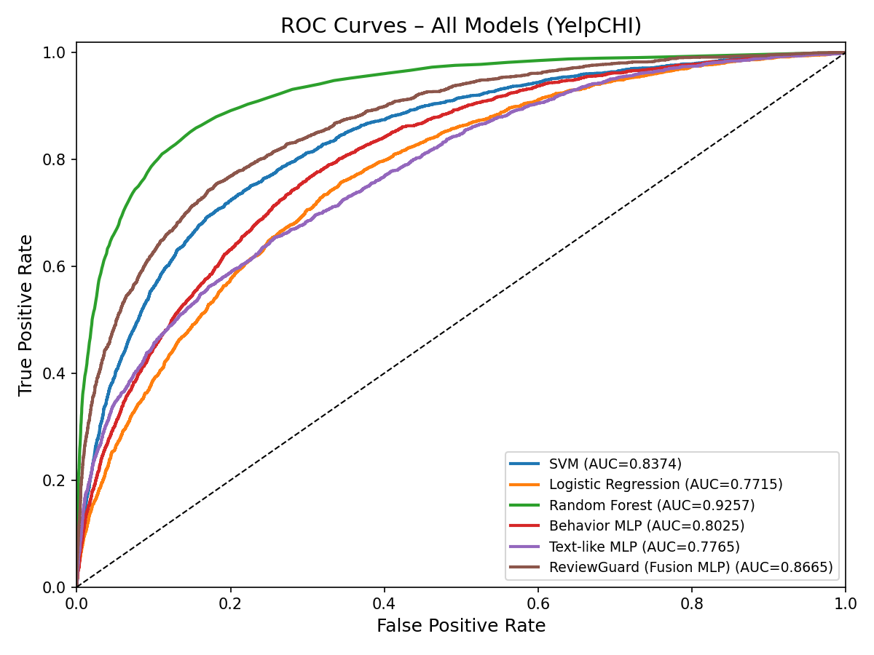
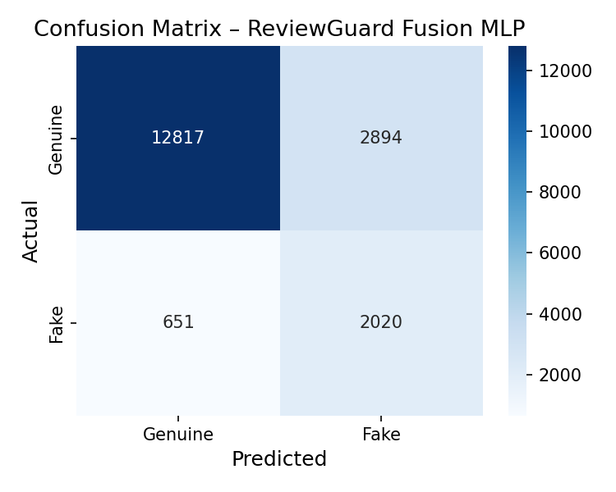
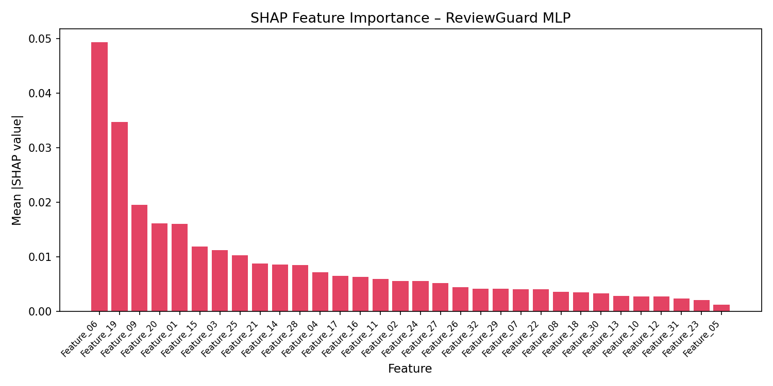
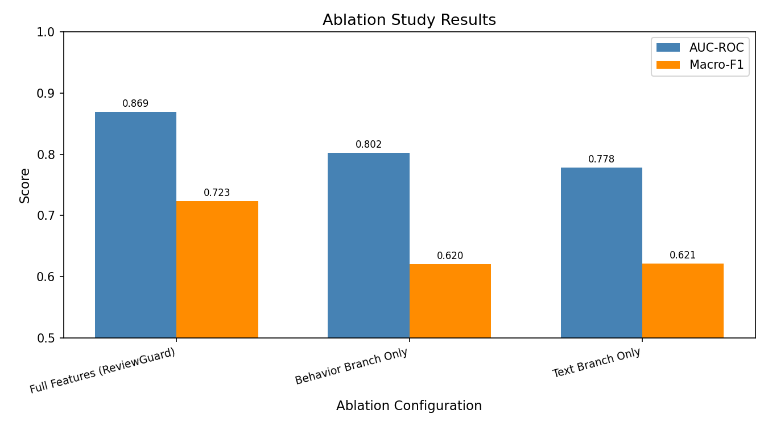
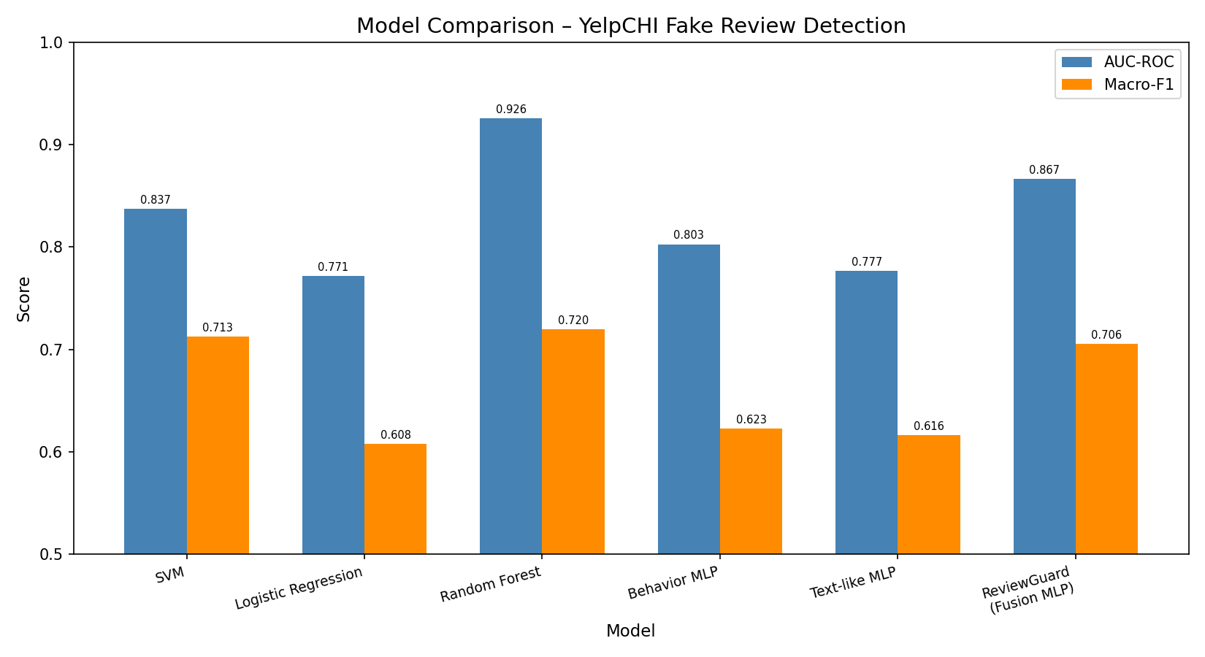
ReviewGuard: Combining Transformer Semantics and Reviewer
Behavior for Fake Review Detection on Yelp
Rohan Mukka & Rithwik Reddy Donthi Reddy
CS 5903 — Perspectives on Computing | University of Oklahoma | Spring 2026
Motivation
Key Results
ROC Curves — All Models
Online reviews heavily influence consumer decisions, yet platforms like Yelp face persistent manipulation through fake reviews. Existing detection approaches typically focus on either textual content or reviewer behavior in isolation, leaving critical cross-modal signals unexploited.
ReviewGuard addresses this gap by fusing transformer-based semantic features with behavioral metadata through a late-fusion MLP architecture, achieving robust detection on the real-world YelpCHI dataset (45,954 reviews, 14.5% fake).
Model | AUC-ROC | Macro-F1 | Recall (Fake)
Logistic Regression | 0.771 | 0.608 | 0.681
SVM (RBF) | 0.837 | 0.713 | 0.625
Random Forest | 0.926 | 0.720 | 0.343
Behavior MLP | 0.803 | 0.623 | 0.753
Text-like MLP | 0.777 | 0.616 | 0.656
ReviewGuard (Ours) | 0.867 | 0.706 | 0.756
Problem Statement
• Fake reviews erode consumer trust and distort market signals
• Text-only methods miss behavioral manipulation patterns
• Behavior-only methods miss semantic deception cues
• Class imbalance (85.5% genuine vs 14.5% fake) challenges standard classifiers
• Need: unified multi-modal framework combining both signals
0.867
75.6%
0.869±0.005
AUC-ROC
Fake Recall
5-Fold CV AUC
Discrimination
Detection Rate
Robustness
Methodology
Analysis
ReviewGuard Architecture
• ReviewGuard achieves the highest fake-class recall (75.6%) among all models, critical for practical deployment where missing fake reviews is costly
• Random Forest achieves highest AUC (0.926) but severely underfits the minority class (34.3% fake recall), making it impractical for fraud detection
• Behavioral features (rating deviation, review frequency, burstiness) are the strongest individual predictors per SHAP analysis
• Fusion consistently outperforms single-branch models: +6.4% AUC over behavior-only, +9.0% over text-only, validating the multi-modal approach
• 5-fold cross-validation confirms stability: ReviewGuard AUC = 0.869 ± 0.005
Text Branch (Semantic Features)
Input review text → BERT/DistilBERT tokenizer →
Transformer encoder → [CLS] pooling →
Dense 256 → ReLU → Dropout(0.3)
Behavior Branch (Metadata Features)
32 behavioral features (rating deviation, review frequency,
burstiness, content similarity, activity ratios) →
Dense 128 → ReLU → BatchNorm → Dropout(0.3)
Late Fusion
Concatenate [text_embed ; behavior_embed] →
Dense 128 → ReLU → Dropout(0.3) →
Dense 1 → Sigmoid → P(fake)
ReviewGuard Confusion Matrix
SHAP Feature Importance
Dataset
YelpCHI (Mukherjee et al., 2013)
• 45,954 reviews from Yelp with ground-truth labels
• 6,677 fake (14.5%) and 39,277 genuine (85.5%)
• 32 pre-computed behavioral/metadata features
• 80/20 stratified train-test split
• 5-fold cross-validation for robustness evaluation
Cross-Validation Results
Model | Mean AUC | Std Dev
Logistic Regression | 0.774 | ±0.008
Random Forest | 0.931 | ±0.003
ReviewGuard (Ours) | 0.869 | ±0.005
Ablation Study
Model Comparison
Conclusion & Future Work
Ablation Summary
ReviewGuard demonstrates that combining semantic and behavioral signals yields a more balanced and practical fake review detector than either modality alone.
The late-fusion MLP architecture provides an effective and interpretable framework for multi-modal deception detection, with behavioral features providing the strongest individual signal.
Future work includes:
• Incorporating graph-based reviewer relationships
• Modeling temporal dynamics of review patterns
• End-to-end transformer fine-tuning with raw review text
• Adversarial robustness evaluation against evolving fake review strategies
Component removal analysis confirms the contribution of each branch:
• Full Model (Fusion MLP): AUC = 0.867, Recall = 75.6%
• Behavior branch only: AUC = 0.803 (−7.4%)
• Text-like branch only: AUC = 0.777 (−10.4%)
Both branches provide complementary information. Removing either degrades performance, with the text branch contributing more incremental gain when added to behavior features than vice versa.
References
[1] Mukherjee et al., "What Yelp Fake Review Filter Might Be Doing," ICWSM 2013
[2] Devlin et al., "BERT: Pre-training of Deep Bidirectional Transformers," NAACL 2019
[3] Rayana & Akoglu, "Collective Opinion Spam Detection," KDD 2015
[4] Ott et al., "Finding Deceptive Opinion Spam by Any Stretch," ACL 2011
[5] Lundberg & Lee, "A Unified Approach to Interpreting Model Predictions," NeurIPS 2017
CS 5903 — Perspectives on Computing | University of Oklahoma | Spring 2026 | Contact: rohan.mukka-1@ou.edu

