Slide 1


SMART INDIA HACKATHON 2024
Microphone Array-based Direction of Arrival for Gunshot Detection
College ID: C - 26162
Problem Statement ID - 1651
Problem Statement Title - Microphone Array-based Direction of Arrival for Gunshot Detection
Theme - Miscellaneous
PS Category - Software
Team ID – VCE-SIH24-042
Team Name - AURUM

Slide 2
Microphone Array-based Direction of Arrival for Gunshot Detection
AURUM
Description: The system consists of a number of omnidirectional microphones, in an array arrangement. The output of the microphones will be fed to the analog to digital converter and then this signal is fed to the FPGA.
Inside the FPGA, each channel will be filtered using a Bandpass filter so as to limit the band to approximately 3Khz. After this, sound classification and localization algorithms will deduce the direction from where the bullet has been fired and display the result on a Graphical LCD.
Expected Solution: An FPGA based solution with a suitable algorithm for classification and localization of sound. The final result will be displayed on a Graphic LCD.

Slide 3
Microphone Array-based Direction of Arrival for Gunshot Detection
AURUM
Proposed Solution:
Design a Gunshot Detection System using an FPGA Board to detect the Direction of Arrival of the gunshot (Requires both hardware and software design)
6 Omni-directional microphones placed in a circular array record the sound signals, which are passed through an ADC before being sent to the FPGA.
After applying band-pass filters on the signals, algorithms like GCC and MUSIC are used to deduce the direction from where the bullet has been fired, which is then indicated via a graphical display, or a GUI.
Unique Value Proposition:
Accuracy and Precision
Real time processing
Reconfigurability
Durability
Customization
Problem Resolution:
Noise Interference and Distortions
False Positives
High Initial Costs
Power Consumption
Environment-based tuning

Slide 4
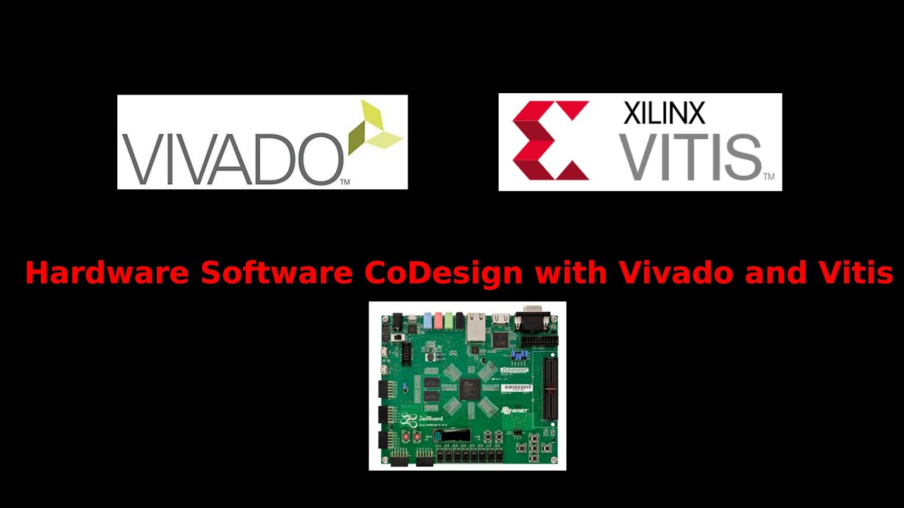
TECHNICAL APPROACH
AURUM
Technologies being used:
Hardware :
FPGA: ZedBoard Zynq-7000 ARM/FPGA SoC Development Board
Microphone : MAX9814 Omnidirectional Electret Microphone with Amplifier
Software :
Vitis and Vivado 2021.2
MATLAB(Vitis Model Composer)
Languages:
Verilog HDL and Embedded C
Algorithms:
GCC(TDOA)(General Cross Correlation)
MUSIC(Multiple signal classification)
Zedboard
Interfacing Microphones
Vivado
Designing a Hardware Block Design using Verilog
Exporting the XSA file from it
Vitis
Developing a codes for algorithms using embedded C, using exported XSA file
Displaying the in Putty interface

Slide 5
FEASIBILITY AND VIABILITY
AURUM
Feasibility:
Hardware: Omnidirectional microphones, ADCs, and FPGAs are suitable. Graphical LCDs are easy to integrate.
Signal Processing: Bandpass filtering, classification, and localization algorithms are done effectively with an FPGA.
FPGA Capability: Modern FPGAs handle multi-channel processing effectively.
Viability:
Complexity: Requires FPGA programming and DSP expertise.
Environmental Factors: Outdoor conditions need robust algorithms.
Cost: High initial cost.
Power Consumption: Considerable power use; important for portable systems.

Slide 6
IMPACT AND BENEFITS
AURUM
Soldier Safety: Can help reduce casualties.
Decision-Making: Immediate feedback speeds up combat reactions.
Improved Situational Awareness: Provides precise direction of enemy fire, giving tactical advantages.
Cost-Effective Long Term: Provides a durable solution, reducing operational costs over time.
Adaptability: Can function in urban, open field, and forest combat situations.
Integration with Other Systems: Can be integrated with communication and surveillance systems for broader intelligence.
Data Analysis: Collects valuable for future analysis.

Slide 7
RESEARCH AND REFERENCES
AURUM
https://www.researchgate.net/publication/342752309_Gunshot_Detection_System_for_National_Security
https://www.linkedin.com/pulse/accurate-time-delay-estimation-gcc-phat-patrick-marmaroli-eu7jf/
https://in.mathworks.com/help/phased/ref/gccphat.html
https://in.mathworks.com/help/phased/ug/music-super-resolution-doa-estimation.html
https://digital.library.txst.edu/server/api/core/bitstreams/c2454f8a-7617-4613-a9ef-7d8446cc7e6e/content

