Slide 1
TIC TAC TOE
PYTHON MINI PROJECT
Guided by-Anita Gunjal
BY-
Dharmika Tank(02)
Ananya Sharma(12)
Rohan Nair(14)

Slide 2
Table of contents
01
04
PROBLEM STATEMENT
Logic of Code
02
05
Output and Visualization screenshots
INTRODUCTION
03
06
FUTURISTIC GOALS and CONCLUSION
DESCRIPTION OF THE MODULE

Slide 3
PROBLEM STATEMENT:
The project consists of developing and implementing a computer program that plays TIC TAC TOE against another player . The project can provide hundreds or thousands of TIC TAC TOE without any interruption.

Slide 4
INTRODUCTION
This project is created using the Tkinter library of python. This game Tic-tac-toe ( noughts & crosses, or Os and Xs) is a pencil and paper game where two people participate O, and X. They take turns when marking the gaps of a 3×3 grid. The one that succeeds to place 3 of their marks vertically, horizontally, or diagonally wins.

Slide 5
DESCRIPTION OF THE MODULE
Tkinter module:
Tkinter is the standard GUI library for Python. Python when combined with Tkinter provides a fast and easy way to create GUI applications. Tkinter provides a powerful object-oriented interface to the Tk GUI toolkit.

Slide 6
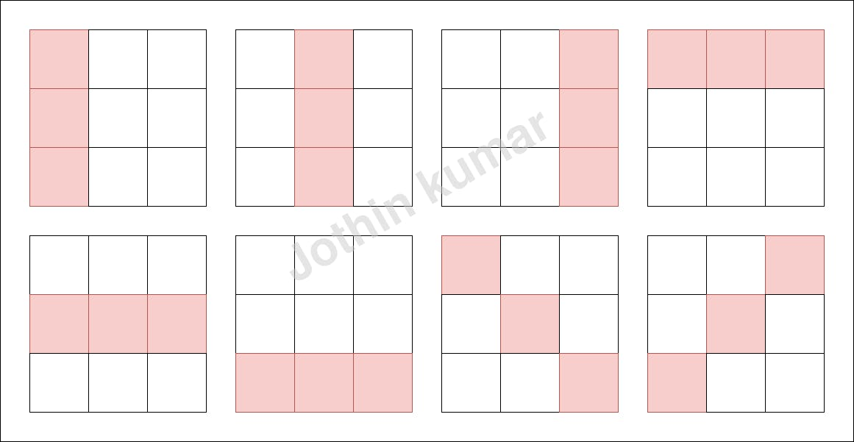
Logic of Code
Create a tkinter window.
Add play area and a label with text "Tic Tac Toe".
Make the GUI functional.
Implement logic to detect win.
Detect draw.
Status Label.
Display whose turn it is.
Create Play again button.

Slide 7
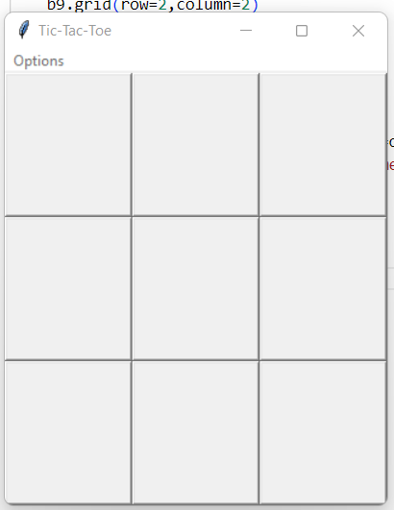
Output and Visualization screenshots

Slide 8
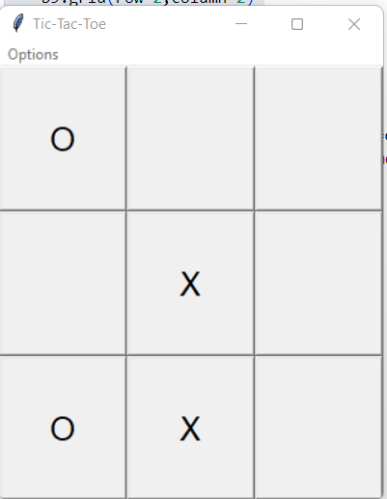
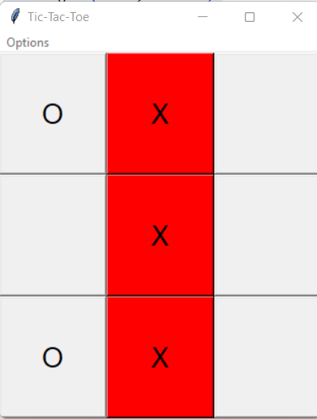
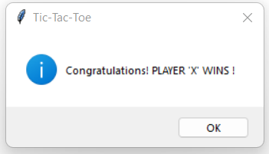

Slide 9
FUTURISTIC GOALS
Introduction of Artificial Intelligence.
Introduction of difficulty levels.
User Profiles and scores.
Allow the Players to define matrices.

Slide 10
Conclusion
We explored that a pen-paper game can be played on electronic device. We learned the logic which decides the winner of the game. Tic-Tac-Toe game cam be made using GUI in Python using Tkinter.

Slide 11
Reference
Books:H.M.Deitel and P.J.Deital, Java How to program: Sixth EditionHerbert Schildt, The Complete Reference: Fifth edition
https://www.upgrad.com/blog/python-gui-projects-project-ideas-for-beginners/

Slide 12
THANK YOU!!

