Slide 1


FUTURE INSTITUTE OF ENGINEERING AND MANAGEMENT
CC – 148
UNDER
MAKAUT, WB
Face recognition based attendance system
PRESENTED BY
ROHAN PRAMANIK (14800320026)
APURBA SAMANTA (14800320010)
B.TECH(ECE)
6 TH SEMESTER
Academic Year: 2022-23

Slide 2

CONTENTS
INTRODUCTION
SYSTEM WORKFLOW
COMPONENTS
BENEFITS
FUTURE SCOPE
CONCLUSION

Slide 3
INTRODUCTION
Attendance management is a crucial aspect of many organizations.
Traditional attendance systems are often time-consuming and prone to errors.
Face recognition technology combined with IoT can offer a more efficient and accurate solution.
This presentation introduces the concept of a Face Recognition Based Attendance System using ESP32 CAM.

Slide 4
System Workflow
Face Enrollment:
Users' faces are captured by the ESP32 CAM module and stored in a face database.
Multiple images of each user are captured to improve recognition accuracy.
User information is associated with their respective face data.

Slide 5
2. Face Recognition:
When a person approaches the system, their face is captured by the ESP32 CAM.
The face recognition algorithm processes the image and matches it against the enrolled faces.
If a match is found, the system identifies the person and records the attendance.

Slide 6
3. Attendance Management:
Attendance data is stored in a centralized database.
The attendance management software retrieves the data from the database.
Reports can be generated, including daily, weekly, and monthly attendance records.

Slide 7
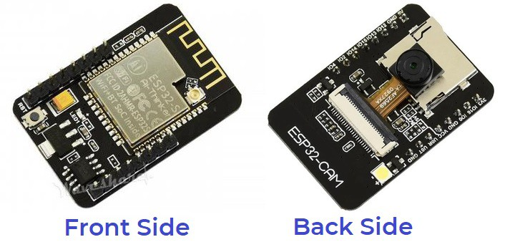
COMPONENTS USED
ESP32-CAM Board AI-Thinker
FTDI Module
Mini-USB Cable
Jumper Wires

Slide 8
BENEFITS
Time-saving: Automated attendance process eliminates manual efforts.
Accuracy: Face recognition technology provides reliable identification.
Cost-effective: ESP32 CAM offers an affordable hardware solution.
Scalability: The system can handle a large number of users.
Integration: Attendance data can be integrated with existing HR systems.

Slide 9
FUTURE SCOPE
Integration with smart classrooms and educational institutions for automated attendance management.
Application in healthcare settings for patient identification and monitoring.
Implementation in public spaces for enhanced security and access control.
Integration with smart homes for personalized settings based on facial recognition.
Use in retail for customer identification and personalized shopping experiences.

Slide 10
CONCLUSION
The Face Recognition Based Attendance System using ESP32 CAM offers a modern and efficient solution for attendance management.
By leveraging the power of face recognition and IoT, organizations can streamline their attendance processes, save time, and improve accuracy.
Implementing this system can lead to increased productivity, reduced administrative burdens, and improved overall efficiency.

Slide 11
THANK YOU

