Slide 1
CSN-232 Operating System Coding Project
Cigarette Smoker Problem
Raghav Arora, 20112087,ECE 3Y
Gaurav R. Kochar, 20116033, ECE 3Y

Slide 2
CIGARETTE SMOKER PROBLEM
Originally given by Suhas Patil
Four threads involved: an agent and three smokers
Cigarette is made of three ingredients: match, paper and tobacco . The smokers loop forever waiting for these ingredients.
The agent has infinite supply of these ingredients. Each smoker has an infinite supply of one of the ingredients; that is, one smoker has matches, another has paper, and the third has tobacco.
The agent repeatedly chooses two different ingredients at random and makes them available to the smokers. Depending on which ingredients are chosen, the smoker with the complementary ingredient should pick up both resources and proceed.

Slide 3
The Correlation
So what does the cigarette smoker problem have to do with operating systems?
To explain the premise, the agent represents an operating system that allocates resources, and the smokers represent applications that need resources. The problem is to make sure that if resources are available that would allow one more applications to proceed, those applications should be woken up. Conversely, we want to avoid waking an application if it cannot proceed.
Restrictions on the solution:
You are not allowed to modify the agent code. If the agent represents an operating system, it makes sense to assume that you don’t want to modify it every time a new application comes along.

Slide 4
Trivial solution
The smoker threads wait on the resources they need , the agent signals the resources he puts on table.
Issue:
The issue with the preceding solution is the potential for deadlock. Imagine that the agent provides tobacco and paper. Since the smoker with the matches is awaiting tobacco, the path may be cleared. However, the smoker with tobacco is awaiting paper, so it is possible (and even likely) that it will be unblocked as well. The first thread will then block on the paper and the second on the match. Deadlock!

Slide 5
Our Solution
Agent semaphore:
agent_sem: Initialized to 1. Shows whether agent can put ingredients on the table.
tobacco: Initialized to 0. Shows whether agent has put tobacco on the table.
paper: Initialized to 0. Shows whether agent has put paper on the table.
match: Initialized to 0. Shows whether agent has put match on the table.
To avoid deadlock we use three helper threads called “pushers” that respond to the signals from the agent, keep track of the available ingredients, and signal the appropriate smoker.
Additional variables:
bool is_tobacco = Initialised to false
bool is_paper = Initialised to false
bool is_match = Initialised to false
The boolean variables indicate whether or not an ingredient is on the table
4. pusher_mutex: to allow only one pusher to be active at a time(achieve mutual exclusion)

Slide 6
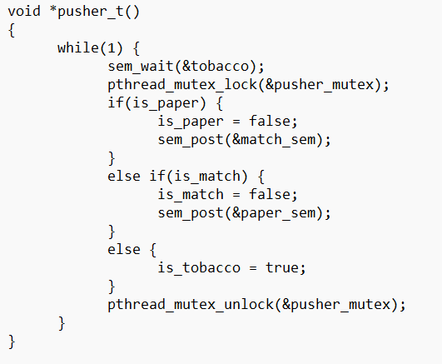
Smoker semaphores
tobacco_sem: To indicate smoker with tobacco to take ingredients and smoke.
paper_sem: To indicate smoker with paper to take ingredients and smoke.
match_sem: To indicate smoker with match to take ingredients and smoke.
Pusher code:
This pusher wakes up any time there is tobacco on the table. If it finds is_Paper true, it knows that pusher_m has already run, so it can signal the smoker with matches. Similarly, if it finds a match on the table, it can signal the smoker with paper.
But if pusher_t runs first, then it will find both is_Paper and is_Match false.
It cannot signal any of the smokers, so it sets is_Tobacco ,i.e. it indicates the smoker with tobacco to pick up paper and match and start smoking
The other pushers are similar.

Slide 7
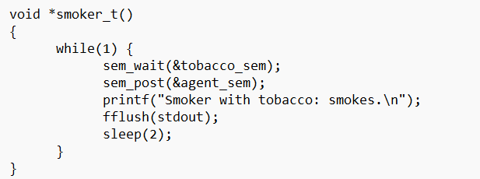
Smoker code(for smoker with tobacco):
Here the smoker with tobacco waits on the tobacco_sem. As soon as this semaphore turns 1, this smoker picks up the match and paper and starts smoking. It then signals the agent semaphore to again produce the ingredients.

