Slide 1
Library Management System
presented by
Hrishi Mhatre
Rohan Phadatare
Yash Ghanate
Akshay Sabale

Slide 2
Tables Of Database
In database , table is a collection of data held in structured format within a database. It consists of rows and columns.
Each row is identified by one or more values appearing in a particular column subset. A specific choice of columns which uniquely identify rows is called primary key.

Slide 3
TABLE NO :- 1
STUDENT
ROLL NO. | STUDENT NAME | DEPARTMENTNAME | MOBILE NO. | BALANCE FINE
Text | Text | Text | Int | Int

Slide 4
TABLE NO :- 2
BOOKS
BOOK ID | BOOK NAME | AUTHOR NAME | BOOK COPIES | AVAILABLE COPIES
Int | Text | Text | Int | Int

Slide 5
TABLE NO :- 3
BOOKS_ISSUED
ROLL NO. | DEPARTMENT NAME | BOOK ID | ISSUE DATE | RETURN DATE
Text | Text | Int | Date | Date

Slide 6
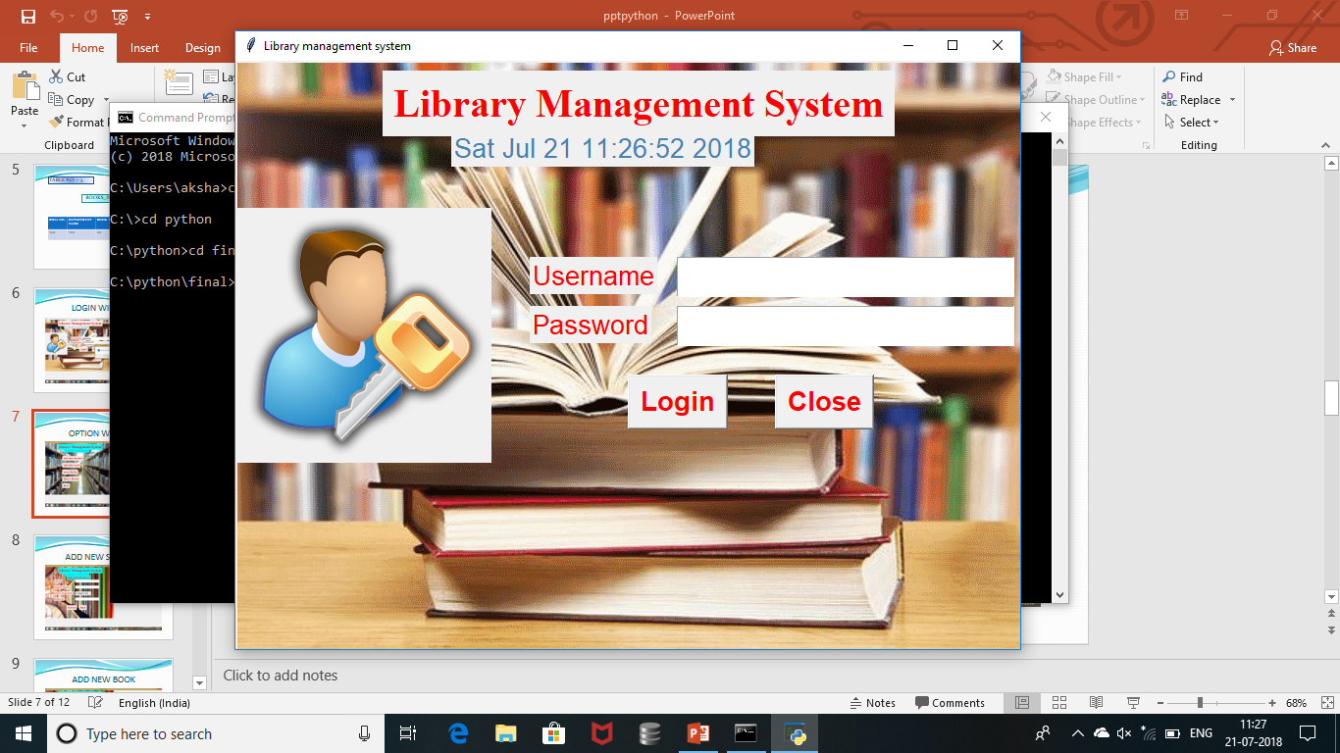
LOGIN WINDOW

Slide 7
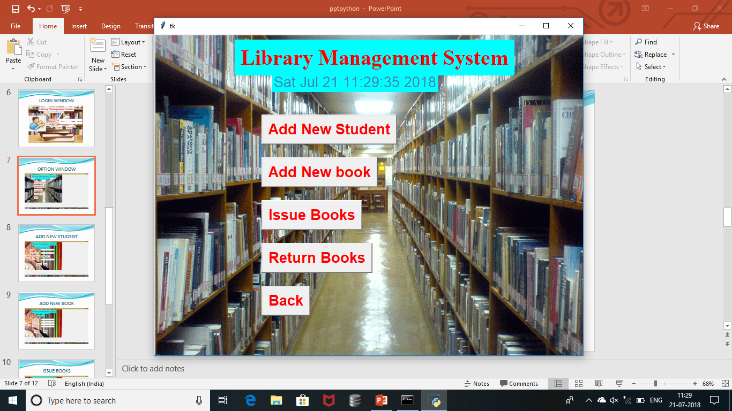
OPTION WINDOW

Slide 8
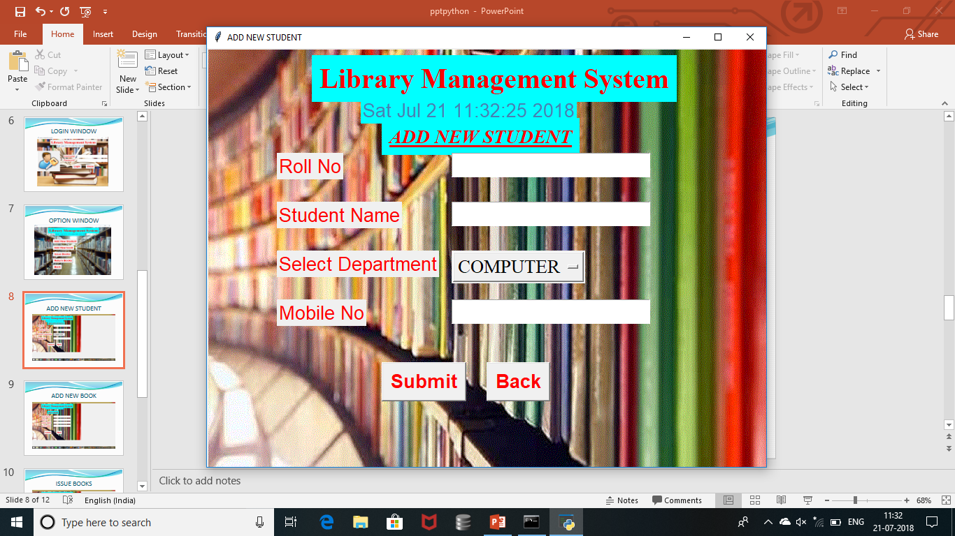
ADD NEW STUDENT

Slide 9
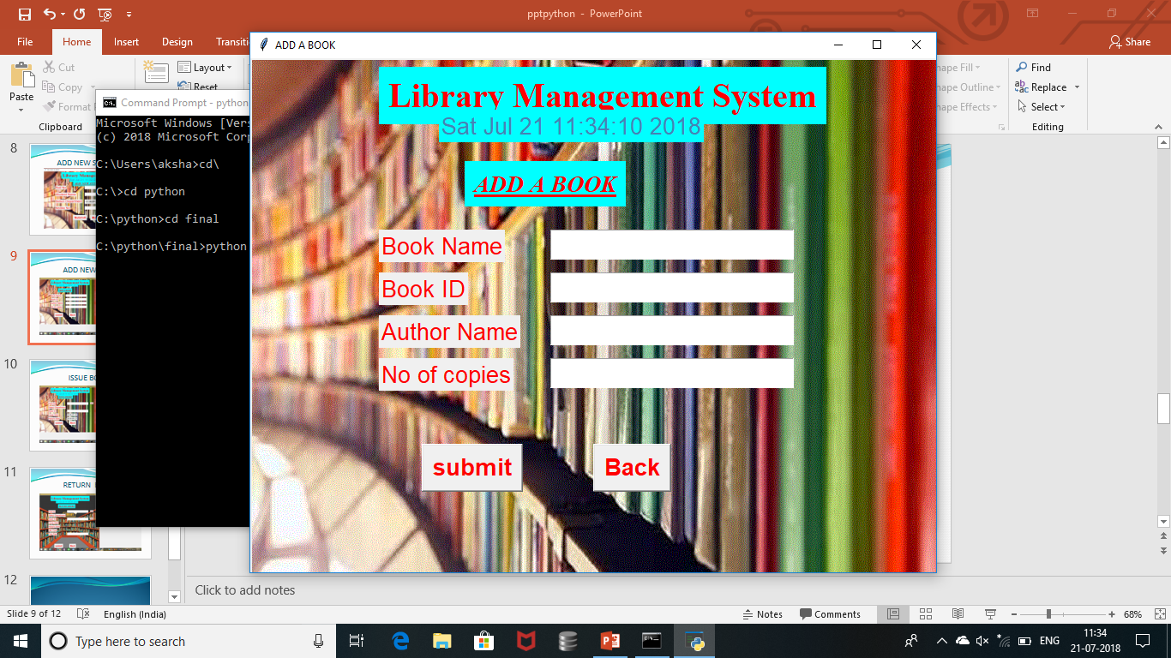
ADD NEW BOOK

Slide 10
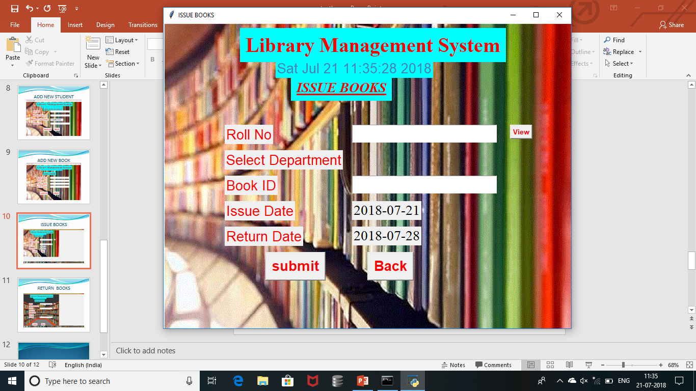
ISSUE BOOKS

Slide 11
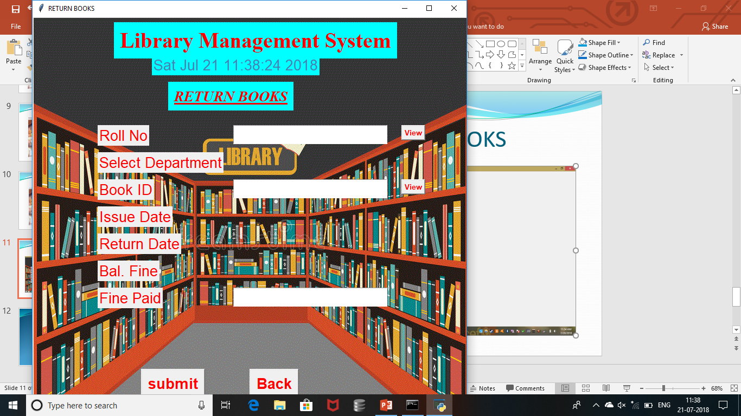
RETURN BOOKS

Slide 12
THANK YOU

