Slide 1








Tech Titans
Domain: Smart Education
PSID: 1369
Problem Statement Title: Online integrated platform for projects taken up by the students of various universities/colleges.
Ministry/Organization Name/Student Innovation:
Government of Jharkhand

Slide 2
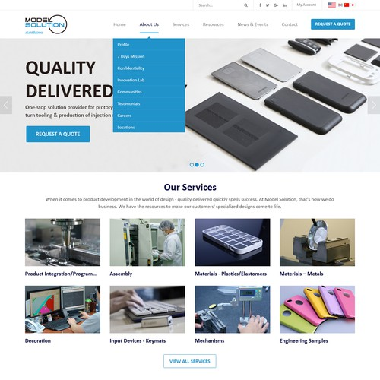
Objective:
The project aims to develop an online platform in which students can collaborate, share projects, and integrate e-learning
We will build an online platform that will allow students to collaborate, share projects, and integrate e-learning into a comprehensive learning environment so that they can better interact with one another.

Slide 3
Technology stack:
React js
Node js
Java api
PHP
Sql Server
What's New:
With one platform, students and teachers can meet all their educational needs, including project sharing, collaboration, and e-learning.
Users would be able to know about the insights by which various projects have been developed. It would be a database cum learning platform.

Slide 4
Dependencies/Show Stopper:
Dependence on user engagement and data input from educational institutions.
Ensuring data privacy and security is a top priority.
Use Cases:
Project Sharing: Students share project work, encouraging knowledge exchange.
Collaboration: Facilitates collaboration among students and educators.
Peer Learning: Provides peer-to-peer learning through the sharing of projects

Slide 5
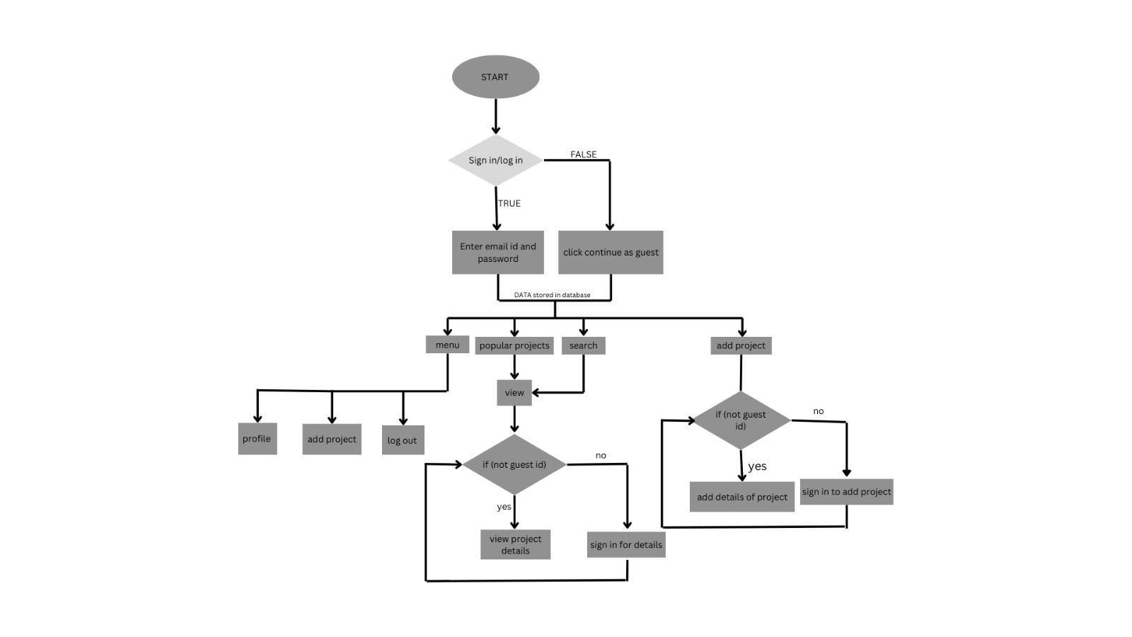
Flowchart:

