Slide 1
CS6200/IS4200
Information Retrieval
David Smith
Khoury College of Computer Sciences
Northeastern University
with slides from Jeff Dalton

Slide 2
Previously: Indexing Process

Slide 3
Query Process

Slide 4
Information Needs
An information need is the underlying cause of the query that a person submits to a search engine
  sometimes called query intent
Categorized using variety of dimensions
  e.g., number of relevant documents being sought
  type of information that is needed
  type of task that led to the requirement for information

Slide 5
Queries and Information Needs
A query can represent very different information needs
  May require different search techniques and ranking algorithms to produce the best rankings
A query can be a poor representation of the information need
  User may find it difficult to express the information need
  User is encouraged to enter short queries both by the search engine interface, and by the fact that long queries don’t work well

Slide 6
Interaction
Interaction with the system occurs
  during query formulation and reformulation
  while browsing the result
Key aspect of effective retrieval
  users can’t change ranking algorithm but can change results through interaction
  helps refine description of information need
    e.g., same initial query, different information needs
    how does user describe what they don’t know?

Slide 7
ASK Hypothesis
Belkin et al (1982) proposed a model called Anomalous State of Knowledge
ASK hypothesis:
  difficult for people to define exactly what their information need is, because that information is a gap in their knowledge
  Search engine should look for information that fills those gaps
Interesting ideas, little practical impact (yet)

Slide 8
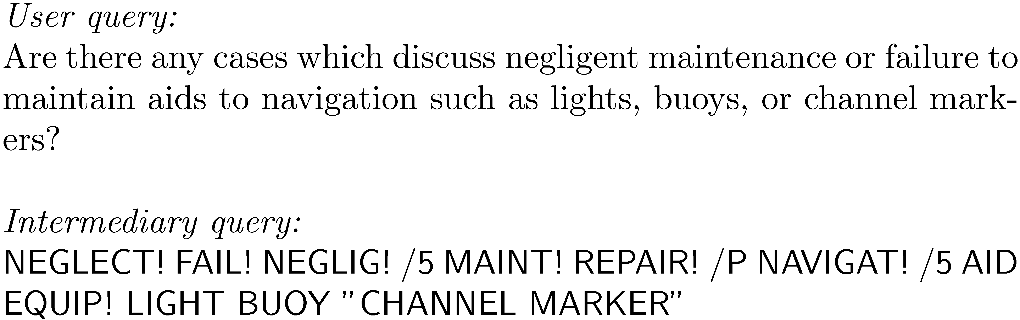
Keyword Queries
Query languages in the past were designed for professional searchers (intermediaries)

Slide 9
Keyword Queries
Simple, natural language queries were designed to enable everyone to search
Current search engines are getting better at natural language queries
People trained (in effect) to use keywords
  compare average of about 2.3 words/web query to average of 30 words/CQA query
Keyword selection is not always easy
  query refinement techniques can help

Slide 10
Query Reformulation
Rewrite or transform original query to better match underlying intent
Can happen implicitly or explicitly (suggestion)
Many techniques
  Query-based stemming
  Spelling correction
  Segmentation
  Substitution
  Expansion

Slide 11
Query-Based Stemming
Make decision about stemming at query time rather than during indexing
  improved flexibility, effectiveness
Query is expanded using word variants
  documents are not stemmed
  e.g., “rock climbing” expanded with “climb”, not stemmed to “climb”

Slide 12
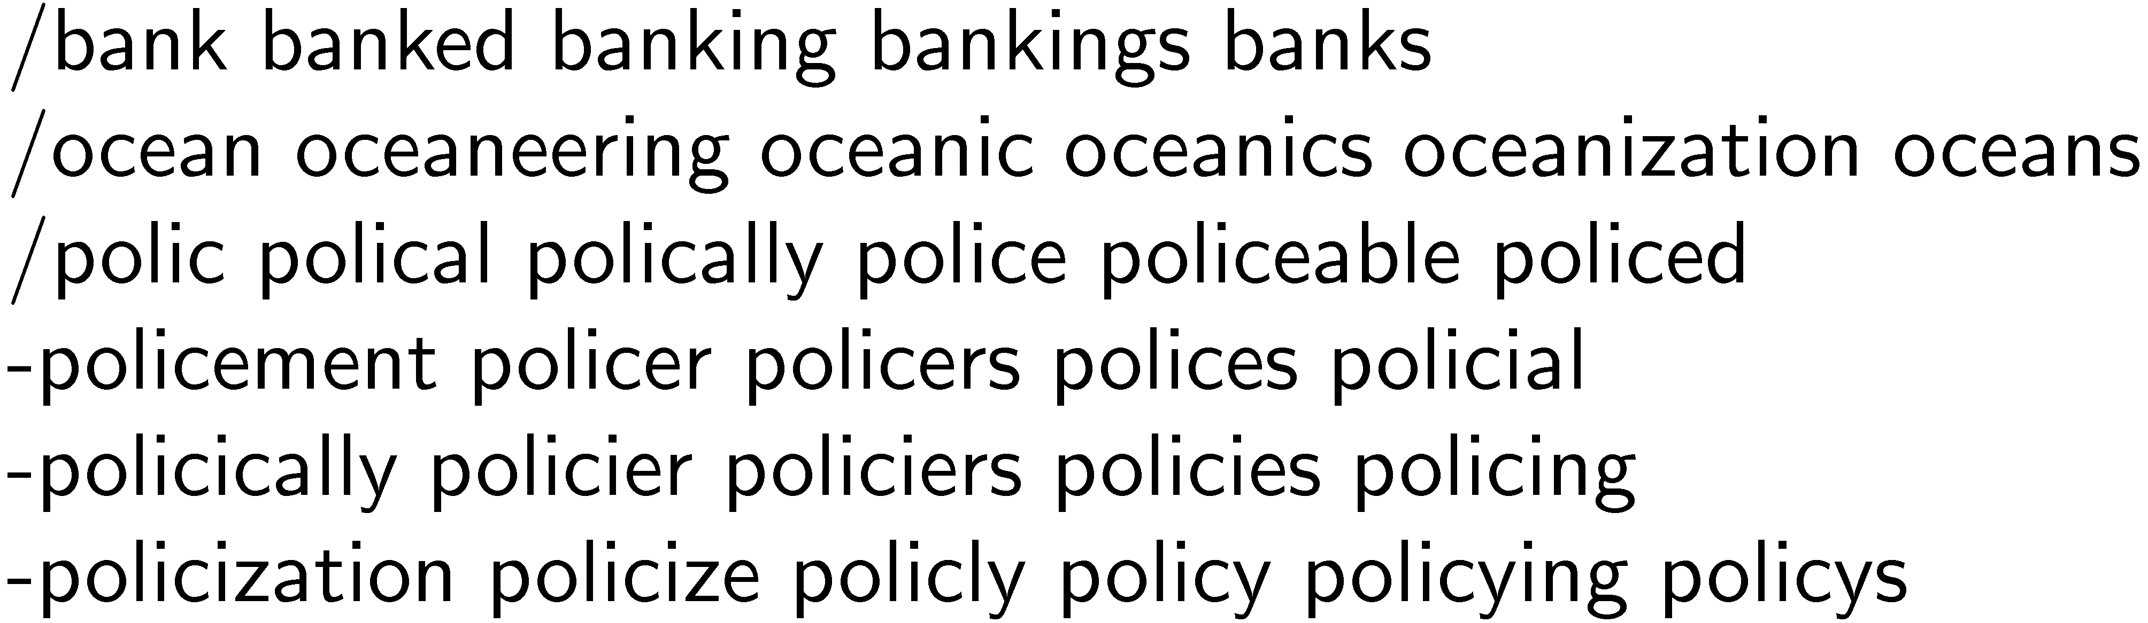
Stem Classes
A stem class is the group of words that will be transformed into the same stem by the stemming algorithm
  generated by running stemmer on large corpus
  e.g., Porter stemmer on TREC News

Slide 13
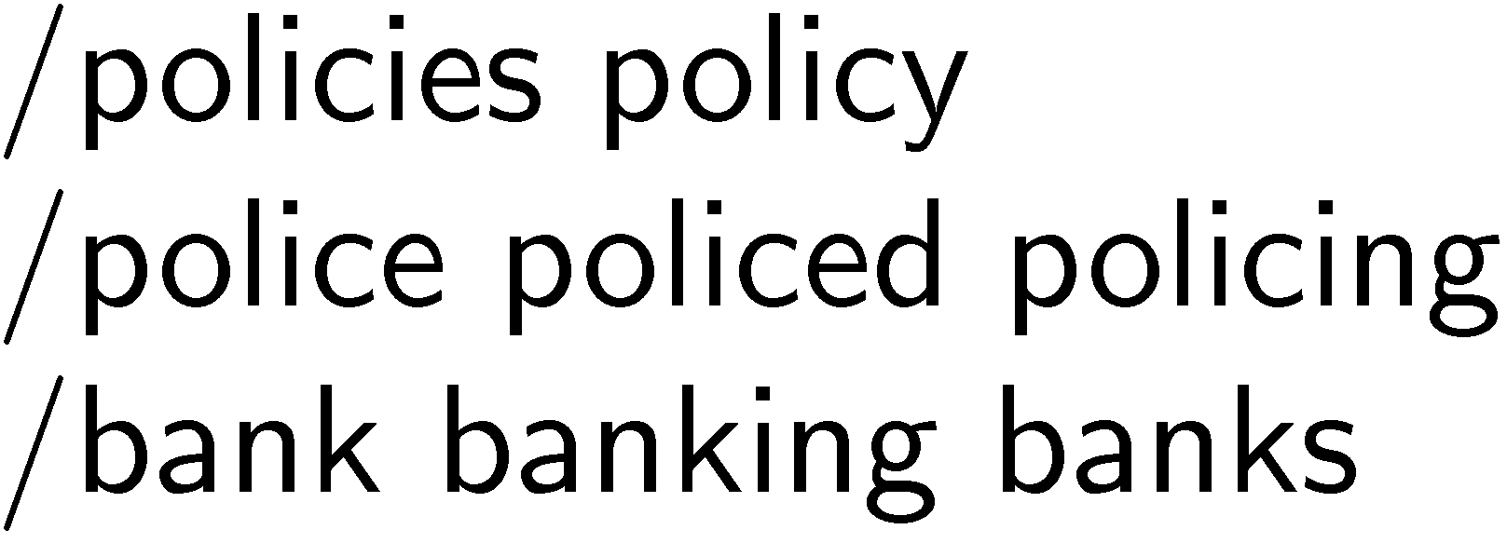
Stem Classes
Stem classes are often too big and inaccurate
Modify using analysis of word co-occurrence
Assumption:
  Word variants that could substitute for each other should co-occur often in documents
    e.g., reduces previous example /polic and /bank classes to

Slide 14
Query Log
Records all queries and documents clicked on by users, along with timestamp
Used heavily for query transformation, query suggestion
Also used for query-based stemming
  Word variants that co-occur with other query words can be added to query
    e.g., for the query “tropical fish”, “fishes” may be found with “tropical” in query log, but not “fishing”
    Classic example: “strong tea” not “powerful tea”

Slide 15
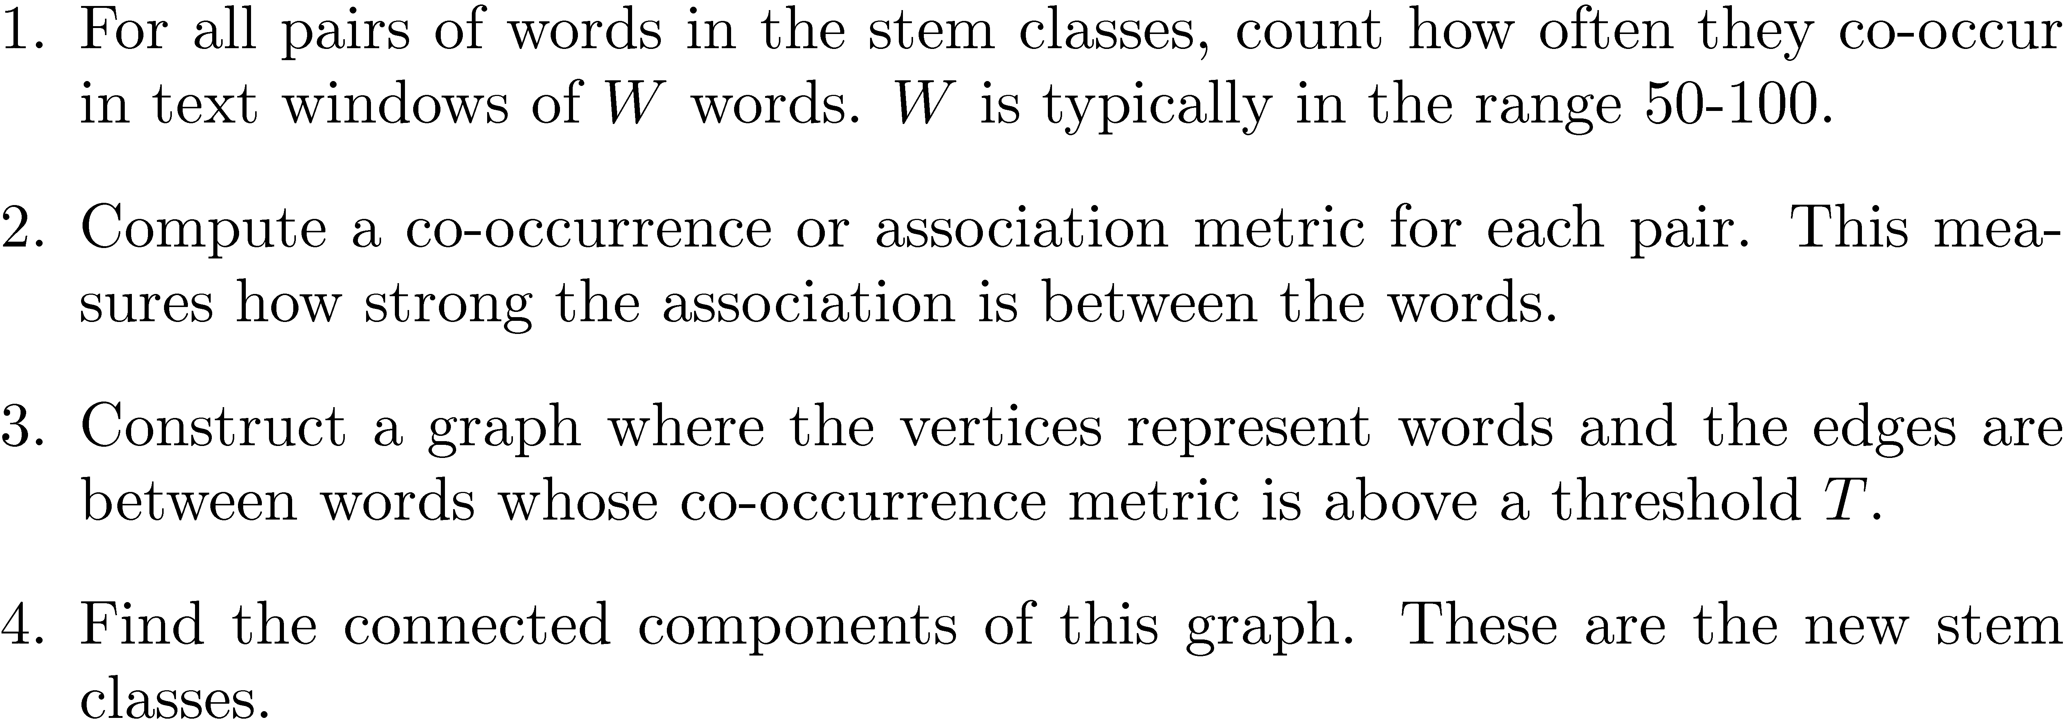
Modifying Stem Classes

Slide 16
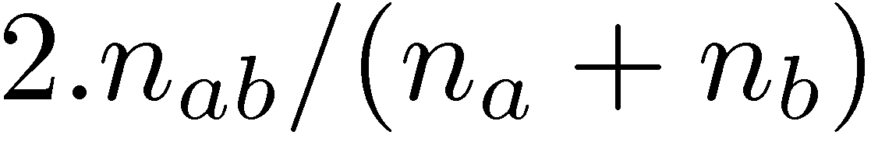
Modifying Stem Classes
Dice’s Coefficient is an example of a term association measure
    where n_{x} is the number of windows containing x
Two vertices are in the same connected component of a graph if there is a path between them
  forms word clusters
Example output of modification
When would this fail?

Slide 17
Query Segmentation
Break up queries into important “chunks”
  e.g., “new york times square” becomes “new york” “times square”
Possible approaches:
 | Treat each term as a concept
[members] [rock] [group] [nirvana]
 | Treat every adjacent pair of terms as a concept
[members rock] [rock group] [group nirvana]
 | Treat all terms within a noun phrase “chunk” as a concept
[members] [rock group nirvana]
 | Treat all terms that occur in common queries as a single concept
[members] [rock group] [nirvana]

Slide 18
The Thesaurus
Used in early search engines as a tool for indexing and query formulation
  specified preferred terms and relationships between them
  also called controlled vocabulary
  or authority list
Particularly useful for query expansion
  adding synonyms or more specific terms using query operators based on thesaurus
  improves search effectiveness

Slide 19
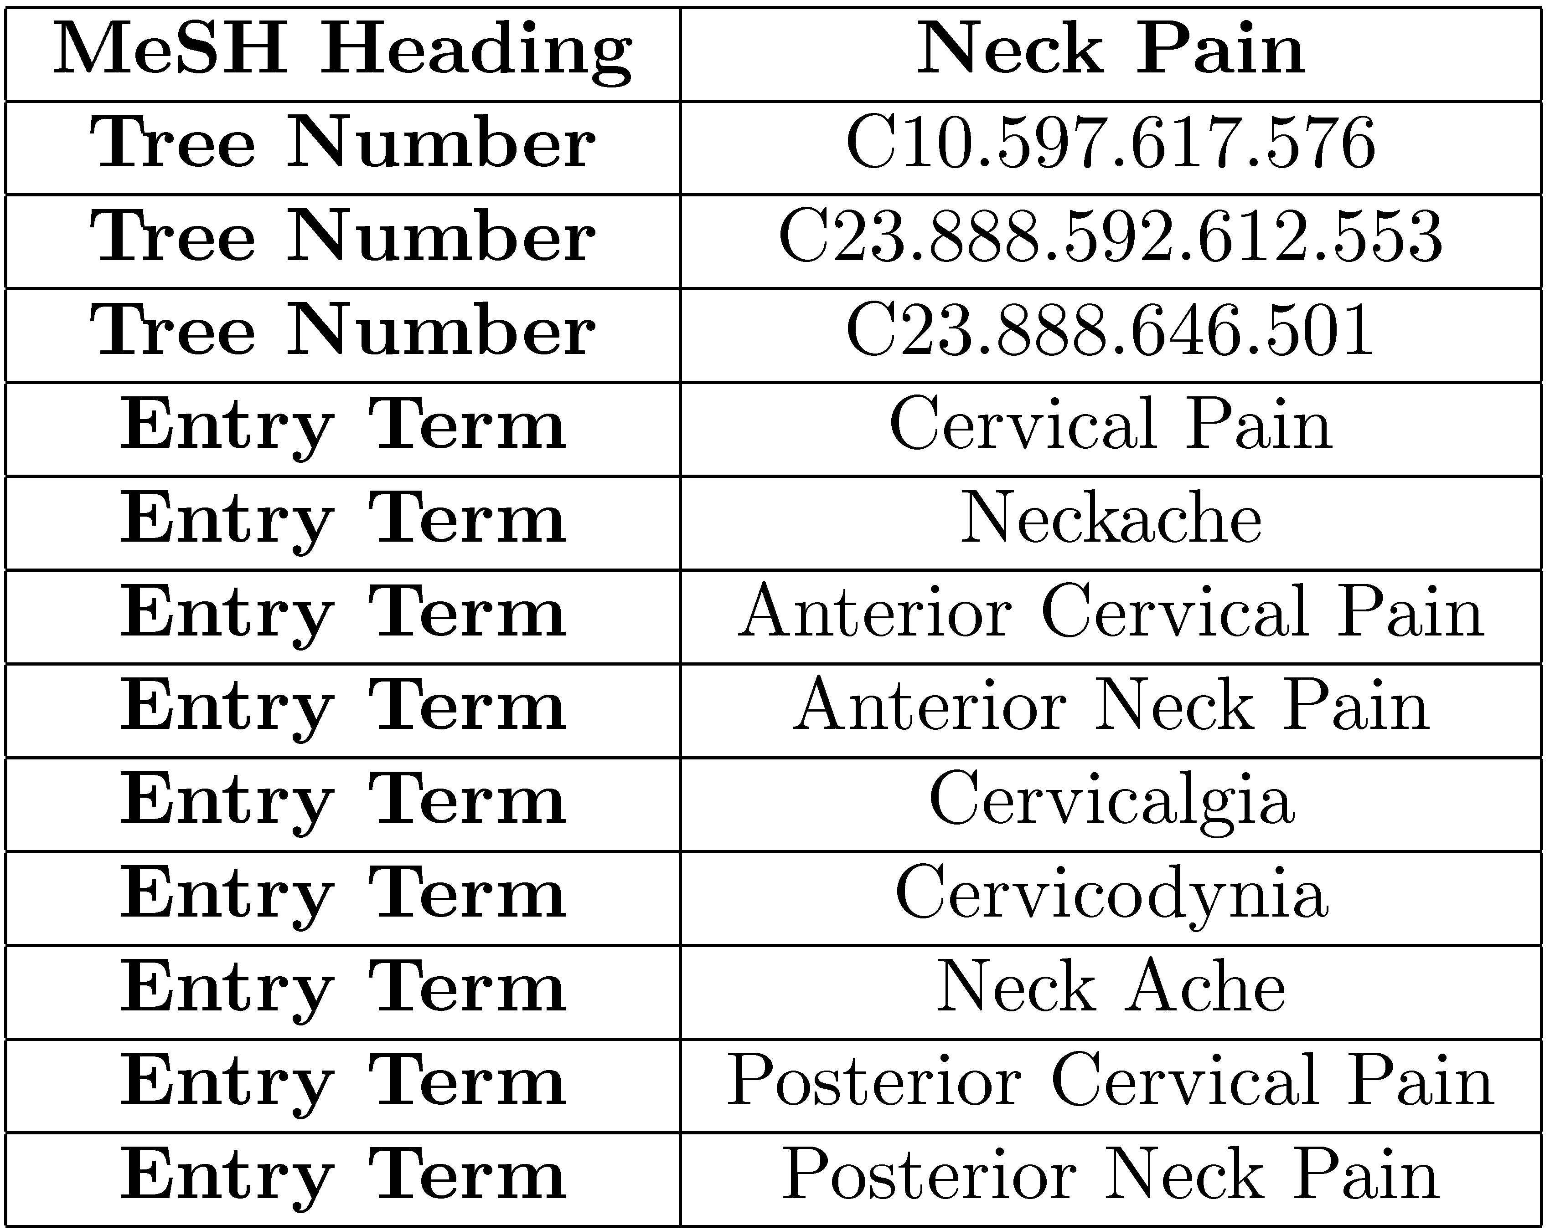
MeSH Thesaurus

Slide 20
Query Expansion
A variety of automatic or semi-automatic query expansion techniques have been developed
  goal is to improve effectiveness by matching related terms
  semi-automatic techniques require user interaction to select best expansion terms
Query suggestion is a related technique
  alternative queries, not necessarily more terms

Slide 21
Query Expansion
Approaches usually based on an analysis of term co-occurrence
  either in the entire document collection, a large collection of queries, or the top-ranked documents in a result list
  query-based stemming also an expansion technique
Automatic expansion based on general thesaurus not generally effective
  does not take context into account

Slide 22
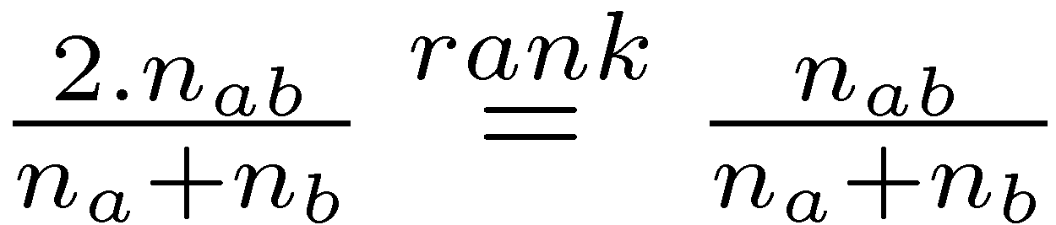
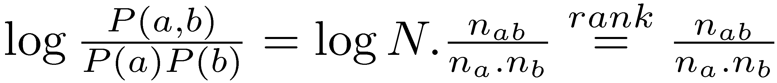
Term Association Measures
Dice’s Coefficient
(Pointwise) Mutual Information

Slide 23
Term Association Measures
Mutual Information measure favors low-frequency terms
Expected Mutual Information Measure (EMIM)
  actually only 1 part of full EMIM, focused on word occurrence
  this is simply what information theory calls “mutual information”

Slide 24
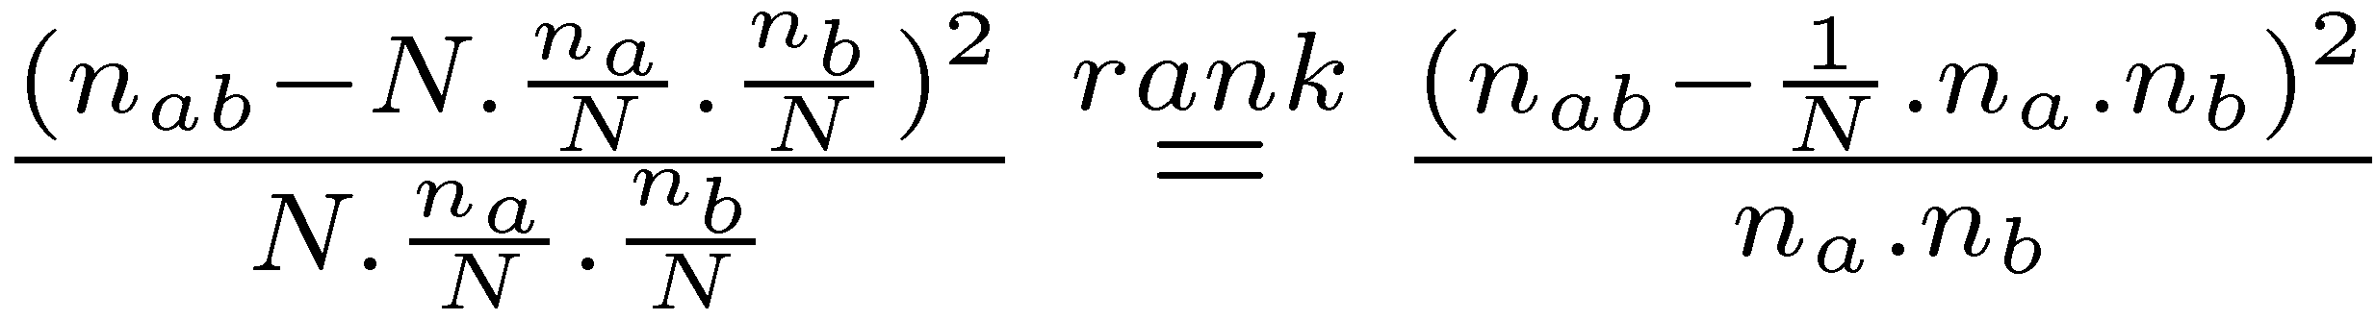
Term Association Measures
Pearson’s Chi-squared (χ²) measure
  compares the number of co-occurrences of two words with the expected number of co-occurrences if the two words were independent
  normalizes this comparison by the expected number
  also limited form focused on word co-occurrence

Slide 25
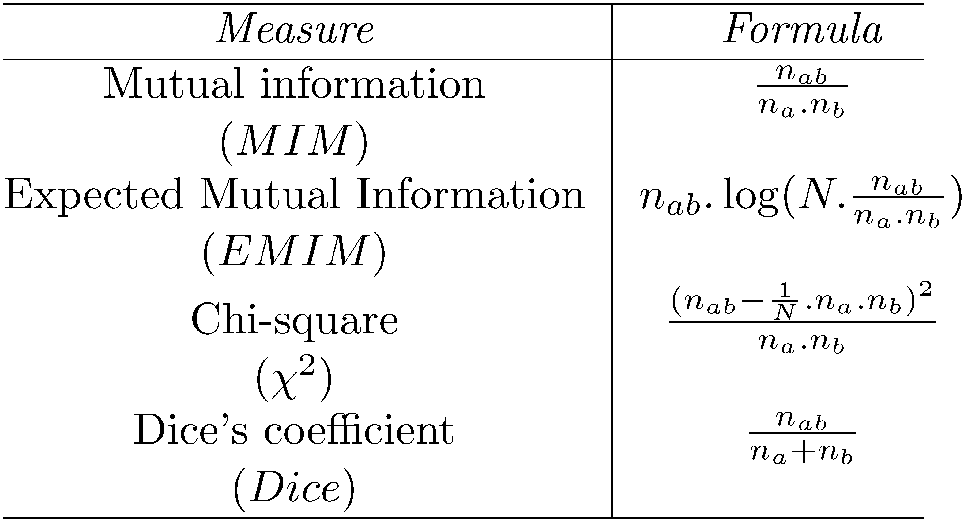
Association Measure Summary

Slide 26
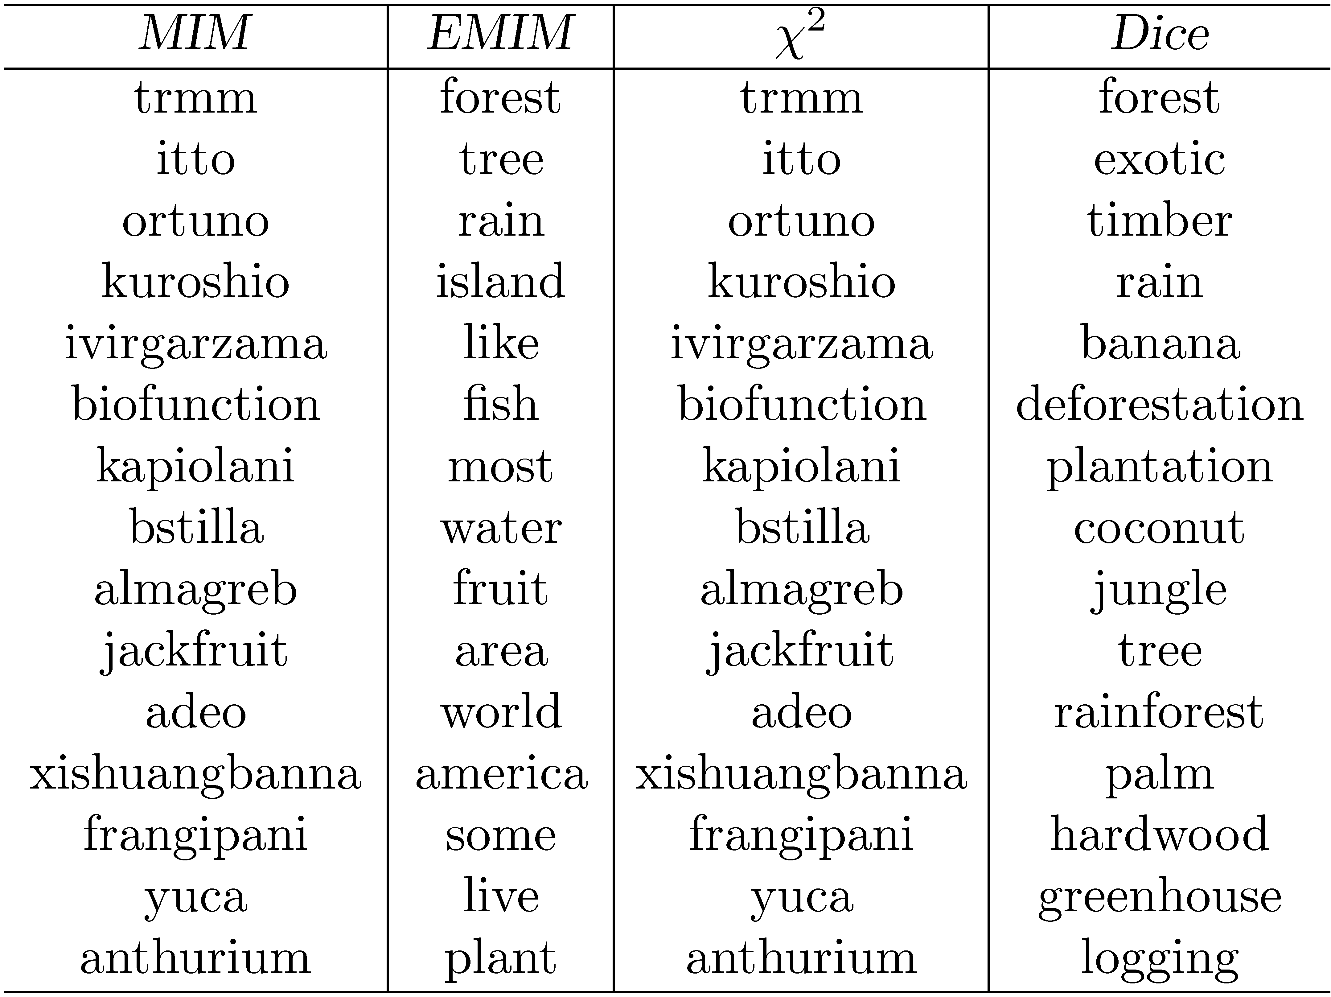
Association Measure Example
Most strongly associated words for “tropical” in a collection of TREC news
stories. Co-occurrence counts are measured at the document level.

Slide 27
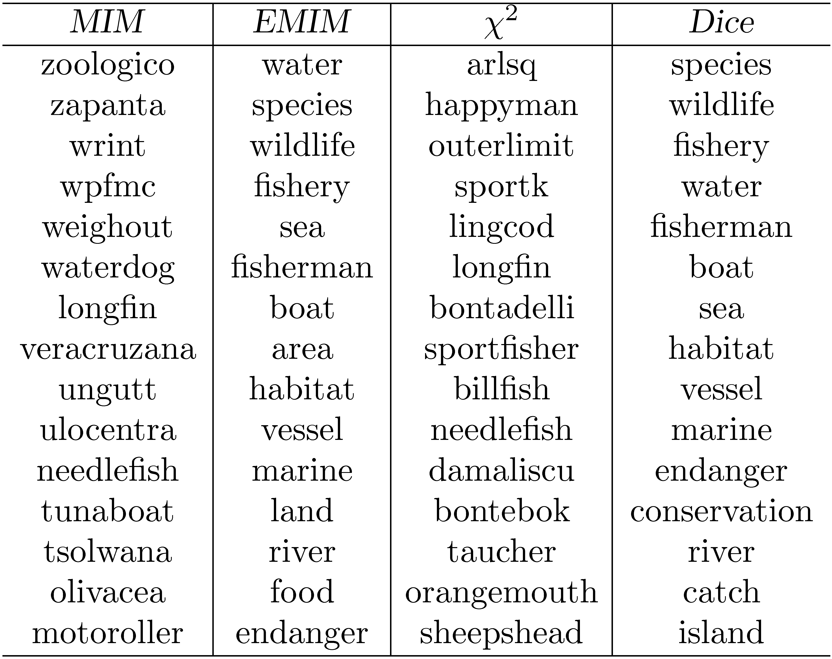
Association Measure Example
Most strongly associated words for “fish” in a collection of TREC news stories.

Slide 28
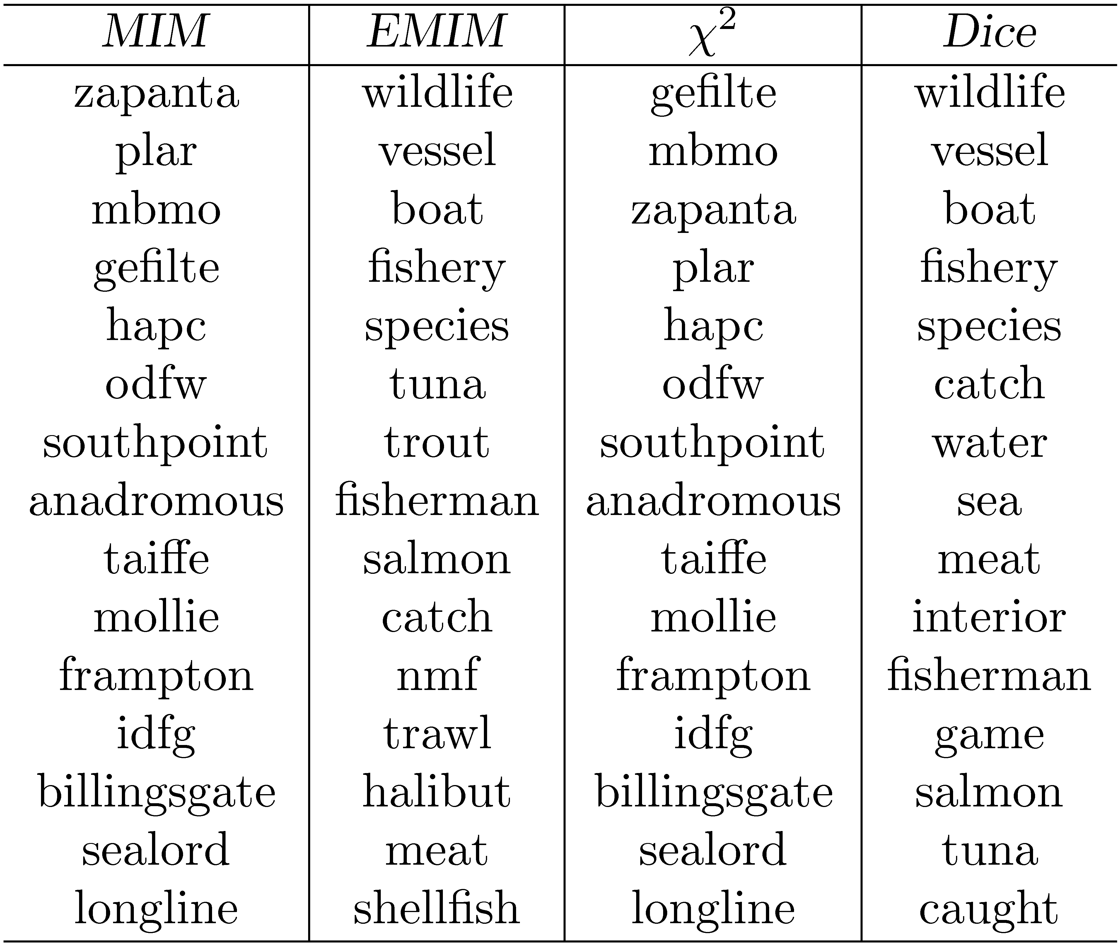
Association Measure Example
Most strongly associated words for “fish” in a collection of TREC news stories. Here, co-occurrence counts are measured in windows of 5 words.

Slide 29
Association Measures
Associated words are of little use for expanding the query “tropical fish”
Expansion based on whole query takes context into account
  e.g., using Dice with term “tropical fish” gives the following highly associated words:
    goldfish, reptile, aquarium, coral, frog, exotic, stripe, regent, pet, wet
Impractical to pre-compute for all possible queries, other approaches used to achieve this effect

Slide 30
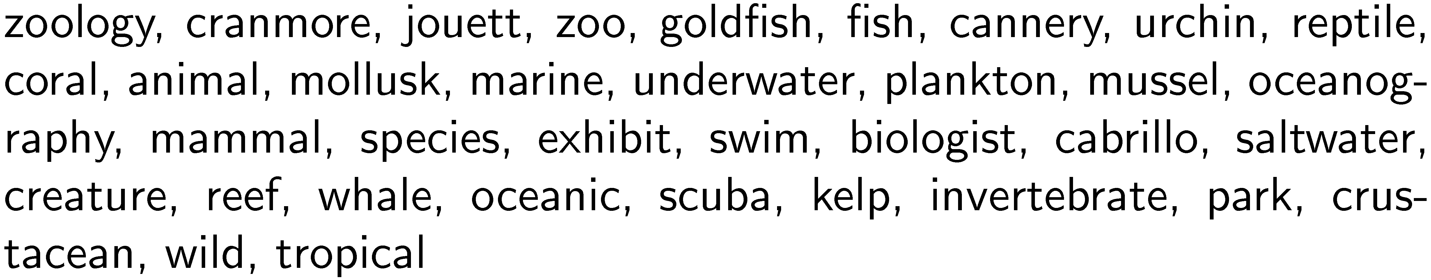
Other Approaches
Pseudo-relevance feedback
  expansion terms based on top retrieved documents for initial query
Context vectors
  Represent words by the words that co-occur with them
      e.g., top 35 most strongly associated words for “aquarium” (using Dice’s coefficient):
  Rank words for a query by ranking context vectors

Slide 31
Other Approaches
Query logs
  Best source of information about queries and related terms
    short pieces of text and click data
  e.g., most frequent words in queries containing “tropical fish” from MSN log:
    stores, pictures, live, sale, types, clipart, blue, freshwater, aquarium, supplies
  Query suggestion based on finding similar queries
    group based on click data
  Query reformulation/expansion based on term associations in logs

Slide 32
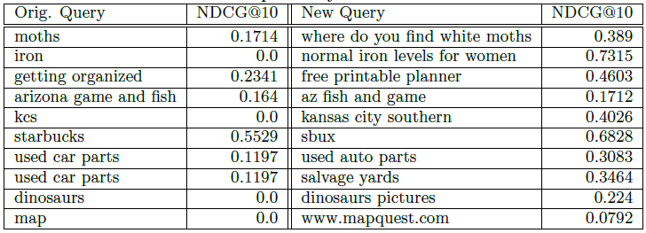
Query Suggestion using Logs

Slide 33
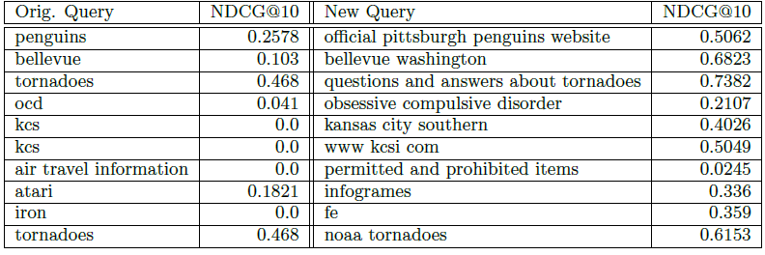
Query Suggestion using Logs

Slide 34
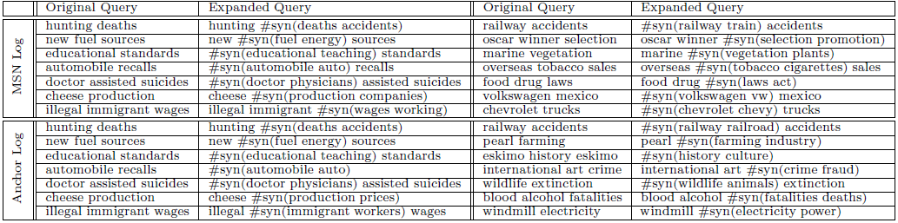
Query Reformulation using Logs

Slide 35
Query Reformulation using Logs

Slide 36
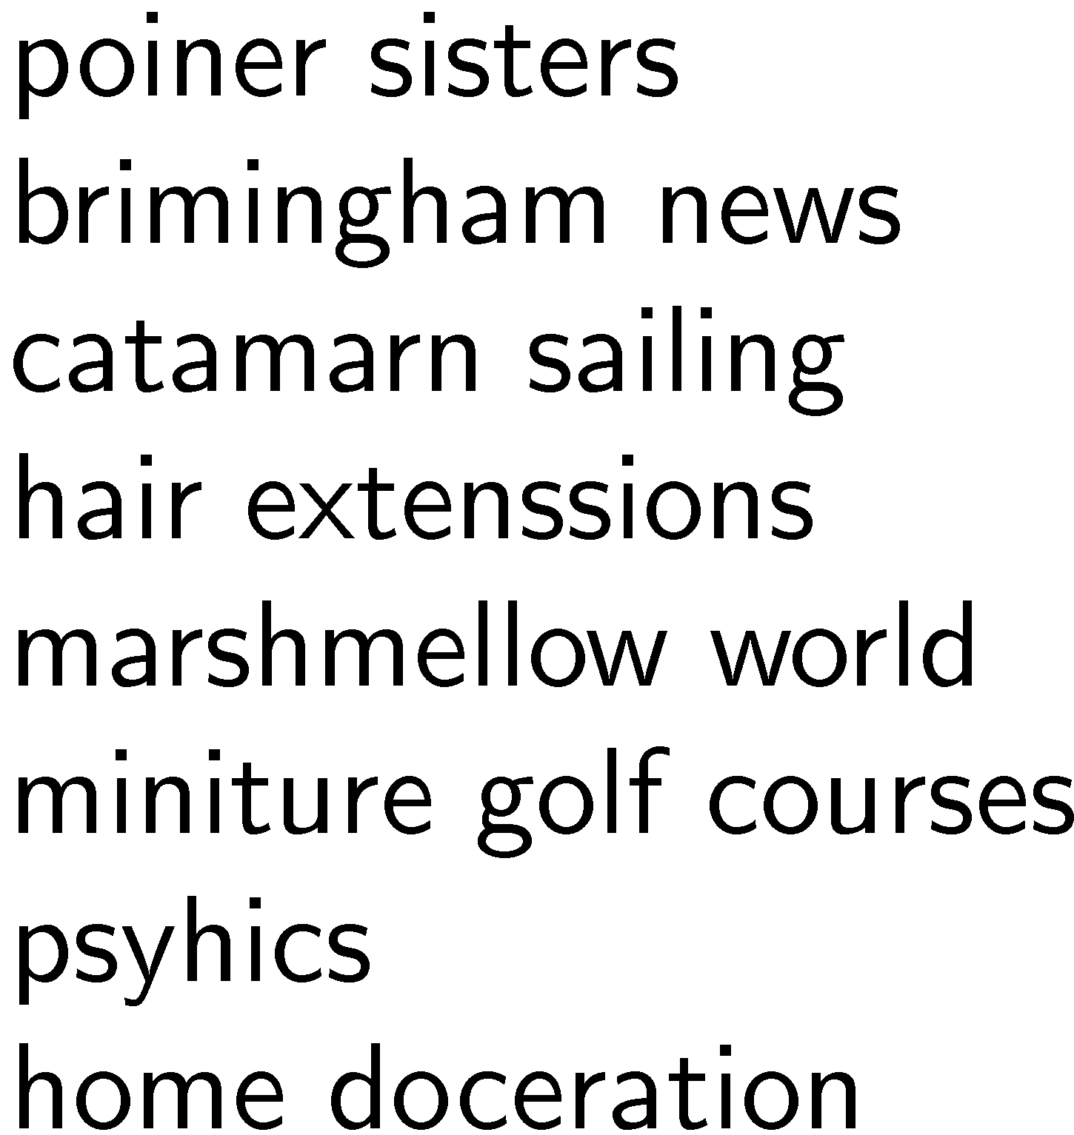
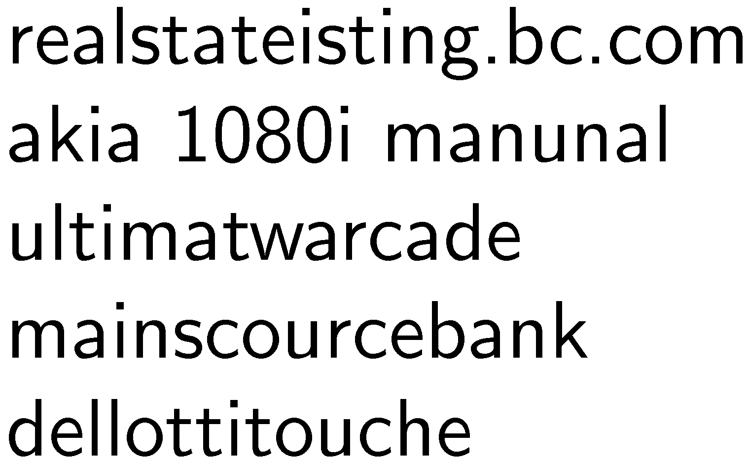
Spell Checking
Important part of query processing
  10-15% of all web queries have spelling errors
Errors include typical word processing errors but also many other types, e.g.

Slide 37
Spell Checking
Basic approach: suggest corrections for words not found in spelling dictionary
Suggestions found by comparing word to words in dictionary using similarity measure
Most common similarity measure is edit distance
  number of operations required to transform one word into the other

Slide 38
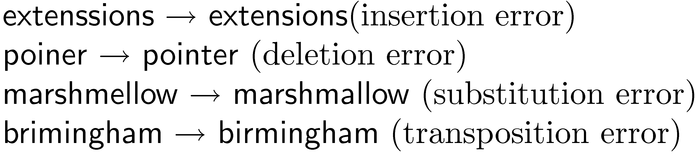

Edit Distance
Damerau-Levenshtein distance
  counts the minimum number of insertions, deletions, substitutions, or transpositions of single characters required
  e.g., Damerau-Levenshtein distance 1
  distance 2

Slide 39
Edit Distance
Dynamic programming algorithm (on board)

Slide 40
Edit Distance
Number of techniques used to speed up calculation of edit distances
  restrict to words starting with same character
  restrict to words of same or similar length
  restrict to words that sound the same
Last option uses a phonetic code to group words
  e.g. Soundex, a 100-year-old locality-sensitive hash function for English (cf. Simhash)

Slide 41
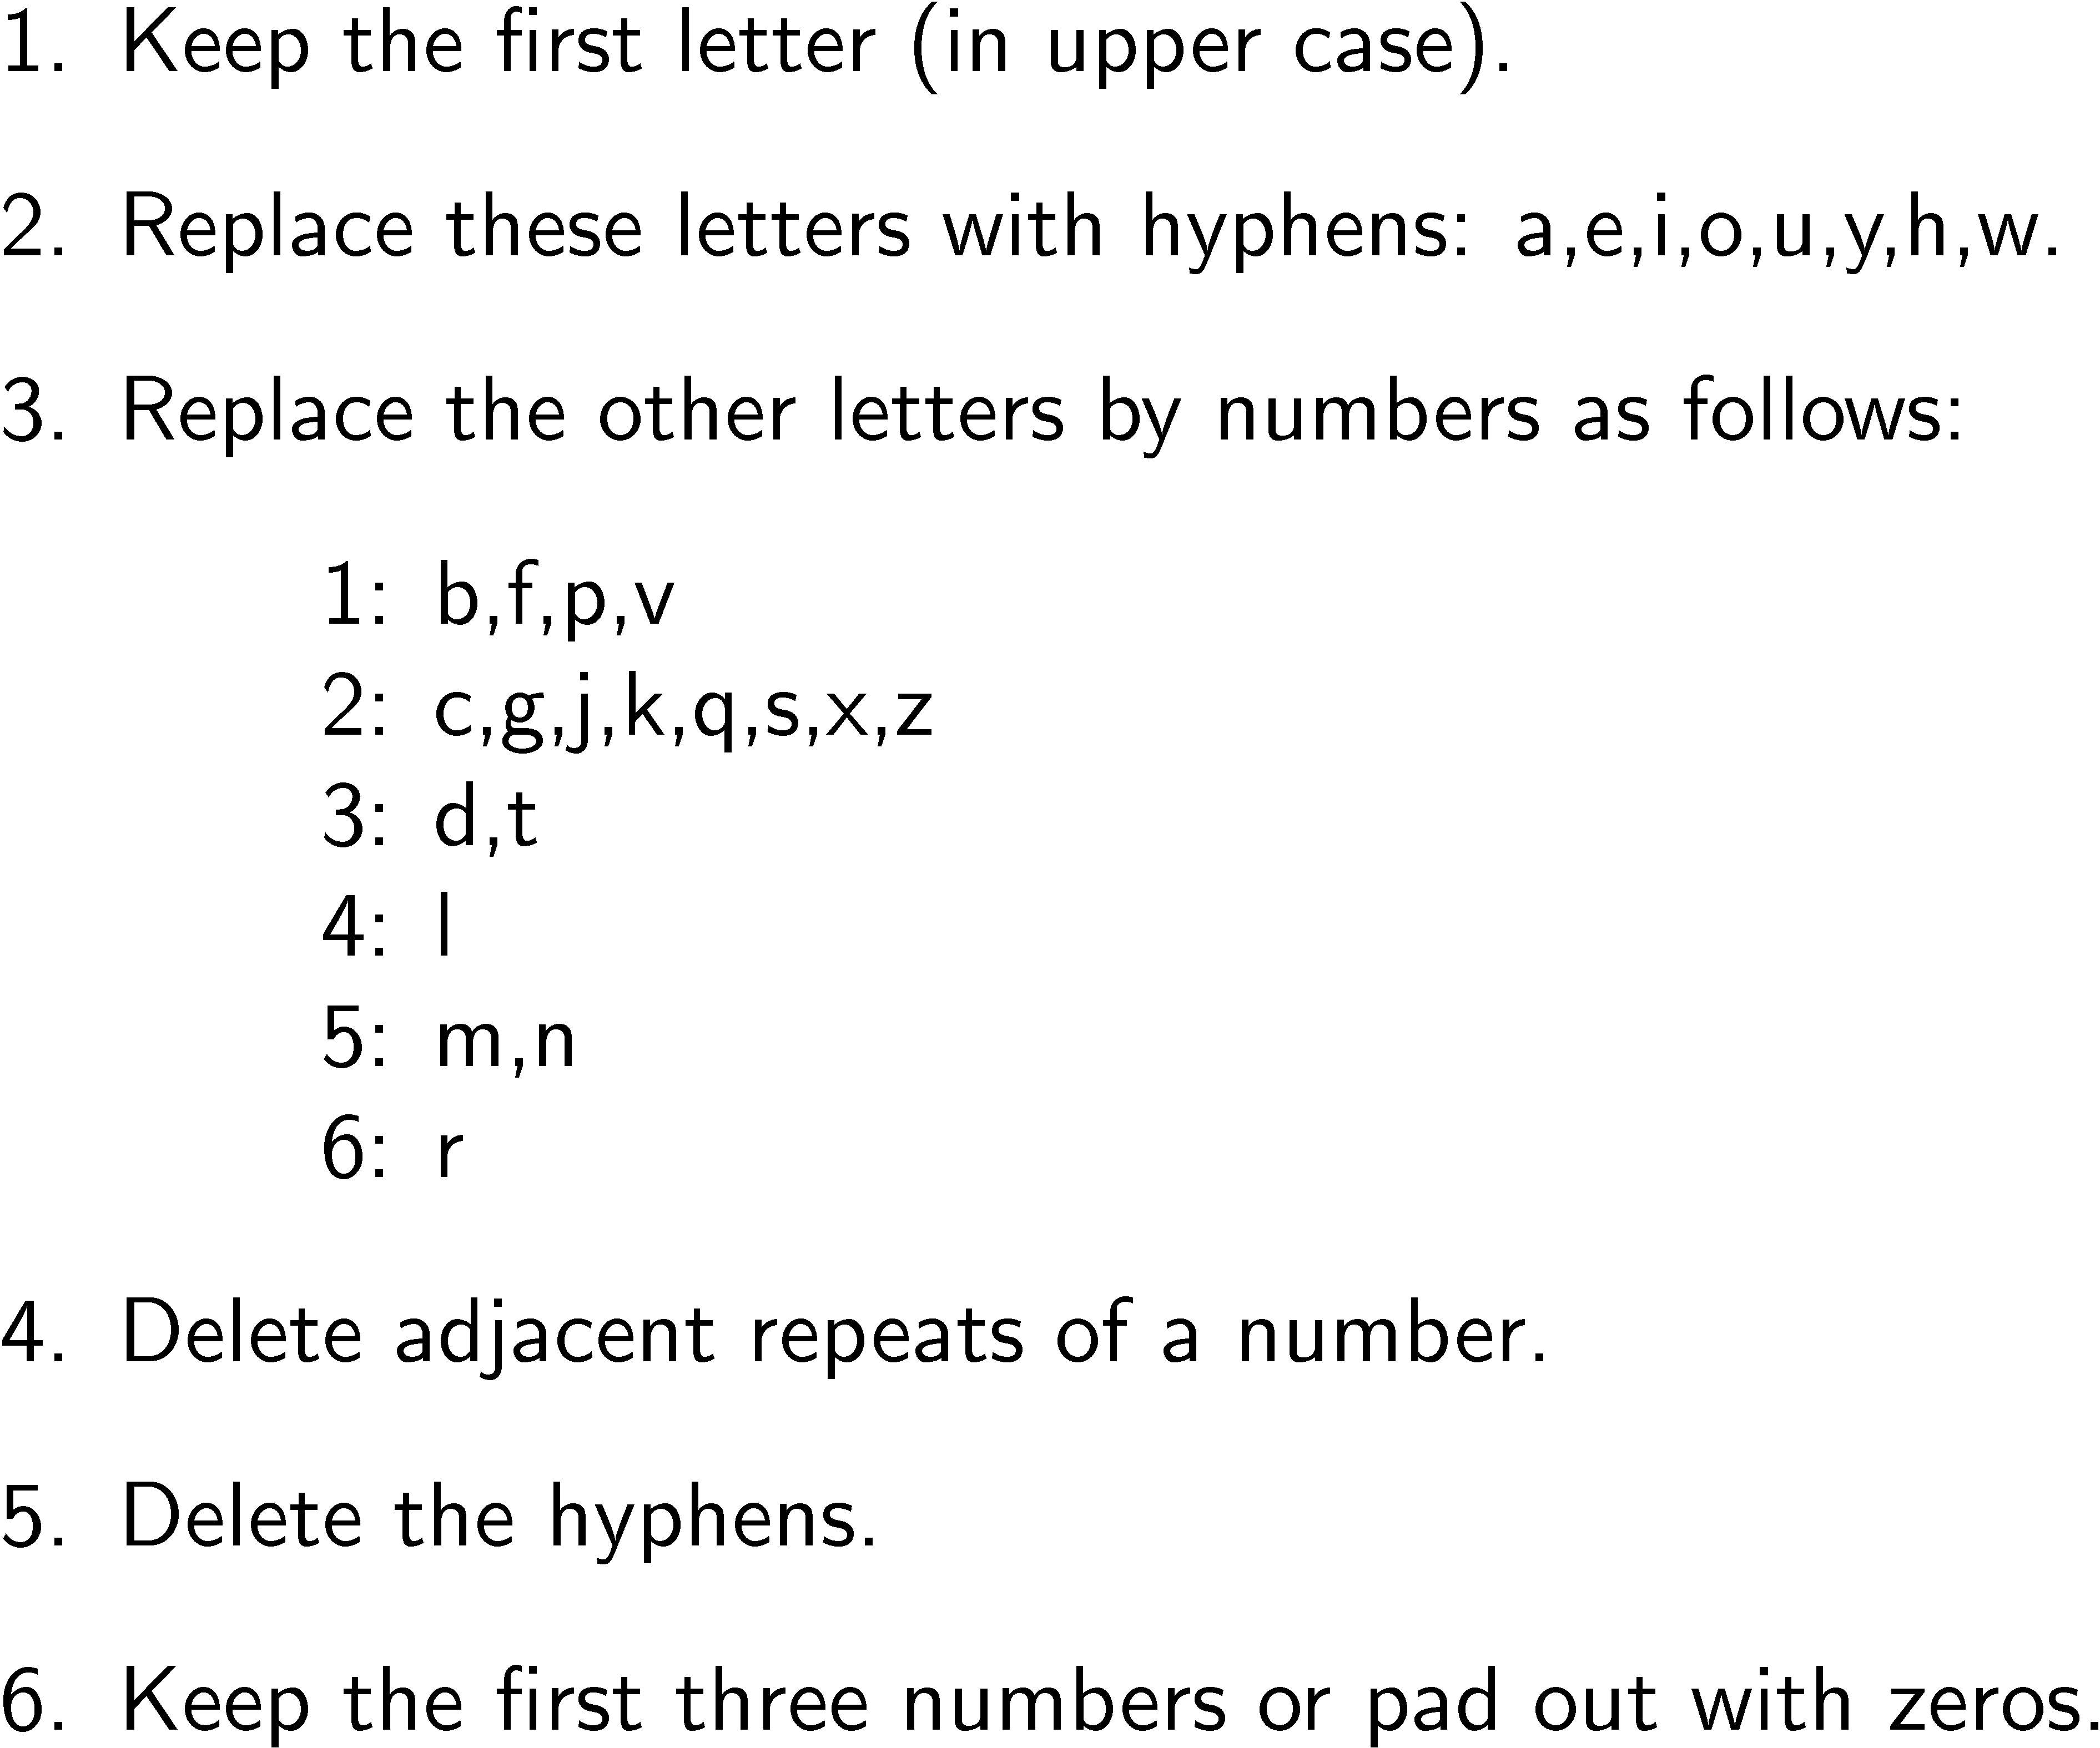
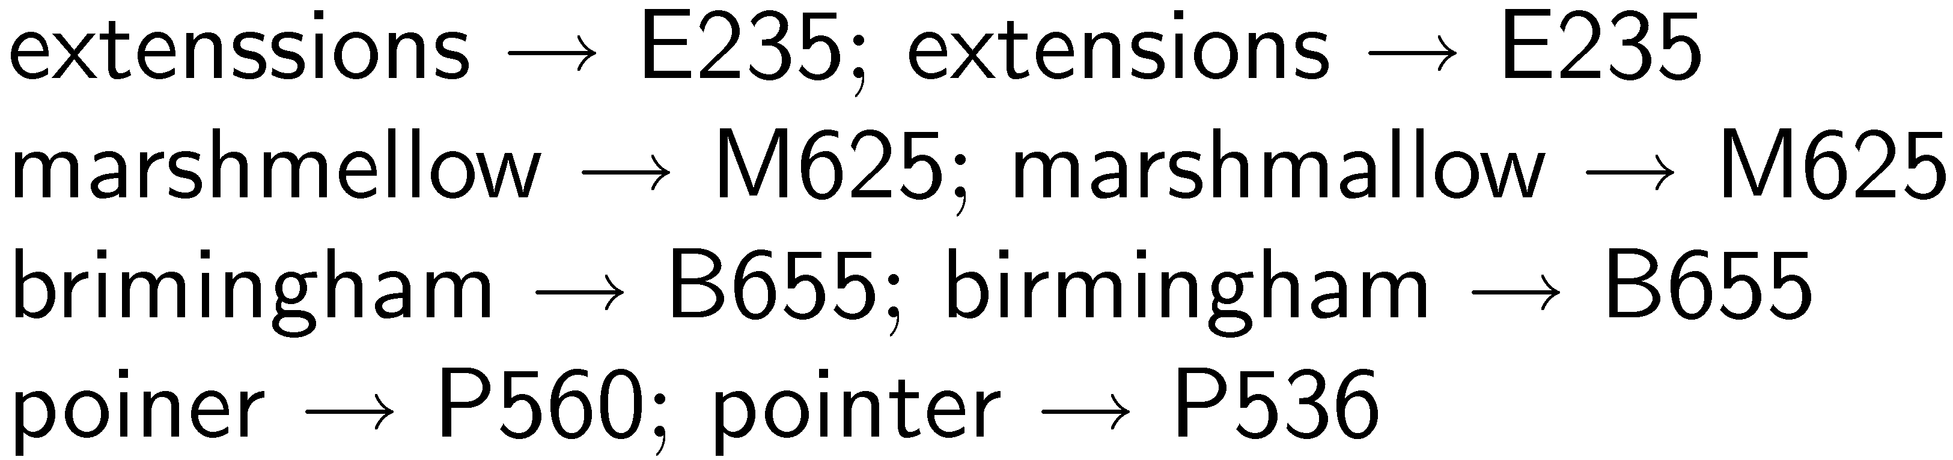
Soundex Code

Slide 42
Spelling Correction Issues
Ranking corrections
  “Did you mean...” feature requires accurate ranking of possible corrections
Context
  Choosing right suggestion depends on context (other words)
  e.g., lawers → lowers, lawyers, layers, lasers, lagers but trial lawers → trial lawyers
Run-on errors
  e.g., “mainscourcebank”
  missing spaces can be considered another single character error in right framework

Slide 43
Noisy Channel Model
User chooses word w based on probability distribution P(w)
  called the language model
  can capture context information, e.g. P(w₁|w₂)
User writes word, but noisy channel causes word e to be written instead with probability P(e|w)
  called error model
  represents information about the frequency of spelling errors

Slide 44
Noisy Channel Model
Need to estimate probability of correction
  P(w|e) = P(e|w)P(w)
Estimate language model using context
  e.g., P(w) = λP(w) + (1 − λ)P(w|w_{p})
  w_{p} is previous word
e.g.,
  “fish tink”
  “tank” and “think” both likely corrections, but P(tank|fish) > P(think|fish)

Slide 45
Noisy Channel Model
Language model probabilities estimated using corpus and query log
Both simple and complex methods have been used for estimating error model
  simple approach: assume all words with same edit distance have same probability, only edit distance 1 and 2 considered
  more complex approach: incorporate estimates based on common typing errors
  even more complex: fine-tune end-to-end seq2seq model to rewrite queries

Slide 46
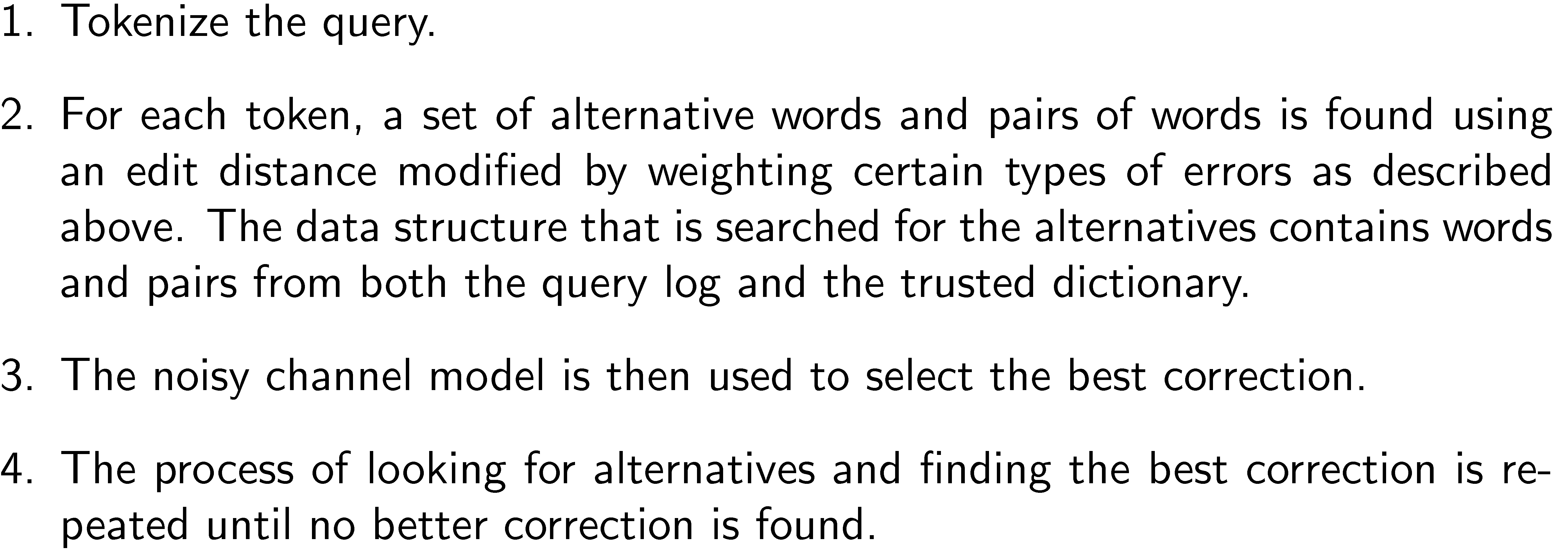
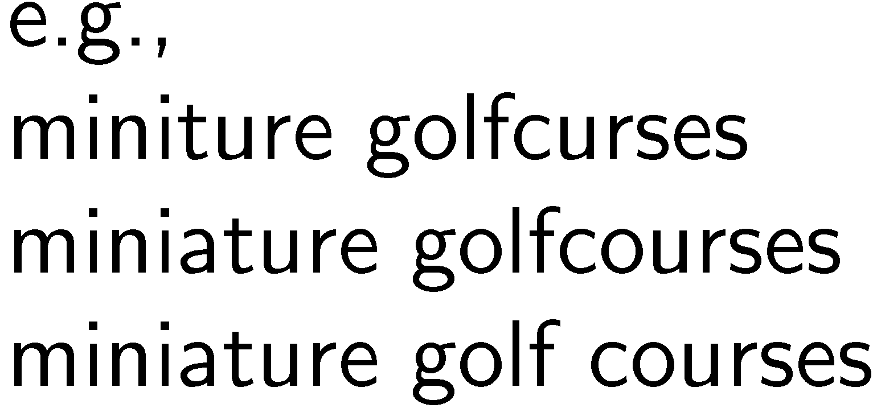
Example Spellcheck Process

Slide 47
Relevance Feedback
User identifies relevant (and maybe non-relevant) documents in the initial result list
System modifies query using terms from those documents and reranks documents
  example of simple machine learning algorithm using training data
  but, very little training data
Pseudo-relevance feedback just assumes top-ranked documents are relevant – no user input
  In machine learning, aka self-training or bootstrapping

Slide 48
Relevance Feedback Example
Top 10 documents
for “tropical fish”

Slide 49
Relevance Feedback Example
If we assume top 10 are relevant, most frequent terms are (with frequency):
    a (926), td (535), href (495), http (357), width (345), com (343), nbsp (316), www (260), tr (239), htm (233), class (225), jpg (221)
    too many stopwords and HTML expressions
Use only snippets (q.v.), remove stopwords
    tropical (26), fish (28), aquarium (8), freshwater (5), breeding (4), information (3), species (3), tank (2), Badman’s (2), page (2), hobby (2), forums (2)

Slide 50
Relevance Feedback Example
If document 7 (“Breeding tropical fish”) is explicitly indicated to be relevant, the most frequent terms are:
    breeding (4), fish (4), tropical (4), marine (2), pond (2), coldwater (2), keeping (1), interested (1)
Specific weights and scoring methods used for relevance feedback depend on retrieval model

Slide 51
Relevance Feedback
Both relevance feedback and pseudo-relevance feedback are effective on average, but are not used in many applications
  pseudo-relevance feedback has reliability issues, especially with queries that don’t retrieve many relevant documents
Some applications use relevance feedback
  filtering, “more like this”
Query suggestion more popular
  may be less accurate, but can work if initial query fails

Slide 52
Context and Personalization
If a query has the same words as another query, should results be the same regardless of
  who submitted the query,
  why the query was submitted,
  where the query was submitted, or
  what other queries were submitted in the same session?
These other factors (the context) could have a significant impact on relevance

Slide 53
User Models
Generate user profiles based on documents that the person looks at
  such as web pages visited, email messages, or word processing documents on the desktop
Modify queries using words from profile
Generally not effective
  imprecise profiles, information needs can change significantly

Slide 54
Query Logs
Query logs provide important contextual information that can be used effectively
Context in this case is
  previous queries that are the same
  previous queries that are similar
  query sessions including the same query
Query history for individuals could be used for caching or query transformation

Slide 55
Local Search
Location is context
Local search uses geographic information to modify the ranking of search results
  location derived from the query text
  location of the device where the query originated
e.g.,
  “underworld 3 cape cod”
  “underworld 3” from mobile device in Hyannis

Slide 56
Local Search
Identify the geographic region associated with web pages
  use location metadata that has been manually added to the document,
  or identify locations such as place names, city names, or country names in text
Identify the geographic region associated with the query
  10-15% of queries contain some location reference
Rank web pages using location information in addition to text and link-based features

Slide 57
Extracting Location Information
Type of information extraction
  ambiguity and significance of locations are issues
Location names are mapped to specific regions and coordinates
Matching done by inclusion, distance

Slide 58
Snippet Generation
Query-dependent document summary
Simple summarization approach
  rank each sentence in a document using a significance factor
  select the top sentences for the summary
  first proposed by Hans Peter Luhn in 1958

Slide 59
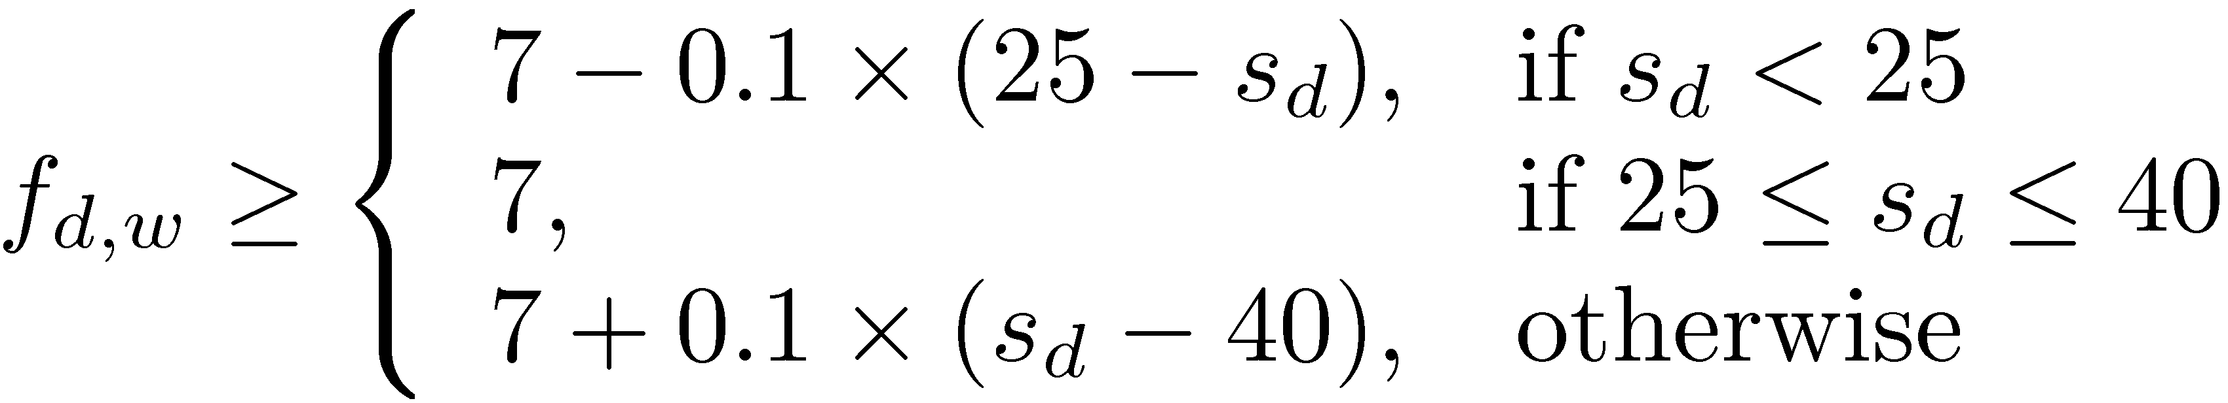
Sentence Selection
Significance factor for a sentence is calculated based on the occurrence of significant words
  If f_{d,w} is the frequency of word w in document d, then w is a significant word if it is not a stopword and
    where s_{d} is the number of sentences in document d
  text is bracketed by significant words (limit on number of non-significant words in bracket)

Slide 60
Sentence Selection
Significance factor for bracketed text spans is computed by dividing the square of the number of significant words in the span by the total number of words
e.g.,
Significance factor = 4²/7 = 2.3

Slide 61
Snippet Generation
Involves more features than just significance factor
e.g. for a news story, could use
  whether the sentence is a heading
  whether it is the first or second line of the document
  the total number of query terms occurring in the sentence
  the number of unique query terms in the sentence
  the longest contiguous run of query words in the sentence
  a density measure of query words (significance factor)
Weighted combination of features used to rank sentences
Where did Luhn, or anyone, get these parameters? How would we estimate them?

Slide 62
Snippet Generation
Web pages are less structured than news stories
  can be difficult to find good summary sentences
Snippet sentences are often selected from other sources
  metadata associated with the web page
    e.g., <meta name="description" content= ...>
  external sources such as web directories
    e.g., Open Directory Project, http://www.dmoz.org
Snippets can be generated from text of pages like Wikipedia

Slide 63
Snippet Guidelines
All query terms should appear in the summary, showing their relationship to the retrieved page
When query terms are present in the title, they need not be repeated
  allows snippets that do not contain query terms
Highlight query terms in URLs
Snippets should be readable text, not lists of keywords

Slide 64
Advertising
Sponsored search – advertising presented with search results
Contextual advertising – advertising presented when browsing web pages
Both involve finding the most relevant advertisements in a database
  An advertisement usually consists of a short text description and a link to a web page describing the product or service in more detail

Slide 65
Searching Advertisements
Factors involved in ranking advertisements
  similarity of text content to query
  bids for keywords in query
  popularity of advertisement
Small amount of text in advertisement
  dealing with vocabulary mismatch is important
  expansion techniques are effective

Slide 66
Example Advertisements
Advertisements retrieved for query “fish tank”

Slide 67
Searching Advertisements
Pseudo-relevance feedback
  expand query and/or document using the Web
  use ad text or query for pseudo-relevance feedback
  rank exact matches first, followed by stem matches, followed by expansion matches
Query reformulation based on query log

Slide 68
Clustering Results
Result lists often contain documents related to different aspects of the query topic
Clustering is used to group related documents to simplify browsing
Example clusters for
query “tropical fish”

Slide 69
Result List Example
Top 10 documents
for “tropical fish”

Slide 70
Clustering Results
Requirements
Efficiency
  must be specific to each query and are based on the top-ranked documents for that query
  typically based on snippets
Easy to understand
  Can be difficult to assign good labels to groups
  Monothetic vs. polythetic classification

Slide 71
Types of Classification
Monothetic
  every member of a class has the property that defines the class
  typical assumption made by users
  easy to understand
Polythetic
  members of classes share many properties but there is no single defining property
  most clustering algorithms you might’ve studied (e.g. k-means) produce this type of output

Slide 72
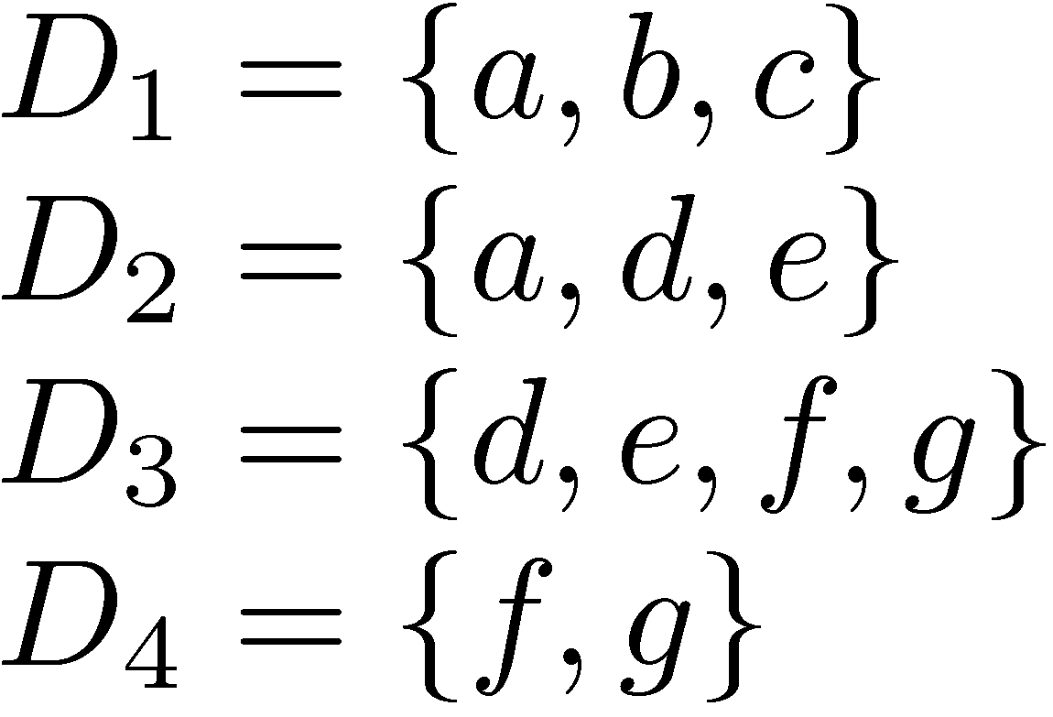
Classification Example
Possible monothetic classification
  {D₁,D₂} (labeled using a) and {D₂,D₃} (labeled e)
Possible polythetic classification
  {D₂,D₃,D₄}, D₁
  labels?

Slide 73
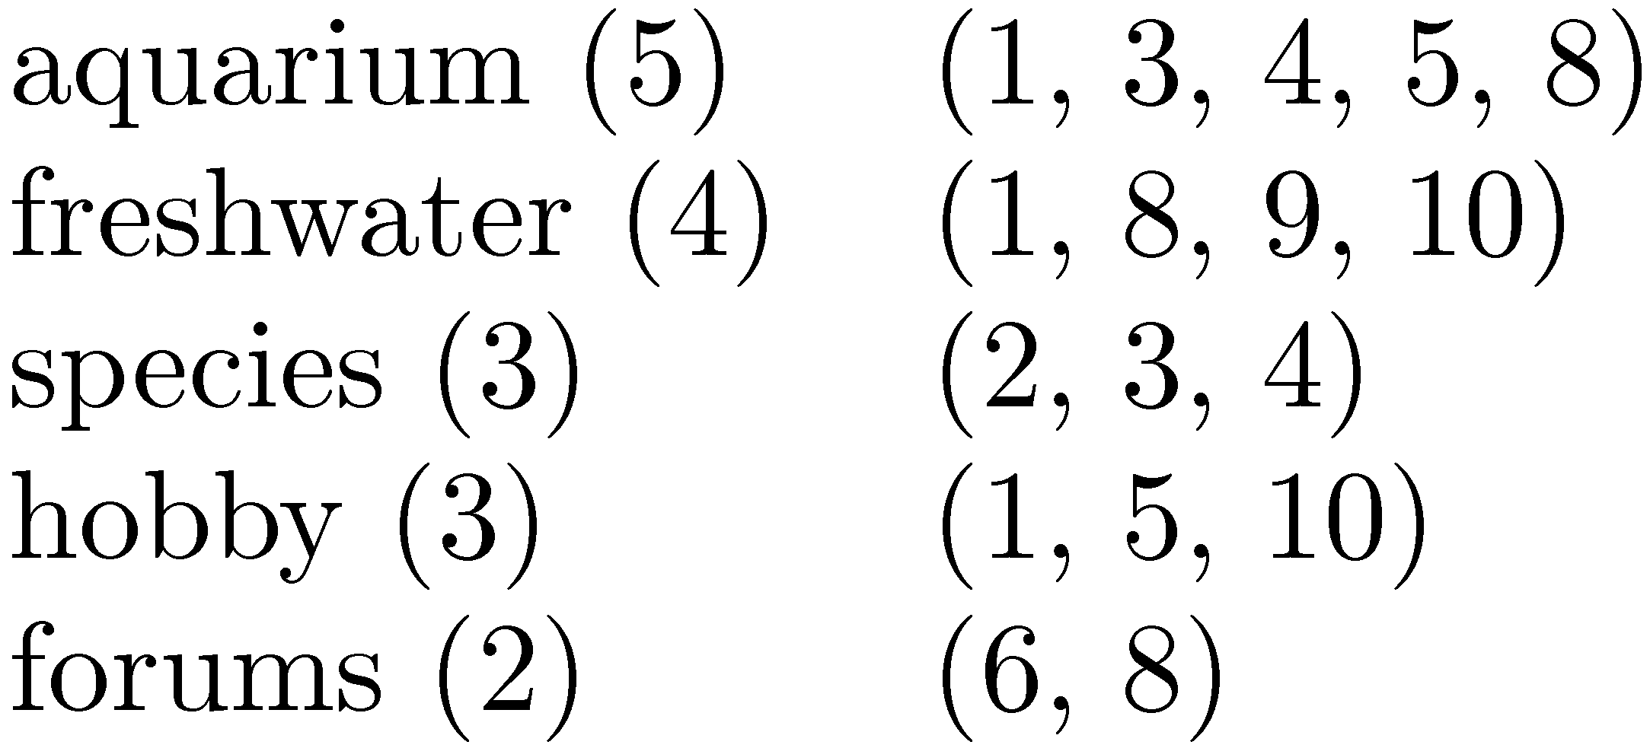
Result Clusters
Simple algorithm
  group based on words in snippets
Refinements
  use phrases
  use more features
    whether phrases occurred in titles or snippets
    length of the phrase
    collection frequency of the phrase
    overlap of the resulting clusters,

Slide 74
Faceted Classification
A set of categories, usually organized into a hierarchy, together with a set of facets that describe the important properties associated with the category
Manually defined
  potentially less adaptable than dynamic classification
Easy to understand
  commonly used in e-commerce

Slide 75
Example Faceted Classification
Categories for “tropical fish”

Slide 76
Example Faceted Classification
Subcategories and facets for “Home & Garden”

Slide 77
Cross-Language Search
Query in one language, retrieve documents in multiple other languages
Involves query translation, and probably document translation
Query translation can be done using bilingual dictionaries
Document translation requires more sophisticated statistical translation models
  similar to some retrieval models

Slide 78
Cross-Language Search

Slide 79
Translation
Web search engines use translation
  e.g. for query “pecheur france”
  translation link translates web page
  uses statistical machine translation models

Slide 80
Statistical Translation Models
Models require parallel corpora for training
  probability estimates based on aligned sentences
Translation of unusual words and phrases is a problem
  also use transliteration techniques
    e.g., Qathafi, Kaddafi, Qadafi, Gadafi, Gaddafi, Kathafi, Kadhafi, Qadhafi, Qazzafi, Kazafi, Qaddafy, Qadafy, Quadhaffi, Gadhdhafi, al-Qaddafi, Al-Qaddafi

Slide 81
Statistical Translation Models
Translation models
  “Adequacy”
  Assign better scores to accurate (and complete) translations
Language models
  “Fluency”
  Assign better scores to natural target language text
Compare: Error models and language models for spelling correction
  Warren Weaver: “When I see an article in Russian, I say, ‘This is really written in English, but in some strange symbols. I will now proceed to decode.’ ”

Slide 82
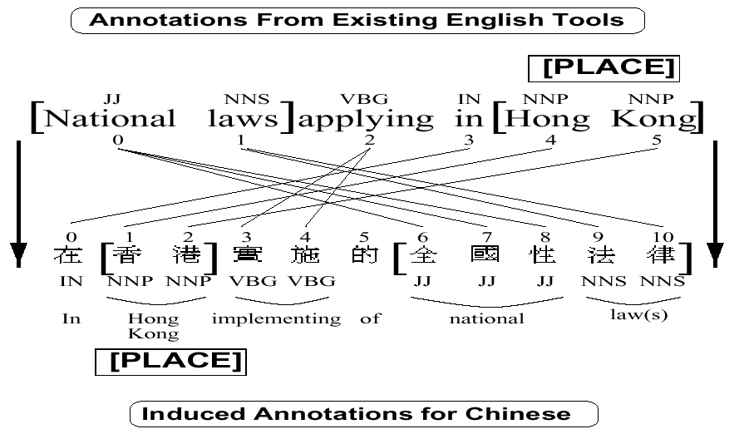
Projecting Hidden Structure

Slide 83
Projection
Train with bitext
Parse one side
Align words
Project dependencies
Many to one links?
Non-projective and circular dependencies?
Im
Anfang
war
das
Wort
In
the
beginning
was
the
word

Slide 84
Midterm Exam: October 15
Material from
  Lectures through this one
  Croft et al. c. 1–6
  Manning et al. 1–5, 19–21
Conceptual questions
  E.g., design tradeoffs
Formal questions
  Equations given
  E.g. you don’t have to memorize Zipf’s law

Slide 85
Exercise
Find a web service or site that uses search
  NOT including web search engines
  How does the service use search?
  How are the results presented?
  Does the search use exact match or ranking?
  What query language is supported?
  What unusual user interfaces do you notice?

Slide 86
User Modeling

Slide 87
“if we consider that unlike art IR is not there for its own sake, that is, IR systems are researched and built to be used, then IR is far, far more than a branch of computer science, concerned primarily with issues of algorithms, computers, and computing.”
- Tefko Saracevic, Salton Keynote 1997

Slide 88

Notes:
Web search: Low density information signal.
Roughly 60% of all users have less than 1 query per day. Roughly 3 words per query. Avg visit time is 3 minutes.
The distribution is very bursty; 4-5 queries in one day then none for a week.

Slide 89
Outline
Data collection methods
3M behavior modeling
Applications
  Trends and prediction
  Classification
  Implicit feedback
Limitations and Privacy

Slide 90
Observing User Behavior

Slide 91
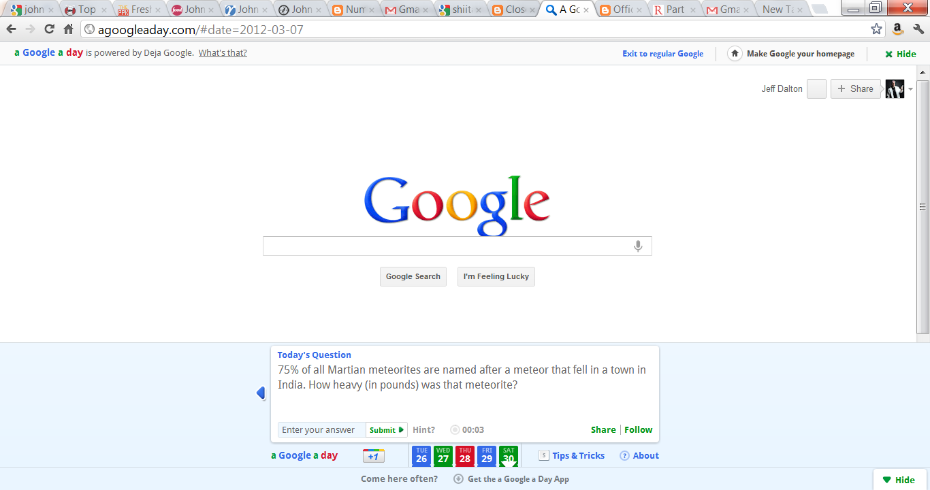
Google-a-day game

Slide 92
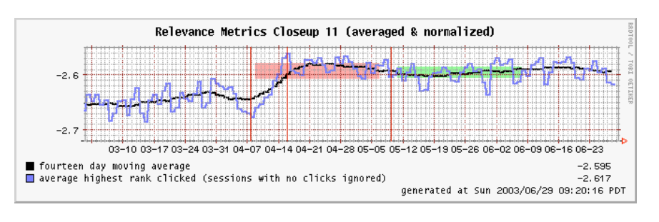

Slide 93
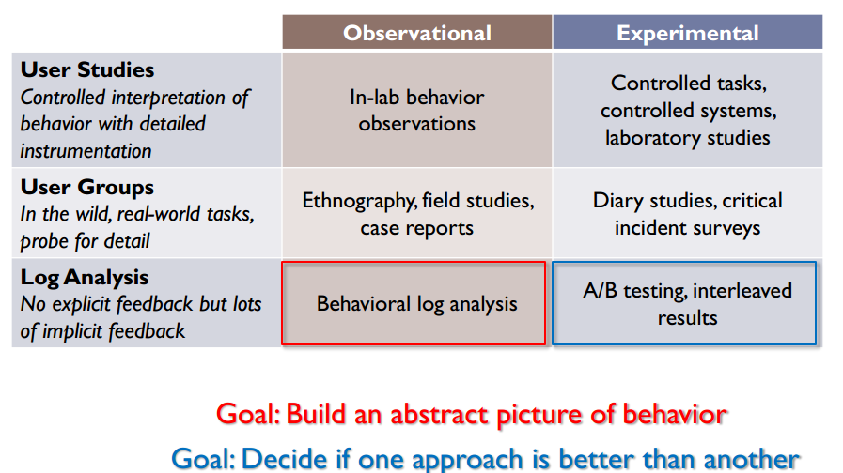
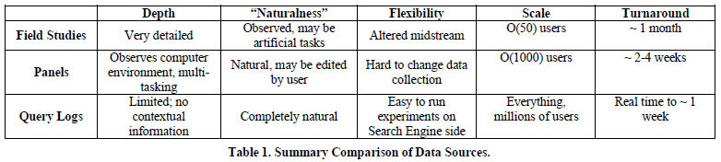
User Behavior Data
Notes:
A team observes a user perform tasks
The session is recorded and notes are taken
May use eyetrackers and other sensors
Browser activity and active applications are recorded.
Users can be prompted to provide qualitative data
Questions are fixed and standard across everyone
Stores query, results clicked, and metadata
Only mass statistics are used: individual records are discarded

Slide 94
3M Behavior Observation
Micro: lowest level – milliseconds
  Eye and mouse tracking
Meso: mid-level observations—minutes to days
  Field studies, session analysis
Macro: millions of observations—days to months
  Instrumented Panels
  Query logs
Notes:
Micro – what do people do when they are moving the mouse.
No one level gives a lock on the truth. Logs are not enough. The log looks great, but the user is screaming “I don’t get it!”

Slide 95
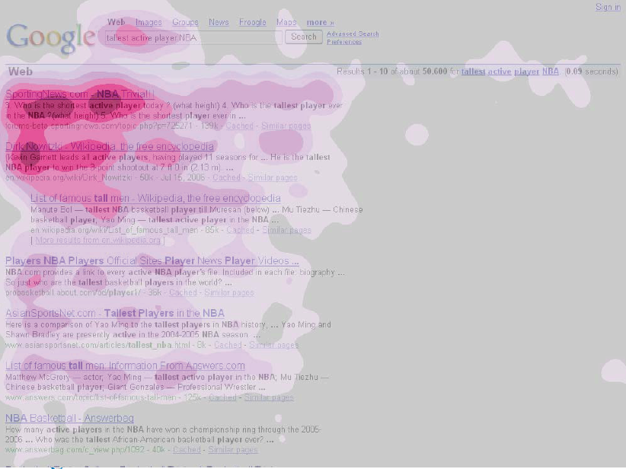
Eyetracking
Golden Triangle
Quick scan candidates
Longer scan for relevance
Notes:
Find tallest player in the NBA.
F shape pattern - the golden triangle
Critical: Did users read it and choose not to click it, or did they not see it?
Counterintuitive example: 1800 flowers. A user is hunting for metadata about whether the task is possible.

Slide 96
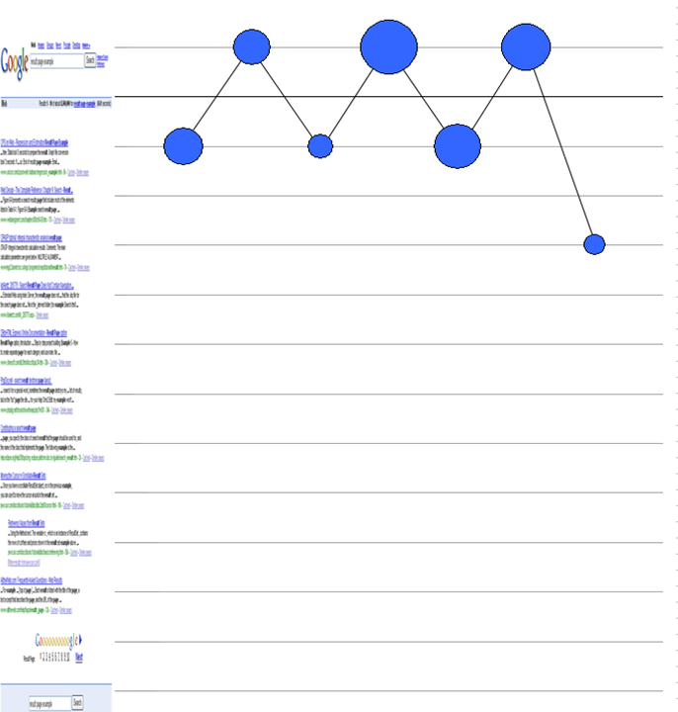
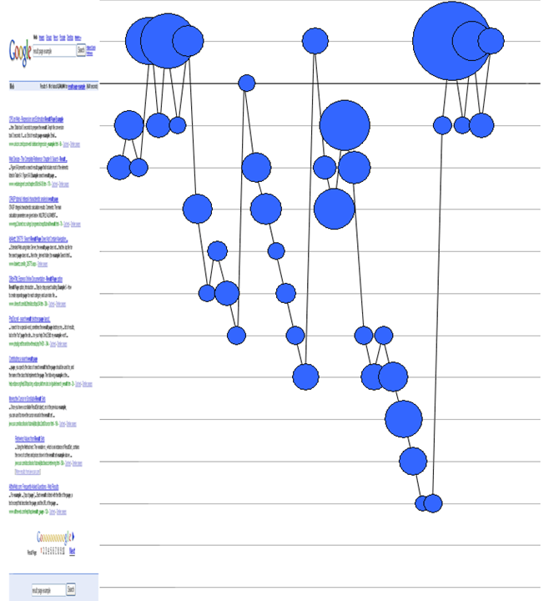
Eye Movement Over Time
Notes:
This is a visualization that shows eye tracking. It only shows vertical movement. The X-axis is time.
The first user is concerned that they typed the wrong query.
The second is even worse.
When someone looks back up the query more than twice in the query, they are re-evaluating their query.
Everyone does this when they do a poor query; it is a subconscious behavior.

Slide 97
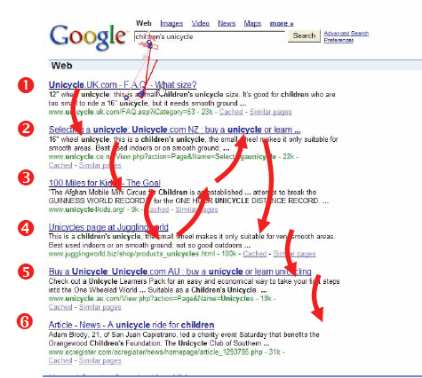
Result Scanning Behavior
Notes:
Rapidly scan the results
What’s learned later influences judgment of previous results
They are not dissatisfied.
Everyone goes back, because you didn’t quite get it right.
This is interesting because the person is reading and trying to understand the results.
How much time should you spend reading each part of a URL?
- a lot of people read URLs; parse apart the URL.

Slide 98
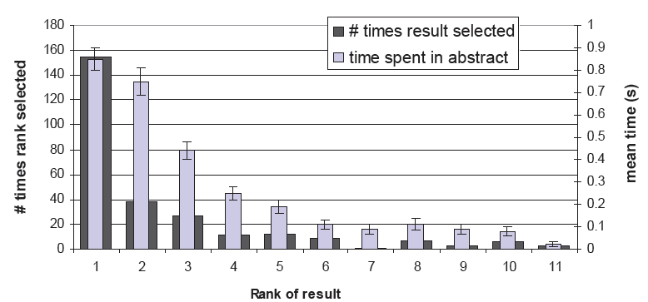
Looking vs. Clicking
Users view results one and two more often thoroughly.
Users most often click on first result.
Notes:
Document selected in under 5 seconds
• Users click on the first promising link they see
• Results viewed linearly
• Top 2 results most likely to be viewed
• Users rather reformulate query than scroll
• Task type and difficulty affect viewing behavior
Users trust the ranking. You can get any order by changing the ordering.

Slide 99
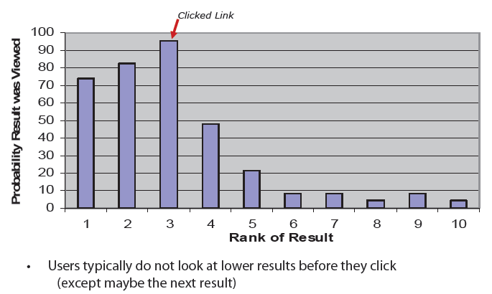
Results viewed before clicking

Slide 100
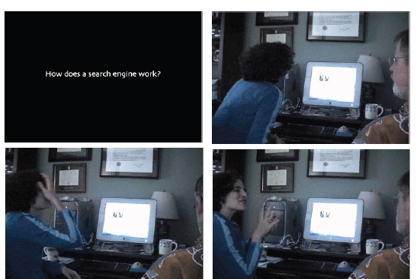
Field Studies (meso)
Notes:
You go to someone’s house and you setup the camera. The dog runs through, you spill your coffee, and the kid runs up…
You will not get timmy running through the lab. People’s behavior on assigned tasks is different from your own task in almost every single behavior. You need to interpret your results – “people are performing for you”.
Interviews held in situ…
Important for Place + context cueing features
Natural use phenomena (ads, distractions, multi-tasking)

Slide 101
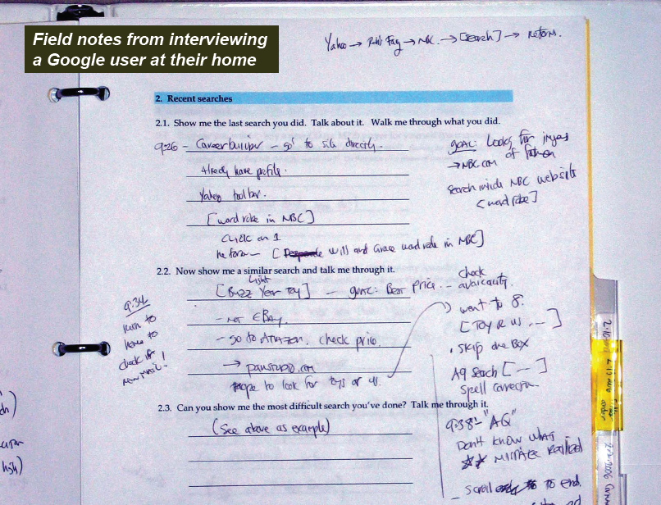
Notes:
Semi-structured form. The side notes are the most interesting parts over 50 notes…
There is a very uneven and inconsistent level of ability – people know about “-” but not using quotes.
- learn how people think, emotional reactions, mental models for a search engine.
- Explains bizarre behavior, explains the why of the logs.

Slide 102
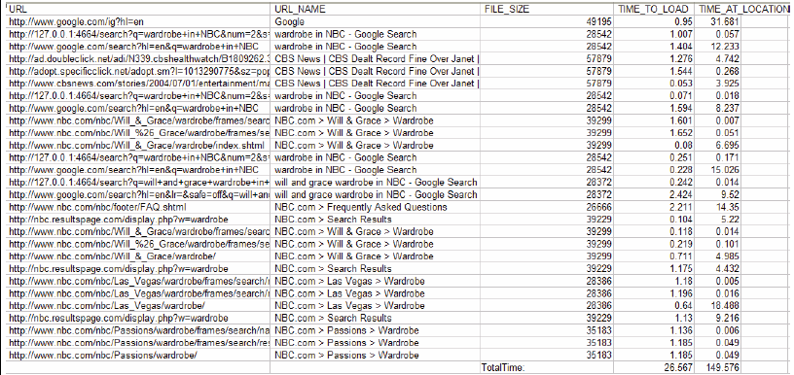
Detailed logs tied to video

Slide 103
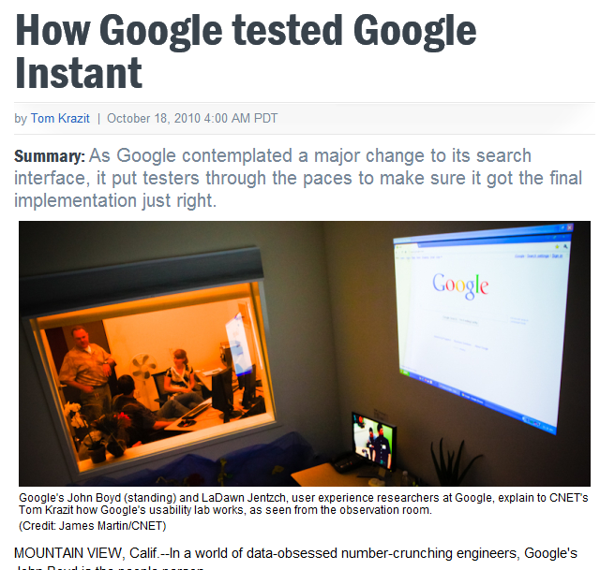
Lab Study
http://news.cnet.com/8301-30684_3-20019652-265.html

Slide 104
Instrumented Panels

Slide 105
Google Keynote Study
401 users
600 sessions
Tasks
User defined
Assume you are looking for a digital camera and a friend suggested the Nikon Coolpix 4600. Use <site> to search for information about the Nikon Coolpix 4600. How many megapixels is it?
Assume you are looking for a man’s watch as a gift for a friend or family member. Use <site> to search for a man’s watch that is water resistant to 100 meters under $100. What brand of watch did you choose?
The data is well-labeled with user-feedback.

Slide 106
Analyzing User Intent
Detailed Session Analysis
  Develop metrics, measure task and user satisfaction
  < 500 sessions, usually 100-200
  Decide: (AND vs OR queries)
Characterize a task
  Short navigation was prevalent for the camera task.
  Topic Exploration in the watch population

Slide 107
Example findings
[Soul Asylum]
  The band Soul Asylum and any news on the band, including possible tour dates in Minneapolis or country wide.
  The importance of recency
[thyroid problems]
  Happy with “hyperthyroid”
[Italian nougat candy]
  Used to find a brand name “torrone” which was used to find a recipe clones

Slide 108
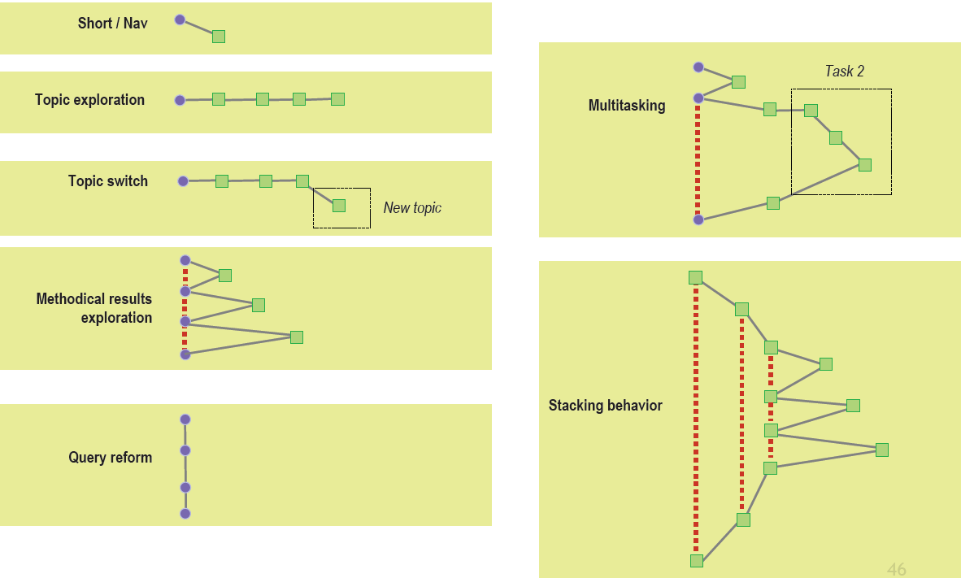
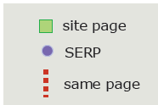
Search and Browsing Behavior
Notes:
What context is important? How can you use this to tune results?
Stacking – methodically going through a website. In this context we should show these kinds of results.
e.g. bump up the useful page over many users.

Slide 109
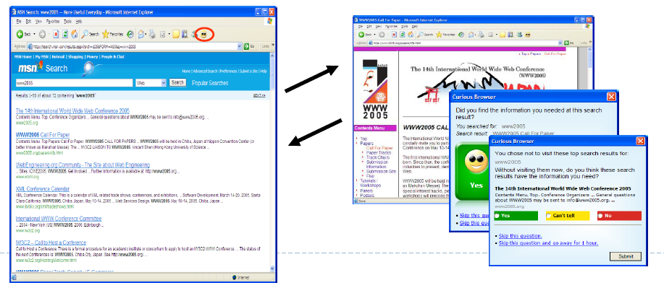
Microsoft Curious Browser Study
Browser plug-in to examine relationship between explicit and implicit behavior
  Capture lots of implicit actions (e.g., click, click position, dwell time, scroll)
  Probe for explicit user judgments of relevance of a page to the Query
Deployed to ~4k people in US and Japan
Learned models to predict explicit judgments from implicit indicators
  45% accuracy w/ just click; 75% accuracy w/ click + dwell + session
Used to learn identify important features, and run model in online evaluation

Slide 110
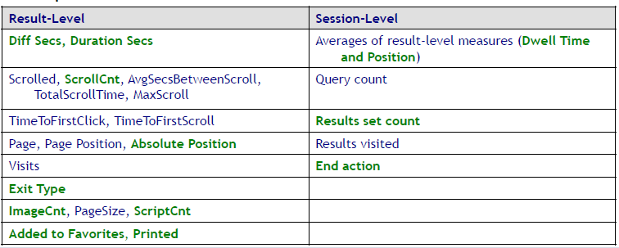
Data Analysis
Bayesian modeling at result and session level
Three levels of SAT – VSAT, PSAT & DSAT
Notes:
Dwell time, clickthrough and exit type
strongest predictors of SAT
2. Printing and Adding to Favorites highly
predictive of SAT when present
3. Combined measures predict SAT better
than clickthrough

Slide 111
Macro – User Logs

Slide 112
Scale
Google handles over 1 billion searches per day
  Logs are easy to collect and analyze
But, logs are completely unlabeled.
  Even with explicit judgments of the quality of results, session level satisfaction is still hard to predict (74% accurate).
Problems with logs
  Logs are noisy (spam, data outages, recording errors)
  Behavior can mean many things
  Don’t allow long-term study of a single user
  Usual problems of observational data and causal inference
Notes:
the researcher may know that the user did a query, but the researcher does not know what the user meant by it, nor does the researcher know whether the user was happy with the result.

Slide 113
Types of logs
Sources of Data
Web logs
Query logs
Proxy (ISP)
Toolbars
  Google, Bing, ASK
Client logging
Types of information
Interactions
  Queries, clicks
  URL visits
Context
  Results shown & metadata
  Ads displayed
  Platform information
  User Location (approx)

Slide 114
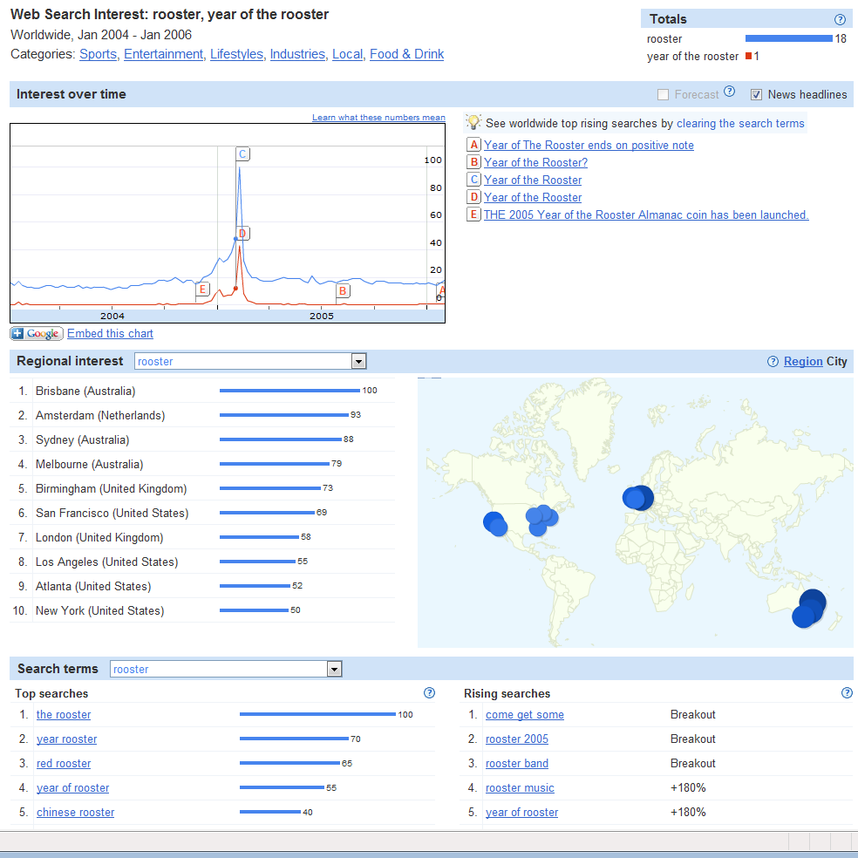
Disambiguation: Rooster

Slide 115
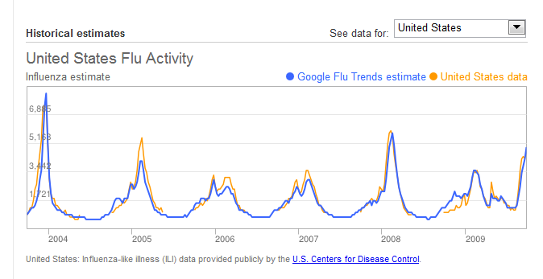
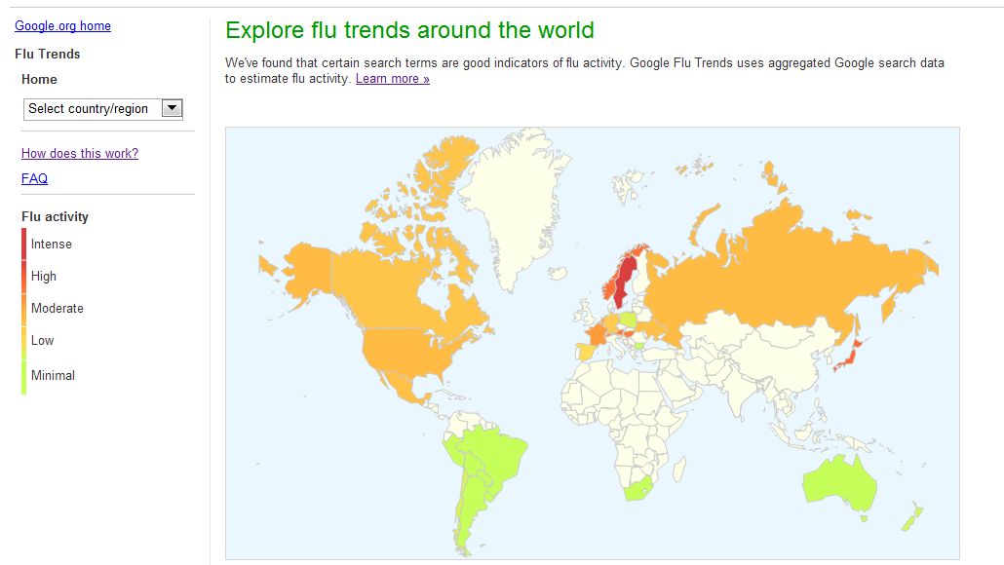
Flu Trends

Slide 116
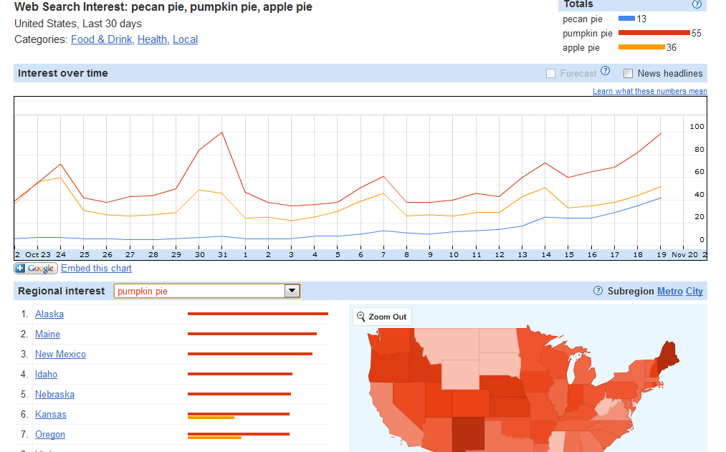
Thanksgiving Trends

Slide 117
Classifying Query Types
Initially developed by Broder, 2002
Analyzed 1000 queries from Altavista query log
Navigational: The immediate intent is to reach a particular site (~25% query log).
  [Bank of America]
Informational: The intent is to acquire some information assumed to be present on one or more Web pages (~40% query log).
  [History of Old Deerfield]
Transactional: The intent is to perform some web-mediated activity (~35% query log).
  [The Art of Cooking Amazon]
Notes:
Broder, 2002 created a taxonomy of Web search goals. He then estimated the frequency of such goals by a combination of an online survey (3,200 responses, 10% response rate) and a manual analysis of 1,000 query from the AltaVista query logs. The three types of “need behind the query”.

Slide 118


Query Classes by Topic
Yahoo! Queries by ODP category
Notes:
The first level ODP categories.
Approximately 6000 queries

Slide 119

Overall clickthrough behavior
Mixture of relevance and position
  Clickthrough (query q, document d, result position p) =
  expected (p) + relevance (q , d)

Slide 120

Clickthroughs with Rel Result @ 1,3
Clickthrough frequency with relevant document at pos 3
Notes:
Higher clickthrough at top non-relevant than at top relevant document – indicates some position bias.

Slide 121
Implicit Click Feedback
Task: predict pairwise preferences
  A user will prefer Result A > Result B
Models for preference prediction
  Current search engine ranking
  Clickthrough
  Full user behavior model

Slide 122
Using clickthrough model
SA+N: “Skip Above” and “Skip Next”
  Adapted from Joachims’ et al. [SIGIR’05]
  Motivated by gaze tracking
Example
  Click on results 2, 4
  Skip Above: 4 > (1, 3), 2>1
  Skip Next: 4 > 5, 2>3

Slide 123
Limitations of Query Logs
Clickthrough and subsequent browsing behavior of individual users influenced by many factors
  Relevance of a result to a query
  Visual appearance and layout
  Result presentation order
  Context, history, etc.
Limitations of implicit feedback
  Hard to determine the meaning of a click. If the best link is not displayed, users might still click on something
  Click duration may be misleading
    People leave machines unattended
    Opening multiple windows quickly, then reading them all slowly
    Multitasking

Slide 124

Query Log Data
MSN Query Log, 2008
  15 million queries
  Queries: [Session ID , Time-stamp, Query, Num results on page, Results page number]
  Clicks: [url, associate query, position in results, time-stamp]
Notes:
15 million queries
Sampled over one month
Queries from the US site (mostly English)
Per query attributes included:
Data per query for each result clicked:
URL, Associated query, Position on results page, Time-stamp

Slide 125

Tag Cloud of frequent AOL terms

Slide 126

Privacy

Slide 127
References
E. Agichtein. WWW 2010 Tutorial: Inferring Searcher Intent.
Baeza-Yates and Silvestri. Tutorial on Query Log Mining, SIGIR 2009.
Marti Hearst, Search User Interfaces, Chapter 2.
Daniel M. Russell. What are they Thinking? Searching for the mind of the searcher. 2007.

