Slide 1
CS6200/IS4200
Information Retrieval
David Smith
Khoury College of Computer Sciences
Northeastern University

Slide 2
Logistical Announcements
Midterm will be in class on Friday 6 November
  We will hold a review session in part of a preceding class
First project milestone: Form teams and write initial pitch by next Friday 16 October
No class on Tuesday 13 October
  I will post a recorded lecture

Slide 3
Query Process

Slide 4
Retrieval Models
Provide a mathematical framework for defining the search process
  includes explanation of assumptions
  basis of many ranking algorithms
  can be implicit
    Retrieval model developed by trial and error
Progress in retrieval models has corresponded with improvements in effectiveness
Theories about—i.e., models of—relevance
Notes:
Q: How would you define “effectiveness”? Retrieve relevant documents at the top of the list.
Q: How do we know that our theory is correct? Empirical evaluation.

Slide 5
Relevance
Complex concept that has been studied for some time
  Many factors to consider
  People often disagree when making relevance judgments
Retrieval models make various assumptions about relevance to simplify problem
  e.g., topical vs. user relevance
  e.g., binary vs. multi-valued relevance

Slide 6
Topical vs. User Relevance
Topical Relevance
  Document and query are on the same topic
  Query: “U.S. Presidents”
  Document: Wikipedia article on Abraham Lincoln
User Relevance
  Incorporate factors beside document topic
    Document freshness
    Style
    Content presentation
Notes:
Q: Do you think that a Wikipedia article on A. Lincoln is relevant to the query “U.S. presidents”?
Q: Do you think that a Wikipedia article on Egypt is relevant to the query “Egyptian revolution”?

Slide 7
Binary vs. Multi-Valued Relevance
Binary Relevance
  The document is either relevant or not
Multi-Valued Relevance
  Makes the evaluation task easier for the judges
  Not as important for retrieval models
  Many retrieval models calculate the probability of relevance
Notes:
Q: Give an example of a result which can have multiple grades of relevance.

Slide 8
Retrieval Model Overview
Older models
  Boolean retrieval
  Vector Space model
Probabilistic Models
  BM25
  Language models
Combining evidence
  Inference networks
  Learning to Rank
  Neural models for reranking and indexing

Slide 9
Boolean Retrieval
Two possible outcomes for query processing
  TRUE and FALSE
  “exact-match” retrieval; “set” retrieval
  simplest form of ranking
Query usually specified using Boolean operators
  AND, OR, NOT
  proximity operators and wildcards also used

Slide 10
Boolean Retrieval
Advantages
  Results are predictable, relatively easy to explain
  Many different features can be incorporated
  Efficient processing since many documents can be eliminated from search
Disadvantages
  Effectiveness depends entirely on user
  Simple queries usually don’t work well
  Complex queries are difficult

Slide 11
Searching by Numbers
Sequence of queries driven by number of retrieved documents
  lincoln
  president AND lincoln
  president AND lincoln AND NOT (automobile OR car)
  president AND lincoln AND biography AND life AND birthplace AND gettysburg AND NOT (automobile OR car)
  president AND lincoln AND (biography OR life OR birthplace OR gettysburg) AND NOT (automobile OR car)
Notes:
Explain what kind of documents each of the queries retrieves, and a problem with each of the queries
Too broad
May include documents about the management of Ford Motor Company
May remove relevant documents that mention the word “car”
Too narrow – might retrieve an empty set
No distinction which of the words in the query are more important than others

Slide 12
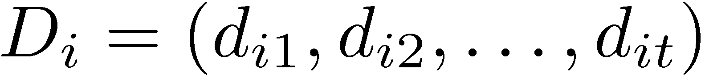
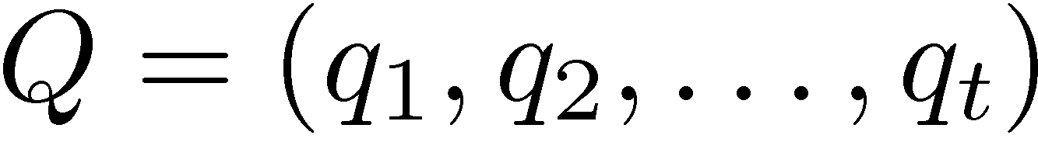
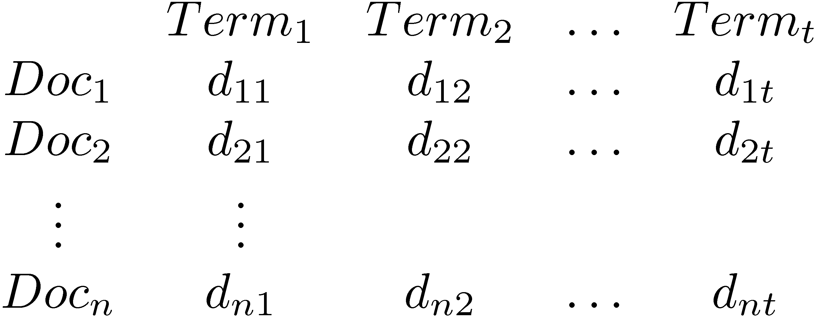
Vector Space Model
Documents and query represented by a vector of term weights
Collection represented by a matrix of term weights

Slide 13
Vector Space Model
Notes:
Q: What characteristics of the documents are lost in this matrix representation?
Q: Is it a good idea to use this matrix structure for indexing the documents?

Slide 14
Vector Space Model
Query: “tropical fish”
Term | Query
aquarium | 0
bowl | 0
care | 0
fish | 1
freshwater | 0
goldfish | 0
homepage | 0
keep | 0
setup | 0
tank | 0
tropical | 1

Slide 15
Vector Space Model
3-d pictures useful, but can be misleading for high-dimensional space

Slide 16
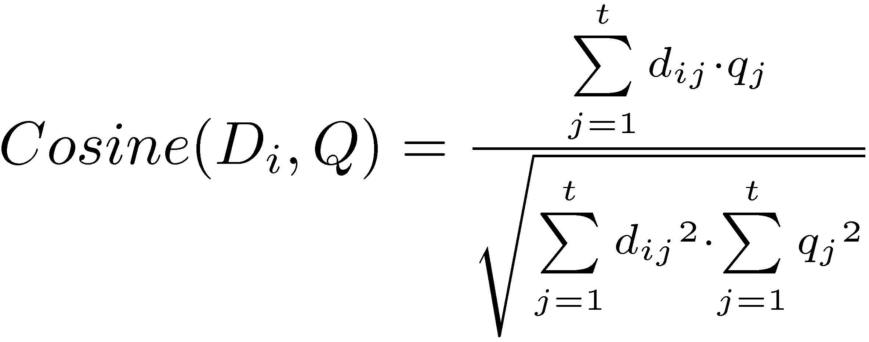
Vector Space Model
Documents ranked by distance between points representing query and documents
  Similarity measure more common than a distance or dissimilarity measure
  e.g. Cosine correlation

Slide 17
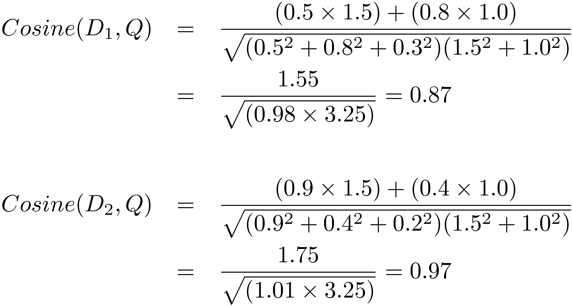
Similarity Calculation
  Consider two documents D_{1,} D₂ and a query Q
    D₁ = (0.5, 0.8, 0.3), D₂ = (0.9, 0.4, 0.2), Q = (1.5, 1.0, 0)

Slide 18
Difference from Boolean Retrieval
Similarity calculation has two factors that distinguish it from Boolean retrieval
  Number of matching terms affects similarity
  Weight of matching terms affects similarity
Documents can be ranked by their similarity scores

Slide 19
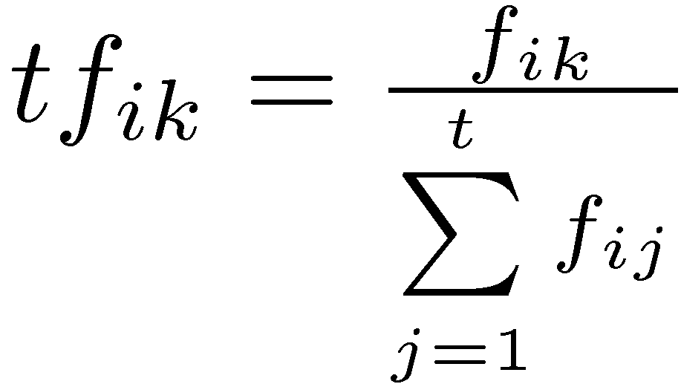
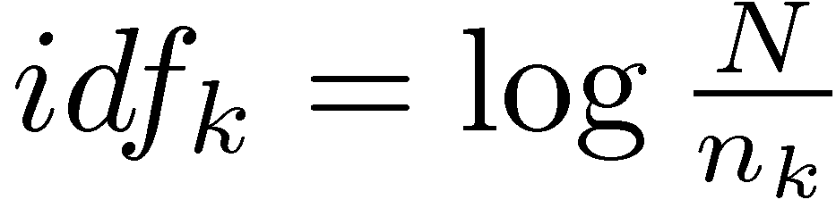
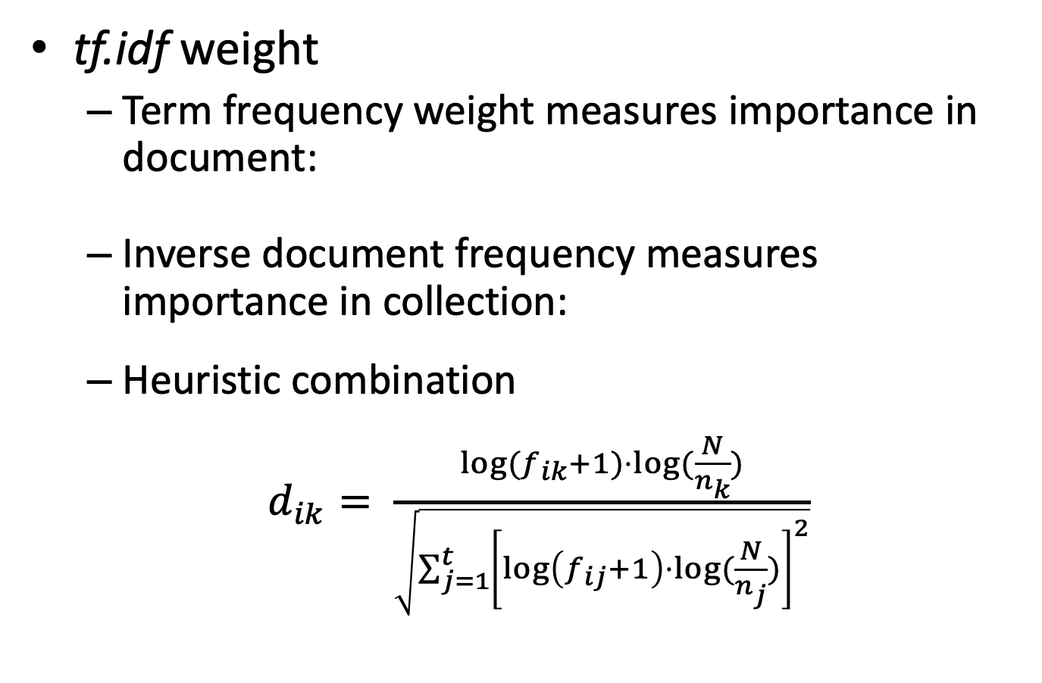
Term Weights
tf.idf weight
  Term frequency weight measures importance in document:
  Inverse document frequency measures importance in collection:
  Heuristic combination
  $d_{ik}= \frac{\log{(f_{ik}+1)⋅\log{(\frac{N}{n_{k}})}}}{\sqrt{\sum_{j=1}^{t}{{\left[\log\left(f_{ij}+1\right)⋅\log{(\frac{N}{n_{j}})}\right]}^{2}}}}$
Notes:
log(f_ik) – dampen the impact of terms that occur a lot in the document
+1 – avoid zero weights
Denominator – Normalization factor
Q: How is relevance defined in the Vector Space Model?

Slide 20
Relevance Feedback
Rocchio algorithm
Optimal query
  Maximizes the difference between the average vector representing the relevant documents and the average vector representing the non-relevant documents
Modifies query according to
  α, β, and γ are parameters
    Typical values 8, 16, 4

Slide 21
Vector Space Model
Advantages
  Simple computational framework for ranking
  Any similarity measure or term weighting scheme could be used
Disadvantages
  Assumption of term independence
  No predictions about techniques for effective ranking

Slide 22
Probability Ranking Principle
Robertson (1977)
  “If a reference retrieval system’s response to each request is a ranking of the documents in the collection in order of decreasing probability of relevance to the user who submitted the request,
  where the probabilities are estimated as accurately as possible on the basis of whatever data have been made available to the system for this purpose,
  the overall effectiveness of the system to its user will be the best that is obtainable on the basis of those data.”

Slide 23
IR as Classification
Notes:
Q: Which set would be bigger, R or NR, and why?

Slide 24
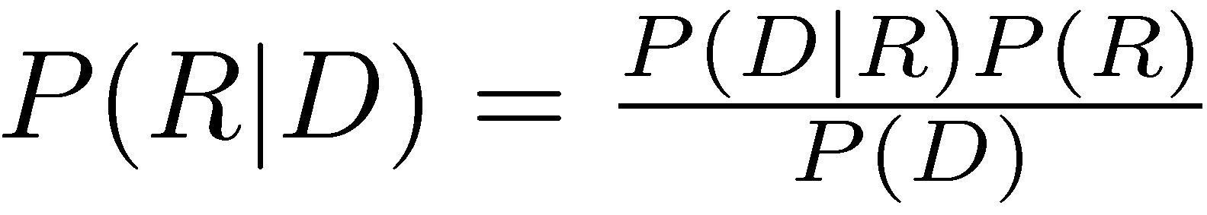
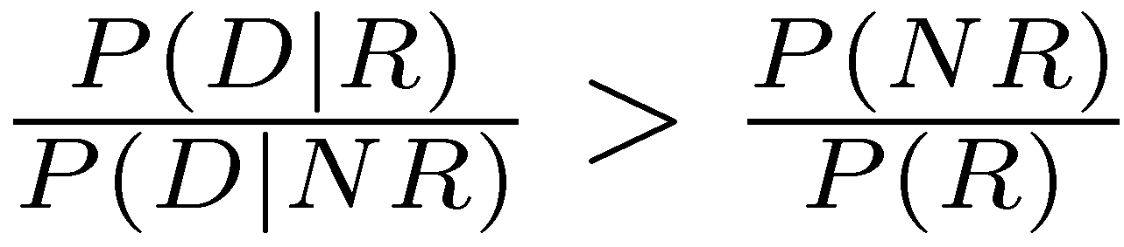
Bayes Classifier
Bayes Decision Rule
  A document D is relevant if P(R|D) > P(NR|D)
Estimating probabilities
  use Bayes Rule
  classify a document as relevant if
    This is likelihood ratio

Slide 25
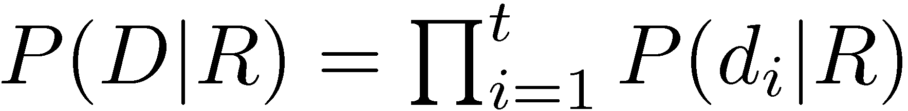
Estimating P(D|R)
Assume independence
Binary independence model
  document represented by a vector of binary features indicating term occurrence (or non-occurrence)
  p_{i} is probability that term i occurs (i.e., has value 1) in relevant document, s_{i} is probability of occurrence in non-relevant document

Slide 26
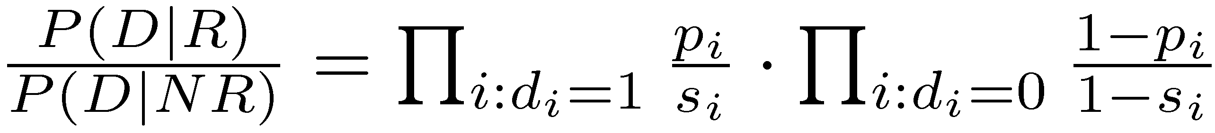
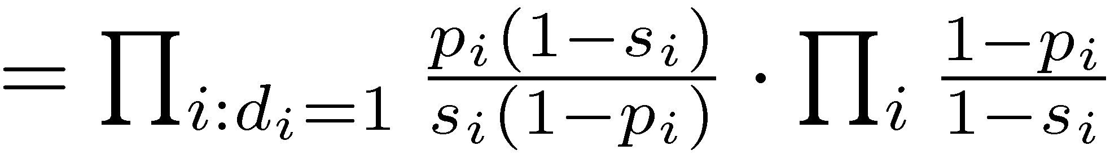
Binary Independence Model

Slide 27
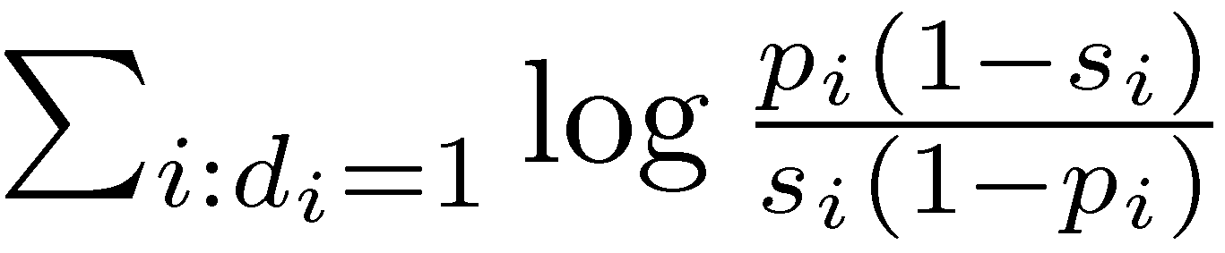
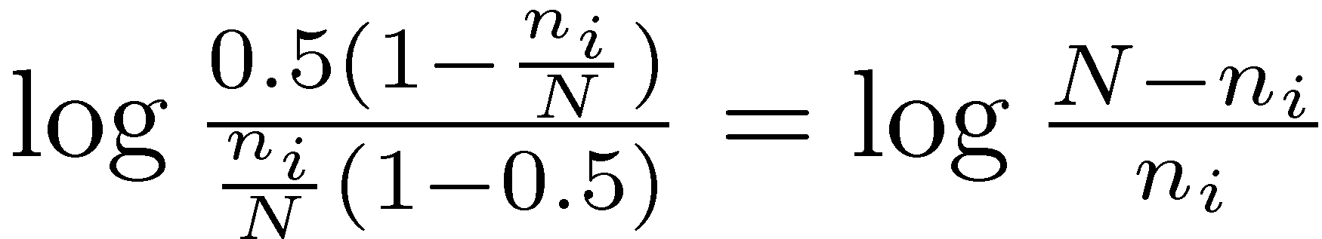
Binary Independence Model
Scoring function is
Query provides information about relevant documents
If we assume p_{i} constant, s_{i} approximated by entire collection, get idf-like weight

Slide 28
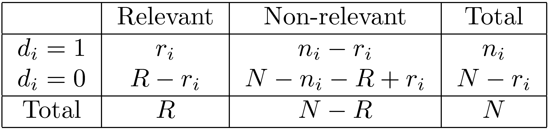
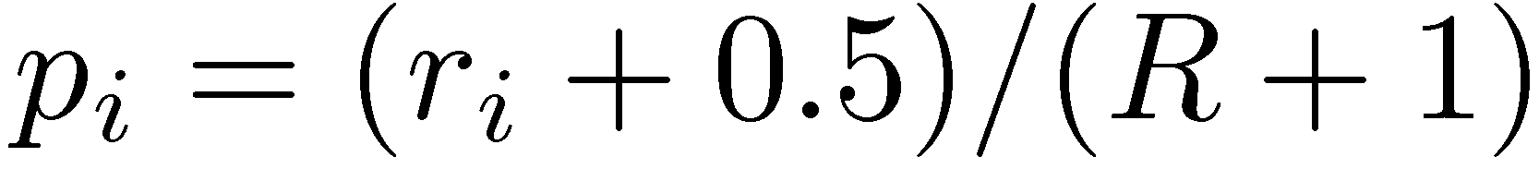
Contingency Table
Gives scoring function:
Notes:
r_i – number of rel. docs containing term i
n_i – number of docs. containing term i
R – number of relevant documents
N – number of documents
Q: Why do we use +0.5 and +1 in the estimates?

Slide 29
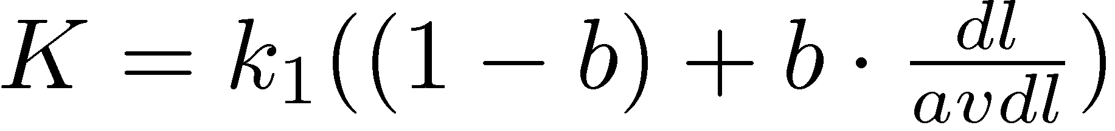
BM25
Popular and effective ranking algorithm based on binary independence model
  adds document and query term weights
  k1, k2 and K are parameters whose values are set empirically
  dl is doc length
  Typical TREC value for k1 is 1.2, k2 varies from 0 to 1000, b = 0.75

Slide 30
BM25 Example
Query with two terms, “president lincoln”, (qf = 1)
No relevance information (r and R are zero)
N = 500,000 documents
“president” occurs in 40,000 documents (n₁ = 40, 000)
“lincoln” occurs in 300 documents (n₂ = 300)
“president” occurs 15 times in doc (f₁ = 15)
“lincoln” occurs 25 times (f₂ = 25)
document length is 90% of the average length (dl/avdl = .9)
k₁ = 1.2, b = 0.75, and k₂ = 100
K = 1.2 · (0.25 + 0.75 · 0.9) = 1.11

Slide 31
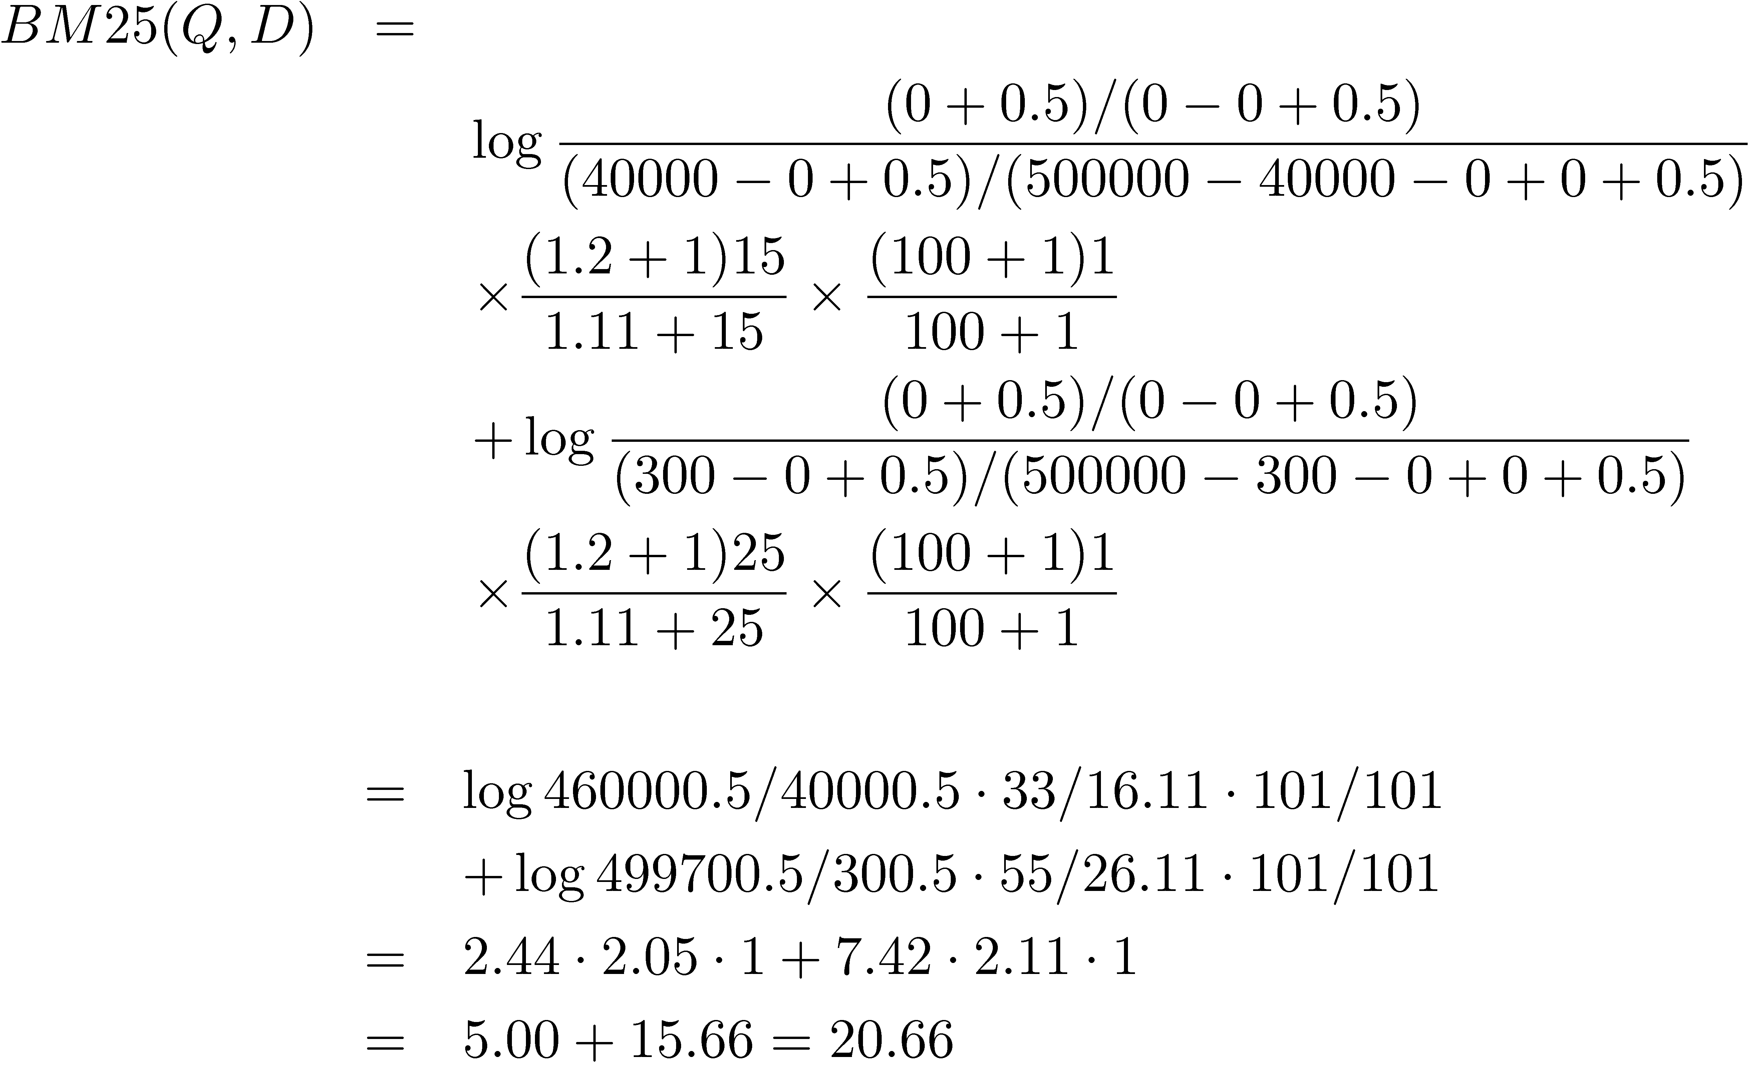
BM25 Example

Slide 32
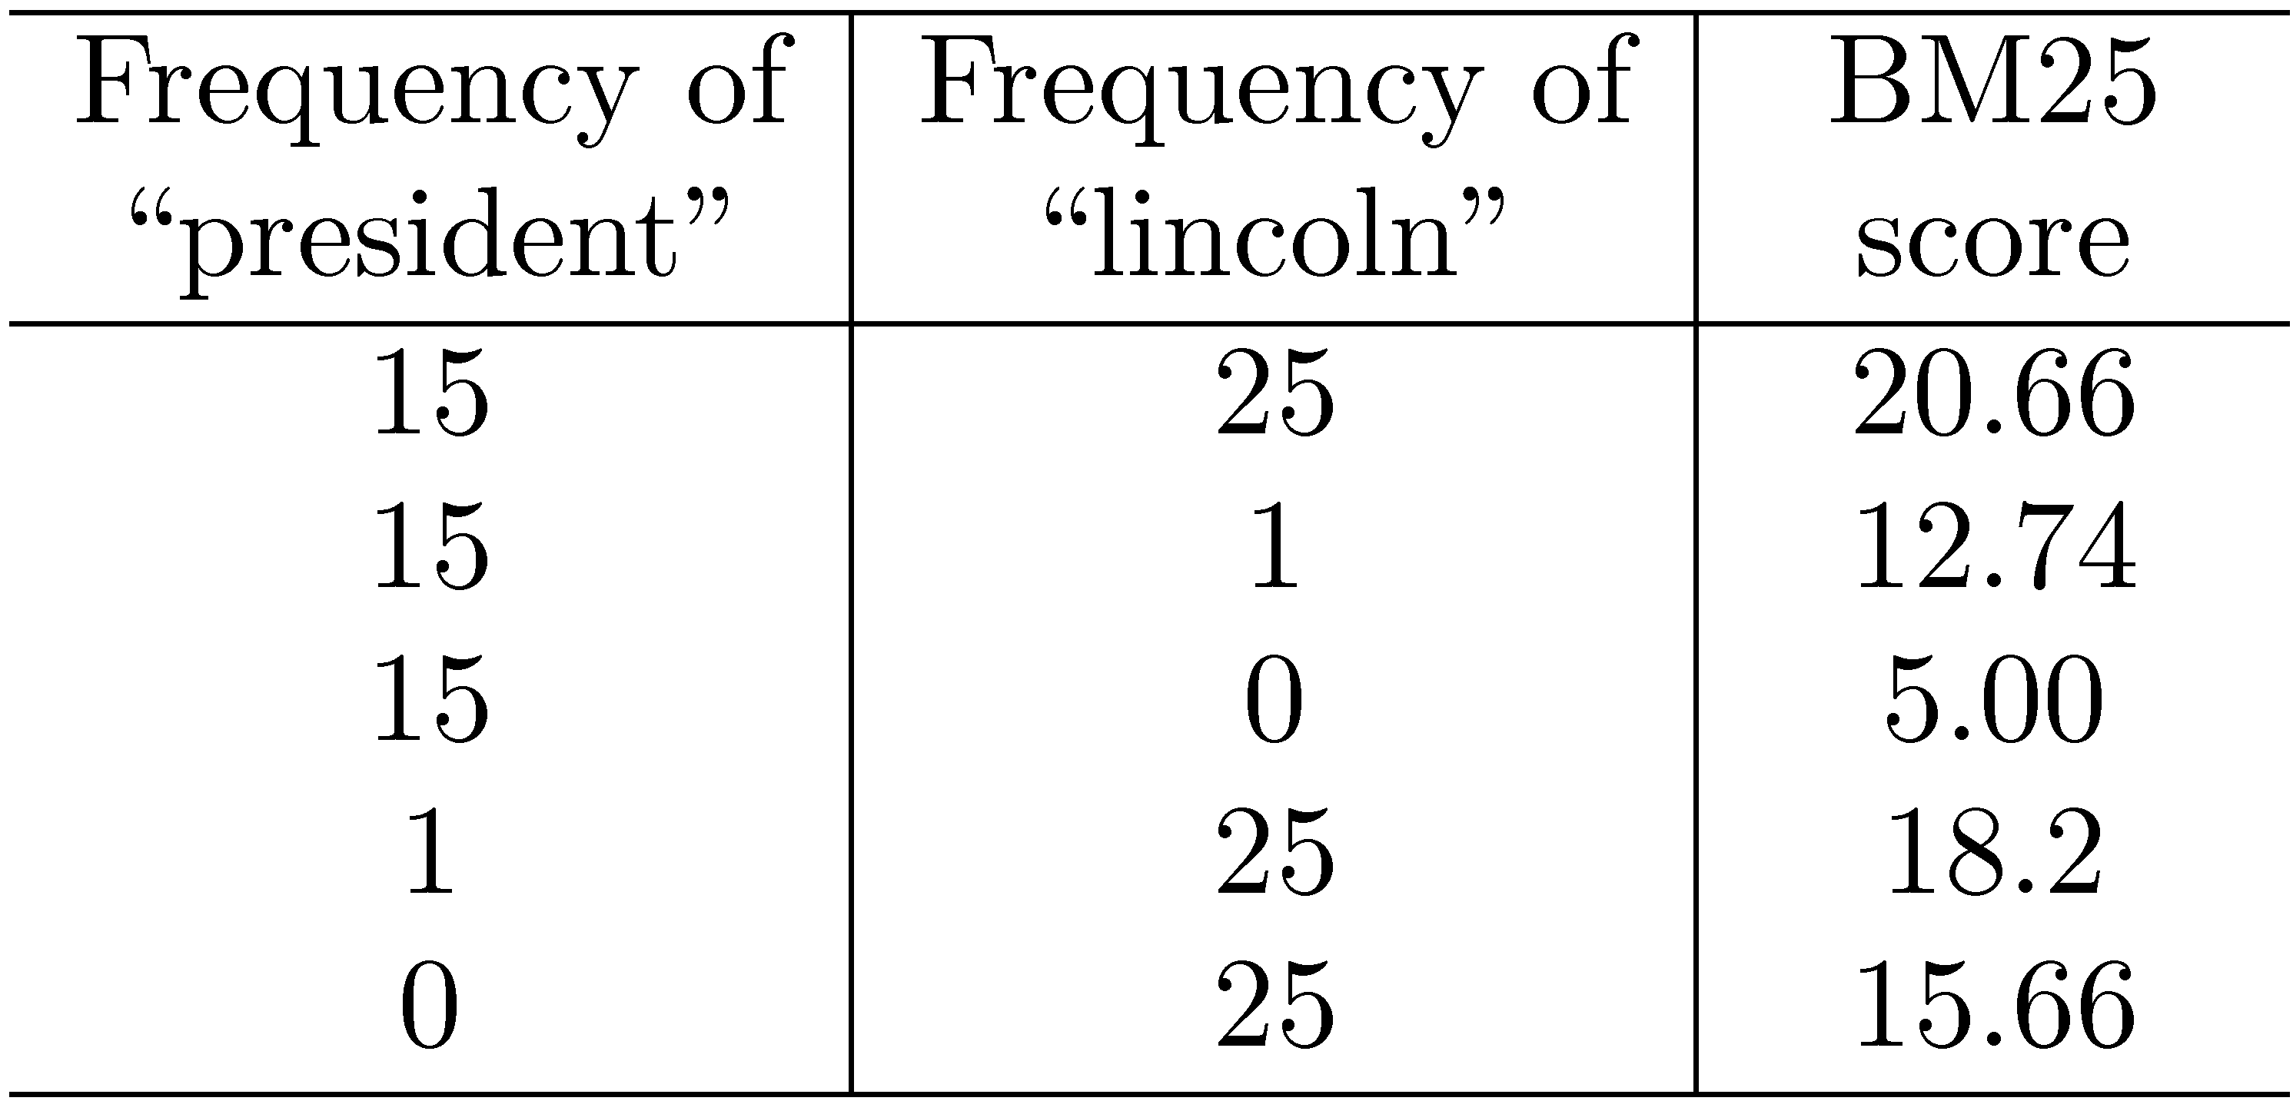
BM25 Example
Effect of term frequencies

Slide 33
Language Models
Language model
  Probability distribution over strings of text
Unigram language model
  generation of text consists of pulling words out of a “bucket” according to the probability distribution and replacing them
N-gram language model
  some applications use bigram and trigram language models where probabilities depend on previous words
We’ll cover larger models in later lectures

Slide 34
Language Model
A topic in a document or query can be represented as a language model
  i.e., words that tend to occur often when discussing a topic will have high probabilities in the corresponding language model
Multinomial distribution over words
  text is modeled as a finite sequence of words, where there are t possible words at each point in the sequence
  commonly used, but not only possibility
  doesn’t model burstiness

Slide 35
LMs for Retrieval
3 possibilities:
  probability of generating the query text from a document language model
  probability of generating the document text from a query language model
  comparing the language models representing the query and document topics
Models of topical relevance

Slide 36
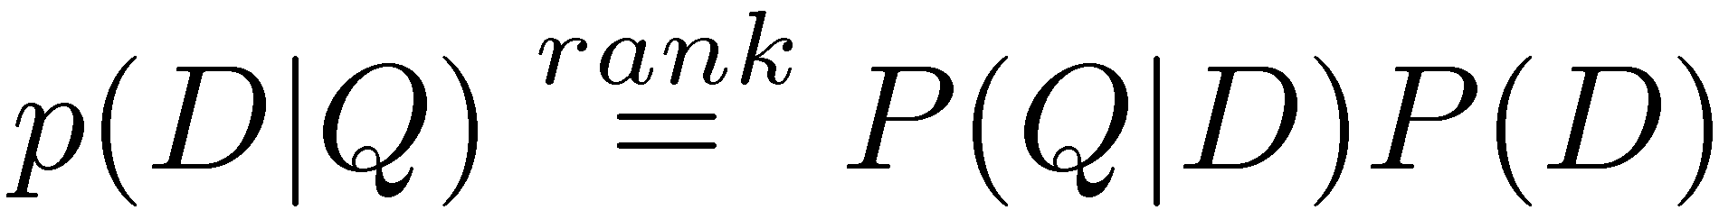
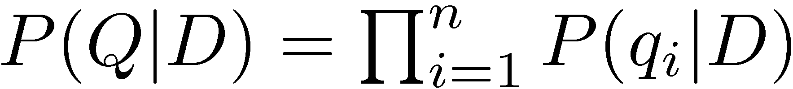
Query-Likelihood Model
Rank documents by the probability that the query could be generated by the document model (i.e. same topic)
Given query, start with P(D|Q)
Using Bayes’ Rule
Assuming prior is uniform, unigram model

Slide 37
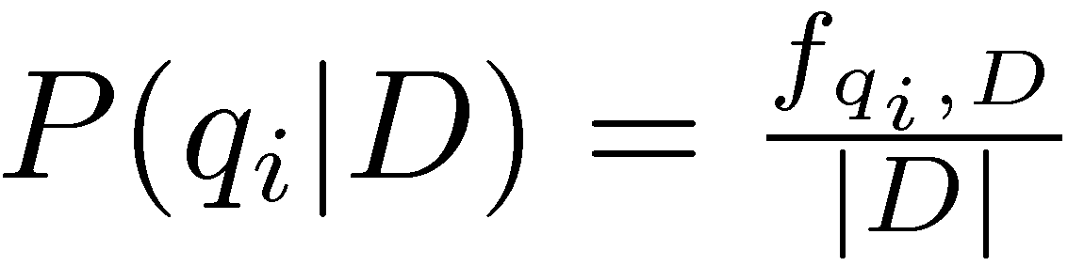
Estimating Probabilities
Obvious estimate for unigram probabilities is
Maximum likelihood estimate
  makes the observed value of fqi;D most likely
If query words are missing from document, score will be zero
  Missing 1 out of 4 query words same as missing 3 out of 4

Slide 38
Smoothing
Document texts are a sample from the language model
  Missing words should not have exactly zero probability of occurring
Smoothing is a technique for estimating probabilities for missing (or unseen) words
  lower (or discount) the probability estimates for words that are seen in the document text
  assign that “left-over” probability to the estimates for the words that are not seen in the text
  What does this do to the likelihood of the document?

Slide 39
Estimating Probabilities
Estimate for unseen words is α_{D}P(q_{i}|C)
  P(q_{i}|C) is the probability for query word i in the collection language model for collection C (background probability)
  α_{D} is a parameter
Estimate for words that occur is
(1 − α_{D}) P(q_{i}|D) + α_{D} P(q_{i}|C)
Different forms of estimation come from different α_{D}

Slide 40
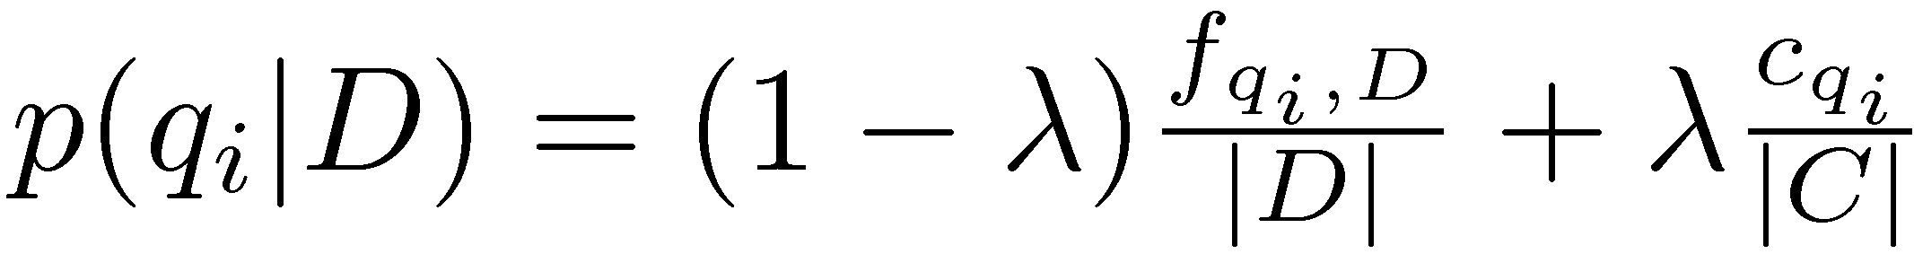
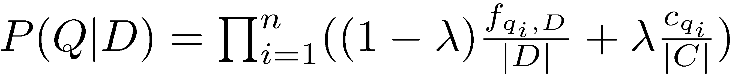
Jelinek-Mercer Smoothing
α_{D} is a constant, λ
Gives estimate of
Ranking score
Use logs for convenience
  accuracy problems multiplying small numbers

Slide 41
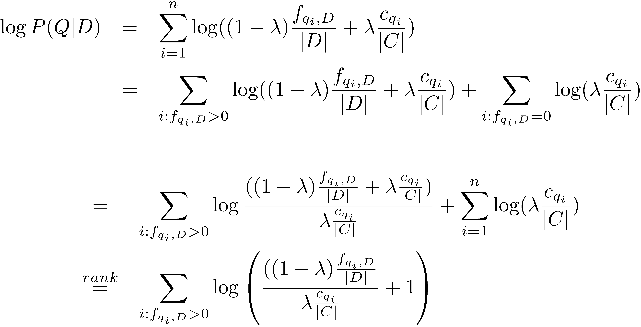
Where is tf.idf Weight?
- proportional to the term frequency, inversely proportional to the collection frequency

Slide 42
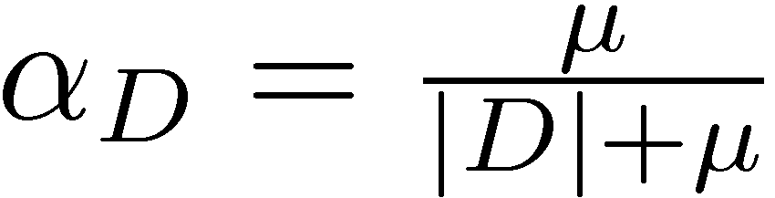
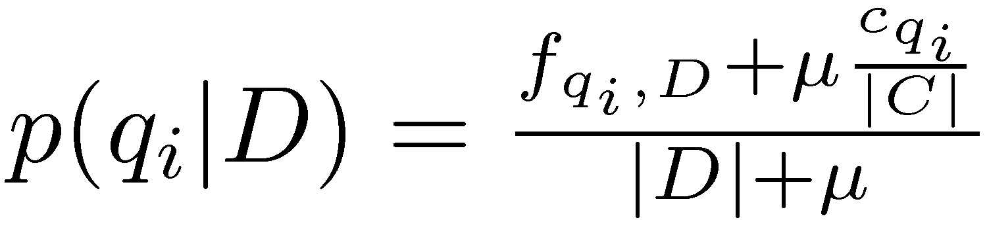
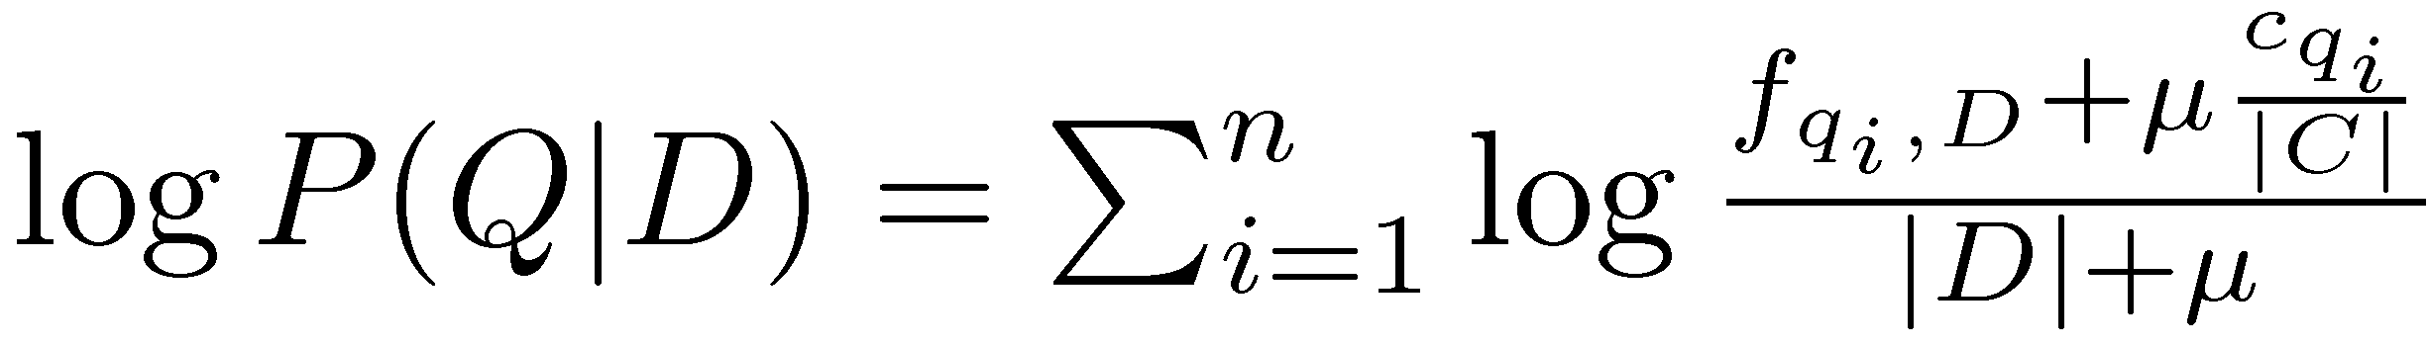
Dirichlet Smoothing
α_{D} depends on document length
Gives probability estimation of
and document score

Slide 43
Query Likelihood Example
For the term “president”
  f_{qi,D} = 15, c_{qi} = 160,000
For the term “lincoln”
  f_{qi,D} = 25, c_{qi} = 2,400
number of word occurrences in the document |d| is assumed to be 1,800
number of word occurrences in the collection is 10⁹
  500,000 documents times an average of 2,000 words
μ = 2,000

Slide 44
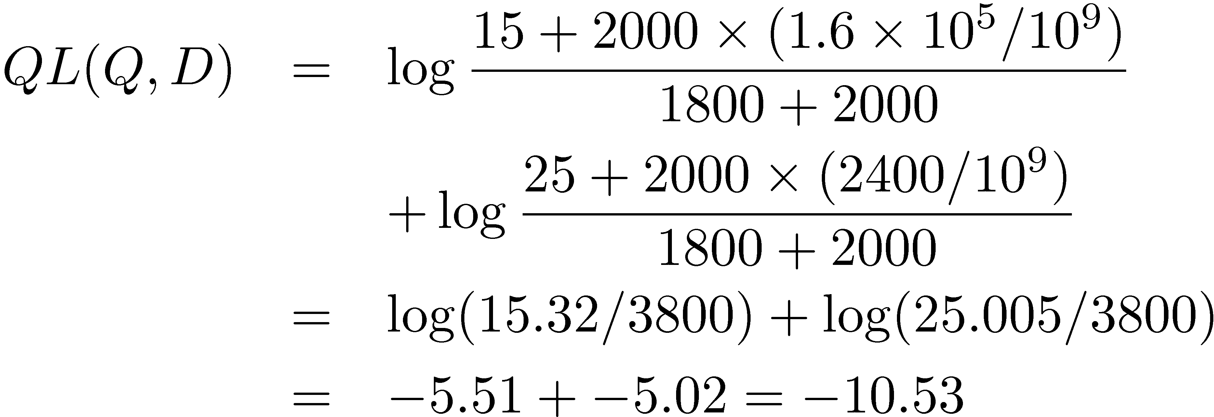
Query Likelihood Example
  Negative number because summing logs of small numbers

Slide 45
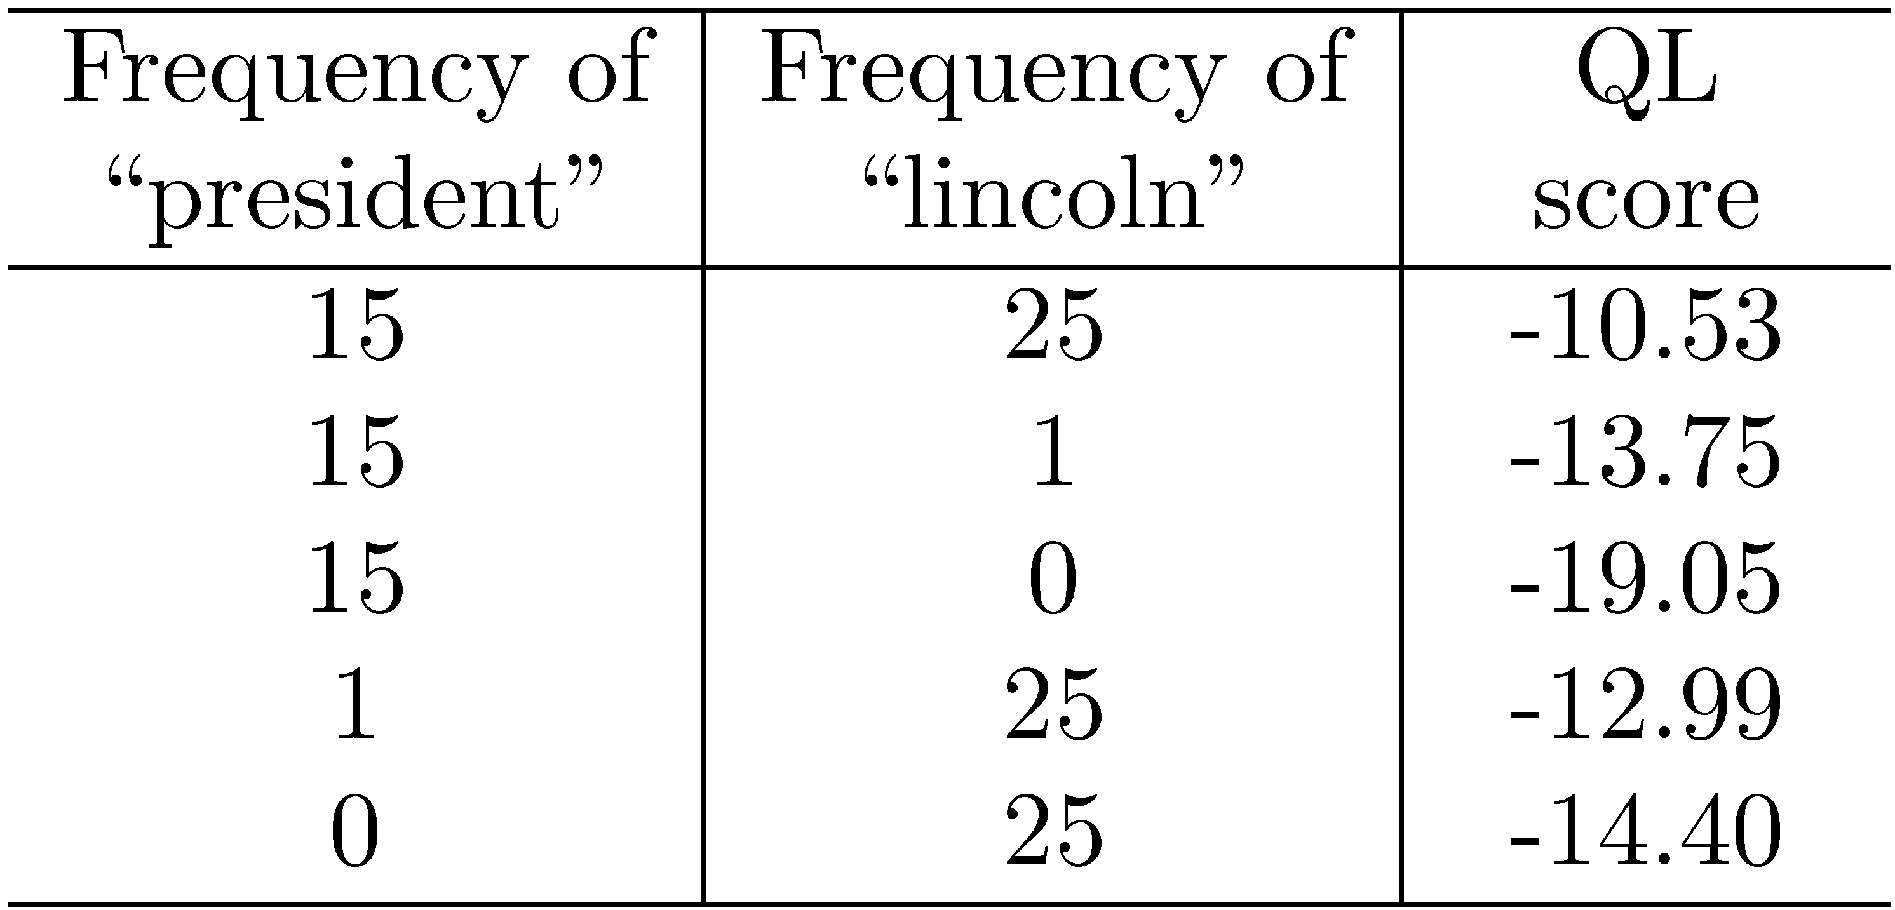
Query Likelihood Example

Slide 46
Relevance Models
Relevance model – language model representing information need
  query and relevant documents are samples from this model
P(D|R) - probability of generating the text in a document given a relevance model
  document likelihood model
  less effective than query likelihood due to difficulties comparing across documents of different lengths

Slide 47
Pseudo-Relevance Feedback
Estimate relevance model from query and top-ranked documents
Rank documents by similarity of document model to relevance model
Kullback-Leibler divergence (KL-divergence) is a well-known measure of the difference between two probability distributions

Slide 48
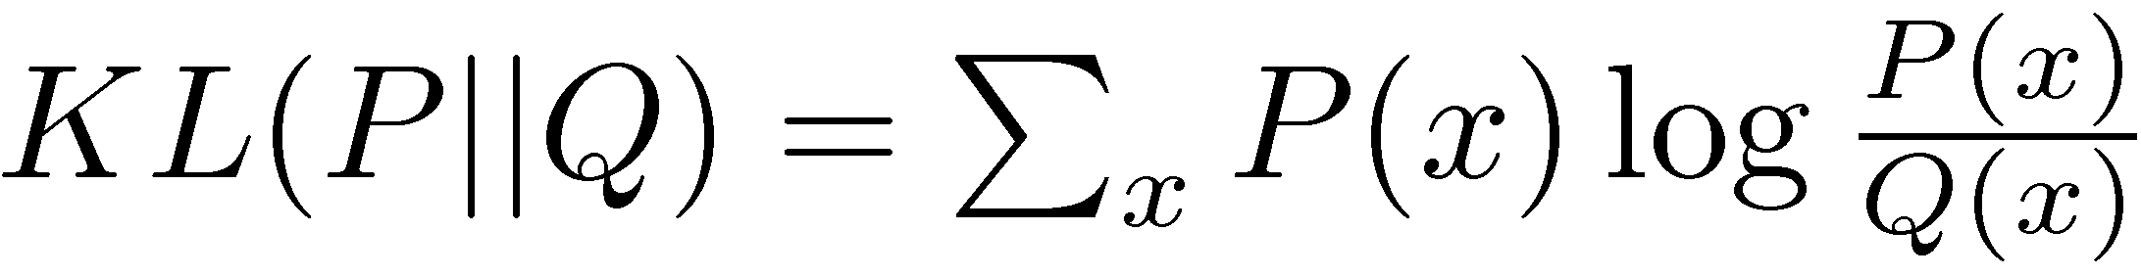
KL-Divergence
Given the true probability distribution P and another distribution Q that is an approximation to P,
  Use negative KL-divergence for ranking, and assume relevance model R is the true distribution (not symmetric),

Slide 49
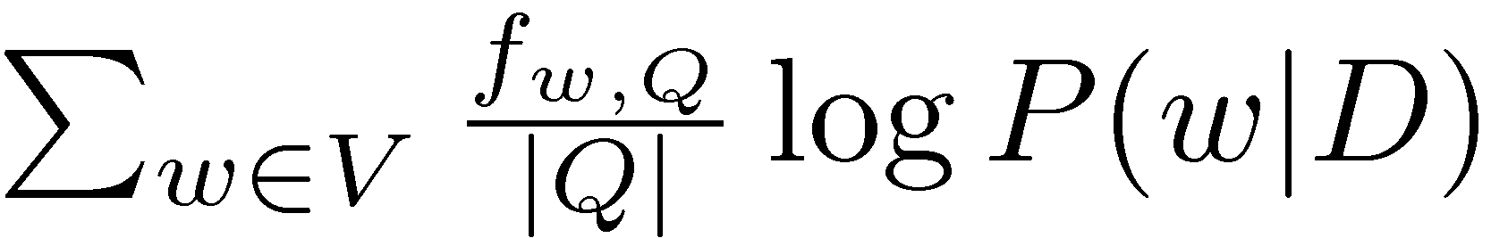
KL-Divergence
Given a simple maximum likelihood estimate for P(w|R), based on the frequency in the query text, ranking score is
  rank-equivalent to query likelihood score
Query likelihood model is a special case of retrieval based on relevance model

Slide 50
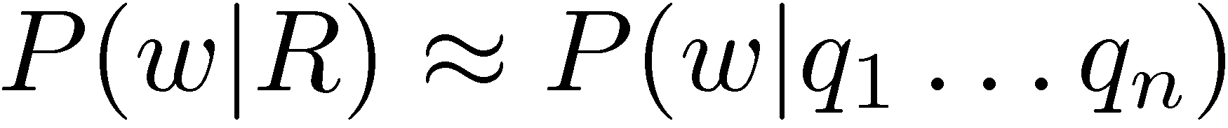
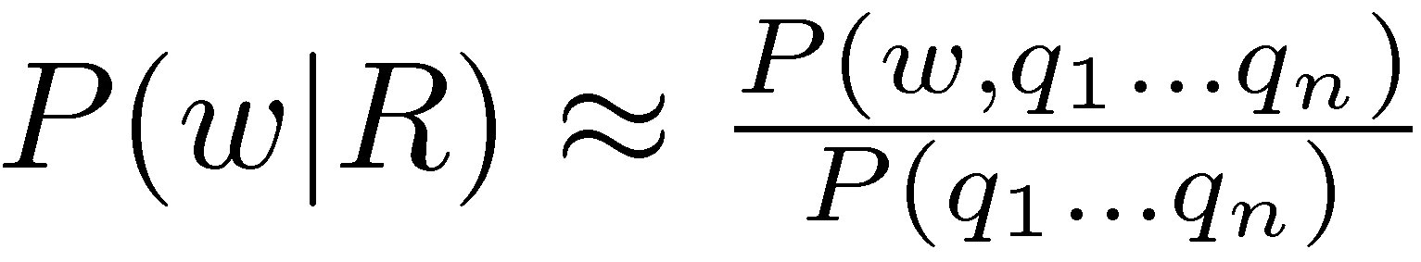
Estimating the Relevance Model
Probability of pulling a word w out of the “bucket” representing the relevance model depends on the n query words we have just pulled out
By definition

Slide 51
Estimating the Relevance Model
Joint probability is
Assume
Gives

Slide 52
Estimating the Relevance Model
P(D) usually assumed to be uniform
P(w, q1 . . . qn) is simply a weighted average of the language model probabilities for w in a set of documents, where the weights are the query likelihood scores for those documents
Formal model for pseudo-relevance feedback
  query expansion technique

Slide 53
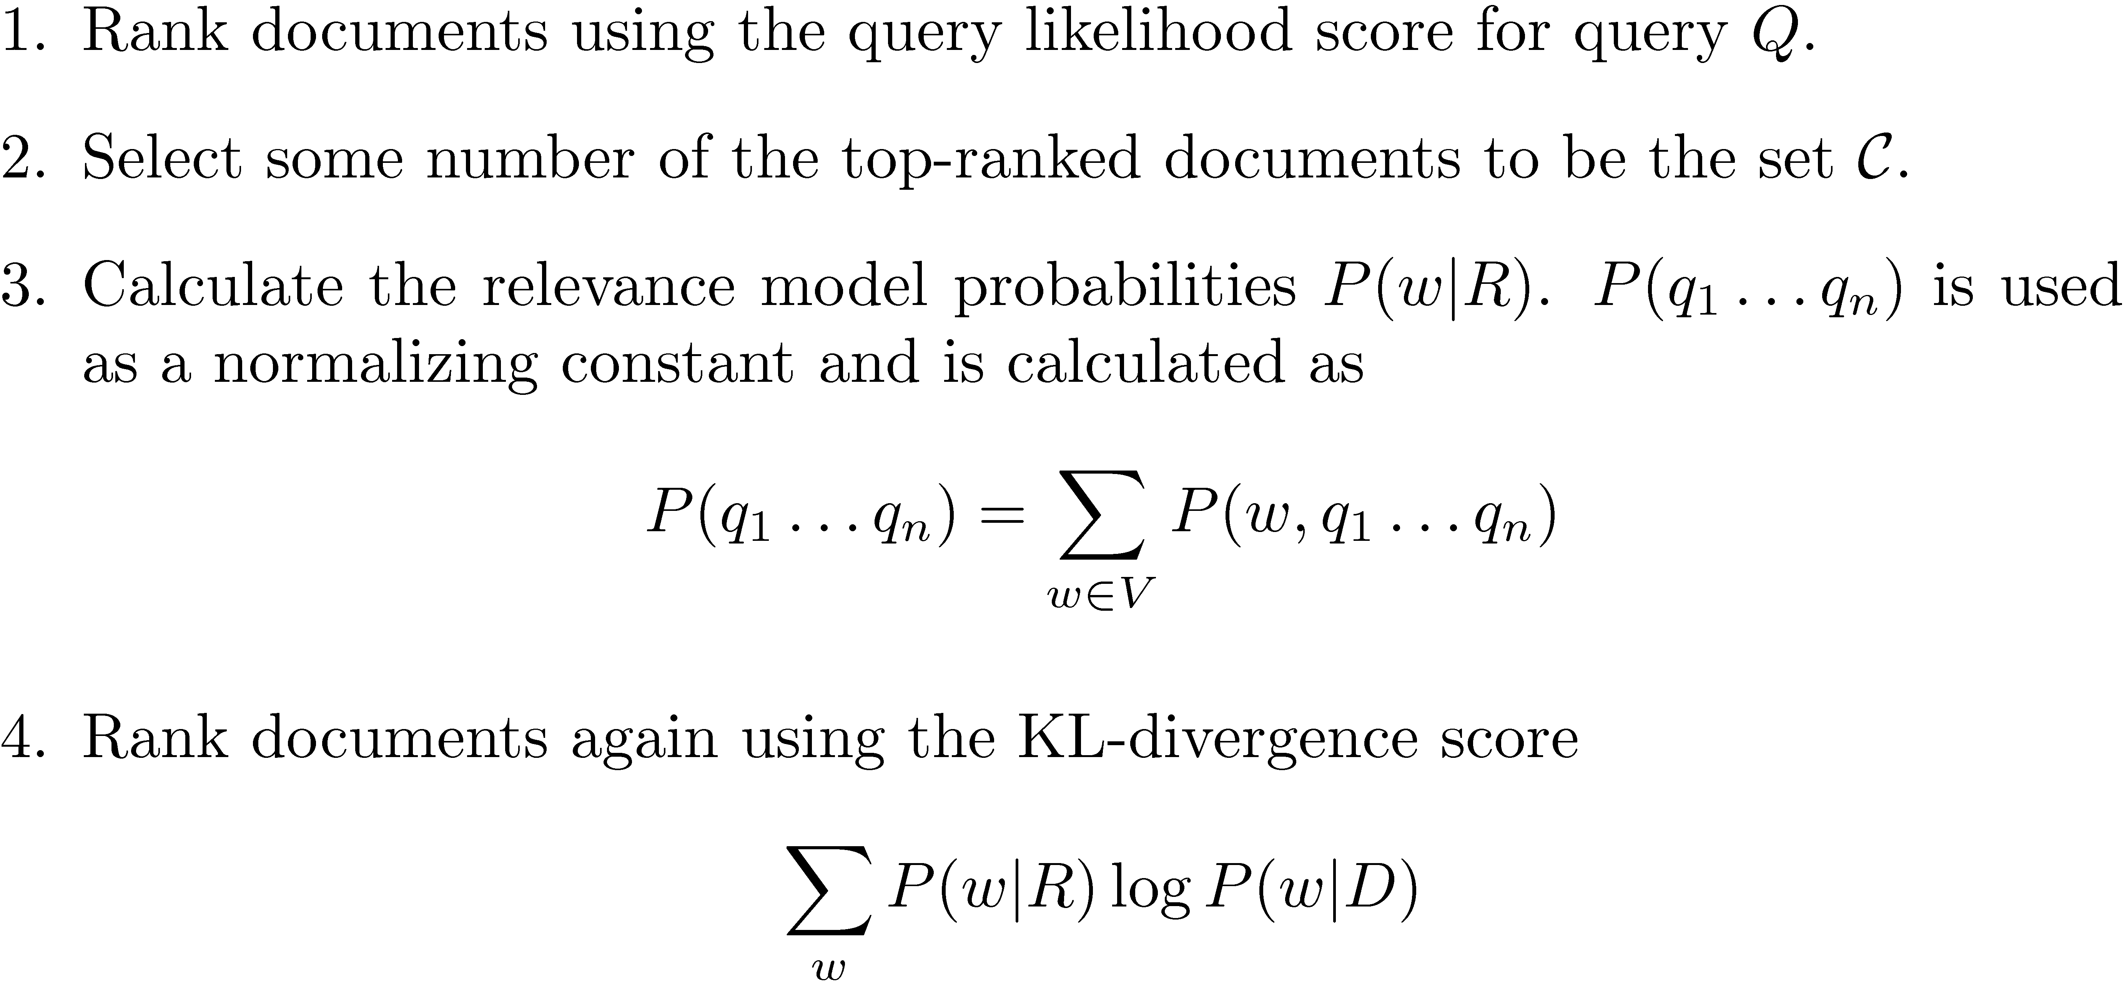
Pseudo-Relevance Feedback Algorithm

Slide 54
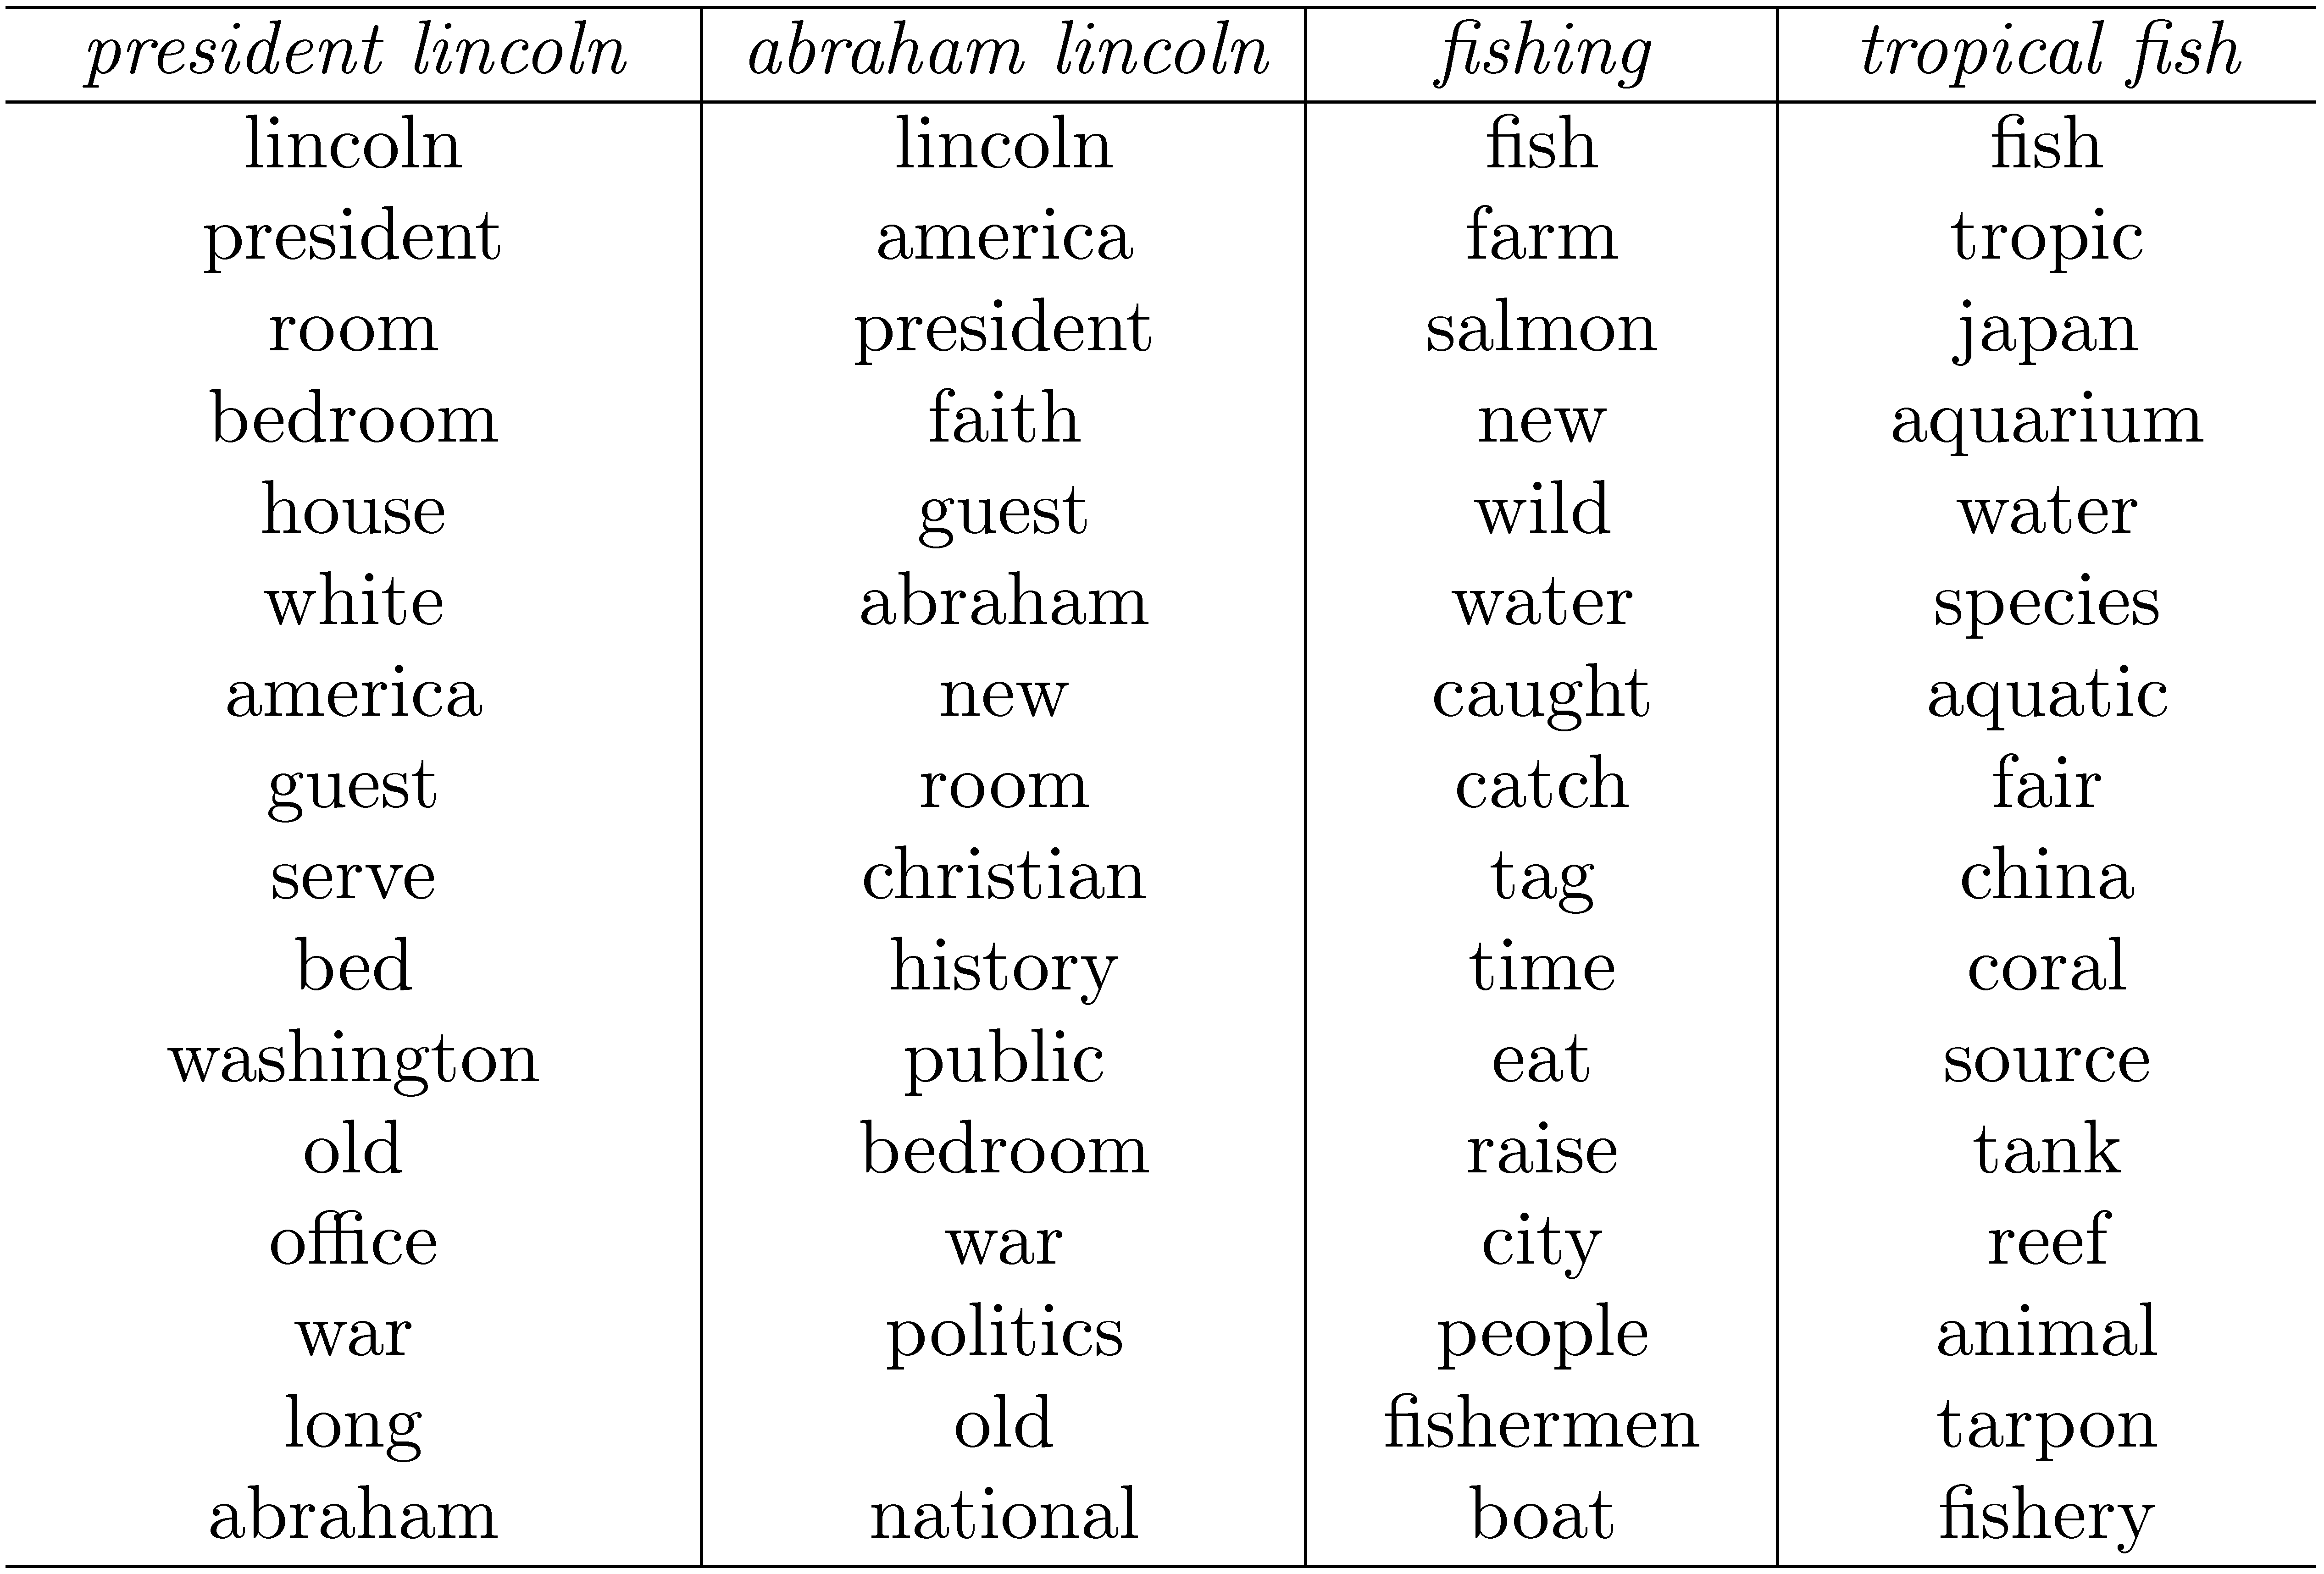
Example from Top 10 Docs

Slide 55
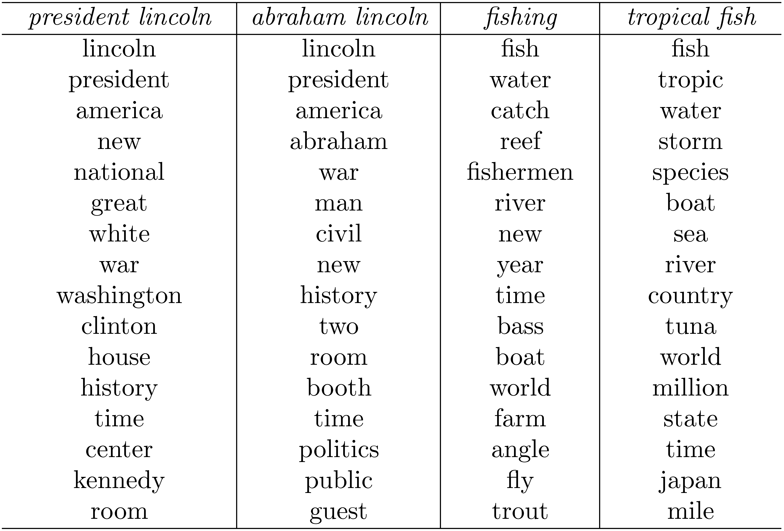
Example from Top 50 Docs

Slide 56
Combining Evidence
Effective retrieval requires the combination of many pieces of evidence about a document’s potential relevance
  have focused on simple word-based evidence
  many other types of evidence
    structure, PageRank, metadata, even scores from different models
Inference network model is one approach to combining evidence
  uses Bayesian network formalism

Slide 57
Inference Network

Slide 58
Inference Network
Document node (D) corresponds to the event that a document is observed
Representation nodes (r_{i}) are document features (evidence)
  Probabilities associated with those features are based on language models θ estimated using the parameters μ
  one language model for each significant document structure
  r_{i} nodes can represent proximity features, or other types of evidence (e.g. date)

Slide 59
Inference Network
Query nodes (q_{i}) are used to combine evidence from representation nodes and other query nodes
  represent the occurrence of more complex evidence and document features
  a number of combination operators are available
Information need node (I) is a special query node that combines all of the evidence from the other query nodes
  network computes P(I|D, μ)

Slide 60
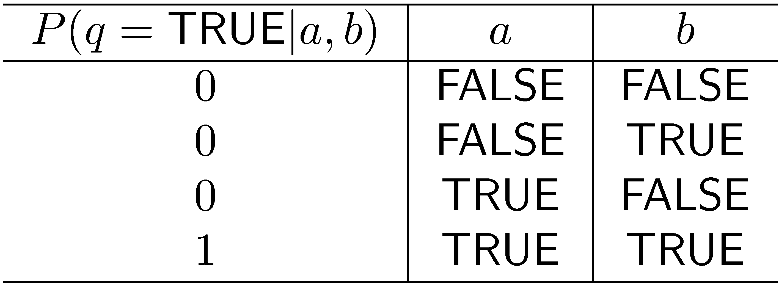
Example: AND Combination
a and b are parent nodes for q

Slide 61
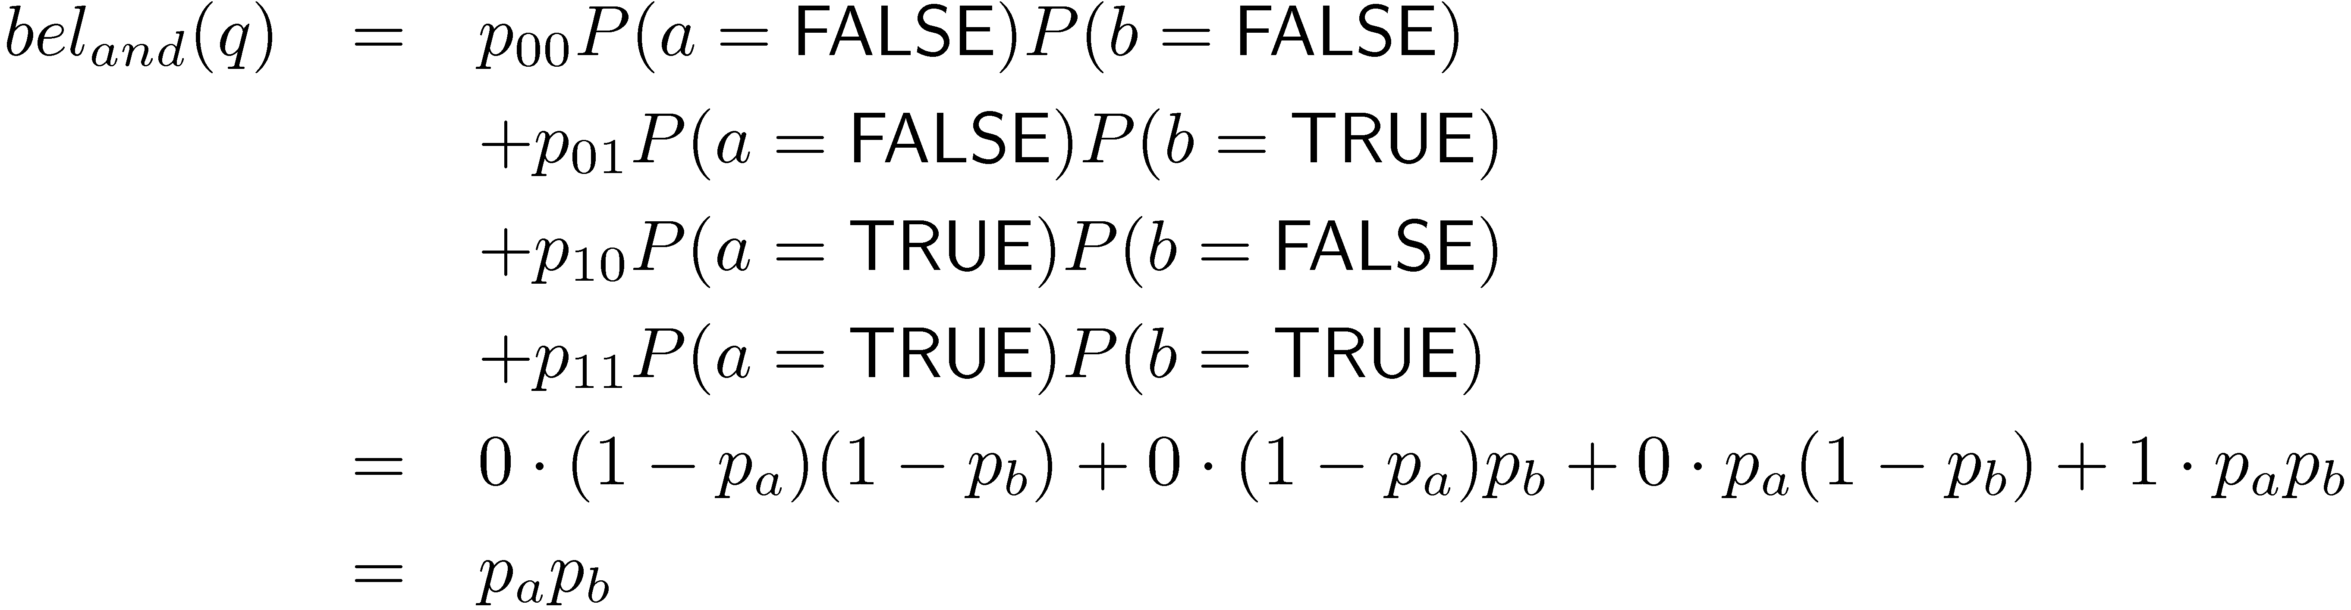
Example: AND Combination
Combination must consider all possible states of parents
Some combinations can be computed efficiently

Slide 62
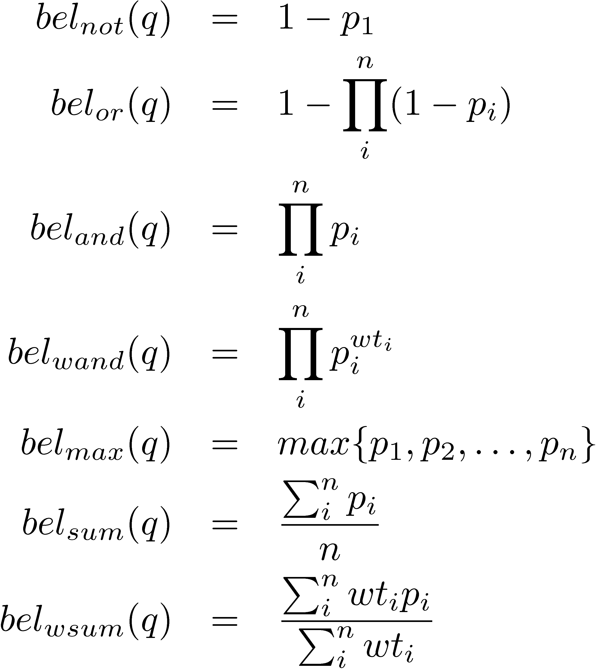
Inference Network Operators

Slide 63
Galago Query Language
A document is viewed as a sequence of text that may contain arbitrary tags
A single context is generated for each unique tag name
An extent is a sequence of text that appears within a single begin/end tag pair of the same type as the context
Similar to Indri, Lemur, other research systems

Slide 64

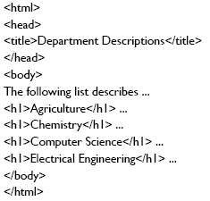


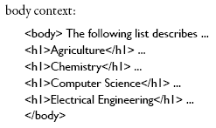
Galago Query Language

Slide 65
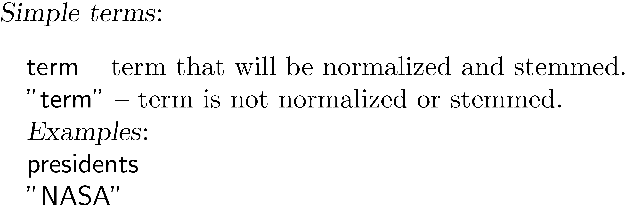
Galago Query Language
TexPoint Display

Slide 66
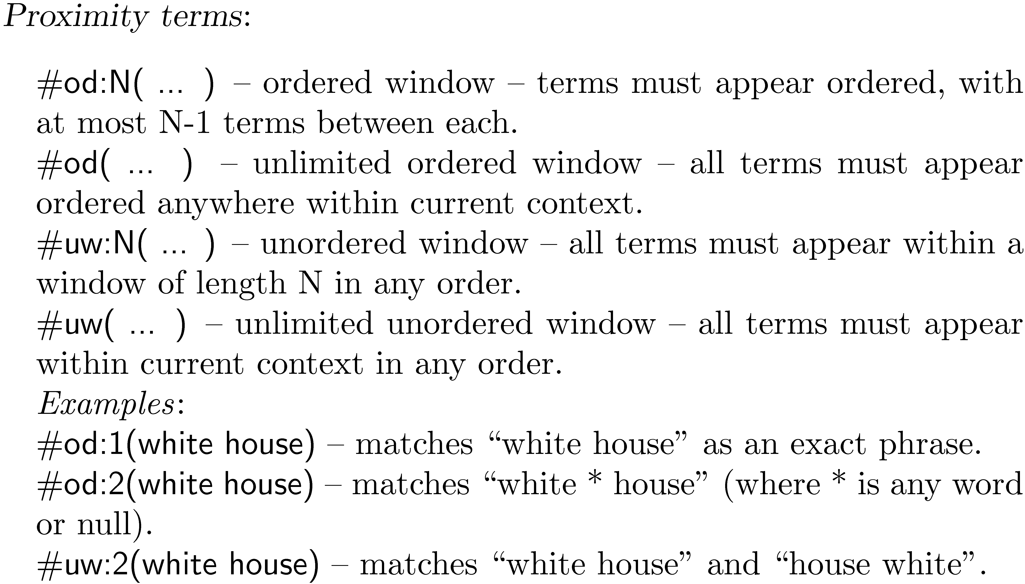
Galago Query Language

Slide 67
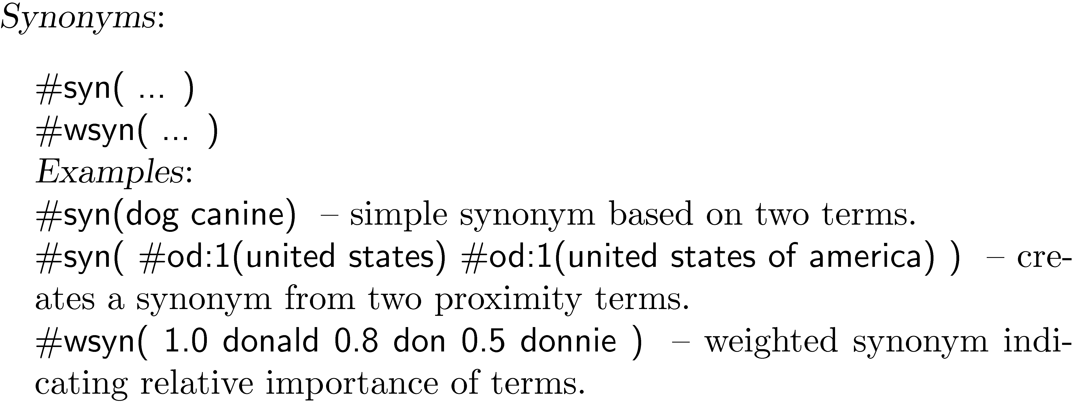
Galago Query Language

Slide 68
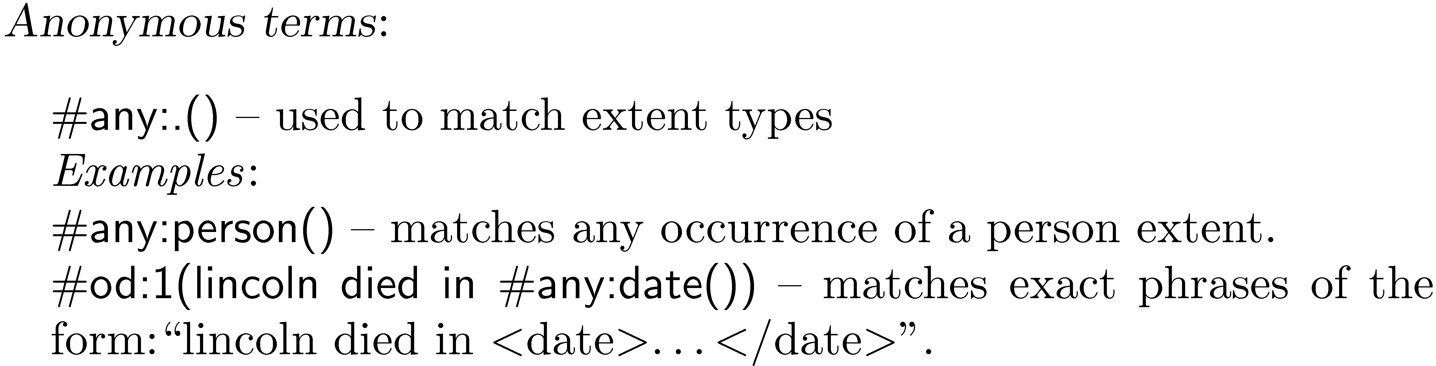
Galago Query Language

Slide 69
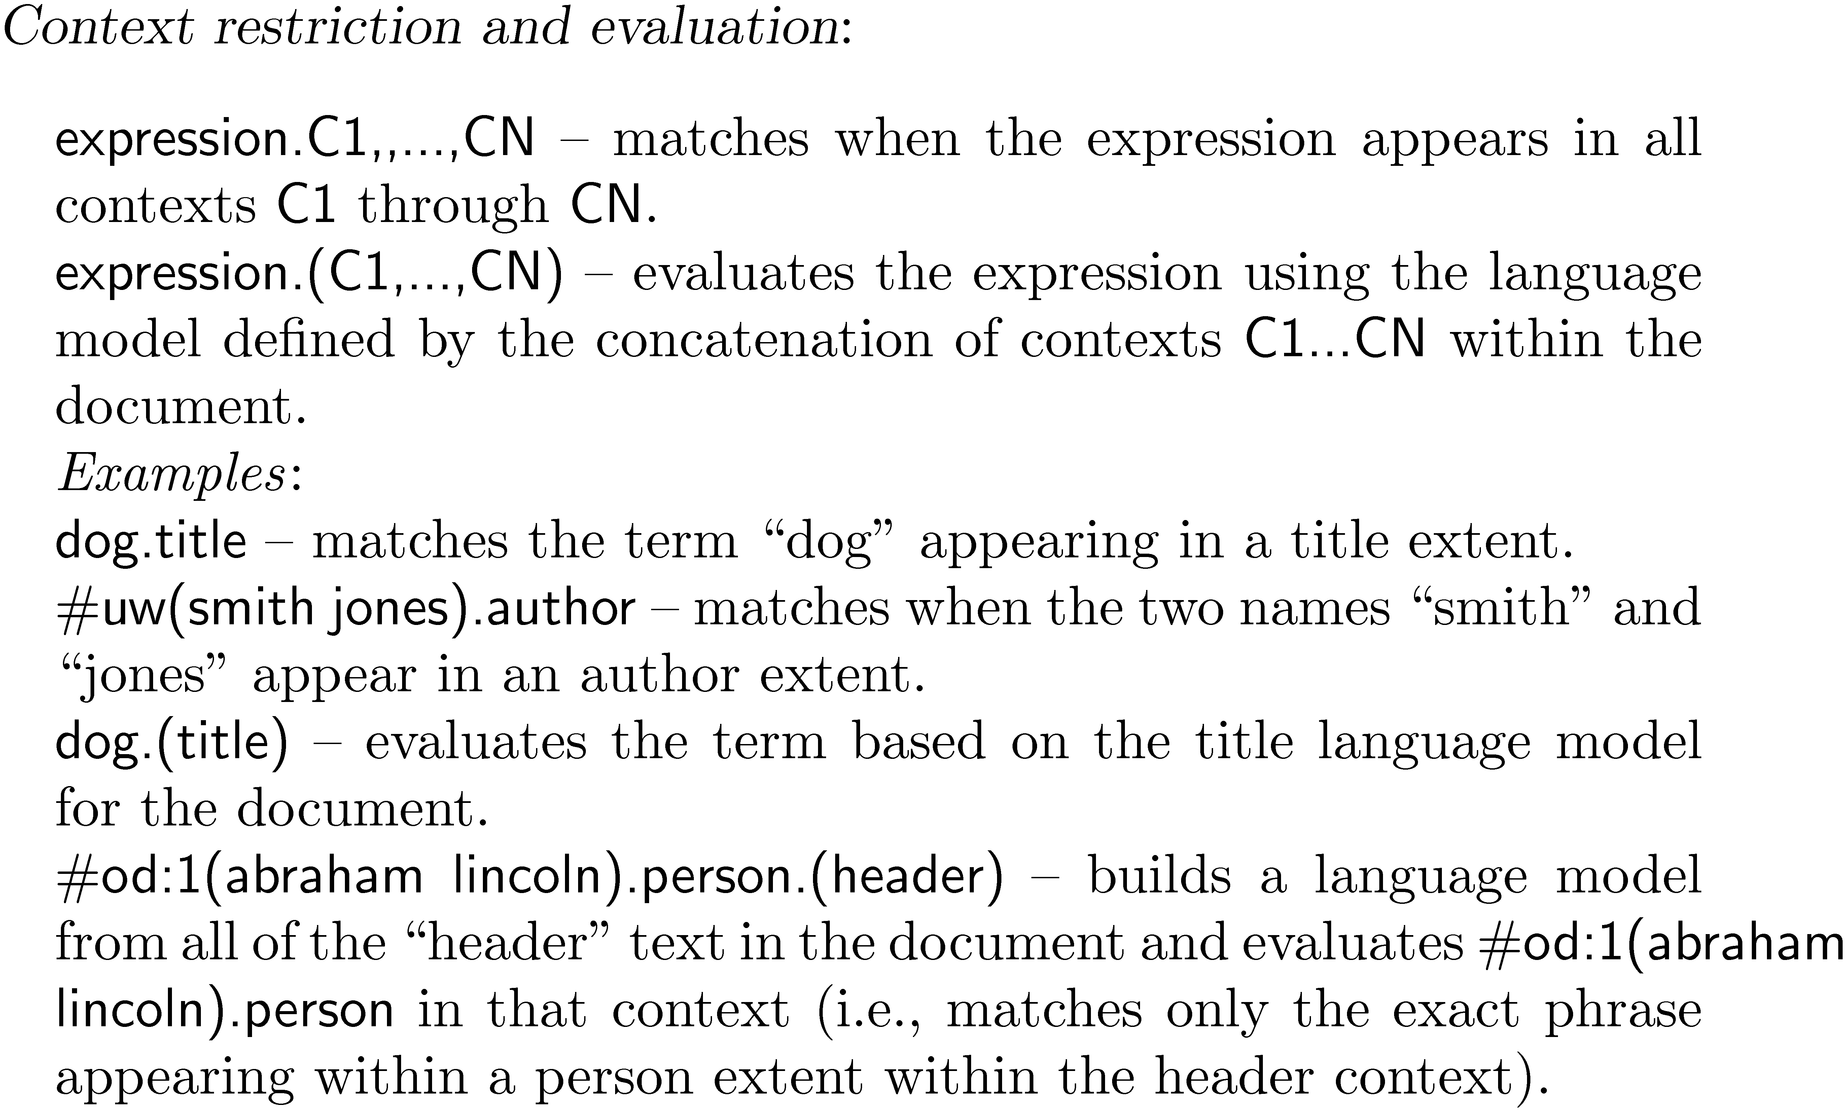
Galago Query Language

Slide 70
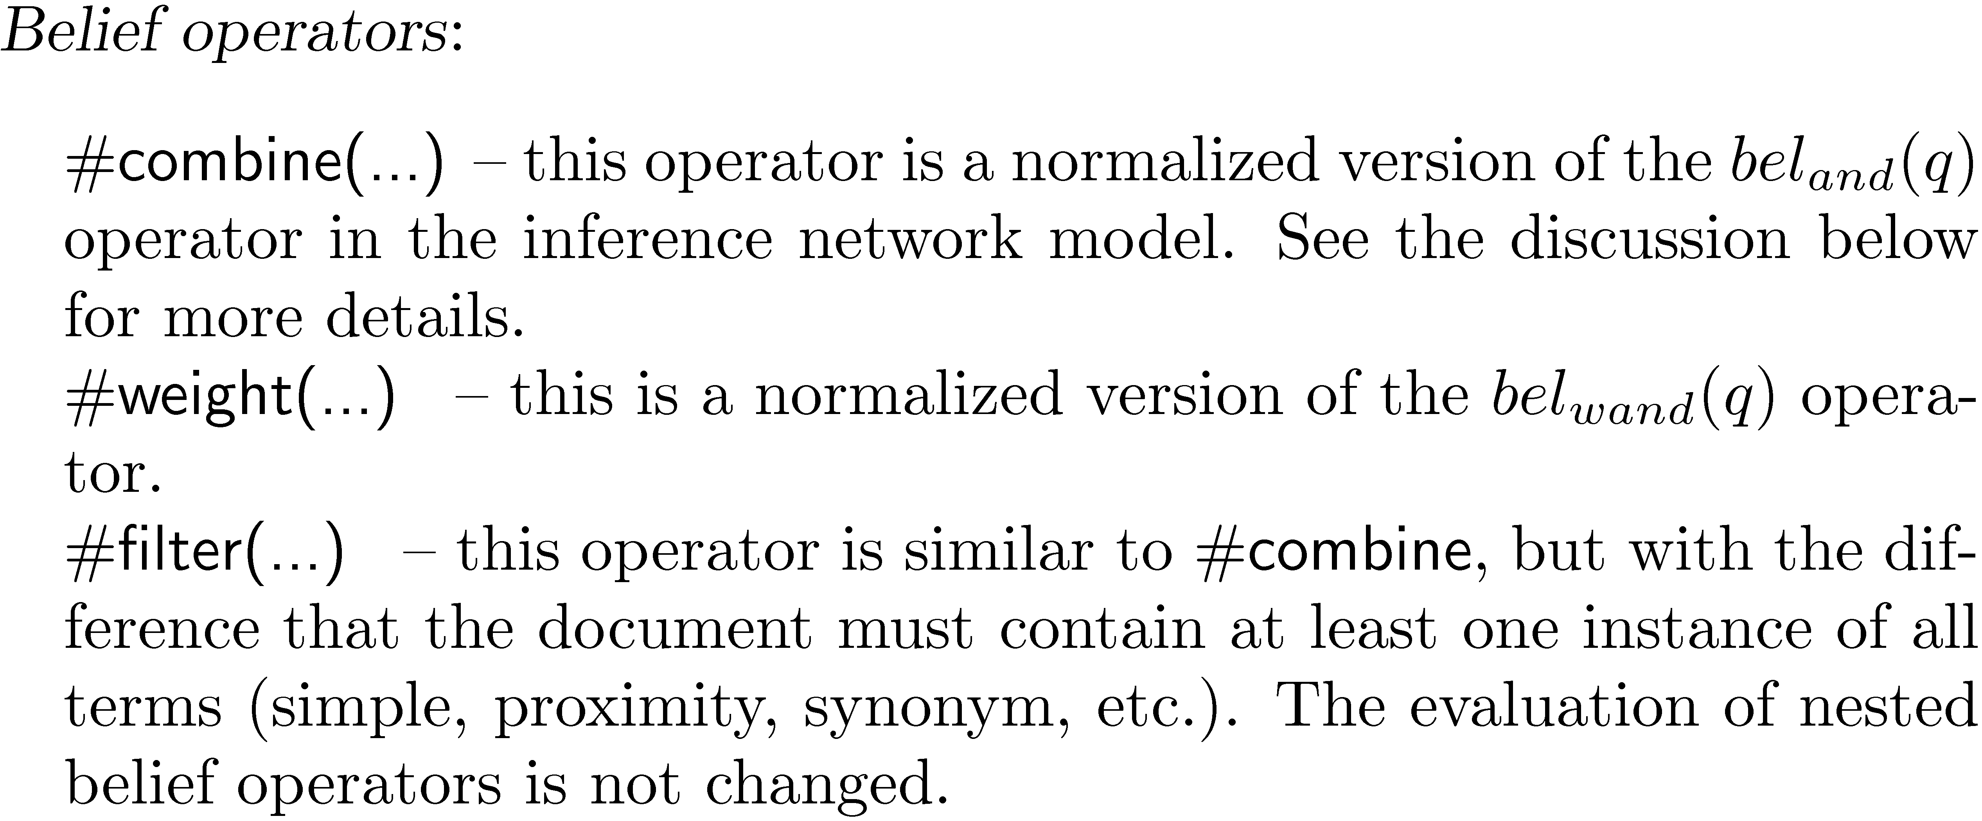
Galago Query Language

Slide 71
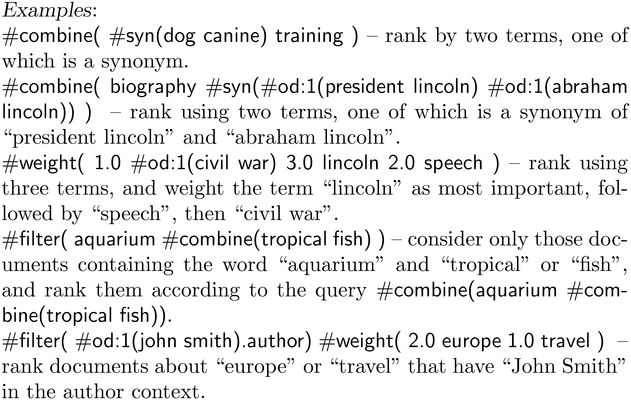
Galago Query Language

Slide 72
Web Search
Most important, but not only, search application
Major differences to TREC news
  Size of collection
  Connections between documents
  Range of document types
  Importance of spam
  Volume of queries
  Range of query types

Slide 73
Search Taxonomy
Informational
  Finding information about some topic which may be on one or more web pages
  Topical search
Navigational
  finding a particular web page that the user has either seen before or is assumed to exist
Transactional
  finding a site where a task such as shopping or downloading music can be performed

Slide 74
Web Search
For effective navigational and transactional search, need to combine features that reflect user relevance
Commercial web search engines combine evidence from hundreds of features to generate a ranking score for a web page
  page content, page metadata, anchor text, links (e.g., PageRank), and user behavior (click logs)
  page metadata – e.g., “age”, how often it is updated, the URL of the page, the domain name of its site, and the amount of text content

Slide 75
Search Engine Optimization
SEO: understanding the relative importance of features used in search and how they can be manipulated to obtain better search rankings for a web page
  e.g., improve the text used in the title tag, improve the text in heading tags, make sure that the domain name and URL contain important keywords, and try to improve the anchor text and link structure
  Some of these techniques are regarded as not appropriate by search engine companies

Slide 76
Web Search
In TREC evaluations, most effective features for navigational search are:
  text in the title, body, and heading (h1, h2, h3, and h4) parts of the document, the anchor text of all links pointing to the document, the PageRank number, and the inlink count
Given size of Web, many pages will contain all query terms
  Ranking algorithm focuses on discriminating between these pages
  Word proximity is important

Slide 77

Term Proximity
Many models have been developed
  N-grams are commonly used in commercial web search
Dependence model based on inference net has been effective in TREC - e.g.

Slide 78

Example Web Query

Slide 79

Term Dependence Models

Slide 80

Term Dependence Models

Slide 81

Term Dependence Models

Slide 82

Term Dependence Models

Slide 83

Syntactic Dependencies

Slide 84

Cross-Language Syntax

Slide 85

Cross-Language Syntax

Slide 86

Alignment Configurations

Slide 87

Quasi-Synchronous Dependence

Slide 88
Machine Learning and IR
Considerable interaction between these fields
  Rocchio algorithm (60s) is a simple learning approach
  80s, 90s: learning ranking algorithms based on user feedback
  2000s: text categorization
Limited by amount of training data
  But unlabeled data to train word embeddings & LMs
Web query logs have generated new wave of research
  e.g., “Learning to Rank”

Slide 89
Machine Learning and IR
Learning representations
  Word embeddings
  Continuous-state language models
Learning end-to-end tasks
  Autoencoding
  Matching
  Predicting
  Generating

Slide 90

Standard Word Representation

Slide 91
Vector Space Model
Query: “tropical fish”
Term | Query
aquarium | 0
bowl | 0
care | 0
fish | 1
freshwater | 0
goldfish | 0
homepage | 0
keep | 0
setup | 0
tank | 0
tropical | 1

Slide 92

Distributional Similarity

Slide 93

Hard/Soft Clustering

Slide 94

Distributed Representation

Slide 95
Visualizing Embeddings

Slide 96


Word2vec (Mikolov et al. 2013)
Continuous bag of words
Skip-gram
To optimize

Slide 97

Vector Semantics

Slide 98

Vector Semantics

Slide 99

Some Advantages

Slide 100
Topic Models
Improved representations of documents
  can also be viewed as improved smoothing techniques
  improve estimates for words that are related to the topic(s) of the document
    instead of just using background probabilities
Approaches
  Heuristic
    Latent Semantic Indexing (LSI)
  Probabilistic and Generative
    Probabilistic Latent Semantic Indexing (pLSI)
    Latent Dirichlet Allocation (LDA)

Slide 101
Vector Space Model
LSI performs SVD on this matrix
LDA slightly more complicated
Notes:
Q: What characteristics of the documents are lost in this matrix representation?
Q: Is it a good idea to use this matrix structure for indexing the documents?

Slide 102




Text Reuse

Slide 103


Topical Similarity

Slide 104
Parallel Bitext
Genehmigung des Protokolls
Das Protokoll der Sitzung vom Donnerstag, den 28. März 1996 wurde verteilt.
Gibt es Einwände?
Die Punkte 3 und 4 widersprechen sich jetzt, obwohl es bei der Abstimmung anders aussah.
Das muß ich erst einmal klären, Frau Oomen-Ruijten.
Approval of the minutes
The minutes of the sitting of Thursday, 28 March 1996 have been distributed.
Are there any comments?
Points 3 and 4 now contradict one another whereas the voting showed otherwise.
I will have to look into that, Mrs Oomen-Ruijten.
Koehn (2005): European Parliament corpus

Slide 105


Multilingual Topical Similarity

Slide 106
What Representation?
Bag of words, n-grams, etc.?
  Vocabulary mismatch within language:
    Jobless vs. unemployed
  What about between languages?
    Translate everything into English?
Represent documents/passages as probability distributions over hidden “topics”

Slide 107
Modeling Text with Topics
Latent Dirichlet Allocation (Blei, Ng, Jordan 2003)
Let the text talk about T topics
Each topic is a probability dist’n over all words
For D documents each with ND words:
D
N
Τ
θ
z
w
β
Prior
Prior
80% economy
20% pres. elect.
economy
“jobs”

Slide 108

Top Words by Topic
Topics →
1
2
3
4
5
6
7
8
Griffiths et al.

Slide 109

Top Words by Topic
Topics →
1
2
3
4
5
6
7
8
Griffiths et al.

Slide 110


Modeling Text with Topics
Latent Dirichlet Allocation (Blei, Ng, Jordan 2003)
D
N
Τ
θ
z
w
β
Prior
Prior
Multiple languages?

Slide 111

LDA
Model document as being generated from a mixture of topics

Slide 112

LDA
Gives language model probabilities
Used to smooth the document representation by mixing them with the query likelihood probability as follows:

Slide 113
LDA
If the LDA probabilities are used directly as the document representation, the effectiveness will be significantly reduced because the features are too smoothed
  e.g., in typical TREC experiment, only 400 topics used for the entire collection
  generating LDA topics is expensive
When used for smoothing, effectiveness is improved

Slide 114

LDA Example
  Top words from 4 LDA topics from TREC news

Slide 115
Generative vs. Discriminative
All of the probabilistic retrieval models presented so far fall into the category of generative models
  A generative model assumes that documents were generated from some underlying model (in this case, usually a multinomial) and uses training data to estimate the parameters of the model
  probability of belonging to a class (i.e. the relevant documents for a query) is then estimated using Bayes’ Rule and the document model

Slide 116
Generative vs. Discriminative
A discriminative model estimates the probability of belonging to a class directly from the observed features of the document based on the training data
Generative models perform well with low numbers of training examples
Discriminative models usually have the advantage given enough training data
  Can also easily incorporate many features

Slide 117
Discriminative Models for IR
Discriminative models can be trained using explicit relevance judgments or click data in query logs
Large class of algorithms called learning to rank
  Learns weights on a linear (or non-linear) combination of features that is used to rank documents
  Best weights optimize a performance metric

Slide 118
Ranking SVM
Training data is
  r is partial rank information
    if document da should be ranked higher than db, then (da, db) ∈ ri
  partial rank information comes from relevance judgments (allows multiple levels of relevance) or click data
    e.g., d1, d2 and d3 are the documents in the first, second and third rank of the search output, only d3 clicked on → (d3, d1) and (d3, d2) will be in desired ranking for this query

Slide 119

Ranking SVM
Learning a linear ranking function
  where w is a weight vector that is adjusted by learning
  d_{a} is the vector representation of the features of document
  non-linear functions also possible
Weights represent importance of features
  learned using training data
  e.g.,

Slide 120

Ranking SVM
Learn w that satisfies as many of the following conditions as possible:
Can be formulated as an optimization problem

Slide 121

Ranking SVM
  ξ, known as a slack variable, allows for misclassification of difficult or noisy training examples, and C is a parameter that is used to prevent overfitting

Slide 122


Ranking SVM
Software available to do the optimization
Each pair of documents in our training data can be represented by the vector:
Score for this pair is:
SVM classifier will find a w that makes the smallest score as large as possible
  make the differences in scores as large as possible for the pairs of documents that are hardest to rank

Slide 123



Document Similarity in Large Collections
All-pairs comparison is practically infeasible
  For N documents -$O\left(N^{2}\right)$
  In case of a query set of k documents -$O(kN)$, even with an inverted index
Solution for metric space
  Frame document similarity as a nearest-neighbor (NN) search problem
  Commonly used approximate NN search approaches:
    Locality Sensitive Hashing (LSH)
    k-d trees
    Designed to handle distance metrics - Euclidean, Cosine, etc.
What about probability distributions?
  $Hellinger\left(p,q\right)=\sum_{i=1}^{n}{{\left(\sqrt{p\left(x_{i}\right)}−\sqrt{q\left(x_{i}\right)}\right)}^{2}}$
But do we have to work on the dense representations?
Locality Sensitive Hashing (LSH)
k-d trees
Notes:
Regardless of the comparison type the actual time complexity of the comparison grows as the collection grows and it gets to a point where its practically infeasible to perform for very large collections.
Now, in the past this issue has been addressed for the metric space by framing the problem as a nearest-neighbor search problem.
And as such approximate nearest neighbor search techniques have been used in the past.
The original LSH and k-d trees approaches to the nearest-neighbor problem were introduced in the Euclidean space
Now for the probability simplex we cannot apply these efficient NN search techniques directly because they were designed to handle distance metrics.
Our contribution is about doing efficient NN search for large collections in the probability simplex.
Additional:
For example Locality Sensitive Hashing (Radius R, probability of success 1-delta=0.9)
LSH construct a data structure which, given any query point q, reports each R-near neighbor of q in P with probability 1 − δ.
Or k-d trees (default parameter –error bound =0.0):
Given a set of n points in a d-dimensional space, the kd-tree is constructed recursively as follows. First, one finds a median of the values of the ith coordinates of the points (initially, i = 1).
The resulting data structure is a binary tree with n leaves, and depth log n. In particular, for d = 1, we get a (standard) balanced binary search tree. Since a median of n coordinates can be found in O(n) time, the whole data structure can be constructed in time O(n log n).

Slide 124

Learning for Ranking & Sparsity
Embeddings and topic models not optimized for IR
Searching dense vector spaces is slow
∴ Jointly optimize ranking & sparsity of embedding
Zamani et al., CIKM 2018

Slide 125

Learning for Ranking & Sparsity
Minimize hinge loss (cf. SVM)
L₁ regularization minimizes non-zero components (cf. L₂ SVM)
Zamani et al., CIKM 2018

Slide 126




Learning for Ranking & Sparsity
Train to match QL model (or query logs)
Dot-product scoring function
Rocchio (pseudo-) relevance feedback
Zamani et al., CIKM 2018

Slide 127

Learning for Ranking & Sparsity
Model | Robust 04 MAP
Query Likelihood | 24.99
Sequential Depend. Mod. | 25.24
Relevance Model | 28.65
QL+CBOW reranker | 28.15
QL+CNN reranker | 28.01
Sparse neural ranking model | 28.56
SNRM+PRF | 29.71
Zamani et al., CIKM 2018

Slide 128
Summary
Best retrieval model depends on application and data available
Evaluation corpus (or test collection), training data, and user data are all critical resources
Modeling term dependence (e.g., SDM) can improve precision
Inferring latent representations from text can improve recall (though less often precision), even weak labels are better than none

