Slide 1
CS6200/IS4200
Information Retrieval
David Smith
Khoury College of Computer Sciences
Northeastern University

Slide 2
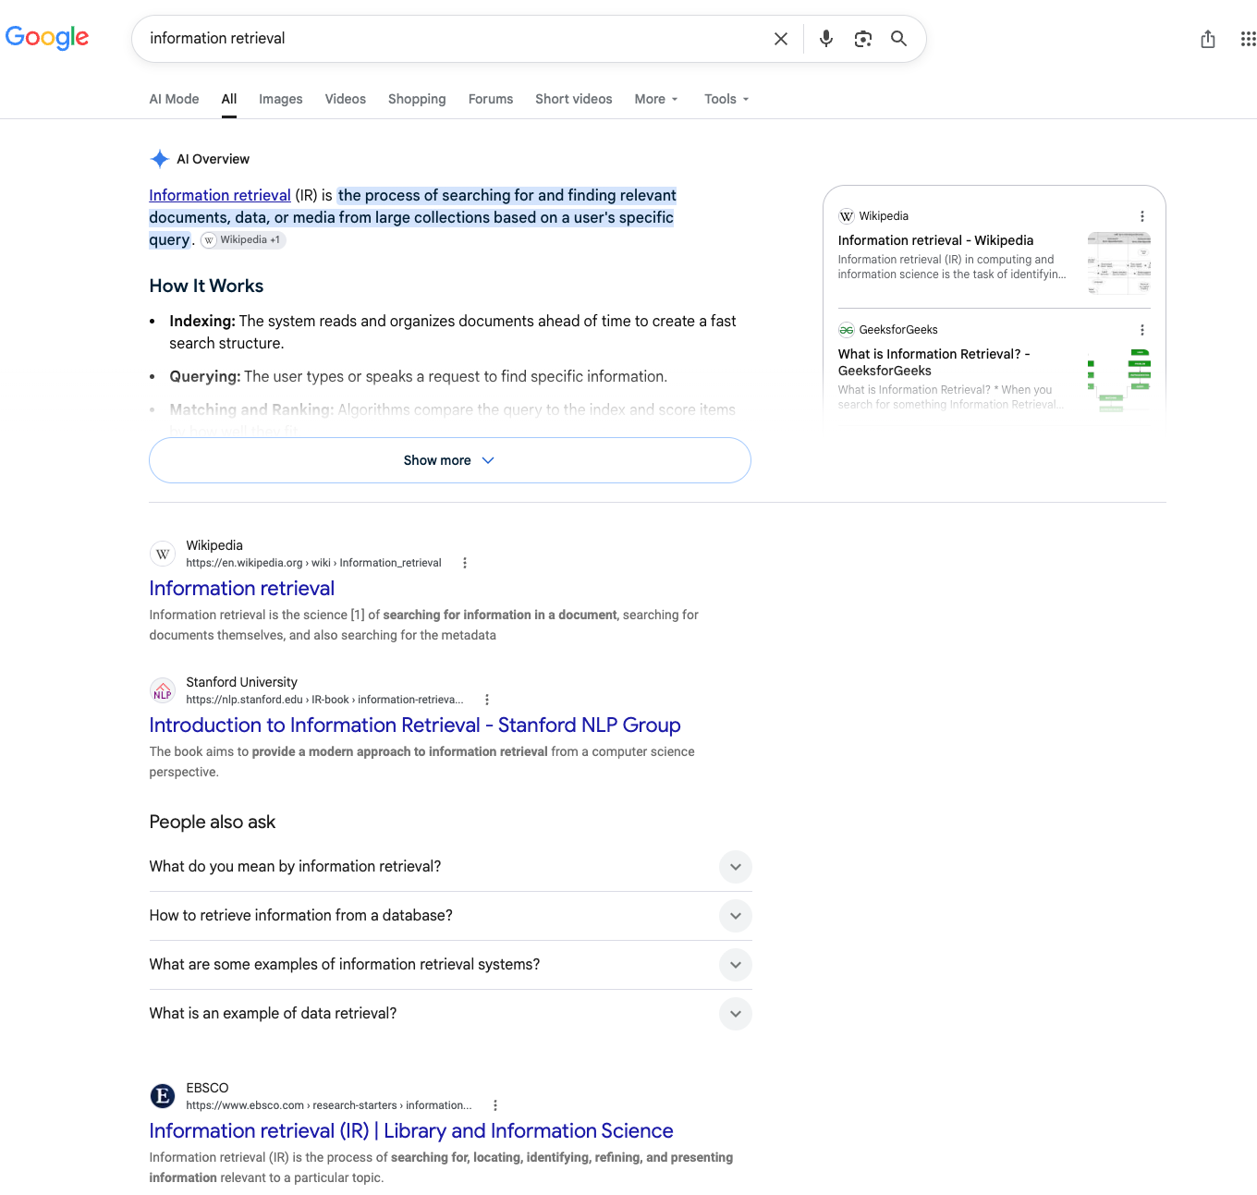

Slide 3
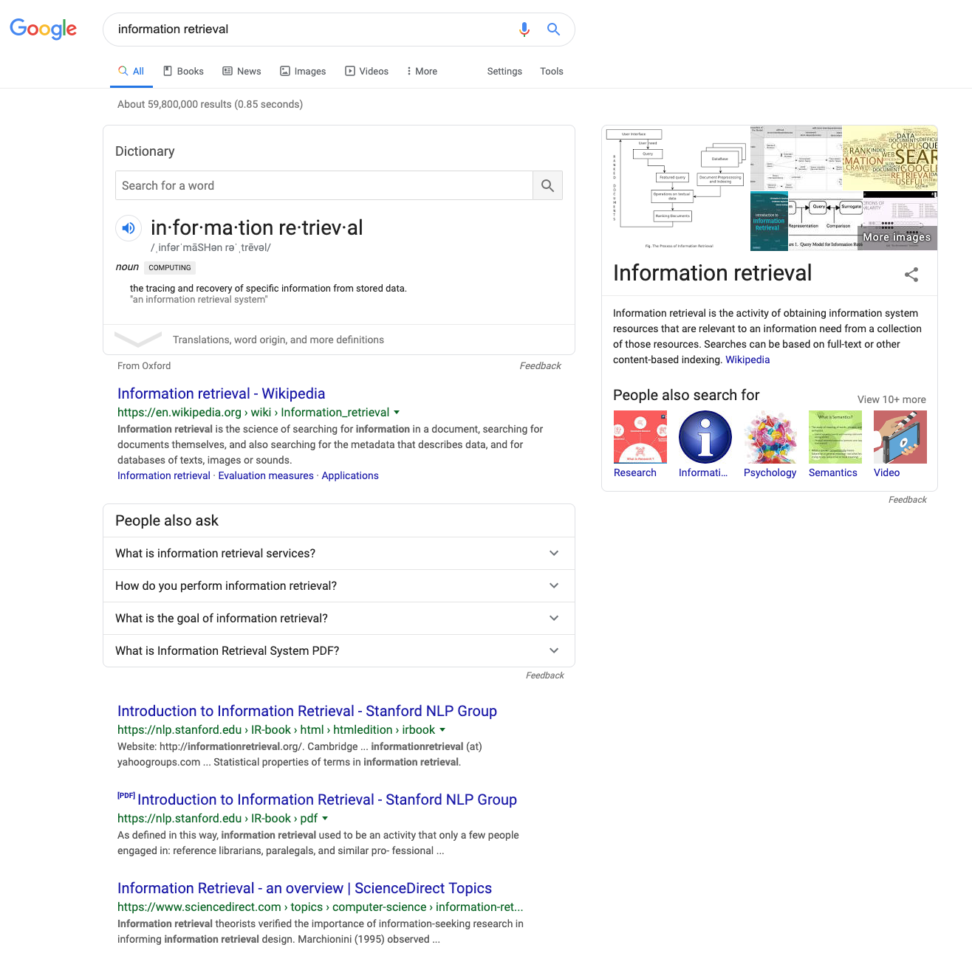

Slide 4
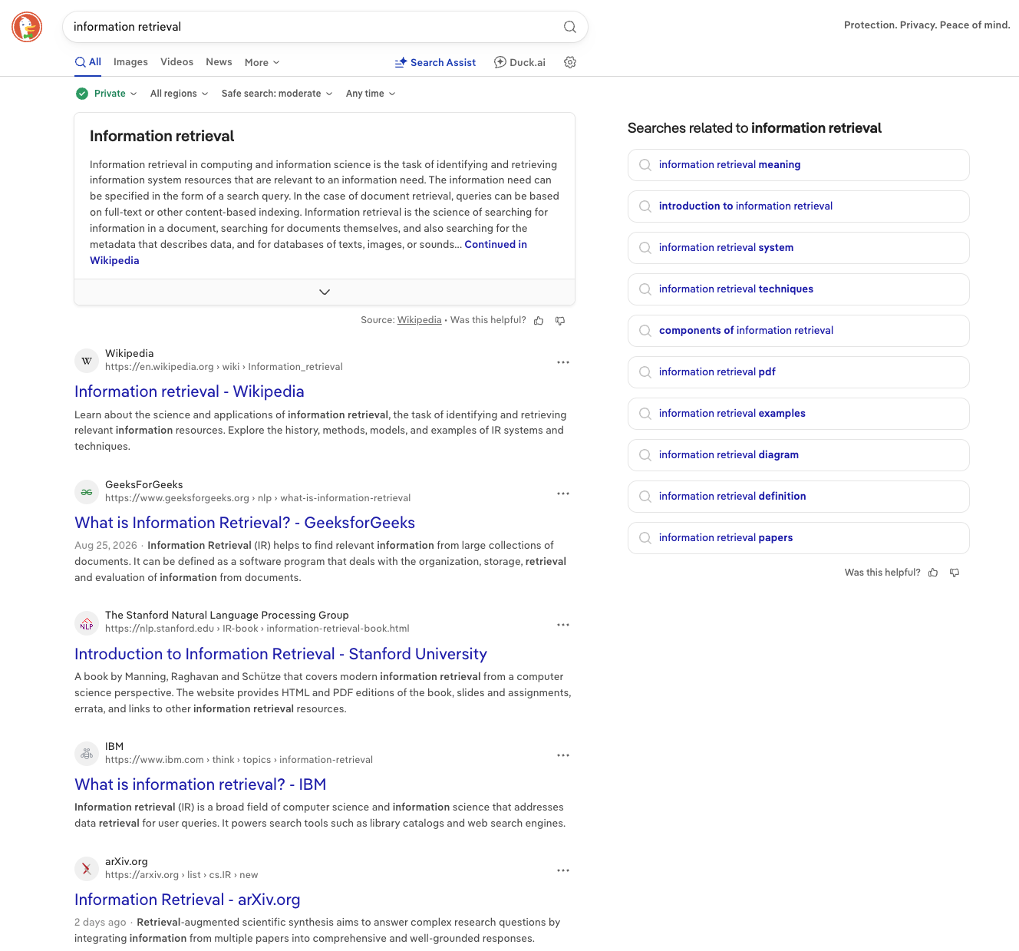

Slide 5
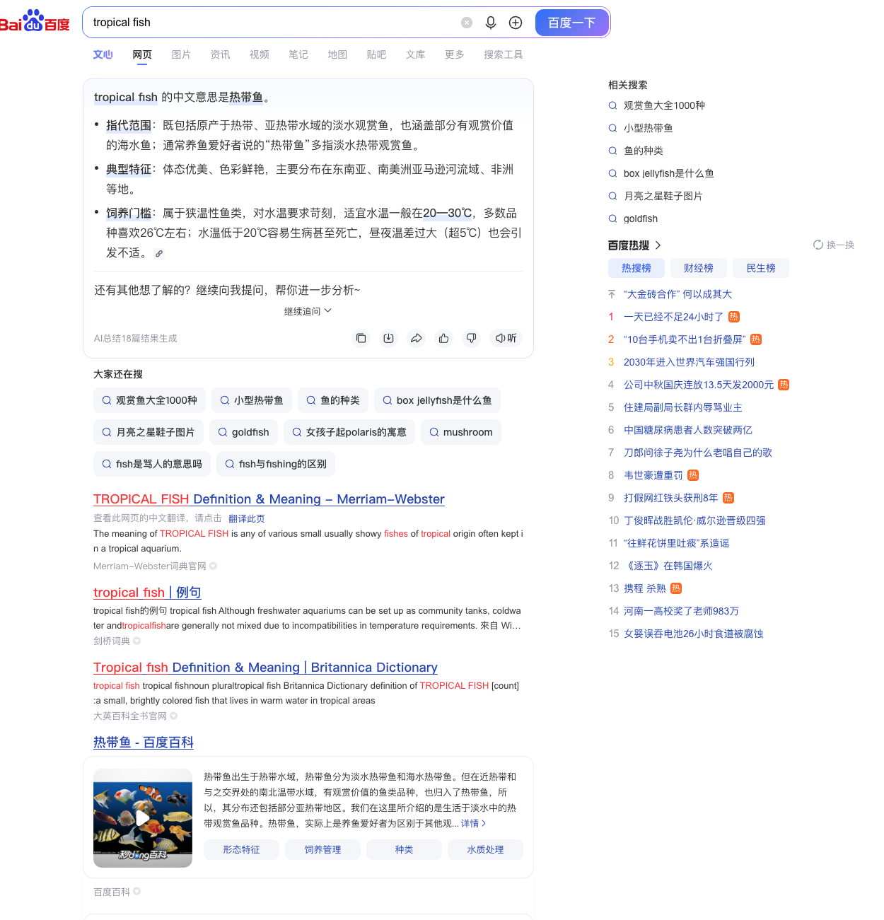

Slide 6
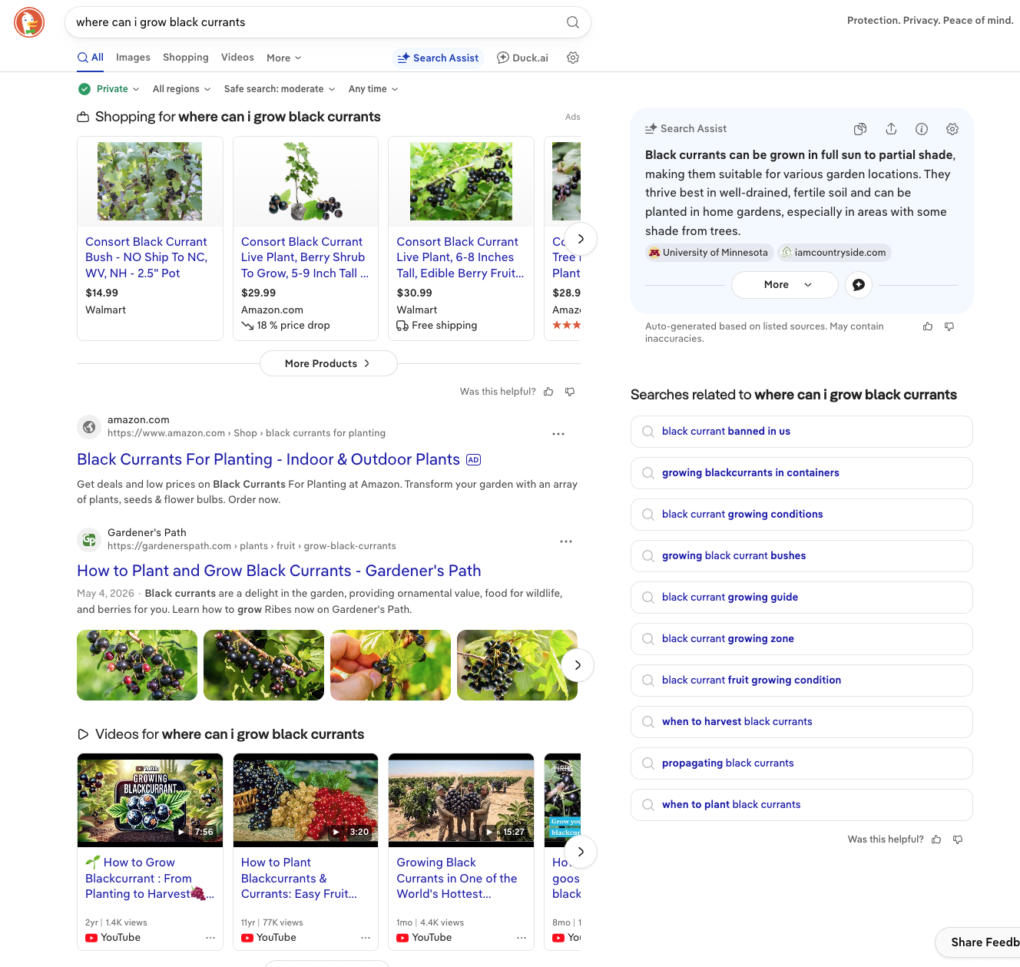

Slide 7


Slide 8
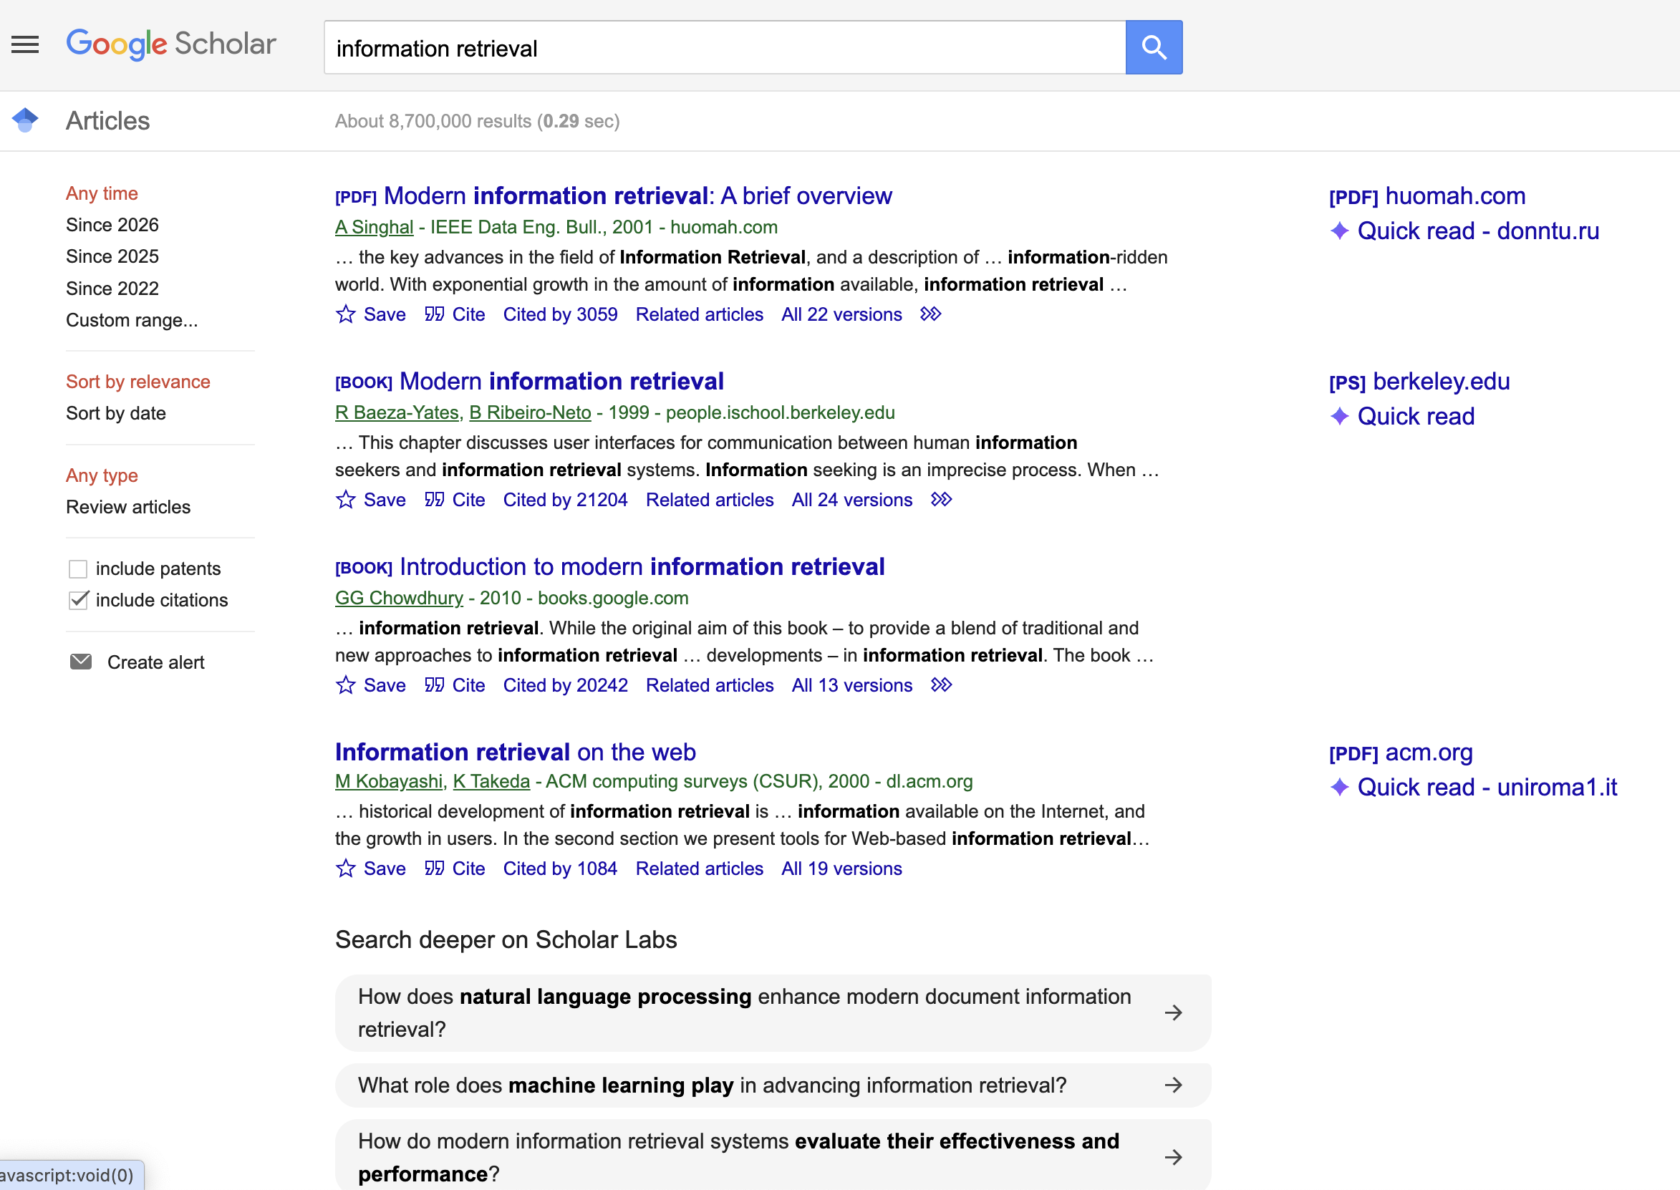

Slide 9
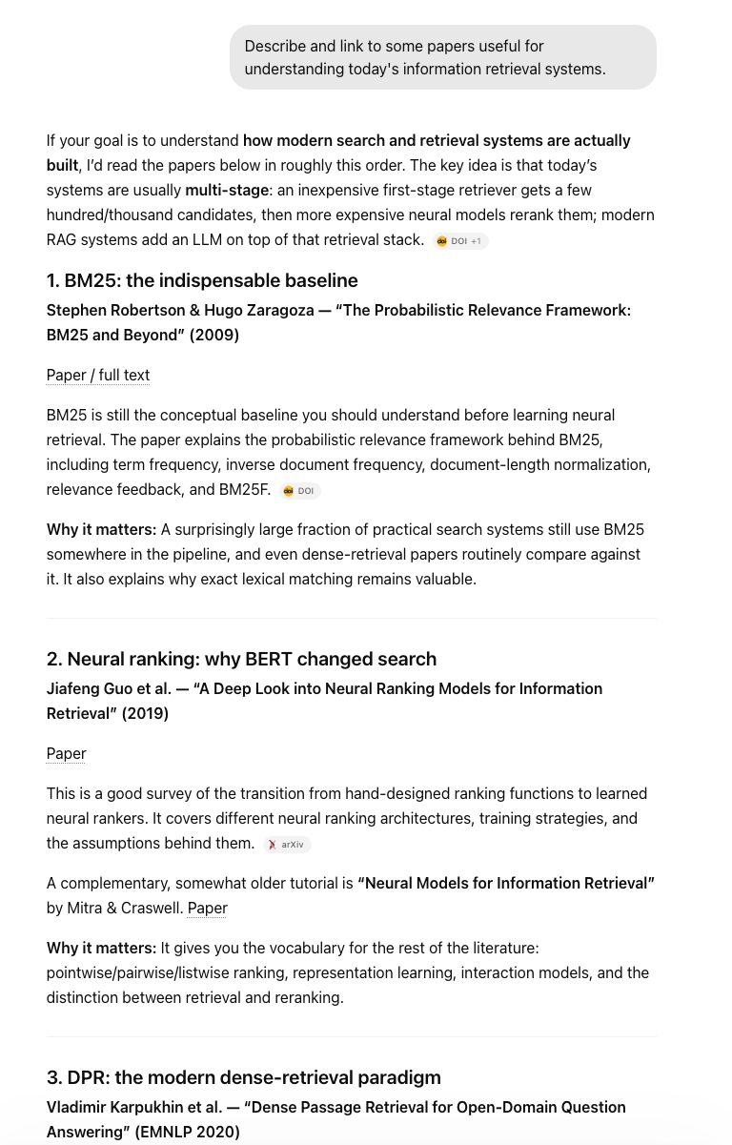

Slide 10
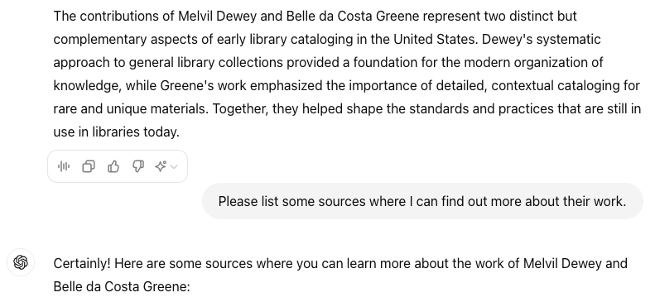
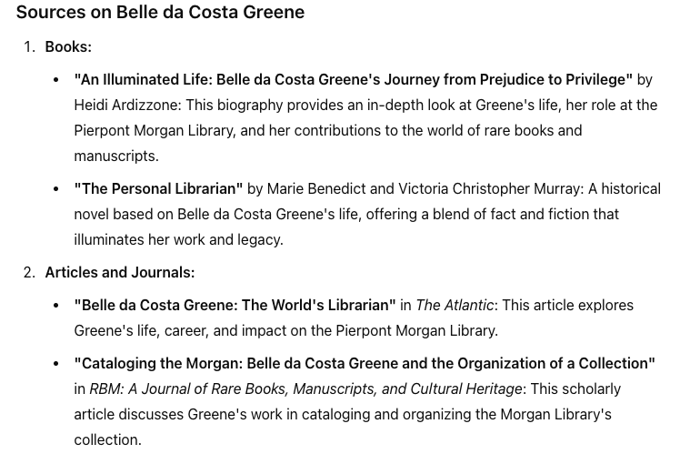
???

Slide 11
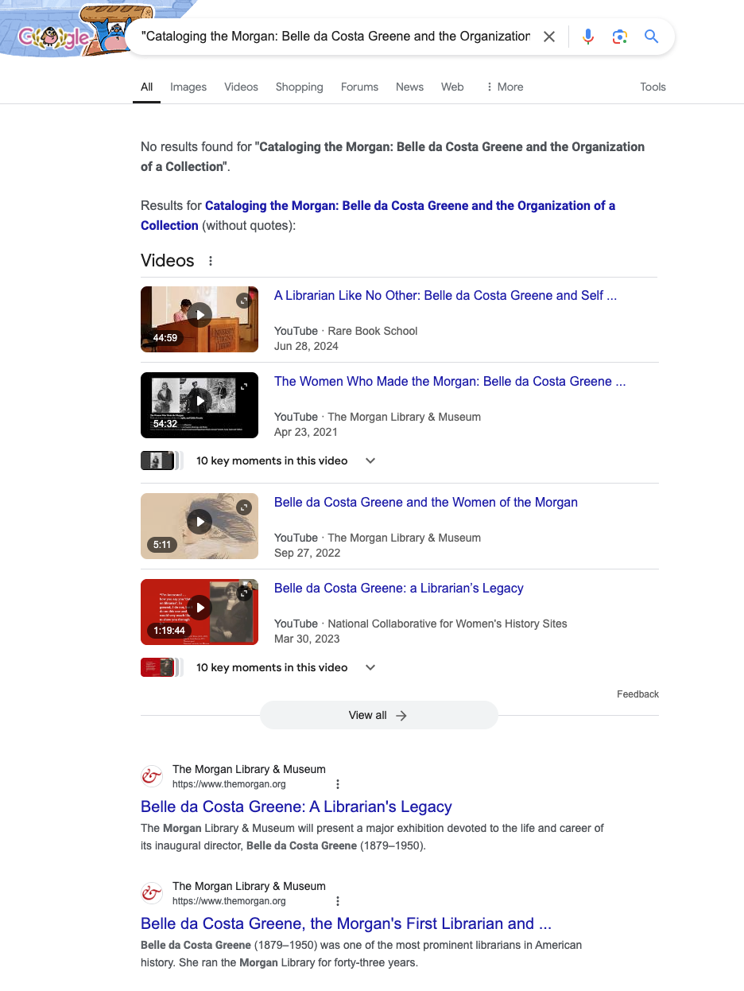

Slide 12
Course Goals
To help you to understand search engines, evaluate and compare them, and modify them for specific applications
Provide broad coverage of the important issues in information retrieval and search engines
Readings from recommended books and papers:
  Search Engines: Information Retrieval in Practice
    Croft, Metzler, and Strohman
  Introduction to Information Retrieval
    Manning, Raghavan, and Schütze

Slide 13
Topics
Overview
Architecture of a search engine
Data acquisition
Text representation
Indexing
Query processing
Ranking
Evaluation
Embeddings and vector search
Retrieval-augmented models and agentic search
Conversational interfaces

Slide 14
Course Evaluation
Five assignments (10% each of course grade)
  Mostly programming and a short written report on your design choices and experimental results.
  You may discuss problems with fellow students or your favorite models. You are responsible for the code and text you submit, and we may ask you about it.
  Programming assignments will use notebooks with python starter code
  Some differences in questions for IS4200

Slide 15
Course Evaluation
One course project (30%)
  Working individually or in teams of up to 4
  Design, build, and evaluate a benchmark for an IR task
  Final report due during final exams (TBA)
One exam in class (TBA)
  Midterm (20%) in class
  Focus on evaluating and thinking critically about retrieval models
  Some differences in questions for CS4220

Slide 16
Late Policy
Assignments are due at the announced time (usually 11:59pm)
You may take a single homework extension of four calendar days, no questions asked. Mention this when turning in.
After the first late assignment, unexcused late assignments will be penalized 10% per calendar day late. We normally will not accept assignments after the date on which the following assignment is due or after the solutions have been handed out, whichever comes first.
If you are in circumstances that would cause you to turn in an assignment late, please contact the instructor in advance to ask for an extension for cause.

Slide 17
Academic Honesty
All work submitted for credit must be your own.
You may discuss the assignments with your classmates, your favorite model, the TA, and the instructor. You must acknowledge the people with whom you discussed your work, and you must write up your own solutions.
Any written sources used (apart from the textbooks) must also be acknowledged; however, you may not consult any solutions from previous years’ assignments whether they are student or faculty generated.

Slide 18
Contact
Me
  Virtual office hours:
    TBA; or by appt.
  dasmith@ccs.neu.edu
TAs:
  Pavani Jain (jain.pav@northeastern.edu)
See Canvas materials and other announcements

Slide 19
Information Retrieval
“Information retrieval is a field concerned with the structure, analysis, organization, storage, searching, and retrieval of information.” (Salton, 1968)
  General definition that can be applied to many types of information and search applications
  Primary focus of IR since the 50s has been on text and documents

Slide 20
What is a Document?
Examples:
  web pages, email, books, news stories, scholarly papers, text messages, social posts, slide decks, PDF, group pages, blogs, forum postings, chat messages (by humans and models), etc.
Common properties
  recorded content (text or other media)
  some structure (e.g., title, author, date for papers; subject, sender, destination for email) relating content to other documents

Slide 21

Notes:
Is a star a document? Is a pebble rolled by a torrent a document? Is a living animal a document? No. But the photographs and catalogues of stars, the stones in a museum of minerology, and the animals that are cataloged and shown in a zoo, are documents.

Slide 22
Documents vs. Database Records
Database records (or tuples in relational databases) are typically made up of well-defined fields (or attributes)
  e.g., bank records with account numbers, balances, names, addresses, social security numbers, dates of birth, etc.
Easy to compare fields with well-defined semantics to queries in order to find matches
Text, images, video, etc., are more difficult

Slide 23
Documents vs. Records
Example bank database query
  Find records with balance > $50,000 in branches located in Somerville, MA.
  Matches easily found by comparison with field values of records
Example search engine query
  bank scandals in western mass
  This text must be compared to the text of entire news stories

Slide 24
Comparing Text
Comparing the query text to the document text and determining what is a good match is the core issue of information retrieval
Exact matching of words is not enough
  Many different ways to write the same thing in a “natural language” like English
  e.g., does a news story containing the text “bank director in Worcester steals funds” match the query?
  Some stories will be better matches than others

Slide 25
Dimensions of IR
IR is more than just text, and more than just web search
  although these are central
People doing IR work with different media, different types of search applications, and different tasks

Slide 26
Dimensions of IR
Content | Applications | Tasks
Text | Web search | Ad hoc search
Images | Vertical search | Filtering
Video | Enterprise search | Classification
Scanned docs | Desktop search | Question answering
Audio | Forum search | Summarization
Music | Social search | Conversational search
 | Literature search | Agentic search

Slide 27
Big Issues in IR
Relevance
  What is it?
  Simple (and simplistic) definition: A relevant document contains the information that a person was looking for when they submitted a query to the search engine
  Many factors influence users’ decision about what is relevant: e.g., task, context, novelty, style, other documents they’ve already read (marginal relevance)
  Topical relevance (same topic) vs. user relevance (everything else)

Slide 28
Big Issues in IR
Relevance
  Retrieval models define a view of relevance
  Ranking algorithms used in search engines are based on retrieval models
  Most models based on “unstructured” text rather than structured data
    Working directly with document contents rather than turning document collections into databases
    Mapping documents to lower dimensional spaces using heuristic (e.g., IDF) and statistical models (e.g., language models)

Slide 29
Big Issues in IR
Evaluation
  Experimental procedures and measures for comparing system output with user expectations
  IR evaluation methods now used in many fields
    e.g. Speech and translation, other ML leaderboards
  Typically use test collection of documents, queries, and relevance judgments
    Most commonly used are TREC collections
  Recall and precision are two examples of effectiveness measures

Slide 30
Big Issues in IR
Users and Information Needs
  Search evaluation is user-centered
  Keyword queries are often poor descriptions (models) of actual information needs
  Belkin’s anomalous state of knowledge
    If you knew what you wanted, you wouldn’t need to ask.
  Interaction and context are important for understanding user intent
  Query refinement techniques such as query expansion, query suggestion, relevance feedback improve ranking

Slide 31
IR and Search Engines
A search engine is the practical application of information retrieval techniques to large-scale collections
Web search engines are best-known examples, but many others
  Open source search engines are important for research and development
    e.g., Lucene, Lemur/Indri, Solr
Big issues include main IR issues but also some others
  Connections to systems, NLP, ML, vision, etc.

Slide 32
IR and Search Engines
Information Retrieval
Search Engines
Performance
-Efficient search and indexing
Incorporating new data
-Coverage and freshness
Scalability
-Growing with data and users
Adaptability
-Tuning for applications
Specific problems
-e.g. Spam
Relevance
-Effective ranking
Evaluation
-Testing and measuring
Information needs
-User interaction

Slide 33
Search Engine Issues
Performance
  Measuring and improving the efficiency of search
    e.g., reducing response time, increasing query throughput, increasing indexing speed
  Indexes are data structures designed to improve search efficiency
    designing and implementing them are major issues for search engines

Slide 34
Search Engine Issues
Dynamic data
  The “collection” for most real applications is constantly changing in terms of updates, additions, deletions
    e.g., web pages
  Acquiring or “crawling” the documents is a major task
    Typical measures are coverage (how much has been indexed) and freshness (how recently was it indexed)
  Updating the indexes and retraining models while processing queries is also a design issue

Slide 35
Search Engine Issues
Scalability
  Making everything work with millions of users every day, and terabytes/petabybtes of data
  Distributed processing is essential
Adaptability
  Changing and tuning search engine components such as ranking algorithm, indexing strategy, interface for different applications
  Changing privacy and legal constraints

Slide 36
Search Engine Issues
Spam
  For web search, spam in all its forms is one of the major issues
  Affects the efficiency of search engines and, more seriously, the effectiveness of the results
  Proliferation of spam varieties
    e.g. spamdexing or term spam, link spam, “search engine optimization”
  Subfield called adversarial IR, since spammers are “adversaries” with different goals

Slide 37
Topics
Overview
Architecture of a search engine
For background, read chapters 1 and 2 of Search Engines by Croft, Metzler, and Strohman

