Slide 1
CS6200/IS4200
Information Retrieval
David Smith
Khoury College of Computer Sciences
Northeastern University

Slide 2
Indexing Process

Slide 3
Processing Text
Converting documents to index terms
Why?
  Matching the exact string of characters typed by the user is too restrictive
    i.e., it doesn’t work very well in terms of effectiveness
  Not all words are of equal value in a search
  Sometimes not clear where words begin and end
    Linguistic disagreement about what a word is in some languages
      e.g., Chinese, Korean

Slide 4
Text Statistics
Huge variety of words used in text but
Many statistical characteristics of word occurrences are predictable
  e.g., distribution of word and n-gram counts
Retrieval models and ranking algorithms depend heavily on statistical properties of words
  e.g., important words occur often in documents but are not high frequency in collection

Slide 5
Zipf’s Law
Distribution of word frequencies is very skewed
  a few words occur very often, many words hardly ever occur
  e.g., two most common words (“the”, “of”) make up about 10% of all word occurrences in text documents
Zipf’s law (more generally, a “power law”):
  observation that rank (r) of a word times its frequency (f) is approximately a constant (k)
    assuming words are ranked in order of decreasing frequency
  i.e., r ⋅ f ≈ k or r ⋅ P_{r} ≈ c, where P_{r} is probability of word occurrence and c ≈ 0.1 for English

Slide 6
Zipf’s Law

Slide 7
News Collection (AP89) Statistics
Total documents 84,678
Total word occurrences 39,749,179
Vocabulary size 198,763
Words occurring > 1000 times 4,169
Words occurring once 70,064
Word Freq. r Pr(%) r.Pr
assistant 5,095 1,021 .013 0.13
sewers 100 17,110 2.56 × 10−4 0.04
toothbrush 10 51,555 2.56 × 10−5 0.01
hazmat 1 166,945 2.56 × 10−6 0.04

Slide 8
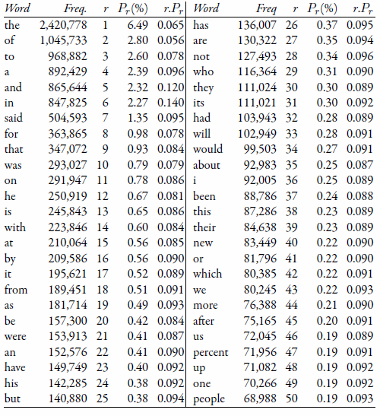
Top 50 Words from AP89

Slide 9
Zipf’s Law for AP89
Log-log plot: Note problems at high and low frequencies

Slide 10
Zipf’s Law
What is the proportion of words with a given frequency?
  Word that occurs n times has rank rn = k/n
  Number of words with frequency n is
    r_{n} − r_{n+1} = k/n − k/(n + 1) = k/n(n + 1)
  Proportion found by dividing by total number of words = highest rank = k
  So, proportion with frequency n is 1/n(n+1)

Slide 11
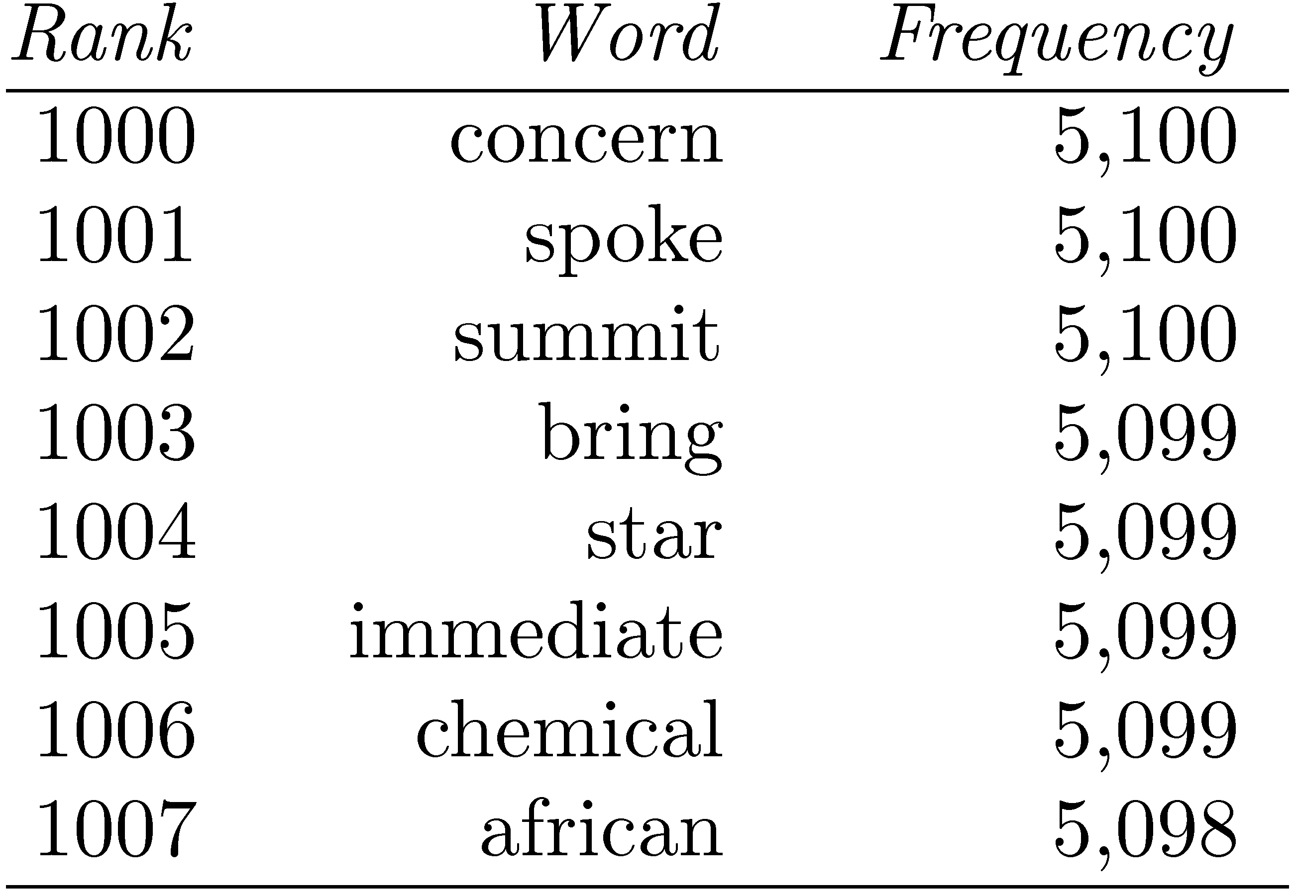
Zipf’s Law
Example word
frequency ranking
To compute number of words with frequency 5,099
  rank of “chemical” minus the rank of “summit”
  1006 − 1002 = 4

Slide 12
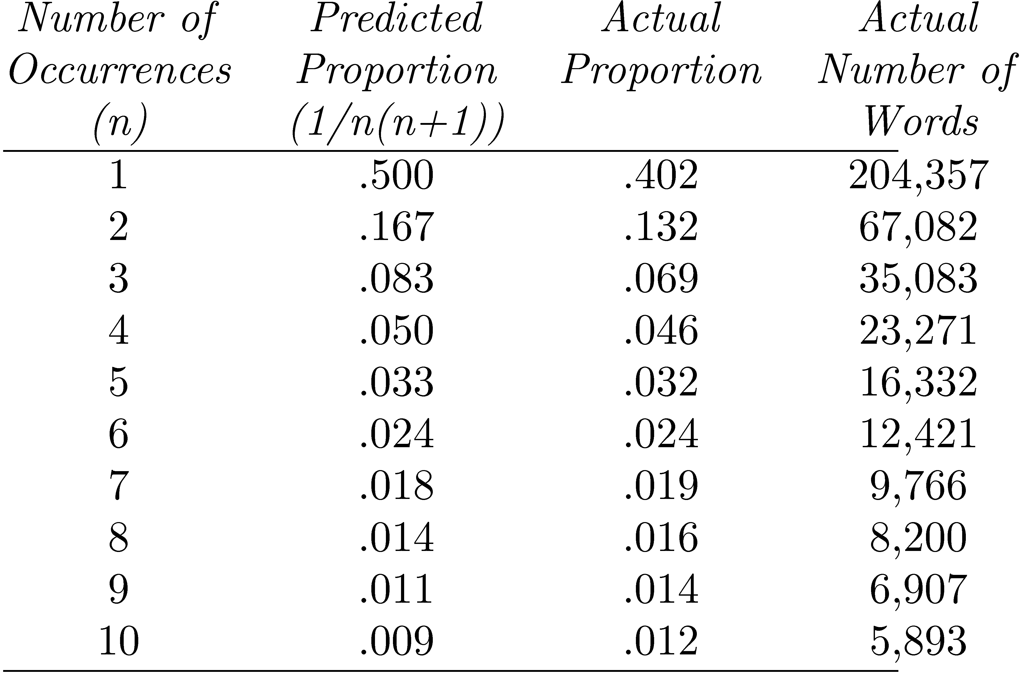
Example
Proportions of words occurring n times in 336,310 TREC documents
Vocabulary size is 508,209

Slide 13
Vocabulary Growth
As corpus grows, so does vocabulary size
  Fewer new words when corpus is already large
Observed relationship (Heaps’ Law):
v = k ⋅ n^{β}
where v is vocabulary size (number of unique words), n is the number of words in corpus,
k, β are parameters that vary for each corpus (typical values given are 10 ≤ k ≤ 100 and β ≈ 0.5)

Slide 14
AP89 Example

Slide 15
Heaps’ Law Predictions
Predictions for TREC collections are accurate for large numbers of words
  e.g., first 10,879,522 words of the AP89 collection scanned
  prediction is 100,151 unique words
  actual number is 100,024
Predictions for small numbers of words (i.e. < 1000) are much worse

Slide 16
GOV2 (Web) Example

Slide 17
Web Example
Heaps’ Law works with very large corpora
  new words occurring even after seeing 30 million!
  parameter values different than typical TREC values
New words come from a variety of sources
    spelling errors, invented words (e.g. product, company names), code, other languages, email addresses, etc.
Search engines must deal with these large and growing vocabularies

Slide 18
Estimating Result Set Size
How many pages contain all of the query terms?
For the query “a b c”:
  f_{abc} = N · f_{a}/N · f_{b}/N · f_{c}/N = (f_{a} · f_{b} · f_{c})/N²
    Assuming that terms occur independently
    f_{abc} is the estimated size of the result set
    f_{a}, f_{b}, f_{c} are the number of documents that terms a, b, and c occur in
    N is the number of documents in the collection

Slide 19
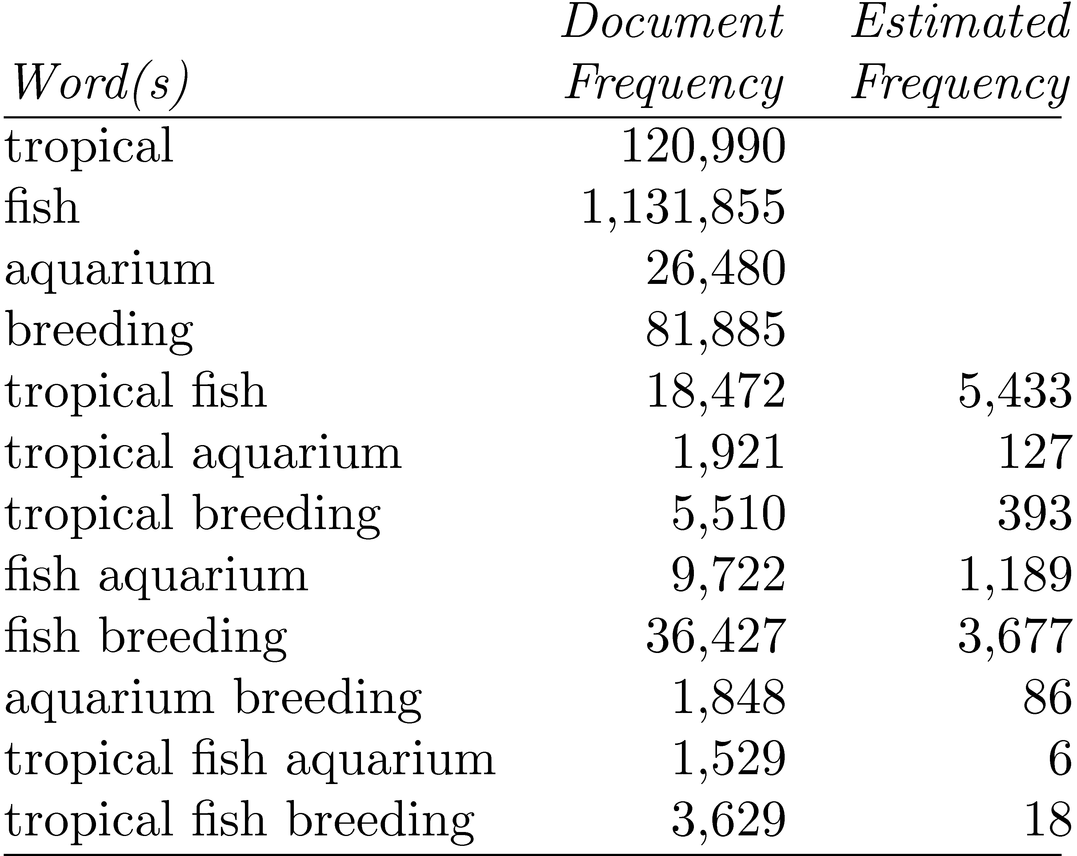
GOV2 Example
Collection size (N) is 25,205,179

Slide 20
Result Set Size Estimation
Poor estimates because words are not independent
Better estimates possible if co-occurrence information available
  P(a ∩ b ∩ c) = P(a ∩ b) · P(c|(a ∩ b))
  f_{tropical∩fish∩aquarium} = f_{tropical∩aquarium} · f_{fish∩aquarium}/f_{aquarium}
  = 1921 · 9722/26480 = 705
  f_{tropical∩fish∩breeding} = f_{tropical∩breeding} · f_{fish∩breeeding}/f_{breeding}
  = 5510 · 36427/81885 = 2451

Slide 21
Result Set Estimation
Even better estimates using initial result set
  Estimate is simply C/s
    where s is the proportion of the total documents that have been ranked, and C is the number of documents found that contain all the query words
  E.g., “tropical fish aquarium” in GOV2
    after processing 3,000 out of the 26,480 documents that contain “aquarium”, C = 258
    f_{tropical∩fish∩aquarium} = 258/(3000÷26480) = 2,277
    After processing 20% of the documents,
    f_{tropical∩fish∩aquarium} = 1,778 (1,529 is real value)

Slide 22
Estimating Collection Size
Useful for auditing Web search engines
Simple technique: use independence model
  Given two words a and b that are independent
  f_{ab}/N = f_{a}/N · f_{b}/N
  N = (f_{a} · f_{b})/f_{ab}
  e.g., for GOV2
    f_{lincoln} = 771,326 f_{tropical} = 120,990 f_{lincoln ∩ tropical} = 3,018
    N = (120990 · 771326)/3018 = 30,922,045
    (actual number is 25,205,179)

Slide 23
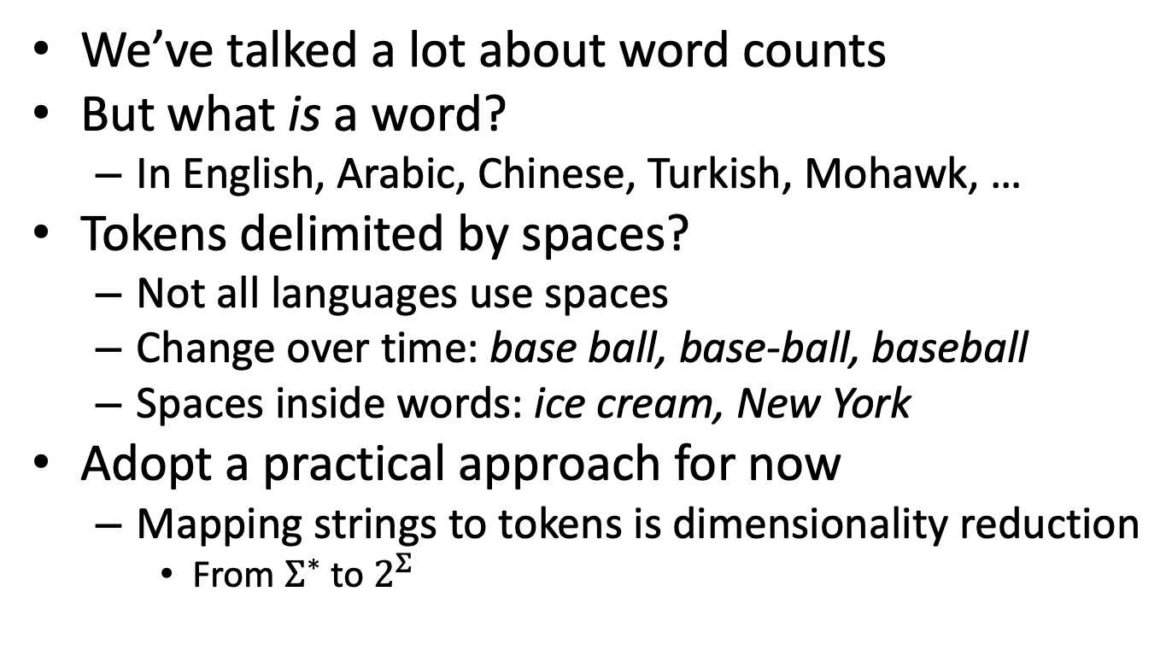
Tokenizing
We’ve talked a lot about word counts
But what is a word?
  In English, Arabic, Chinese, Turkish, Mohawk, …
Tokens delimited by spaces?
  Not all languages use spaces
  Change over time: base ball, base-ball, baseball
  Spaces inside words: ice cream, New York
Adopt a practical approach for now
  Mapping strings to tokens is dimensionality reduction
    From $Σ^{∗}$ to $2^{Σ}$

Slide 24
Tokenizing
Forming words from sequence of characters
Surprisingly complex in English, can be harder in other languages
Early IR systems:
  any sequence of alphanumeric characters of length 3 or more
  terminated by a space or other special character
  upper-case changed to lower-case

Slide 25
Tokenizing
Example:
  “Bigcorp's 2007 bi-annual report showed profits rose 10%.” becomes
  “bigcorp 2007 annual report showed profits rose”
Too simple for search applications or even large-scale experiments
Why? Too much information lost
  Small decisions in tokenizing can have major impact on effectiveness of some queries

Slide 26
Tokenizing Problems
Small words can be important in some queries, usually in combinations
    xp, ma, pm, ben e king, el paso, master p, gm, j lo, world war II
Both hyphenated and non-hyphenated forms of many words are common
  Sometimes hyphen is not needed
    e-bay, wal-mart, active-x, cd-rom, t-shirts
  At other times, hyphens should be considered either as part of the word or a word separator
    winston-salem, mazda rx-7, e-cards, pre-diabetes, t-mobile, spanish-speaking

Slide 27
Tokenizing Problems
Special characters are an important part of tags, URLs, code in documents
Capitalized words can have different meaning from lower case words
  Trump, Apple
Apostrophes can be a part of a word, a part of a possessive, or just a mistake
  sandra day o’connor, can't, don't, 80's, 1890's, men's straw hats, master's degree, england's ten largest cities, shriner's

Slide 28
Tokenizing Problems
Numbers can be important, including decimals
  nokia 3250, top 10 courses, united 93, quicktime 6.5 pro, 92.3 the beat, 288358
Periods can occur in numbers, abbreviations, URLs, ends of sentences, and other situations
  I.B.M., Ph.D., ccs.neu.edu, F.E.A.R.
Note: tokenizing steps for queries must be identical to steps for documents

Slide 29
Tokenizing Process
First step is to use parser to identify appropriate parts of document to tokenize
Defer complex decisions to other components
  word is any sequence of alphanumeric characters, terminated by a space or special character, with everything converted to lower-case
  everything indexed
  example: 92.3 → 92 3 but search finds documents with 92 and 3 adjacent
  incorporate some rules to reduce dependence on query transformation components

Slide 30
Tokenizing Process
Not that different than simple tokenizing process used in past
Examples of rules used with TREC
  Apostrophes in words ignored
    o’connor → oconnor bob’s → bobs
  Periods in abbreviations ignored
    I.B.M. → ibm Ph.D. → ph d
The future: learned cross-language tokenizers
  E.g., Byte-pair encoding, “word pieces”
  Reduces vocab. size: recall/precision tradeoff

Slide 31
Stopping
Function words (determiners, prepositions) have little meaning on their own
High occurrence frequencies
Treated as stopwords (i.e. removed)
  reduce index space, improve response time, improve effectiveness
Can be important in combinations
  e.g., “to be or not to be”

Slide 32
Zipf’s Law for AP89
Log-log plot: Note problems at high and low frequencies

Slide 33
Stopping
Stopword list can be created from high-frequency words or based on a standard list
Lists are customized for applications, domains, and even parts of documents
  e.g., “click” is a good stopword for anchor text
Best policy is to index all words in documents, make decisions about which words to use at query time

Slide 34
Stemming
Many morphological variations of words
  inflectional (plurals, tenses)
  derivational (making verbs nouns etc.)
In most cases, these have the same or very similar meanings (but cf. “building”)
Stemmers attempt to reduce morphological variations of words to a common stem
  morphology: many-many; stemming: many-one
  usually involves removing suffixes
Can be done at indexing time or as part of query processing (like stopwords)

Slide 35
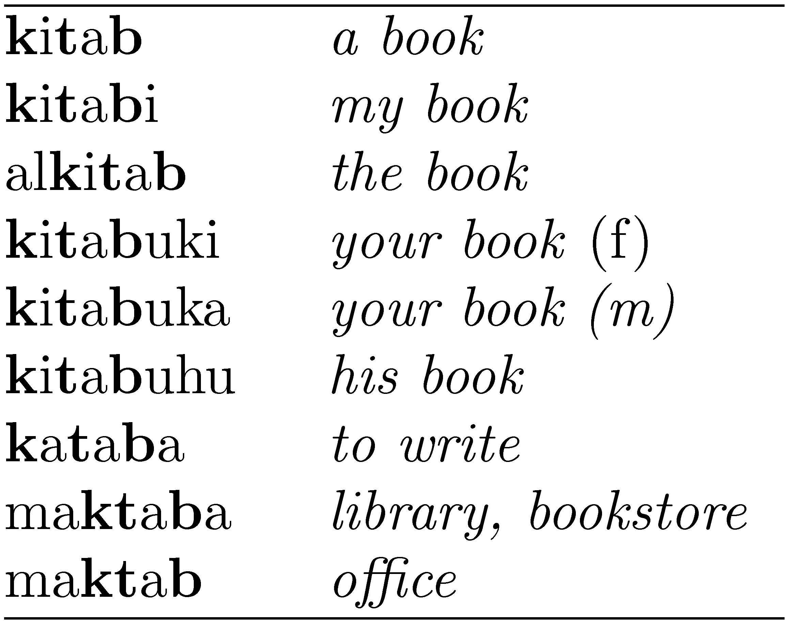
Stemming
Generally a small but significant effectiveness improvement
  can be crucial for some languages
  e.g., 5-10% improvement for English, up to 50% in Arabic
Words with the Arabic root ktb

Slide 36
Stemming
Two basic types
  Dictionary-based: uses lists of related words
  Algorithmic: uses program to determine related words
Algorithmic stemmers
  suffix-s: remove ‘s’ endings assuming plural
    e.g., cats → cat, lakes → lake, wiis → wii
    Many false negatives: supplies → supplie
    Some false positives: ups → up

Slide 37
Porter Stemmer
Algorithmic stemmer used in IR experiments since the 70s
Consists of a series of rules designed to the longest possible suffix at each step
Effective in TREC
Produces stems not words
Makes a number of errors and difficult to modify

Slide 38
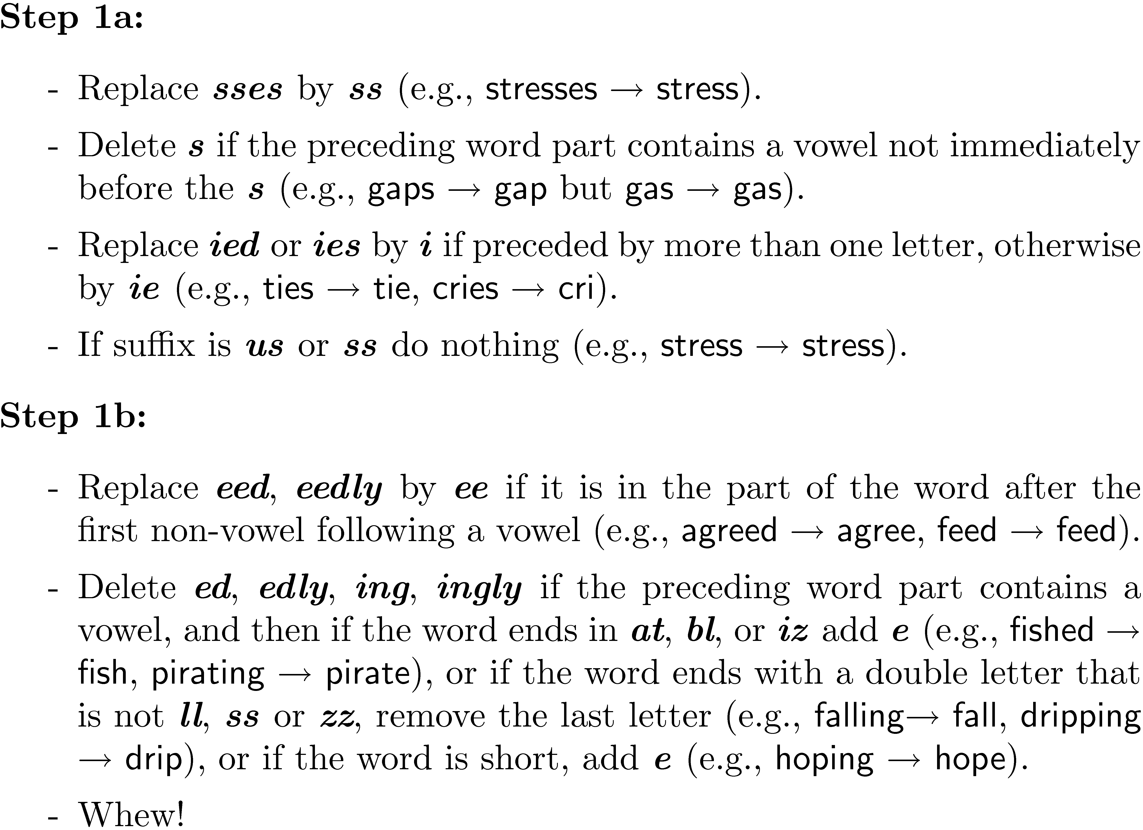
Porter Stemmer
Example step (1 of 5)

Slide 39
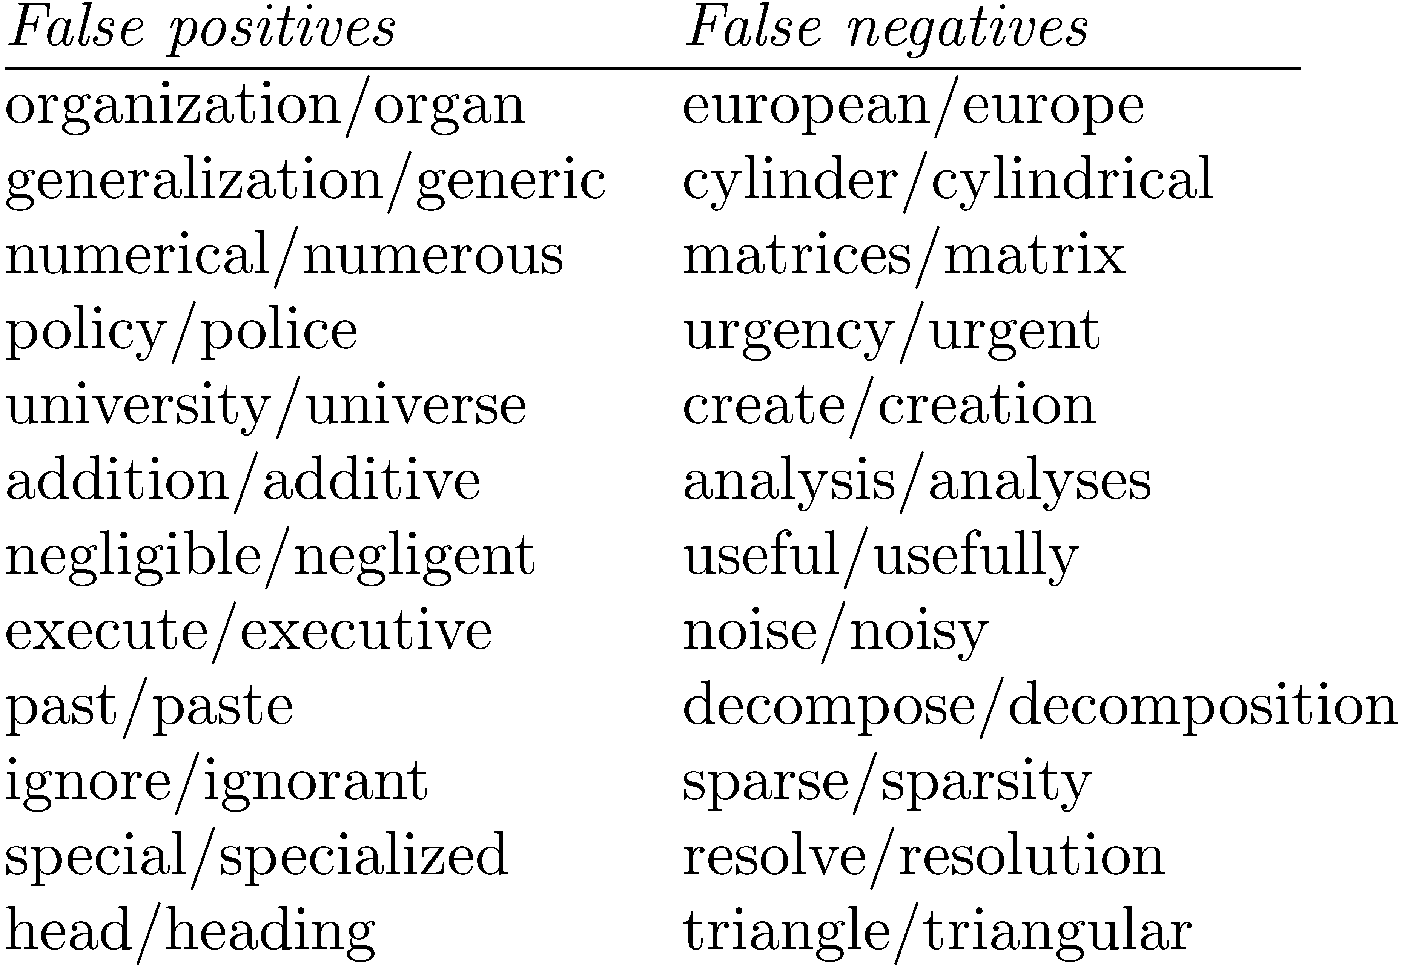
Porter Stemmer
Porter2 stemmer addresses some of these issues
Approach has been used with other languages

Slide 40
Krovetz Stemmer
Hybrid algorithmic-dictionary
  Word checked in dictionary
    If present, either left alone or replaced with “exception”
    If not present, word is checked for suffixes that could be removed
    After removal, dictionary is checked again
Produces words not stems
Comparable effectiveness
Lower false positive rate, somewhat higher false negative

Slide 41
Stemmer Comparison

Slide 42
Phrases
Many queries are 2-3 word phrases
Phrases are
  More precise than single words
    e.g., documents containing “black sea” vs. two words “black” and “sea”
  Less ambiguous
    e.g., “big apple” vs. “apple”
Can be difficult for ranking
    e.g., Given query “fishing supplies”, how do we score documents with
      exact phrase many times, exact phrase just once, individual words in same sentence, same paragraph, whole document, variations on words?

Slide 43
Phrases
Text processing issue – how are phrases recognized?
Interaction w/tokenization (e.g., Chinese)
Three possible approaches:
  Identify syntactic phrases using a part-of-speech (POS) tagger
  Use word n-grams
  Store word positions in indexes and use proximity operators in queries

Slide 44
POS Tagging
POS taggers use statistical models of text to predict syntactic tags of words
  Example tags:
    NN (singular noun), NNS (plural noun), VB (verb), VBD (verb, past tense), VBN (verb, past participle), IN (preposition), JJ (adjective), CC (conjunction, e.g., “and”, “or”), PRP (pronoun), and MD (modal auxiliary, e.g., “can”, “will”).
Phrases can then be defined as simple noun groups, for example

Slide 45
Pos Tagging Example

Slide 46
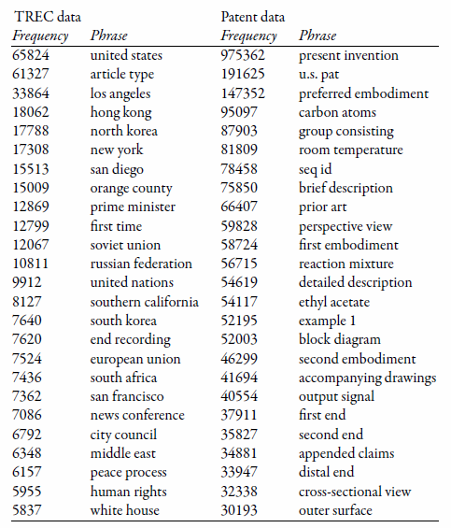
Example Noun Phrases

Slide 47
Word N-Grams
POS tagging can be slow for large collections
Simpler definition – phrase is any sequence of n words – known as n-grams
  bigram: 2 word sequence, trigram: 3 word sequence, unigram: single words
  N-grams also used at character level for applications such as OCR
N-grams typically formed from overlapping sequences of words
  i.e. move n-word “window” one word at a time in document

Slide 48
N-Grams
Frequent n-grams are more likely to be meaningful phrases
N-grams form a Zipf distribution
  Better fit than words alone
Could index all n-grams up to specified length
  Much faster than POS tagging
  Uses a lot of storage
    e.g., document containing 1,000 words would contain 3,990 instances of word n-grams of length 2 ≤ n ≤ 5

Slide 49
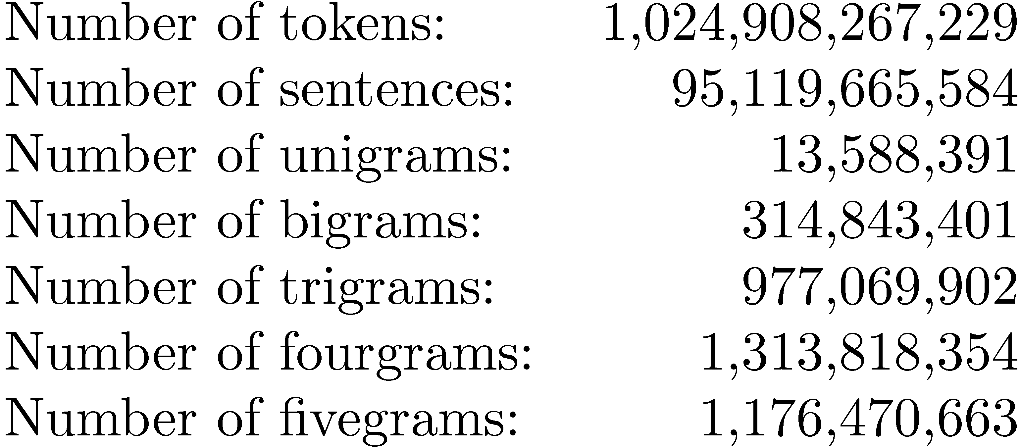
Google N-Grams
Web search engines index n-grams
Google sample (frequency > 40):
Most frequent trigram in English is “all rights reserved”
  In Chinese, “limited liability corporation”

Slide 50
Document Structure and Markup
Some parts of documents are more important than others
Document parser recognizes structure using markup, such as HTML tags
  Headers, anchor text, bolded text all likely to be important
  Metadata can also be important
  Links used for link analysis

Slide 51
Example Web Page

Slide 52
Example Web Page

Slide 53
Link Analysis
Links are a key component of the Web
Important for navigation, but also for search
  e.g., <a href="http://example.com" >Example website</a>
  “Example website” is the anchor text
  “http://example.com” is the destination link
  both are used by search engines

Slide 54
Exercise: Link Analysis
Assumption 1: A link on the web is a quality signal – the author of the link (usually) thinks that the linked-to page is informative.
Assumption 2: The anchor text describes the content of the linked-to page.
Is assumption 1 true in general?
Is assumption 2 true in general?

Slide 55
Anchor Text
Used as a description of the content of the destination page
  i.e., collection of anchor text in all links pointing to a page used as an additional text field
Anchor text tends to be short, descriptive, and similar to query text
Retrieval experiments have shown that anchor text has significant impact on effectiveness for some types of queries
  i.e., more than PageRank

Slide 56
PageRank
Billions of web pages, some more informative than others
Links can be viewed as information about the popularity (authority?) of a web page
  can be used by ranking algorithm
Inlink count could be used as simple measure
Link analysis algorithms like PageRank provide more reliable ratings
  less susceptible to link spam

Slide 57
Random Surfer Model
Browse the Web using the following algorithm:
  Choose a random number r between 0 and 1
  If r < λ:
    Go to a random page
  If r ≥ λ:
    Click a link at random on the current page
  Start again
PageRank of a page is the probability that the “random surfer” will be looking at that page
  links from popular pages will increase PageRank of pages they point to

Slide 58
Dangling Links
Random jump prevents getting stuck on pages that
  do not have links
  contains only links that no longer point to other pages
  have links forming a loop
Links that point to the first two types of pages are called dangling links
  may also be links to pages that have not yet been crawled

Slide 59
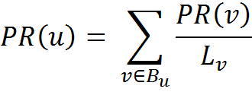
PageRank
PageRank (PR) of page C = PR(A)/2 + PR(B)/1
More generally,
  where B_{u} is the set of pages that point to u, and L_{v} is the number of outgoing links from page v (not counting duplicate links)

Slide 60
PageRank
Don’t know PageRank values at start
Assume equal values (1/3 in this case), then iterate:
  first iteration: PR(C) = 0.33/2 + 0.33 = 0.5, PR(A) = 0.33/1 = 0.33, and PR(B) = 0.33/2 = 0.17
  second: PR(C) = 0.33/2 + 0.17 = 0.33, PR(A) = 0.5, PR(B) = 0.17
  third: PR(C) = 0.42, PR(A) = 0.33, PR(B) = 0.25
Converges to PR(C) = 0.4, PR(A) = 0.4, and PR(B) = 0.2

Slide 61
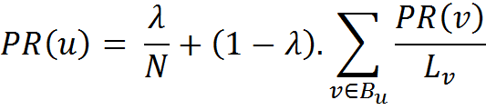
PageRank
Taking random page jump into account, 1/3 chance of going to any page when r < λ
PR(C) = λ/3 + (1 − λ) · (PR(A)/2 + PR(B)/1)
More generally,
  where N is the number of pages, λ typically 0.15

Slide 62
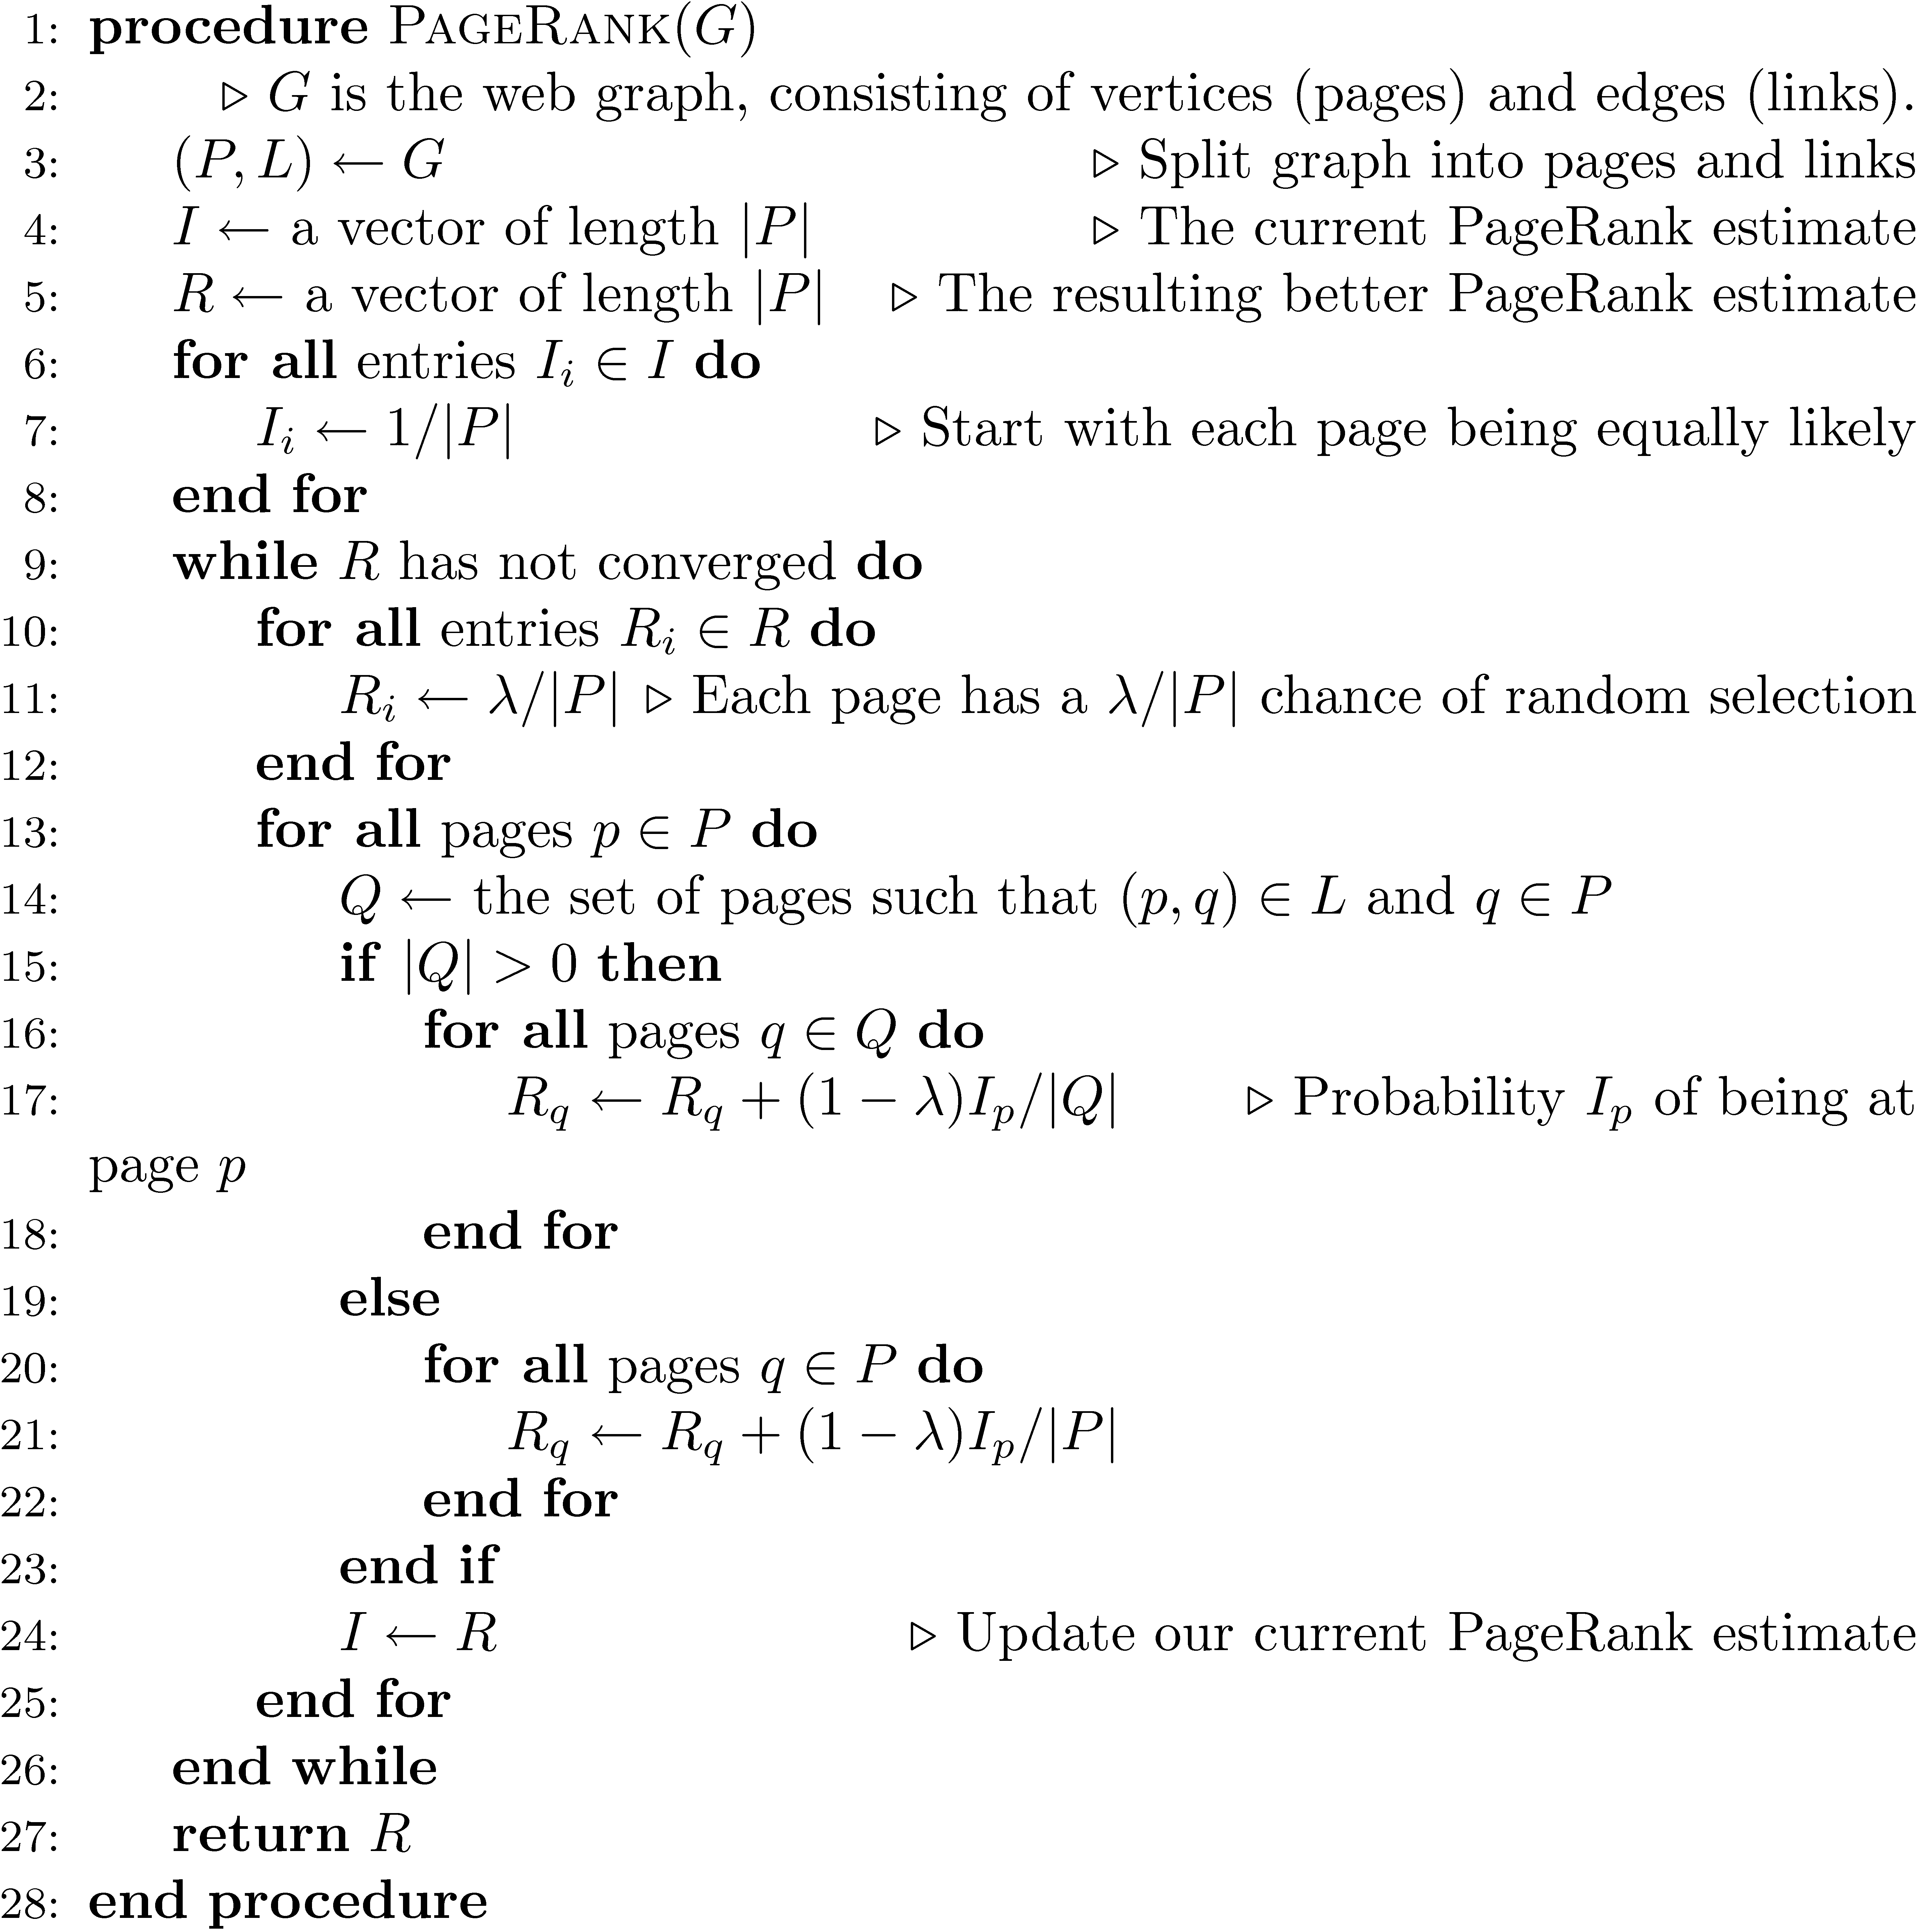
Swap these two lines:
assignment should be outside the for loop.

Slide 63
A PageRank Implementation
Preliminaries:
  1) Extract links from the source text. You'll also want to extract the URL from each document in a separate file. Now you have all the links (source-destination pairs) and all the source documents
  2) Remove all links from the list that do not connect two documents in the corpus. The easiest way to do this is to sort all links by destination, then compare that against the corpus URLs list (also sorted)
  3) Create a new file I that contains a (url, pagerank) pair for each URL in the corpus. The initial PageRank value is 1/#D (#D = number of urls)
At this point there are two interesting files:
  [L] links (trimmed to contain only corpus links, sorted by source URL)
  [I] URL/PageRank pairs, initialized to a constant

Slide 64
A PageRank Implementation
Preliminaries - Link Extraction from .corpus file using Galago
  DocumentSplit -> IndexReaderSplitParser -> TagTokenizer
  split = new DocumentSplit ( filename, filetype, new byte[0], new byte[0] )
  index = new IndexReaderSplitParser ( split )
  tokenizer = new.TagTokenizer ( )
  tokenizer.setProcessor ( NullProcessor ( Document.class ) )
  doc = index.nextDocument ( )
  tokenizer.process ( doc )
  doc.identifier contains the file’s name
  doc.tags now contains all tags
  Links can be extracted by finding all tags with name “a”
  Links should be processed so that they can be compared with some file name in the corpus

Slide 65
A PageRank Implementation
Iteration:
Steps:
  Make a new output file, R.
  Read L and I in parallel (since they're all sorted by URL).
  For each unique source URL, determine whether it has any outgoing links:
  If not, add its current PageRank value to the sum: T (terminals).
  If it does have outgoing links, write (source_url, dest_url, Ip/|Q|), where Ip is the current PageRank value, |Q| is the number of outgoing links, and dest_url is a link destination.
  Do this for all outgoing links. Write this to R.
  Sort R by destination URL.
  Scan R and I at the same time. The new value of Rp is:
  (1 - lambda) / #D (a fraction of the sum of all pages)
  plus: lambda * sum(T) / #D (the total effect from terminal pages), plus: lambda * all incoming mass from step 5. ()
  Check for convergence
  Write new Rp values to a new I file.

Slide 66
A PageRank Implementation
Convergence check
  Stopping criteria for this types of PR algorithm typically is of the form ||new - old|| < tau where new and old are the new and old PageRank vectors, respectively.
  Tau is set depending on how much precision you need. Reasonable values include 0.1 or 0.01. If you want really fast, but inaccurate convergence, then you can use something like tau=1.
  The setting of tau also depends on N (= number of documents in the collection), since ||new-old|| (for a fixed numerical precision) increases as N increases, so you can alternatively formulate your convergence criteria as ||new – old|| / N < tau.
  Either the L1 or L2 norm can be used.

Slide 67
Link Quality
Link quality is affected by spam and other factors
  e.g., link farms to increase PageRank
  trackback links in blogs can create loops
  links from comments section of popular blogs
    Blog services modify comment links to contain rel=nofollow attribute
    e.g., “Come visit my <a rel=nofollow href="http://www.page.com">web page</a>.”

Slide 68
Trackback Links

Slide 69
PageRank in Detail with slides from
Hinrich Schütze and Christina Lioma

Slide 70
Exercise: Assumptions of Link Analysis
Assumption 1: A link on the web is a quality signal – the
author of the link thinks that the linked-to page is high-quality.
Assumption 2: The anchor text describes the content of the linked-to page.
Is assumption 1 true in general?
Is assumption 2 true in general?
70

Slide 71
Google bombs
71

Slide 72
Google bombs
A Google bomb is a search with “bad” results due to maliciously manipulated anchor text.
72

Slide 73
Google bombs
A Google bomb is a search with “bad” results due to maliciously manipulated anchor text.
Google introduced a new weighting function in January 2007
that fixed many Google bombs.
73

Slide 74
Google bombs
A Google bomb is a search with “bad” results due to maliciously manipulated anchor text.
Google introduced a new weighting function in January 2007
that fixed many Google bombs.
Still some remnants: [dangerous cult] on Google, Bing, Yahoo
74

Slide 75
Google bombs
A Google bomb is a search with “bad” results due to maliciously manipulated anchor text.
Google introduced a new weighting function in January 2007
that fixed many Google bombs.
Still some remnants: [dangerous cult] on Google, Bing, Yahoo
  Coordinated link creation by those who dislike the Church of Scientology
75

Slide 76
Google bombs
A Google bomb is a search with “bad” results due to maliciously manipulated anchor text.
Google introduced a new weighting function in January 2007
that fixed many Google bombs.
Still some remnants: [dangerous cult] on Google, Bing, Yahoo
  Coordinated link creation by those who dislike the Church of Scientology
Defused Google bombs: [dumb motherf…], [who is a failure?], [evil empire]
76

Slide 77
Origins of PageRank: Citation analysis (1)
Citation analysis: analysis of citations in the scientific literature.
Example citation: “Miller (2001) has shown that physical activity alters the metabolism of estrogens.”
We can view “Miller (2001)” as a hyperlink linking two scientific articles.
One application of these “hyperlinks” in the scientific literature:
  Measure the similarity of two articles by the overlap of other articles citing them.
  This is called cocitation similarity.
  Cocitation similarity on the web: Google’s “find pages like this” or “Similar” feature.
77

Slide 78
Origins of PageRank: Citation analysis (2)
Another application: Citation frequency can be used to measure the impact of an article .
  Simplest measure: Each article gets one vote – not very accurate.
On the web: citation frequency = inlink count
  A high inlink count does not necessarily mean high quality ...
  ... mainly because of link spam.
Better measure: weighted citation frequency or citation rank
  An article’s vote is weighted according to its citation impact.
  Circular? No: can be formalized in a well-defined way.
78

Slide 79
Origins of PageRank: Citation analysis (3)
Better measure: weighted citation frequency or citation rank.
This is basically PageRank.
PageRank was invented in the context of citation analysis by Pinsker and Narin in the 1960s.
Citation analysis is a big deal: The budget and salary of this lecturer are / will be partly determined by the impact of his publications!
79

Slide 80
Origins of PageRank: Summary
We can use the same formal representation for
  citations in the scientific literature
  hyperlinks on the web
Appropriately weighted citation frequency is an excellent measure of quality ...
  ... both for web pages and for scientific publications.
Next: PageRank algorithm for computing weighted citation frequency on the web.
80

Slide 81
Model behind PageRank: Random walk
Imagine a web surfer doing a random walk on the web
  Start at a random page
  At each step, go out of the current page along one of the links on that page, equiprobably
In the steady state, each page has a long-term visit rate.
This long-term visit rate is the page’s PageRank.
PageRank = long-term visit rate = steady state probability.
81

Slide 82
Formalization of random walk: Markov chains
82

Slide 83
Formalization of random walk: Markov chains
A Markov chain consists of N states, plus an N ×N transition probability matrix P.
83

Slide 84
Formalization of random walk: Markov chains
A Markov chain consists of N states, plus an N ×N transition probability matrix P.
state = page
84

Slide 85
Formalization of random walk: Markov chains
A Markov chain consists of N states, plus an N ×N transition probability matrix P.
state = page
At each step, we are on exactly one of the pages.
85

Slide 86
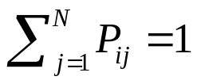

Formalization of random walk: Markov chains
A Markov chain consists of N states, plus an N ×N transition probability matrix P.
state = page
At each step, we are on exactly one of the pages.
For 1 ≤ i, j ≤ N, the matrix entry P_{ij} tells us the probability of j being the next page, given we are currently on page i.
Clearly, for all i,
86

Slide 87
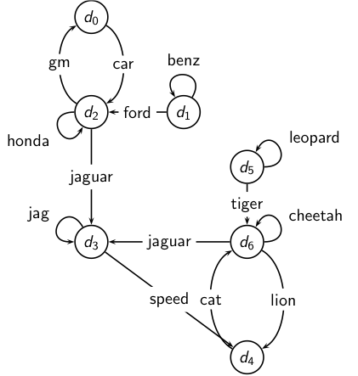
Example web graph

Slide 88
Link matrix for example
88

Slide 89
Link matrix for example
 | d₀ | d₁ | d₂ | d₃ | d₄ | d₅ | d₆
d₀ | 0 | 0 | 1 | 0 | 0 | 0 | 0
d₁ | 0 | 1 | 1 | 0 | 0 | 0 | 0
d₂ | 1 | 0 | 1 | 1 | 0 | 0 | 0
d₃ | 0 | 0 | 0 | 1 | 1 | 0 | 0
d₄ | 0 | 0 | 0 | 0 | 0 | 0 | 1
d₅ | 0 | 0 | 0 | 0 | 0 | 1 | 1
d₆ | 0 | 0 | 0 | 1 | 1 | 0 | 1
89

Slide 90
Transition probability matrix P for example
90

Slide 91
Transition probability matrix P for example
 | d₀ | d₁ | d₂ | d₃ | d₄ | d₅ | d₆
d₀ | 0.00 | 0.00 | 1.00 | 0.00 | 0.00 | 0.00 | 0.00
d₁ | 0.00 | 0.50 | 0.50 | 0.00 | 0.00 | 0.00 | 0.00
d₂ | 0.33 | 0.00 | 0.33 | 0.33 | 0.00 | 0.00 | 0.00
d₃ | 0.00 | 0.00 | 0.00 | 0.50 | 0.50 | 0.00 | 0.00
d₄ | 0.00 | 0.00 | 0.00 | 0.00 | 0.00 | 0.00 | 1.00
d₅ | 0.00 | 0.00 | 0.00 | 0.00 | 0.00 | 0.50 | 0.50
d₆ | 0.00 | 0.00 | 0.00 | 0.33 | 0.33 | 0.00 | 0.33
91

Slide 92
Long-term visit rate
92

Slide 93
Long-term visit rate
Recall: PageRank = long-term visit rate.
93

Slide 94
Long-term visit rate
Recall: PageRank = long-term visit rate.
Long-term visit rate of page d is the probability that a web surfer is at page d at a given point in time.
94

Slide 95
Long-term visit rate
Recall: PageRank = long-term visit rate.
Long-term visit rate of page d is the probability that a web surfer is at page d at a given point in time.
Next: what properties must hold of the web graph for the long-term visit rate to be well defined?
95

Slide 96
Long-term visit rate
Recall: PageRank = long-term visit rate.
Long-term visit rate of page d is the probability that a web surfer is at page d at a given point in time.
Next: what properties must hold of the web graph for the long-term visit rate to be well defined?
The web graph must correspond to an ergodic Markov chain.
96

Slide 97
Long-term visit rate
Recall: PageRank = long-term visit rate.
Long-term visit rate of page d is the probability that a web surfer is at page d at a given point in time.
Next: what properties must hold of the web graph for the long-term visit rate to be well defined?
The web graph must correspond to an ergodic Markov chain.
First a special case: The web graph must not contain dead ends.
97

Slide 98
Dead ends
98

Slide 99
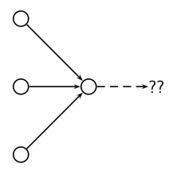
Dead ends
99

Slide 100
Dead ends
The web is full of dead ends.
100

Slide 101
Dead ends
The web is full of dead ends.
Random walk can get stuck in dead ends.
101

Slide 102
Dead ends
The web is full of dead ends.
Random walk can get stuck in dead ends.
If there are dead ends, long-term visit rates are not well-defined.
102

Slide 103
Teleporting – to get us of dead ends
103

Slide 104
Teleporting – to get us of dead ends
At a dead end, jump to a random web page with prob.
1/ N .
104

Slide 105
Teleporting – to get us of dead ends
At a dead end, jump to a random web page with prob.
1/ N .
At a non-dead end, with probability 10%, jump to a random web page (to each with a probability of 0.1/N ).
105

Slide 106
Teleporting – to get us of dead ends
At a dead end, jump to a random web page with prob.
1/ N .
At a non-dead end, with probability 10%, jump to a random web page (to each with a probability of 0.1/N ).
With remaining probability (90%), go out on a random hyperlink.
106

Slide 107
Teleporting – to get us of dead ends
At a dead end, jump to a random web page with prob.
1/ N .
At a non-dead end, with probability 10%, jump to a random web page (to each with a probability of 0.1/N ).
With remaining probability (90%), go out on a random hyperlink.
  For example, if the page has 4 outgoing links: randomly choose one with probability (1-0.10)/4=0.225
107

Slide 108
Teleporting – to get us of dead ends
At a dead end, jump to a random web page with prob.
1/ N .
At a non-dead end, with probability 10%, jump to a random web page (to each with a probability of 0.1/N ).
With remaining probability (90%), go out on a random hyperlink.
  For example, if the page has 4 outgoing links: randomly choose one with probability (1-0.10)/4=0.225
10% is a parameter, the teleportation rate.
108

Slide 109
Teleporting – to get us of dead ends
At a dead end, jump to a random web page with prob.
1/ N .
At a non-dead end, with probability 10%, jump to a random web page (to each with a probability of 0.1/N ).
With remaining probability (90%), go out on a random hyperlink.
  For example, if the page has 4 outgoing links: randomly choose one with probability (1-0.10)/4=0.225
10% is a parameter, the teleportation rate.
Note: “jumping” from dead end is independent of teleportation rate.
109

Slide 110
Result of teleporting
110

Slide 111
Result of teleporting
With teleporting, we cannot get stuck in a dead end.
111

Slide 112
Result of teleporting
With teleporting, we cannot get stuck in a dead end.
But even without dead ends, a graph may not have well-defined long-term visit rates.
112

Slide 113
Result of teleporting
With teleporting, we cannot get stuck in a dead end.
But even without dead ends in the original graph, we may not have well-defined long-term visit rates.
More generally, we require that the Markov chain be ergodic.
113

Slide 114
Ergodic Markov chains
A Markov chain is ergodic if it is irreducible and aperiodic.
114

Slide 115
Ergodic Markov chains
A Markov chain is ergodic if it is irreducible and aperiodic.
Irreducibility. Roughly: there is a path from any other page.
115

Slide 116
Ergodic Markov chains
A Markov chain is ergodic if it is irreducible and aperiodic.
Irreducibility. Roughly: there is a path from any other page.
Aperiodicity. Roughly: The pages cannot be partitioned such that the random walker visits the partitions sequentially.
116

Slide 117

Ergodic Markov chains
A Markov chain is ergodic if it is irreducible and aperiodic.
Irreducibility. Roughly: there is a path from any other page.
Aperiodicity. Roughly: The pages cannot be partitioned such that the random walker visits the partitions sequentially.
A non-ergodic Markov chain:
117

Slide 118
Ergodic Markov chains
Theorem: For any ergodic Markov chain, there is a unique long-term visit rate for each state.
118

Slide 119
Ergodic Markov chains
Theorem: For any ergodic Markov chain, there is a unique long-term visit rate for each state.
This is the steady-state probability distribution.
119

Slide 120
Ergodic Markov chains
Theorem: For any ergodic Markov chain, there is a unique long-term visit rate for each state.
This is the steady-state probability distribution.
Over a long time period, we visit each state in proportion to this rate.
120

Slide 121
Ergodic Markov chains
Theorem: For any ergodic Markov chain, there is a unique long-term visit rate for each state.
This is the steady-state probability distribution.
Over a long time period, we visit each state in proportion to this rate.
It doesn’t matter where we start.
121

Slide 122
Ergodic Markov chains
Theorem: For any ergodic Markov chain, there is a unique long-term visit rate for each state.
This is the steady-state probability distribution.
Over a long time period, we visit each state in proportion to this rate.
It doesn’t matter where we start.
Teleporting makes the web graph ergodic.
122

Slide 123

Ergodic Markov chains
Theorem: For any ergodic Markov chain, there is a unique long-term visit rate for each state.
This is the steady-state probability distribution.
Over a long time period, we visit each state in proportion to this rate.
It doesn’t matter where we start.
Teleporting makes the web graph ergodic.
Web-graph+teleporting has a steady-state probability distribution.
123

Slide 124
Ergodic Markov chains
Theorem: For any ergodic Markov chain, there is a unique long-term visit rate for each state.
This is the steady-state probability distribution.
Over a long time period, we visit each state in proportion to this rate.
It doesn’t matter where we start.
Teleporting makes the web graph ergodic.
Web-graph+teleporting has a steady-state probability distribution.
Each page in the web-graph+teleporting has a PageRank.
124

Slide 125
Formalization of “visit”: Probability vector
125

Slide 126

Formalization of “visit”: Probability vector
A probability (row) vector x = (x₁ , ..., x_{N}) tells us where the random walk is at any point.
126

Slide 127
Formalization of “visit”: Probability vector
A probability (row) vector x = (x₁ , ..., x_{N}) tells us where the random walk is at any point.
Example:
( | 0 | 0 | 0 | … | 1 | … | 0 | 0 | 0 | )
 | 1 | 2 | 3 | … | i | … | N-2 | N-1 | N
127

Slide 128
Formalization of “visit”: Probability vector
A probability (row) vector x = (x₁ , ..., x_{N}) tells us where the random walk is at any point.
Example:
More generally: the random walk is on the page i with probability x_{i}.
( | 0 | 0 | 0 | … | 1 | … | 0 | 0 | 0 | )
 | 1 | 2 | 3 | … | i | … | N-2 | N-1 | N
128

Slide 129
Formalization of “visit”: Probability vector
A probability (row) vector x = (x₁ , ..., x_{N}) tells us where the random walk is at any point.
Example:
More generally: the random walk is on the page i with probability x_{i}.
Example:
( | 0 | 0 | 0 | … | 1 | … | 0 | 0 | 0 | )
 | 1 | 2 | 3 | … | i | … | N-2 | N-1 | N
( | 0.05 | 0.01 | 0.0 | … | 0.2 | … | 0.01 | 0.05 | 0.03 | )
 | 1 | 2 | 3 | … | i | … | N-2 | N-1 | N
129

Slide 130
Formalization of “visit”: Probability vector
A probability (row) vector x = (x₁ , ..., x_{N}) tells us where the random walk is at any point.
Example:
More generally: the random walk is on the page i with probability x_{i}.
Example:
Σ x_{i} = 1
( | 0 | 0 | 0 | … | 1 | … | 0 | 0 | 0 | )
 | 1 | 2 | 3 | … | i | … | N-2 | N-1 | N
( | 0.05 | 0.01 | 0.0 | … | 0.2 | … | 0.01 | 0.05 | 0.03 | )
 | 1 | 2 | 3 | … | i | … | N-2 | N-1 | N
130

Slide 131
Change in probability vector
If the probability vector is x = (x₁ , ..., x_{N}), at this step, what is it at the next step?
131

Slide 132
Change in probability vector
If the probability vector is x = (x₁ , ..., x_{N}), at this step, what is it at the next step?
Recall that row i of the transition probability matrix P tells us where we go next from state i.
132

Slide 133
Change in probability vector
If the probability vector is x = (x₁ , ..., x_{N}), at this step, what is it at the next step?
Recall that row i of the transition probability matrix P tells us where we go next from state i.
So from x, our next state is distributed as xP.
133

Slide 134
Steady state in vector notation
134

Slide 135
Steady state in vector notation
The steady state in vector notation is simply a vector
π = (π₁, π₂, …, π_{Ν}) of probabilities.
135

Slide 136
Steady state in vector notation
The steady state in vector notation is simply a vector
π = (π₁, π₂, …, π_{Ν}) of probabilities.
(We use π to distinguish it from the notation for the probability vector x.)
136

Slide 137
Steady state in vector notation
The steady state in vector notation is simply a vector
π = (π₁, π₂, …, π_{Ν}) of probabilities.
(We use π to distinguish it from the notation for the probability vector x.)
π is the long-term visit rate (or PageRank) of page i.
137

Slide 138
Steady state in vector notation
The steady state in vector notation is simply a vector
π = (π₁, π₂, …, π_{Ν}) of probabilities.
(We use π to distinguish it from the notation for the probability vector x.)
π is the long-term visit rate (or PageRank) of page i.
So we can think of PageRank as a very long vector – one entry per page.
138

Slide 139
Steady-state distribution: Example
139

Slide 140
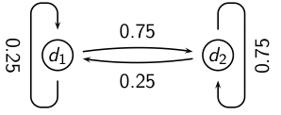
Steady-state distribution: Example
What is the PageRank / steady state in this example?
140

Slide 141
Steady-state distribution: Example
141

Slide 142
Steady-state distribution: Example
 | x₁ P_{t}(d₁) | x₂ P_{t}(d₂)
 |  |  | P₁₁ = 0.25 P₂₁ = 0.25 | P₁₂ = 0.75 P₂₂ = 0.75
t₀ t₁ | 0.25 | 0.75
PageRank vector = π = (π₁, π₂) = (0.25, 0.75)
P_{t}(d₁) = P_{t-1}(d₁) * P₁₁ + P_{t-1}(d₂) * P₂₁
  P_{t}(d₂) = P_{t-1}(d₁) * P₁₂ + P_{t-1}(d₂) * P₂₂
142

Slide 143
Steady-state distribution: Example
 | x₁ P_{t}(d₁) | x₂ P_{t}(d₂)
 |  |  | P₁₁ = 0.25 P₂₁ = 0.25 | P₁₂ = 0.75 P₂₂ = 0.75
t₀ t₁ | 0.25 | 0.75 | 0.25 | 0.75
PageRank vector = π = (π₁, π₂) = (0.25, 0.75)
P_{t}(d₁) = P_{t-1}(d₁) * P₁₁ + P_{t-1}(d₂) * P₂₁
  P_{t}(d₂) = P_{t-1}(d₁) * P₁₂ + P_{t-1}(d₂) * P₂₂
143

Slide 144
Steady-state distribution: Example
 | x₁ P_{t}(d₁) | x₂ P_{t}(d₂)
 |  |  | P₁₁ = 0.25 P₂₁ = 0.25 | P₁₂ = 0.75 P₂₂ = 0.75
t₀ t₁ | 0.25 0.25 | 0.75 0.75 | 0.25 | 0.75
PageRank vector = π = (π₁, π₂) = (0.25, 0.75)
P_{t}(d₁) = P_{t-1}(d₁) * P₁₁ + P_{t-1}(d₂) * P₂₁
  P_{t}(d₂) = P_{t-1}(d₁) * P₁₂ + P_{t-1}(d₂) * P₂₂
144

Slide 145
Steady-state distribution: Example
 | x₁ P_{t}(d₁) | x₂ P_{t}(d₂)
 |  |  | P₁₁ = 0.25 P₂₁ = 0.25 | P₁₂ = 0.75 P₂₂ = 0.75
t₀ t₁ | 0.25 0.25 | 0.75 0.75 | 0.25 | 0.75
 |  |  | (convergence)
PageRank vector = π = (π₁, π₂) = (0.25, 0.75)
P_{t}(d₁) = P_{t-1}(d₁) * P₁₁ + P_{t-1}(d₂) * P₂₁
  P_{t}(d₂) = P_{t-1}(d₁) * P₁₂ + P_{t-1}(d₂) * P₂₂
145

Slide 146
How do we compute the steady state vector?
In other words: how do we compute PageRank?
146

Slide 147
How do we compute the steady state vector?
In other words: how do we compute PageRank?
Recall: π = (π₁, π₂, …, π_{N}) is the PageRank vector, the vector of steady-state probabilities ...
147

Slide 148
How do we compute the steady state vector?
In other words: how do we compute PageRank?
Recall: π = (π₁, π₂, …, π_{N}) is the PageRank vector, the vector of steady-state probabilities ...
… and if the distribution in this step is x, then the distribution in the next step is xP.
148

Slide 149
How do we compute the steady state vector?
In other words: how do we compute PageRank?
Recall: π = (π₁, π₂, …, π_{N}) is the PageRank vector, the vector of steady-state probabilities ...
… and if the distribution in this step is x, then the distribution in the next step is xP.
But π is the steady state!
149

Slide 150
How do we compute the steady state vector?
In other words: how do we compute PageRank?
Recall: π = (π₁, π₂, …, π_{N}) is the PageRank vector, the vector of steady-state probabilities ...
… and if the distribution in this step is x, then the distribution in the next step is xP.
But π is the steady state!
So: π = π P
150

Slide 151
How do we compute the steady state vector?
In other words: how do we compute PageRank?
Recall: π = (π₁, π₂, …, π_{N}) is the PageRank vector, the vector of steady-state probabilities ...
… and if the distribution in this step is x, then the distribution in the next step is xP.
But π is the steady state!
So: π = π P
Solving this matrix equation gives us π.
Computational complexity?
151

Slide 152
How do we compute the steady state vector?
In other words: how do we compute PageRank?
Recall: π = (π₁, π₂, …, π_{N}) is the PageRank vector, the vector of steady-state probabilities ...
… and if the distribution in this step is x, then the distribution in the next step is xP.
But π is the steady state!
So: π = π P
Solving this matrix equation gives us π.
π is the principal left eigenvector for P …
152

Slide 153
How do we compute the steady state vector?
In other words: how do we compute PageRank?
Recall: π = (π₁, π₂, …, π_{N}) is the PageRank vector, the vector of steady-state probabilities ...
… and if the distribution in this step is x, then the distribution in the next step is xP.
But π is the steady state!
So: π = π P
Solving this matrix equation gives us π.
π is the principal left eigenvector for P …
… that is, π is the left eigenvector with the largest eigenvalue.
153

Slide 154
How do we compute the steady state vector?
In other words: how do we compute PageRank?
Recall: π = (π₁, π₂, …, π_{N}) is the PageRank vector, the vector of steady-state probabilities ...
… and if the distribution in this step is x, then the distribution in the next step is xP.
But π is the steady state!
So: π = π P
Solving this matrix equation gives us π.
π is the principal left eigenvector for P …
… that is, π is the left eigenvector with the largest eigenvalue.
All transition probability matrices have largest eigenvalue 1.
154

Slide 155
One way of computing the PageRank π
Start with any distribution x, e.g., uniform distribution
155

Slide 156
One way of computing the PageRank π
Start with any distribution x, e.g., uniform distribution
After one step, we’re at xP.
156

Slide 157
One way of computing the PageRank π
Start with any distribution x, e.g., uniform distribution
After one step, we’re at xP.
After two steps, we’re at xP².
157

Slide 158
One way of computing the PageRank π
Start with any distribution x, e.g., uniform distribution
After one step, we’re at xP.
After two steps, we’re at xP².
After k steps, we’re at xP^{k}.
158

Slide 159
One way of computing the PageRank π
Start with any distribution x, e.g., uniform distribution
After one step, we’re at xP.
After two steps, we’re at xP².
After k steps, we’re at xP^{k}.
Algorithm: multiply x by increasing powers of P until convergence.
159

Slide 160
One way of computing the PageRank π
Start with any distribution x, e.g., uniform distribution
After one step, we’re at xP.
After two steps, we’re at xP².
After k steps, we’re at xP^{k}.
Algorithm: multiply x by increasing powers of P until convergence.
This is called the power method.
160

Slide 161
One way of computing the PageRank π
Start with any distribution x, e.g., uniform distribution
After one step, we’re at xP.
After two steps, we’re at xP².
After k steps, we’re at xP^{k}.
Algorithm: multiply x by increasing powers of P until convergence.
This is called the power method.
Recall: regardless of where we start, we eventually reach the steady state π.
161

Slide 162
One way of computing the PageRank π
Start with any distribution x, e.g., uniform distribution
After one step, we’re at xP.
After two steps, we’re at xP².
After k steps, we’re at xP^{k}.
Algorithm: multiply x by increasing powers of P until convergence.
This is called the power method.
Recall: regardless of where we start, we eventually reach the steady state π.
Thus: we will eventually (asymptotically) reach the steady state.
162

Slide 163
Power method: Example
163

Slide 164
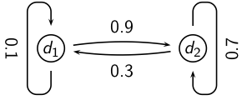
Power method: Example
What is the PageRank / steady state in this example?
164

Slide 165
Computing PageRank: Power Example
165

Slide 166
Computing PageRank: Power Example
 | x₁ P_{t}(d₁) | x₂ P_{t}(d₂)
 |  |  | P₁₁ = 0.1 P₂₁ = 0.3 | P₁₂ = 0.9 P₂₂ = 0.7
t₀ | 0 | 1 |  |  | = xP
t₁ |  |  |  |  | = xP²
t₂ |  |  |  |  | = xP³
t₃ |  |  |  |  | = xP⁴
 |  |  |  |  | . . .
t∞ |  |  |  |  | = xP∞
P_{t}(d₁) = P_{t-1}(d₁) * P₁₁ + P_{t-1}(d₂) * P₂₁
  P_{t}(d₂) = P_{t-1}(d₁) * P₁₂ + P_{t-1}(d₂) * P₂₂
166

Slide 167
Computing PageRank: Power Example
 | x₁ P_{t}(d₁) | x₂ P_{t}(d₂)
 |  |  | P₁₁ = 0.1 P₂₁ = 0.3 | P₁₂ = 0.9 P₂₂ = 0.7
t₀ | 0 | 1 | 0.3 | 0.7 | = xP
t₁ |  |  |  |  | = xP²
t₂ |  |  |  |  | = xP³
t₃ |  |  |  |  | = xP⁴
 |  |  |  |  | . . .
t∞ |  |  |  |  | = xP∞
P_{t}(d₁) = P_{t-1}(d₁) * P₁₁ + P_{t-1}(d₂) * P₂₁
  P_{t}(d₂) = P_{t-1}(d₁) * P₁₂ + P_{t-1}(d₂) * P₂₂
167

Slide 168
Computing PageRank: Power Example
 | x₁ P_{t}(d₁) | x₂ P_{t}(d₂)
 |  |  | P₁₁ = 0.1 P₂₁ = 0.3 | P₁₂ = 0.9 P₂₂ = 0.7
t₀ | 0 | 1 | 0.3 | 0.7 | = xP
t₁ | 0.3 | 0.7 |  |  | = xP²
t₂ |  |  |  |  | = xP³
t₃ |  |  |  |  | = xP⁴
 |  |  |  |  | . . .
t∞ |  |  |  |  | = xP∞
P_{t}(d₁) = P_{t-1}(d₁) * P₁₁ + P_{t-1}(d₂) * P₂₁
  P_{t}(d₂) = P_{t-1}(d₁) * P₁₂ + P_{t-1}(d₂) * P₂₂
168

Slide 169
Computing PageRank: Power Example
 | x₁ P_{t}(d₁) | x₂ P_{t}(d₂)
 |  |  | P₁₁ = 0.1 P₂₁ = 0.3 | P₁₂ = 0.9 P₂₂ = 0.7
t₀ | 0 | 1 | 0.3 | 0.7 | = xP
t₁ | 0.3 | 0.7 | 0.24 | 0.76 | = xP²
t₂ |  |  |  |  | = xP³
t₃ |  |  |  |  | = xP⁴
 |  |  |  |  | . . .
t∞ |  |  |  |  | = xP∞
P_{t}(d₁) = P_{t-1}(d₁) * P₁₁ + P_{t-1}(d₂) * P₂₁
  P_{t}(d₂) = P_{t-1}(d₁) * P₁₂ + P_{t-1}(d₂) * P₂₂
169

Slide 170
Computing PageRank: Power Example
 | x₁ P_{t}(d₁) | x₂ P_{t}(d₂)
 |  |  | P₁₁ = 0.1 P₂₁ = 0.3 | P₁₂ = 0.9 P₂₂ = 0.7
t₀ | 0 | 1 | 0.3 | 0.7 | = xP
t₁ | 0.3 | 0.7 | 0.24 | 0.76 | = xP²
t₂ | 0.24 | 0.76 |  |  | = xP³
t₃ |  |  |  |  | = xP⁴
 |  |  |  |  | . . .
t∞ |  |  |  |  | = xP∞
P_{t}(d₁) = P_{t-1}(d₁) * P₁₁ + P_{t-1}(d₂) * P₂₁
  P_{t}(d₂) = P_{t-1}(d₁) * P₁₂ + P_{t-1}(d₂) * P₂₂
170

Slide 171
Computing PageRank: Power Example
 | x₁ P_{t}(d₁) | x₂ P_{t}(d₂)
 |  |  | P₁₁ = 0.1 P₂₁ = 0.3 | P₁₂ = 0.9 P₂₂ = 0.7
t₀ | 0 | 1 | 0.3 | 0.7 | = xP
t₁ | 0.3 | 0.7 | 0.24 | 0.76 | = xP²
t₂ | 0.24 | 0.76 | 0.252 | 0.748 | = xP³
t₃ |  |  |  |  | = xP⁴
 |  |  |  |  | . . .
t∞ |  |  |  |  | = xP∞
P_{t}(d₁) = P_{t-1}(d₁) * P₁₁ + P_{t-1}(d₂) * P₂₁
  P_{t}(d₂) = P_{t-1}(d₁) * P₁₂ + P_{t-1}(d₂) * P₂₂
171

Slide 172
Computing PageRank: Power Example
 | x₁ P_{t}(d₁) | x₂ P_{t}(d₂)
 |  |  | P₁₁ = 0.1 P₂₁ = 0.3 | P₁₂ = 0.9 P₂₂ = 0.7
t₀ | 0 | 1 | 0.3 | 0.7 | = xP
t₁ | 0.3 | 0.7 | 0.24 | 0.76 | = xP²
t₂ | 0.24 | 0.76 | 0.252 | 0.748 | = xP³
t₃ | 0.252 | 0.748 |  |  | = xP⁴
 |  |  |  |  | . . .
t∞ |  |  |  |  | = xP∞
P_{t}(d₁) = P_{t-1}(d₁) * P₁₁ + P_{t-1}(d₂) * P₂₁
  P_{t}(d₂) = P_{t-1}(d₁) * P₁₂ + P_{t-1}(d₂) * P₂₂
172

Slide 173
Computing PageRank: Power Example
 | x₁ P_{t}(d₁) | x₂ P_{t}(d₂)
 |  |  | P₁₁ = 0.1 P₂₁ = 0.3 | P₁₂ = 0.9 P₂₂ = 0.7
t₀ | 0 | 1 | 0.3 | 0.7 | = xP
t₁ | 0.3 | 0.7 | 0.24 | 0.76 | = xP²
t₂ | 0.24 | 0.76 | 0.252 | 0.748 | = xP³
t₃ | 0.252 | 0.748 | 0.2496 | 0.7504 | = xP⁴
 |  |  |  |  | . . .
t∞ |  |  |  |  | = xP∞
P_{t}(d₁) = P_{t-1}(d₁) * P₁₁ + P_{t-1}(d₂) * P₂₁
  P_{t}(d₂) = P_{t-1}(d₁) * P₁₂ + P_{t-1}(d₂) * P₂₂
173

Slide 174
Computing PageRank: Power Example
 | x₁ P_{t}(d₁) | x₂ P_{t}(d₂)
 |  |  | P₁₁ = 0.1 P₂₁ = 0.3 | P₁₂ = 0.9 P₂₂ = 0.7
t₀ | 0 | 1 | 0.3 | 0.7 | = xP
t₁ | 0.3 | 0.7 | 0.24 | 0.76 | = xP²
t₂ | 0.24 | 0.76 | 0.252 | 0.748 | = xP³
t₃ | 0.252 | 0.748 | 0.2496 | 0.7504 | = xP⁴
 |  |  | . . . |  | . . .
t∞ |  |  |  |  | = xP∞
P_{t}(d₁) = P_{t-1}(d₁) * P₁₁ + P_{t-1}(d₂) * P₂₁
  P_{t}(d₂) = P_{t-1}(d₁) * P₁₂ + P_{t-1}(d₂) * P₂₂
174

Slide 175
Computing PageRank: Power Example
 | x₁ P_{t}(d₁) | x₂ P_{t}(d₂)
 |  |  | P₁₁ = 0.1 P₂₁ = 0.3 | P₁₂ = 0.9 P₂₂ = 0.7
t₀ | 0 | 1 | 0.3 | 0.7 | = xP
t₁ | 0.3 | 0.7 | 0.24 | 0.76 | = xP²
t₂ | 0.24 | 0.76 | 0.252 | 0.748 | = xP³
t₃ | 0.252 | 0.748 | 0.2496 | 0.7504 | = xP⁴
 |  |  | . . . |  | . . .
t∞ | 0.25 | 0.75 |  |  | = xP∞
P_{t}(d₁) = P_{t-1}(d₁) * P₁₁ + P_{t-1}(d₂) * P₂₁
  P_{t}(d₂) = P_{t-1}(d₁) * P₁₂ + P_{t-1}(d₂) * P₂₂
175

Slide 176
Computing PageRank: Power Example
 | x₁ P_{t}(d₁) | x₂ P_{t}(d₂)
 |  |  | P₁₁ = 0.1 P₂₁ = 0.3 | P₁₂ = 0.9 P₂₂ = 0.7
t₀ | 0 | 1 | 0.3 | 0.7 | = xP
t₁ | 0.3 | 0.7 | 0.24 | 0.76 | = xP²
t₂ | 0.24 | 0.76 | 0.252 | 0.748 | = xP³
t₃ | 0.252 | 0.748 | 0.2496 | 0.7504 | = xP⁴
 |  |  | . . . |  | . . .
t∞ | 0.25 | 0.75 | 0.25 | 0.75 | = xP∞
P_{t}(d₁) = P_{t-1}(d₁) * P₁₁ + P_{t-1}(d₂) * P₂₁
  P_{t}(d₂) = P_{t-1}(d₁) * P₁₂ + P_{t-1}(d₂) * P₂₂
176

Slide 177
Computing PageRank: Power Example
 | x₁ P_{t}(d₁) | x₂ P_{t}(d₂)
 |  |  | P₁₁ = 0.1 P₂₁ = 0.3 | P₁₂ = 0.9 P₂₂ = 0.7
t₀ | 0 | 1 | 0.3 | 0.7 | = xP
t₁ | 0.3 | 0.7 | 0.24 | 0.76 | = xP²
t₂ | 0.24 | 0.76 | 0.252 | 0.748 | = xP³
t₃ | 0.252 | 0.748 | 0.2496 | 0.7504 | = xP⁴
 |  |  | . . . |  | . . .
t∞ | 0.25 | 0.75 | 0.25 | 0.75 | = xP∞
PageRank vector = π = (π₁, π₂) = (0.25, 0.75)
P_{t}(d₁) = P_{t-1}(d₁) * P₁₁ + P_{t-1}(d₂) * P₂₁
  P_{t}(d₂) = P_{t-1}(d₁) * P₁₂ + P_{t-1}(d₂) * P₂₂
177

Slide 178
Power method: Example
What is the PageRank / steady state in this example?
The steady state distribution (= the PageRanks) in this example are 0.25 for d₁ and 0.75 for d₂.
178

Slide 179
Exercise: Compute PageRank using power method
179

Slide 180
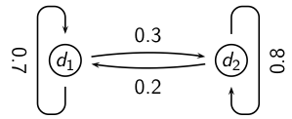
Exercise: Compute PageRank using power method
180

Slide 181
Solution
181

Slide 182
Solution
 | x₁ P_{t}(d₁) | x₂ P_{t}(d₂)
 |  |  | P₁₁ = 0.7 P₂₁ = 0.2 | P₁₂ = 0.3 P₂₂ = 0.8
t₀ | 0 | 1
t₁
t₂
t₃
t∞
PageRank vector = π = (π₁, π₂) = (0.4, 0.6)
P_{t}(d₁) = P_{t-1}(d₁) * P₁₁ + P_{t-1}(d₂) * P₂₁
  P_{t}(d₂) = P_{t-1}(d₁) * P₁₂ + P_{t-1}(d₂) * P₂₂
182

Slide 183
Solution
 | x₁ P_{t}(d₁) | x₂ P_{t}(d₂)
 |  |  | P₁₁ = 0.7 P₂₁ = 0.2 | P₁₂ = 0.3 P₂₂ = 0.8
t₀ | 0 | 1 | 0.2 | 0.8
t₁
t₂
t₃
t∞
PageRank vector = π = (π₁, π₂) = (0.4, 0.6)
P_{t}(d₁) = P_{t-1}(d₁) * P₁₁ + P_{t-1}(d₂) * P₂₁
  P_{t}(d₂) = P_{t-1}(d₁) * P₁₂ + P_{t-1}(d₂) * P₂₂
183

Slide 184
Solution
 | x₁ P_{t}(d₁) | x₂ P_{t}(d₂)
 |  |  | P₁₁ = 0.7 P₂₁ = 0.2 | P₁₂ = 0.3 P₂₂ = 0.8
t₀ | 0 | 1 | 0.2 | 0.8
t₁ | 0.2 | 0.8
t₂
t₃
t∞
PageRank vector = π = (π₁, π₂) = (0.4, 0.6)
P_{t}(d₁) = P_{t-1}(d₁) * P₁₁ + P_{t-1}(d₂) * P₂₁
  P_{t}(d₂) = P_{t-1}(d₁) * P₁₂ + P_{t-1}(d₂) * P₂₂
184

Slide 185
Solution
 | x₁ P_{t}(d₁) | x₂ P_{t}(d₂)
 |  |  | P₁₁ = 0.7 P₂₁ = 0.2 | P₁₂ = 0.3 P₂₂ = 0.8
t₀ | 0 | 1 | 0.2 | 0.8
t₁ | 0.2 | 0.8 | 0.3 | 0.7
t₂
t₃
t∞
PageRank vector = π = (π₁, π₂) = (0.4, 0.6)
P_{t}(d₁) = P_{t-1}(d₁) * P₁₁ + P_{t-1}(d₂) * P₂₁
  P_{t}(d₂) = P_{t-1}(d₁) * P₁₂ + P_{t-1}(d₂) * P₂₂
185

Slide 186
Solution
 | x₁ P_{t}(d₁) | x₂ P_{t}(d₂)
 |  |  | P₁₁ = 0.7 P₂₁ = 0.2 | P₁₂ = 0.3 P₂₂ = 0.8
t₀ | 0 | 1 | 0.2 | 0.8
t₁ | 0.2 | 0.8 | 0.3 | 0.7
t₂ | 0.3 | 0.7
t₃
t∞
PageRank vector = π = (π₁, π₂) = (0.4, 0.6)
P_{t}(d₁) = P_{t-1}(d₁) * P₁₁ + P_{t-1}(d₂) * P₂₁
  P_{t}(d₂) = P_{t-1}(d₁) * P₁₂ + P_{t-1}(d₂) * P₂₂
186

Slide 187
Solution
 | x₁ P_{t}(d₁) | x₂ P_{t}(d₂)
 |  |  | P₁₁ = 0.7 P₂₁ = 0.2 | P₁₂ = 0.3 P₂₂ = 0.8
t₀ | 0 | 1 | 0.2 | 0.8
t₁ | 0.2 | 0.8 | 0.3 | 0.7
t₂ | 0.3 | 0.7 | 0.35 | 0.65
t₃
t∞
PageRank vector = π = (π₁, π₂) = (0.4, 0.6)
P_{t}(d₁) = P_{t-1}(d₁) * P₁₁ + P_{t-1}(d₂) * P₂₁
  P_{t}(d₂) = P_{t-1}(d₁) * P₁₂ + P_{t-1}(d₂) * P₂₂
187

Slide 188
Solution
 | x₁ P_{t}(d₁) | x₂ P_{t}(d₂)
 |  |  | P₁₁ = 0.7 P₂₁ = 0.2 | P₁₂ = 0.3 P₂₂ = 0.8
t₀ | 0 | 1 | 0.2 | 0.8
t₁ | 0.2 | 0.8 | 0.3 | 0.7
t₂ | 0.3 | 0.7 | 0.35 | 0.65
t₃ | 0.35 | 0.65
t∞
PageRank vector = π = (π₁, π₂) = (0.4, 0.6)
P_{t}(d₁) = P_{t-1}(d₁) * P₁₁ + P_{t-1}(d₂) * P₂₁
  P_{t}(d₂) = P_{t-1}(d₁) * P₁₂ + P_{t-1}(d₂) * P₂₂
188

Slide 189
Solution
 | x₁ P_{t}(d₁) | x₂ P_{t}(d₂)
 |  |  | P₁₁ = 0.7 P₂₁ = 0.2 | P₁₂ = 0.3 P₂₂ = 0.8
t₀ | 0 | 1 | 0.2 | 0.8
t₁ | 0.2 | 0.8 | 0.3 | 0.7
t₂ | 0.3 | 0.7 | 0.35 | 0.65
t₃ | 0.35 | 0.65 | 0.375 | 0.625
t∞
PageRank vector = π = (π₁, π₂) = (0.4, 0.6)
P_{t}(d₁) = P_{t-1}(d₁) * P₁₁ + P_{t-1}(d₂) * P₂₁
  P_{t}(d₂) = P_{t-1}(d₁) * P₁₂ + P_{t-1}(d₂) * P₂₂
189

Slide 190
Solution
 | x₁ P_{t}(d₁) | x₂ P_{t}(d₂)
 |  |  | P₁₁ = 0.7 P₂₁ = 0.2 | P₁₂ = 0.3 P₂₂ = 0.8
t₀ | 0 | 1 | 0.2 | 0.8
t₁ | 0.2 | 0.8 | 0.3 | 0.7
t₂ | 0.3 | 0.7 | 0.35 | 0.65
t₃ | 0.35 | 0.65 | 0.375 | 0.625
 |  |  | . . .
t∞
PageRank vector = π = (π₁, π₂) = (0.4, 0.6)
P_{t}(d₁) = P_{t-1}(d₁) * P₁₁ + P_{t-1}(d₂) * P₂₁
  P_{t}(d₂) = P_{t-1}(d₁) * P₁₂ + P_{t-1}(d₂) * P₂₂
190

Slide 191
Solution
 | x₁ P_{t}(d₁) | x₂ P_{t}(d₂)
 |  |  | P₁₁ = 0.7 P₂₁ = 0.2 | P₁₂ = 0.3 P₂₂ = 0.8
t₀ | 0 | 1 | 0.2 | 0.8
t₁ | 0.2 | 0.8 | 0.3 | 0.7
t₂ | 0.3 | 0.7 | 0.35 | 0.65
t₃ | 0.35 | 0.65 | 0.375 | 0.625
 |  |  | . . .
t∞ | 0.4 | 0.6
PageRank vector = π = (π₁, π₂) = (0.4, 0.6)
P_{t}(d₁) = P_{t-1}(d₁) * P₁₁ + P_{t-1}(d₂) * P₂₁
  P_{t}(d₂) = P_{t-1}(d₁) * P₁₂ + P_{t-1}(d₂) * P₂₂
191

Slide 192
Solution
 | x₁ P_{t}(d₁) | x₂ P_{t}(d₂)
 |  |  | P₁₁ = 0.7 P₂₁ = 0.2 | P₁₂ = 0.3 P₂₂ = 0.8
t₀ | 0 | 1 | 0.2 | 0.8
t₁ | 0.2 | 0.8 | 0.3 | 0.7
t₂ | 0.3 | 0.7 | 0.35 | 0.65
t₃ | 0.35 | 0.65 | 0.375 | 0.625
 |  |  | . . .
t∞ | 0.4 | 0.6 | 0.4 | 0.6
PageRank vector = π = (π₁, π₂) = (0.4, 0.6)
P_{t}(d₁) = P_{t-1}(d₁) * P₁₁ + P_{t-1}(d₂) * P₂₁
  P_{t}(d₂) = P_{t-1}(d₁) * P₁₂ + P_{t-1}(d₂) * P₂₂
192

Slide 193
PageRank summary
193

Slide 194
PageRank summary
Offline processing
194

Slide 195
PageRank summary
Offline processing
  Given graph of links, build matrix P
195

Slide 196
PageRank summary
Offline processing
  Given graph of links, build matrix P
  Apply teleportation
196

Slide 197
PageRank summary
Offline processing
  Given graph of links, build matrix P
  Apply teleportation
  From modified matrix, compute π
197

Slide 198
PageRank summary
Offline processing
  Given graph of links, build matrix P
  Apply teleportation
  From modified matrix, compute π
  π_{i} is the PageRank of page i.
198

Slide 199
PageRank summary
Offline processing
  Given graph of links, build matrix P
  Apply teleportation
  From modified matrix, compute π
  π_{i} is the PageRank of page i.
Query processing
199

Slide 200
PageRank summary
Offline processing
  Given graph of links, build matrix P
  Apply teleportation
  From modified matrix, compute π
  π_{i} is the PageRank of page i.
Query processing
  Retrieve pages satisfying the query
200

Slide 201
PageRank summary
Offline processing
  Given graph of links, build matrix P
  Apply teleportation
  From modified matrix, compute π
  π_{i} is the PageRank of page i.
Query processing
  Retrieve pages satisfying the query
  Rank them by their PageRank
201

Slide 202
PageRank summary
Offline processing
  Given graph of links, build matrix P
  Apply teleportation
  From modified matrix, compute π
  π_{i} is the PageRank of page i.
Query processing
  Retrieve pages satisfying the query
  Rank them by their PageRank
  Return reranked list to the user
202

Slide 203
PageRank summary
Offline processing
  Given graph of links, build matrix P
  Apply teleportation
  From modified matrix, compute π
  π_{i} is the PageRank of page i.
Query processing
  Retrieve pages satisfying the query
  Rank them by their PageRank
  Return reranked list to the user
Question: How should we represent matrix P w/teleportation?
  How much memory will be need?
203

Slide 204
Exploit sparsity of links
Do you need to do this in the inner loop?
Swap these two lines:
assignment should be outside the for loop.

Slide 205
PageRank issues
Real surfers are not random surfers.
  Examples of nonrandom surfing: back button, short vs. long paths, bookmarks, directories – and search!
  → Markov model is not a good model of surfing.
  But it’s good enough as a model for our purposes.
Simple PageRank ranking (as described on previous slide) produces bad results for many pages.
  Consider the query [video service].
  The Facebook home page (i) has a very high PageRank and (ii) contains both video and service.
  If we rank all pages containing the query terms according to PageRank, then the FB home page would be top-ranked.
  Clearly not desirable.
205

Slide 206
How important is PageRank?
Frequent claim: PageRank is the most important component of web ranking.
The reality:
  There are several components that are at least as important: e.g., anchor text, phrases, proximity, tiered indexes ...
  Rumor has it that PageRank in his original form (as presented here) now has a negligible impact on ranking!
  However, variants of a page’s PageRank are still an essential part of ranking.
  Addressing link spam is difficult and crucial.
206

