Slide 1
CS6200/IS4200
Information Retrieval
David Smith
Khoury College of Computer Sciences
Northeastern University

Slide 2
Indexing Process

Slide 3
Indexes
Indexes are data structures designed to make search faster
Text search has unique requirements, which leads to unique data structures
Most common data structure is inverted index
  general name for a class of structures
  “inverted” because documents are associated with words, rather than words with documents
    similar to a concordance

Slide 4
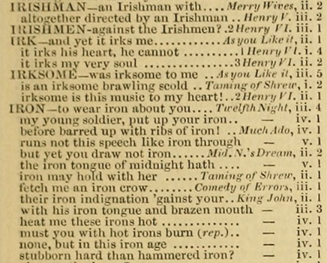
A Shakespeare Concordance

Slide 5
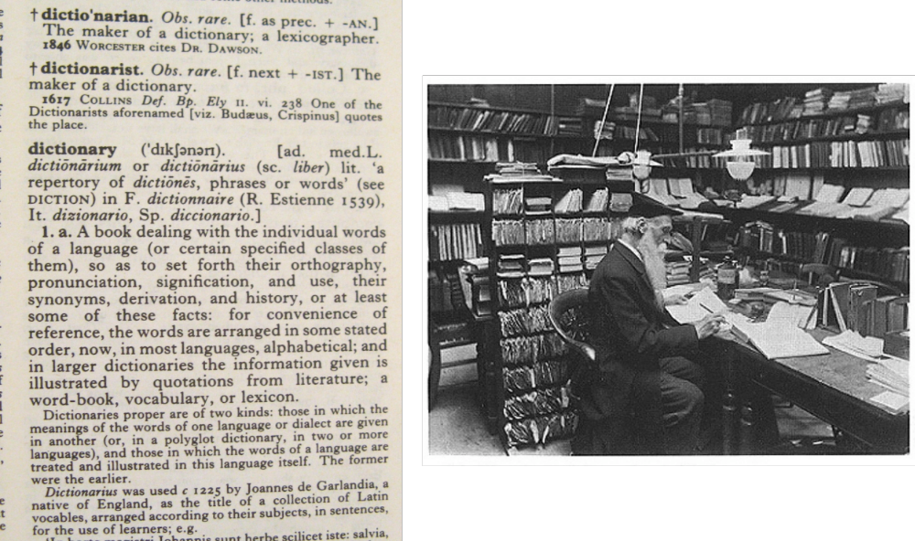
How to Write a Dictionary

Slide 6
Indexes and Ranking
Indexes are designed to support search
  faster response time, supports updates
Text search engines use a particular form of search: ranking
  documents are retrieved in sorted order according to a score computing using the document representation, the query, and a ranking algorithm
What is a reasonable abstract model for ranking?
  enables discussion (and some implementation) of indexes without details of retrieval model

Slide 7
Abstract Model of Ranking

Slide 8
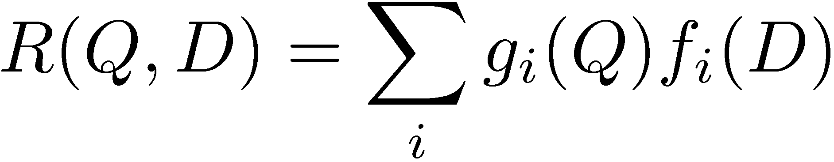
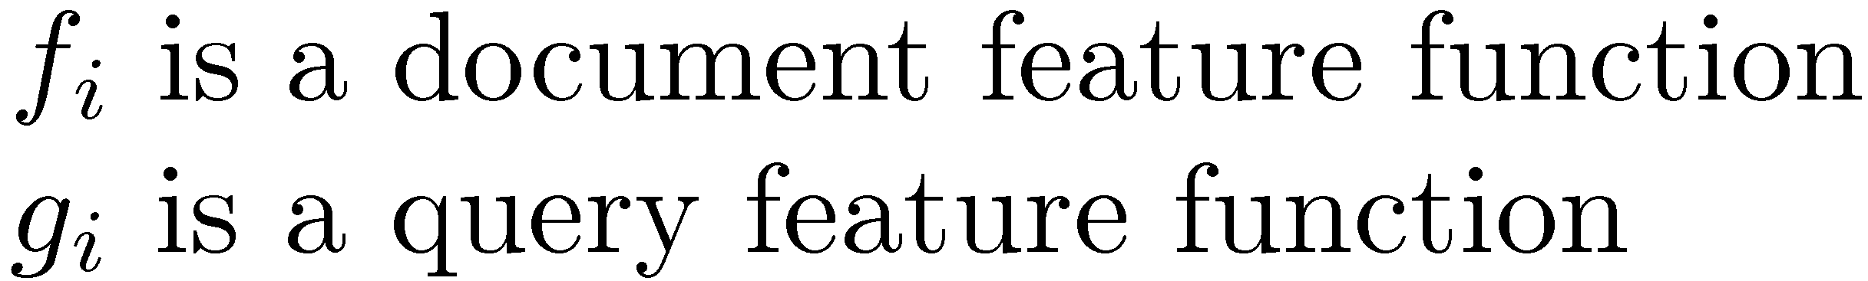
More Concrete Model

Slide 9
Inverted Index
Each index term is linked to an inverted list
  Contains lists of documents, or lists of word occurrences in documents, and other information
  Each entry is called a posting
  The part of the posting that refers to a specific document or location is called a pointer
  Each document in the collection is given a unique number
  Lists are usually document-ordered (sorted by document number) so that different lists are comparable

Slide 10
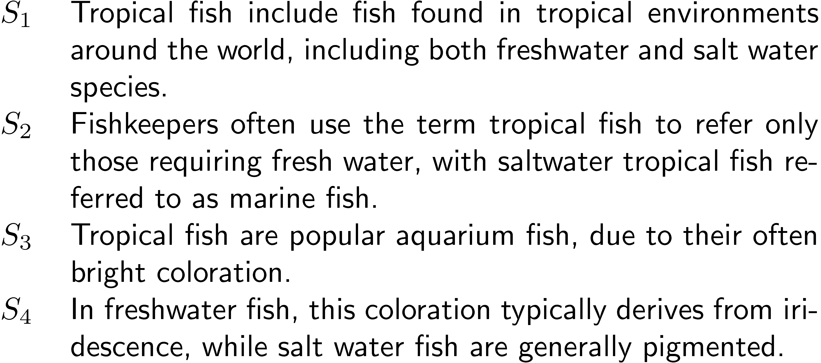
Example “Collection”

Slide 11
Simple Inverted
Index

Slide 12
Inverted Index
with counts
supports better ranking algorithms

Slide 13
Inverted Index
with positions
  supports
proximity matches

Slide 14
Proximity Matches
Matching phrases or words within a window
  e.g., "tropical fish", or “find tropical within 5 words of fish”
Word positions in inverted lists make these types of query features efficient
  e.g.,

Slide 15
Fields and Extents
Document structure is useful in search
  field restrictions
    e.g., date, from:, etc.
  some fields more important
    e.g., title
Options:
  separate inverted lists for each field type
  add information about fields to postings
  use extent lists

Slide 16
Extent Lists
An extent is a contiguous region of a document
  represent extents using word positions
  inverted list records all extents for a given field type
  e.g.,
extent list

Slide 17
Other Issues
Precomputed scores in inverted list
  e.g., list for “fish” [(1:3.6), (3:2.2)], where 3.6 is total feature value for document 1
  improves speed but reduces flexibility
Score-ordered lists
  query processing engine can focus only on the top part of each inverted list, where the highest-scoring documents are recorded
  very efficient for single-word queries

Slide 18
Compression
Inverted lists are very large
  e.g., 25-50% of collection for TREC collections using Indri search engine
  Much higher if n-grams are indexed
Compression of indexes saves disk and/or memory space
  Typically have to decompress lists to use them
  Best compression techniques have good compression ratios and are easy to decompress
Lossless compression – no information lost

Slide 19
Compression
Basic idea: Common data elements use short codes while uncommon data elements use longer codes
  Example: coding numbers
    number sequence:
    possible encoding:
    encode 0 using a single 0:
    only 10 bits, but...
0, 1, 0, 2, 0, 3, 0
00 01 00 10 00 11 00
0 01 0 10 0 11 0

Slide 20
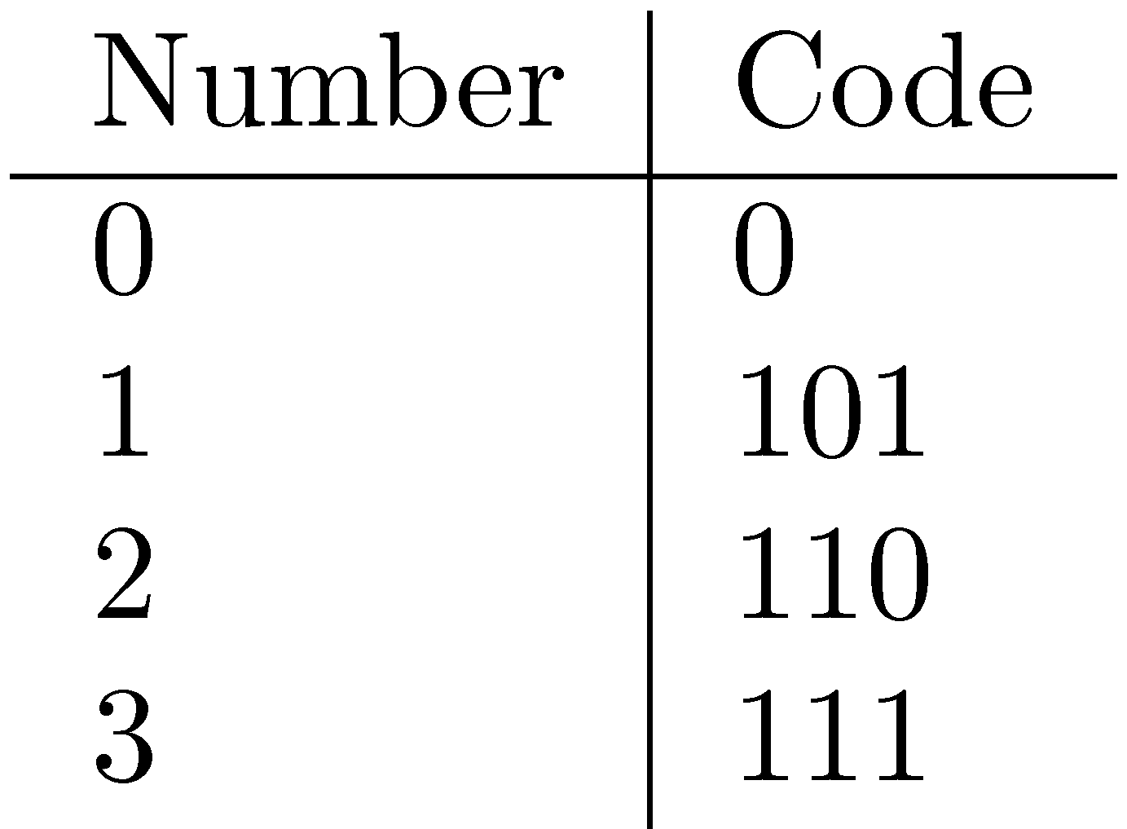
Compression Example
Ambiguous encoding – not clear how to decode
    another decoding:
    which represents:
    use unambiguous code:
    which gives:
0 01 01 0 0 11 0
0, 1, 1, 0, 0, 3, 0
0 101 0 110 0 110 0

Slide 21
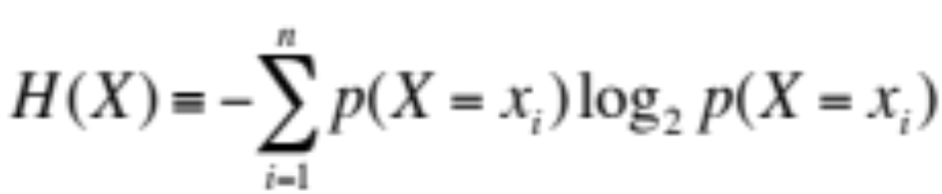
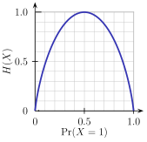
Compression and Entropy
Entropy measures “randomness”
  Inverse of “compressability”
  Log2: measured in bits
  Upper bound: log n
  Entropy = log(perplexity)
  Example curve for binomial

Slide 22
Compression and Entropy
Entropy bounds compression rate
  Theorem: H(X) ≤ E[ |encoded(X)| ]
  Recall: H(X) ≤ log(n)
  n is the size of the domain of X
Standard binary encoding of integers optimizes for the worst case where choice of numbers is completely unpredictable (= max entropy)
It turns out, we can do better. At best:
  H(X) ≤ E[ |encoded(X)| ] < H(X) + 1
  Bound achieved by Huffman codes

Slide 23
Delta Encoding
Word count data is good candidate for compression
  many small numbers and few larger numbers
  encode small numbers with small codes
Document numbers are less predictable
  but differences between numbers in an ordered list are smaller and more predictable
Delta encoding:
  encoding differences between document numbers (d-gaps)

Slide 24
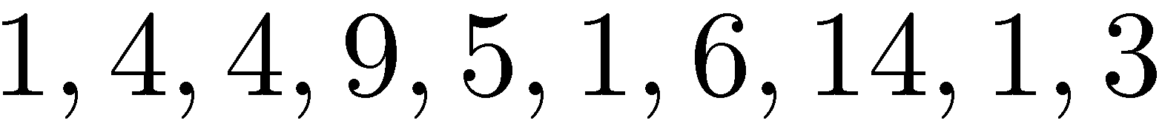
Delta Encoding
  Inverted list (without counts)
  Differences between adjacent numbers
  Differences for a high-frequency word are easier to compress, e.g.,
  Differences for a low-frequency word are large, e.g.,

Slide 25
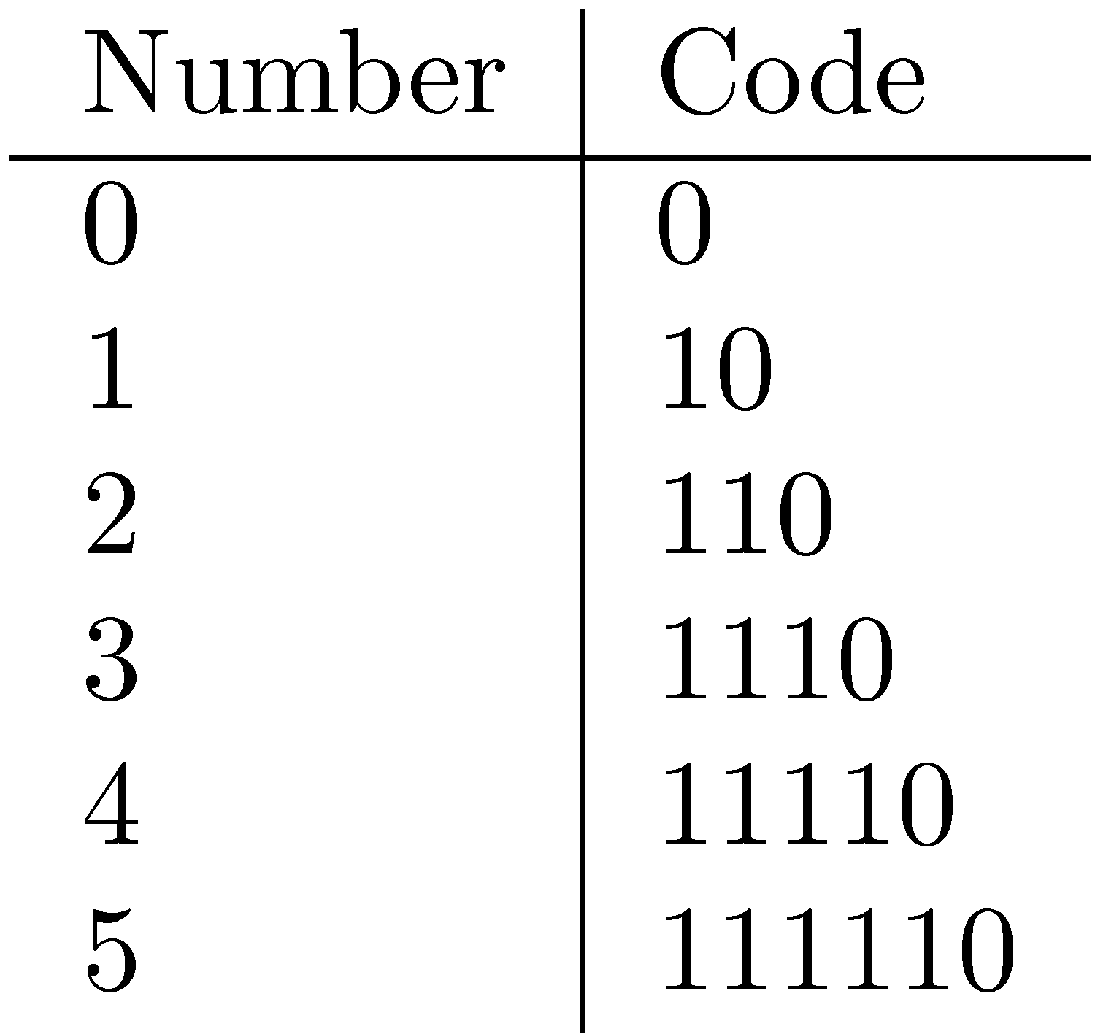
Bit-Aligned Codes
Breaks between encoded numbers can occur after any bit position
Unary code
  Encode k by k 1s followed by 0
  0 at end makes code unambiguous

Slide 26
Unary and Binary Codes
Unary is very efficient for small numbers such as 0 and 1, but quickly becomes very expensive
  1023 can be represented in 10 binary bits, but requires 1024 bits in unary
Binary is more efficient for large numbers, but it may be ambiguous

Slide 27
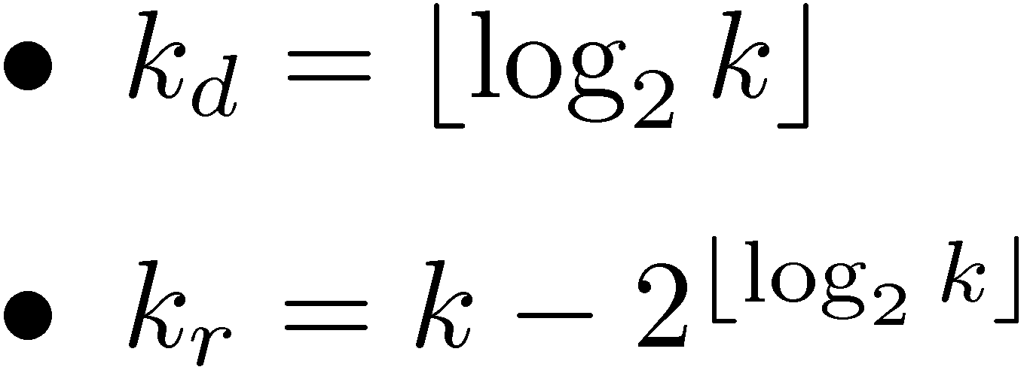
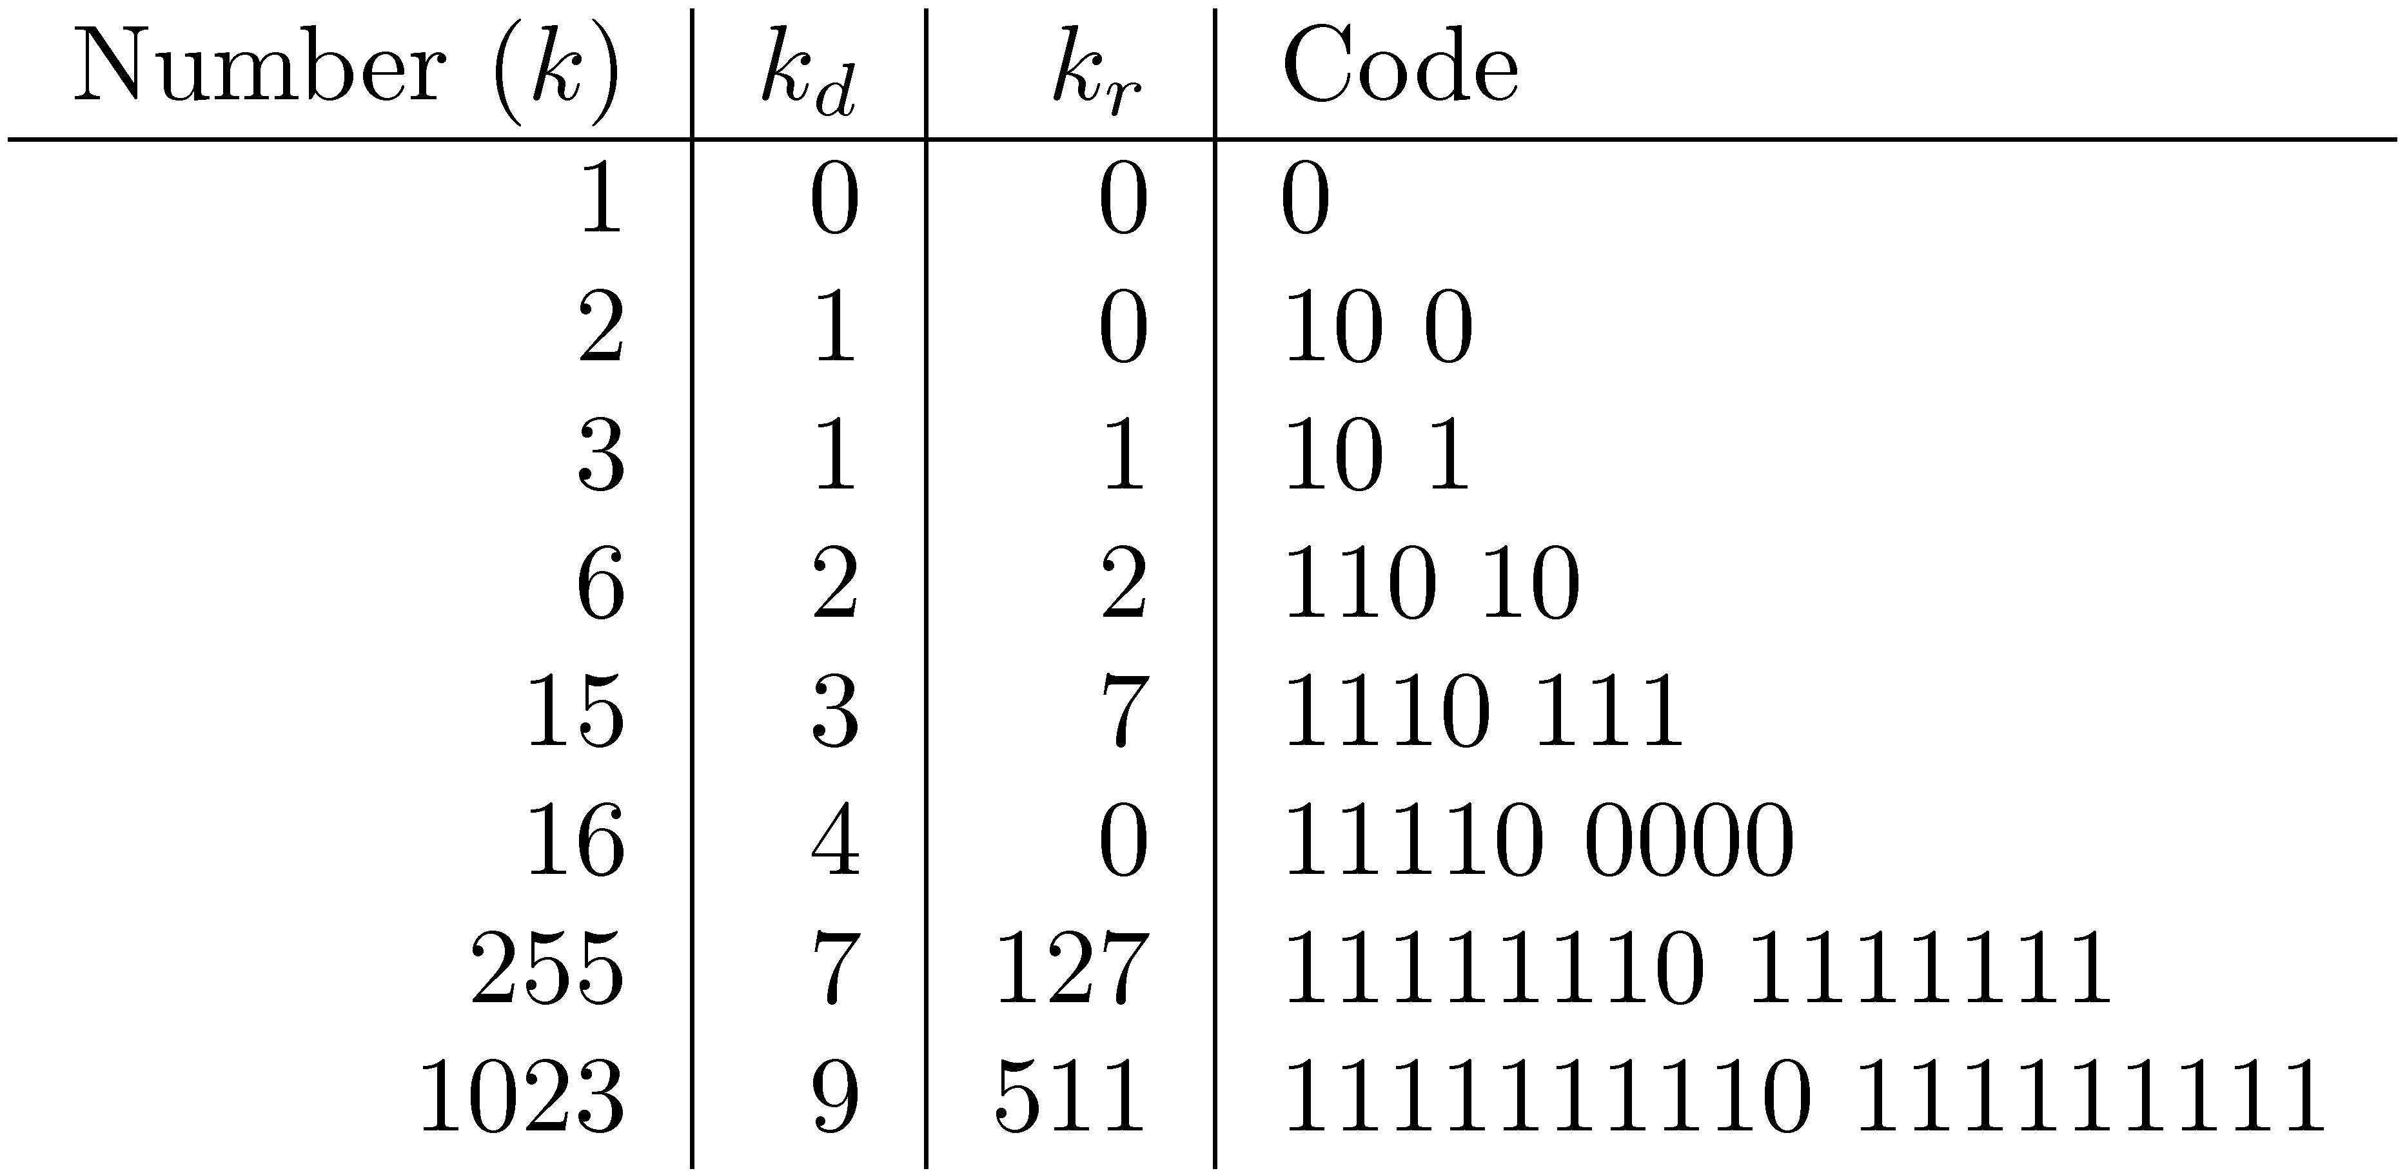
Elias-γ Code
To encode a number k, compute
    k_{d} is number of binary digits, encoded in unary

Slide 28
Elias-δ Code
Elias-γ code uses no more bits than unary, many fewer for k > 2
  1023 takes 19 bits instead of 1024 bits using unary
In general, takes 2⌊log₂k⌋+1 bits
To improve coding of large numbers, use Elias-δ code
  Instead of encoding k_{d} in unary, we encode k_{d} + 1 using Elias-γ
  Takes approximately 2 log₂ log₂ k + log₂ k bits

Slide 29
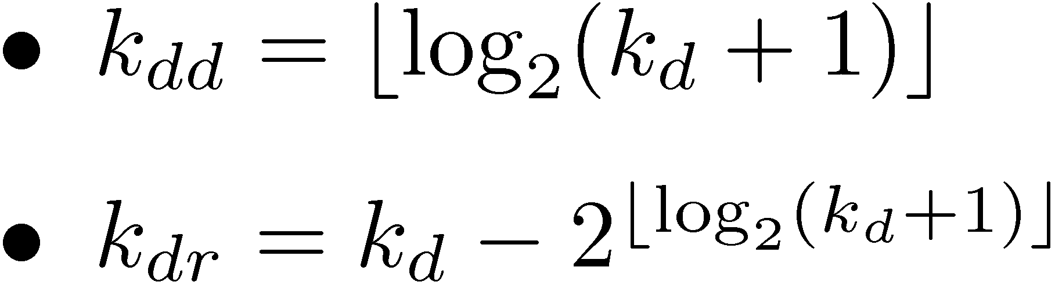
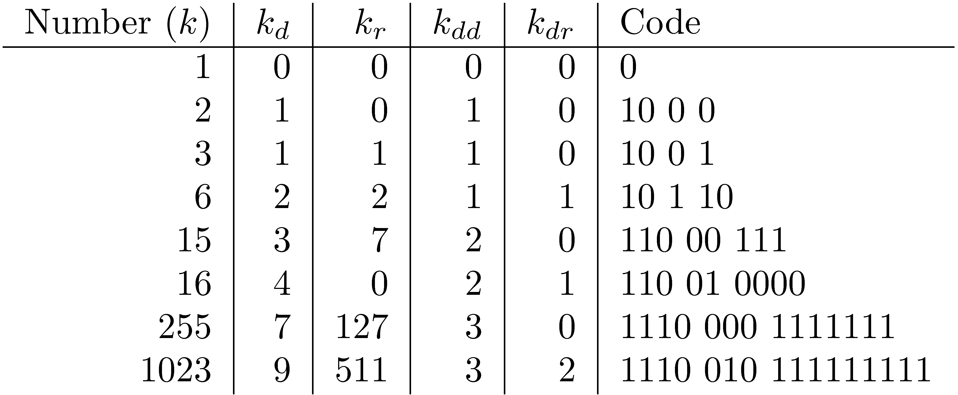
Elias-δ Code
Split k_{d} into:
  encode k_{dd} in unary, k_{dr} in binary, and k_{r} in binary

Slide 31
Byte-Aligned Codes
Variable-length bit encodings can be a problem on processors that process bytes
v-byte is a popular byte-aligned code
  Similar to Unicode UTF-8
Shortest v-byte code is 1 byte
Numbers are 1 to 4 bytes, with high bit 1 in the last byte, 0 otherwise

Slide 32
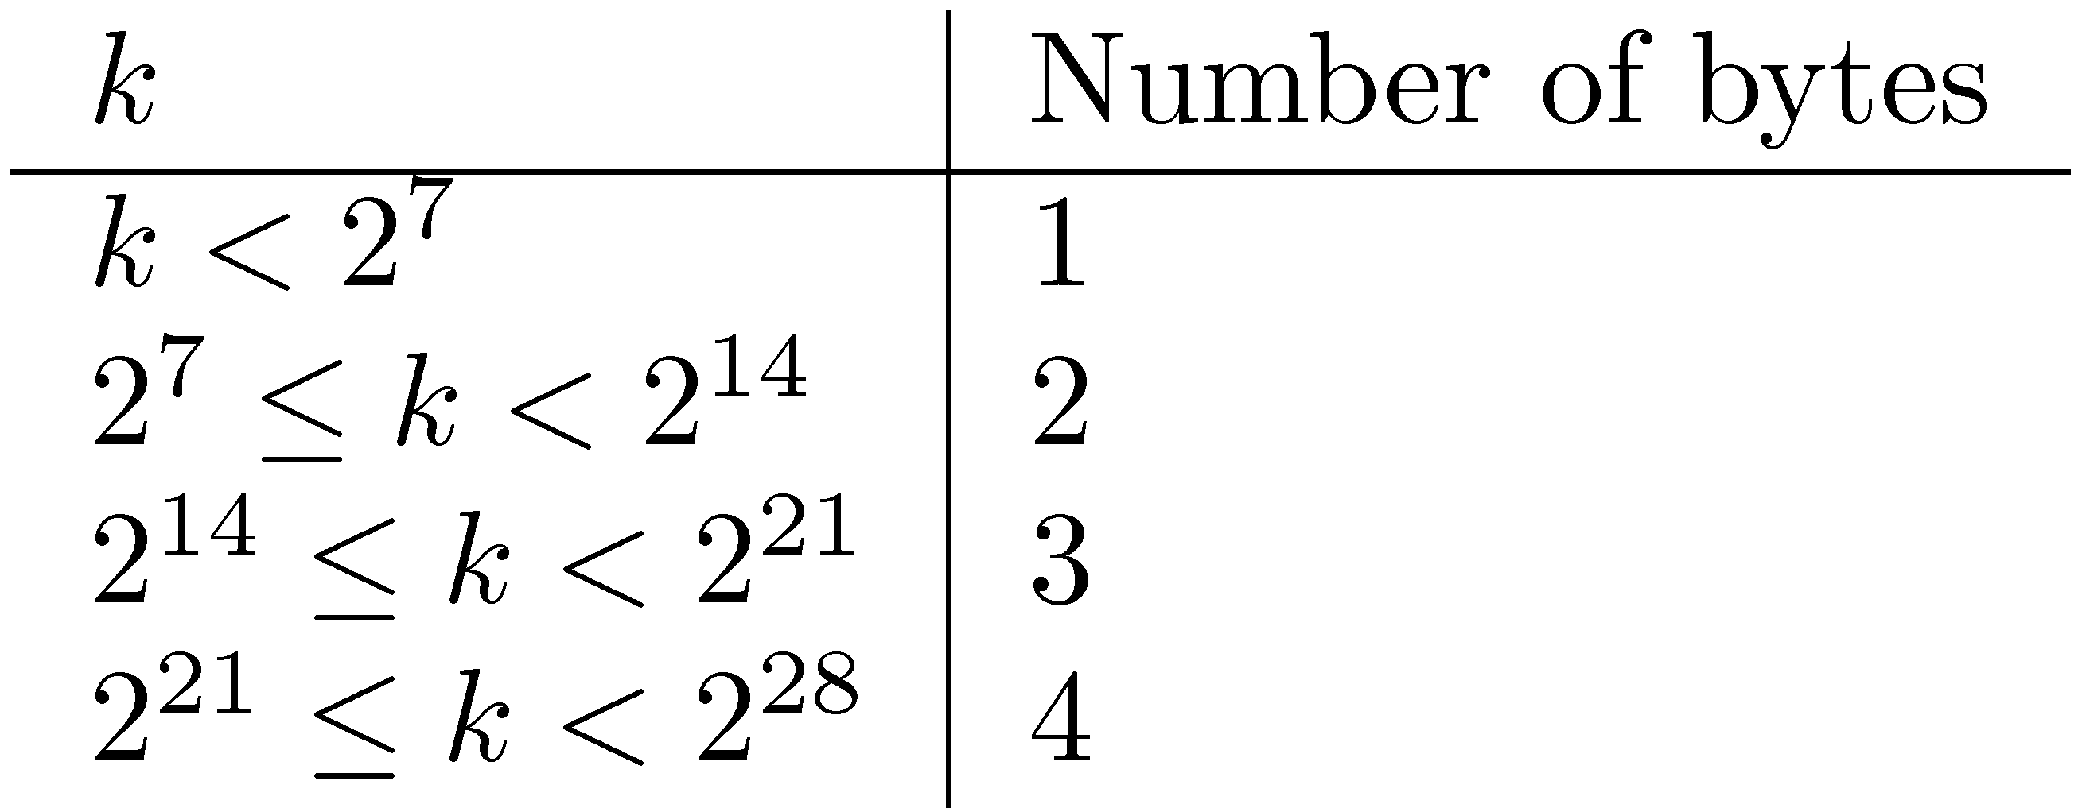
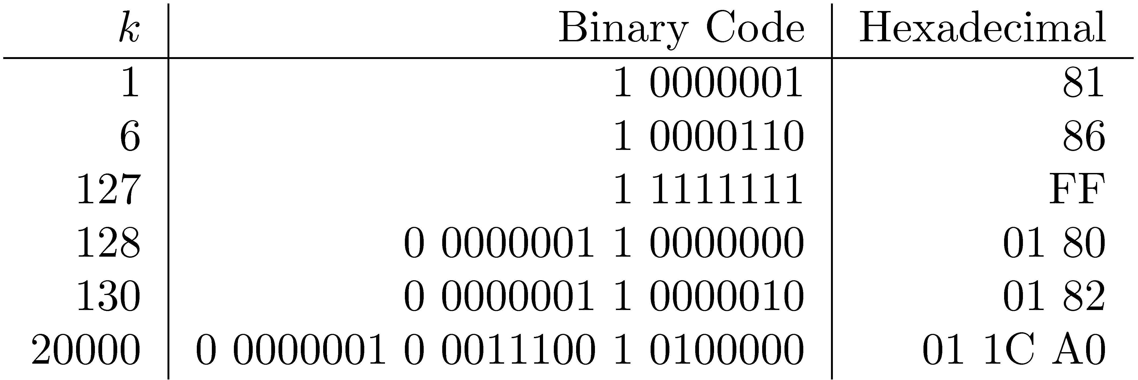
V-Byte Encoding

Slide 33
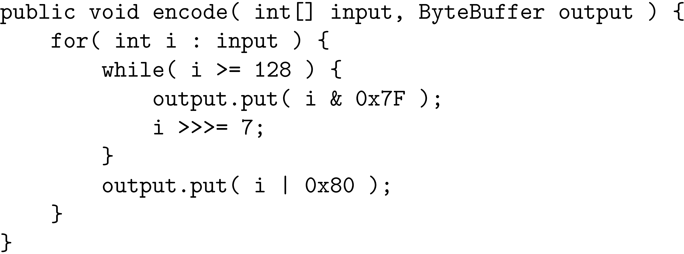
V-Byte Encoder

Slide 34
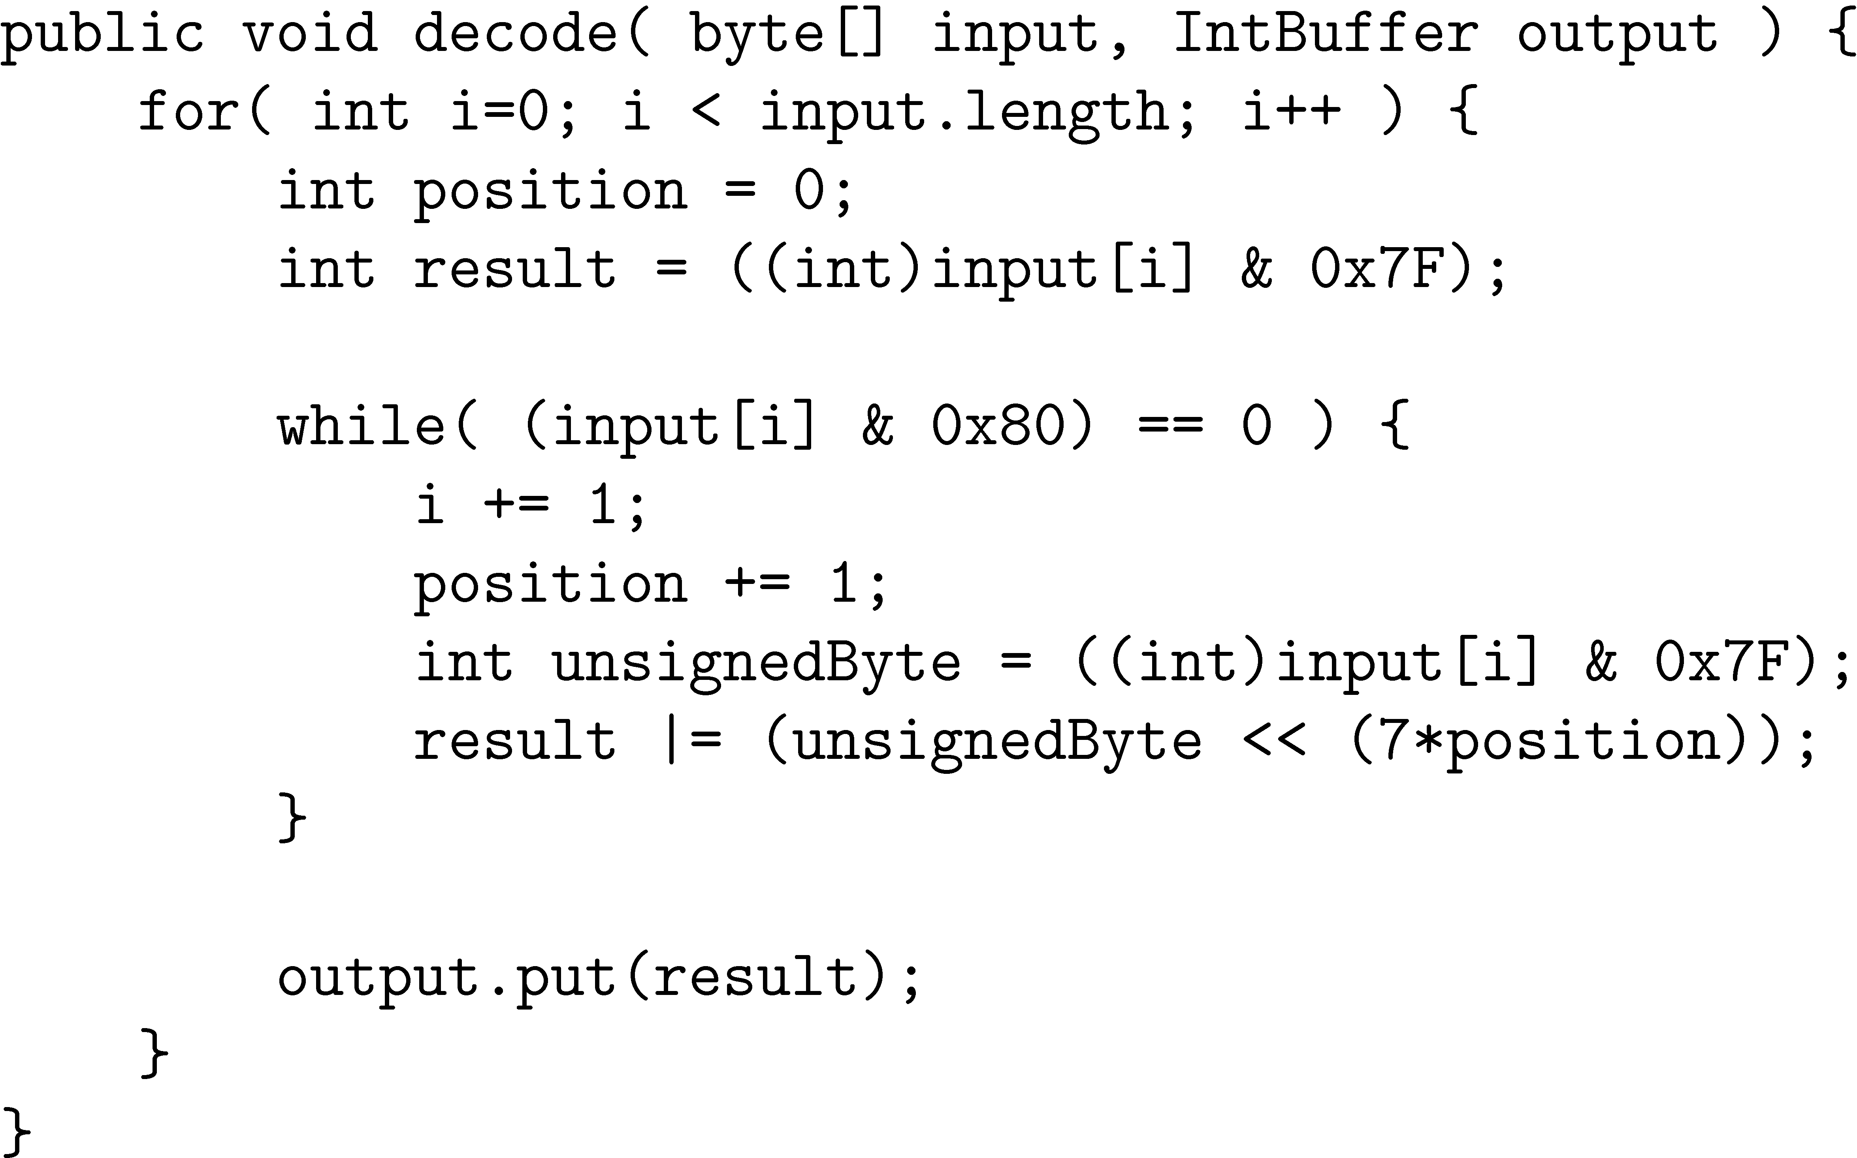
V-Byte Decoder

Slide 35
Compression Example
Consider inverted list with counts & positions:
Delta encode document numbers and positions:
Compress using v-byte:
81 82 81 86 81 83 86 8B 01 B4 81 81 81

Slide 36
Skipping
Search involves comparison of inverted lists of different lengths
  Can be very inefficient
  “Skipping” ahead to check document numbers is much better
  Compression makes this difficult
    Variable size, only d-gaps stored
Skip pointers are additional data structure to support skipping

Slide 37
Skip Pointers
A skip pointer (d, p) contains a document number d and a byte (or bit) position p
  Means there is an inverted list posting that starts at position p, and the posting before it was for document d
Inverted list
skip pointers

Slide 38
Skip Pointers
Example
  Inverted list
  D-gaps
  Skip pointers

Slide 39
Auxiliary Structures
Inverted lists usually stored together in a single file for efficiency
  Inverted file
Vocabulary or lexicon
  Contains a lookup table from index terms to the byte offset of the inverted list in the inverted file
  Either hash table in memory or B-tree for larger vocabularies
Term statistics stored at start of inverted lists
Collection statistics stored in separate file

Slide 40
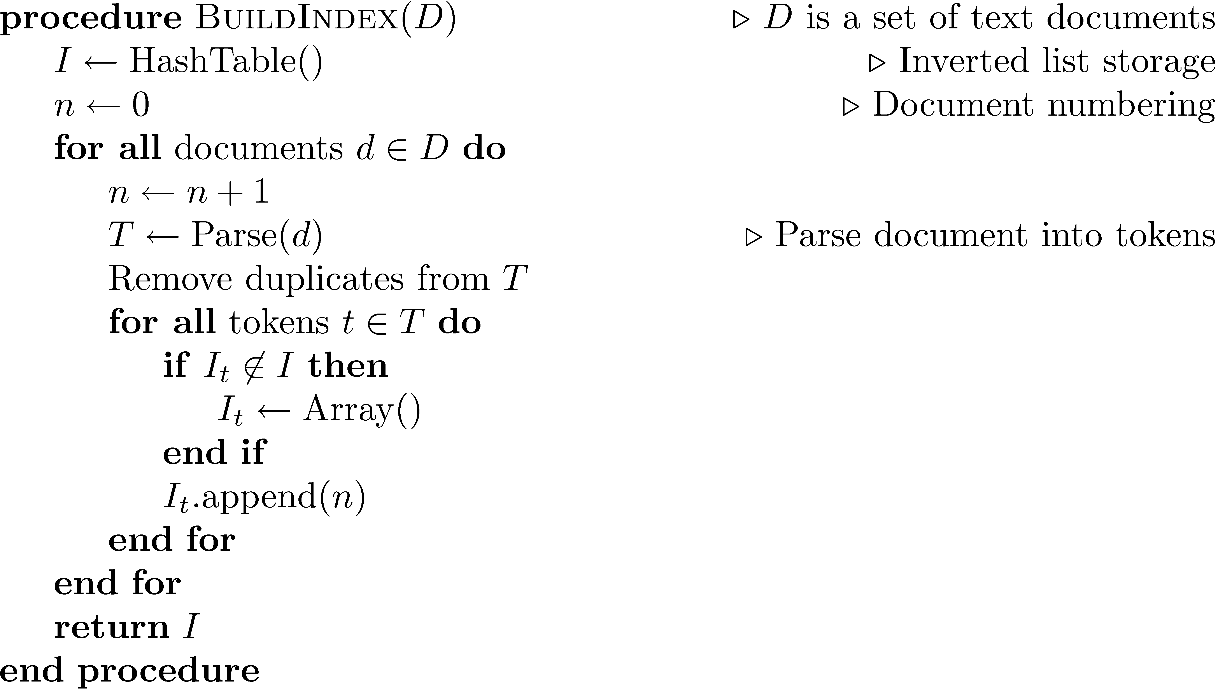
Index Construction
Simple in-memory indexer

Slide 41
Merging
Merging addresses limited memory problem
  Build the inverted list structure until memory runs out
  Then write the partial index to disk, start making a new one
  At the end of this process, the disk is filled with many partial indexes, which are merged
Partial lists must be designed so they can be merged in small pieces
  e.g., storing in alphabetical order

Slide 42
Merging

Slide 43
Distributed Indexing
Distributed processing driven by need to index and analyze huge amounts of data (i.e., the Web)
Large numbers of inexpensive servers used rather than larger, more expensive machines
MapReduce is a distributed programming model designed for indexing and analysis tasks

Slide 44
Example
Given a large text file that contains data about credit card transactions
  Each line of the file contains a credit card number and an amount of money
  Determine the number of unique credit card numbers
Could use hash table – memory problems
  counting is simple with sorted file
Similar with distributed approach
  sorting and placement are crucial

Slide 45
MapReduce
Distributed programming framework that focuses on data placement and distribution
Mapper
  Generally, transforms a list of items into another list of items of the same length
Reducer
  Transforms a list of items into a single item
  Definitions not so strict in terms of number of outputs
Many mapper and reducer tasks on a cluster of machines

Slide 46
MapReduce
Basic process
  Map stage which transforms data records into pairs, each with a key and a value
  Shuffle uses a hash function so that all pairs with the same key end up next to each other and on the same machine
  Reduce stage processes records in batches, where all pairs with the same key are processed at the same time
Idempotence of Mapper and Reducer provides fault tolerance
  redundant runs on same input gives same output

Slide 47
MapReduce

Slide 48
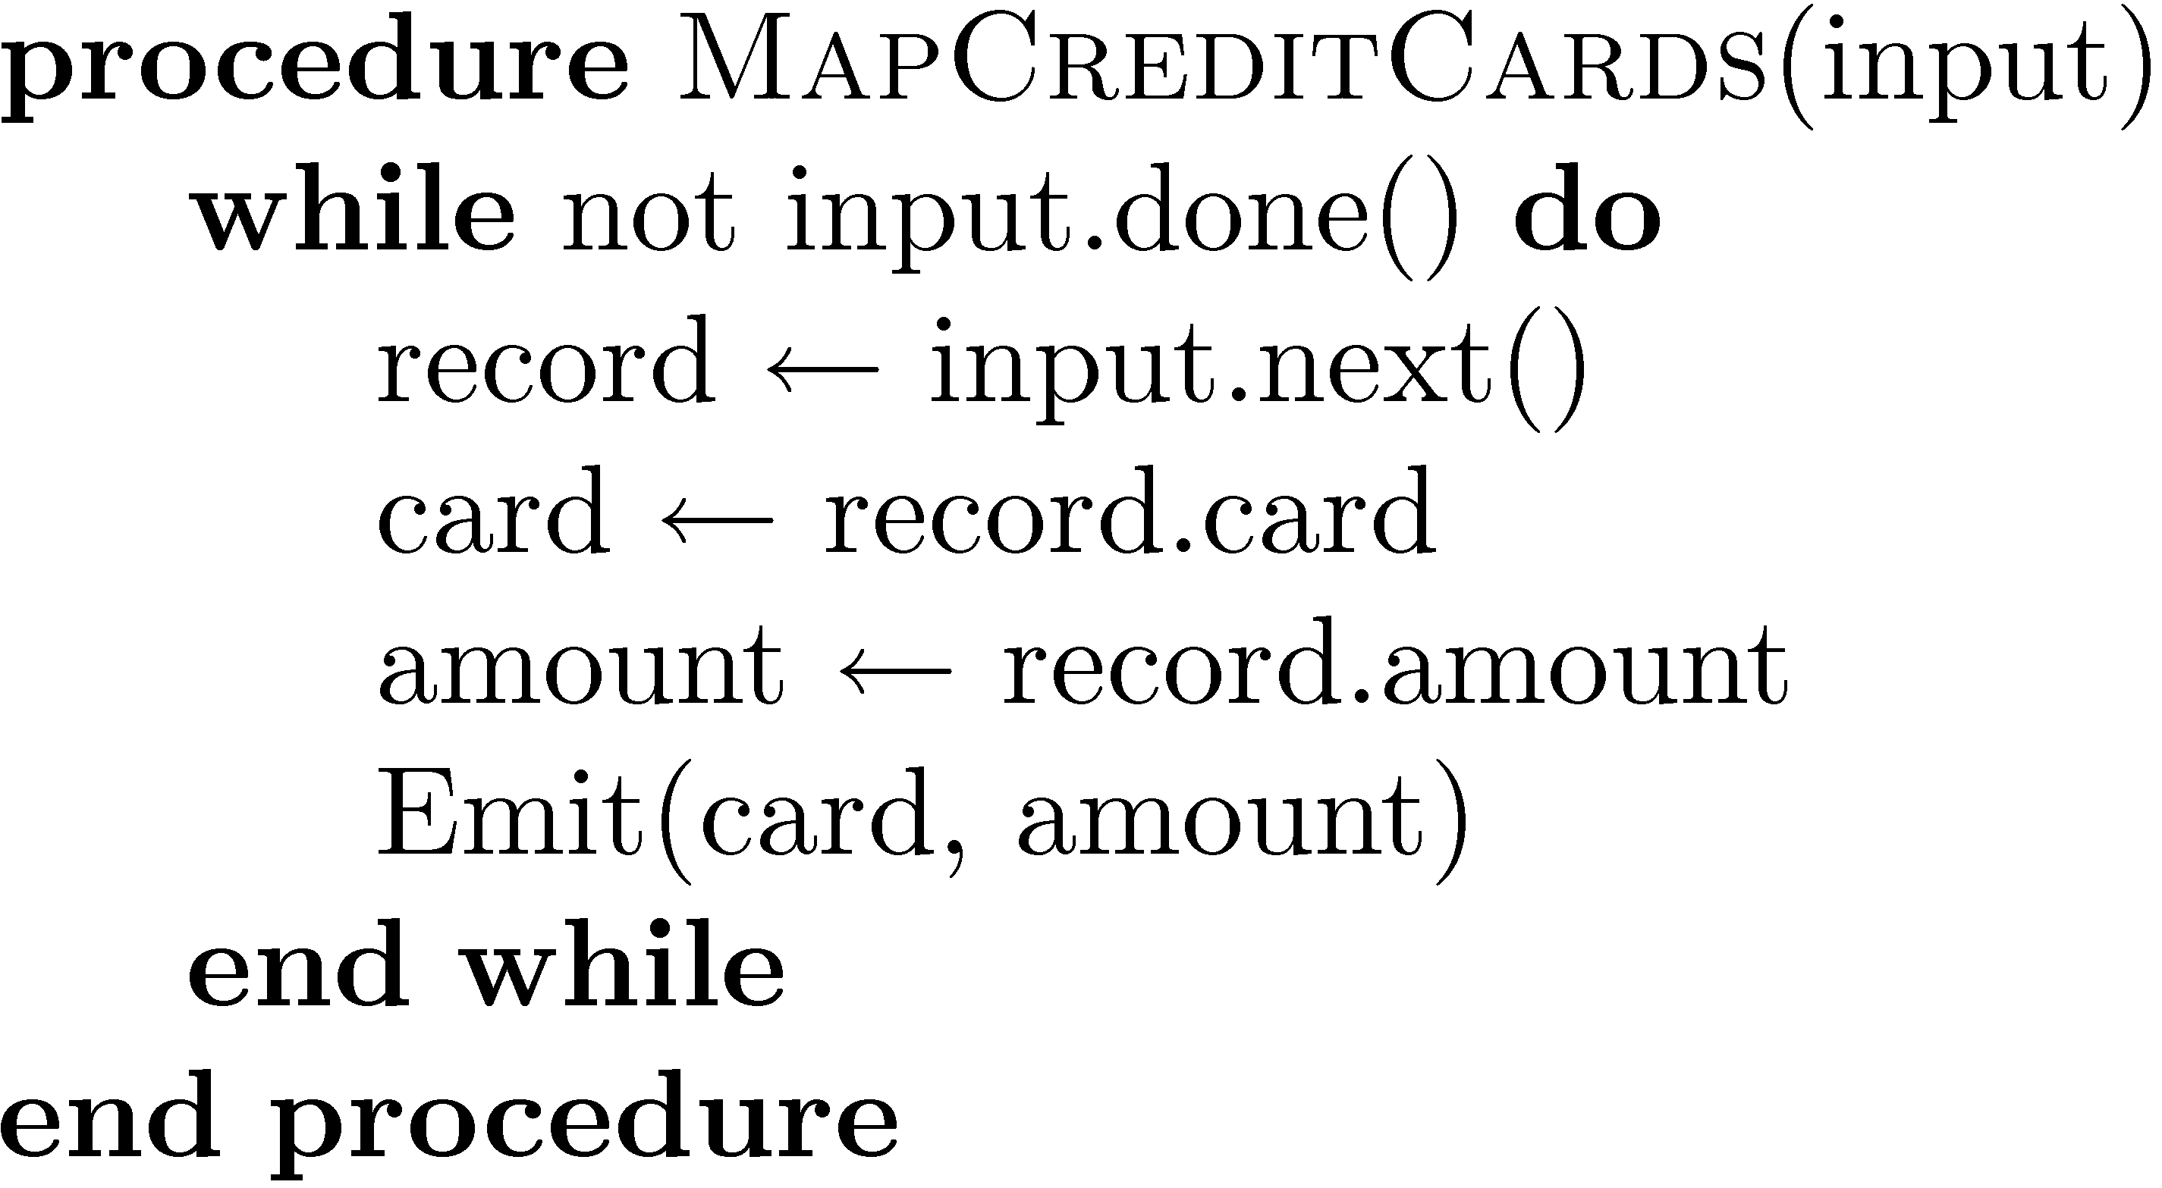
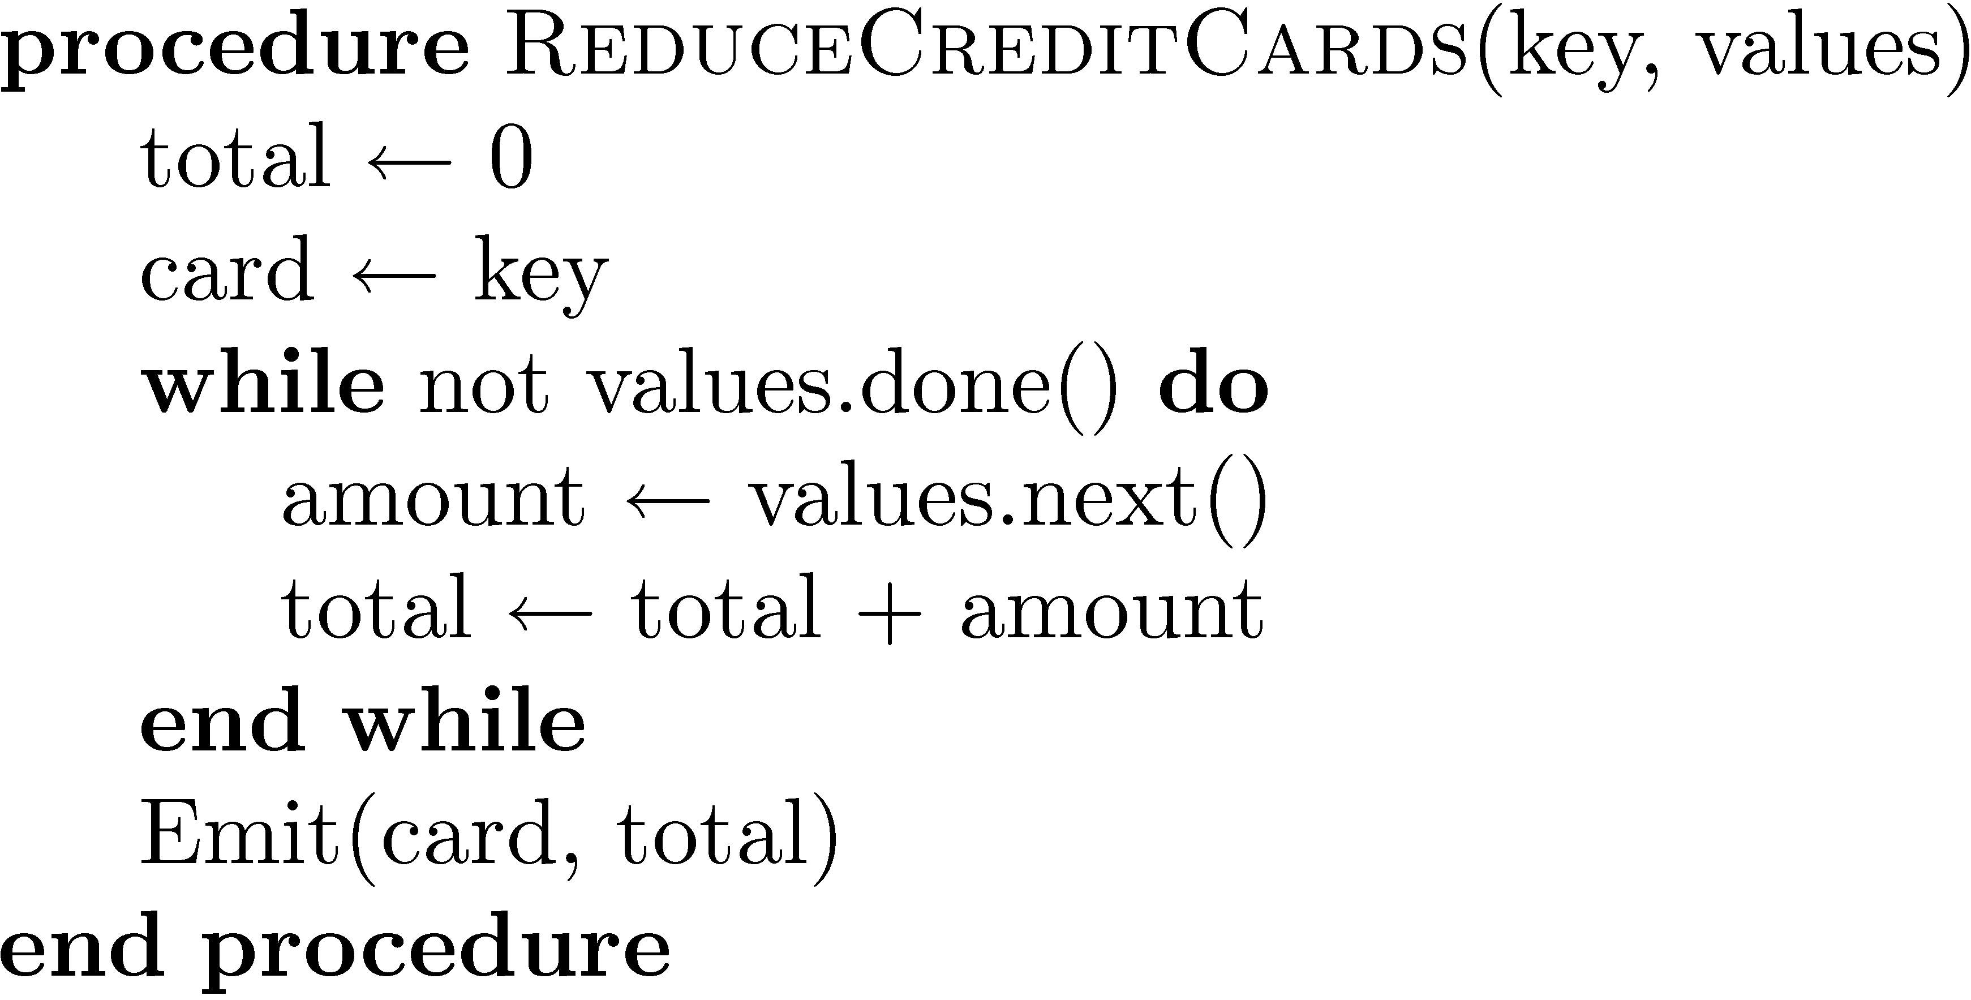
Example

Slide 49
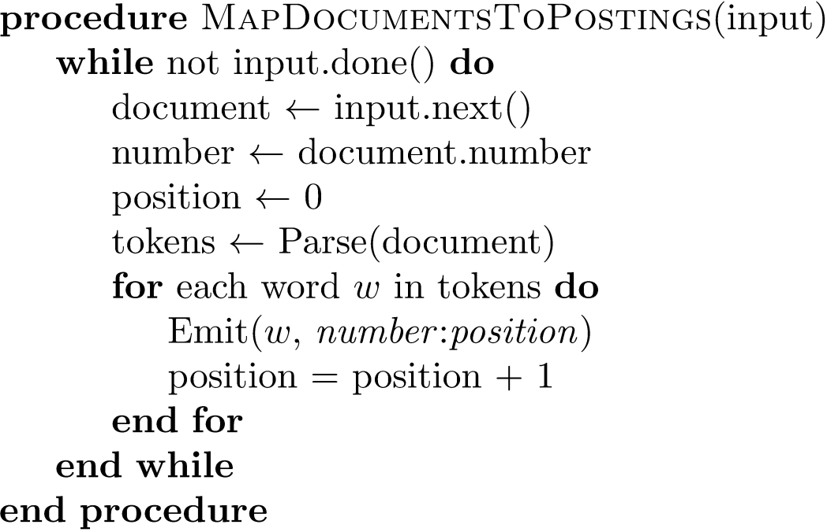
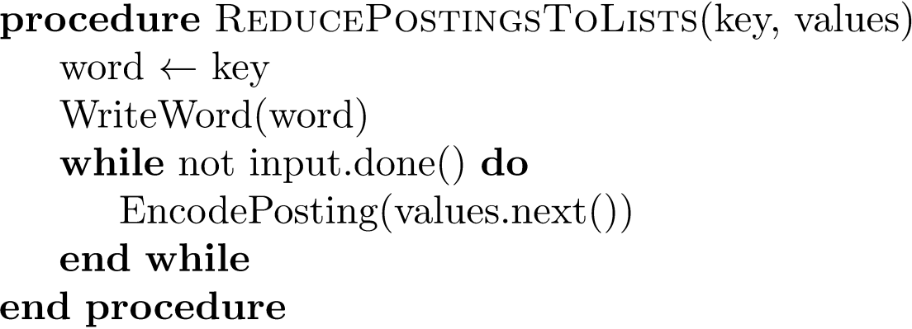
Indexing Example

Slide 50
Result Merging
Index merging is a good strategy for handling updates when they come in large batches
For small updates this is very inefficient
  instead, create separate index for new documents, merge results from both searches
  could be in-memory, fast to update and search
Deletions handled using delete list
  Modifications done by putting old version on delete list, adding new version to new documents index

Slide 51
Query Processing
Document-at-a-time
  Calculates complete scores for documents by processing all term lists, one document at a time
Term-at-a-time
  Accumulates scores for documents by processing term lists one at a time
Both approaches have optimization techniques that significantly reduce time required to generate scores

Slide 52
Document-At-A-Time

Slide 53
Pseudocode Function Descriptions
getCurrentDocument()
  Returns the document number of the current posting of the inverted list.
skipForwardToDocument(d)
  Moves forward in the inverted list until getCurrentDocument() <= d. This function may read to the end of the list.
movePastDocument(d)
  Moves forward in the inverted list until getCurrentDocument() < d.
moveToNextDocument()
  Moves to the next document in the list. Equivalent to movePastDocument(getCurrentDocument()).
getNextAccumulator(d)
  returns the first document number d' >= d that has already has an accumulator.
removeAccumulatorsBetween(a, b)
  Removes all accumulators for documents numbers between a and b. A_{d} will be removed iff a < d < b.

Slide 54
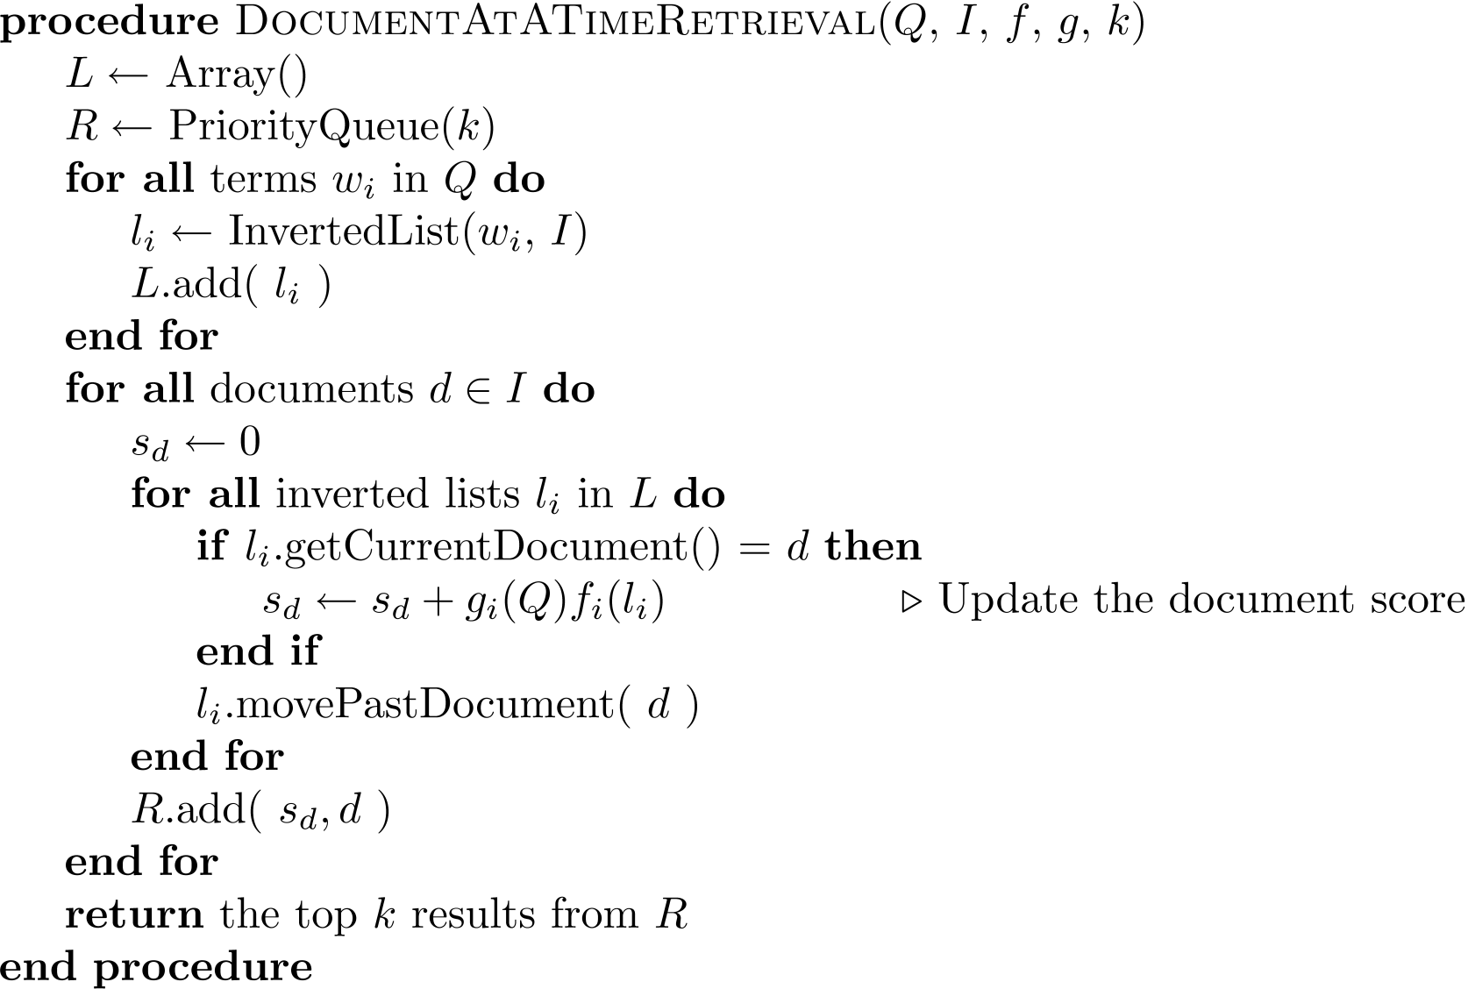
Document-At-A-Time

Slide 55
Term-At-A-Time

Slide 56
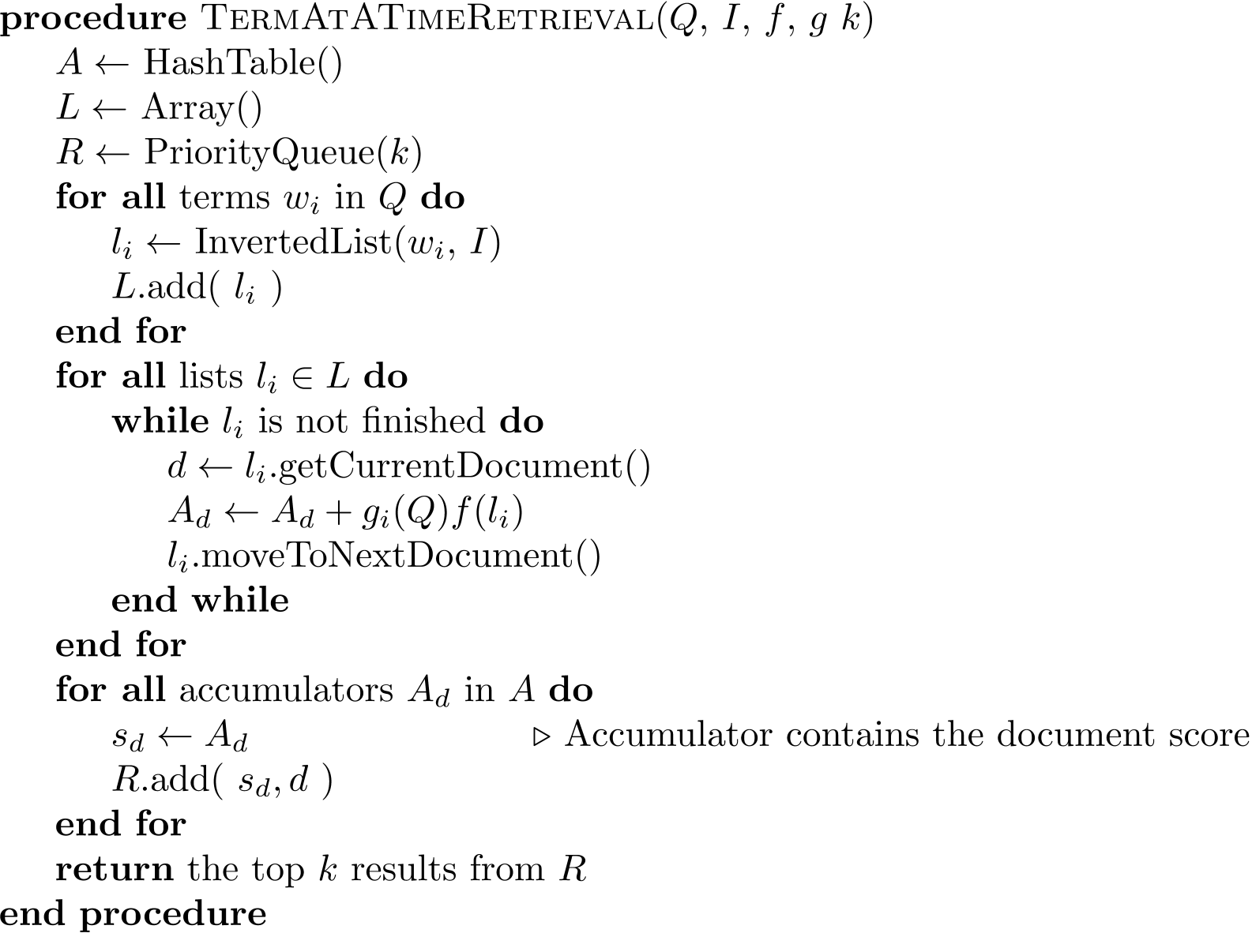
Term-At-A-Time

Slide 57
Optimization Techniques
Term-at-a-time uses more memory for accumulators, but accesses disk more efficiently
Two classes of optimization
  Read less data from inverted lists
    e.g., skip lists
    better for simple feature functions
  Calculate scores for fewer documents
    e.g., conjunctive processing
    better for complex feature functions

Slide 58
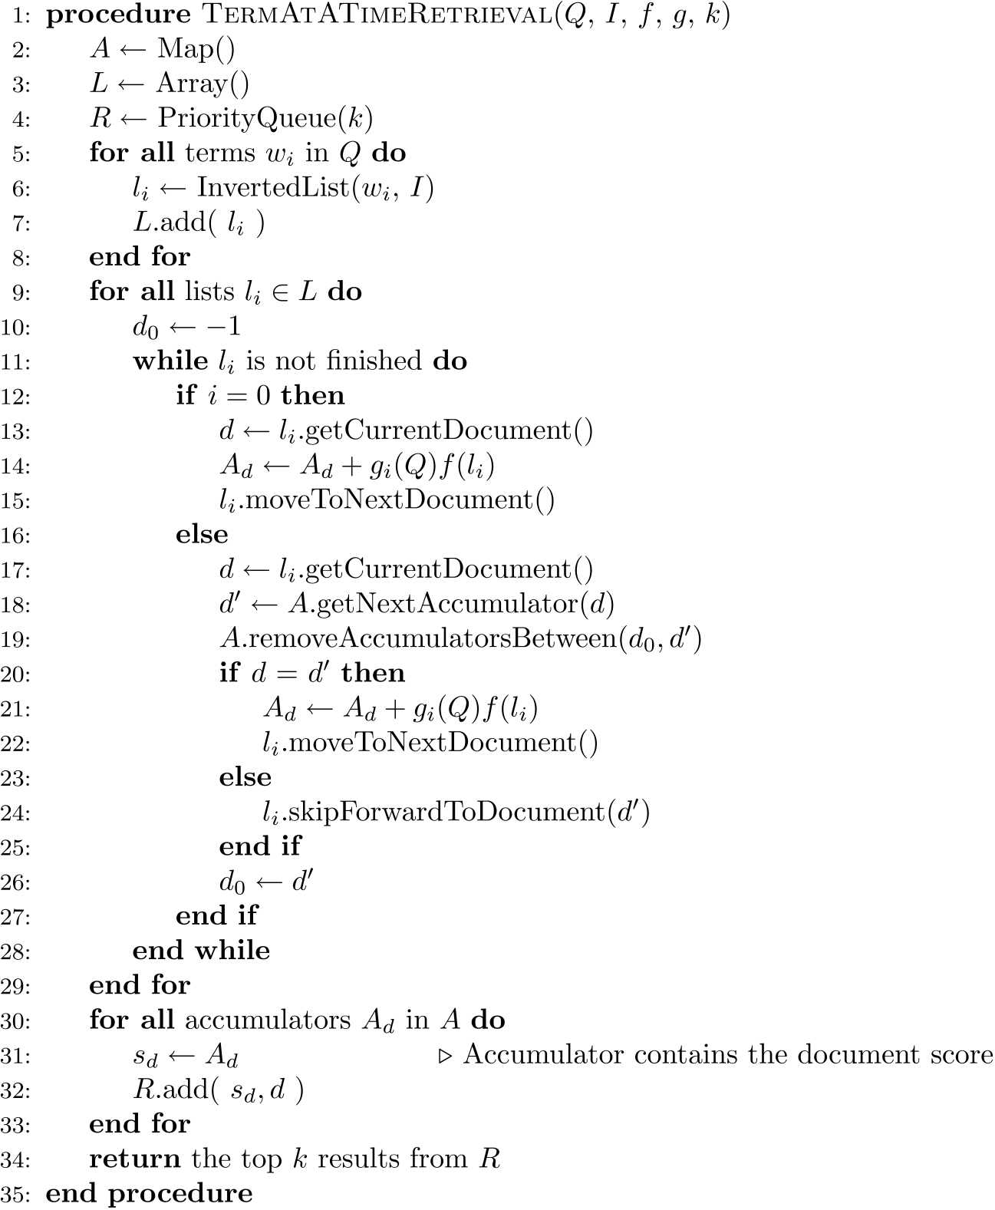
Conjunctive
Term-at-a-Time

Slide 59
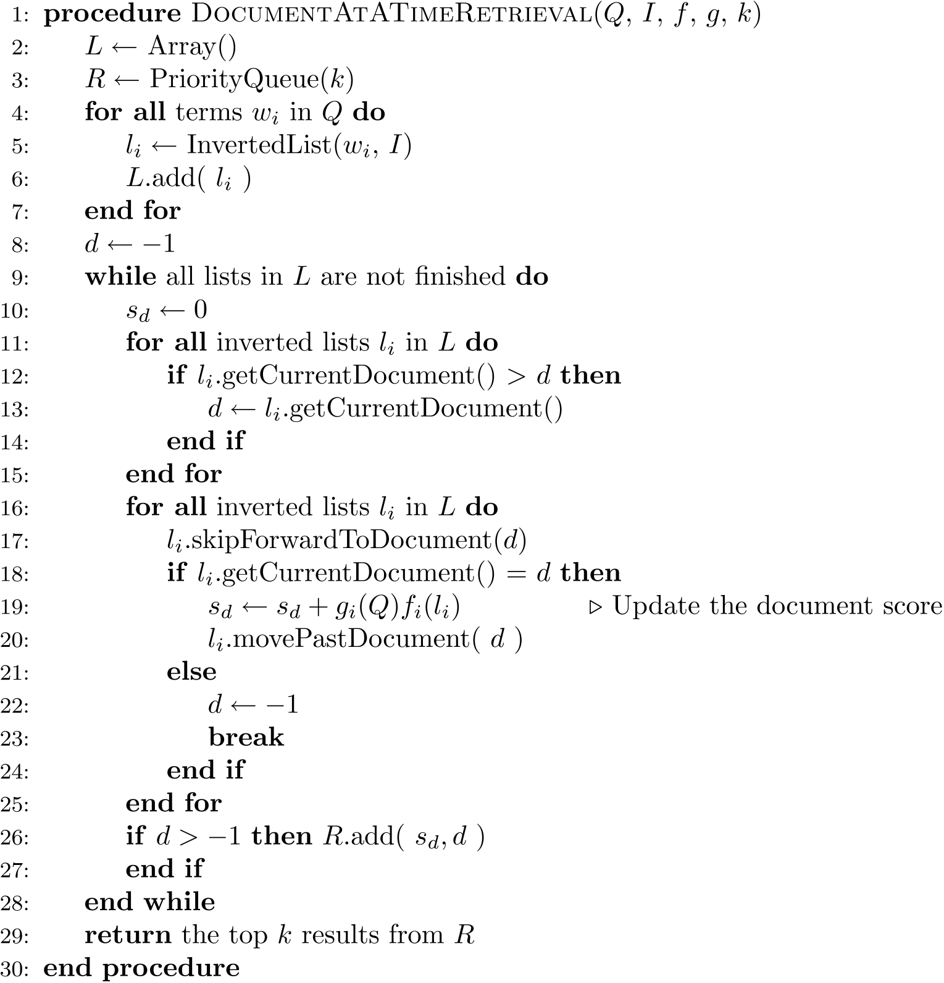
Conjunctive
Document-at-a-Time

Slide 60
Threshold Methods
Threshold methods use number of top-ranked documents needed (k) to optimize query processing
  for most applications, k is small
For any query, there is a minimum score that each document needs to reach before it can be shown to the user
  score of the kth-highest scoring document
  gives threshold τ
  optimization methods estimate τ′ to ignore documents

Slide 61
Threshold Methods
For document-at-a-time processing, use score of lowest-ranked document so far for τ′
  for term-at-a-time, have to use kth-largest score in the accumulator table
MaxScore method compares the maximum score that remaining documents could have to τ′
  safe optimization in that ranking will be the same without optimization (cf. A* search)

Slide 62
MaxScore Example
Indexer computes μ_{tree}
  maximum score for any document containing just “tree”
Assume k =3, τ′ is lowest score after first three docs
Likely that τ ′ > μ_{tree}
  τ ′ is the score of a document that contains both query terms
Can safely skip over all gray postings

Slide 63
Other Approaches
Early termination of query processing
  ignore high-frequency word lists in term-at-a-time
  ignore documents at end of lists in doc-at-a-time
  unsafe optimization
List ordering
  order inverted lists by document quality metric (e.g., PageRank) or by partial score
  makes unsafe (and fast) optimizations more likely to produce good documents

Slide 64
Structured Queries
Query language can support specification of complex features
  similar to SQL for database systems
  query translator converts the user’s input into the structured query representation
  Galago query language is the example used here
  e.g., Galago query:

Slide 65
Evaluation Tree for Structured Query

Slide 66
Distributed Evaluation
Basic process
  All queries sent to a director machine
  Director then sends messages to many index servers
  Each index server does some portion of the query processing
  Director organizes the results and returns them to the user
Two main approaches
  Document distribution
    by far the most popular
  Term distribution

Slide 67
Distributed Evaluation
Document distribution
  each index server acts as a search engine for a small fraction of the total collection
  director sends a copy of the query to each of the index servers, each of which returns the top-k results
  results are merged into a single ranked list by the director
Collection statistics shared
  E.g., document frequencies (for idf)

Slide 68
Distributed Evaluation
Term distribution
  Single index is built for the whole cluster of machines
  Each inverted list in that index is then assigned to one index server
    in most cases the data to process a query is not stored on a single machine
  One of the index servers is chosen to process the query
    usually the one holding the longest inverted list
  Other index servers send information to that server
  Final results sent to director

Slide 69
Caching
Query distributions similar to Zipf
  About ½ each day are unique, but some are very popular
Caching can significantly improve effectiveness
  Cache popular query results
  Cache common inverted lists
Inverted list caching can help with unique queries
Cache must be refreshed to prevent stale data

Slide 70
Future Topics
When are inverted indices helpful?
When are they not helpful?
What IR models are not well-served by inverted indices?
What architectures do not serve inverted indices well?

