Slide 1
CS6200/IS4200
Information Retrieval
David Smith
Khoury College of Computer Sciences
Northeastern University

Slide 2
Query Process

Slide 3
Evaluation
IR systems often components of larger search engines or other user application
Might evaluate several aspects
  Assistant in formulating queries
  Speed of retrieval
  Resources required
  Presentation of documents
  Ability to find relevant documents
  Appeal to users (market evaluation)
Evaluation generally comparative
  System A vs. B
  But could be absolute: response time < 1s
Possible improvements could have costs

Slide 4
Evaluation
Evaluation is key to building effective and efficient search engines
  measurement usually carried out in controlled laboratory experiments
  online testing can also be done
Efficiency measures similar to database systems
  e.g., indexing time, query throughput, index size
Our focus mostly on effectiveness metrics

Slide 5
Test Collections
Compare retrieval performance using a test collection
  Set of documents
  Set of queries
  Set of relevance judgments
To compare the performance of two techniques
  Each technique used to evaluate test queries
  Results (set or ranked list) compared using some performance measure
Usually use multiple measures to get different views of performance
Usually test with multiple collections
  Performance can vary widely with collection
    Especially for small, expensive-to-produce ad-hoc retrieval eval sets

Slide 6
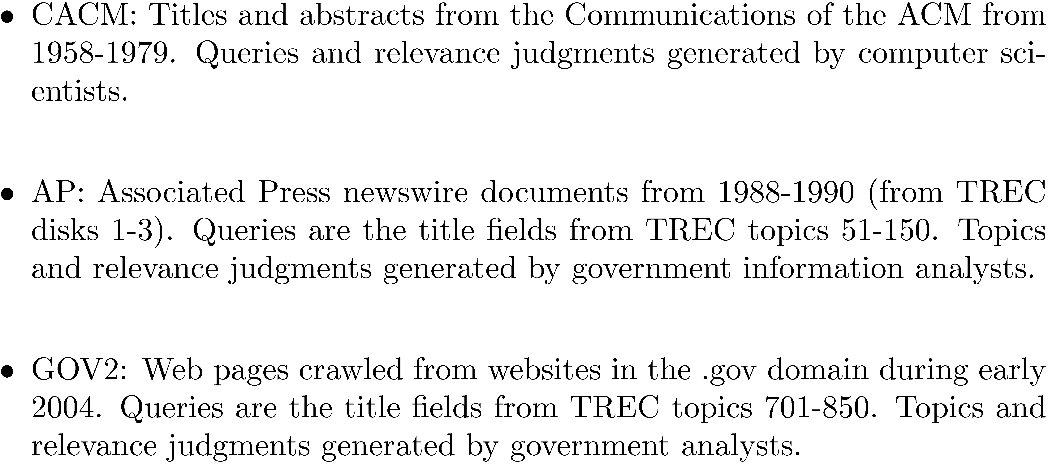
Test Collections
Examples of historically important collections

Slide 7
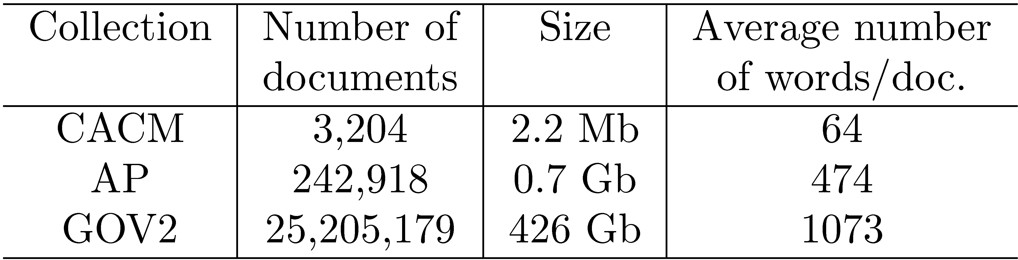
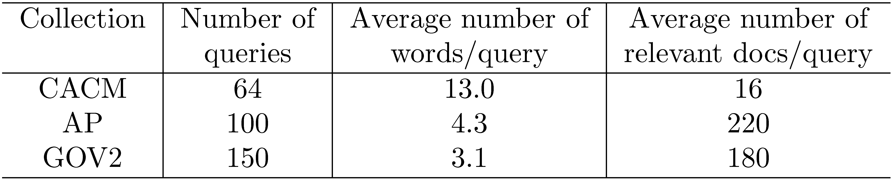
Test Collections

Slide 8
TREC Topic Example

Slide 9
Relevance
Difficult to define
Relevant document: judged “useful” in the context of a query
  By whom?
  Humans not very consistent
  Judgments depend on more than doc+query
With real collections, never know full set of relevant documents
Retrieval model incorporates some notion of relevance
Individual humans disagree but (hopefully) converge on average, in the limit

Slide 10
Relevance Judgments
Obtaining relevance judgments is an expensive, time-consuming process
Sources of variation similar to psychometrics, opinion polling, etc.
  who does it?
  what are the instructions?
  what is the level of agreement?
TREC judgments
  depend on task being evaluated
  generally binary
  agreement good because of “narrative”

Slide 11
TREC
Text REtrieval Conference
Established in 1992 to evaluate large-scale IR
  Retrieving documents from a gigabyte collection
Run by NIST’s Information Access Division
  Initially sponsored by DARPA as part of Tipster program
  Now supported by many, including DARPA, ARDA, and NIST
Probably most well known IR evaluation setting
Proceedings available on-line (http://trec.nist.gov)

Slide 12
Pooling
Exhaustive judgments for all documents in a collection is not practical
Pooling technique is used in TREC
  top k results (for TREC, k varied between 50 and 200) from the rankings obtained by different search engines (or retrieval algorithms) are merged into a pool
  duplicates are removed
  documents are presented in some random order to the relevance judges
Produces a large number of relevance judgments for each query, although still incomplete

Slide 13
Query Logs
Used for both tuning and evaluating search engines
  also for various techniques such as query suggestion
Typical contents
  User identifier or user session identifier
  Query terms - stored exactly as user entered
  List of URLs of results, their ranks on the result list, and whether they were clicked on
  Timestamp(s) - records the time of user events such as query submission, clicks

Slide 14
Query Logs
Clicks are not relevance judgments
  although they are correlated
  biased by a number of factors such as rank on result list
Can use clickthough data to predict preferences between pairs of documents
  appropriate for tasks with multiple levels of relevance, focused on user relevance
  various “policies” used to generate preferences

Slide 15
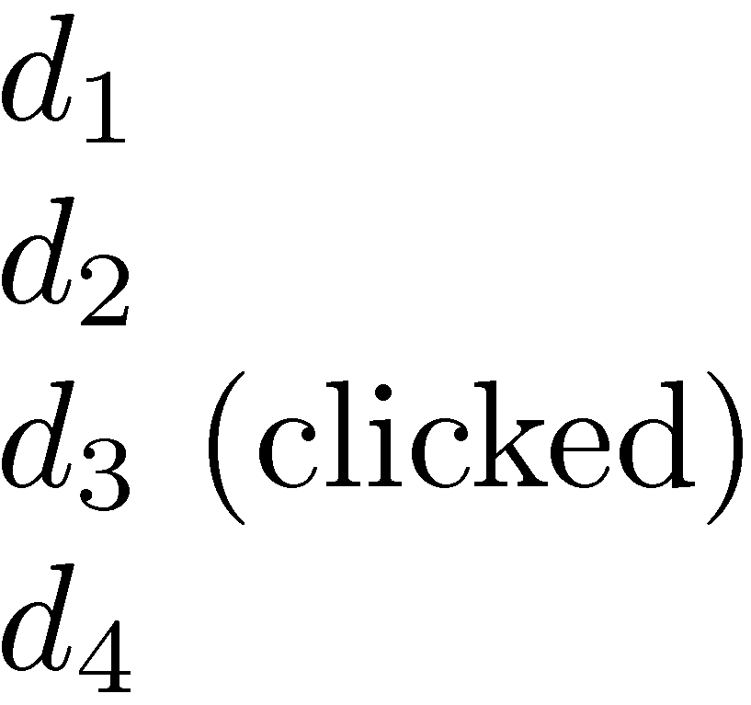
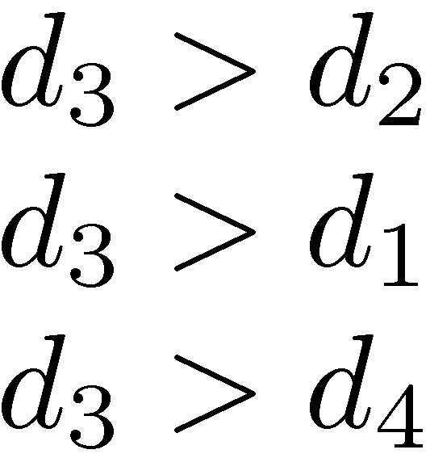
Example Click Policy
Skip Above and Skip Next
  click data
  generated preferences

Slide 16
Query Logs
Click data can also be aggregated to remove noise
Click distribution information
  can be used to identify clicks that have a higher frequency than would be expected
  high correlation with relevance
  e.g., using click deviation to filter clicks for preference-generation policies

Slide 17
Filtering Clicks
Click deviation CD(d, p) for a result d in position p:
  O(d,p): observed click frequency for a document in a rank position p over all instances of a given query
  E(p): expected click frequency at rank p averaged across all queries

Slide 18
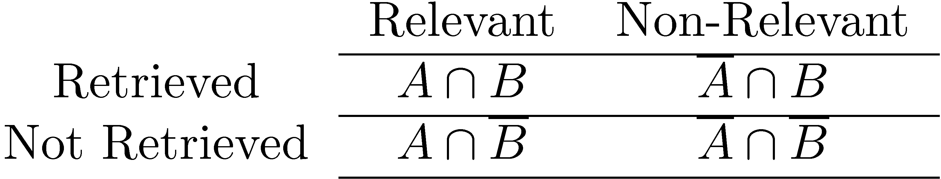
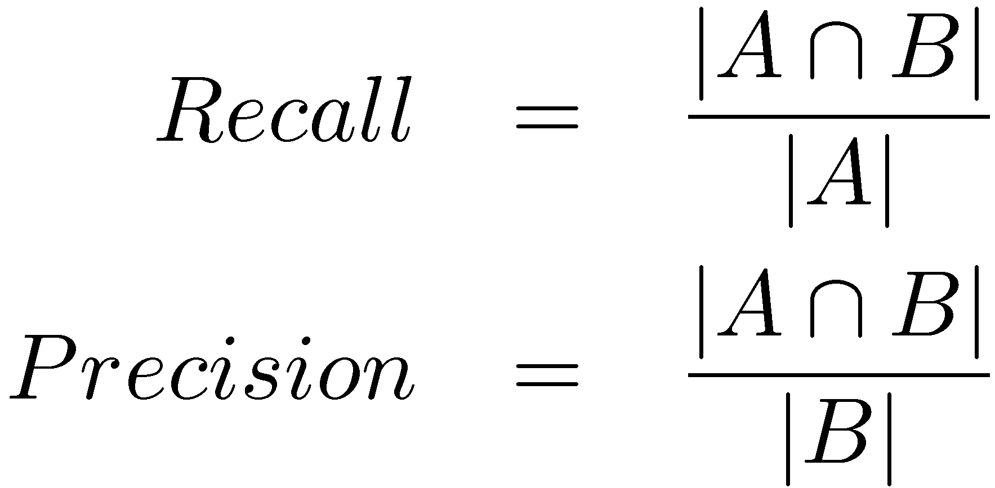
Effectiveness Measures
A is set of relevant documents,
B is set of retrieved documents

Slide 19
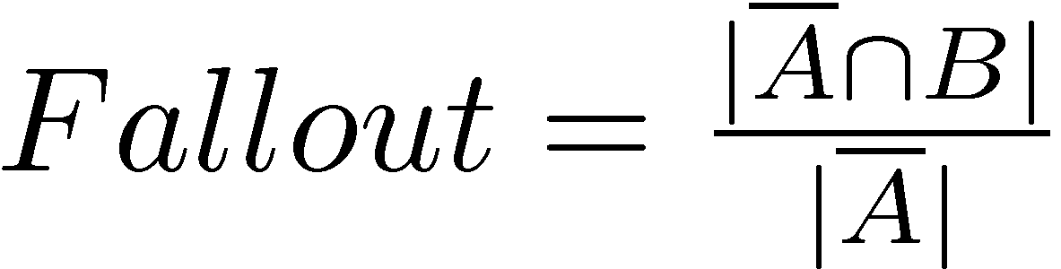
Classification Errors
False Positive (Type I error)
  a non-relevant document is retrieved
False Negative (Type II error)
  a relevant document is not retrieved
  1- Recall
Precision is used when probability that a positive result is correct is important

Slide 20
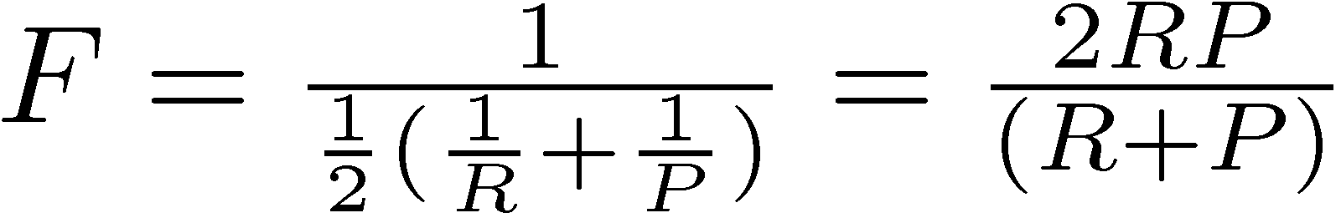
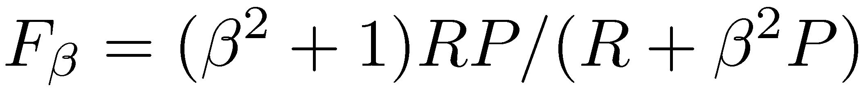
F Measure
Harmonic mean of recall and precision
  Generally used when averaging probabilities and proportions
  Harmonic mean emphasizes the importance of small values, whereas the arithmetic mean is affected more by outliers that are unusually large
More general form
  β is a parameter that determines relative importance of recall and precision

Slide 21
Ranking Effectiveness

Slide 22
Summarizing a Ranking
Calculating recall and precision at fixed rank positions
Calculating precision at standard recall levels, from 0.0 to 1.0
  requires interpolation
Averaging the precision values from the rank positions where a relevant document was retrieved

Slide 23
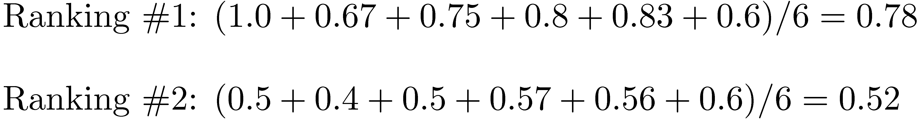
Average Precision

Slide 24
Averaging Across Queries

Slide 25
Averaging
Mean Average Precision (MAP)
  summarize rankings from multiple queries by averaging average precision
  most commonly used measure in research papers
  assumes user is interested in finding many relevant documents for each query
  requires many relevance judgments in text collection
Recall-precision graphs are also useful summaries

Slide 26
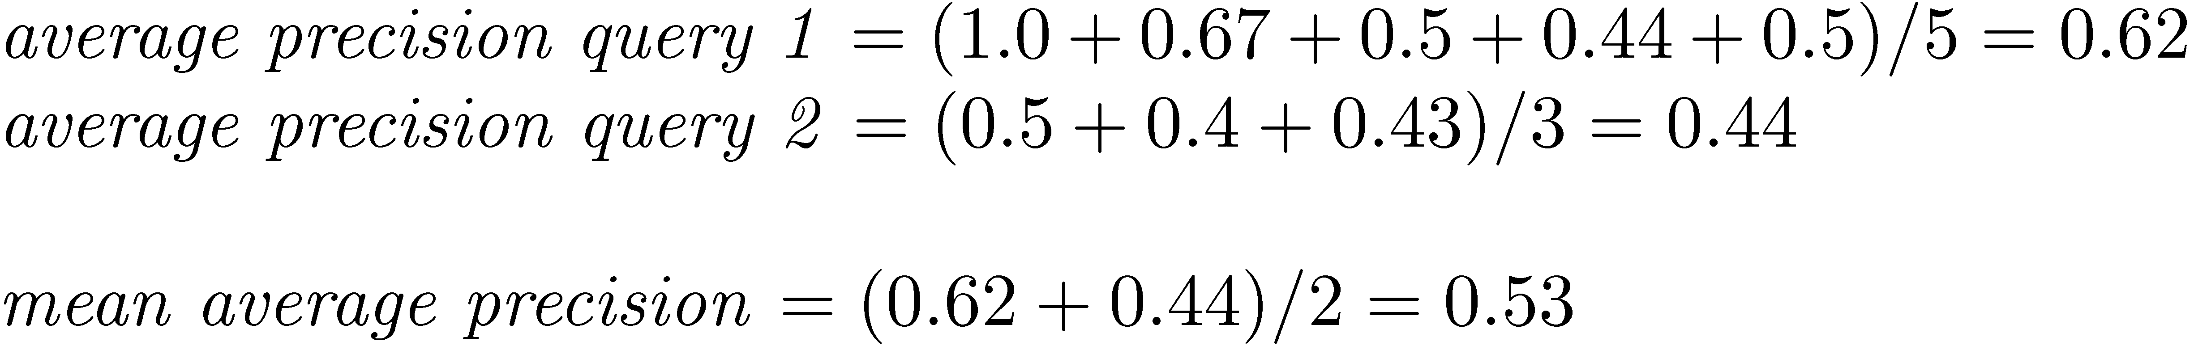
MAP

Slide 27
Recall-Precision Graph

Slide 28
Interpolation
To average graphs, calculate precision at standard recall levels:
  where S is the set of observed (R,P) points
Defines precision at any recall level as the maximum precision observed in any recall-precision point at a higher recall level
  produces a step function
  defines precision at recall 0.0

Slide 29
Interpolation

Slide 30
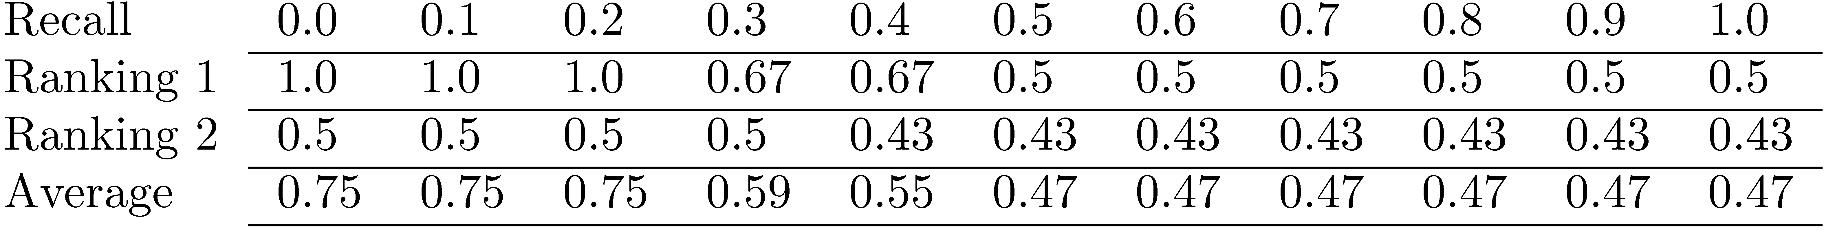
Average Precision at
Standard Recall Levels
Recall-precision graph plotted by simply
joining the average precision points at
the standard recall levels

Slide 31
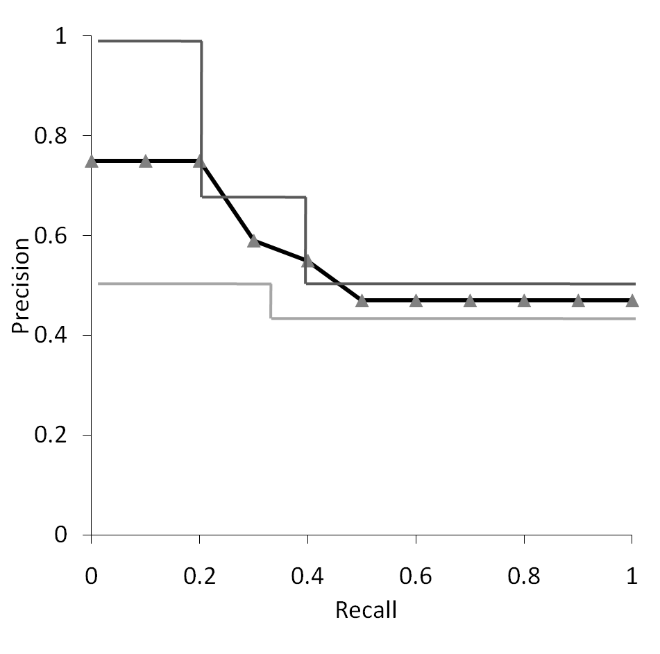
Average Recall-Precision Graph

Slide 32
Graph for 50 Queries

Slide 33
Focusing on Top Documents
Users tend to look at only the top part of the ranked result list to find relevant documents
Some search tasks have only one relevant document
  e.g., navigational search, question answering
Recall not appropriate
  instead need to measure how well the search engine does at retrieving relevant documents at very high ranks

Slide 34
Focusing on Top Documents
Precision at Rank R
  R typically 5, 10, 20
  easy to compute, average, understand
  not sensitive to rank positions less than R
Reciprocal Rank
  reciprocal of the rank at which the first relevant document is retrieved
  Mean Reciprocal Rank (MRR) is the average of the reciprocal ranks over a set of queries
  very sensitive to rank position

Slide 35
Discounted Cumulative Gain
Popular measure for evaluating web search and related tasks
Two assumptions:
  Highly relevant documents are more useful than marginally relevant document
  the lower the ranked position of a relevant document, the less useful it is for the user, since it is less likely to be examined

Slide 36
Discounted Cumulative Gain
Uses graded relevance as a measure of the usefulness, or gain, from examining a document
Gain is accumulated starting at the top of the ranking and may be reduced, or discounted, at lower ranks
Typical discount is 1/log (rank)
  With base 2, the discount at rank 4 is 1/2, and at rank 8 it is 1/3

Slide 37
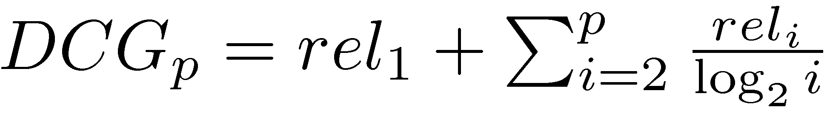
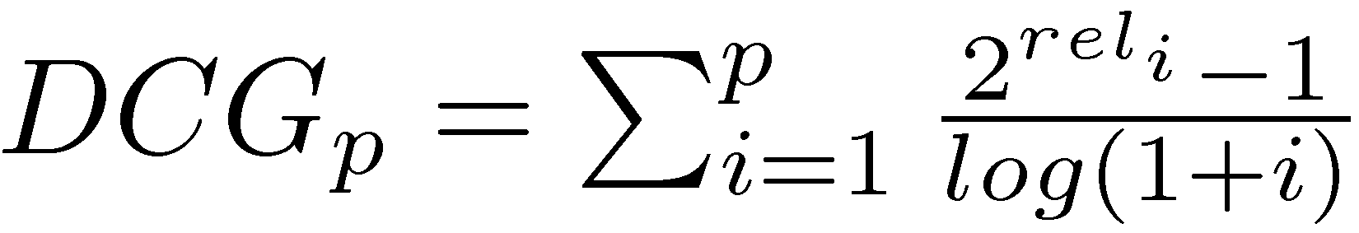
Discounted Cumulative Gain
DCG is the total gain accumulated at a particular rank p:
Alternative formulation:
  used by some web search companies
  emphasis on retrieving highly relevant documents

Slide 38
DCG Example
10 ranked documents judged on 0-3 relevance scale:
  3, 2, 3, 0, 0, 1, 2, 2, 3, 0
discounted gain:
  3, 2/1, 3/1.59, 0, 0, 1/2.59, 2/2.81, 2/3, 3/3.17, 0
  = 3, 2, 1.89, 0, 0, 0.39, 0.71, 0.67, 0.95, 0
DCG:
  3, 5, 6.89, 6.89, 6.89, 7.28, 7.99, 8.66, 9.61, 9.61

Slide 39
Normalized DCG
DCG numbers are averaged across a set of queries at specific rank values
  e.g., DCG at rank 5 is 6.89 and at rank 10 is 9.61
DCG values are often normalized by comparing the DCG at each rank with the DCG value for the perfect ranking
  makes averaging easier for queries with different numbers of relevant documents

Slide 40
NDCG Example
Perfect ranking:
  3, 3, 3, 2, 2, 2, 1, 0, 0, 0
ideal DCG values:
  3, 6, 7.89, 8.89, 9.75, 10.52, 10.88, 10.88, 10.88, 10
NDCG values (divide actual by ideal):
  1, 0.83, 0.87, 0.76, 0.71, 0.69, 0.73, 0.8, 0.88, 0.88
  NDCG ≤ 1 at any rank position

Slide 41
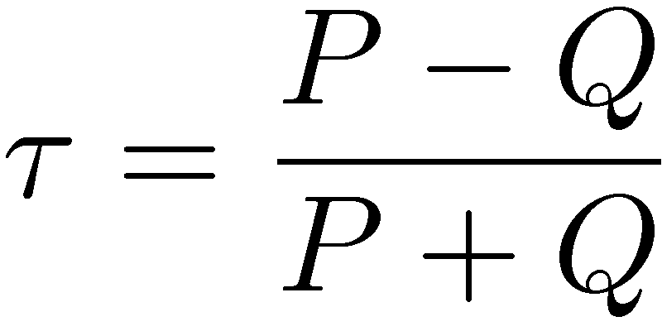
Using Preferences
Two rankings described using preferences can be compared using the Kendall tau coefficient (τ ):
  P is the number of preferences that agree and Q is the number that disagree
For preferences derived from binary relevance judgments, can use BPREF

Slide 42
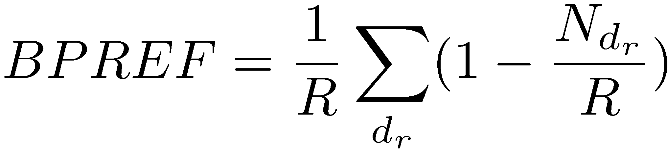
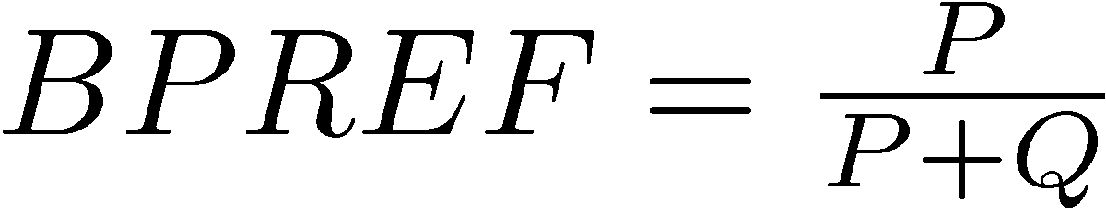
BPREF
For a query with R relevant documents, only the first R non-relevant documents are considered
  d_{r} is a relevant document, and N_{dr} gives the number of non-relevant documents
Alternative definition

Slide 43
Q: emily dickinson college
Try
  duckduckgo.com
  google.com
Compute
  P@10
  AP@10
  (Not NDCG@10 for now)

Slide 44
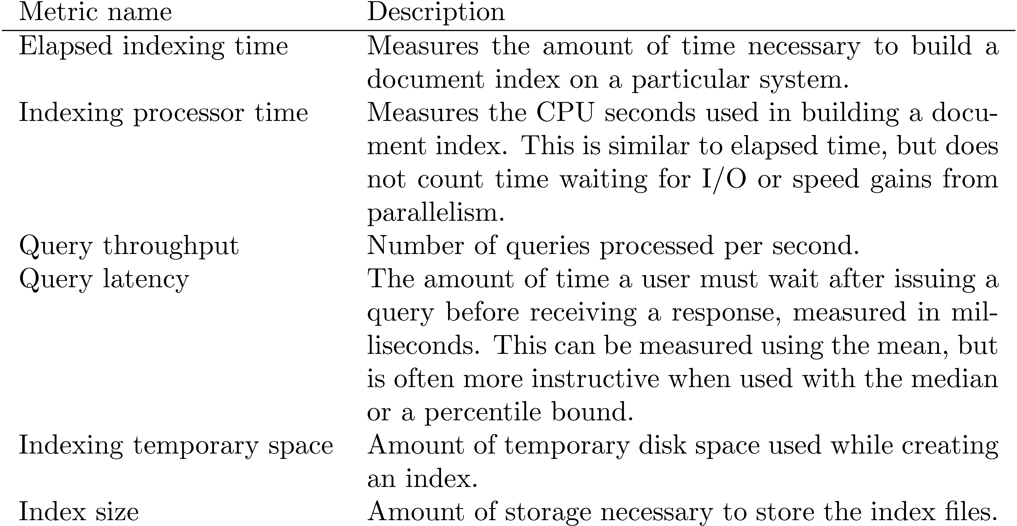
Efficiency Metrics

Slide 45
Hypothesis Testing
One-sample
  “Is the system’s response time under 1 sec.?”
Two-sample
  “Does the system perform equally well on these two types of queries?”
Paired-sample
  “Is this system A better than system B?”

Slide 46
Terminological Prelude
Populations
  Population distributions
  “Performance on all queries”. How big?
Samples
  Sampling distributions
  “Performance on this test set”
Statistics
  Functions of data
  “What is the MAP? P@10? NDCG?”
Models
  Parameters

Slide 47
Significance Tests
Given the results from a number of queries, how can we conclude that ranking algorithm A is better than algorithm B?
A significance test enables us to reject the null hypothesis (no difference) in favor of the alternative hypothesis (B is better than A)
  the power of a test is the probability that the test will reject the null hypothesis correctly
  increasing the number of queries in the experiment also increases power of test

Slide 48
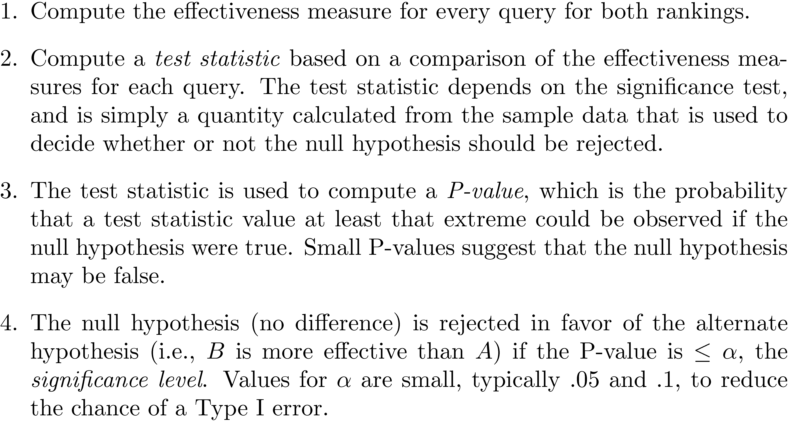
Significance Tests

Slide 49
One-Sided Test
Distribution for the possible values of a test statistic assuming the null hypothesis
    shaded area is region of rejection

Slide 50
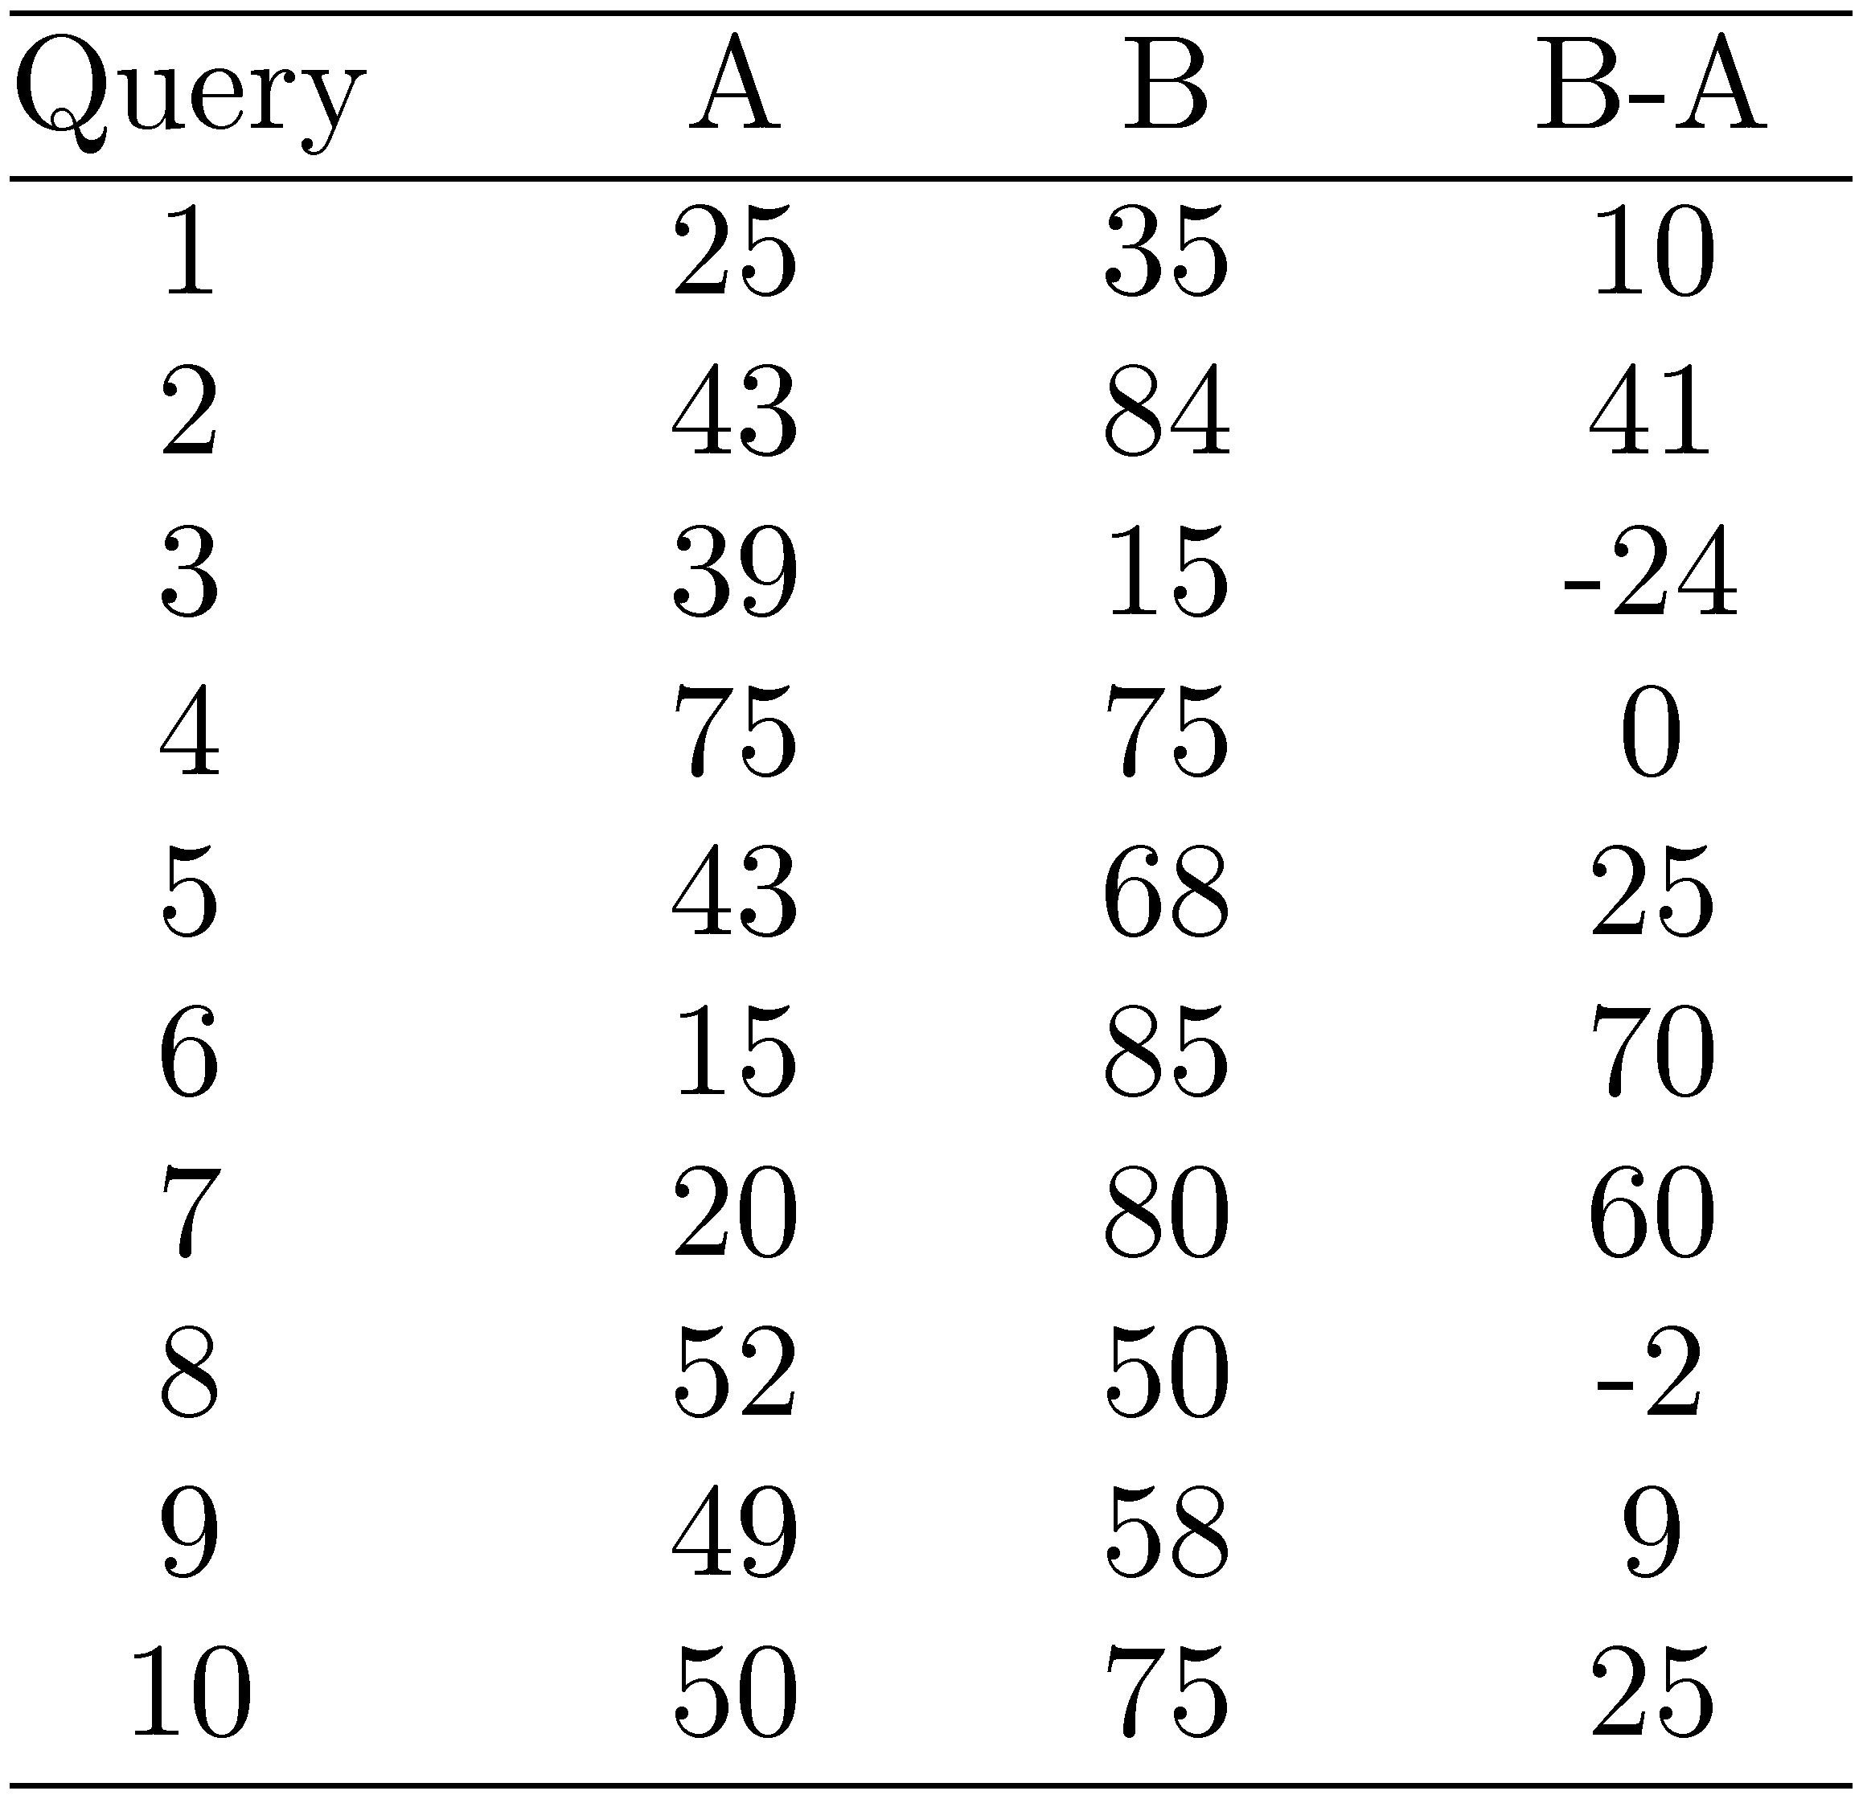
Example Experimental Results

Slide 51
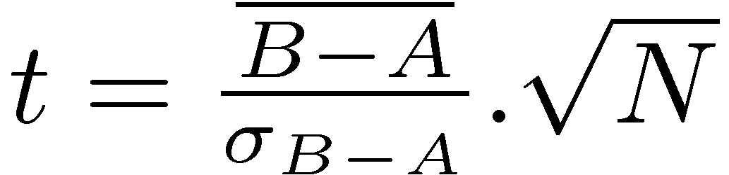
t-Test
Assumption is that the difference between the effectiveness values is a sample from a normal distribution
Null hypothesis is that the mean of the distribution of differences is zero
Test statistic
  for the example,

Slide 52
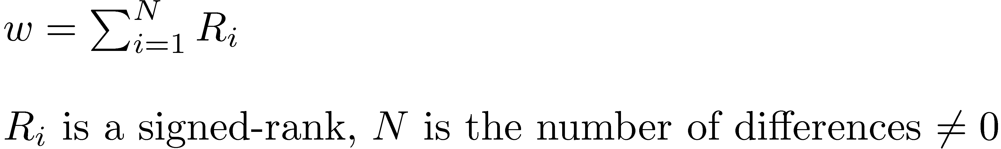
Wilcoxon Signed-Ranks Test
Nonparametric test based on differences between effectiveness scores
Test statistic
  To compute the signed-ranks, the differences are ordered by their absolute values (increasing), and then assigned rank values
  rank values are then given the sign of the original difference

Slide 53
Wilcoxon Example
9 non-zero differences are (in rank order of absolute value):
  2, 9, 10, 24, 25, 25, 41, 60, 70
Signed-ranks:
  -1, +2, +3, -4, +5.5, +5.5, +7, +8, +9
w = 35, p-value = 0.025

Slide 54
Notation
P is a population
S = [s₁, s₂, ..., s_{n}] is a sample from P
Let X = [x₁, x₂, ..., x_{n}] be some numerical measurement on the s_{i}
  distributed over P according to unknown F
We may use Y, Z for other measurements.

Slide 55

Plug-in principle
We don’t have (and can’t get) P
  We don’t know F, the true distribution over X
We do have S (the sample)
  We do know , the sample distribution over X
Estimating a statistic: use for F

Slide 56
The Bootstrap
Simulates the sampling distribution
Proposed by Efron in 1979
  Anticipated by permutation tests, jackknife, cross-validation
From original sample of size n, draw B samples of size n with replacement and calculate the statistic on each

Slide 57


Bootstrap world
unknown distribution F
empirical distribution
observed random sample X
bootstrap random sample X*
statistic of interest
bootstrap replication
statistics about the estimate (e.g., standard error)

Slide 58
Bootstrap sample
X = [3.0, 2.8, 3.7, 3.4, 3.5]
X* could be:
  [2.8, 3.4, 3.7, 3.4, 3.5]
  [3.5, 3.0, 3.4, 2.8, 3.7]
  [3.5, 3.5, 3.4, 3.0, 2.8]
  ...
Draw n elements with replacement.

Slide 59
Reflection
Imagine doing this with a pencil and paper.
The bootstrap was born in 1979.
Typically, measuring data samples is costly and computation is cheap.
In (empirical) CS, measurement isn’t even necessarily all that costly.

Slide 60
Paired-Sample Permutation Test
“Is ranking algorithm F better than G?”
Match the ranked list for each query
Swap the lists in each pair with 0.5 probability
Replicate this process B=100s of times
Calculate the mean difference in metric (MAP, NDGC, P@10, etc.) for each replicate
P-value: #{θ*(b) >= θ}/B

Slide 61
Example Experimental Results

Slide 62
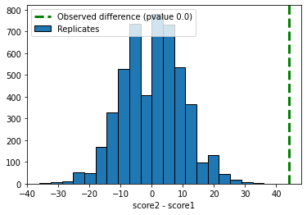
Resampling Distribution

Slide 63
A Two-Sample Bootstrap Test
“Is this system better at long than short queries?”
H₀: equality of two distributions F and G, samples z and y or size n and m
Test statistic θ = z – y
Pool samples into x; draw B samples with replacement; call first n in resample observations from F
p-value: #{θ*(b) >= θ}/B

Slide 64
Sign Test
Ignores magnitude of differences
Null hypothesis for this test is that
  P(B > A) = P(A > B) = ½
  number of pairs where B is “better” than A would be the same as the number of pairs where A is “better” than B
Test statistic is number of pairs where B>A
For example data,
  test statistic is 7, p-value = 0.17
  cannot reject null hypothesis

Slide 65
Setting Parameter Values
Retrieval models often contain parameters that must be tuned to get best performance for specific types of data and queries
For experiments:
  Use training and test data sets
  If less data available, use cross-validation by partitioning the data into K subsets
  Using training and test data avoids overfitting – when parameter values do not generalize well to other data

Slide 66
Finding Parameter Values
Many techniques used to find optimal parameter values given training data
  standard problem in machine learning
In IR, often explore the space of possible parameter values by brute force
  requires large number of retrieval runs with small variations in parameter values (parameter sweep)
Learning to rank techniques are efficient procedures for finding good parameter values with large numbers of parameters

Slide 67
Online Testing
Test (or even train) using live traffic on a search engine
Benefits:
  real users, less biased, large amounts of test data
Drawbacks:
  noisy data, can degrade user experience
Often done on small proportion (1-5%) of live traffic (for efficiency)

Slide 68
Summary
No single measure is the correct one for any application
  choose measures appropriate for task
  use a combination
  shows different aspects of the system effectiveness
Use significance tests
  t-test, permutation test
Analyze performance of individual queries

Slide 69
Query Summary

