Slide 1
CS6200/IS4200
Information Retrieval
David Smith
Khoury College of Computer Sciences
Northeastern University

Slide 2
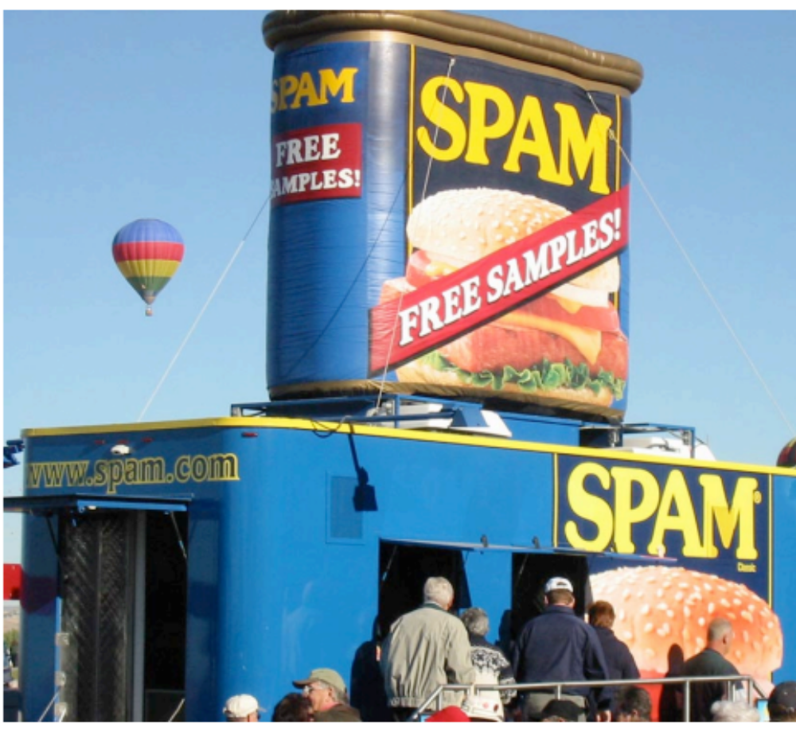
Spam

Slide 3
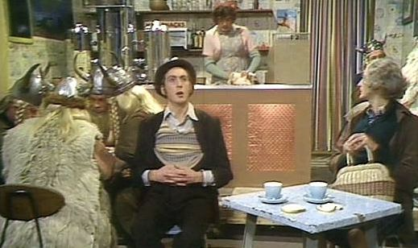
Spam

Slide 4
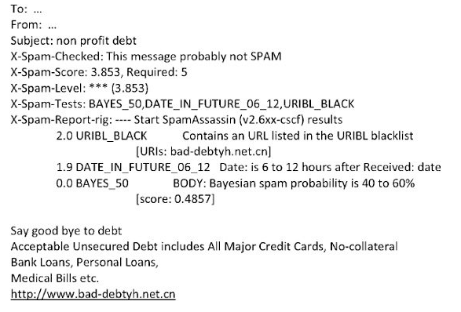
Spam

Slide 5
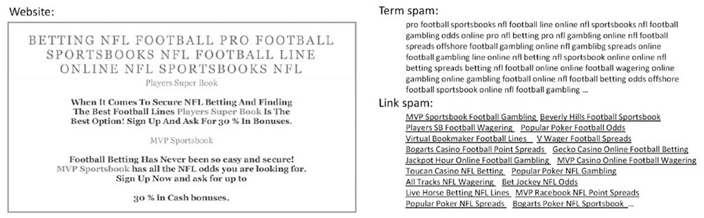
Spam

Slide 6
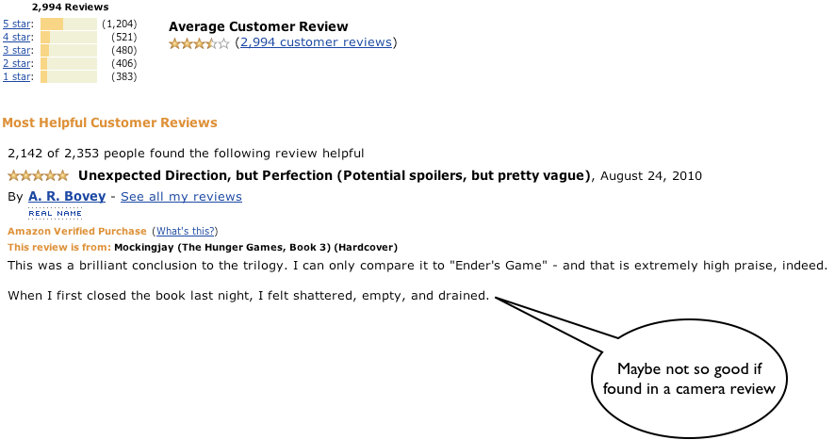
Sentiment

Slide 7
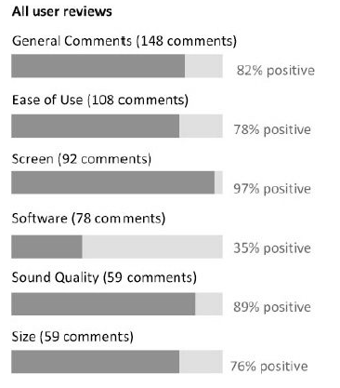
Sentiment

Slide 8
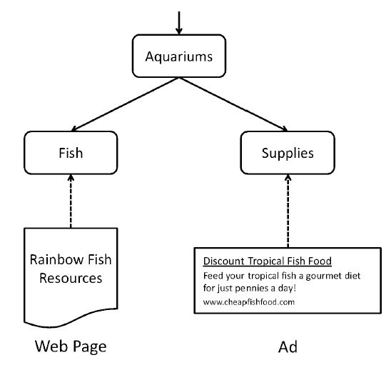
Advertising

Slide 9
Standing queries
Ch. 13
Another path from IR to text classification:
  You have an information need to monitor, say:
    Unrest in the Niger delta region
  You want to rerun an appropriate query periodically to find new news items on this topic
  You will be sent new documents that are found
    i.e., it’s not ranking but classification (relevant vs. not relevant)
Such queries are called standing queries
  Long used by “information professionals”
  A modern mass instantiation is Google Alerts
Standing queries are text classifiers written by hand, i.e., by specifying the query

Slide 10
Language Models

Slide 11
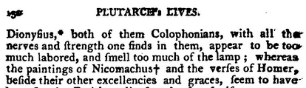
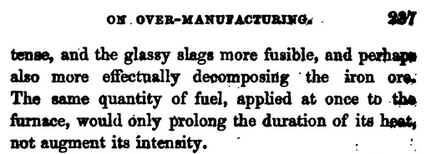
Predicting Language

Slide 12
Predicting Language

Slide 13
Predicting Language

Slide 14
Predicting Language

Slide 15
Predicting Language
Optical character recognition
Automatic speech recognition
Machine translation
Spelling/grammar correction
Restoring redacted texts

Slide 16
Scoring Language
Language identification
Text categorization
Grading essays (!)
Information retrieval
Paraphrase detection
Question answering

Slide 17
Language Models
Probability distribution over strings of text
There may be hidden variables
  Grammatical structure, topics, NN state
Some hidden variables may be queried for sequence classification or for representing (“embedding”) (sequences of) words in vector space

Slide 18
Probability

Slide 19




Axioms of Probability
Define event space
Probability function, s.t.
  Disjoint events sum
  All events sum to one
Show that:

Slide 20
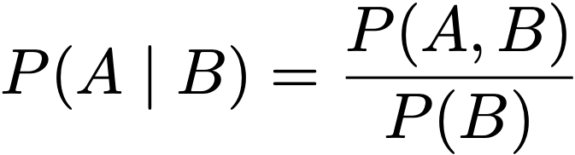

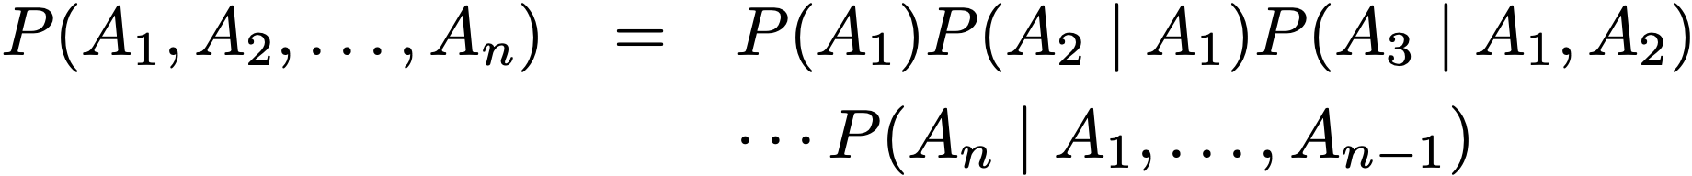
Conditional Probability
A
B
Chain rule

Slide 21
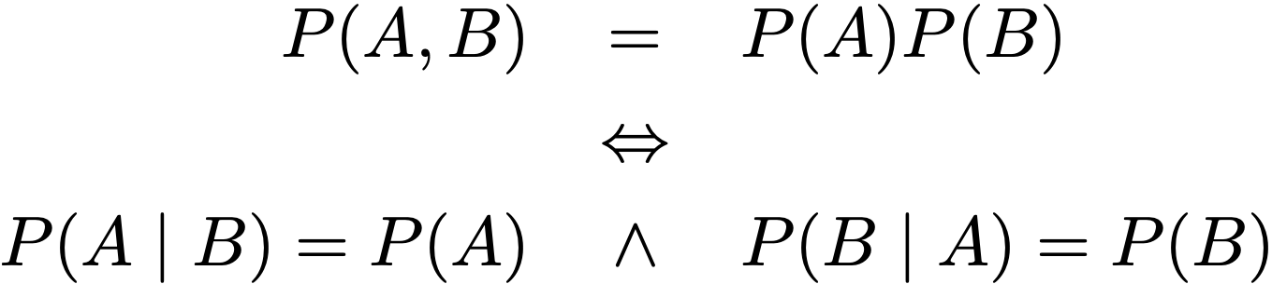
Independence
In coding terms, knowing B doesn’t help in decoding A, and vice versa.

Slide 22
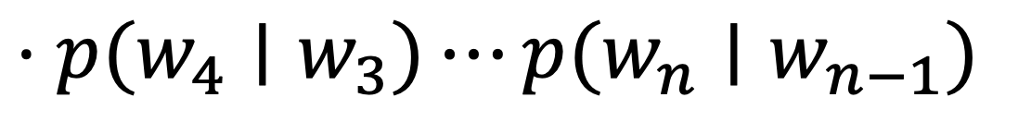
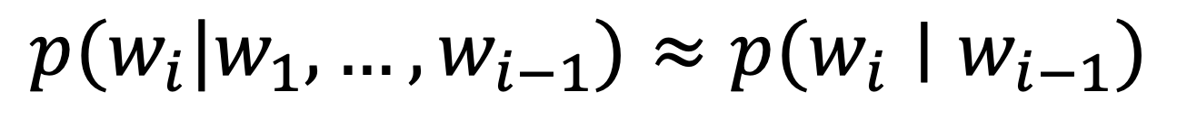
Markov Models
$$p(w_{1},w_{2},…,w_{n})=p(w_{1})p(w_{2}|w_{1})p(w_{3}|w_{1},w_{2})$$
$$⋅p(w_{4}|w_{1},w_{2},w_{3})⋯p(w_{n}|w_{1},…,w_{n−1})$$
Markov independence assumption
$$p(w_{i}|w_{1},…,w_{i−1})≈p(w_{i}∣w_{i−1})$$
$$p(w_{1},w_{2},…,w_{n})≈p(w_{1})p(w_{2}|w_{1})p(w_{3}|w_{2})$$
$$⋅p(w_{4}∣w_{3})⋯p(w_{n}∣w_{n−1})$$

Slide 23
Another View
Directed graphical models: lack of edge means conditional independence
w1
w2
w3
w4
p(w2|The)
p(w3|results)
p(w4|have)
p(w5|shown)
The
results
have
shown
Bigram model as (dynamic) Bayes net
p(w2|The)
p(w3|The,results)
p(w4|results,have)
p(w5|have,shown)
The
results
have
shown
Trigram model as (dynamic) Bayes net

Slide 24
Yet Another View
The
have
results
shown
Bigram model as finite state machine
What about a trigram model?

Slide 25
Classifiers:
Language under Different Conditions

Slide 26
Movie Reviews
there ' s some movies i enjoy even though i know i probably shouldn '
t and have a difficult time trying to explain why i did . " lucky
numbers " is a perfect example of this because it ' s such a blatant
rip - off of " fargo " and every movie based on an elmore leonard
novel and yet it somehow still works for me . i know i ' m in the
minority here but let me explain . the film takes place in harrisburg
, pa in 1988 during an unseasonably warm winter . ...
☺
seen at : amc old pasadena 8 , pasadena , ca ( in sdds ) paul
verhoeven ' s last movie , showgirls , had a bad script , bad acting ,
and a " plot " ( i use the word in its loosest possible sense ) that
served only to allow lots of sex and nudity . it stank . starship
troopers has a bad script , bad acting , and a " plot " that serves
only to allow lots of violence and gore . it stinks . nobody will
watch this movie for the plot , ...
☹
the rich legacy of cinema has left us with certain indelible images .
the tinkling christmas tree bell in " it ' s a wonderful life . "
bogie ' s speech at the airport in " casablanca . " little elliott ' s
flying bicycle , silhouetted by the moon in " e . t . " and now , "
starship troopers " director paul verhoeven adds one more image that
will live in our memories forever : doogie houser doing a vulcan mind
meld with a giant slug . " starship troopers , " loosely based on
☹

Slide 27
Setting up a Classifier
What we want:
p(☺ | w1, w2, ..., wn) > p(☹ | w1, w2, ..., wn) ?
What we know how to build:
  A language model for each class
    p(w1, w2, ..., wn | ☺)
    p(w1, w2, ..., wn | ☹)

Slide 28
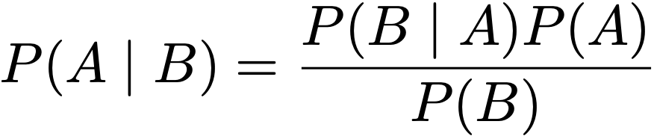
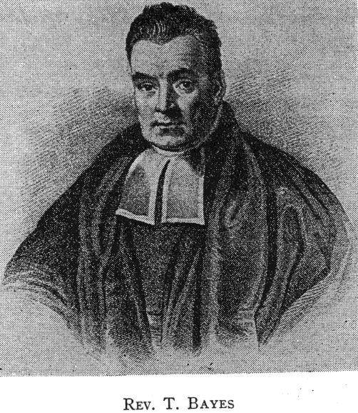
Bayes’ Theorem
By the definition of conditional probability:
we can show:
Seemingly trivial result from 1763; interesting consequences...

Slide 29
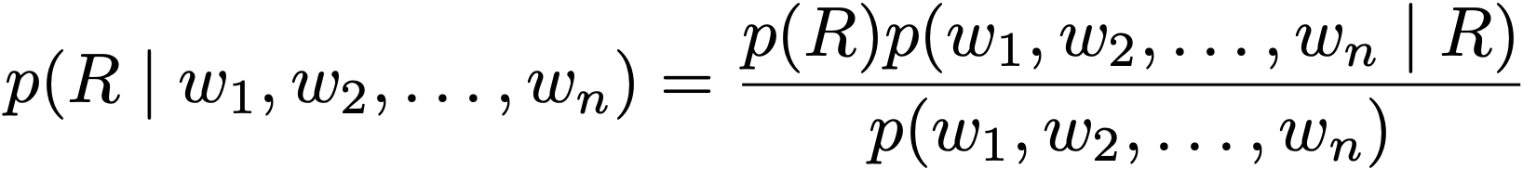
A “Bayesian” Classifier
Nowadays also means modeling uncertainty about p
Posterior
Likelihood
Prior

Slide 30
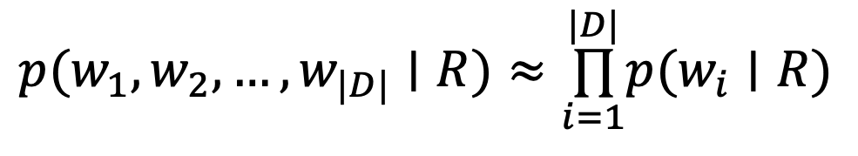
Naive Bayes Classifier
One variable per token in
(like query likelihood)
w1
w2
w3
w4
No dependencies among words!
$$p(w_{1},w_{2},…,w_{|D|}∣R)≈\overset{|D|}{\underset{i=1}{∏}}p(w_{i}∣R)$$
R

Slide 31
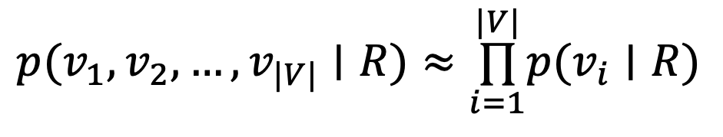
Alternate NB Classifier
One variable per word type in vocabulary
(like binary independence model)
v1
v2
v3
v4
No dependencies among words!
$$p(v_{1},v_{2},…,v_{|V|}∣R)≈\overset{|V|}{\underset{i=1}{∏}}p(v_{i}∣R)$$
R

Slide 32
NB on Movie Reviews
Train models for positive, negative
For each review, find higher posterior
Which word probability ratios are highest?
>>> classifier.show_most_informative_features(5)
classifier.show_most_informative_features(5)
Most Informative Features
contains(outstanding) = True pos : neg = 14.1 : 1.0
contains(mulan) = True pos : neg = 8.3 : 1.0
contains(seagal) = True neg : pos = 7.8 : 1.0
contains(wonderfully) = True pos : neg = 6.6 : 1.0
contains(damon) = True pos : neg = 6.1 : 1.0

Slide 33
What’s Wrong With NB?
What happens when word dependencies are strong?
What happens when some words occur only once?
What happens when the classifier sees a new word?

Slide 34
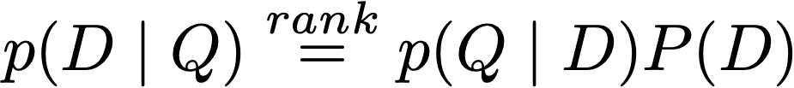
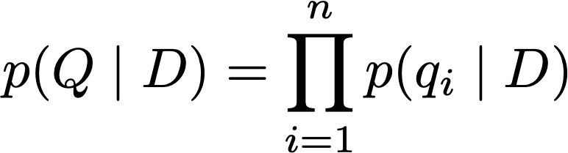
Query Likelihood in IR
Rank documents by the probability that the query could be generated by language model estimated from that document
Given user query, start with p(D | Q)
Using Bayes’ Rule
Assuming prior is uniform, use unigram LM

Slide 35
Estimation for Markov (n-gram) models

Slide 36
Simple Estimation
Probability courses usually start with equiprobable events
  Coins, dice, cards used by 17c gamblers
How likely to get a 6 rolling 1 die?
How likely the sum of two dice is 6?
How likely to see 3 heads in 10 flips?

Slide 37
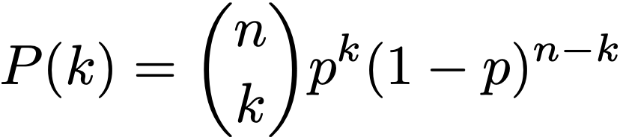
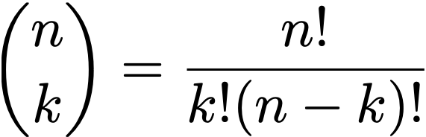
Binomial Distribution
For n trials, k successes, and success probability p:
Prob. mass function
Estimation problem: If we observe n and k, what is p?

Slide 38
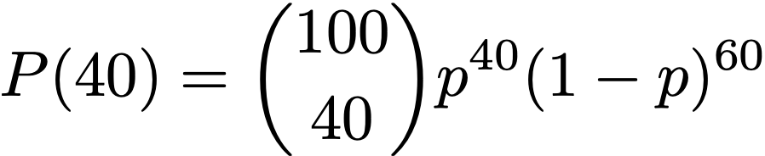
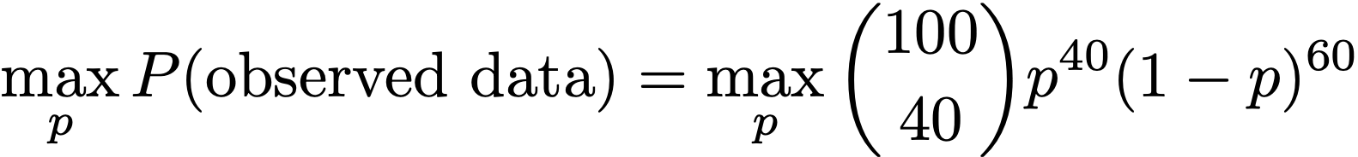
Maximum Likelihood
Say we win 40 games out of 100.
The maximum likelihood estimator for p solves:

Slide 39
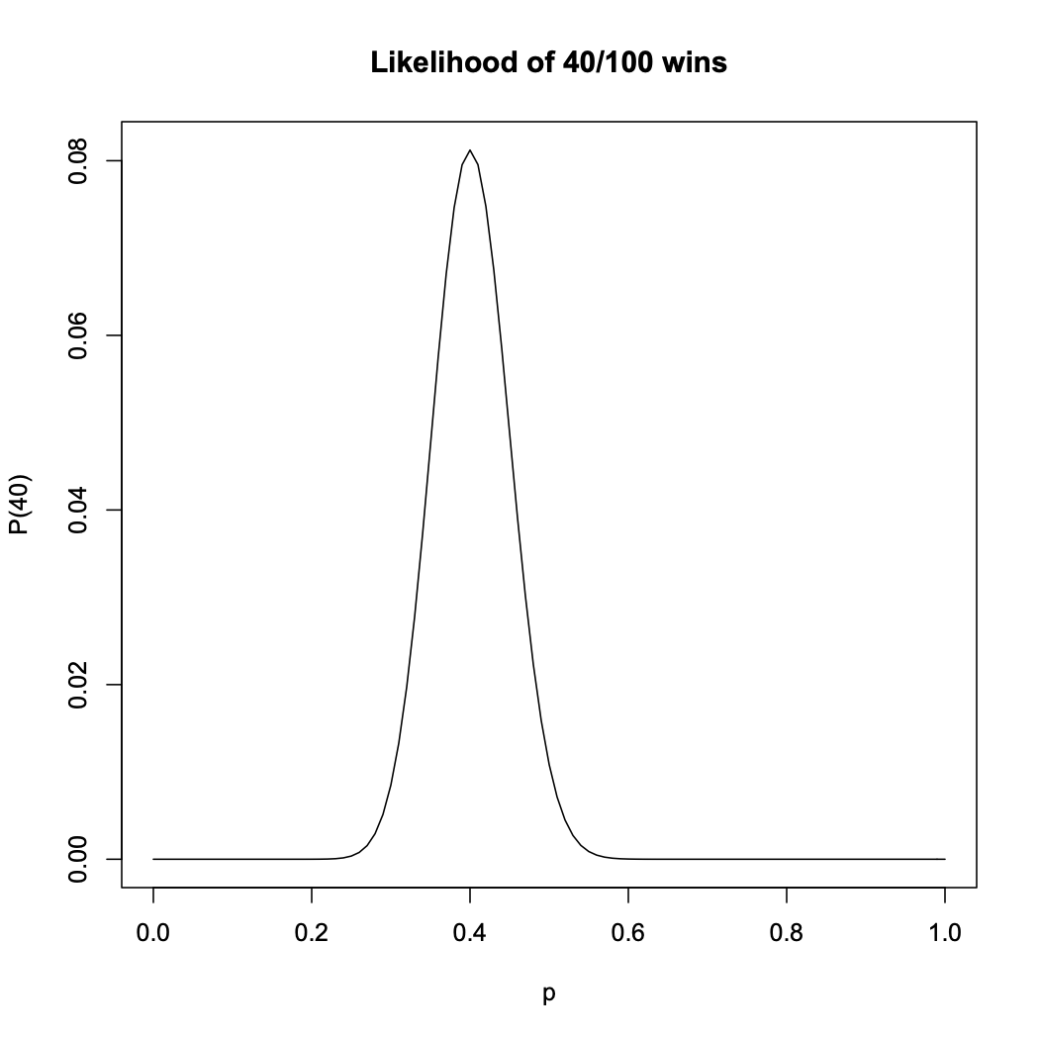
Maximum Likelihood

Slide 40
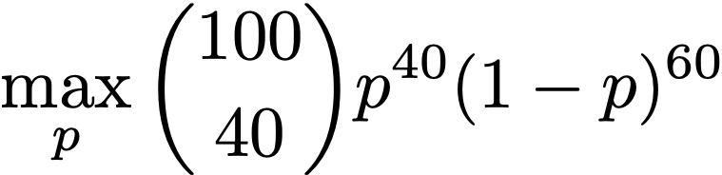
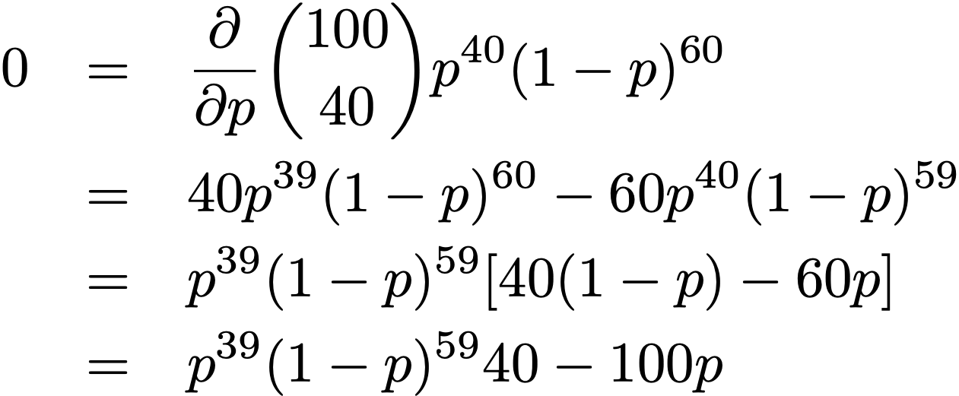

Maximum Likelihood
How to solve
The maximizer!
In general, k/n
Solutions: 0, 1, .4
This is trivial here, but a widely useful approach.

Slide 41
ML for Language Models
Say the corpus has “in the” 100 times
If we see “in the beginning” 5 times,
pML(beginning | in the) = ?
If we see “in the end” 8 times,
pML(end | in the) = ?
If we see “in the kitchen” 0 times,
pML(kitchen | in the) = ?

Slide 42
ML for Naive Bayes
Recall: p(+ | Damon movie)
= p(Damon | +) p(movie | +) p(+)
If corpus of positive reviews has 1000 words, and “Damon” occurs 50 times,
pML(Damon | +) = ?
If pos. corpus has “Affleck” 0 times,
p(+ | Affleck Damon movie) = ?

Slide 43

Will the Sun Rise Tomorrow?

Slide 44
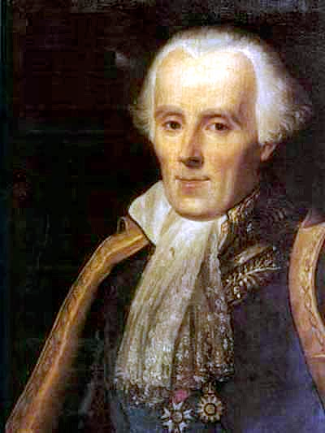
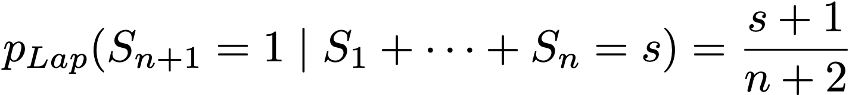
Will the Sun Rise Tomorrow?
Laplace’s Rule of Succession:
On day n+1, we’ve observed that the sun has risen s times before.
What’s the probability on day 0?
On day 1?
On day 10⁶?
Start with prior assumption of equal rise/not-rise probabilities; update after every observation.

Slide 45
Laplace (Add One) Smoothing
From our earlier example:
pML(beginning | in the) = 5/100? reduce!
pML(end | in the) = 8/100? reduce!
pML(kitchen | in the) = 0/100? increase!

Slide 46
Laplace (Add One) Smoothing
Let V be the vocabulary size:
i.e., the number of unique words that could follow “in the”
From our earlier example:
pLap(beginning | in the) = (5 + 1)/(100 + V)
pLap(end | in the) = (8 + 1)/(100 + V)
pLap(kitchen | in the) = (0 + 1) / (100 + V)

Slide 47
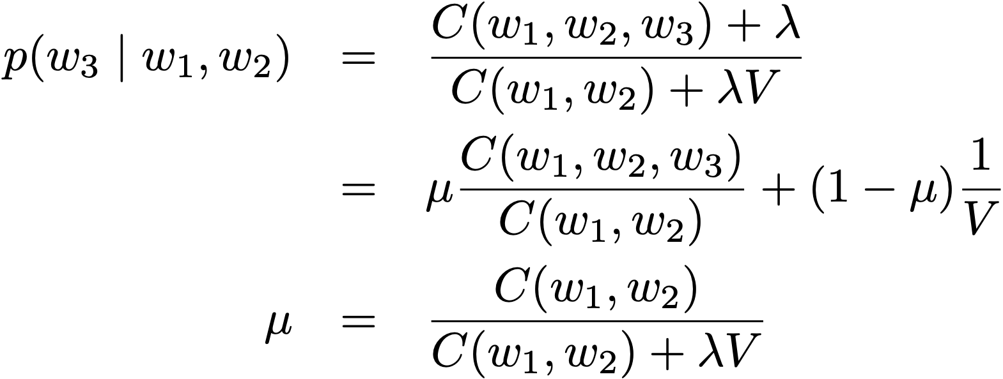
Generalized Additive Smoothing
Laplace add-one smoothing generally assigns too much probability to unseen words
More common to use λ instead of 1:
What’s the right λ?
interpolation

Slide 48
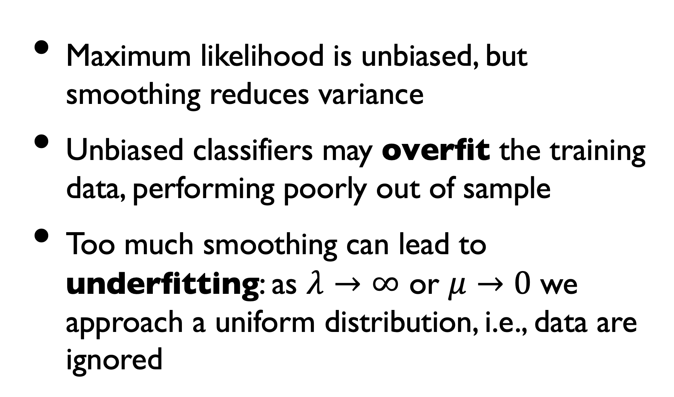
Bias vs. Variance
Maximum likelihood is unbiased, but smoothing reduces variance
Unbiased classifiers may overfit the training data, performing poorly out of sample
Too much smoothing can lead to underfitting: as $λ→∞$ or $μ→0$ we approach a uniform distribution, i.e., data are ignored

Slide 49
Picking Parameters
What happens if we optimize parameters on training data, i.e. the same corpus we use to get counts?
Maximum likelihood estimate!
Use held-out data aka development data
  or K-fold cross-validation (jackknife)
  or leave-one-out cross-validation

Slide 50
Good-Turing Smoothing
Intuition: Can judge rate of novel events by rate of singletons
  Developed to estimate # of unseen species in field biology
Let Nr = # of word types with r training tokens
  e.g., N0 = number of unobserved words
  e.g., N1 = number of singletons (hapax legomena)
Let N = ∑ r Nr = total # of training tokens

Slide 51
Good-Turing Smoothing
Max. likelihood estimate if w has r tokens? r/N
Total max. likelihood probability of all words with r tokens? Nr r / N
Good-Turing estimate of this total probability:
  Defined as: Nr+1 (r+1) / N
  So proportion of novel words in test data is estimated by proportion of singletons in training data.
  Proportion in test data of the N1 singletons is estimated by proportion of the N2 doubletons in training data. etc.
  p(any given word w/freq. r) = Nr+1 (r+1) / (N Nr)
NB: No parameters to tune on held-out data

Slide 52
Backoff
Say we have the counts:
C(in the kitchen) = 0
C(the kitchen) = 3
C(kitchen) = 4
C(arboretum) = 0
ML estimates seem counterintuitive:
p(kitchen | in the) = p(arboretum | in the) = 0

Slide 53
Backoff
Clearly we shouldn’t treat “kitchen” the same as “arboretum”
Basic add-λ (and similar) smoothing methods assign the same prob. to all unseen events
Backoff divides up prob. of unseen unevenly in proportion to, e.g., lower-order n-grams
If p(z | x,y) = 0, use p(z | y), etc.

Slide 54
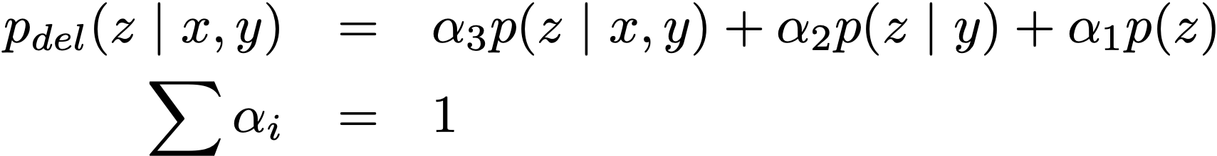
Deleted Interpolation
Simplest form of backoff (Jelinek-Mercer)
Form a mixture of different order n-gram models; learn weights on held-out data
How else could we back off?

Slide 55
Classification
as
Function Learning

Slide 56
Classification vs. LMs
Language models exhibit analogies to human abilities—we’ll return to LMs shortly
Naive Bayes trains simple LMs for classification
Now, a separate tradition of classification as function learning (Breiman, 2001)

Slide 57
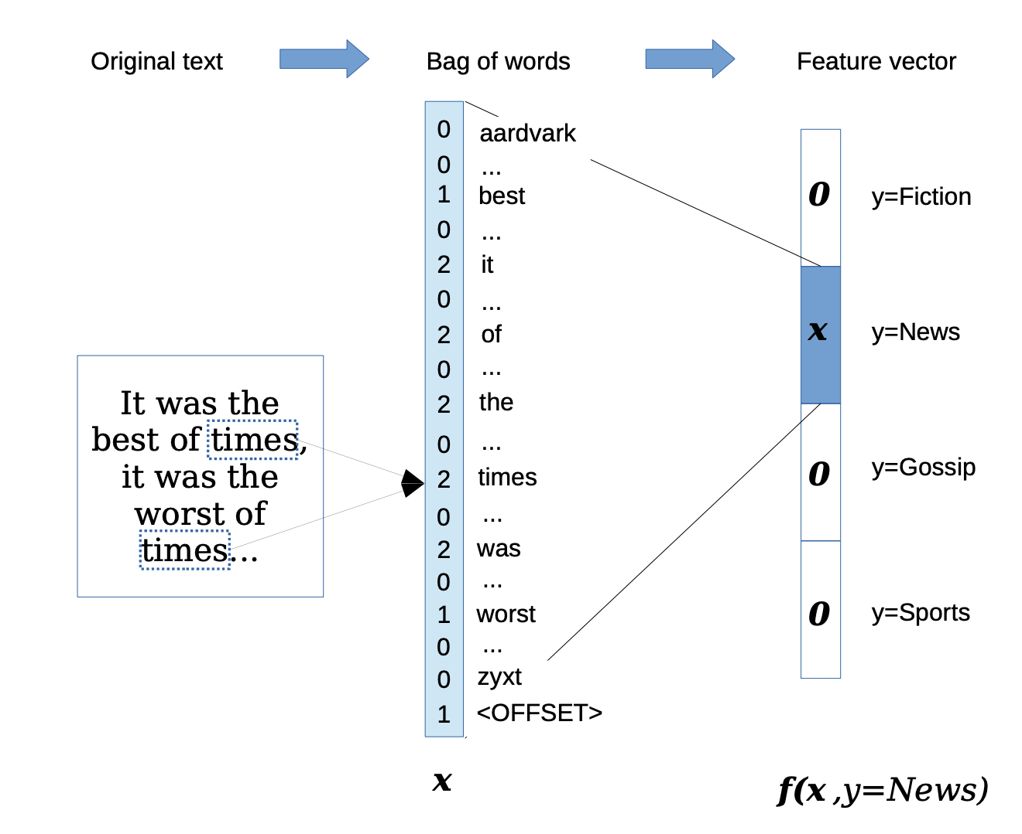
Bag-of-Words Vectors

Slide 58
Bag-of-Words Vectors
Common in vector-space information retrieval (Salton et al., 1960s) and good-old-fashioned expert systems
What values to assign to elements (here, words)?
  Introspection: “Hmm, Moby Dick is about whales… We’ll make whale and harpoon positive and lion negative…” (Cf. sentiment dictionaries)
  Try simple functions and find one that works: binary, counts, tf-idf (log or sqrt scaling?), …

Slide 59


Slide 60
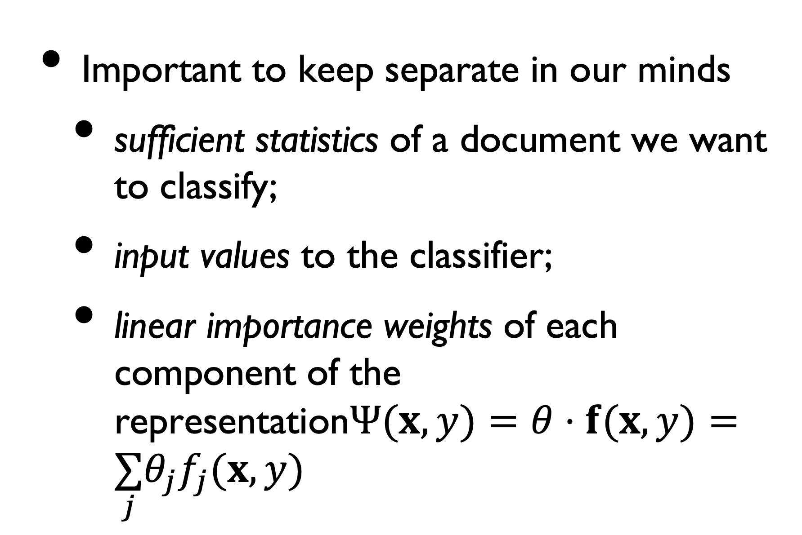
Words, Features, Weights
Important to keep separate in our minds
  sufficient statistics of a document we want to classify;
  input values to the classifier;
  linear importance weights of each component of the representation$Ψ(x,y)=θ⋅f(x,y)=\underset{j}{∑}θ_{j}f_{j}(x,y)$

Slide 61
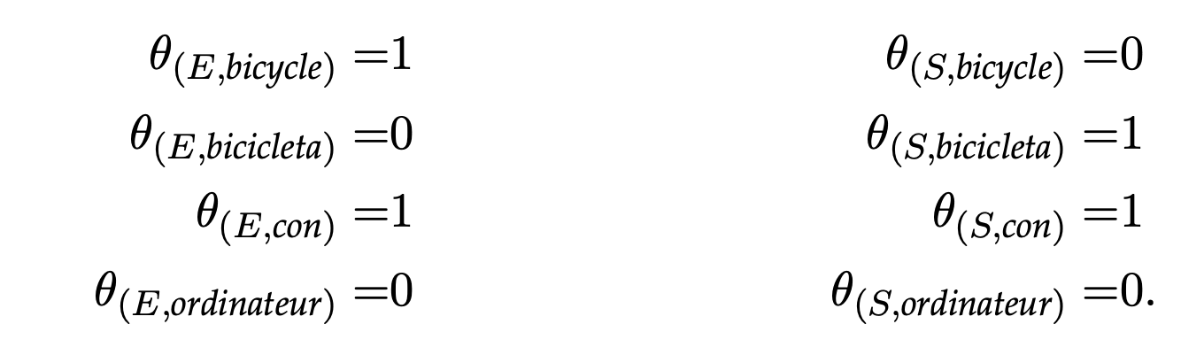
Weights for a Multiclass Problem

Slide 62
Sparse Representations
Most word features will be 0 for most documents
Manipulating lots of |V|-length vectors is inefficient
Compare inverted indices in IR
def compute_score(x, y, weights):
total = 0
for feature, count in feature_function(x,y).items():
total += weights[feature] + count
return total

Slide 63
Bag-of-Words Vectors

Slide 64
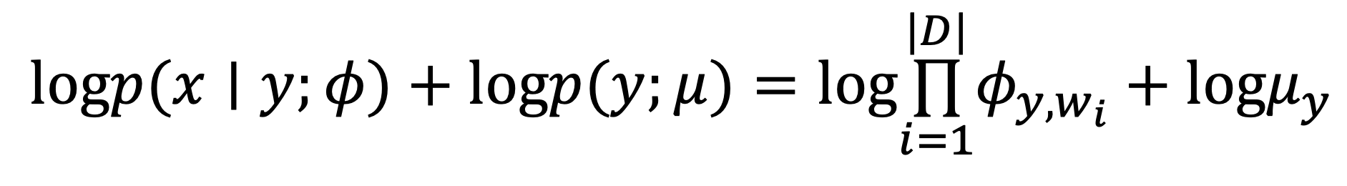
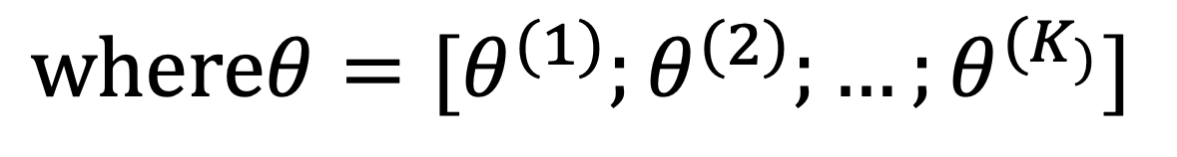
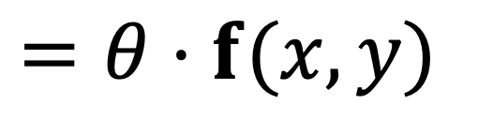
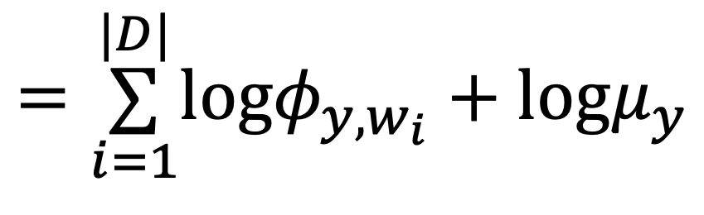
Naive Bayes is a Linear Classifier
$$\overset{̂}{y}=arg\max_{y}logp(x,y;μ,φ)=arg\max_{y}logp(x∣y;φ)+logp(y;μ)$$
$$logp(x∣y;φ)+logp(y;μ)=log\overset{|D|}{\underset{i=1}{∏}}φ_{y,w_{i}}+logμ_{y}$$
$$=\overset{|D|}{\underset{i=1}{∑}}logφ_{y,w_{i}}+logμ_{y}$$
$$=θ⋅f(x,y)$$
$$whereθ=[θ^{(1)};θ^{(2)};…;θ^{(K_{)}}]$$
$$θ^{(y)}=[logφ_{y,1};logφ_{y,2};…;logφ_{y,V};logμ_{y}]$$

Slide 65
Generative vs. Discriminative
Naive Bayes learning maximizes the likelihood of the data
But data are constant during classification!
Instead, consider a simple model of concept learning by an idealized neuron that updates weights only when it makes a mistake: the perceptron (McCullough & Pitts, 1943)

Slide 66
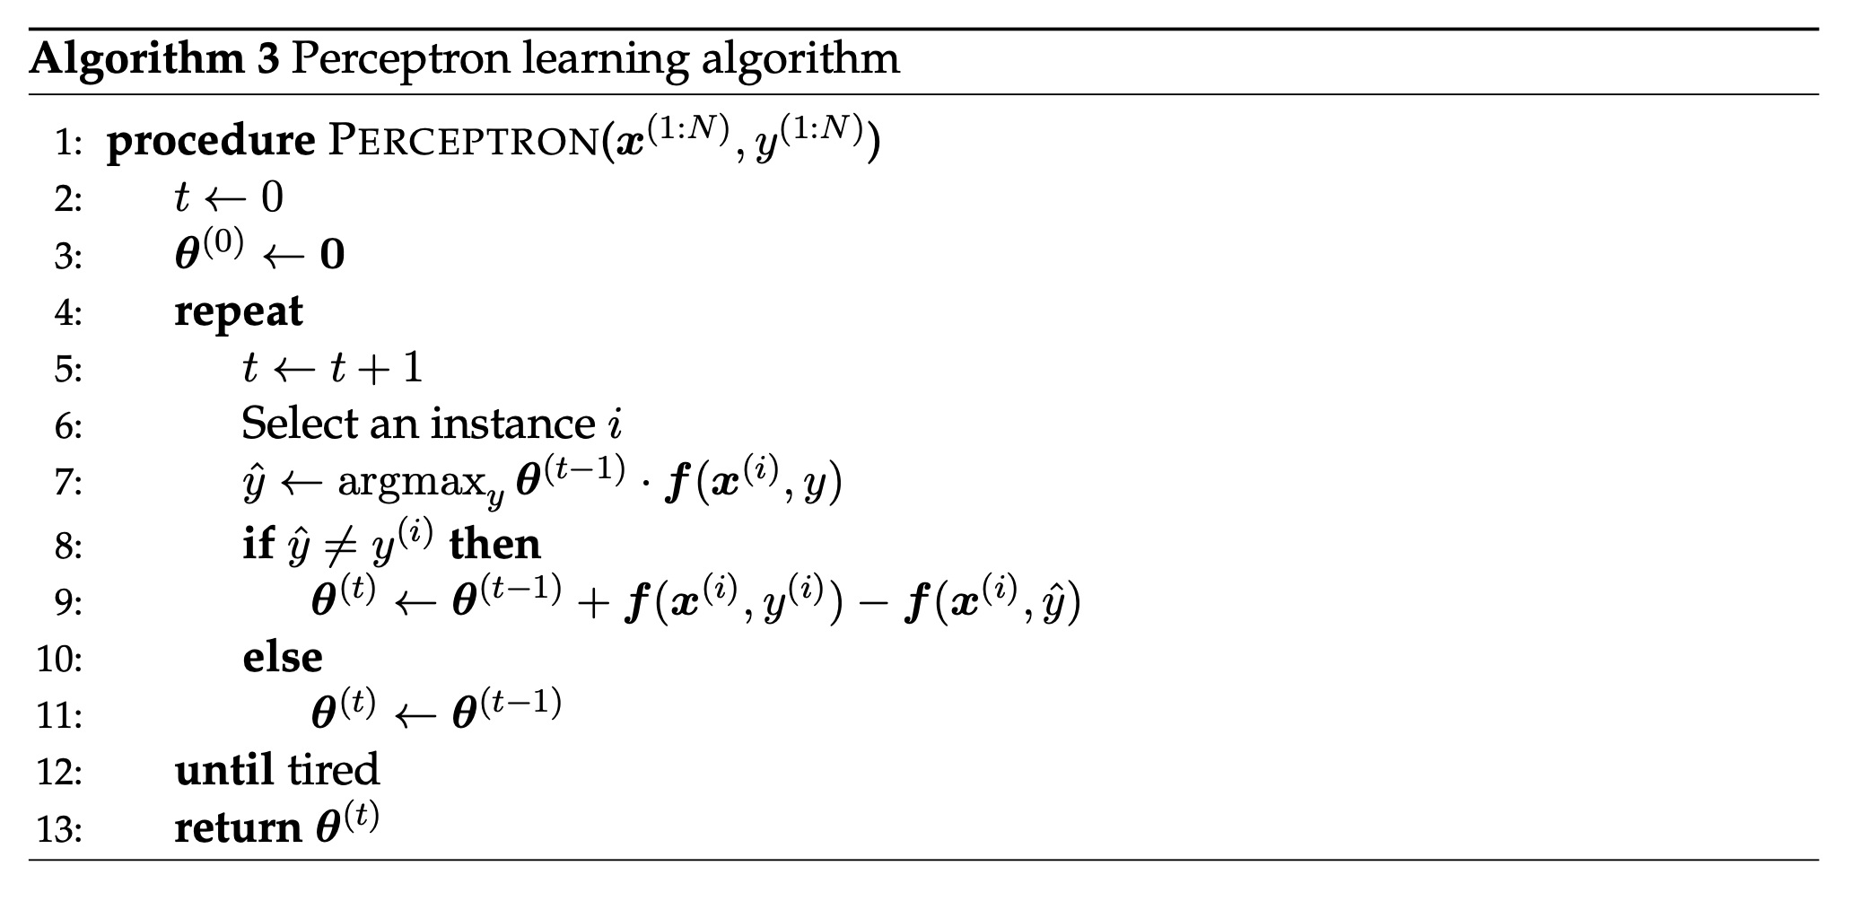

Slide 67
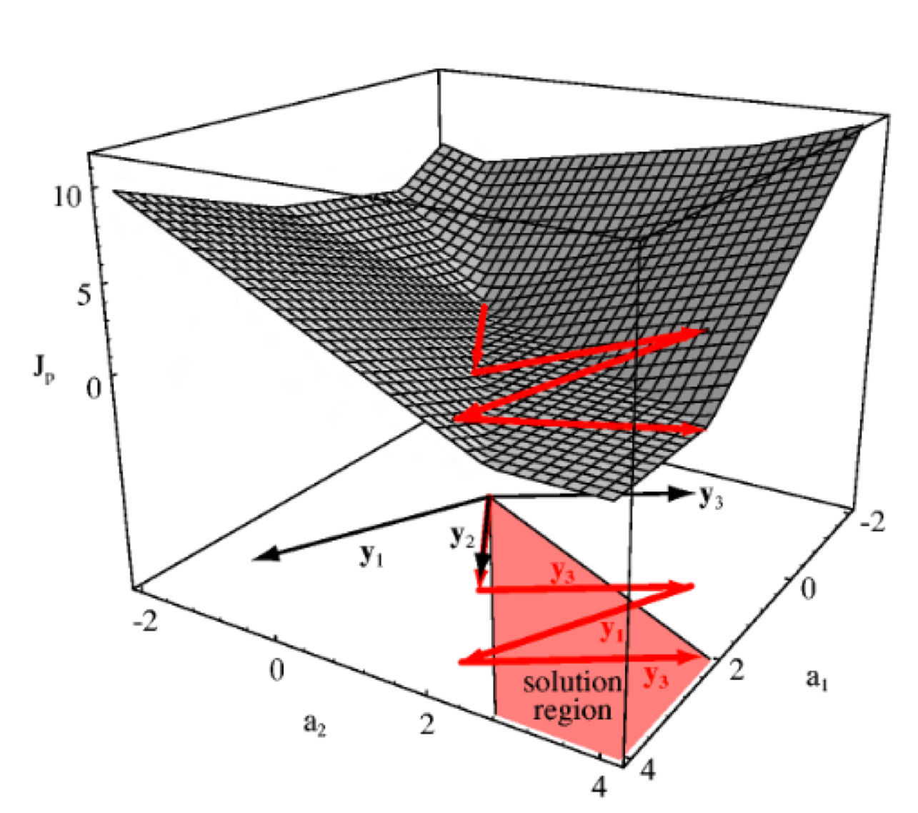

Slide 68

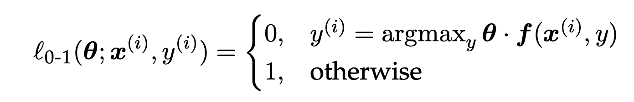
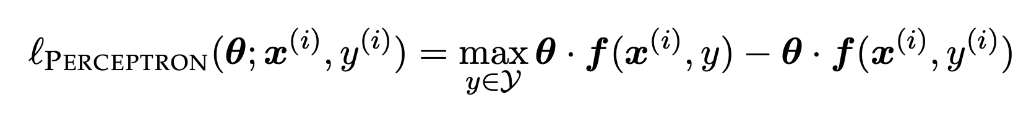
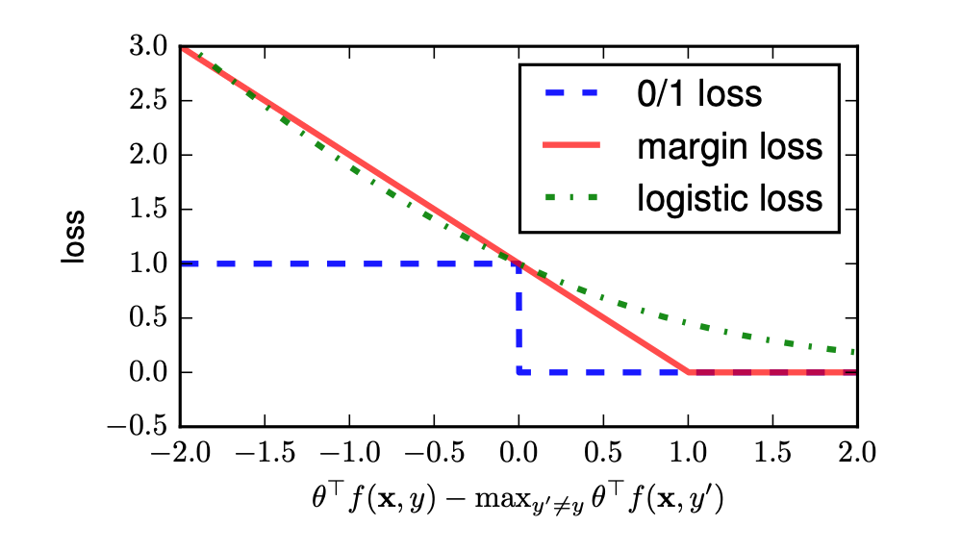
Loss Functions

Slide 69
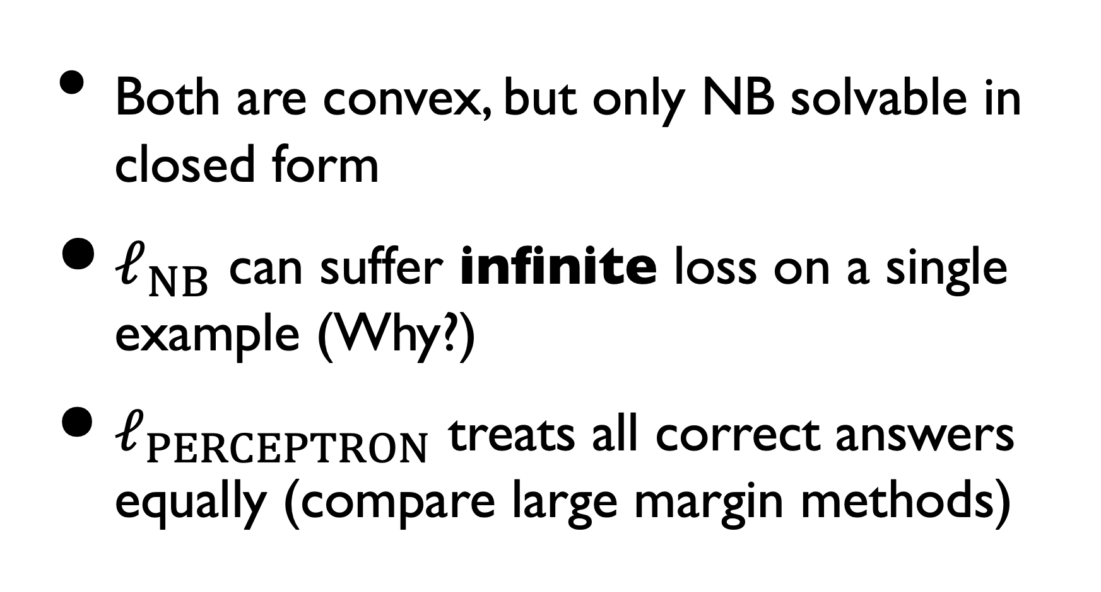
Perceptron vs. NB
Both are convex, but only NB solvable in closed form
$ℓ_{NB}$ can suffer infinite loss on a single example (Why?)
$ℓ_{PERCEPTRON}$ treats all correct answers equally (compare large margin methods)

Slide 70
Logistic Regression

Slide 71
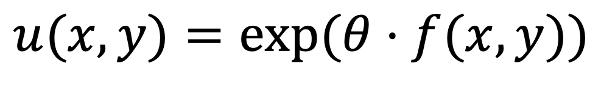
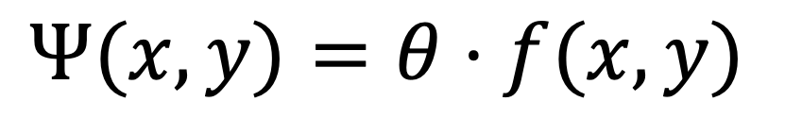
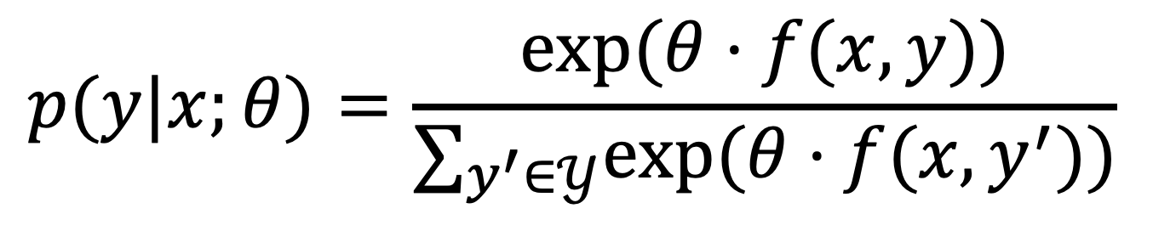
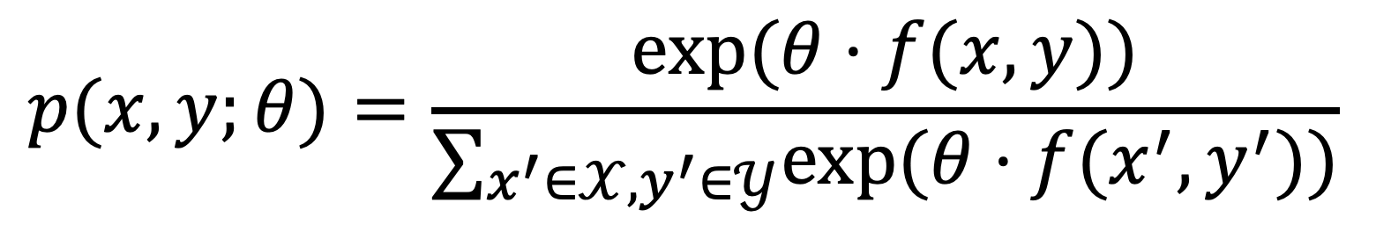
From Classifier to Probability
$$Ψ(x,y)=θ⋅f(x,y)$$
Scoring function
Nonnegative
$$u(x,y)=exp(θ⋅f(x,y))$$
$$p(x,y;θ)=\frac{exp(θ⋅f(x,y))}{∑_{x^{′}∈𝒳,y^{′}∈𝒴}exp(θ⋅f(x^{′},y^{′}))}$$
Joint probability
Conditional prob.
$$p(y|x;θ)=\frac{exp(θ⋅f(x,y))}{∑_{y^{′}∈𝒴}exp(θ⋅f(x,y^{′}))}$$

Slide 72

Logistic Regression
$$p(y|x;θ)=\frac{exp(θ⋅f(x,y))}{∑_{y^{′}∈𝒴}exp(θ⋅f(x,y^{′}))}$$
$$ℓ_{LogReg}(θ;x^{(i)},y^{(i)})=−θ⋅f(x^{(i)},y^{(i)})+log\underset{y^{′}∈𝒴}{∑}exp(θ⋅f(x^{(i)},y^{′}))$$
$$ℓ_{Perceptron}(θ;x^{(i)},y^{(i)})=−θ⋅f(x^{(i)},y^{(i)})+\max_{y^{′}∈𝒴}θ⋅f(x^{(i)},y^{′})$$

Slide 73


Priors/Regularization
In the original LogReg loss function
$$ℓ_{LogReg}(θ;x^{(i)},y^{(i)})=−θ⋅f(x^{(i)},y^{(i)})+log\underset{y^{′}∈𝒴}{∑}exp(θ⋅f(x^{(i)},y^{′}))$$
What if $θ_{(j,y^{(i)})}→∞$ ?
Do we think, a priori, that weights should be infinite? No!
$$p(y∣x)=p(y∣x;θ)⋅p(θ)$$

Slide 74



Priors/Regularization
Maximum a Posteriori (MAP) loss function
$$ℓ_{LogReg}(θ;x^{(i)},y^{(i)})+???$$
$$logN(θ;0,σ^{2})=−\frac{1}{2σ^{2}}∥θ∥_{2}^{2}=−\frac{1}{2σ^{2}}\underset{j}{∑}θ_{j}^{2}$$
Gaussian/L2
$$logL(θ;0,b)=−\frac{1}{b}∥θ∥_{1}=−\frac{1}{b}\underset{j}{∑}|θ_{j}|$$
Laplace/L1
Generic variance term/Lagrange multiplier λ

Slide 75





LogReg Gradients
all data + L2 prior

Slide 76



Gradient-Based Optimization
Batch
Gradient descent
$$θ^{(t+1)}←θ^{(t)}−η^{(t)}∇_{θ}L$$
for learning rate $η$
See also conjugate gradient, quasi-Newton methods
Online
Stochastic gradient descent
$$θ^{(t+1)}←θ^{(t)}−η^{(t)}E[∇_{θ}L]$$

Slide 77





Single-example Update
$$\max_{\overset{̂}{y}}f(x^{(i)},\overset{̂}{y})]$$
$$θ^{(t+1)}←θ^{(t)}−η^{(t)}[−f(x^{(i)},y^{(i)})+$$
$$E_{Y∣X}f(x^{(i)},y)]$$

Slide 78

Gradient-Based Optimization

Slide 79



Reparameterizing LogReg
$$p(y|x;θ)=\frac{exp(θ⋅f(x,y))}{∑_{y^{′}∈𝒴}exp(θ⋅f(x,y^{′}))}$$
$$p(pos|x;θ)=\frac{exp(θ⋅f(x,pos))}{exp(θ⋅f(x,pos))+exp(θ⋅f(x,neg))}$$
$$p(pos|x;θ)=\frac{1}{1+\frac{exp(θ⋅f(x,neg))}{exp(θ⋅f(x,pos))}}$$
$$p(pos|x;θ)=\frac{1}{1+exp(−θ⋅[f(x,pos)−f(x,neg)])}$$

Slide 80


Logistic Sigmoid
Squashing function:
[-∞,∞]→[0,1]
Bias b = 0 here
Offset, scaled tanh
$θ$ is a slope parameter
$$σ(x)=\frac{1}{1+e^{−θx+b}}$$

Slide 81
What Should My Inputs Look Like?

Slide 82
One-Hot Encoding

Slide 83
Summary of Linear Classifiers
Naive Bayes
  Pro: single-pass, closed-form estimation; probabilistic predictions
  Con: poor accuracy w/correlated features
Logistic regression
  Pro: error-driven + probabilistic; regularization well-motivated
  Con: logistic loss saturates/overtrains on correct labels

Slide 84
Readings
Eisenstein, 2.1–3, 2.5–6, 6.1–2, Appendix A
Rao & McMahan, ch. 1, sparse vectors
Perspectives on prediction vs. explanation:
  Bo Pang, Lillian Lee, Shivakumar Vaithyanathan. Thumbs up? Sentiment Classification using Machine Learning Techniques. EMNLP 2002.
  Victor Chahuneau, Kevin Gimpel, Bryan R. Routledge, Lily Scherlis, and Noah A. Smith. Word Salad: Relating Food Prices and Descriptions. EMNLP 2012.

