Slide 1
BDA404-5N | ARTIFICIAL NEURAL NETWORKS
SleepWise AI
Estimating recorded sleep quality with a neural network
Rohan Raphael Arora · 24215220
Project implementation and deployment
EDUCATIONAL PROTOTYPE
Notes:
Introduce the project as an educational regression prototype. The model estimates the sleep-quality score recorded in the dataset from the other recorded characteristics. It does not diagnose a condition or forecast future sleep.

Slide 2
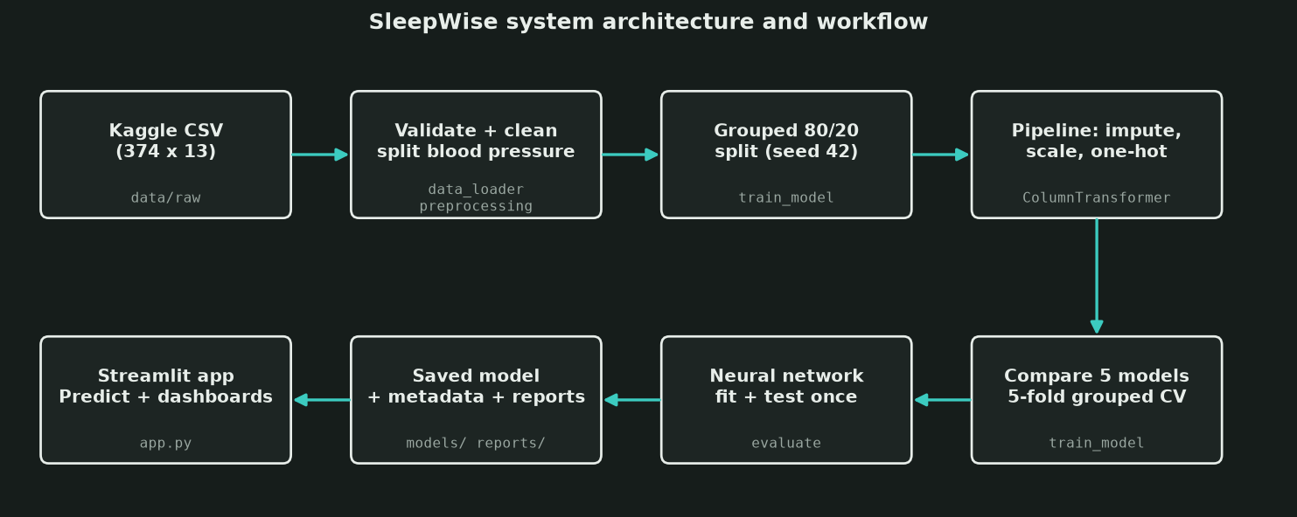
01 | PROBLEM
Project question and scope
Can a feed-forward neural network estimate a recorded sleep-quality score from the characteristics collected with it?
TARGET
Quality of Sleep, treated as a numeric regression target
INPUTS
Sleep duration plus 10 lifestyle and health fields
One estimate from recorded data. No clinical interpretation.
Notes:
The target is the recorded Quality of Sleep score. The model uses eleven available characteristics: age, gender, occupation, sleep duration, physical activity, stress, BMI category, heart rate, daily steps, and systolic and diastolic blood pressure. Person ID and Sleep Disorder are excluded. Sleep Disorder is excluded because it is a recorded outcome that could leak information. Source: docs/PROJECT_REPORT.md and reports/dataset_schema.json.

Slide 3
02 | SYSTEM ARCHITECTURE
System architecture
TRAINING AND MODEL BUILD
Data + preparation
Train + evaluate
Save model + evidence
374 rows; validate CSV
Split blood pressure fields
Drop ID and leakage fields
Scale numbers; encode categories
Group-aware 80/20 holdout
Five-fold grouped cross-validation
Train MLP, NumPy ANN and baselines
Save fitted preprocessing with deployed MLP
Write metrics and model metadata
Store plots and audit reports
PREDICTION WHEN SOMEONE USES THE APP
Input form
app.py
Saved pipeline
Estimate
Sleep duration is required
Other details are optional
Validate values and build a record
Call predict.py
Same scaler and category encoder
Trained MLP weights
Model returns a score estimate
App displays the result
ANN role: 23 encoded inputs feed hidden layers with 64 and 32 ReLU units, then one linear score output. Backpropagation updates weights with squared-error loss and Adam. L2 regularization and early stopping help limit overfitting. The app loads this saved pipeline for each estimate. It does not retrain on each form change.
Notes:
This slide separates the offline training path from live prediction. During a rebuild, data_loader.py validates the CSV and preprocessing.py parses blood pressure, excludes the identifier and potential leakage fields, scales numeric columns, and one-hot encodes categories. train_model.py uses a grouped holdout split and grouped cross-validation, trains the MLP and comparison models, and writes the chosen model and evaluation reports. At app time, app.py collects validated values and predict.py uses the saved preprocessing-and-model pipeline to estimate the score. The ANN does not train again on each submission. The scikit-learn MLPRegressor is the deployed network. A separate NumPy implementation demonstrates manual forward propagation, backpropagation, and Adam updates for comparison. Sources: docs/PROJECT_REPORT.md sections 2–3; src/sleepwise/data_loader.py, preprocessing.py, train_model.py, numpy_mlp.py and predict.py; app.py; reports/model_metrics.json.

Slide 4
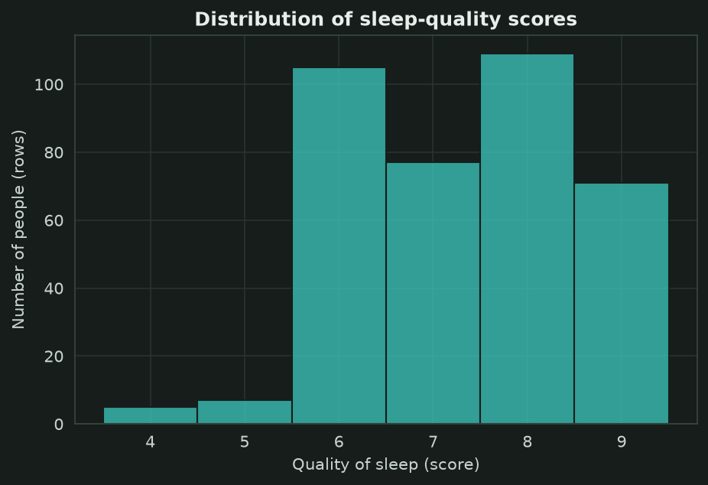
03 | DATA
Dataset and signal
374
109
rows in the source file
distinct input combinations
RECORDED TARGET VALUES
4 to 9 on the nominal 1–10 scale
No missing values. 242 rows repeat another row’s input values when Person ID is ignored.
Repeated profiles make the effective sample much smaller than 374 people.
Notes:
The CSV contains 374 rows and no missing values. However, 242 rows repeat another row’s model inputs when Person ID is ignored. There are 109 distinct feature combinations. The recorded quality target ranges from 4 to 9, even though the nominal scale runs from 1 to 10. Source: reports/dataset_schema.json and reports/figures/dark/01_target_distribution.png.

Slide 5
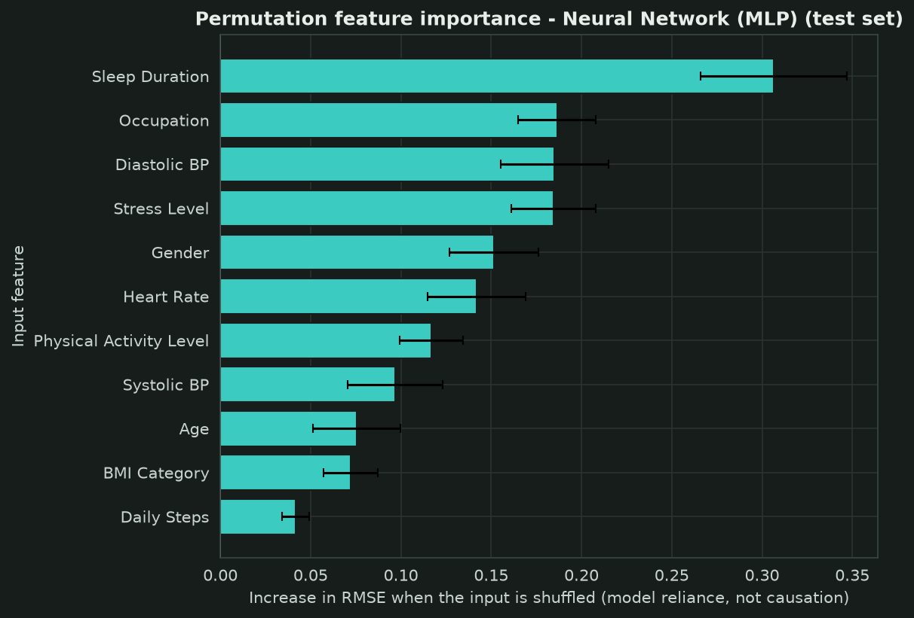
04 | METHOD
Preprocessing, evaluation, and model reliance
NUMERIC FEATURES
Median imputation, then StandardScaler normalization
CATEGORICAL FEATURES
Most-frequent imputation, then one-hot encoding
LEAKAGE CONTROL
80/20 grouped split. Identical input profiles stay together. Five-fold grouped cross-validation uses training data only.
Permutation importance measures model reliance, not causation.
Notes:
The numeric and categorical transformations live inside the model pipeline, so imputation, scaling and encoding are fitted only on training data. An 80/20 GroupShuffleSplit keeps identical feature profiles on one side of the split. Five-fold grouped cross-validation runs within the training set. The grouping matters because a random split would put near-copies of most test rows into training. The chart shows permutation importance: the increase in test RMSE when an input is shuffled. It measures model reliance, not causation. Source: docs/PROJECT_REPORT.md, reports/dataset_schema.json and reports/figures/dark/feature_importance.png.

Slide 6
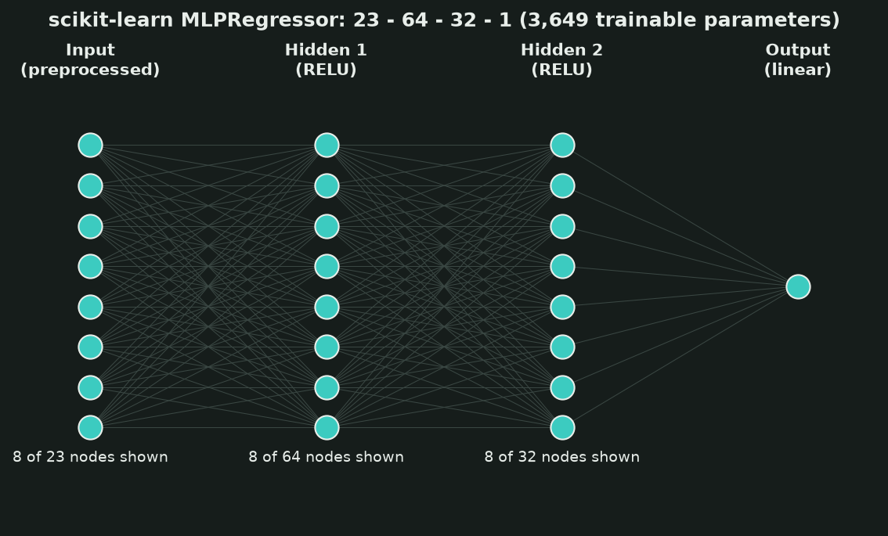
05 | MODEL
Neural network architecture
23 → 64 → 32 → 1
Two ReLU hidden layers learn nonlinear combinations. A linear output predicts the numeric score.
TRAINING
Squared-error loss · Adam optimizer · L2 regularization · early stopping
3,649 trainable parameters
Notes:
The deployed estimator is a scikit-learn MLPRegressor. One-hot encoded inputs produce 23 input features, followed by hidden layers of 64 and 32 units and a single linear regression output. ReLU activations support nonlinear learning. Backpropagation computes gradients for squared error, Adam updates the weights, and L2 regularization plus early stopping reduce overfitting risk. Source: reports/model_metrics.json and reports/figures/dark/network_architecture.png.

Slide 7
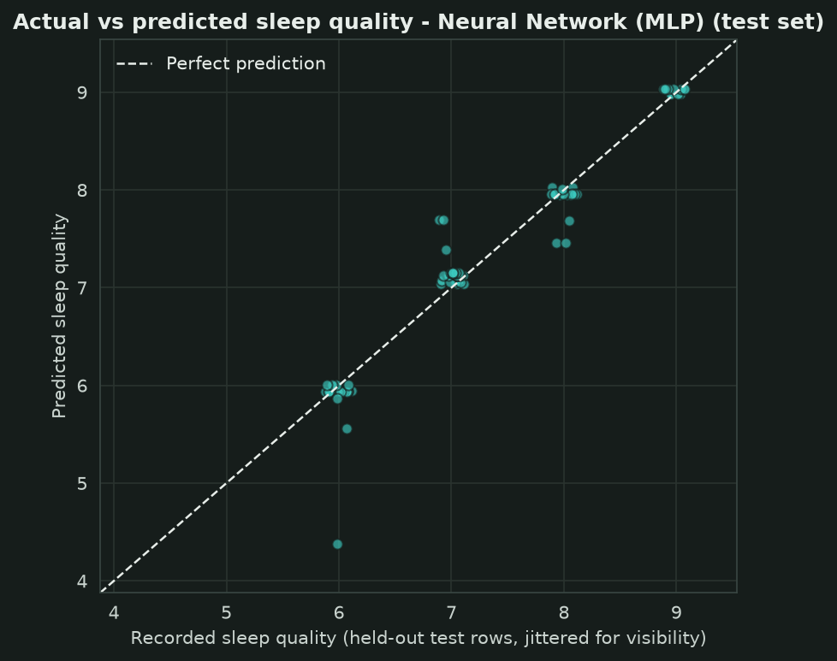
06 | EVALUATION
Held-out performance
0.121
0.244
0.942
MAE
RMSE
R²
One grouped test set: 86 rows across 22 distinct input profiles
Baseline RMSE: 1.047
Strong fit on this split. Small, repetitive data still limits confidence beyond it.
Notes:
The held-out set contains 86 rows but only 22 distinct feature profiles. The deployed MLP achieved MAE 0.121, RMSE 0.244, and R-squared 0.942. The training-mean baseline had RMSE 1.047. These metrics are real results from the saved run in reports/model_metrics.json. They describe this dataset split, not clinical accuracy or performance on a new population. Source: reports/model_metrics.json and reports/figures/dark/actual_vs_predicted.png.

Slide 8
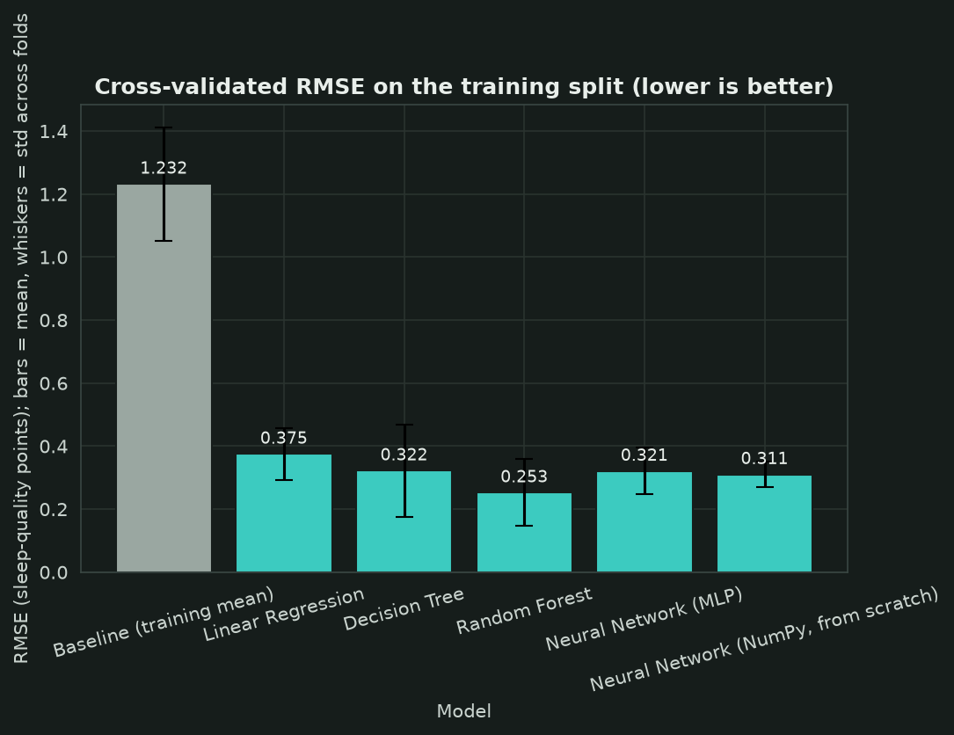
07 | EVALUATION
Model comparison and selection
WHY DEPLOY THE MLP?
The neural network was selected by design for this ANN course project.
Random Forest had the lowest grouped CV RMSE: 0.237 vs 0.268 for the MLP.
Its test RMSE was also lower: 0.195 vs 0.244. Reported transparently.
Small test sample: differences need cautious interpretation.
Notes:
The MLP did not win the model comparison. On the training split, grouped five-fold CV RMSE was 0.268 for the neural network and 0.237 for Random Forest. Held-out RMSE was 0.244 for the MLP and 0.195 for the forest. The project selected the MLP by design because this is an ANN course project, before viewing the test result. The gap is suggestive, not decisive, given only 22 distinct held-out profiles. Source: reports/model_metrics.json and reports/figures/dark/model_comparison.png.

Slide 9
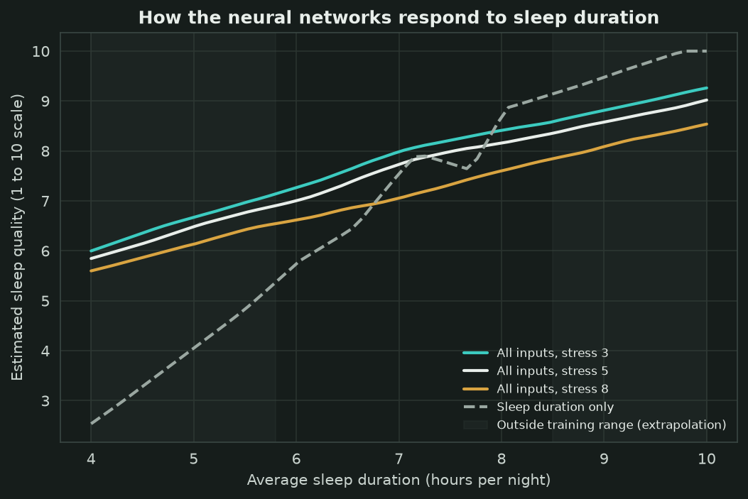
08 | APPLICATION
Prediction behavior and data limits
INPUT CONTROLS
Age: 1–100 years
Sleep duration: 1–10 hours
WHAT THE CSV SUPPORTS
Recorded ages: 27–59
Recorded sleep duration: 5.8–8.5 hours
Underweight is selectable, but the training data has no Underweight examples. The model cannot learn its specific effect.
Outside observed ranges, estimates are extrapolations.
Notes:
The form restricts age to 1–100 and sleep duration to 1–10 hours. These are interface limits, not the ranges represented in the training CSV. The dataset only records ages 27–59 and sleep duration 5.8–8.5 hours. Underweight is offered in the BMI control but occurs zero times in the training dataset, so the model cannot learn a category-specific Underweight effect. Predictions outside the observed range should be treated as extrapolations. Source: src/sleepwise/config.py and reports/dataset_schema.json.

Slide 10
09 | SUMMARY
Takeaways and questions
01
A trained ANN estimates recorded sleep-quality scores from eleven available inputs.
02
Grouped evaluation limits leakage from repeated profiles, but the effective dataset remains small.
03
The application is an educational prototype, not a diagnosis or forecast.
Questions
Thank you
Notes:
Close with the central result and its limits. The model learned useful patterns in the supplied dataset, and grouped evaluation avoids the most obvious duplication leak. The small number of distinct feature combinations, absent Underweight examples, and lack of external validation limit what we can claim. Invite questions. Source: docs/PROJECT_REPORT.md and reports/model_metrics.json.

Slide 11
10 | SOURCES
References
01
Rumelhart, D. E., Hinton, G. E., & Williams, R. J. (1986). Learning representations by back-propagating errors. Nature, 323, 533–536.
05
Grinsztajn, L., Oyallon, E., & Varoquaux, G. (2022). Why do tree-based models still outperform deep learning on typical tabular data? NeurIPS 2022, Datasets and Benchmarks Track.
doi.org/10.1038/323533a0
papers.neurips.cc/paper/2022/hash/0378c7692da36807bdec87ab043cdadc
02
Kingma, D. P., & Ba, J. (2015). Adam: A method for stochastic optimization. International Conference on Learning Representations.
06
Pedregosa, F., et al. (2011). Scikit-learn: Machine learning in Python. Journal of Machine Learning Research, 12(85), 2825–2830.
arxiv.org/abs/1412.6980
03
Glorot, X., Bordes, A., & Bengio, Y. (2011). Deep sparse rectifier neural networks. AISTATS 2011, PMLR 15, 315–323.
jmlr.org/papers/v12/pedregosa11a.html
07
Tharmalingam, L. (n.d.). Sleep Health and Lifestyle Dataset [Data set]. Kaggle.
proceedings.mlr.press/v15/glorot11a
04
Prechelt, L. (1998). Early stopping, but when? In Neural Networks: Tricks of the Trade, LNCS 1524, Springer, 55–69.
kaggle.com/datasets/uom190346a/sleep-health-and-lifestyle-dataset
doi.org/10.1007/3-540-49430-8_3
Selected references used in this presentation. Full bibliography: docs/PROJECT_REPORT.md.
Notes:
Selected references shown in the project’s supplied bibliography and cited for the methods and dataset discussed in this presentation.
Rumelhart et al. (1986): https://doi.org/10.1038/323533a0
Kingma and Ba (2015): https://arxiv.org/abs/1412.6980
Glorot et al. (2011): https://proceedings.mlr.press/v15/glorot11a
Prechelt (1998): https://doi.org/10.1007/3-540-49430-8_3
Grinsztajn et al. (2022): https://papers.neurips.cc/paper_files/paper/2022/hash/0378c7692da36807bdec87ab043cdadc-Abstract-Datasets_and_Benchmarks.html
Pedregosa et al. (2011): https://jmlr.org/papers/v12/pedregosa11a.html
Tharmalingam (n.d.), dataset page: https://www.kaggle.com/datasets/uom190346a/sleep-health-and-lifestyle-dataset

