Slide 1
Healthcare Analytics Dashboard Report
Prepared By : Rohan Runghe(Data Analyst)
Role in Healthcare Project :
Collected and cleaned healthcare datasets.
Performed patient and hospital data analysis.
Analyze treatment costs, patient visit and disease trends
Generated business insights for hospital management
Tools And Technology Used :
Database and Query Tools:
PostgreSql
SQL
Data Analysis and Visualization :
Microsoft Excel
Power BI
Programming :
Python
Pandas (Library)
Numpy (Library)
Matplotlib (Library)

Slide 2
Objective : The main objective of the Healthcare Analytics Project is to analyze patient and hospital data to improve healthcare decision-making, identify disease patterns, reduce treatment costs, and enhance patient care quality.
Dataset Description :
The dataset used in this project contains healthcare-related information collected from hospitals, patients, and medical systems. It includes demographic, medical, and treatment details.
Column Name Description
Patient Id Unique Id for each patient
Age Age of Patient
Gender Male/Female
City Patient City Name
Disease Patient disease
Admission Date Patient admission date
Region Patient Region
Department Department Name
Treatment Cost Patient Treatment Cost
Insurance type Patient Insurance Type
Payment Status Patient Payment Stats
Feedback Patient Feedback
Treatment outcome Patient Treatment Outcome
Rating Patient Rating

Slide 3
Records: 50,000+patient records Source: Hospital management dataset Format: CSV and PosgreSQL dataset
Total columns :
2507
Total rows :
16
Data Preparation
Imported data into PostgreSQL.
Cleaned missing and duplicate records.
Standardized data types and formats.
Performed SQL joins, aggregations, filtering, and window functions.
Processed the cleaned data for Power BI visualization. The
Feature Engnieering :
The dataset used in this project contains healthcare-related information collected from hospitals, patients, and medical systems. It includes demographic, medical, and treatment details.
Creating New features.
Date and time feature extraction.
Text feature engineering.
Handling Imbalanced data.
Feature selection.

Slide 4
EDA(Exploratory Data Analysis) :
EDA (Exploratory Data Analysis) means analyzing data to understand patterns, relationships, errors, trends, and important insights before creating Machine Learning models or dashboards.
Data Collection.
Import Libraries.
Missing Value Analysis.
Universal Analysis.
Feature Engnieering.
Dashboard Visuals
Power BI Dashboard Features
KPI Cards: Flow Total Patients, Total Revenue, Average Treatment Cost, Recovery Rate
Department-wise Revenue Analysis
Top Diseases Analysis
Patient Age Distribution
Gender Distribution
Insurance Claim Status
Treatment Outcome Analysis
Interactive slicers for Department, Disease, Gender, Insurance Status , Rating , City

Slide 5
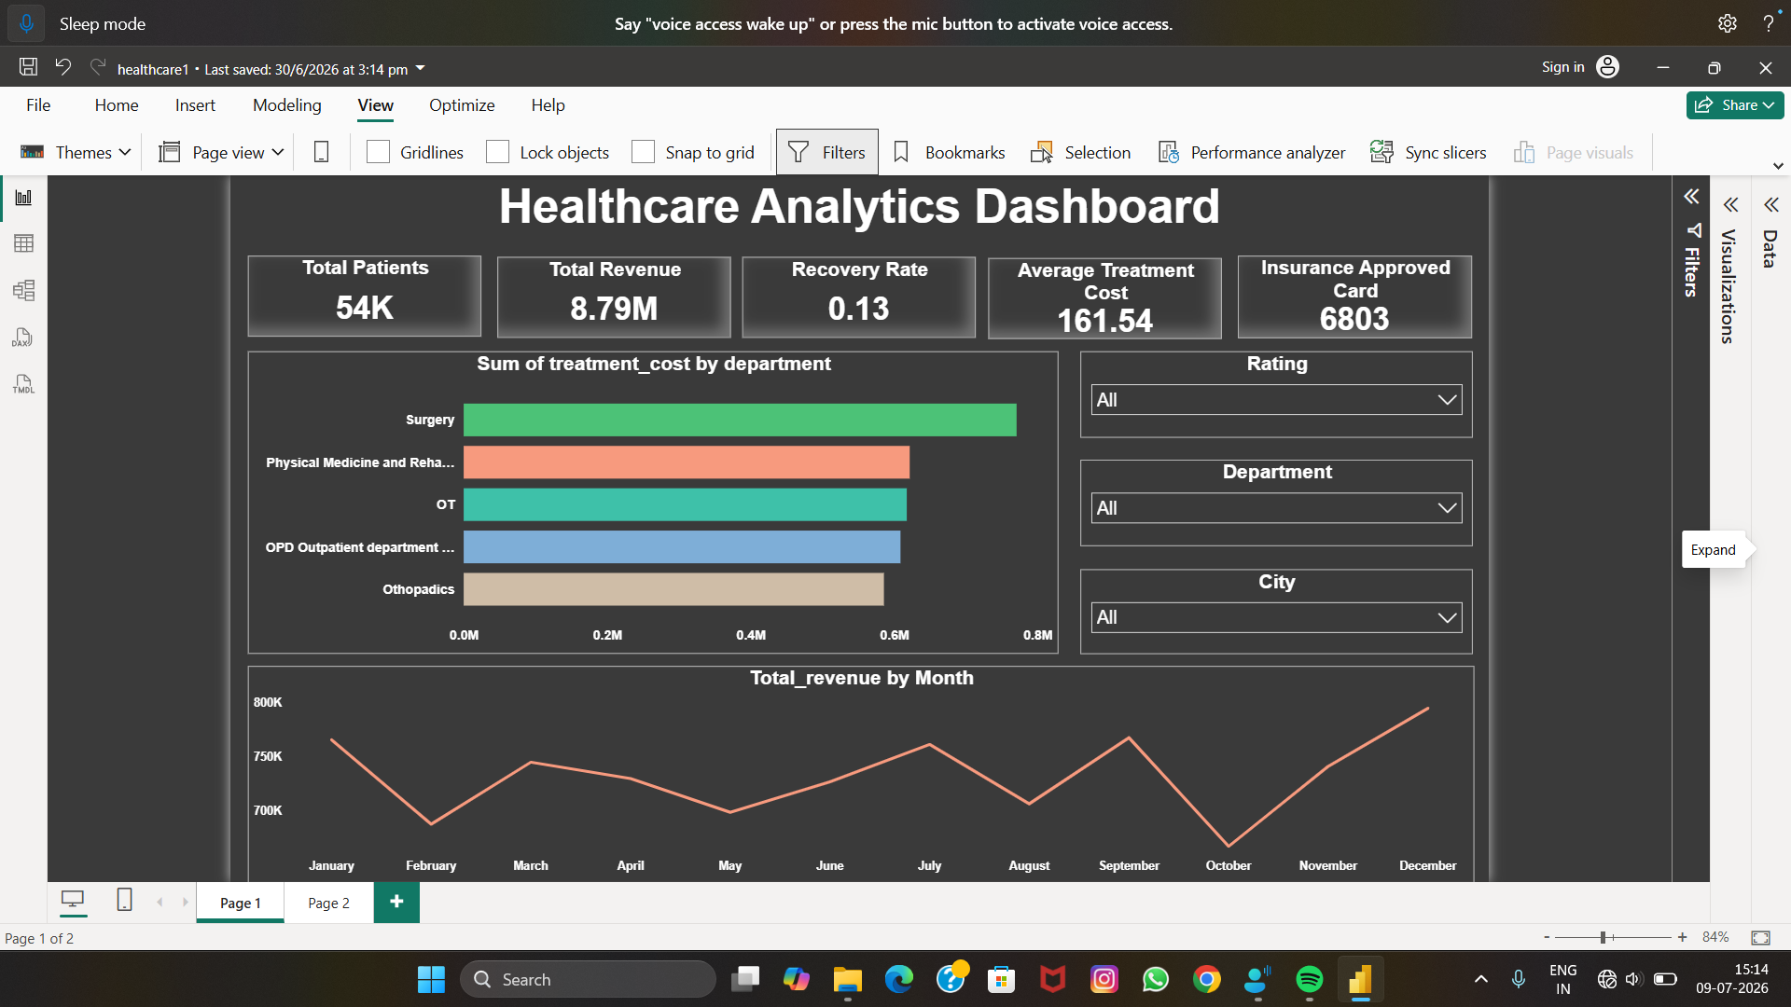

Slide 6
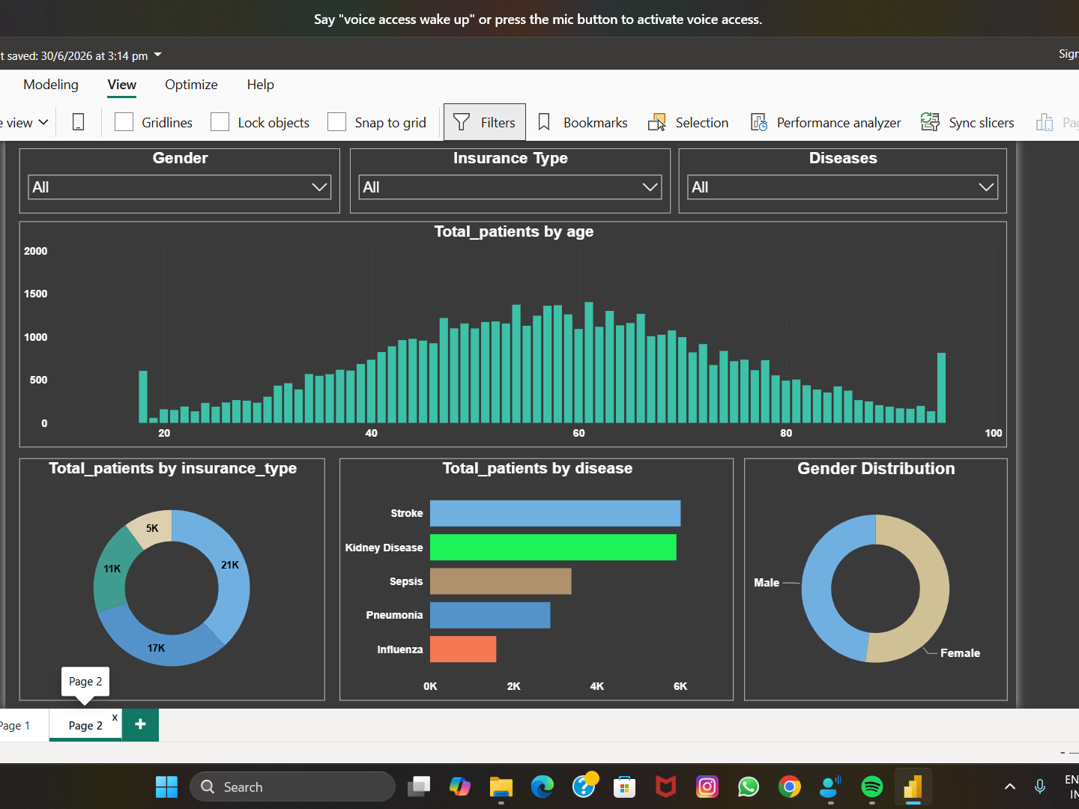

Slide 7
Key Insights:
Identified departments generating the highest revenue.
Determined the most common diseases among patients.
Analyzed patient demographics based on age and gender.
Evaluated insurance approval trends.
Monitored treatment outcomes and recovery rates.
Business Impact
Reduced manual reporting efforts through interactive dashboards.
Improved visibility into hospital performance and patient care.
Supported data-driven decisions for hospital management.
Enabled quick identification of operational trends and patient risks
Conclusion
The Healthcare Analytics Dashboard provides a centralized view of hospital operations using Power BI, SQL, PostgreSQL, Python, and Excel. It improves reporting efficiency, supports better healthcare decisions, and demonstrates practical data analytics skills applicable to real-world healthcare environments.

