Slide 1
Create Selenium Grid Using Docker Compose and Execute the test cases in parallel with different browsers at single instance

Slide 2
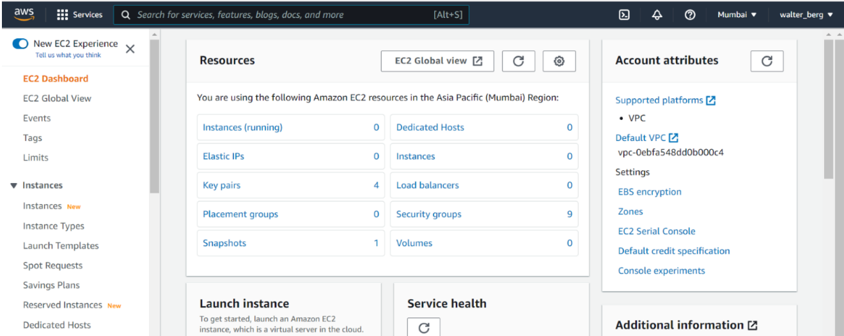
Step 1: Login to Aws Console and Launch an ec2 dashboard

Slide 3
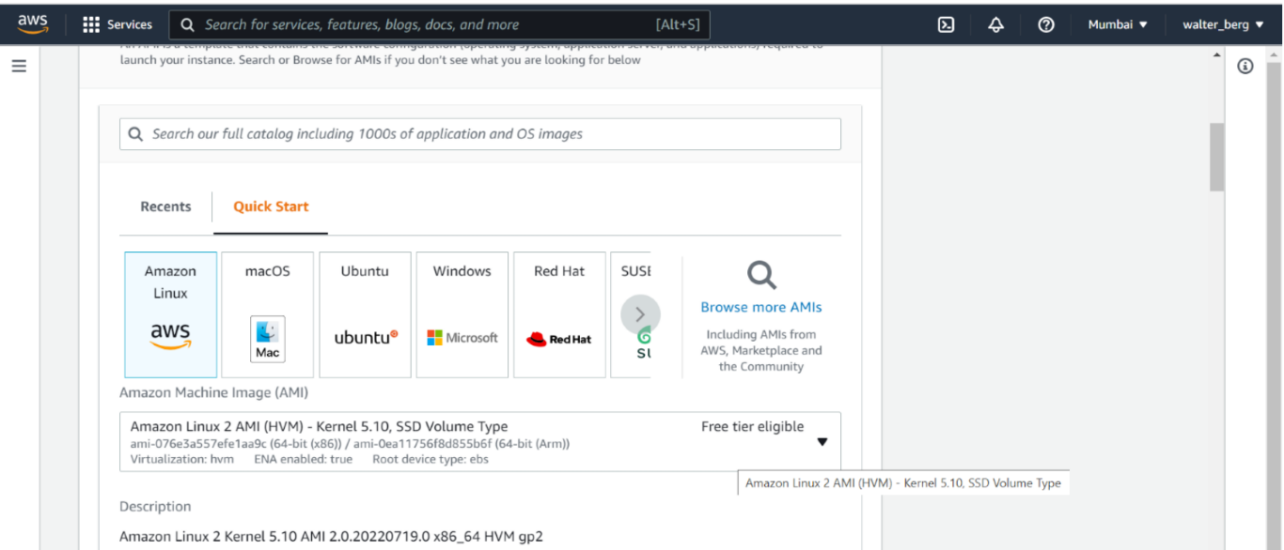
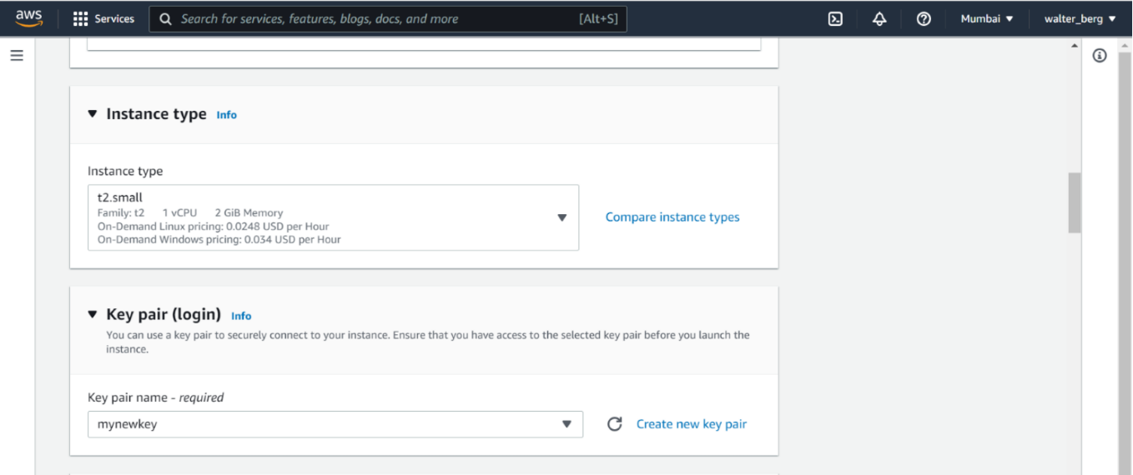
Step 2: Launch an Amazon Linux EC2 Instance

Slide 4
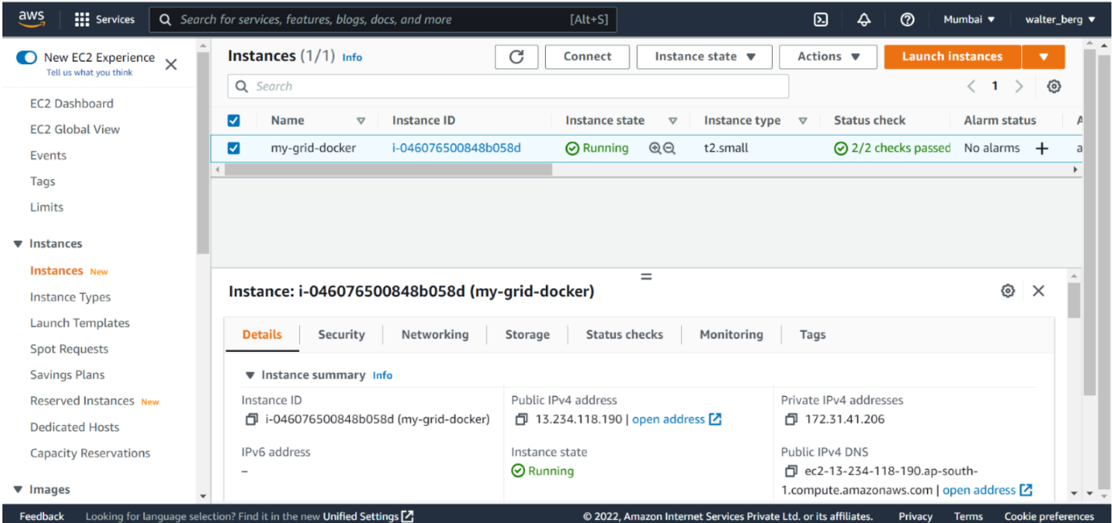
Instance is running

Slide 5
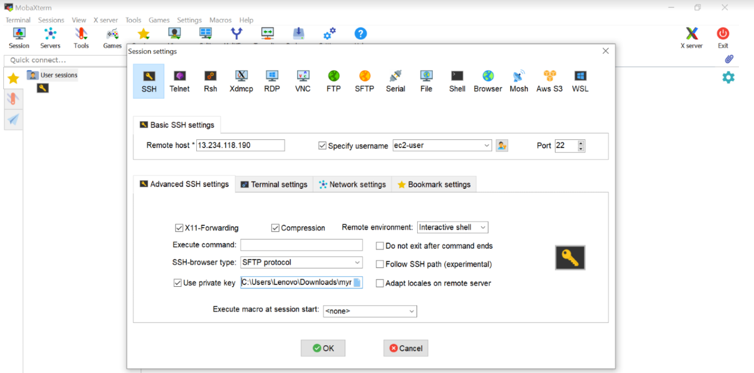
Step 3: Access the server from Mobaxterm

Slide 6
Step 3: Access the server from Mobaxterm

Slide 7
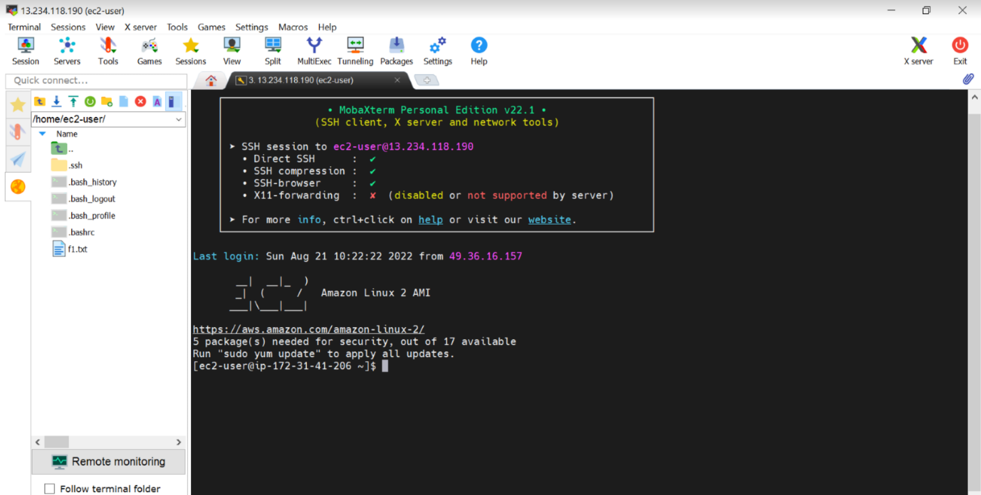
Step 3 contd…..
Instance is running and up

Slide 8
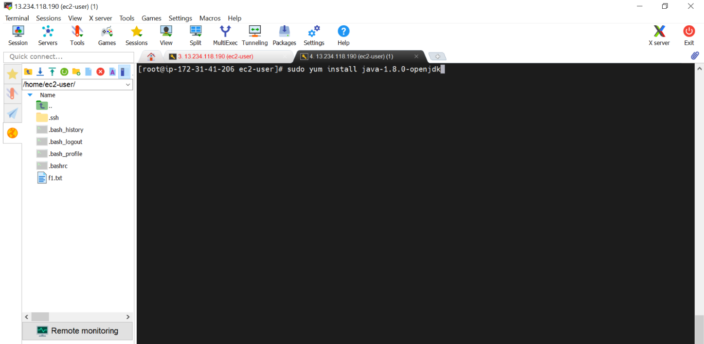
Step 4: we need to install java Command to install java: sudo yum install java-1.8.0-openjdk

Slide 9
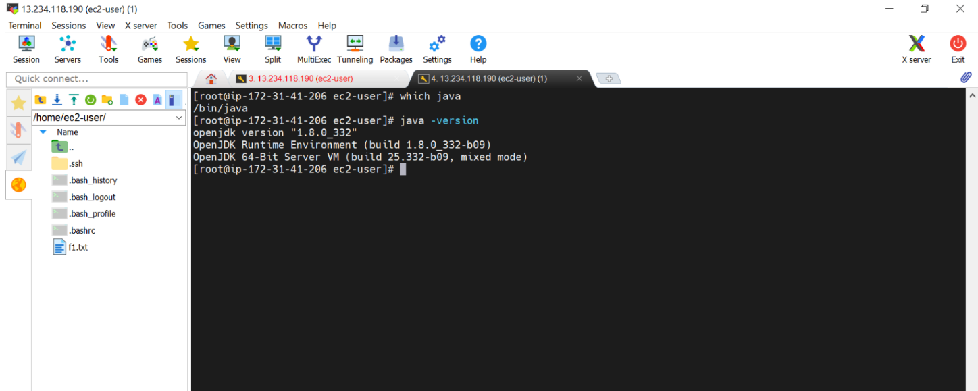
Step 4 Contd… Now check whether java is installed or not with command: Java -version

Slide 10
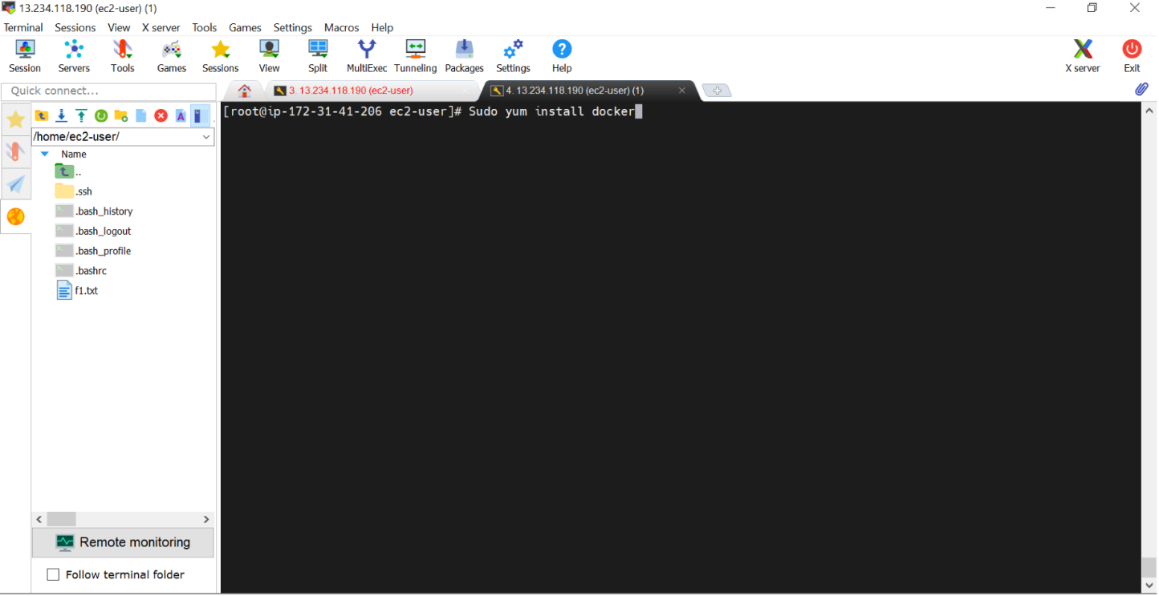
Step 5: we need to install docker with command: sudo yum install docker

Slide 11
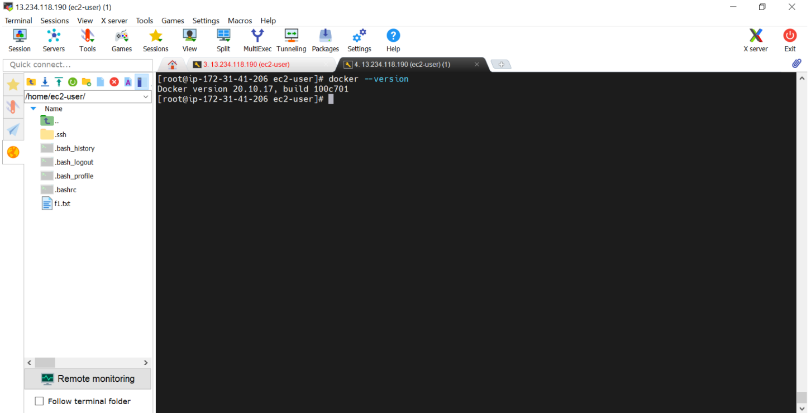
Step 5 contd… Check docker version with command: docker --version

Slide 12
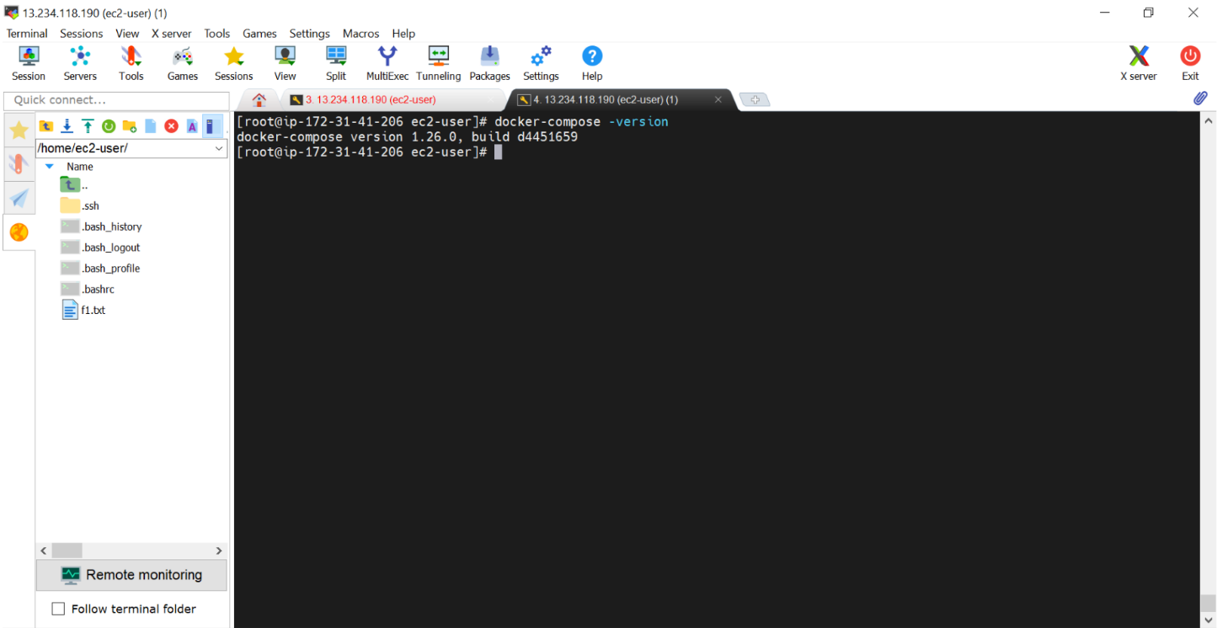
Step 6: After that we need to install docker-compose with commands: sudo curl -L "https://github.com/docker/compose/releases/download/1.26.0/docker-compose-$(uname -s)-$(uname -m)" -o /usr/local/bin/docker-compose sudo mv /usr/local/bin/docker-compose /usr/bin/docker-compose sudo chmod +x /usr/bin/docker-compose Now we need to check whether docker-compose is installed or not with command: docker-compose -version

Slide 13
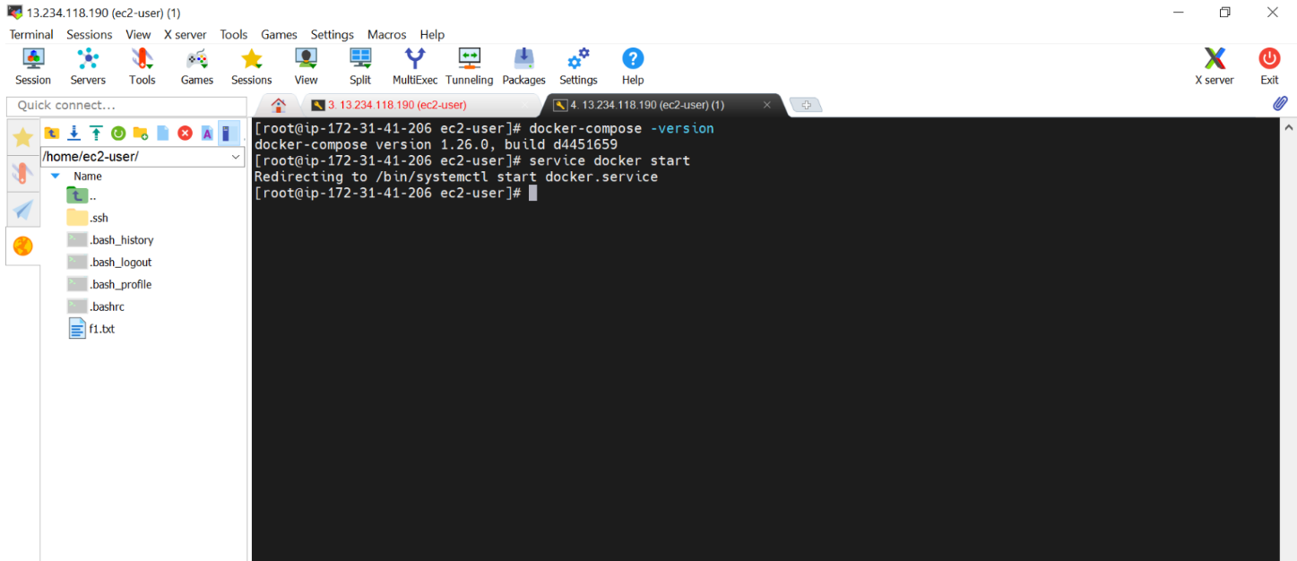
Step 7: we need to start docker service with command: service docker start

Slide 14
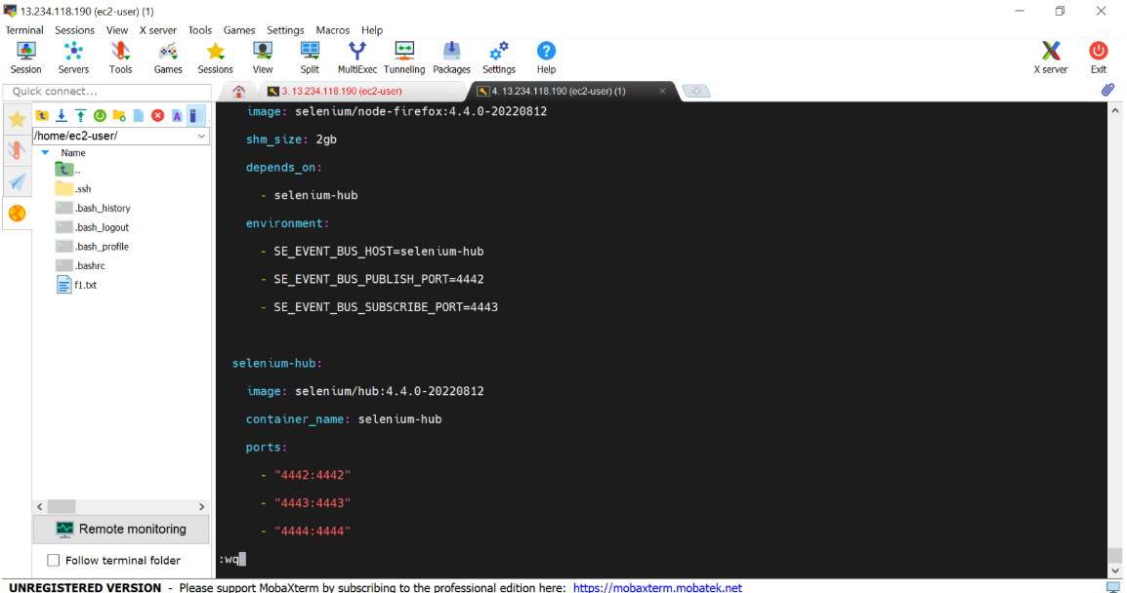
Step 8: After that we need to create file docker -compose.yml in order to run more than one containers in a one go.

Slide 15
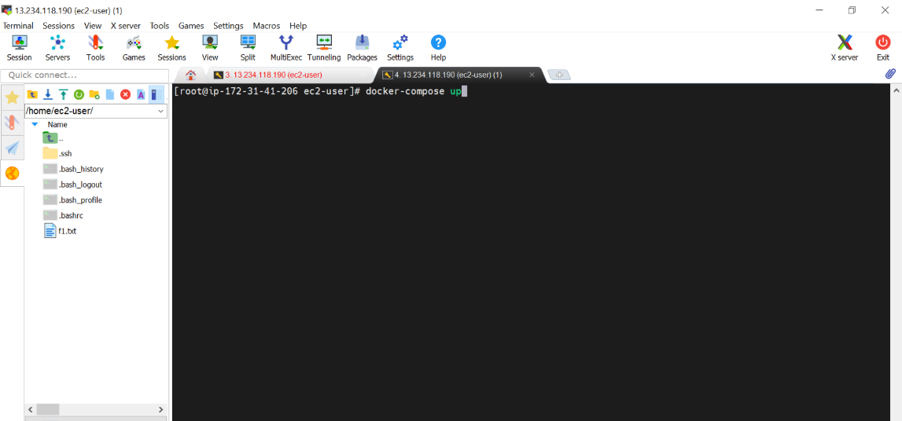
Step 9 : Now we need to run our docker-compose file to setup the selenium hub and nodes with command : docker-compose up

Slide 16
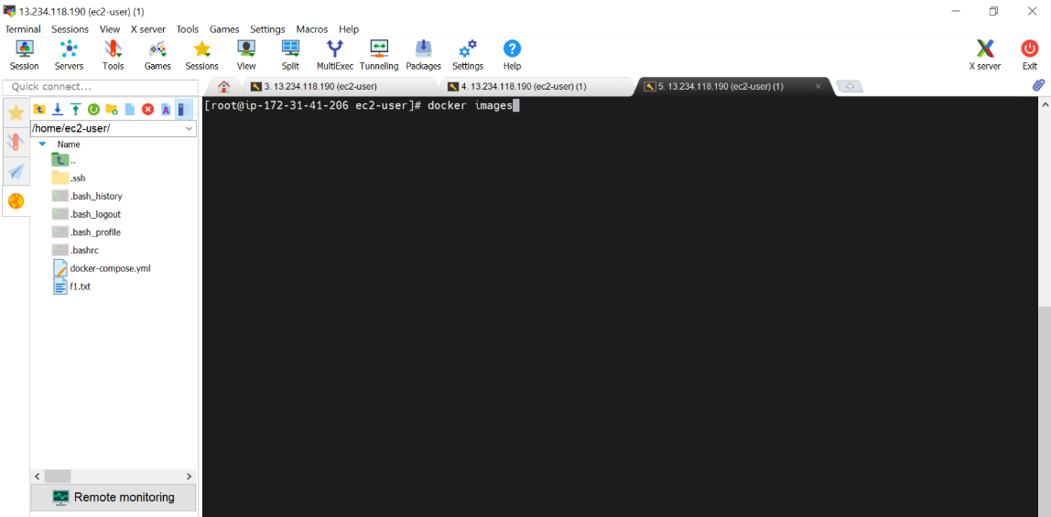
We can check docker images with command: docker images

Slide 17
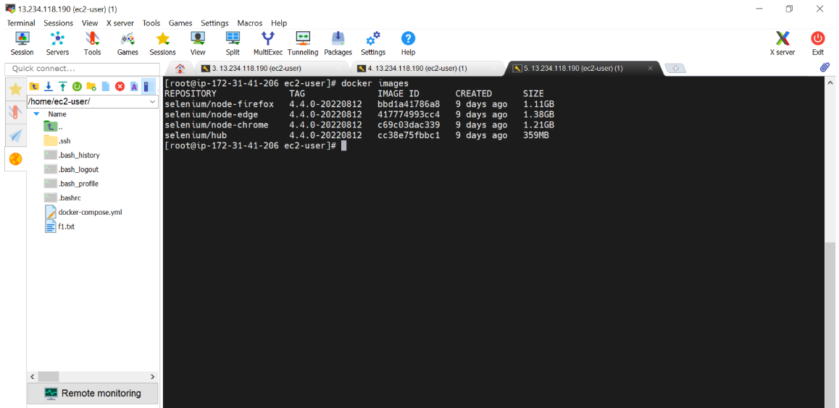
We can check docker images with command: docker images

Slide 18
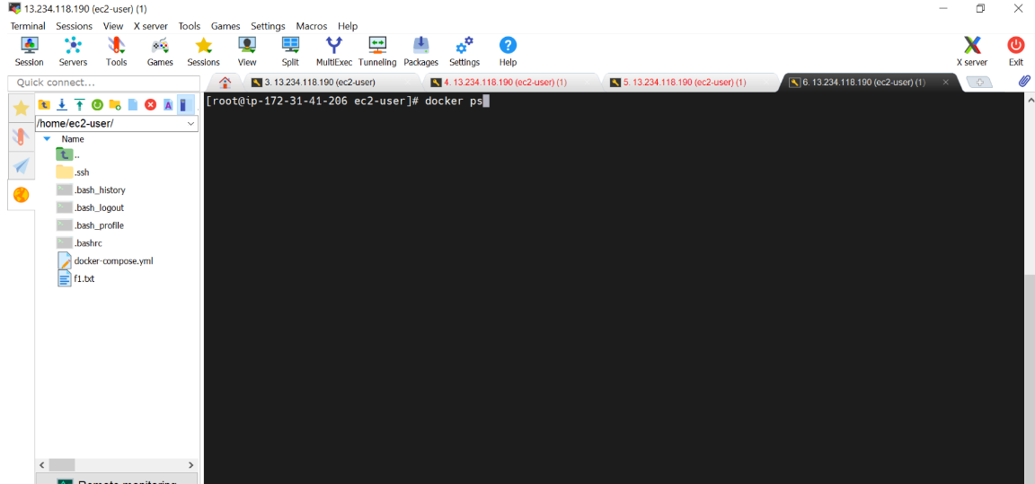
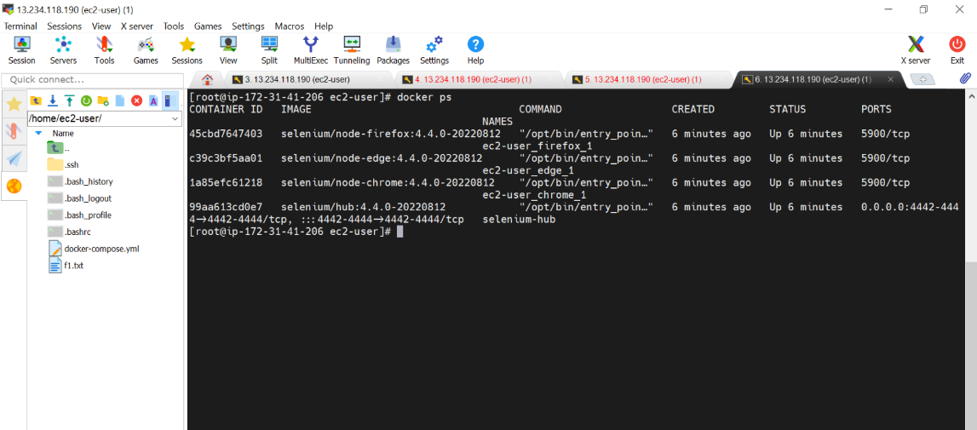
In order to check running Containers we use command: docker ps

Slide 19
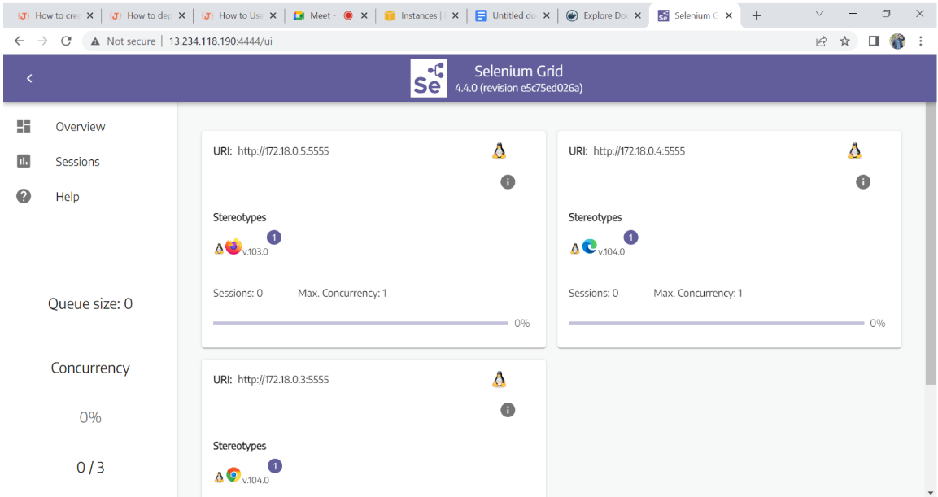
Step 10: After that our selenium hub and nodes are ready and up and we can check that by accessing them with public ip of our amazon ec2 instance

Slide 20
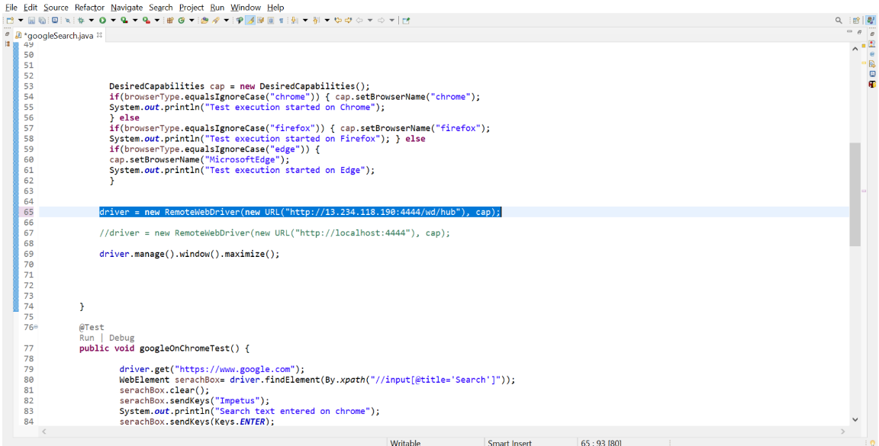
After that we can run our selenium testcases on eclipse by providing url of our hub

Slide 21
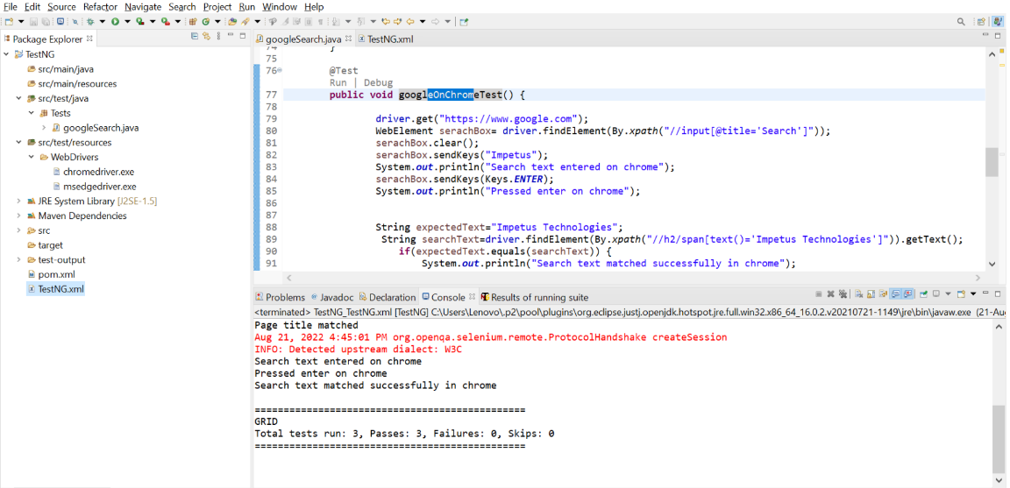
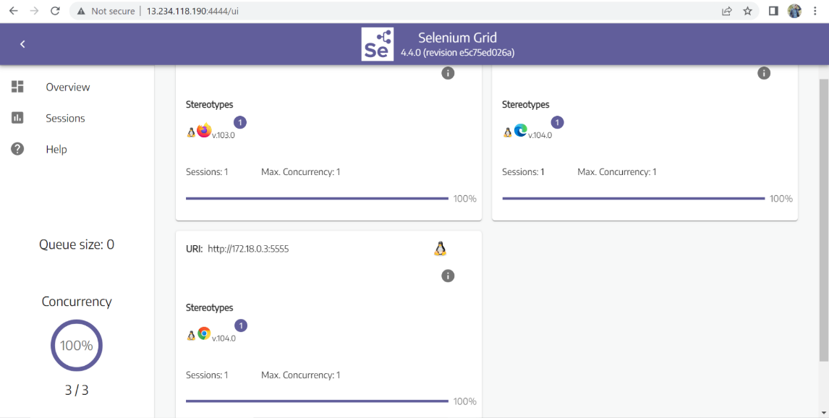
All test cases are running on grid parallelly on different browser nodes.

