Slide 1
Ad Hoc Business Insights Through SQL Analysis
By: Rohan Saxena

Slide 2
Background & Objectives
Atliq Hardware is a leading computer hardware producer in India and has expanded into other countries.
They are looking to expand their data analytics team led by Director Tony Sharma.
The goal of this exercise is to explore data insights that could help Atliq, to demonstrate a return on investment for building out their data science team.

Slide 3
Topics Covered
Market operations
Product trends and growth
Customer insights and sales performance

Slide 4
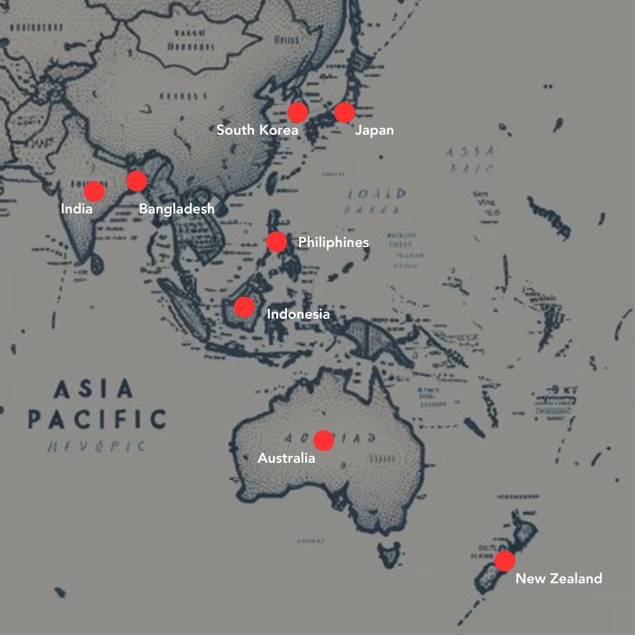
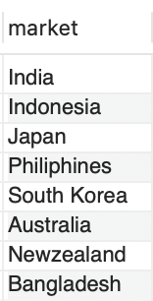
1. Provide the list of markets in which customer "Atliq Exclusive" operates its business in the APAC region.
INSIGHT: Atliq Exclusive operates in a diverse set of markets within the APAC region

Slide 5
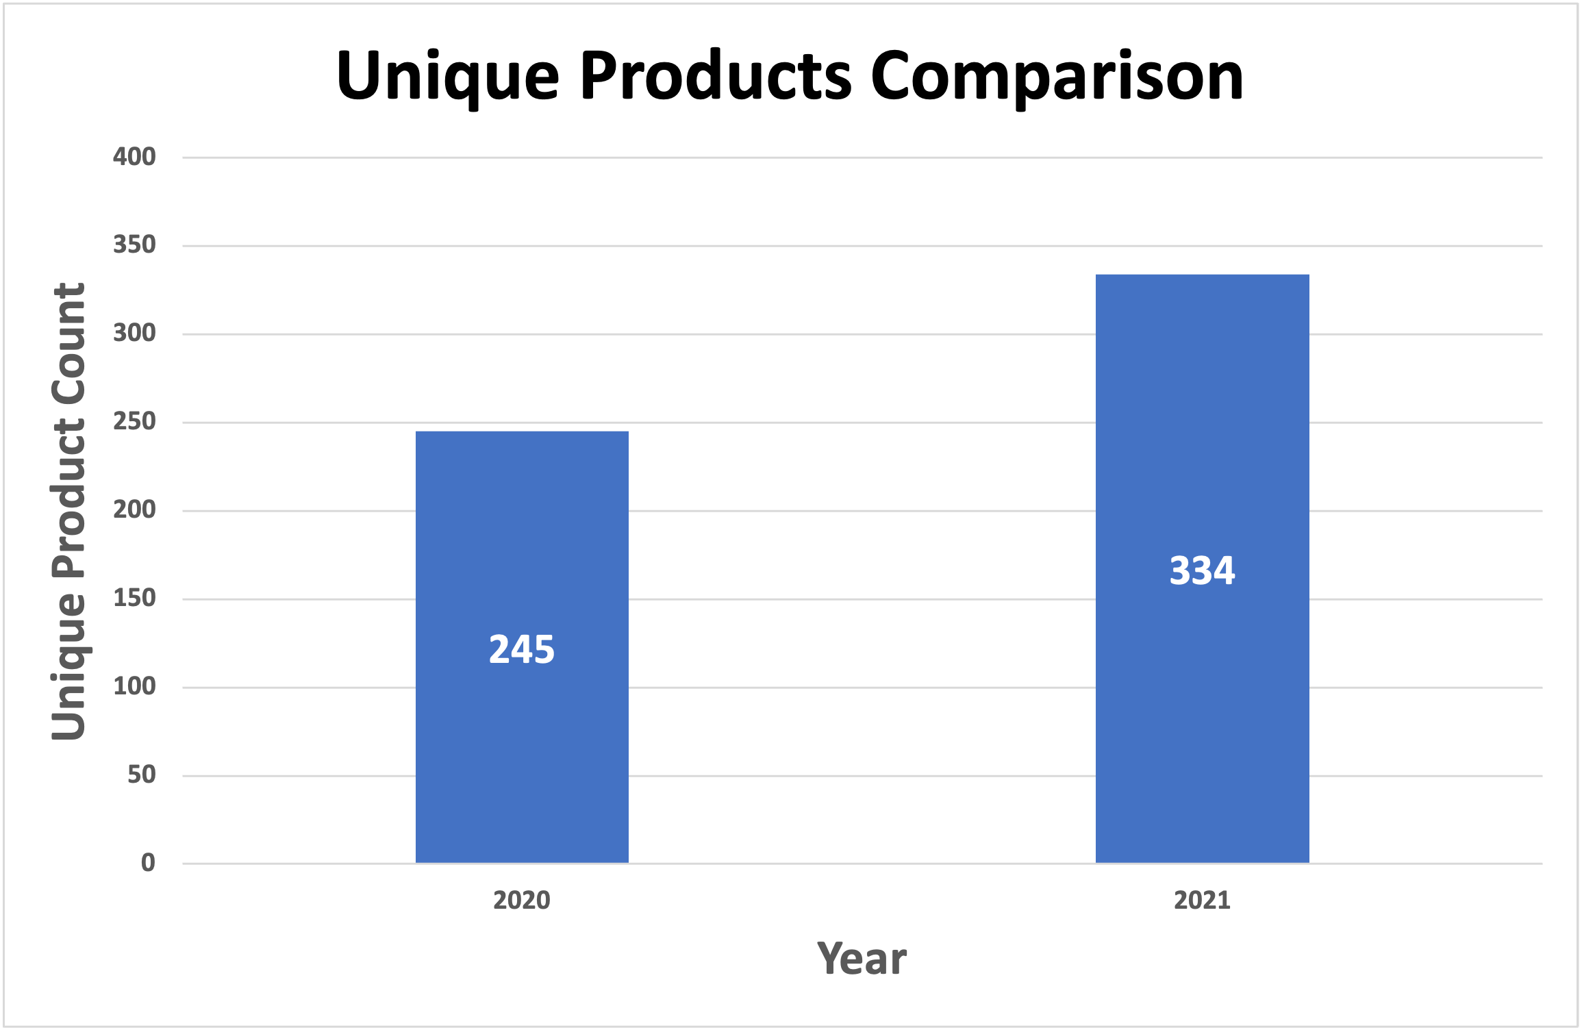
2. What is the percentage of unique product increase in 2021 vs. 2020?
We saw a 36.33% increase in unique products from 2020 in 2021
36.33%

Slide 6
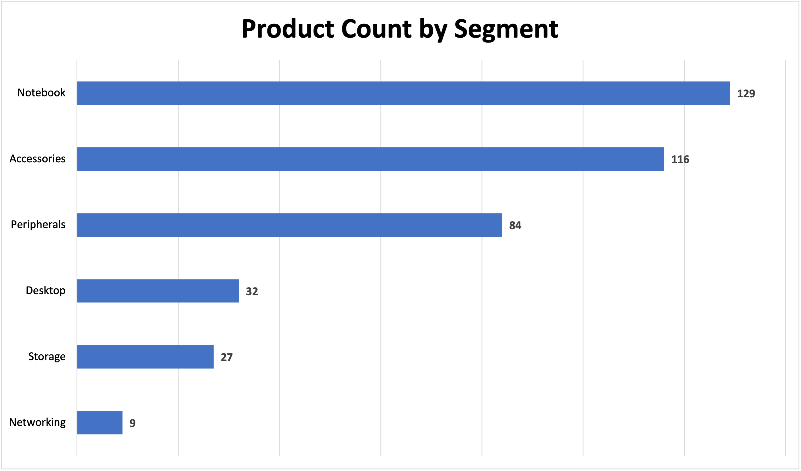
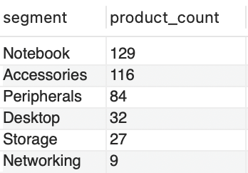
3. Provide a report with all the unique product counts for each segment and sort them in descending order of product counts

Slide 7
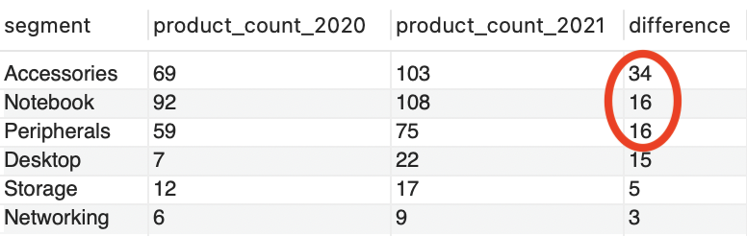
4. Follow-up: Which segment had the most increase in unique products in 2021 vs 2020?
INSIGHT: Accessories gained over 2 times the product count than the 2nd highest segments. This could demonstrate increased consumer demand.

Slide 8
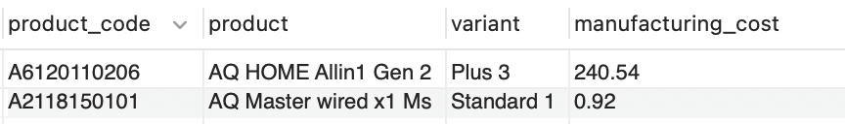
5. Get the products that have the highest and lowest manufacturing costs.
INSIGHTS:
Lowest manufacturing cost: AQ Master wired x1 Ms Standard 1 Variant (Mouse)
Highest manufacturing cost: AQ Home Allin1 Gen2 Plus 3 Variant (Personal Desktop)
The ”plus” variants of a product have higher a manufacturing cost versus the standard variants which have a lower cost.
A question we should ask: does the increased price or sales volume make up for the higher manufacturing cost?

Slide 9
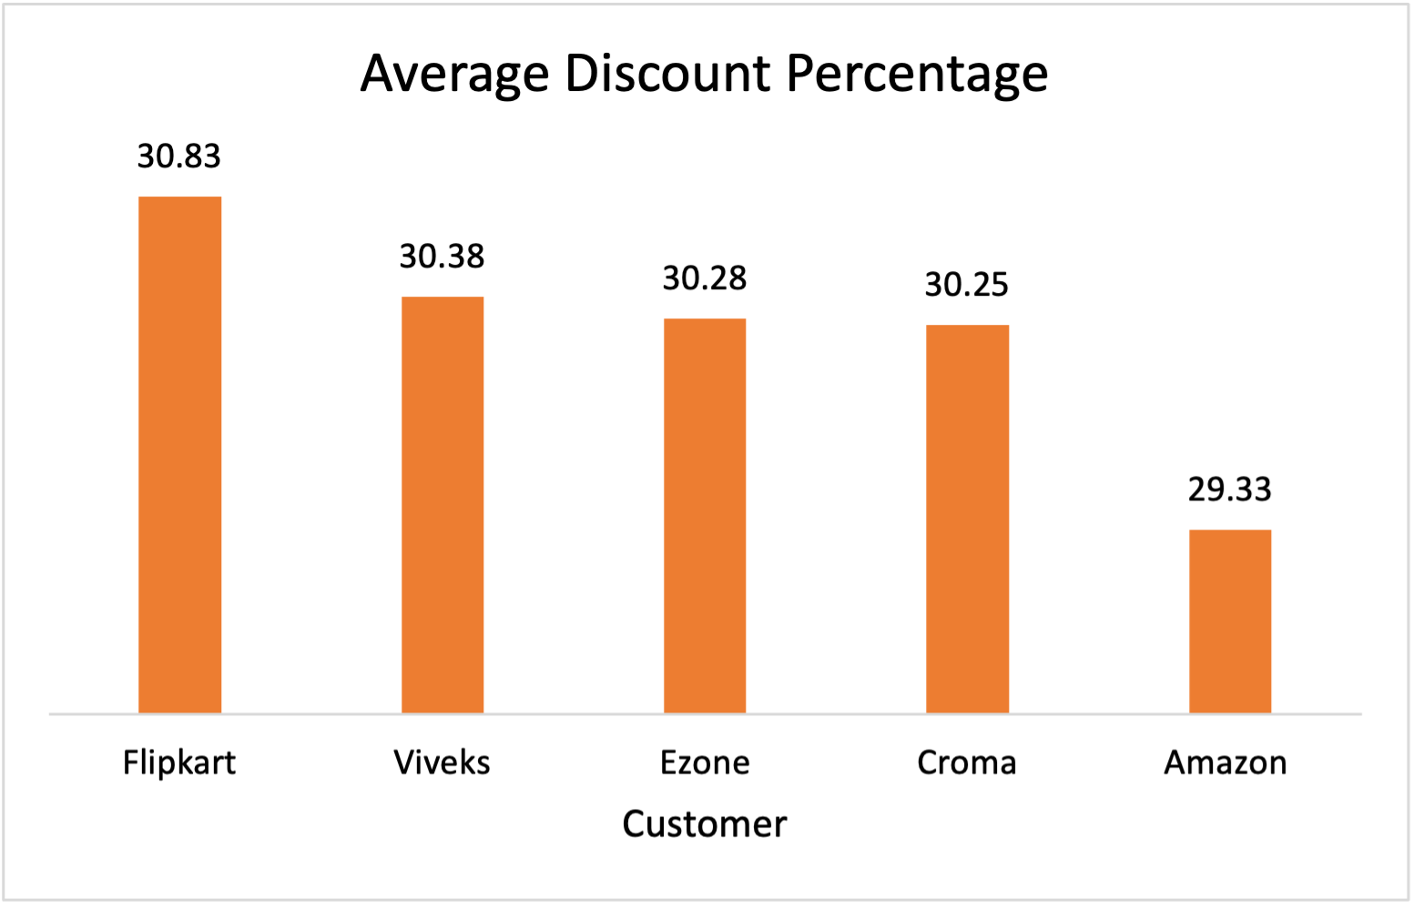
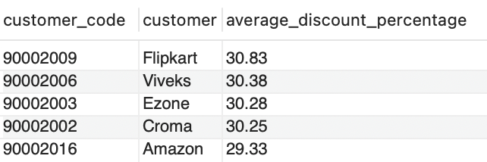
6. Generate a report which contains the top 5 customers who received an average high pre_invoice_discount_pct for the fiscal year 2021 and in the Indian market.

Slide 10
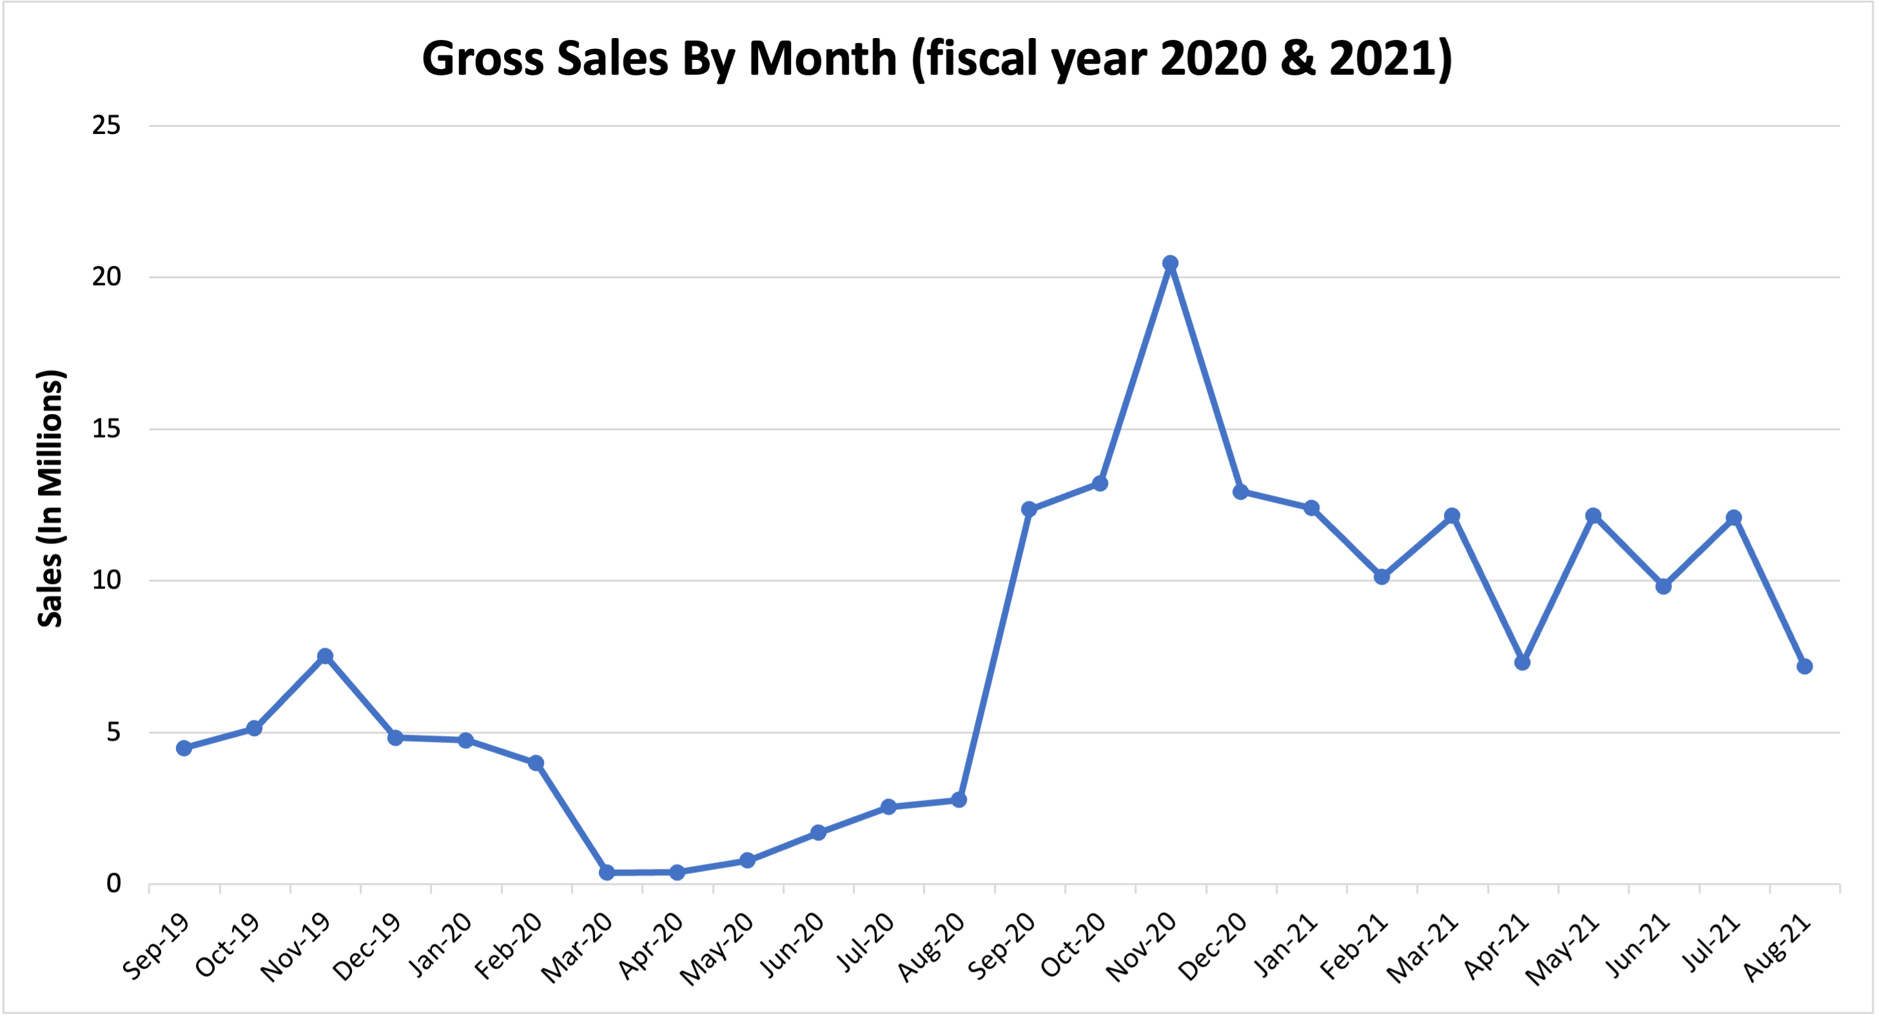
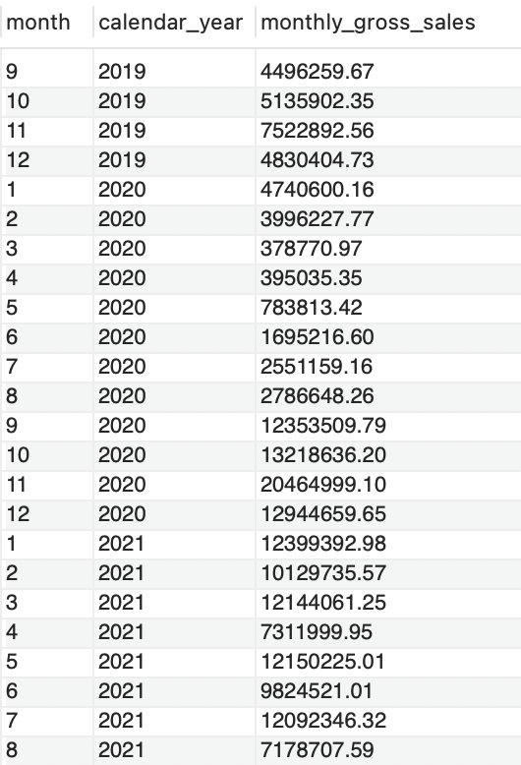
7. Get the complete report of the Gross sales amount for the customer “Atliq Exclusive” for each month. This analysis helps to get an idea of low and high-performing months and take strategic decisions.
INSIGHT: After sales fell due to the pandemic (which started in March 2020), they boomed (peaking in November 2020) and are now more stable slightly above pre pandemic levels.

Slide 11
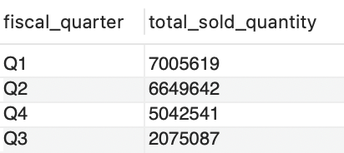
8. In which quarter of 2020, got the maximum total_sold_quantity
INSIGHTS:
The last two months of fiscal Q1 (October & November) and the first month of fiscal Q2 (December) make up Q4 of the calendar year.
Due to the holidays, consumer spending tends to be the highest during calendar Q4, which can explain why those two quarters were strongest.
The pandemic started in fiscal Q3 2020 (March), which can explain why the sales are the lowest.

Slide 12
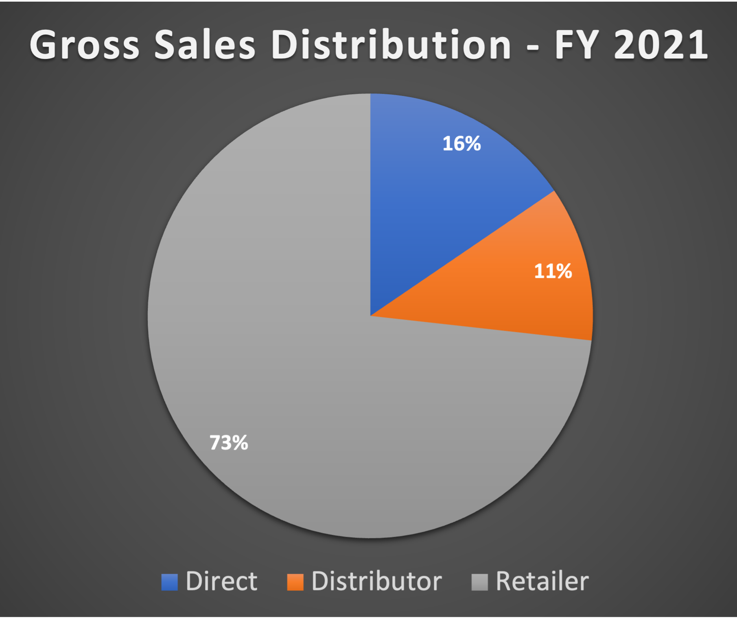
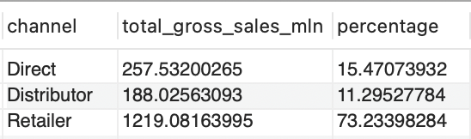
9. Which channel helped to bring more gross sales in the fiscal year 2021 and the percentage of contribution?

Slide 13
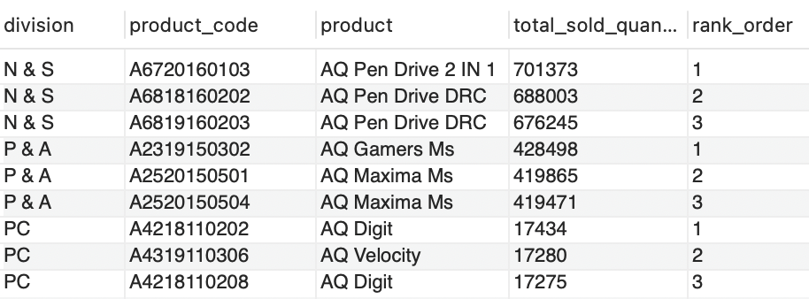
10. Get the Top 3 products in each division that have a high total_sold_quantity in the fiscal_year 2021?

Slide 14
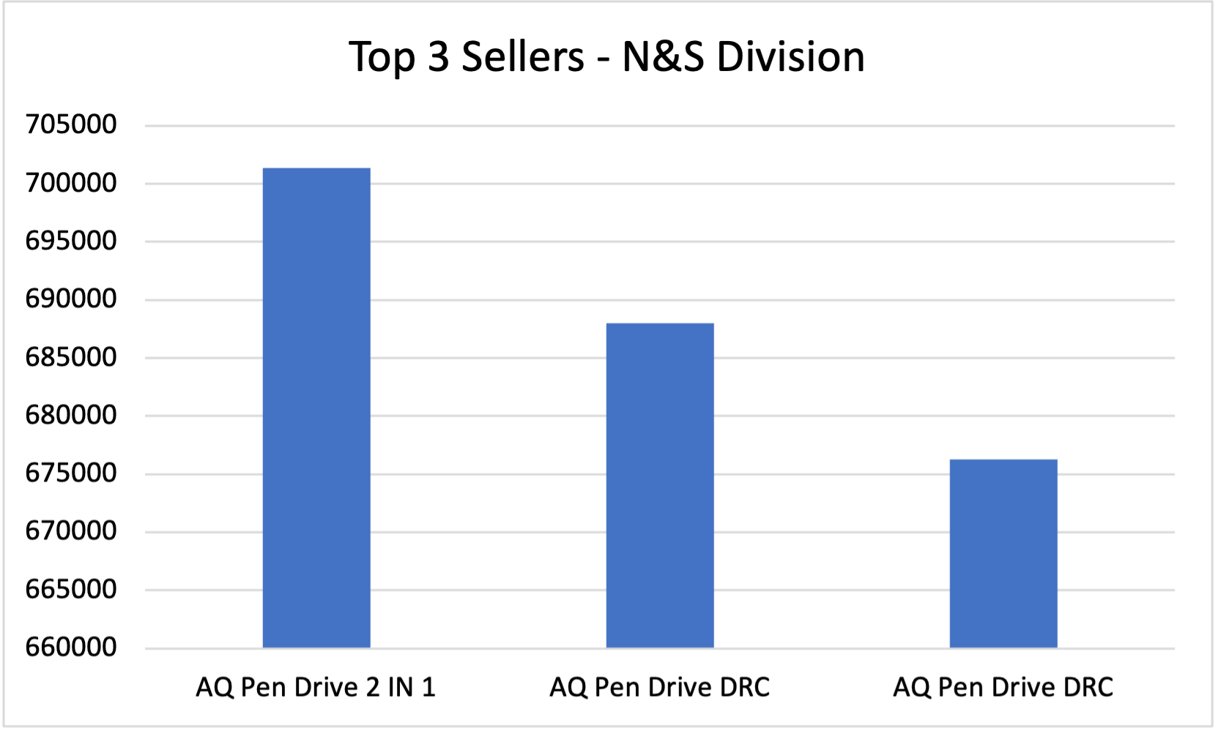
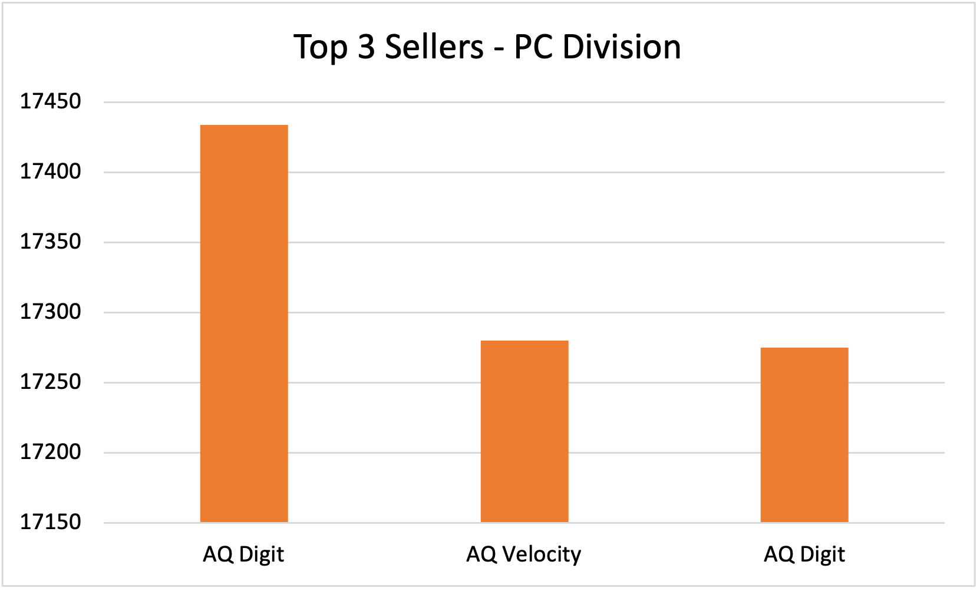
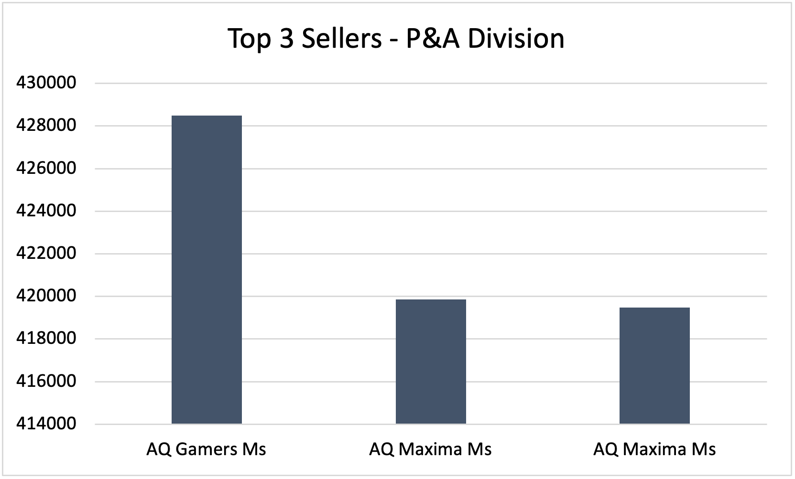

Slide 15
Thank You For Listening! Special Thank You to Dhaval, Hemanand, and the whole Codebasics team :)

