Slide 1
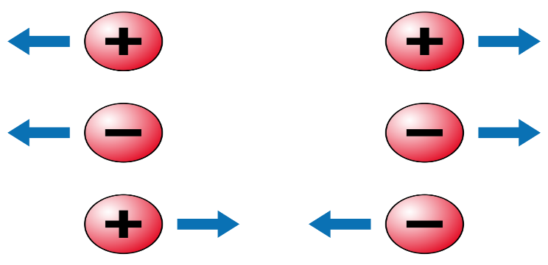
Coulomb’s Law
Coulomb’s law explain the interaction between two charges.
Like charges repels and unlike charges attracts.
Statement: The scalar force acts along the line joining center of two charges let
Q1 and Q2 is directly proportional to the product of the charge Q1 and Q2 and inversely proportional to the square of distance between this two charges.

Slide 2
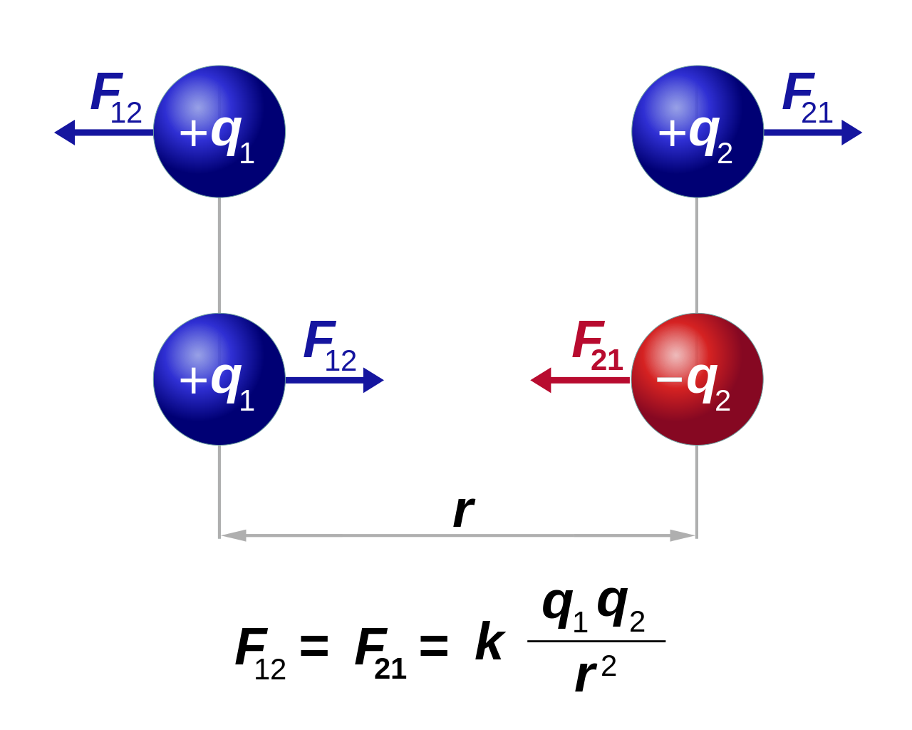

Slide 3
F12 is the force on charge q1 due to charge q2 and F21 is the force on charge q2 due to q1.
K is the constant which depends on medium.
K = 1/(4*pi*ɛ)
For free space the value of ‘K’ is 9*10^9 Nm^2/C^2.
The above formula for ‘F’ is applicable for point charge only
Point Charge
Whose charge is on small space is point charge means whose charge is not spread in large space.
There is no actual definition of point charge. It depends on distance.
If two charges are near to each other these charges may not be point charge but if the same two charges at a large distance then those two charges may be point charge for each other

Slide 4
Coulomb’s Law In Vector Form
Let q1 and q2 be the two like charges placed at points A and B respectively in vacuum. r1 be the position vector of point A and r2 be the position vector of point B.
Let r21 be the vector from A to B.
r21=r2−r1 and |r21|=r=|r2−r1|
Unit vector r21=r21/ r
=r2−r1/|r2−r1|
.

Slide 5
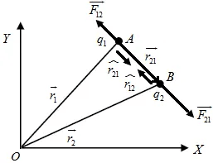
F12 = ((K*q1*q2)/|r1-r2|^3)*(r1-r2) = - F21

