Slide 1
PMG SQL ASSESSMENT
Rohan Shukla
rohanshukla2998@gmail.com

Slide 2
Loading the Data in SQL
SQL Query:
Creating store_revenue table from CSV create table store_revenue (date date, brand_id int, store_location varchar(250), revenue float);
COPY store_revenue FROM '/Users/rohan/Downloads/store_revenue.csv’ DELIMITER ',’ CSV HEADER;
Creating marketing_data table from CSV
create table marketing_data ( date date, geo varchar(2), impressions float, clicks float );
COPY marketing_data FROM '/Users/rohan/Downloads/marketing_data.csv’ DELIMITER ',’ CSV HEADER;

Slide 3
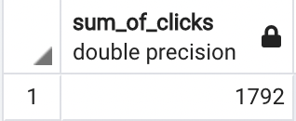
QUESTION 1
SQL Query: select sum(m.clicks) from marketing_data m;

Slide 4
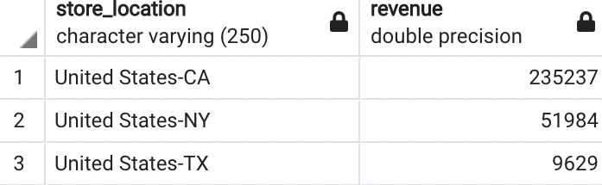
QUESTION 2
SQL Query: select s.store_location, sum(s.revenue) as revenue from store_revenue s group by s.store_location order by 2 desc;

Slide 5
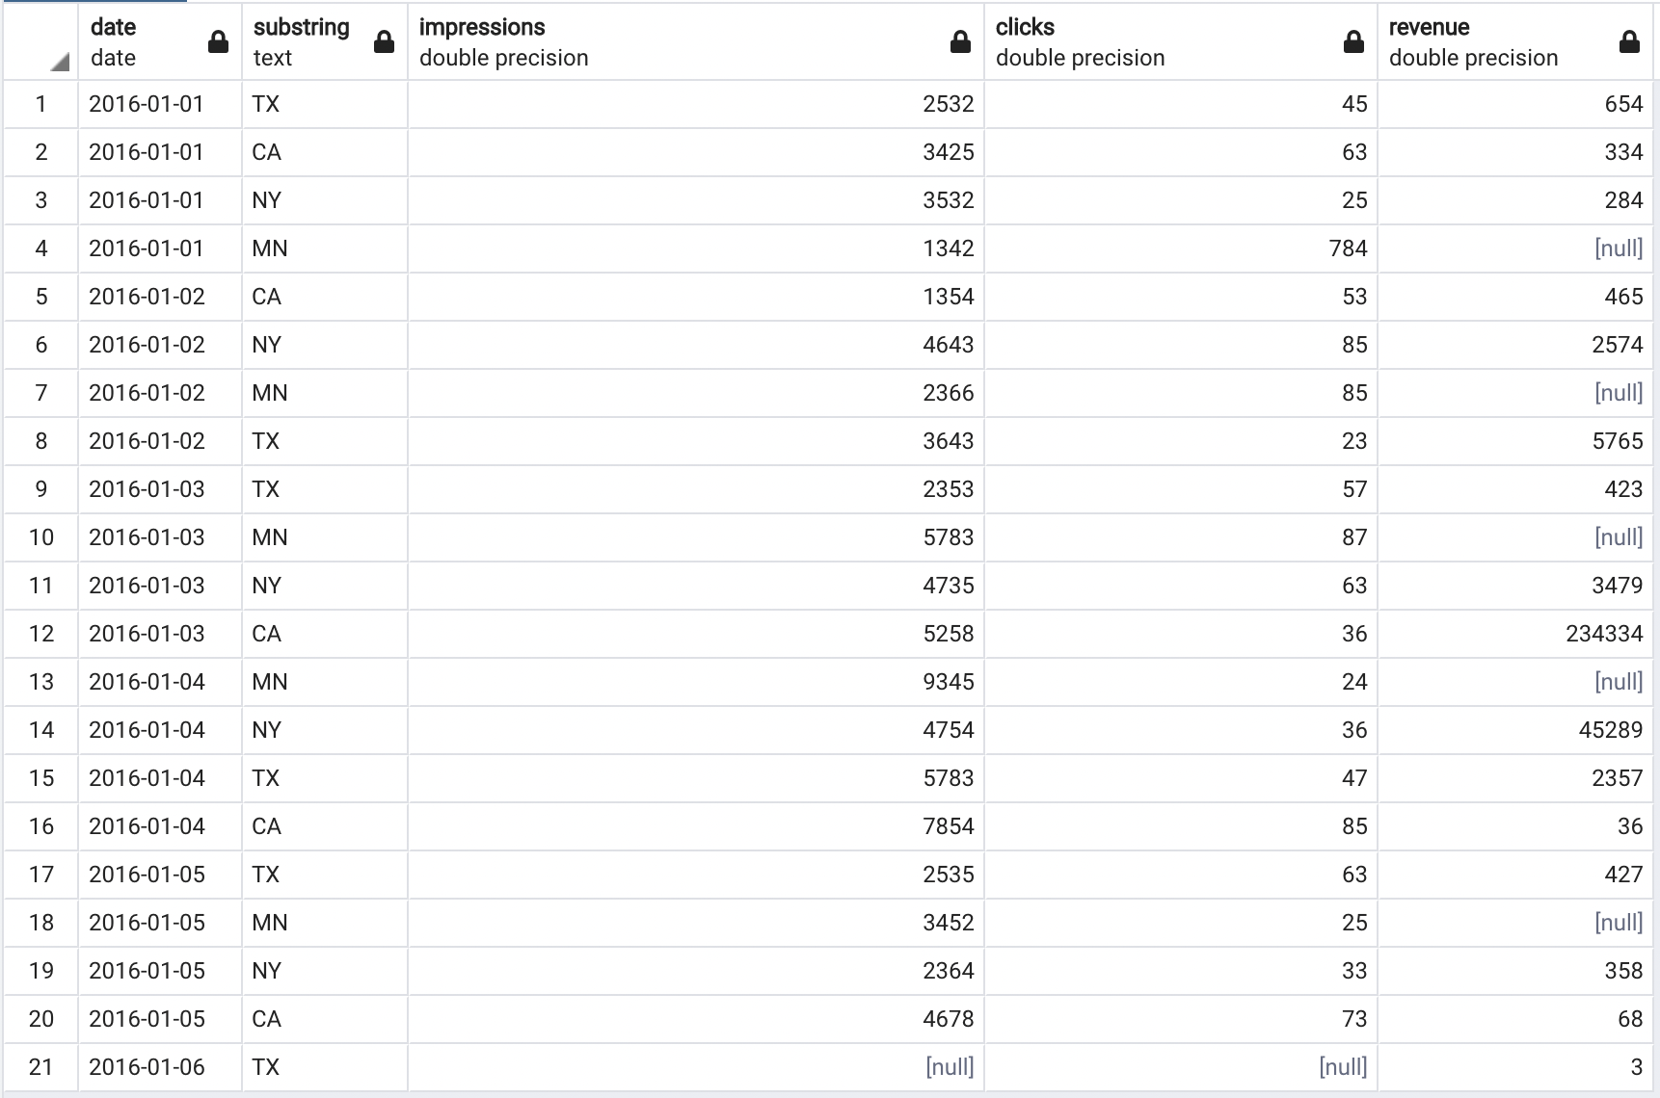
QUESTION 3
SQL Query: select distinct s.date, SUBSTRING(s.store_location, 15),AVG(m.impressions)::float as impressions, AVG(m.clicks)::float as clicks, SUM(s.revenue) as revenue from store_revenue s left outer join marketing_data m on m.date = s.date and m.geo = SUBSTRING(s.store_location, 15) group by s.store_location, s.date UNION select distinct m.date, m.geo,AVG(m.impressions)::float as impressions, AVG(m.clicks)::float as clicks, SUM(s.revenue) as revenue from store_revenue s right outer join marketing_data m on m.date = s.date and m.geo = SUBSTRING(s.store_location, 15) group by m.geo, m.date order by 1;

Slide 6
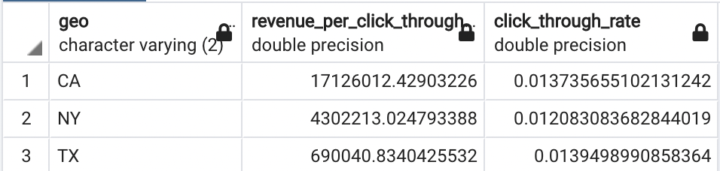
QUESTION 4
SQL Query: with click_revenue as ( select distinct m.date, m.geo,AVG(m.impressions)::float as impressions, AVG(m.clicks)::float as clicks, SUM(s.revenue) as revenue from store_revenue s join marketing_data m on m.date = s.date and m.geo = SUBSTRING(s.store_location, 15) group by m.geo, m.date) select c.geo, SUM(c.revenue)/(SUM(c.clicks)/SUM(c.impressions)) as revenue_per_click_through, SUM(c.clicks)/SUM(c.impressions) as click_through_rate from click_revenue c group by c.geo order by 2 desc;
Best Performing Store is California
Store with best Click Through Rate is Texas
Metric Used to Evaluate: Click through rate proportional to Revenue
Conversion rate of clicks proportional to Revenue
Assuming product costs common for all stores
Thus,
CTR*Conv. Rate * Cost ~ Revenue
Conv. Rate ~ Revenue/CTR
Hence, CA has the best Conversion Rate of Clicks,
making it the most efficient store

Slide 7
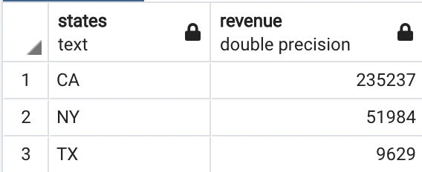
QUESTION 5
SQL Query: select SUBSTRING(s.store_location,15) as states, SUM(s.revenue)::float as revenue from store_revenue s group by s.store_location order by 2 desc limit 10;

Slide 8
THANK YOU

