Slide 1
Final Project Stock Price Prediction Using Temporal Convolutional Networks (TCNs)
Singh, Rohan
CS767A1 Advanced Machine Learning and Neural Networks
Fall 2024
Boston University MET College
Prof. Zoran B. Djordjević

Slide 2
Introduction
Stock market prediction is one of the most challenging tasks due to the non-linear, volatile, and dynamic nature of the financial markets. Accurate predictions can provide investors with a competitive edge, enabling informed decision-making. This project leverages Temporal Convolutional Networks (TCNs), a cutting-edge deep learning architecture, to predict future stock prices based on historical data.

Slide 3
Problem Statement
This study aims to implement and evaluate Temporal Convolutional Networks (TCNs) as an approach to predict stock market trends using historical stock price data. TCNs, with their unique architectural features like causal and dilated convolutions, are designed to efficiently capture both short-term and long-term dependencies in time-series data. The goal is to leverage these capabilities to develop a robust model for forecasting stock prices and trends. The model is benchmarked against a LSTM model for the same stock.

Slide 4
Dataset Description
The study uses historical stock price data from the SPY ETF, downloaded using the Yahoo Finance API, to train and evaluate the Temporal Convolutional Network (TCN) model for stock market trend prediction.
The training dataset contains stock price data from 2004 to 2019 (SPY.csv), while the testing dataset includes data from 2020 onward (SPY_test.csv).
The training dataset was split into 90% for training and 10% for validation to balance learning and evaluation during the training phase.
This data preparation ensures the model is evaluated comprehensively for its ability to generalize and predict future stock market trends.

Slide 5
Train Dataset
Date | Open | High | Low | Close | Volume | Adj Close | Return | Short_MA | Long_MA
01-02-2004 | 111.74 | 112.19 | 110.73 | 111.23 | 38072300 | 75.16 |  | 75.16 | 75.16
01-05-2004 | 111.69 | 112.52 | 111.59 | 112.44 | 27959800 | 75.97 | 0.010878 | 75.565 | 75.565
01-06-2004 | 112.16 | 112.73 | 112 | 112.55 | 20472800 | 76.05 | 0.000978 | 75.72667 | 75.72667
01-07-2004 | 112.39 | 113.06 | 111.89 | 112.93 | 30170400 | 76.31 | 0.003376 | 75.8725 | 75.8725
01-08-2004 | 113.25 | 113.41 | 112.77 | 113.38 | 36438400 | 76.61 | 0.003985 | 76.02 | 76.02
01-09-2004 | 112.83 | 113.5 | 112.27 | 112.39 | 54084300 | 75.94 | -0.00873 | 76.00667 | 76.00667
01-12-2004 | 112.55 | 113.25 | 112.36 | 113.22 | 31564100 | 76.5 | 0.007385 | 76.07714 | 76.07714
Test Dataset
Date | Open | High | Low | Close | Volume | Adj Close | Return | Short_MA | Long_MA
01-02-2020 | 323.54 | 324.89 | 322.53 | 324.87 | 59151200 | 302.21 |  | 302.21 | 302.21
01-03-2020 | 321.16 | 323.64 | 321.1 | 322.41 | 77709700 | 299.92 | -0.00757 | 301.065 | 301.065
01-06-2020 | 320.49 | 323.73 | 320.36 | 323.64 | 55653900 | 301.06 | 0.003815 | 301.0633 | 301.0633
01-07-2020 | 323.02 | 323.54 | 322.24 | 322.73 | 40496400 | 300.22 | -0.00281 | 300.8525 | 300.8525
01-08-2020 | 322.94 | 325.78 | 322.67 | 324.45 | 68296000 | 301.82 | 0.005329 | 301.046 | 301.046
01-09-2020 | 326.16 | 326.73 | 325.52 | 326.65 | 48473300 | 303.86 | 0.006781 | 301.515 | 301.515
01-10-2020 | 327.29 | 327.46 | 325.2 | 325.71 | 53029300 | 302.99 | -0.00288 | 301.7257 | 301.7257

Slide 6
Preprocessing
The normalized stock price data is transformed into sequences of fixed-length sequence length, where each sequence represents past data, and the target is the next price.
The create sequences function generates overlapping sequences (`X`) and targets (`y`) using a sliding window approach.
The dataset is split into training (90%) and validation (10%) sets, maintaining chronological order to preserve temporal structure.
The training set optimizes the model, while the validation set evaluates its performance on unseen future data.

Slide 7
Introduction to Temporal Convolutional Networks (TCNs)
TCNs are designed for sequential data like time-series.
Key Features:
Causal Convolutions: Ensure predictions rely only on past data.
Dilated Convolutions: Capture long-term dependencies efficiently.
Parallel Processing: Faster than recurrent models like LSTMs.

Slide 8
Model Architecture
1. Input Layer: Accepts input data with the specified shape.
2. Conv1D Layer 1: Applies 64 filters with a kernel size of 3 using causal padding and ReLU activation to extract temporal features.
3. Dropout Layer 1: Randomly drops 20% of neurons to prevent overfitting.
4. Conv1D Layer 2: Applies 32 filters with a kernel size of 3 using causal padding and ReLU activation for further feature extraction.
5. Dropout Layer 2: Randomly drops 20% of neurons to reduce overfitting.
6. Flatten Layer: Converts the 2D tensor into a 1D tensor for the dense layer.
7. Dense Layer: Outputs a single value (closing price) using a linear activation function for regression.

Slide 9
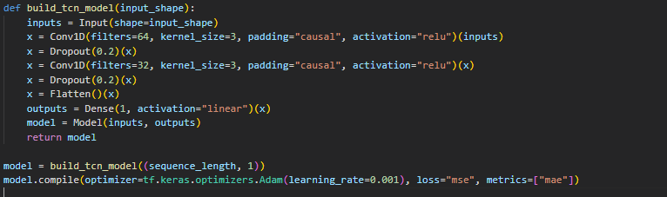
Model Architecture

Slide 10
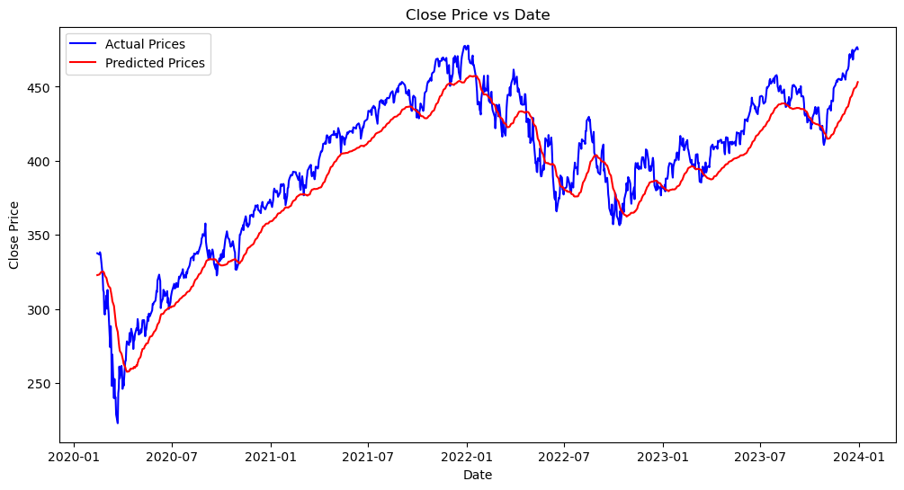
Results
Results for TCN

Slide 11
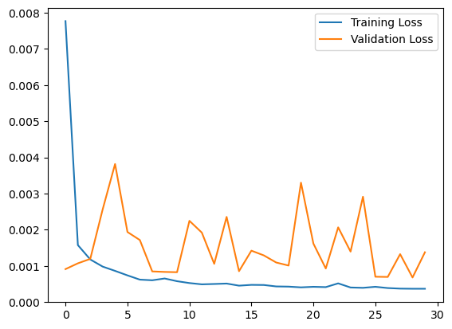

Slide 12
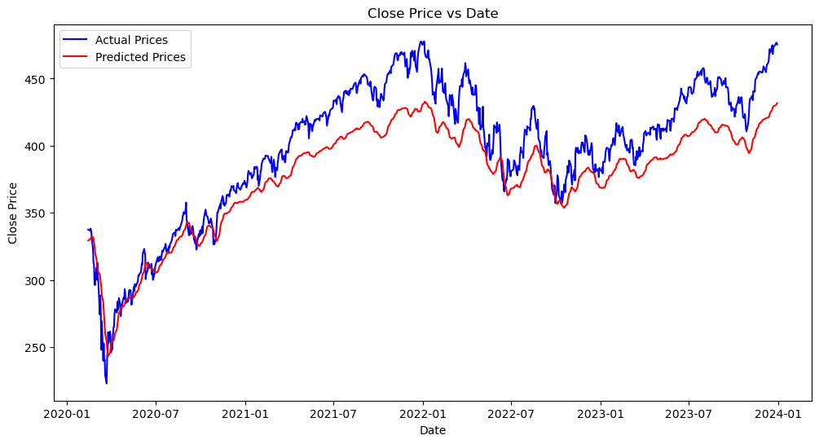
Comparison with LSTM

Slide 13
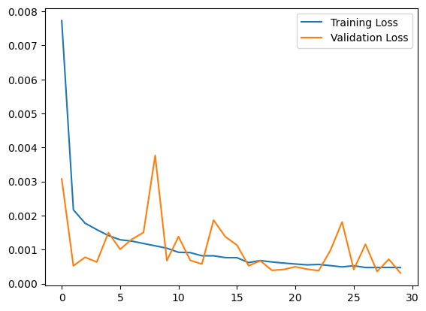

Slide 14
Pros and Cons of TCN
Pros:
Faster training and inference.
Better at capturing long-term dependencies.
More efficient for large datasets.
Cons:
Lack of explicit memory mechanisms.
Performance depends on data quality.

Slide 15
Challenges
Data Quality: Missing or inconsistent data can affect performance.
Feature Limitations: Using only Close price might restrict accuracy.
Computational Resources: Large datasets require optimized code.

Slide 16
Conclusion
TCNs effectively capture both short-term and long-term dependencies, making them highly suitable for stock price prediction. They demonstrate superior accuracy and training efficiency compared to LSTMs, offering a robust solution for time-series forecasting.

Slide 17
Video URLs
Video link long- https://youtu.be/nAna5Ya-B-s
Video link short- https://youtu.be/xh3HlXFqZtw

