Slide 1
Discussion 5
Pure Virtual Function, Templates, Standard Template Library Basics

Slide 2
Pure Virtual Functions
A special kind of virtual function
Also called abstract function
Has no body at all!
Acts as a placeholder that is meant to be redefined by derived classes.
We are effectively saying, “it is up to the derived classes to implement this function”.

Slide 3
class Base{
public:
const char* sayHi() { return "Hi"; }
virtual const char* getName() { return "Base"; }
virtual int getValue() = 0;
int doSomething() = 0;
};
// a normal non-virtual function
// a normal virtual function
// a pure virtual function
// Compile error: can not set non-virtual functions to 0

Slide 4
Consequences
int main()
{
Base base;
base.getValue(); // what would this do?
return 0;
}
2 main consequences
First, any class with one or more pure virtual functions becomes an abstract base class
Which means that it can not be instantiated!
Second, any derived class must define a body for this function, or that derived class will be considered an abstract base class as well.

Slide 5
#include <string>
class Animal
{
protected:
std::string m_name;
// We're making this constructor protected because
// we don't want people creating Animal objects directly,
// but we still want derived classes to be able to use it.
Animal(std::string name)
: m_name(name)
{
}
public:
std::string getName() { return m_name; }
virtual const char* speak() { return "???"; }
};
class Cat: public Animal
{
public:
Cat(std::string name)
: Animal(name)
{
}
virtual const char* speak() { return "Meow"; }
};
class Dog: public Animal
{
public:
Dog(std::string name)
: Animal(name)
{
}
virtual const char* speak() { return "Woof"; }
};

Slide 6
#include <iostream>
class Cow: public Animal
{
public:
Cow(std::string name)
: Animal(name)
{
}
// We forgot to redefine speak
};
int main()
{
Cow cow("Betsy");
std::cout << cow.getName()
<<" says "<< cow.speak()<< '\n';
return 0;
}
#include <string>
class Animal // This Animal is an abstract base class
{
protected:
std::string m_name;
public:
Animal(std::string name)
: m_name(name)
{
}
std::string getName() { return m_name; }
virtual const char* speak() = 0;
// note that speak is now a pure virtual function
};
error C2259: 'Cow' : cannot instantiate abstract class due to following members:
C:Test.cpp(128) : see declaration of 'Cow'
Betsy says ???

Slide 7
Templates
I hope you’ve learned how to write functions and classes
While functions and classes are powerful and flexible tools
In certain cases they can also be somewhat limiting. Why?
ANS: C++’s requirement that you specify the type of all parameters.
Having to specify different “flavors” of the same function where the only thing that changes is the type of the parameters can become a maintenance headache and time-waster
int max(int x, int y)
{
return (x > y) ? x : y;
}
double max(double x, double y)
{
return (x > y) ? x : y;
}
How to make this better?

Slide 8
Templates
Dictionary definition: a template is a model that serves as a pattern for creating similar objects
Real Life Example: A stencil.
Note that you only need to create a given stencil once
You can then use it as many times as you like

Slide 9
Function Templates
T max(T x, T y)
{
return (x > y) ? x : y;
}
Looks Good, But Incomplete
Function templates serve as a pattern for creating other similar functions.
Basic idea: To create a function without having to specify the exact type(s) of some or all of the variables
Tell the compiler two things:
This is a template definition
T is a placeholder type
template <typename T> //declaration
T max(T x, T y)
{
return (x > y) ? x : y;
}
template <typename T1, typename T2>
// template function here

Slide 10
What happens behind the scenes?
When compiling, the compiler encounters a call to the templated function
compiler says, “oh, we want to call max(int, int)”
This is now a “normal function” that can be compiled into machine language.
template <typename T>
const T& max(const T& x, const T& y)
{
return (x > y) ? x : y;
}
int i{ max(3, 7) }; // calls max(int, int)
const int& max(const int &x, const int &y)
{
return (x > y) ? x : y;
}

Slide 11
Some Rules
Template fn work with both built-in types (e.g. char, int, double, etc…) and classes
With one caveat.
When the compiler compiles the template instance, it compiles it just like a normal fn
In a normal fn, any operators or fn calls that you use with your types must be defined
Else you get compiler error.
Similarly, any operators or function calls in your template function must be defined for any types the function template is instantiated for
Example templateError.cpp

Slide 12
Template Classes
Homework. :)

Slide 13
STL - Standard Template Library
In 1990, Alex Stepanov and Meng Lee of Hewlett Packard Laboratories extended C++ with a library of class and function templates which has come to be known as the STL.
In 1994, STL was adopted as part of ANSI/ISO Standard C++.

Slide 14
STL: Basic Components
STL had three basic components:
Containers
Generic class templates for storing collection of data.
Algorithms
Generic function templates for operating on containers.
Iterators
Generalized ‘smart’ pointers that facilitate use of containers.
They provide an interface that is needed for STL algorithms to operate on STL containers.

Slide 15
Containers
Maintain the ordering of elements in the container.
Sequence Container
Container classes that maintain the ordering of elements in the container.
Adaptive Container
containers that automatically sort their inputs when those inputs are inserted into the container.
Container Adapters
Special predefined containers that are adapted to specific uses.
The interesting part about container adapters is that you can choose which sequence container you want them to use.

Slide 16
Sequence Container
vector: one-dimensional array
Fast access at any position.
Add and remove elements only at the back.
list: doubly-linked list
Fast access to front and back only.
Add and remove elements at any position.
deque: double-ended array, pronounced “deck”
Fast access at any position.
Add and remove elements only at the front and back.

Slide 17
Associative Containers
A set is a container that stores unique elements, with duplicate elements disallowed. The elements are sorted according to their values.
A multiset is a set where duplicate elements are allowed.
A map (also called an associative array) is a set where each element is a pair, called a key/value pair. The key is used for sorting and indexing the data, and must be unique. The value is the actual data.
A multimap (also called a dictionary) is a map that allows duplicate keys. Real-life dictionaries are multimaps: the key is the word, and the value is the meaning of the word. All the keys are sorted in ascending order, and you can look up the value by key. Some words can have multiple meanings, which is why the dictionary is a multimap rather than a map.

Slide 18
Container Adapters
A stack is a container where elements operate in a LIFO (Last In, First Out) context, where elements are inserted (pushed) and removed (popped) from the end of the container. Stacks default to using deque as their default sequence container (which seems odd, since vector seems like a more natural fit), but can use vector or list as well.
A queue is a container where elements operate in a FIFO (First In, First Out) context, where elements are inserted (pushed) to the back of the container and removed (popped) from the front. Queues default to using deque, but can also use list.
A priority queue is a type of queue where the elements are kept sorted (via operator<). When elements are pushed, the element is sorted in the queue. Removing an element from the front returns the highest priority item in the priority queue.

Slide 19
Iterators
An Iterator is an object that can traverse (iterate over) a container class without the user having to know how the container is implemented.
An iterator is best visualized as a pointer to a given element in the container
Set of overloaded operators
Operator* -- Dereferencing the iterator returns the element that the iterator is currently pointing at.
Operator++ -- Moves the iterator to the next element in the container. Most iterators also provide Operator-- to move to the previous element.
Operator== and Operator!= -- Basic comparison operators to determine if two iterators point to the same element. To compare the values that two iterators are pointing at, dereference the iterators first, and then use a comparison operator.
Operator= -- Assign the iterator to a new position (typically the start or end of the container’s elements). To assign the value of the element the iterator is pointing at, dereference the iterator first, then use the assign operator.

Slide 20
Algorithms
STL provides quite a few algorithms
To use any of the STL algorithms, simply include the algorithm header file.
#include <algorithm>
Examples: Will be attached

Slide 21
Remember Headers
#include<vector>
#include<list>
#include<set>
#include<map>
#include<stack>
#include<queue>
#include<priorityqueue>
#include<algorithm>
Damn!!
That’s so much to remember

Slide 22

Pro Tip
USE #include<bits/stdc++.h>
It is basically a header file that includes every standard library
Disadvantages: is not a standard header file of GNU C++ library
So, if you try to compile your code with some compiler other than GCC it might fail; e.g. MSVC do not have this header.
This is just for reference, in your exams please use the actual headers

Slide 23
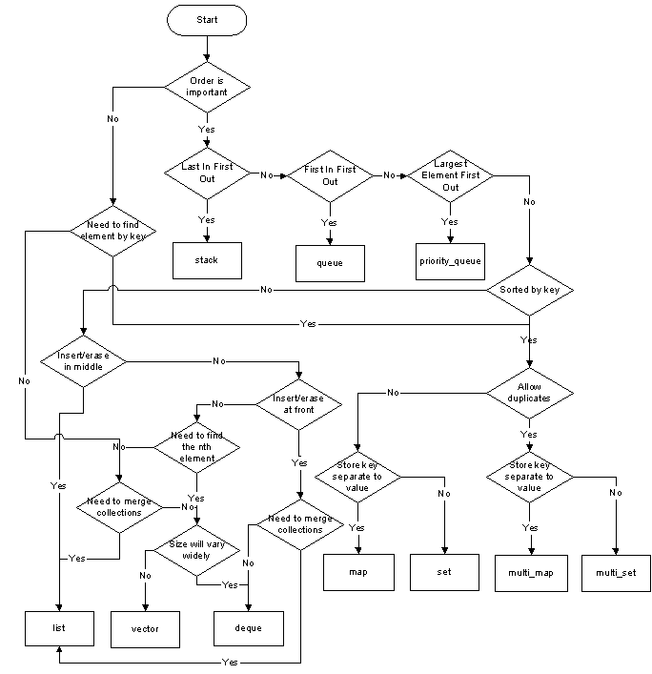

Slide 24

GitHub URL for ECS36B

