Slide 1
Discussion 9
Trees, Binary Trees, General Review

Slide 2
Trees
A tree is a widely used abstract data type (ADT)
simulates a hierarchical tree structure
It has a root value
Subtrees of children with a parent node, represented as a set of linked nodes

Slide 3
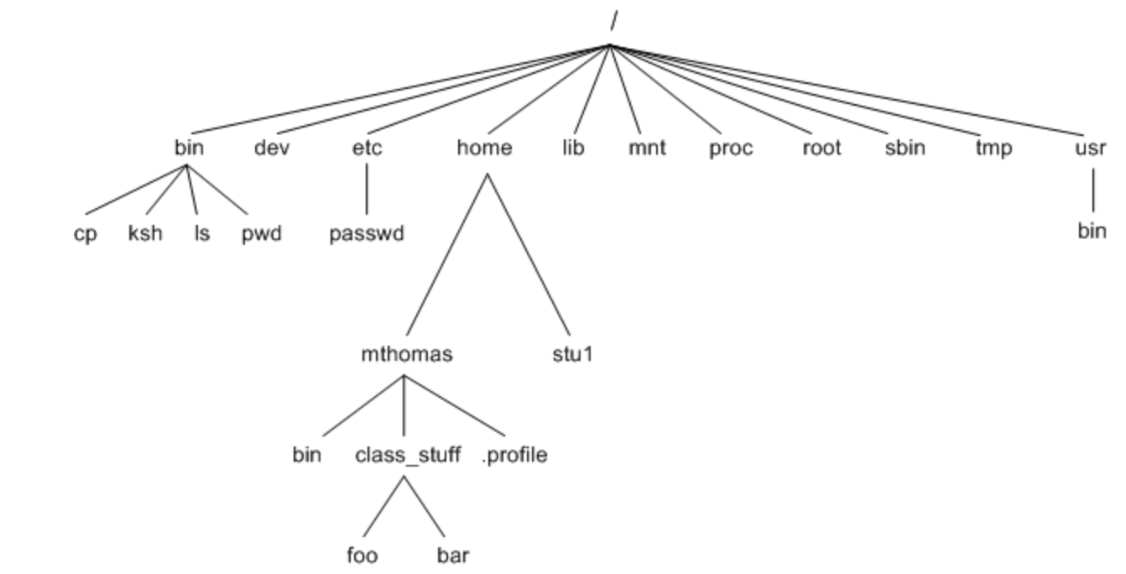
Unix File System is a Tree

Slide 4

Binary Tree
A data structure in which each node is connected to at most 2 other nodes

Slide 5
Binary Tree
A
B
C
D
NULL
NULL
NULL

Slide 6
Traversal (Secret: Follow the root)
PreOrder → (Root, Left, Right)
InOrder → (Left, Root, Right)
PostOrder → (Left, Right, Root)

Slide 7
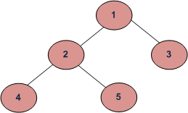
Traversal Example
Preorder (Root, Left, Right) : 1 2 4 5 3
Inorder (Left, Root, Right) : 4 2 5 1 3
Postorder (Left, Right, Root) : 4 5 2 3 1

Slide 8
Multiple Choice
#include<iostream>
using namespace std;
class Test {
int value;
public:
Test(int v);
};
Test::Test(int v) {
value = v;
}
int main() {
Test t[100];
return 0;
}
#include<iostream>
using namespace std;
class Test {
int value;
public:
Test(int v = 0);
};
Test::Test(int v) {
value = v;
}
int main() {
Test t[100];
return 0;
}
Does the code snippet compile?
Yes
No
Ans is No, The class Test has one user defined constructor “Test(int v)” that expects one argument. It doesn’t have a constructor without any argument as the compiler doesn’t create the default constructor if user defines a constructor

Slide 9
Multiple Choice
#include<iostream>
using namespace std;
class Test
{
public:
Test();
};
Test::Test() {
cout<<"Constructor Called \n";
}
int main()
{
cout<<"Start \n";
Test t1();
cout<<"End \n";
return 0;
}
What is the output of the code snippet?
Start Constructor End
Start End
Compiler Error
None of the above
Ans is b

Slide 10
Multiple Choice
#include<iostream>
using namespace std;
class Test {
int value;
public:
Test (int v = 0) {value = v;}
int getValue() { return value; }
};
int main() {
const Test t;
cout << t.getValue();
return 0;
}
What is the problem in the given code?
A const object cannot call a non-const function
How do you fix this?
either making getValue() const or
making t non-const
int getValue() const { return value; }

Slide 11
Multiple Choice
#include<iostream>
using namespace std;
class Test {
int &t;
public:
Test (int &x) { t = x; }
int getT() { return t; }
};
int main()
{
int x = 20;
Test t1(x);
cout << t1.getT() << " ";
x = 30;
cout << t1.getT() << endl;
return 0;
}
Fix by adding intializer list →
Test (int &x):t(x) { }
Output?
What is the output of this?
20
20 30
Compiler Error
None of the above
Output: Compiler Error
Since t is a reference in Test, it must be initialized using Initializer List.

Slide 12
Multiple Choice
#include<iostream>
using namespace std;
class Test1
{
int x;
public:
void show() { }
};
class Test2
{
int x;
public:
virtual void show() { }
};
int main(void)
{
cout<<sizeof(Test1)<<endl;
cout<<sizeof(Test2)<<endl;
return 0;
}
What is the output of the program?
4 4
16 16
4 16
Don’t know?
Ans is c:
There is only one difference between Test1 and Test2. show() is non-virtual in Test1, but virtual in Test2. When we make a function virtual, compiler adds an extra pointer vptr to objects of the class.

Slide 13
Multiple Choice
What is the correct way to initialize vector?
(A) std::vector<integer> vecOfInts;
(B) std::vector int <vecOfInts>
(C) std::vector(int) vecOfInts;
(D) std::vector<int> vecOfInts;
Ans is D

Slide 14
Multiple Choice
What is true about his statement in C++? std::vector<int> vecInts(5)
(A) Initialize a Vector with 5 int & all default value is 0
(B) Initialize a Vector with 5 int
(C) Initialize a Vector with 5 int & all default values will be garbage
(D) Initialize a Vector with 5 int & All default value with be -1
Ans is A

Slide 15
Multiple Choice
int main(){
list<std::string> l; l.push_back("1"); l.push_back("2"); l.push_back("3"); l.push_back("4");
// Initialize a vector with std::list vector<string> vecOfStr(l.begin(), l.end()); for(std::string str : vecOfStr) std::cout<<str; return 0; }
What should be the output of below program? Assume that all header files are included.
(A) 1 2 3 4
(B) 1234
(C) 12340
(D) 01234
(E) Compiler Error
Ans is B

Slide 16
Multiple Choice
Exceptions are Caught at ?
Compile Time
Run Time
Linking Time
None of the above
Ans is b

Slide 17
Multiple Choice
class base{
public:
base(){
cout<<"BCon";
}
~base(){
cout<<"BDest ";
}
};
class derived: public base{
public:
derived(){ cout<<"DCon ";
}
~derived(){ cout<<"DDest ";
}
};
int main(){
derived object;
return 0;
}
What is the output of this program?
(A) Dcon DDest
(B) Dcon DDest BCon BDest
(C) BCon DCon DDest BDest
(D) BCon DCon BDes DDest
Ans is C Constructor and destructor follow opposite order

Slide 18
Multiple Choice
Abstract Classes
(a) contain only one pure virtual function.
(b) can have objects instantiated from them if the proper permissions are set.
(c) cannot have abstract derived classes.
(d) are defined, but the programmer never intends to instantiate any objects from them
Can contain more than one
Abstract classes can never be instantiated
Ans: (d)

Slide 19
Multiple Choice
Base class constructors and assignment operators
(a) are not inherited by derived classes.
(b) should not be called by derived class constructors and assignment operators.
(c) can be inherited by derived classes, but generally are not.
(d) can call derived class constructors and assignment operators.
Should be called in derived class appropriately
Ans: (a)

Slide 20
Multiple Choice
When an object of a derived class is instantiated, the ____ constructor must be called for the ____ members.
(a) base class, base class
(b) derived class, base class
(c) base class, derived class
(d) derived class, public
Derived class cannot initialize base class member directly
Ans: (a)

Slide 21
Multiple Choice
#include <iostream>
using namespace std;
template <typename T>
T max(T x, T y)
{
return (x > y)? x : y;
}
int main()
{
cout << max(3, 7) << std::endl;
cout << max(3.0, 7.0) << std::endl;
cout << max(3, 7.0) << std::endl;
return 0;
}
What is the output of the program?
7 7.0 7.0
Compiler Error in all cout
Compiler error in last cout
None
Ans is C, the call to max is ambiguous You have confused the compiler, good work! :D

Slide 22
Multiple Choice
Which of the following operators cannot be overloaded
. (member Access or Dot Operator)
?: (Ternary operator)
:: (Scope Resolution Operator)
.* (Pointer-to-member Operator)
All of the above
Ans e, All of the above

Slide 23
Multiple Choice
static member functions
(a) can use the this pointer.
(b) can only access other static member functions and static variables.
(c) cannot be called until their class is instantiated.
(d) can be declared const as well.
Ans: (b)

Slide 24
Multiple Choice
Assuming the following is the beginning of the constructor definition for class Circle:
Circle::Circle(double r, int a, int b)
: Point(a, b)
The second line
(a) invokes the Point constructor with values a and b.
(b) causes a compiler error.
(c) is unnecessary because the Point constructor is called automatically.
(d) indicates inheritance.
Ans: (a)

Slide 25
Multiple Choice
What is output of below program?
int main(){ const int a=10; a++; cout<<a; return 0; }
(A) 10 (B) 11 (C) Compilation Error (D) Linking Error
Ans is C

Slide 26
Multiple Choice
A function template can be overloaded by
(a) using other function templates with the same function name and parameters.
(b) using non-template functions with the same function name but different parameters.
(c) using non-template functions with the same function name and parameters.
(d) using other function templates with a different function name but the same parameters.
Ans: (b)

Slide 27
Multiple Choice
To prevent class objects from being copied,
(a) make the overloaded assignment operator private.
(b) make the copy constructor private.
(c) both (a) and (b)
(d) none of the above
Ans: (c)

Slide 28
Multiple Choice
protected base class members cannot be accessed by
(a) non-friend functions and non-derived class member functions.
(b) friends of the base class.
(c) derived classes.
(d) friends of derived classes.
Ans: (a)

Slide 29
Multiple Choice
virtual destructors must be used when
(a) the constructor in the base class is virtual.
(b) delete is used on a base class pointer to a derived class object.
(c) delete is used on a derived class object.
(d) a constructor in either the base class or derived class is virtual.
Ans: (b)

Slide 30
Multiple Choice
Which of the following is a difference between vectors and arrays?
(a) access to any element using the [] operator
(b) contiguous blocks of memory
(c) the ability to change size dynamically
(d) efficient, direct access
Ans: (c)

Slide 31
Multiple Choice
Polymorphism and virtual functions are not appropriate for
(a) programs where classes may be added in the future.
(b) programs that have strict memory and processor requirements.
(c) programs that must be easily extensible.
(d) programs that use many inherited classes with similar functions.
Ans: (b)

Slide 32
Multiple Choice
_________ is/are used to solve the problem of variables with the same name and overlapping scopes.
(a) namespaces
(b) Classes
(c) Casts
(d) Dynamic memory allocation
Ans: (a)

Slide 33


Slide 34
Multiple Choice
Variables defined inside a member function of a class have
(a) file scope.
(b) class scope.
(c) function scope.
(d) class or function scope, depending on whether the binary scope resolution operator (::) is used.
Ans: (c)

Slide 35
Multiple Choice
Inside a function definition, and for an object with data element x, which of the following is not equivalent to this->x?
(a) *this.x
(b) (*this).x
(c) x
(d) (*(&(*this))).x
= (*this).x = this->x
Ans: (a)

Slide 36
Multiple Choice
Which overloaded operator is not required to be a member function of a class?
(a) ()
(b) []
(c) +=
(d) ==
Ans: (c, d)

