Slide 1
ECS 36B - Discussion2
This pointer, operator overloading, exceptions revisit

Slide 2
Outline
this pointer
Function Overloading
Operator Overloading
Exceptions

Slide 3
this pointer
Hidden pointer
this is a constant pointer?
When we call simple.setID(2), the compiler actually calls setID(&simple, 2)
Inside setID(), the “this” pointer holds the address of object simple.
For m_id = id, the compiler is actually executing this->m_id = id
class Simple{ private: int m_id; Public: Simple(int id){ setID(id); } void setID(int id) { m_id = id; } int getID() { return m_id; } }; int main(){ Simple simple(1); simple.setID(2); std::cout << simple.getID() << '\n'; return 0; }
void setID(Simple* const this, int id) { this->m_id = id; }
setID(&simple, 2)

Slide 4
this pointer
Most of the time, you never need to explicitly reference the “this” pointer
BUT
class Something{ Private: int data; Public: Something(int data){ this->data = data; // this->data is the member, data is the local parameter } };
Avoids confusion

Slide 5
Function Overloading
// the ‘add’ function
int add(int a, int b) {return a+b;}
float add(float a, float b) {return a+b;}
double add(double a, double b) {return a+b;}
int main() {
int ai = 1, bi = 1;
float af = 2.f, bf = 2.f;
double ad = 2., bd = 2.d;
std::cout
<< add(ai, bi) // ai + bi
<< add(af, bf) // af + bf
<< add(ad, bd);
return 0;
}
Allows to create multiple functions with same name, must have different parameters
What about return types?

Slide 6
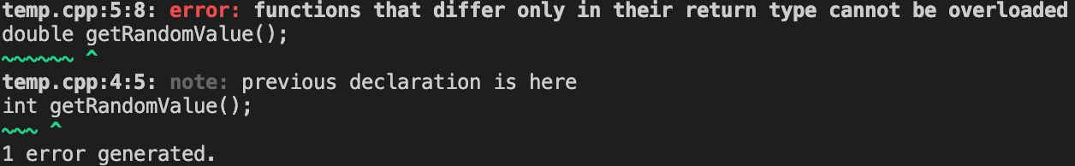
Function Overloading
Does this work?
int getRandomValue(); double getRandomValue();

Slide 7
Operator Overloading
Overloaded operators are functions with special function names
Almost any existing operator in C++ can be overloaded
Some Exceptions are
conditional (?:), sizeof, scope (::), member selector (.), member pointer selector (.*)
int x = 2;
int y = 3;
std::cout << x + y << '\n';
Built In
double z = 2.0;
double w = 3.0;
std::cout << w + z << '\n';
Mystring string1 = "Hello, ";
Mystring string2 = "World!";
std::cout << string1 + string2 << '\n';
compiler does not have a built-in version of the plus

Slide 8
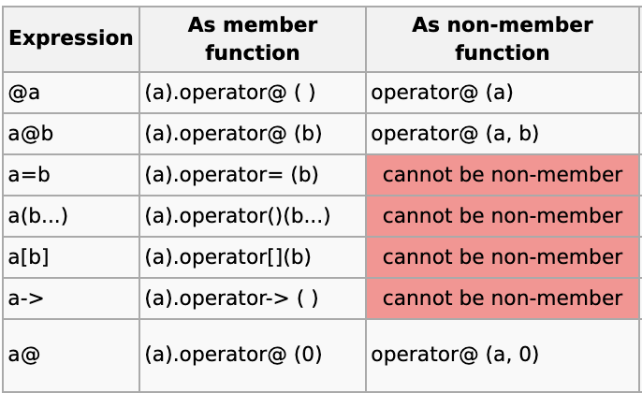
Operator Overloading
You can overload an operator either as a member function or as a non-member function.
Restrictions:
You cannot create new operators.
The overloads of operators && and || lose short-circuit evaluation.

Slide 9
Operator Overloading
SO why use this?
calculation = add(multiply(a, b),divide(a, b));
calculation = (a*b)+(a/b);

Slide 10
Operator Overloading
Here, returnType is the return type of the function.
The returnType of the function is followed by operator keyword.
Symbol is the operator symbol you want to overload. Like: +, <, -, ++
You can pass arguments to the operator function in similar way as functions.
class className
{
... .. ...
public
returnType operator symbol (arguments)
{
... .. ...
}
... .. ...
};

Slide 11
Operator Overloading
class Test{
private:
int count;
public:
Test(): count(5){}
void operator ++() {
count = count+1;
}
void Display() { cout<<"Count: "<<count; }
};
int main(){
Test t;
// this calls "function void operator ++()" function
++t;
t.Display();
return 0;
}
Outputs: 6 (I guess)

Slide 12
Exceptions
int findFirstChar(const char* string, char ch)
{
const std::size_t stringlength{ strlen(string) };
// Step through each character in string
for (std::size_t i=0; i < stringlength ; ++i)
// If the character matches ch, return i
if (string[i] == ch)
return i;
// If no match was found, return -1
return -1;
}
One of the most common ways to handle potential errors is via return codes
Return codes do not mix with constructors very well. What happens if you’re creating an object and something inside the constructor goes catastrophically wrong?
Return codes may disrupt the normal control flow of a program
double divide(int x, int y){
return static_cast<double>(x)/y;
}
What do we do then???
Easy: Three keywords “throw, try, and catch.”

Slide 13
Exceptions: Throw
Throwing Signals
For example, during football, if a player has committed a foul, the referee will throw a flag on the ground.
A throw statement is used to signal that an exception has occurred
throw <value>; value can be of any data type
throw -1; // throw a literal integer value
throw ENUM_INVALID_INDEX; // throw an enum value
throw "Can not take square root of negative number"; // throw a literal C-style (const char*) string
throw dX; // throw a double variable that was previously defined
throw MyException("Fatal Error"); // Throw an object of class MyException

Slide 14
Exceptions: Try
Football Example again: Once a referee has thrown a penalty flag, what happens next?
The players notice that a penalty has occurred and stop play.
try keyword to defines a block of statements
The try block acts as an observer, looking for any exceptions that are thrown by any of the statements within the try block.
try
{
// Statements that may throw exceptions you want to handle go here
throw -1; // here's a trivial throw statement
}
Note that the try block doesn’t define HOW we’re going to handle the exception

Slide 15
Exceptions: Catch
Okay one last time, the football example again, After the penalty has been called and play has stopped, the referee assesses the penalty and executes it. In other words, the penalty must be handled before normal play can resume.
Actually handling exceptions is the job of the catch block(s)
Catch parameters work just like function parameters
catch (int x)
{
// Handle an exception of type int here
std::cerr << "We caught an int exception with value" << x << '\n';
}

Slide 16
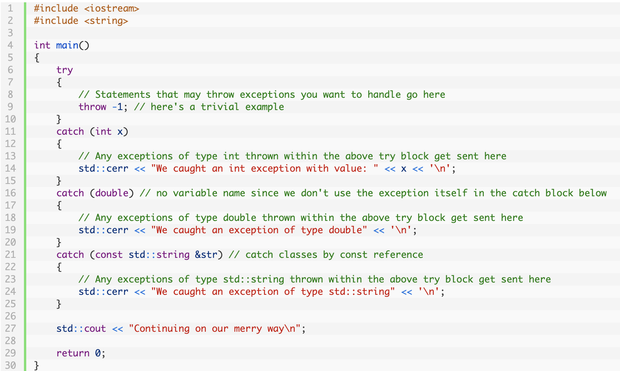
Exceptions
We caught an int exception with value -1
Continuing on our merry way

