Slide 1
ECS 36B - OOP
Discussion 1

Slide 2
Outline
Access Specifiers/Modifiers
Constructors
Order of Construction
https://docs.microsoft.com/en-us/cpp/cpp/constructors-cpp?view=vs-2019

Slide 3
Access Specifiers and its Types
Access Specifiers determine who has access to the members that follow the specifiers
Question: What is the default access specifier in C++?
Types
Public
Private
Protected (Self-Read)

Slide 4
Access Specifiers: Public
class DateClass {
public:
int month; //can be accessed by anyone
int day; //can be accessed by anyone
int year; //can be accessed by anyone
};
int main() {
DateClass date;
date.month = 11; //okay because month is public
}

Slide 5
Access Specifiers: Private
class DateClass {
int month; //private by default can only be accessed by member functions
int day; //private by default can only be accessed by member functions
int year; //private by default can only be accessed by member functions
};
int main() {
DateClass date;
date.month = 11; //error
}

Slide 6
Why Access Specifiers?
To achieve Encapsulation (Data Hiding)
For eg: TV has a remote control to turn the TV on/off
Button is a simple interface here
How it operates is hidden away from us
You don’t need to know the details of the implementation

Slide 7
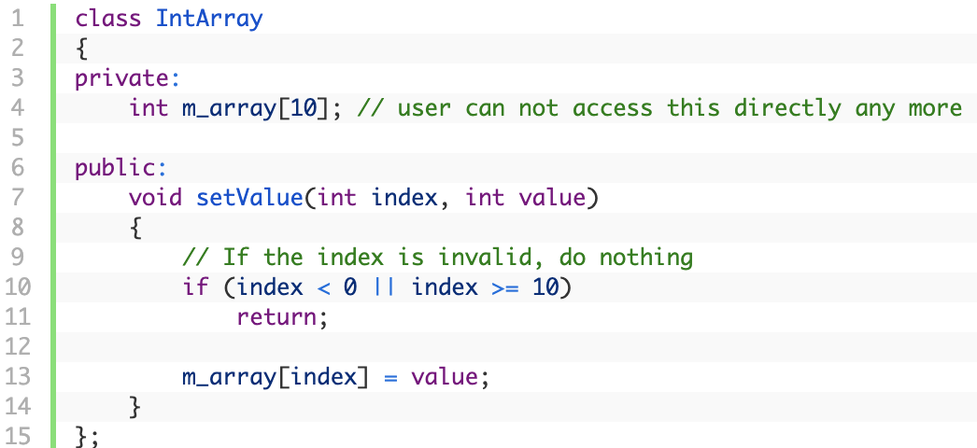
Sample

Slide 8
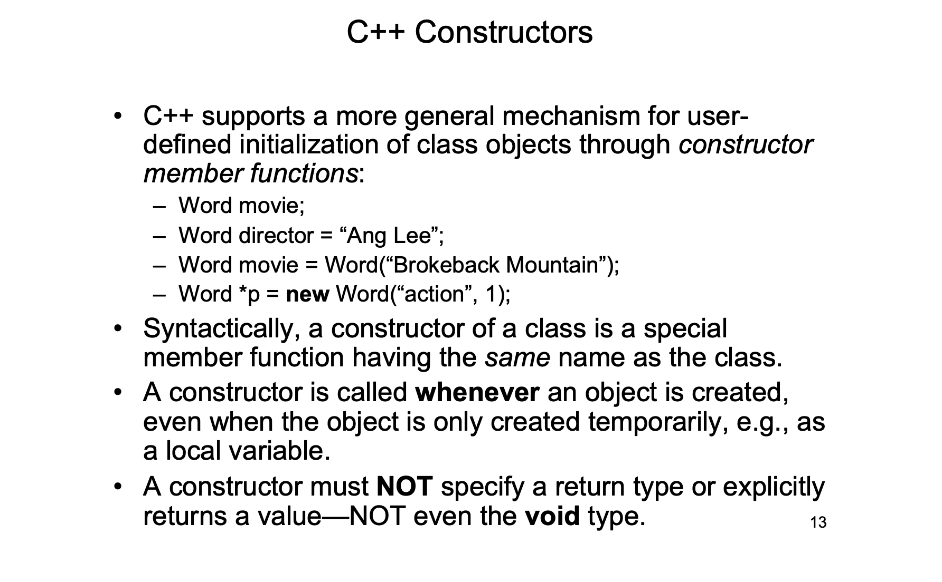
http://home.cse.ust.hk/~dekai/2012H_2014Q1/lectures/l08_constructors.pdf

Slide 9
Types of Constructor
Default Constructor
Type Conversion Constructor
Copy Constructor
Move Constructor (Self-Learning)
https://docs.microsoft.com/en-us/cpp/cpp/constructors-cpp?view=vs-2019

Slide 10
Default Constructor
class Word {
public:
Word() { frequency = 0; str = 0; }
private:
int frequency; char* str;
};
int main(int argc, char* argv[]) {
Word movie;
}
A default constructor is a constructor that is called with NO argument
It is used to initialize an object with user-defined default values

Slide 11
Default Constructor
class Word {
public:
int frequency;
char* str;
};
int main(int argc, char* argv[]) {
Word movie;
}
which constructor called?
If there are NO user-defined constructors, the compiler will generate
the default constructor: X::X() for class X for you.
Word() { } only creates a record with space for an int quantity and a
char* quantity. Their initial values CANNOT be trusted.

Slide 12
Default Constructor
struct Word {
int frequency;
char* str;
};
int main(int argc, char* argv[]) {
Word movie;
}
Identical to previous struct
which constructor called?
If there are NO user-defined constructors, the compiler will generate
the default constructor: X::X() for class X for you.
Word() { } only creates a record with space for an int quantity and a
char* quantity. Their initial values CANNOT be trusted.

Slide 13
Default Constructor: Bug
a.cc: 16: no matching function for call to ‘Word::Word()’
a.cc: 12: candidates are: Word::Word(const Word &)
a.cc: 7: Word::Word(const char*, int)
class Word { …
public:
Word(const char* s, int k = 0);
};
int main() {
// which constructor?
Word movie;
// which constructor?
Word song(“Mountain“);
}
BUT: only when there are NO user-defined constructors, will the compiler automatically supply the default constructor.

Slide 14
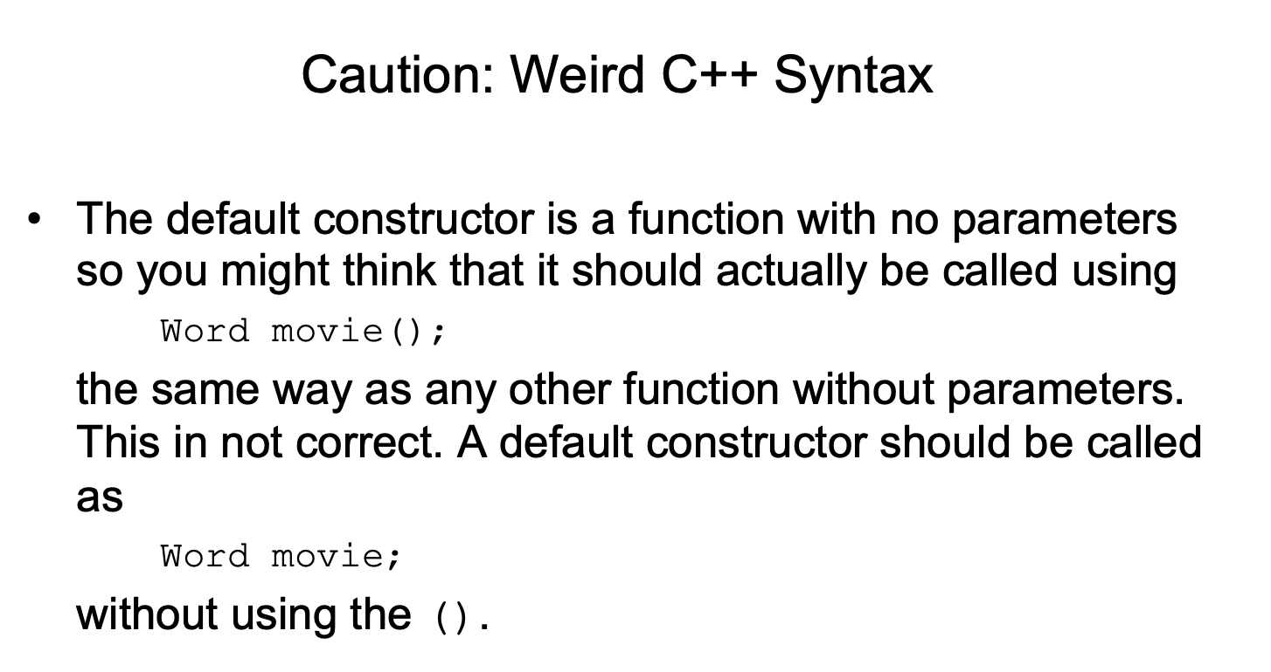

Slide 15
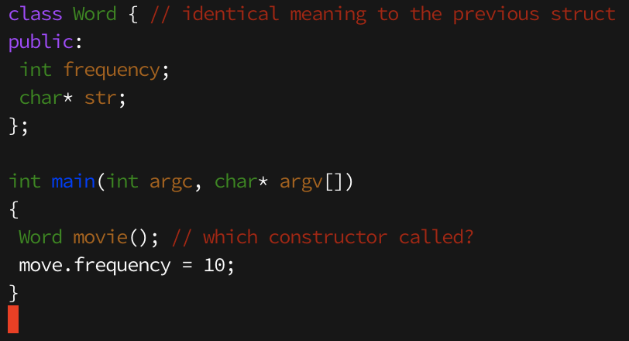

Slide 16
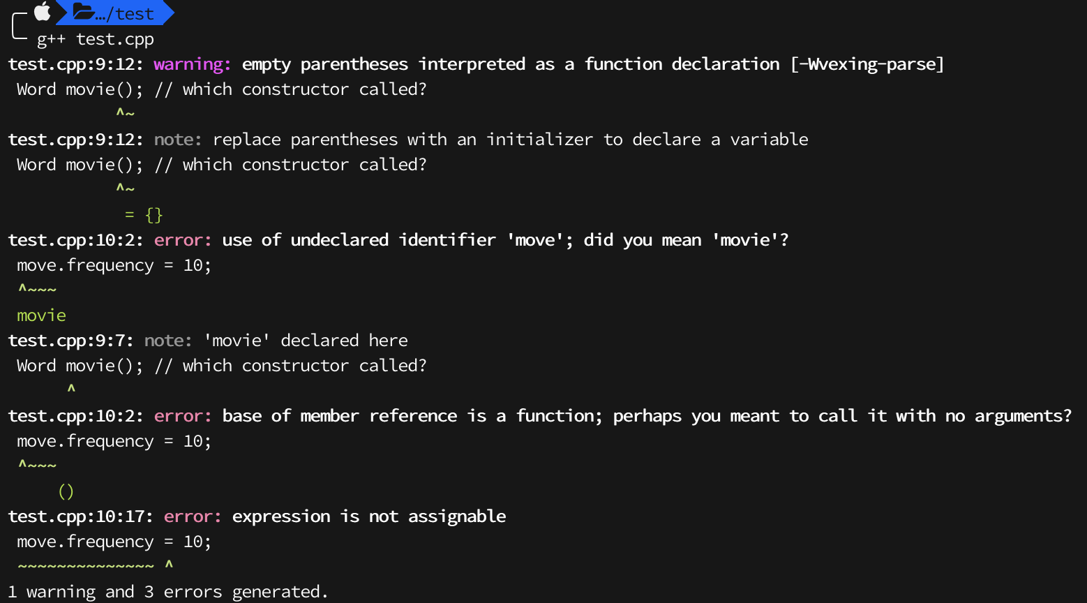

Slide 17
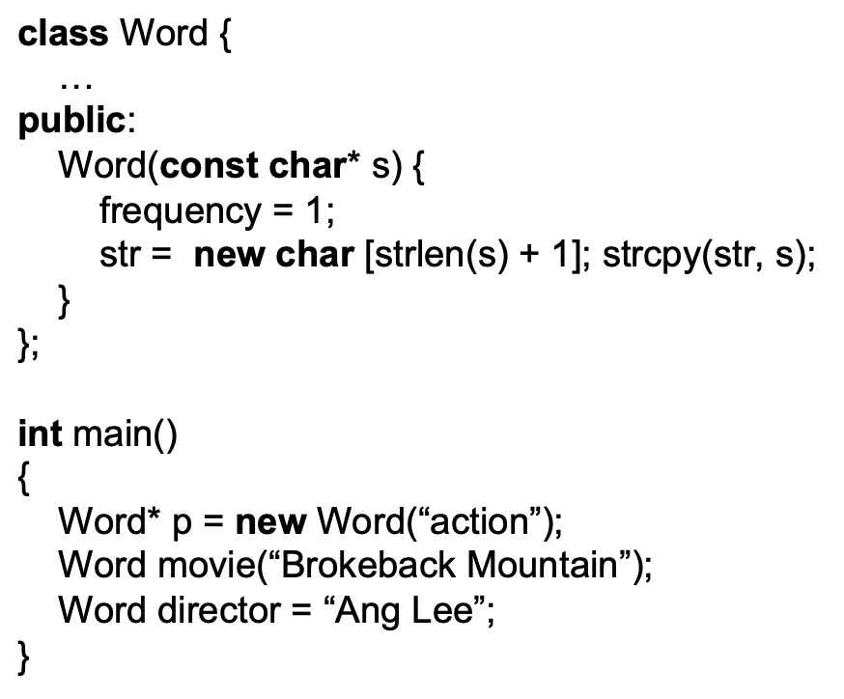
Type Conversion Constructor
A constructor accepting a single argument specifies a conversion from its argument type to the type of its class: Word(const char*) converts from type const char* to type Word.
Notice that if all but ONE argument of a constructor have default values, it is still considered a conversion constructor.

Slide 18
Copy Constructor
A copy constructor has only ONE argument of the same class
Syntax: X(const X&) for the class X.
It is called upon:
parameter passing to a function (call-by-value)
initialization assignment: Word x(“Oscars”); Word y = x;
value returned by a function

Slide 19
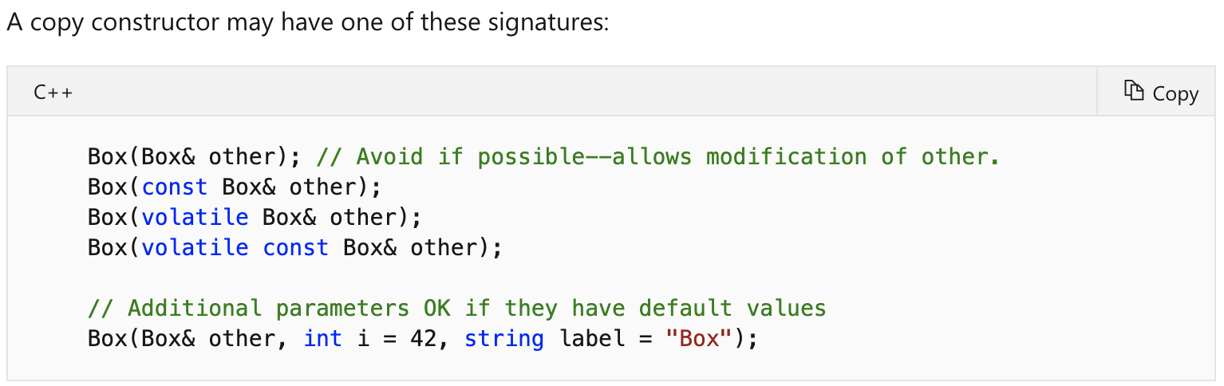
Copy Constructor

Slide 20
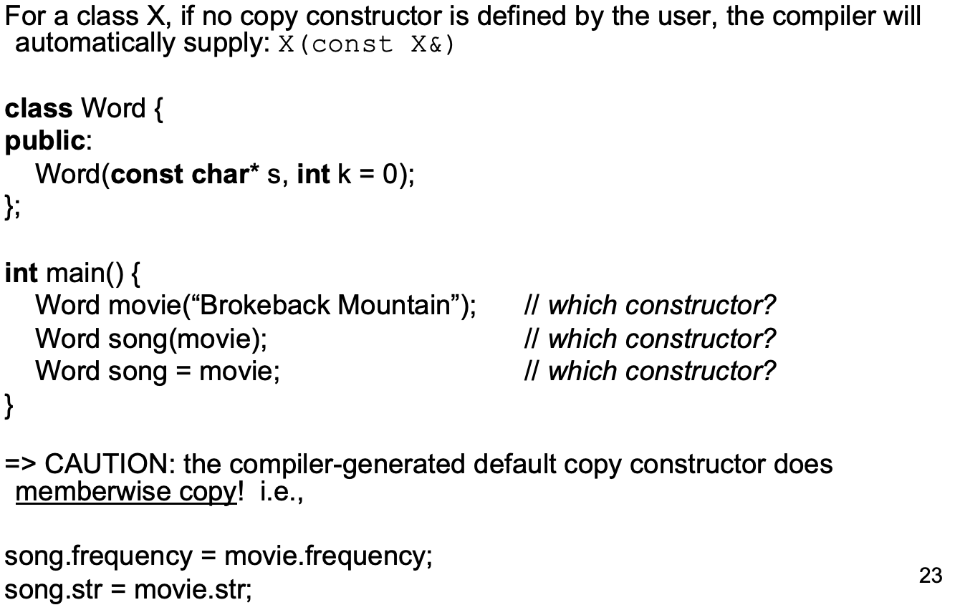
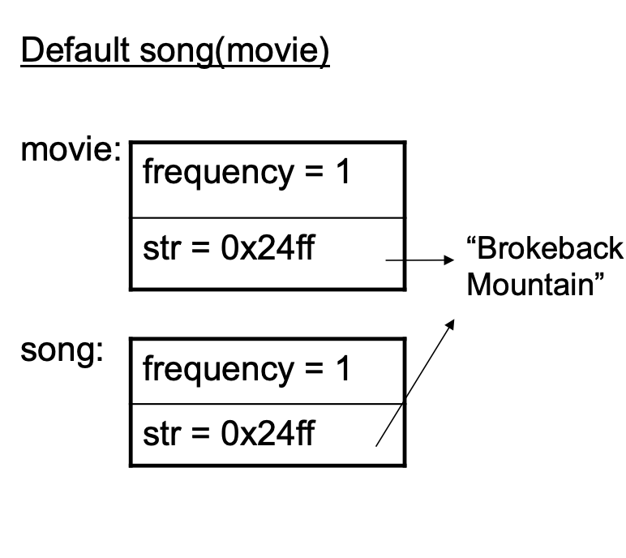
Default Copy Constructor

Slide 21
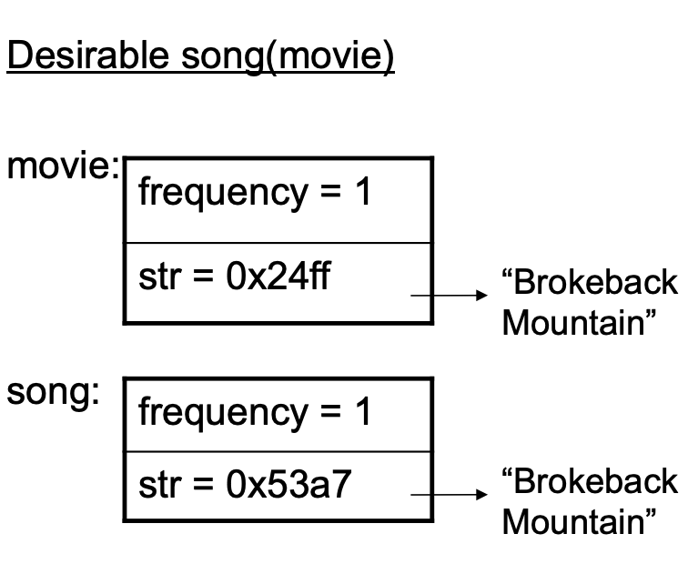
Default Copy Constructor

Slide 22
Order of Construction
It calls base class and member constructors in the order of declaration.
If the class is derived from virtual base classes, it initializes the object's virtual base pointers.
If the class has or inherits virtual functions, it initializes the object's virtual function pointers. Virtual function pointers point to the class's virtual function table to enable correct binding of virtual function calls to code.
It executes any code in its function body.
Notes:
demo

Slide 23
Rule of Three
The rule of three (also known as the Law of The Big Three or The Big Three) is a rule of thumb in C++ (prior to C++11)
It claims that if a class defines one (or more) of the following it should probably explicitly define all three:
destructor
copy constructor
copy assignment operator
Reading: Rule of Five & Rule of Zero

