Slide 1
ECS - 36B Discussion 3
Static Members, Inheritance, Class Design, Access Control

Slide 2
Outline
Static Members
Inheritance
Class Design
Access Control

Slide 3
Static Members
Static member variables are shared by all objects of the class
Static members are not associated with class objects
Better to think of static members as belonging to the class itself, not to the objects of the class
Cannot be initialized using constructors.
What happens when static variable is private?
Is initialization allowed?
Can we access it without the object in main?

Slide 4
Static Members: Variables
class Something{
public:
int m_value = 1;
};
int main(){
Something first;
Something second;
first.m_value = 2;
std::cout << first.m_value << '\n';
std::cout << second.m_value << '\n';
return 0;
}
class Something{
public:
static int s_value;
};
int Something::s_value = 1;
int main(){
Something first;
Something second;
first.s_value = 2;
std::cout << first.s_value << '\n';
std::cout << second.s_value << '\n';
return 0;
}
Output
2
1
Output
2
2

Slide 5
Static Members: Variables
class Something{
Private:
static int p;
public:
static int s_value; // declares the static member variable
};
int Something::p = 10 // How about this?
int Something::s_value = 1; // defines the static member variable
int main(){
// note: we're not instantiating any objects of type Something
Something::p = 10; // Can this be done?
Something::s_value = 2;
std::cout << Something::s_value << '\n';
return 0;
}
← is allowed
← this isn’t

Slide 6
Static Members: Functions
Static member functions are not attached to any particular object
Can be called directly by using the class name and the scope resolution operator
Are not attached to an object, they have no this pointer!
Can directly access other static members (variables or functions), but not non-static members

Slide 7
Static Members: Functions
class IDGenerator{
private:
static int s_nextID; // Here's the declaration for a static member
public:
static int getNextID(); // Here's the declaration for a static function
};
int IDGenerator::s_nextID = 1;
int IDGenerator::getNextID() { return s_nextID++; }
int main(){
for (int count=0; count < 5; ++count)
std::cout << "The next ID is: " << IDGenerator::getNextID() << '\n';
return 0;
}
← No Object Initialized, yet called the function. Yay!
The next ID is: 1
The next ID is: 2
The next ID is: 3
The next ID is: 4
The next ID is: 5

Slide 8
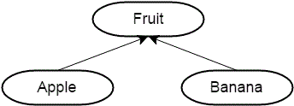
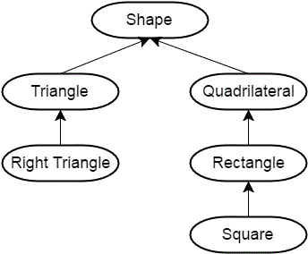
Inheritance
Inheritance involves creating new objects by directly acquiring the attributes and behaviors of parent objects
Then extending or specializing them
Used to create hierarchies
Example
Both Apple and Banana are fruits
All fruits have a name, colour, size/shape
Both of them acquire the properties of fruits
More complex example →

Slide 9
Inheritance
// BaseballPlayer publicly inheriting Person
class BaseballPlayer : public Person{
public:
double m_battingAverage;
int m_homeRuns;
BaseballPlayer(double battingAverage = 0.0, int homeRuns = 0)
: m_battingAverage(battingAverage), m_homeRuns(homeRuns)
{
}
};
int main(){
// Create a new BaseballPlayer object
BaseballPlayer joe;
joe.m_name = "Joe";
// Print out the name
std::cout << joe.getName() << '\n';
return 0;
}
#include <iostream>
#include <string>
class Person{
public:
std::string m_name;
int m_age;
Person(std::string name = "", int age = 0)
: m_name(name), m_age(age)
{
}
std::string getName() const { return m_name; }
int getAge() const { return m_age; }
};

Slide 10
Inheritance: Order of construction
class Base{
public:
int m_id;
Base(int id=0) : m_id(id){
std::cout << "Base\n";
}
int getId() const { return m_id; }
};
int main(){
std::cout << "Instantiating Base\n";
Base cBase;
std::cout << "Instantiating Derived\n";
Derived cDerived;
return 0;
}
Instantiating Base
Base
Instantiating Derived
Base
Derived
class Derived: public Base{
public:
double m_cost;
Derived(double cost=0.0) : m_cost(cost){
std::cout << "Derived\n";
}
double getCost() const { return m_cost; }
};

Slide 11
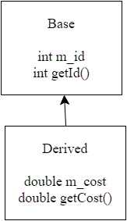
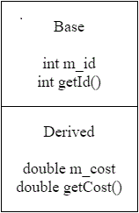
Inheritance: Order of Construction
Because Derived inherits functions and variables from Base, you may assume that the members of Base are copied into Derived
Instead, we can consider Derived as a two part class: one part Derived, and one part Base.
C++ constructs derived classes in phases, starting with the most-base class and finishing with the most-child class

Slide 12
Inheritance: Order of Destruction
#include <iostream>
using namespace std;
class Address {
public:
Address() { cout << "Address's constructor" << endl; }
~Address() { cout << "Address's destructor" << endl; }
};
class Person {
public:
Person() { cout << "Person's constructor" << endl; }
~Person() { cout << "Person's destructor" << endl; }
};
class Student : public Person {
private: Address address;
public:
Student() { cout << "Student's constructor" << endl; }
~Student() { cout << "Student's destructor" << endl; }
};
int main() { Student x; }
Each destructor is called in the reverse order of construction
Example, when student is destroyed, the Student destructor is called first, then the Address destructor, then the Person destructor

Slide 13
Inheritance: Order of Destruction
Person's constructor
Address's constructor
Student's constructor
Student's destructor
Address's destructor
Person's destructor

Slide 14
Inheritance: Debug
//Will this work??
#include<iostream>
using namespace std;
class B{
private:
int x;
public:
B(int x_val): x(x_val) {};
void displayB() {
cout<<"X = "<<x<<endl;
}
};
class D: public B {
private:
int y;
public:
D(){};
void displayB() {
cout<<"Y = "<<y<<endl;
}
};
int main(){
D derived;
};
No
Class D must call the constructor B
Unless there is default constructor for B
Moreover, constructors and destructor are an exception. They are never inherited.
Read more about Inheritance Chain

Slide 15
Class Design
class Apple: public Fruit{
.
.
}
Apple “IS-A” Fruit
“IS-A” relationship → Inheritance
“HAS-A” → Composition
class Room{
.
Table table = new Table ();
.
.
}
Room “HAS-A” Table

Slide 16
Access Control
class Person {
private:
string name;
string address;
Department dept;
protected:
void set_name(const char* name);
void set_address(const char* adr);
void set_department(Department dept);
public:
Person(string n, string a, Department d)
: name(n), address(a), dept(d) {};
string get_name() const;
string get_address() const;
Department get_department() const;
};
class Student : public Person {
private:
Course* enrolled;
int num_courses;
public:
Student(string n, string a, Department d)
: Person(n, a, d)
, enrolled(NULL)
, num_courses(0)
{}
bool enroll_course(const string&);
bool drop_course(const Course&);
};
Are public functions/fields accessible in Student?
How about protected and private?

Slide 17
Access Control
class Person {
private:
string name;
string address;
Department dept;
protected:
void set_name(const char* name);
void set_address(const char* adr);
void set_department(Department dept);
public:
Person(string n, string a, Department d)
: name(n), address(a), dept(d) {};
string get_name() const;
string get_address() const;
Department get_department() const;
};
class Student : public Person {
private:
Course* enrolled;
int num_courses;
public:
Student(string n, string a, Department d)
: Person(n, a, d)
, enrolled(NULL)
, num_courses(0)
{}
bool enroll_course(const string&);
bool drop_course(const Course&);
};
protected
private
public
public

Slide 18
Access Control
class Person {
private:
string name;
string address;
Department dept;
protected:
void set_name(const char* name);
void set_address(const char* adr);
void set_department(Department dept);
public:
Person(string n, string a, Department d)
: name(n), address(a), dept(d) {};
string get_name() const;
string get_address() const;
Department get_department() const;
};
class Student : protected Person {
private:
Course* enrolled;
int num_courses;
public:
Student(string n, string a, Department d)
: Person(n, a, d)
, enrolled(NULL)
, num_courses(0)
{}
bool enroll_course(const string&);
bool drop_course(const Course&);
};
Are the functions/fields accessible in Student?
How about protected and private?

Slide 19
Access Control
class Person {
private:
string name;
string address;
Department dept;
protected:
void set_name(const char* name);
void set_address(const char* adr);
void set_department(Department dept);
public:
Person(string n, string a, Department d)
: name(n), address(a), dept(d) {};
string get_name() const;
string get_address() const;
Department get_department() const;
};
class Student : protected Person {
private:
Course* enrolled;
int num_courses;
public:
Student(string n, string a, Department d)
: Person(n, a, d)
, enrolled(NULL)
, num_courses(0)
{}
bool enroll_course(const string&);
bool drop_course(const Course&);
};
protected
private
public

Slide 20
Access Control
class Person {
private:
string name;
string address;
Department dept;
protected:
void set_name(const char* name);
void set_address(const char* adr);
void set_department(Department dept);
public:
Person(string n, string a, Department d)
: name(n), address(a), dept(d) {};
string get_name() const;
string get_address() const;
Department get_department() const;
};
class Student : private Person {
private:
Course* enrolled;
int num_courses;
public:
Student(string n, string a, Department d)
: Person(n, a, d)
, enrolled(NULL)
, num_courses(0)
{}
bool enroll_course(const string&);
bool drop_course(const Course&);
};
Are the functions/fields accessible in Student?
How about protected and private?

Slide 21
Access Control
class Person {
private:
string name;
string address;
Department dept;
protected:
void set_name(const char* name);
void set_address(const char* adr);
void set_department(Department dept);
public:
Person(string n, string a, Department d)
: name(n), address(a), dept(d) {};
string get_name() const;
string get_address() const;
Department get_department() const;
};
class Student : private Person {
private:
Course* enrolled;
int num_courses;
public:
Student(string n, string a, Department d)
: Person(n, a, d)
, enrolled(NULL)
, num_courses(0)
{}
bool enroll_course(const string&);
bool drop_course(const Course&);
};
private
private
public

Slide 22
Access Control: Summary
Public inheritance preserves the original accessibility of the base class’ public and protected members:
public => public
protected => protected
private => not accessible
Protected inheritance causes the accessibility of inherited public and protected members to be protected.
public => protected
protected => protected
private => not accessible
Private inheritance renders all inherited members private.
public => private
protected => private
private => not accessible

Slide 23
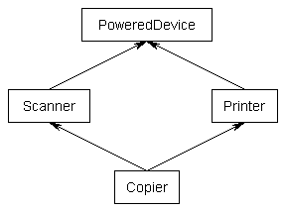
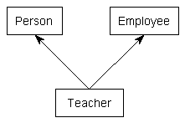
Food for thought
Multiple Inheritance
Diamond Problem

Slide 24
Questions?

