Slide 1
Discussion 8
Streams, Unix Files, Binary Tree, and Strings

Slide 2
Streams so far..
You included the iostream library header and made use of the cin and cout objects to do simple I/O.
Today, we’ll take a look at the iostream library in more detail

Slide 3
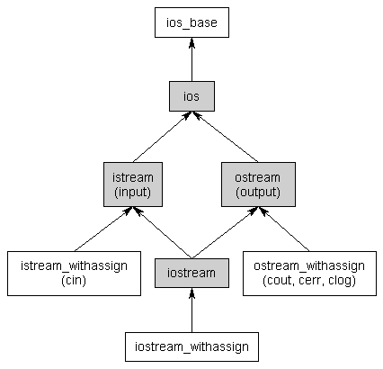
Hierarchy Diagram
What is the first thing you observe here?
It uses multiple inheritance (that thing I told you to avoid if at all possible).
Don’t You Worry (btw Nice song by Swedish House Mafia)

Slide 4
What is this word Streams? :/
A stream is just a sequence of bytes that can be accessed sequentially.
A stream may produce or consume potentially unlimited amounts of data.
Typically 2 types
Input Streams
Output Streams

Slide 5
Input Streams
Input streams are used to hold input from a data producer
keyboard, a file, or a network
For example, the user may press a key on the keyboard while the program is currently not expecting any input. Rather than ignore the users keypress, the data is put into an input stream, where it will wait until the program is ready for it.

Slide 6
Output Streams
Conversely, output streams are used to hold output for a particular data consumer
monitor, a file, or a printer
When writing data to an output device, the device may not be ready to accept that data yet -- for example, the printer may still be warming up when the program writes data to its output stream. The data will sit in the output stream until the printer begins consuming it.

Slide 7
Input/Output in C++
The istream class is the primary class used when dealing with input streams
The ostream class is the primary class used when dealing with output streams
The iostream class can handle both input and output, allowing bidirectional I/O
Finally, there are a bunch of classes that end in “_withassign”
In most cases, you won’t be dealing with these classes directly.

Slide 8
Quiz
How many streams are automatically created when executing a program?
a) 1
b) 2
c) 3
d) 4
std::cin, std::cout, std::cerr, std::clog

Slide 9
Standard Streams in C++
A standard stream is a pre-connected stream provided to a computer program by its environment. C++ comes with four predefined standard stream objects that have already been set up for your use. The first three, you have seen before:
cin -- an istream_withassign class tied to the standard input (typically the keyboard)
cout -- an ostream_withassign class tied to the standard output (typically the monitor)
cerr -- an ostream_withassign class tied to the standard error (typically the monitor), providing unbuffered output
clog -- an ostream_withassign class tied to the standard error (typically the monitor), providing buffered output

Slide 10
Input with streams
You have already used extraction operator >> to read info from an input stream
char buf[10];
cin >> buf;
But what if you read 20 characters
The buffer overflows, and bad stuff happens.

Slide 11
Use Manipulators
A manipulator is an object that is used to modify a stream when applied with the extraction (>>) or insertion (<<) operators.
One manipulator you have already worked with extensively is "endl"
C++ provides a manipulator known as setw that can be used to limit the number of characters read in from a stream
#include <iomanip.h>
char buf[9];
cin >> setw(9) >> buf;
This program will now only read the first 8 characters out of the stream. Why?? Why only 8? :’(
Any remaining characters will be left in the stream until the next extraction.

Slide 12

Extraction and White Space
The extraction operator works with “formatted” data -- that is, it skips whitespace
int main()
{
char ch;
while (cin >> ch)
cout << ch;
return 0;
}
Consider the input is Hello my name is Pikachu
What is the output?
HellomynameisPikachu

Slide 13

What if white spaces are precious?
Don’t worry, we have get()
simply gets a character from the input stream
Consider the input is Hello my name is Pikachu
What is the output?
int main()
{
char ch;
while (cin.get(ch))
cout << ch;
return 0;
}
Hello my name is Pikachu

Slide 14
Beware of newlines
One important thing to note about get() is that it does not read in a newline character!
This can cause some unexpected results:
int main()
{
char strBuf[11];
// Read up to 10 characters
cin.get(strBuf, 11);
cout << strBuf << endl;
// Read up to 10 more characters
cin.get(strBuf, 11);
cout << strBuf << endl;
return 0;
}
What is the Output when you hit enter after taking in the first
because the first get() read up to the newline and then stopped. The second get() saw there was still input in the cin stream and tried to read it. But the first character was the newline, so it stopped immediately.

Slide 15
A few more useful istream function
There are a few more useful input functions that you might want to make use of:
ignore() discards the first character in the stream.
ignore(int nCount) discards the first nCount characters.
peek() allows you to read a character from the stream without removing it from the stream.
unget() returns the last character read back into the stream so it can be read again by the next call.
putback(char ch) allows you to put a character of your choice back into the stream to be read by the next call.

Slide 16
Output with ostream and Manipulators
The insertion operator (<<) is used to put information into an output stream.
There are two ways to change the formatting options:
Flags
Manipulators.
To switch a flag on, use the setf() function, with the appropriate flag as a parameter
Example: C++ does not print a + sign in front of positive numbers. However, by using the std::ios::showpos flag, we can change this behavior:
std::cout.setf(std::ios::showpos); // turn on the std::ios::showpos flag
std::cout << 27 << '\n';

Slide 17
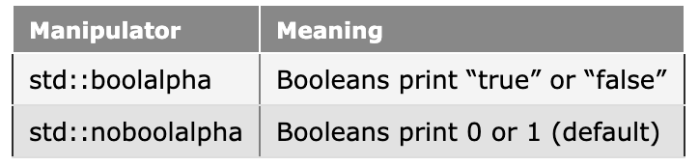
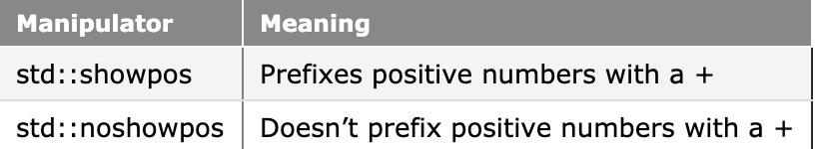
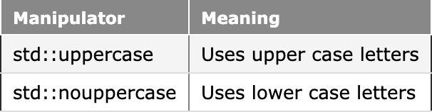
Useful Formatters

Slide 18
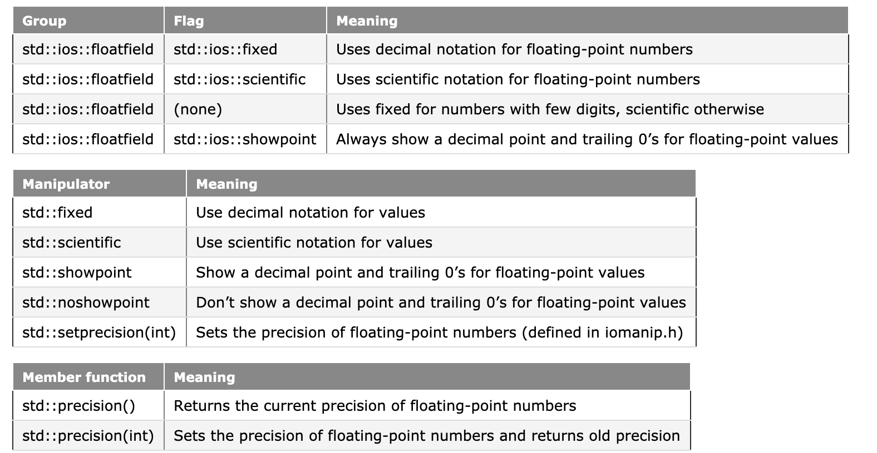
Some more

Slide 19
Input/Output with files in cpp
ofstream: Stream class to write on files
ifstream: Stream class to read from files
fstream: Stream class to both read and write from/to files.

Slide 20
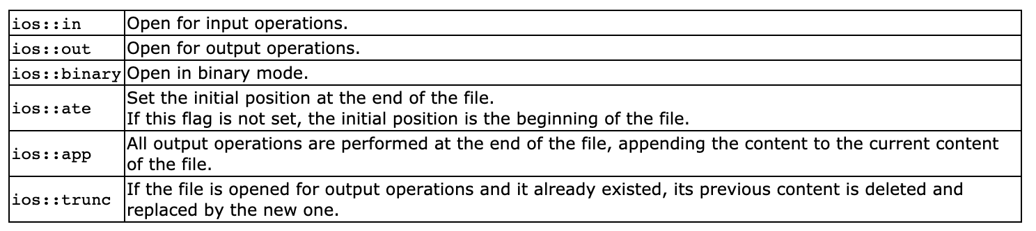
Open a File
To open a file open (filename, mode);
What is mode?

Slide 21

Close a file

Slide 22
Homework
tellg()
tellp()
seekg()
seekp()

Slide 23
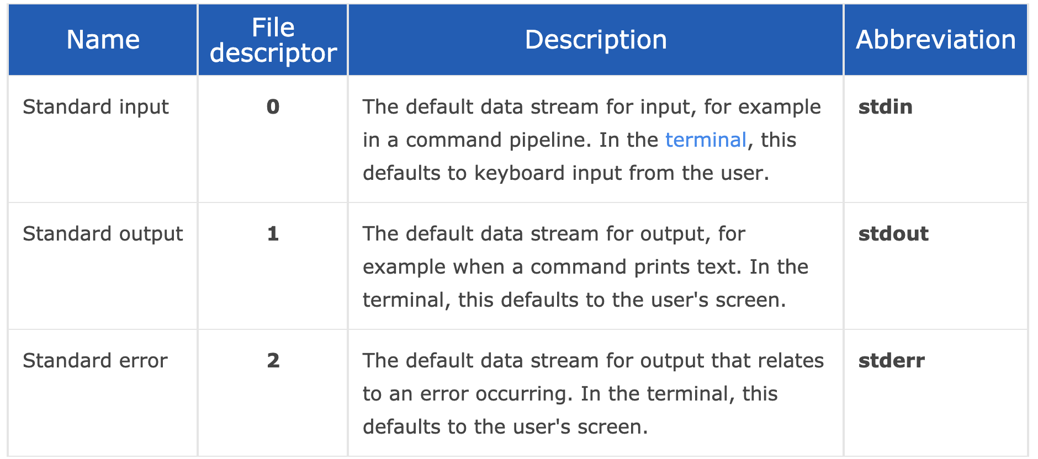
Unix File Descriptors

Slide 24
Redirection
Print content of program on stdout $ ./a.out
Redirect to a file $ ./a.out > filename.txt
Alternatively $ ./a.out 1> filename.txt
Append to already existing file $ ./a.out >> filename.txt
Redirect stderr to stdout $ ./a.out 2>&1

Slide 25

Binary Tree
A data structure in which each node is connected to at most 2 other nodes

Slide 26
Traversal (Secret: Follow the root)
PreOrder → (Root, Left, Right)
InOrder → (Left, Root, Right)
PostOrder → (Left, Right, Root)

Slide 27

Strings
You all know this, don’t you?

Slide 28


