Slide 1
Discussion 7
Midterm 2 Review, STL Algorithms, Predicates and Function Objects

Slide 2
Midterm Review
Questions?

Slide 3
STL Algorithms: Find
Question 1: Given a vector of integers, find a value ‘x’, where x is an integer
Iterate over the vector from 0 to size - 1 till you find x
Or just use find(v.begin(), v.end(), x);

Slide 4
STL Algorithms: Sort + Something
Question 2: Given a vector of numbers (in any order), find a given number ‘x’ efficiently.
Old School method would be to implement any sort function and then implement your own binary search
With STL it is almost just 2 lines sort(v.begin(), v.end()) binary_search(v.begin(), v.end(), x)

Slide 5
STL Algorithms: Copy
Question 3: Given an array of numbers (in any order), copy elements from a specific start-point to a specified end-point.
Boringly write a for loop starting from specified SP upto the EP and carefully copy one element to the other.
With STL it is just 1 line copy(array, array + 3, v)

Slide 6
STL Algorithms: For each
Instead of using for, while, etc
C++ allows us to use “for-each”.
This loop accepts a function which executes over each of the container elements.
Question: For every element of an integer vector, can you print its square and cube?

Slide 7

STL Algorithms: Wrap-Up
Defined separately from containers
Can only interact with a container through iterators.
Can copy elements , but not add or remove elements
Cannot resize the container
STL is very powerful and can lead to the ability to write complex code very quickly
It’s also got a dark side:
Some combination of algorithms and container types may not work
May cause infinite loops
May work but be extremely poor performing.

Slide 8
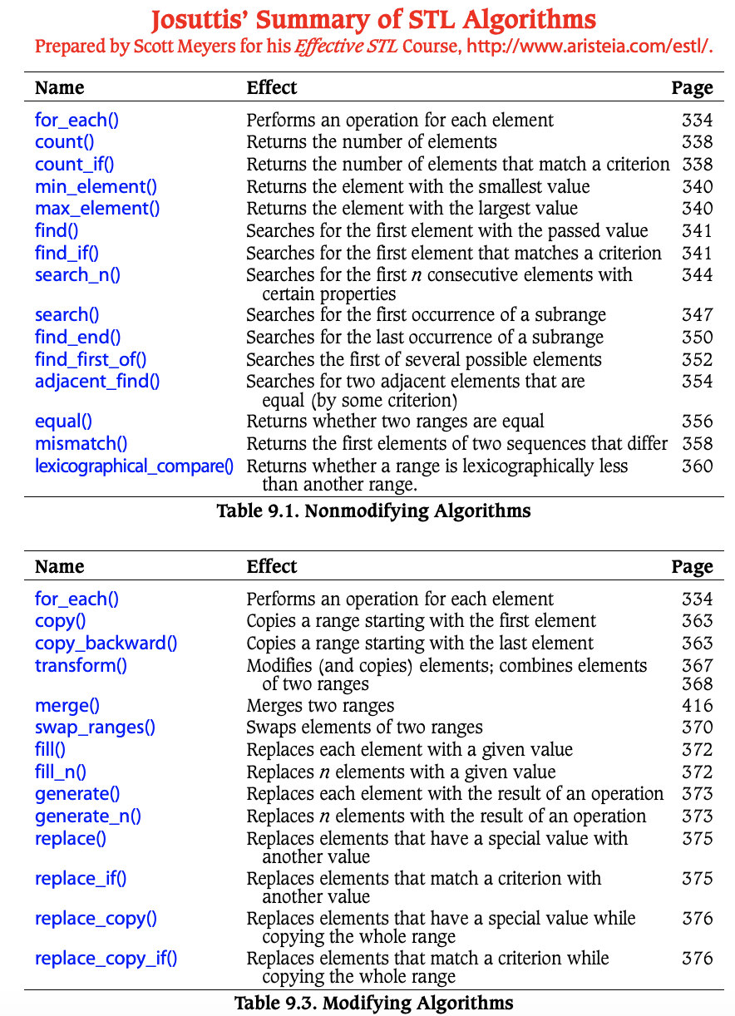

List of Algorithms
Can be found here!

Slide 9

Question?
When should the STL algorithms be used instead of using your own?
Short answer: Always.
Long answer: Always. That's what they are there for. They're optimized for use with STL containers, and they're faster, clearer, and more idiomatic than anything you can write yourself. The only situation you should consider rolling your own is if you can articulate a very specific, mission-critical need that the STL algorithms don't satisfy.

Slide 10
Functors (Function Objects)
Functors are simply put object + ().
A functor is any object that can be used with () in the manner of a function.
This includes normal functions, pointers to functions, and class objects for which the () operator (function call operator) is overloaded, i.e., classes for which the function operator()() is defined.

Slide 11
Question
#include <iostream>
struct absValue
{
float operator()(float f) {
return f > 0 ? f : -f;
}
};
int main( )
{
using namespace std;
float f = -123.45;
absValue aObj;
float abs_f = aObj(f);
cout << "f = " << f << " abs_f = " << abs_f << endl;
return 0;
}
Define a struct named absValue that encapsulates the operation of converting a value of type float to its absolute value

Slide 12
General use case of functor
//Declare First
Class X {
public:
// define "function call" operator
return-value operator() (arguments) const;
...
};
//Call
X fn;
...
fn(arg1, arg2); // call operator () for function object fn
//Equivalent to
fn.operator()(arg1,arg2); // call operator () for function object fn

Slide 13
Advantages of Function Objects
Function object are "smart functions."
Each function object has its own type.
Function objects are usually faster than ordinary functions.

Slide 14
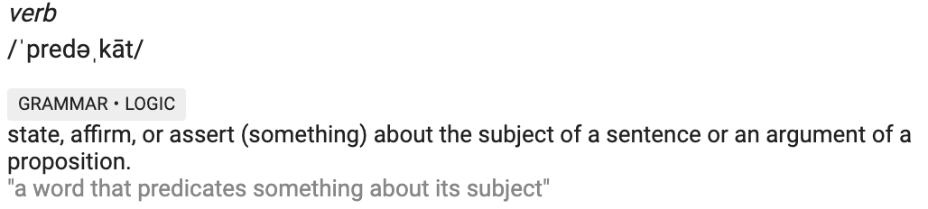
Predicates
A predicate is a C++ function returning a boolean or an object having a bool operator() member.
A unary predicate takes one argument
A binary takes two, and so on
Examples of questions predicates can answer for a particular algorithm are:
Is this element what we are looking for?
Is the first of two arguments ordered first in our order?
Are the two arguments equal?

Slide 15
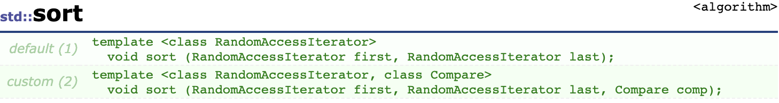
Predicates
Sort by default sorts in ascending order
What if we want to sort in descending order
This is where predicates come into the picture

Slide 16
Question?
Given a vector of points, sort them by their x coordinate.
V = {{2, 3}, {5, 8}, {3, 8}, {13, 10}}
bool compareInterval(Interval i1, Interval i2) {
return (i1.start < i2.start);
}
class classCompareInterval{
public:
bool operator()(const Interval &i1, const Interval &i2) {
return (i1.start < i2.start);
}
};

Slide 17
Question?
Given a vector of integers, can you find the first odd element?
Use the find_if with a predicate function
bool IsOdd (int i) {
return ((i%2)==1);
}
find_if (myvector.begin(), myvector.end(), IsOdd);

