Slide 1


Hybrid RAG Framework for Enterprise Knowledge Management
KL UNIVERSITY

Slide 2
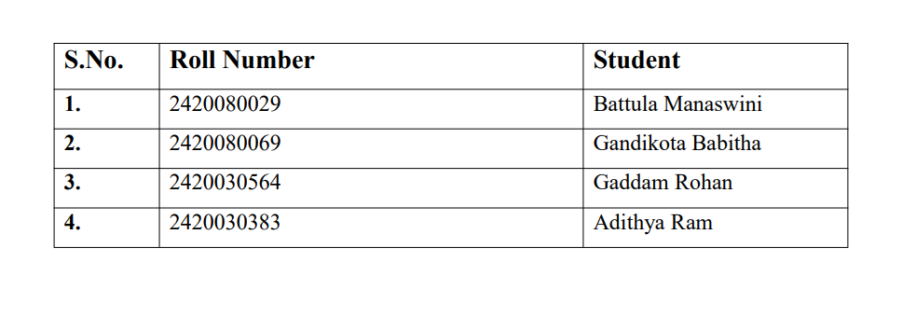
TEAM MEMBERS

Slide 3
INTRODUCTION
Modern organizations generate vast amounts of enterprise documents such as annual reports, company
policies, technical manuals, financial statements, product documentation, and knowledge base articles.
As these documents continue to grow, finding accurate information becomes difficult using traditional
keyword-based search systems.
Large Language Models (LLMs) provide intelligent responses but often generate incorrect or
hallucinated answers when they lack access to enterprise-specific information.
Retrieval-Augmented Generation (RAG) improves this by retrieving relevant enterprise documents
before generating responses. This project further enhances RAG using a Hybrid Retrieval approach
that combines semantic and keyword search for more accurate and context-aware enterprise
knowledge management.

Slide 4
PROBLEM STATEMENT
Organizations face several challenges while managing enterprise knowledge:
Large volumes of enterprise documents
Slow manual document search
Traditional keyword search misses contextual information
Semantic search alone may miss exact keyword matches
LLMs produce hallucinated responses without enterprise context
Employees spend significant time searching for information
There is a need for an intelligent enterprise assistant capable of retrieving accurate information
from organizational documents.

Slide 5
OBJECTIVES
The objectives of the proposed system are:
Improve retrieval accuracy by overcoming the limitations of semantic-only retrieval.
Combine semantic and keyword-based search using FAISS and BM25.
Improve relevance of retrieved context for enterprise-specific queries.
Reduce irrelevant or incomplete responses caused by ineffective document retrieval.
Reduce LLM hallucinations by providing more relevant and reliable context.
Evaluate the proposed Hybrid RAG against the existing RAG approach using multiple enterprise
datasets.

Slide 6
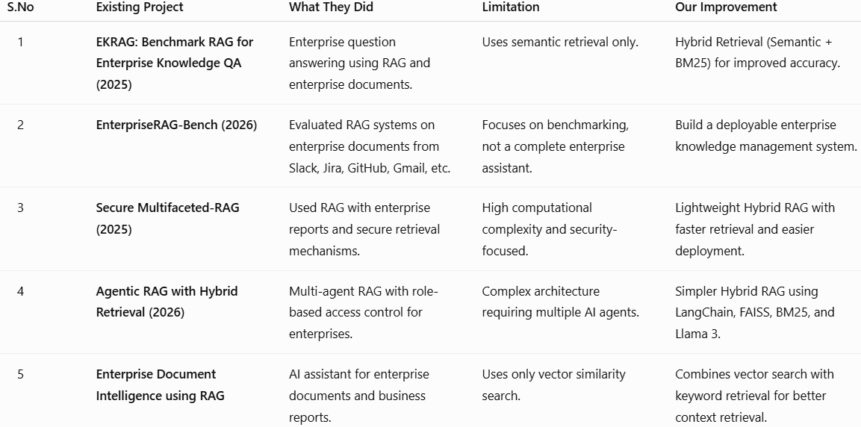
LITERATURE SURVEY

Slide 7
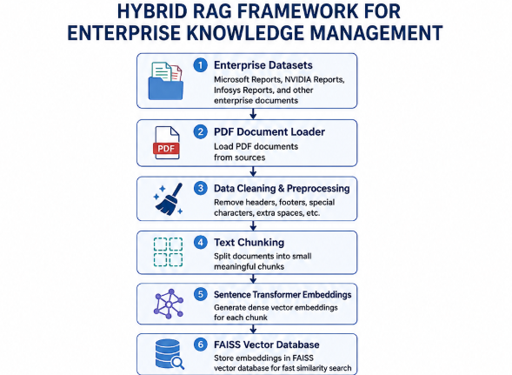
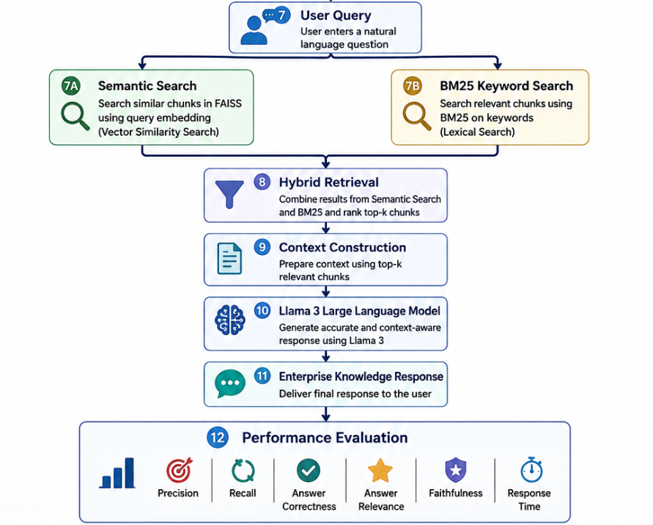
FLOW CHART

Slide 8
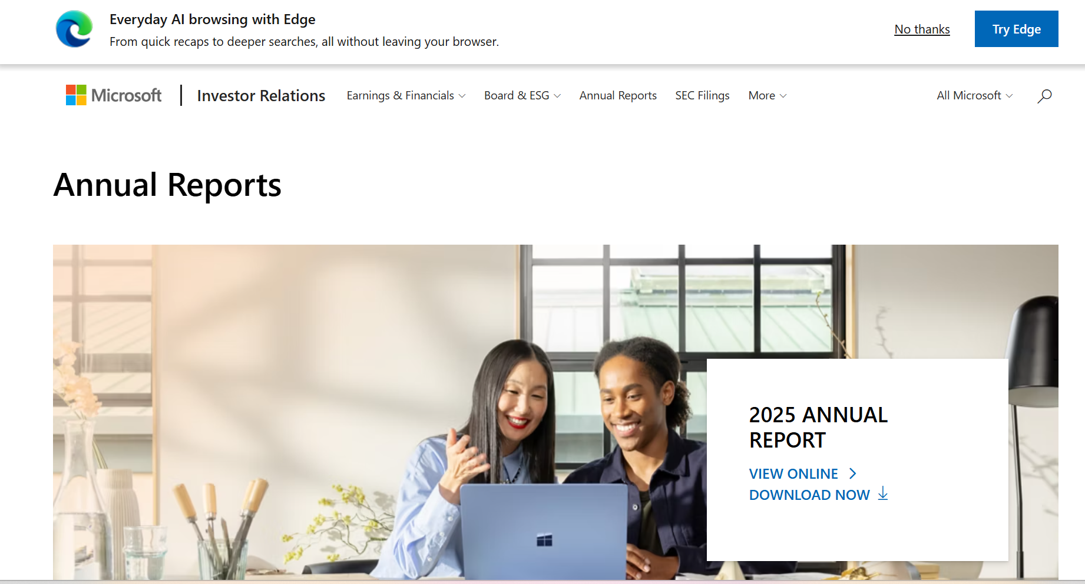
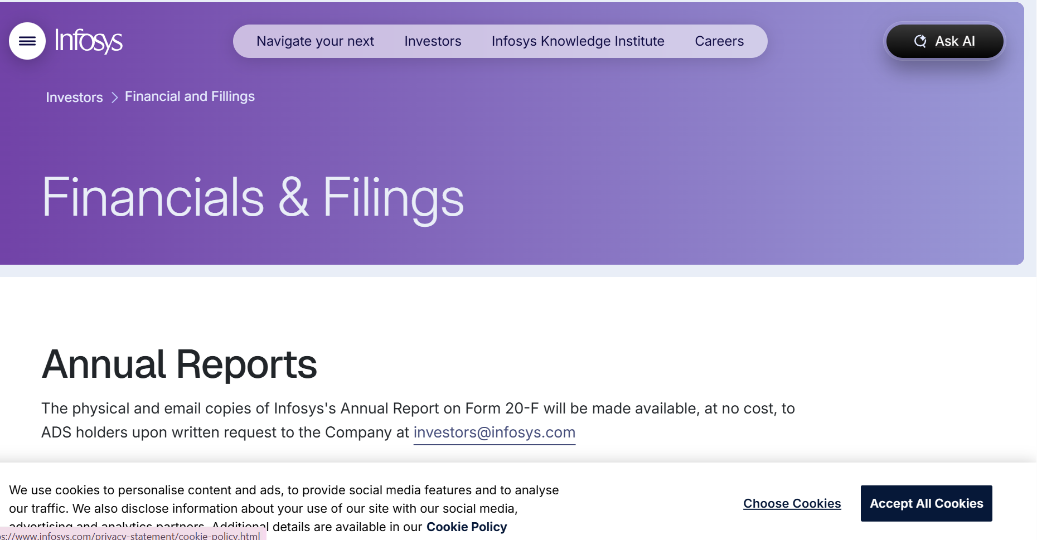
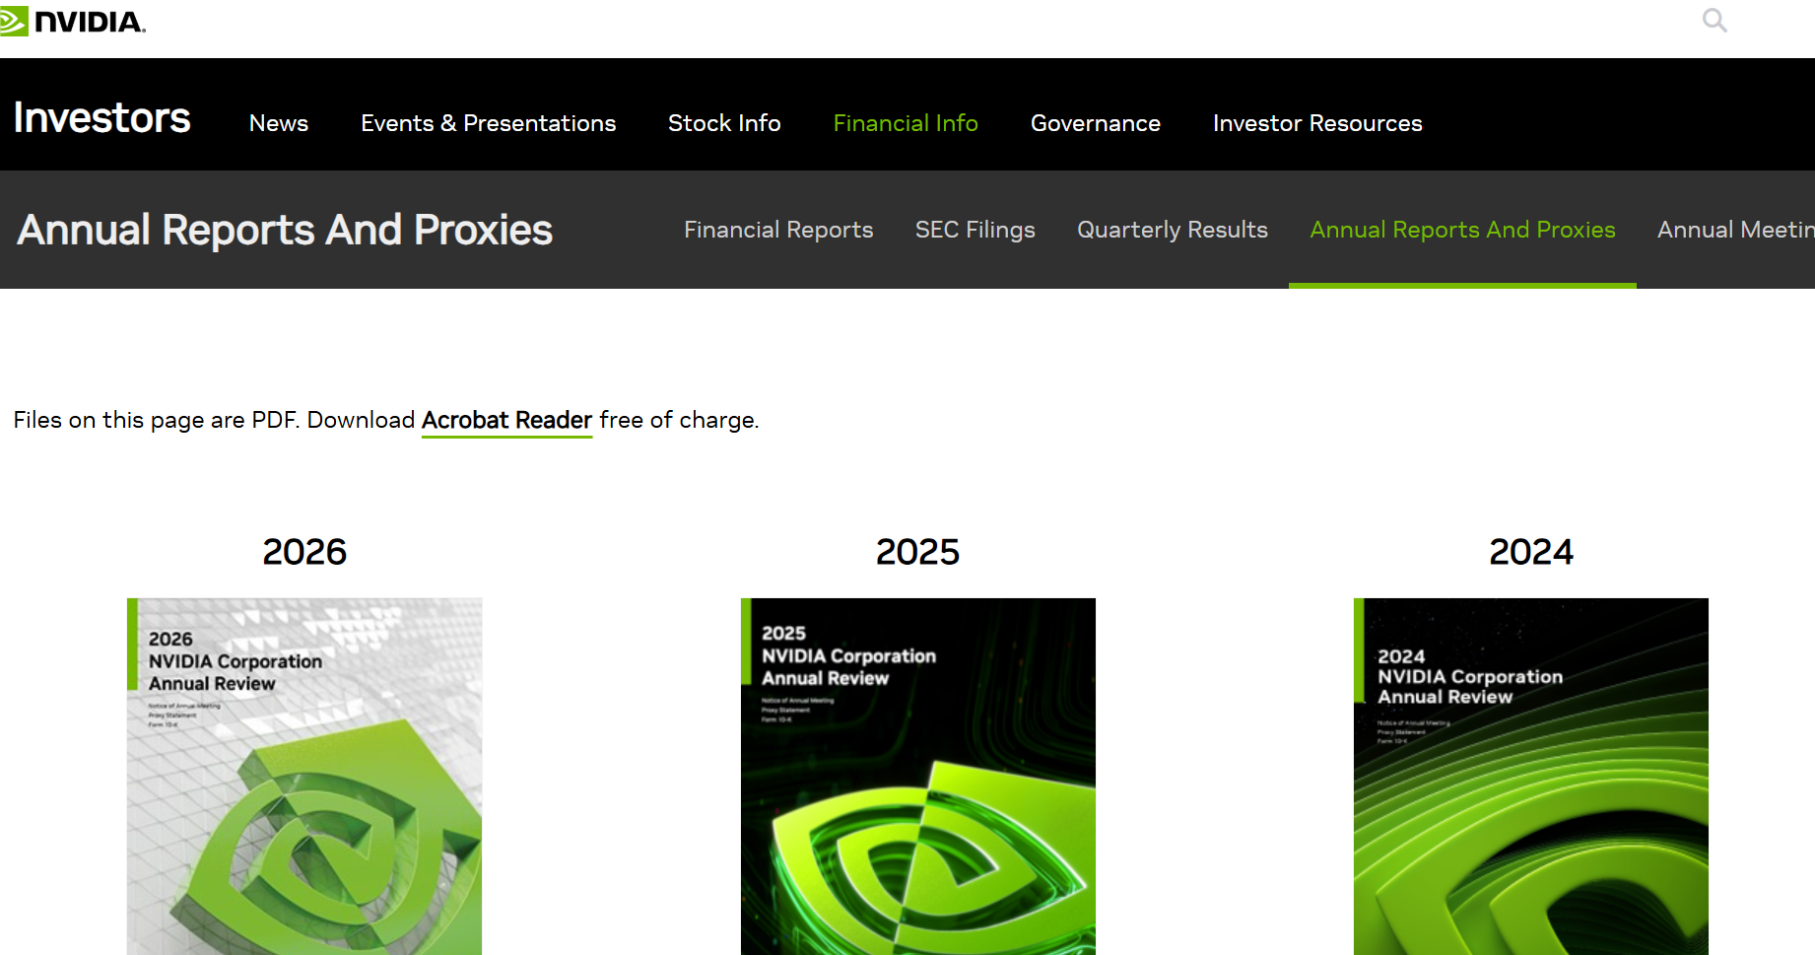
DATASETS
The proposed system uses publicly available enterprise
documents from three companies:
Microsoft Annual Reports – Business, financial, and
sustainability reports.
NVIDIA Annual Reports – AI, technology, and corporate
reports.
Infosys Annual Reports – Annual, ESG, and governance
reports.
These datasets are used to evaluate the performance and
effectiveness of the proposed Hybrid RAG framework in enterprise
knowledge retrieval.

Slide 9
EXPECTED OUTCOME
The proposed Hybrid RAG Framework for Enterprise Knowledge Management is expected
to provide fast, accurate, and context-aware responses by combining semantic search and keyword
based retrieval. The system will efficiently retrieve relevant information from enterprise documents
such as annual reports and corporate publications, reducing hallucinations and improving answer
relevance. It aims to enhance enterprise knowledge accessibility, decision-making, and overall
information retrieval performance.

Slide 10
CONCLUSION
The proposed Hybrid RAG Framework offers an effective solution for enterprise knowledge
management by integrating semantic retrieval, BM25 keyword search, and Llama 3. By leveraging
publicly available enterprise documents from Microsoft, NVIDIA, and Infosys, the system delivers
reliable and context-aware responses. Compared to traditional RAG systems, the proposed framework
improves retrieval accuracy, response quality, and user experience, making it a practical solution for
modern enterprise information management.

Slide 11

THANK YOU
THANK YOU

