Slide 1
99acres Automation Module-Wise Analysis
Comprehensive End-to-End Testing Report covering Buy, Rent, New Launch, Commercial, Projects, and Land/Plots Modules using Selenium, Pytest, and Behave BDD.

Slide 2
Project Contributors
■
■
■
Shaury Rawat
PROJECTS MODULE
Jagadeeshkanna S
LAND/PLOTS MODULE
Satyam Gangwar
COMMERCIAL MODULE
■
■
■
Madhu Damsani
RENT MODULE
Rohan
NEW LAUNCH
Vijay Kumar
BUY MODULE

Slide 3


Rent Module: End-to-End Workflow
1. Initialization
Open browser, navigate to 99acres website, and authenticate by logging in with configured Excel data.
3. Property Details
Open individual property detail pages from the filtered results to validate listing integrity and data display.
2. Search & Filter
4. Owner Contact
Initiate the 'Open Owner Details' action and verify the presence and functionality of the Contact Section.
Execute location search for rental properties and apply specific filters like the '2 BHK' criteria.

Slide 4
Rent Module: Test Case Breakdown
Positive Test Cases
Negative Test Cases
Shortlist Requires Login: Ensures unauthorized users are prompted to login when attempting to shortlist a property.
Empty Location Validation: Verifies that submitting an empty search query is blocked and handled gracefully by the UI.
■
■
Verify Valid Search: Ensures accurate property listings appear for valid inputs.
■
Verify 2 BHK Filter: Confirms the property type filter accurately isolates relevant
listings.
■
■
Search Location Display: Validates UI renders correct location headers.
■
Property Details Page: Checks that clicking a listing correctly opens the detailed view.

Slide 5
New Launch: End-to-End Workflow
1. Launch & Login
Open Browser, navigate to 99acres website, and authenticate via Login with mobile and OTP.
3. Property Detail
Open specific Project Details Page and automatically close any dynamic Disclaimer popups if visible.
2. Search & Filter
4. View Number
Fill contact details, select '3 Months' if asked, click View Number, and verify the Contact Section.
Open New Launch Module, search Noida, and meticulously apply Property, Budget, and Bedroom Filters.

Slide 6
New Launch: Automated Test Coverage
Positive Test Cases
Negative Test Cases
test_open_newlaunch_module_from_homepage
Verifies that the New Launch module opens from the homepage and the search box is visible and empty.
test_search_valid_location_in_newlaunch
Searches for the configured valid location and verifies that New Launch results are displayed.
test_location_suggestions_display_for_partial_location
Enters partial location text and validates that Noida suggestions are shown.
test_residential_property_type_filter_applies_successfully
Applies the Flat/Apartment property type filter and validates that results remain loaded.
test_invalid_location_does_not_show_valid_suggestions_or_proceed
Enters an invalid location and verifies that valid suggestions are not shown and the application does not navigate away.
test_search_does_not_proceed_without_location
Clicks Search without entering a location and verifies that the page stays on the New Launch search screen.
End-to-End Test Case
test_newlaunch_end_to_end_flow
Validates login, New Launch search, filters, project detail opening, disclaimer handling, contact form handling, and View Number flow.

Slide 7
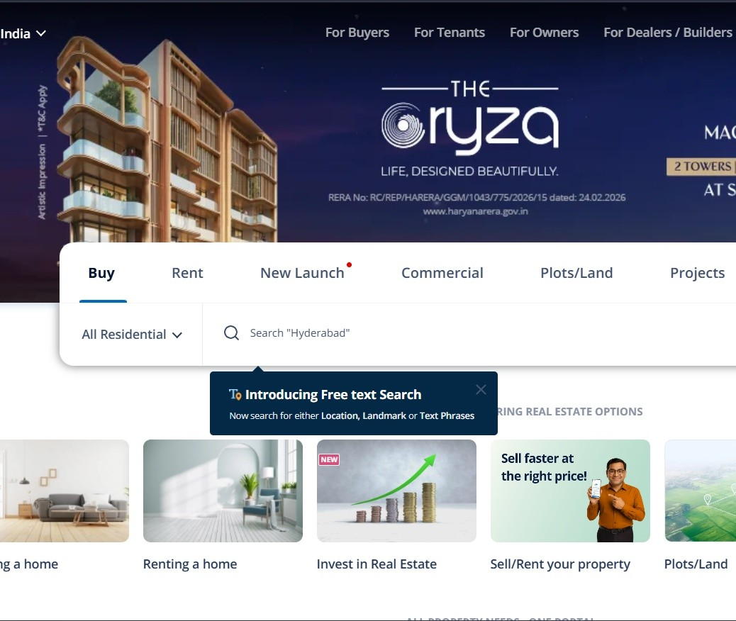
Commercial Module: Pytest Suite
■
Commercial Module
The Pytest suite for the Commercial module features 10 rigorous steps covering full flow validation. It explicitly tests complex multi-city parameters and edge cases.
Full Commercial Flow: Validates the complete E2E journey from mobile login to commercial search results.
Multi-City Operations: Ensures listings load correctly for specific hubs like Mumbai, Delhi, and Noida.
UI Interactions: Verifies that property cards open detailed pages and View Number buttons are clickable.
URL Resiliency: Robust negative testing handles invalid locations (xyz123) and special characters (@@@@) without crashing.

Slide 8
Commercial Module: BDD Scenarios
Positive Scenarios
Search by Location: Inputting Mumbai/Hyderabad yields corresponding commercial listings.
Advanced Filtering: Applying filters to a Noida search correctly refines the displayed listings.
Property Navigation: Clicking a result card seamlessly transitions the user to the specific property detail page.
Negative Scenarios & E2E
Invalid Inputs: Searching with special characters (e.g., @@@@@@) is handled safely without application crashes.
Empty State Logic: Searching without entering a location is blocked, prompting proper UI handling.
E2E Login Flow: Verifies Open 99acres → Login (mobile + OTP) → Search commercial property → Navigate to result.

Slide 9
Projects Module: Configured Test Data
Configuration Field | Assigned Test Value | Expected Workflow Outcome
Module / Location | Projects / Mumbai | Search executes and relevant project results are displayed instantly.
Property Type | Flat/Apartment | Results dynamically filter to exclude non-residential project types.
Bedroom Configuration | 3 BHK | Project listings refine to strictly match the requested bedroom layout.
Possession In Timeline | 2036 | Buying timeline is captured correctly during the View Number lead form phase.
Popup Interaction | Disclaimer Popup | Automation identifies and closes the disclaimer, allowing the flow to continue.

Slide 10
Projects Module: Test Cases & Coverage
Functional Test Cases
Negative Test Cases
Test Case 1 → Projects location search
Validates that entering a valid location successfully fetches relevant project listings.
Test Case 2 → Property listing + 3 BHK + 2036 filter
Applies configuration filters (3 BHK, Possession in 2036) and verifies the listings update.
Test Case 3 → View Number popup + screenshot
Executes the contact flow, handles the popup, and captures test evidence via screenshot.
Test Case 4 → Rent search
Validates the rent search functionality integrated within the testing workflow.
Test Case 5 → Invalid location negative test
Inputs an invalid string to verify the system safely rejects the search without failing.
Test Case 6 → Empty location negative test
Attempts to search with an empty location field to ensure the UI blocks the action.

Slide 11
Land/Plots Module: End-to-End Workflow
1. Launch & Login
3. Property Selection
Open Browser, navigate to 99acres website, and securely login with Phone Number.
Open property details directly based on the applied filters to verify accurate mapping.
2. Search & Filter
4. Owner Contact
Search for desired location and apply specific financial parameters including Min and Max Budget Filters.
Access the Owner Details component and meticulously verify the Contact Section visibility.

Slide 12
Land/Plots Module: Test Cases & Coverage
Functional Test Cases
Negative Test Cases
Test Case 1 → Verify Valid Property Search
Ensures accurate Land/Plots listings are fetched for valid search queries.
Test Case 2 → Verify Min Budget Filter
Validates that listings correctly filter to meet the minimum budget threshold.
Test Case 3 → Verify Max Budget Filter
Validates that listings do not exceed the maximum requested budget constraint.
Test Case 4 → Verify Property Based on Applied Filter
End-to-End verification ensuring opened properties match all active filters.
Negative Case 1 → Enter Only Spaces in Search Field
Tests system resilience against whitespace-only inputs without triggering errors.
Negative Case 2 → Search with Empty Input
Verifies that empty searches are gracefully blocked before form submission.

Slide 13
Buy Module: End-to-End Workflow
1. Launch & Access
Open browser, authenticate user, and verify that the primary Buy module opens successfully from the homepage.
3. Property Details
Navigate directly to the loaded property detail pages to validate listing specifications against applied filters.
2. Search & Filter
4. Engagement
Execute the contact form handling process and complete the final View Number lead generation flow.
Search configured valid locations and rigorously apply Budget, BHK, and Residential Property Type filters.

Slide 14
Buy Module: Automated Test Coverage
Positive Test Cases
Negative Test Cases
test_open_buy_module_from_homepage
Verifies that the Buy module opens from the homepage and the search box is visible and empty.
test_search_valid_location_in_buy
Searches for the configured valid location and verifies that Buy property results are displayed.
test_location_suggestions_display...
Enters partial location text and validates that relevant location suggestions are shown.
test_residential_property_type_filter...
Applies the Flat/Apartment property type filter and validates that results remain loaded.
test_budget_filter_applies_successfully
Applies a budget range filter and verifies that the Buy results are updated accordingly.
test_bhk_filter_applies_successfully
Applies a BHK filter and validates that matching property results are displayed.
test_invalid_location_does_not_show_valid...
Enters an invalid location and verifies no valid suggestions show; app does not navigate away.
test_search_does_not_proceed_without_location
Clicks Search without a location; verifies page stays on the Buy search screen.
test_no_results_message_for_unavailable_location
Searches for a location with no properties; verifies a proper no-results message is displayed.
test_invalid_budget_filter_does_not_break...
Applies conflicting budget filter; verifies page handles it without crashing.
End-to-End Test Case
test_buy_end_to_end_flow
Validates login, Buy module search, location selection, filters, property detail opening, contact form handling, and View Number flow.

Slide 15
Thank You
Thank you for reviewing the 99acres Automation Testing Report.

