Slide 1
Q
QuickieFix
PRODUCT REVIEW · JULY 2026
UI & conversion review
An outside read on how the app looks today — and the handful of changes most likely to move users from install to booked job.
Android customer app
4-step request flow
Company web portal
Notes:
An outside UI and conversion read of QuickieFix. Covers the Android customer app and the company web portal. Focus: how it looks, and where it wins or loses users.

Slide 2
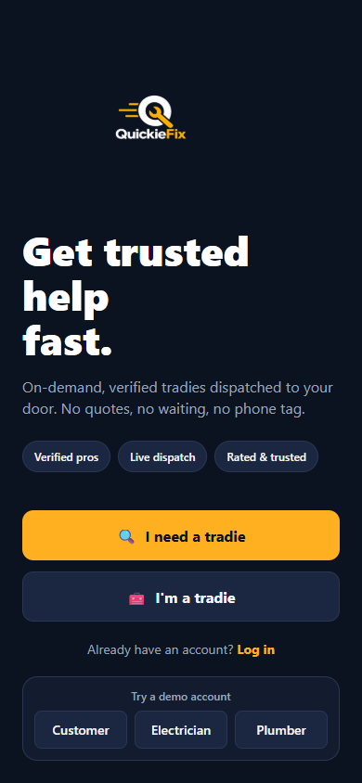
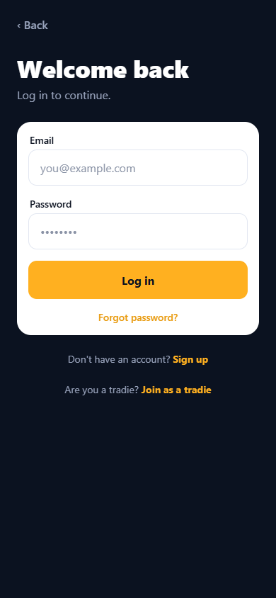
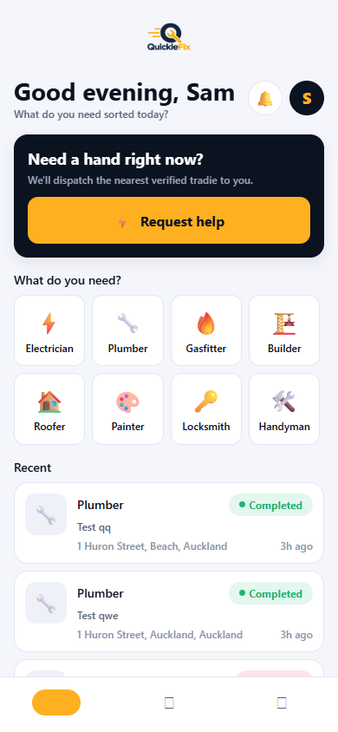
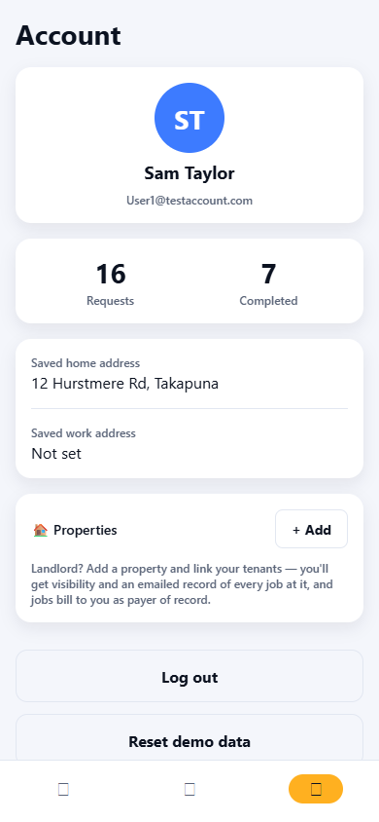
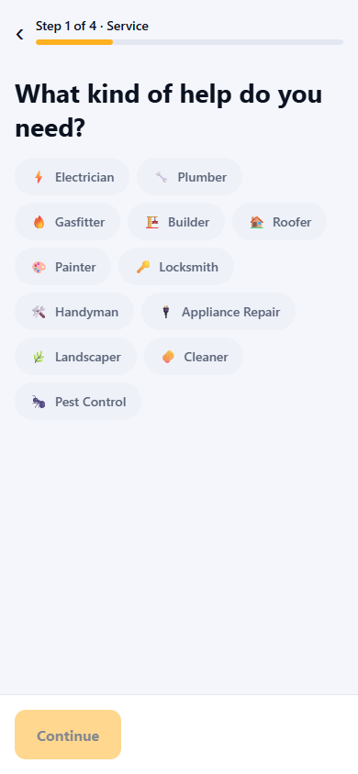
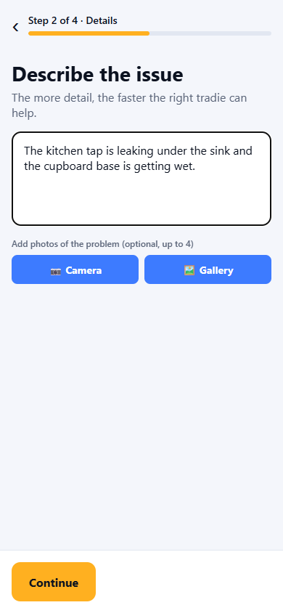
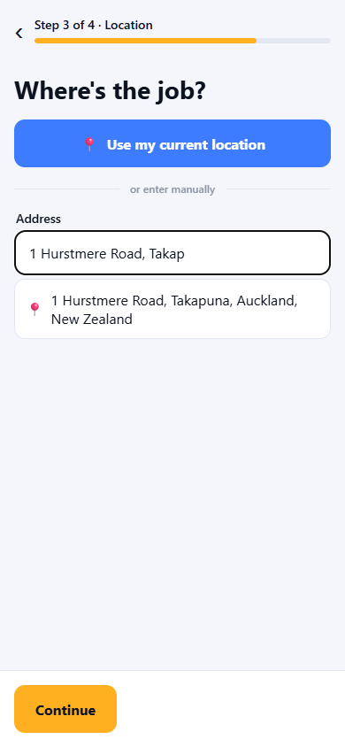
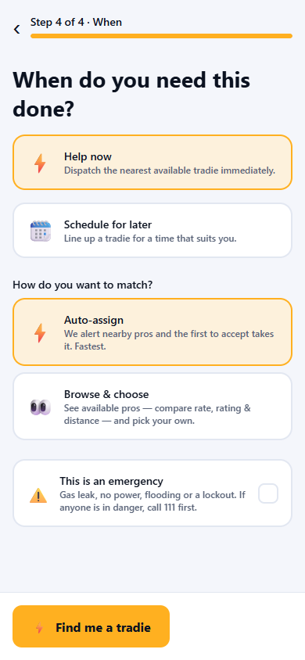
SCOPE
What I looked at
10 screens, 3 surfaces
Welcome & login · customer home & account · the four-step new-job flow · the company dashboard & My Tradies portal.
Two lenses, by request
Visual / UI
Conversion
MVP-appropriate
Recommendations are ranked by leverage — what earns trust and bookings first, not a full polish pass.
Notes:
Ten screens across three surfaces. I was asked to focus on visual/UI design and conversion. This is an MVP read, so recommendations are weighted toward highest leverage, not exhaustive polish.

Slide 3
EXECUTIVE SUMMARY
Three things to know
01
02
03
The bones are solid
Small bugs leak trust
The promise isn't in the flow
A clear four-step flow, sensible defaults, and honest empty states. The structure is right — this is a polish and emphasis problem, not a rebuild.
Invisible nav icons, two accent colours fighting, and emoji standing in for an icon set all read as "unfinished" to a first-time user deciding whether to trust you.
"Minutes, priced upfront, verified" is the whole pitch — but ETA, price and trust never appear on the screens where users decide to book.
Notes:
Three-sentence version. The bones are good. But small visual bugs are quietly leaking trust, and the core promise — fast, priced upfront — never shows up in the flow where people decide to commit.

Slide 4
PART ONE
Visual & UI
Four fixes that make the app look as trustworthy as the service behind it.
Notes:
First lens: visual and UI. Four issues, roughly in order of how much they hurt.

Slide 5
High impact · Quick win
The bottom nav is invisible
The tab bar renders as blank squares — no glyphs, no labels — on both home and account. Even the active (amber) tab has nothing in it. A user can't tell where they are or how to get back.
Do this
Ship real icons with text labels — Home · Activity · Account.
Label the active tab; an amber pill with no icon reads as broken, not selected.
Guarantee a fallback glyph so a missing asset never renders an empty box.
Notes:
The bottom tab bar renders as blank squares with no labels on both home and account. Users literally cannot tell the tabs apart. Highest-priority, lowest-effort fix.

Slide 6
High impact · Quick win
Two accent colours are fighting
Amber owns your primary actions — but a saturated blue appears on Use my current location, Camera and Gallery . Two loud accents on one screen split attention and weaken the brand.
Brand amber
Stray blue
Do this
One primary colour: amber for the action that moves the flow forward.
Make supporting actions neutral — outlined or grey, not a second brand colour.
Reserve blue, if at all, for informational links only.
Notes:
Amber is the brand, but bright blue shows up on Use current location, Camera and Gallery. Two saturated accents compete for the eye and dilute the brand. Pick amber for primary; make supporting actions neutral.

Slide 7
Medium impact
Emoji are doing an icon's job
The home grid uses large colour emoji; step 1 uses the same emoji shrunk into grey pills. Emoji render differently on every Android device, don't match your brand, and quietly signal "placeholder."
Do this
Commission one trade icon set — a consistent line or duotone style.
Use the same icon for a trade everywhere it appears, at one visual weight.
Bonus: a small licence/verified mark on each becomes a reusable trust cue.
Notes:
Home uses big colour emoji tiles; step 1 uses tiny emoji in grey pills. Emoji render differently on every Android device and read as placeholder. Adopt one custom icon set used consistently.

Slide 8
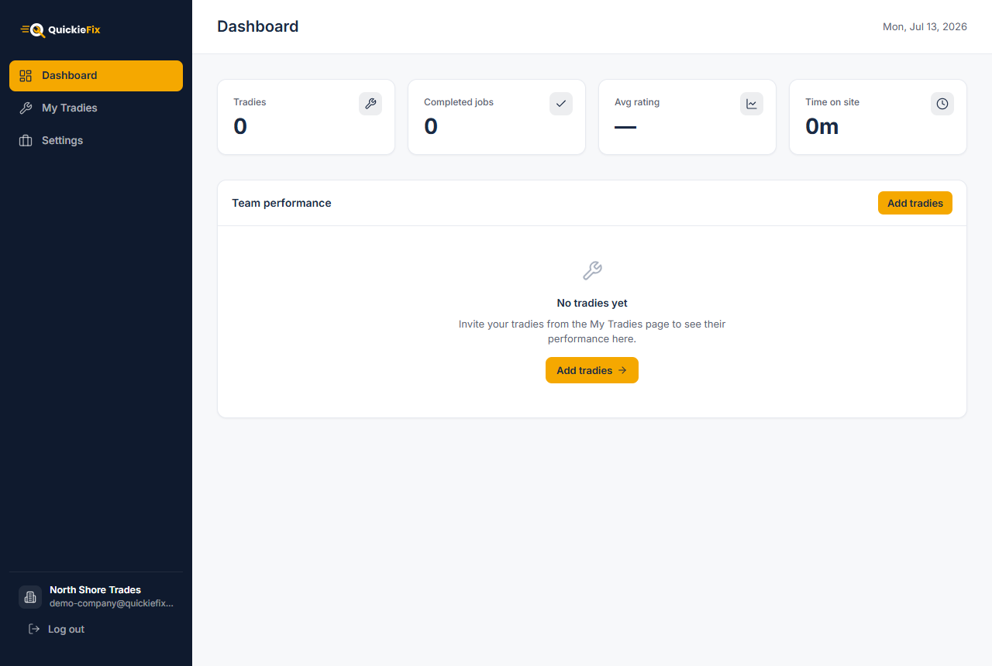
Medium impact · Quick win
Small states send big signals
Disabled reads as broken
Zeros feel like a dead app
The faded-amber Continue before a selection looks like a bug, not a "not yet." Use a clearly-inactive grey, and let the button explain what's missing — "Pick a trade to continue."
A new company portal opens on four bold zeros and a blank dash. First impression: nothing works. Replace cold metrics with a setup state — see the conversion section.
Notes:
Two small state problems. The disabled Continue is a washed-out amber that looks broken rather than not-yet-ready. And a brand-new company lands on four bold zeros, which reads as a dead product.

Slide 9
PART TWO
Conversion
Five moments where a hesitating user needs a reason to keep going.
Notes:
Second lens: conversion. Where users hesitate, and what to surface so they book.

Slide 10
Biggest lever
Put the promise in the flow
Nearby now
Your whole pitch is fast, verified, priced upfront . Yet a user reaches Find me a tradie without seeing a single ETA, rate, or how many pros are nearby. You're asking for a blind commit.
12 verified plumbers
Arrives in
Call-out from
~8 min
$89
Do this
Show live availability early: "12 verified plumbers near you."
On the final step, preview ~ETA and a from-price before commit.
Find me a tradie · ~8 min
Make the CTA carry it: "Find me a tradie · ~8 min away."
Notes:
The single biggest lever. Your pitch is minutes, verified, priced upfront — but ETA, price and availability never appear before Find me a tradie. Surface them and you convert on the promise instead of asking for blind faith.

Slide 11
High impact
Lower the bar to get in
An urgent "my tap is flooding" user hits a cold email-and-password wall. The demo accounts are a nice touch, but real first-timers face maximum friction at the worst moment.
Do this
Add phone-number OTP — the NZ consumer default, one tap on Android.
Let users describe the job first , create the account only once they've seen matches.
Keep password as a fallback, not the front door.
Notes:
On-demand urgency but a cold email/password wall. NZ consumers expect phone OTP. Also consider letting people describe the job first and only create the account once they've seen matches — defer the commitment.

Slide 12
High impact
Carry trust through the request
Verified pros · Rated & trusted lives on the welcome screen — then vanishes for all four steps where the user is deciding to let a stranger into their home. Trust needs reinforcing exactly there.
Do this
Show a licence / verified badge and rating on every matched tradie.
On Browse & choose , lead with rating and jobs completed, not just rate.
Reassure at match time: "Police-checked · Licensed · Tracked to your door."
Notes:
Verified, rated, licensed is promised on the welcome screen then disappears for the four steps where the user is actually deciding to let a stranger into their home. Reinforce trust in-flow.

Slide 13
Medium impact · Safety
Make timing & emergency unmissable
Step 4 stacks two separate decisions — when and how to match — and hides a safety-critical emergency toggle as the last checkbox. In a real emergency, that's the wrong place for it.
Do this
Split "when" and "matching" into two clean decisions.
Surface emergency guidance early, with a prominent call 111 prompt.
Make the danger path visually distinct — not a quiet checkbox.
Notes:
Step 4 crams two decisions — when (now vs later) and how to match — plus a critical emergency checkbox that's easy to miss. Separate the decisions and make emergency unmissable with 111 guidance.

Slide 14
High impact · Portal
Replace empty with onboarding
Get North Shore Trades live
A trade company signs up and lands on four zeros and an empty chart. There's no path to value. The activation moment is clear — add tradies, set a rate card, get the first job — so make the dashboard walk them there.
✓
Create company account
2
Add your first tradie →
3
Set your rate card
Do this
Show a setup checklist until the first metrics exist.
One primary next action per state — don't scatter two "Add tradies" buttons.
Celebrate the first completed job; that's the retention hook.
4
Land your first job
Notes:
A company signs up and sees empty zeros. The activation moment is adding tradies and setting a rate card. Turn the dashboard into a setup checklist that pulls them to first value.

Slide 15
PART THREE
Mockups
Three of the fixes made concrete, in your own brand. Concept renders to show direction — not final artwork.
Notes:
Three of the recommendations, mocked up. These are quick concept renders in your brand, not final designs — meant to make the direction concrete.

Slide 16
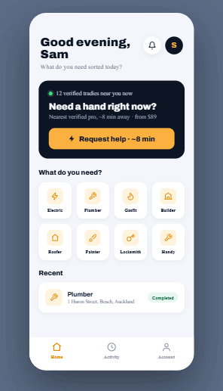
MOCKUP · CUSTOMER HOME
Icons, one accent, a real nav bar
AFTER
BEFORE
One consistent line-icon set replaces mixed emoji.
Amber only — the stray blue is gone.
Bottom nav has real icons and labels.
Live proof up top: 12 verified · ~8 min · from $89.
Notes:
Home, reworked. Real line-icon set at one weight, amber-only, a visible labelled nav bar, and the promise — 12 verified nearby, ~8 min, from 89 dollars — pulled up top where it drives the tap.

Slide 17
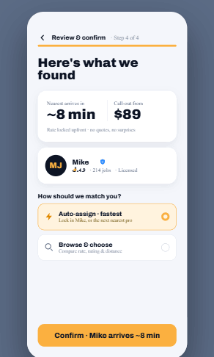
MOCKUP · CONFIRM STEP
Show ETA, price & trust before commit
AFTER
BEFORE
~8 min ETA and a from-price shown before commit.
The matched pro's rating, jobs done & licence badge.
"Rate locked upfront — no quotes, no surprises."
CTA carries it: Confirm · Mike arrives ~8 min.
Notes:
The final step. Before committing, the user sees ETA, a from-price, and the actual matched tradie with rating, jobs done and a licence badge. The CTA restates the promise: Confirm, Mike arrives in about 8 minutes.

Slide 18
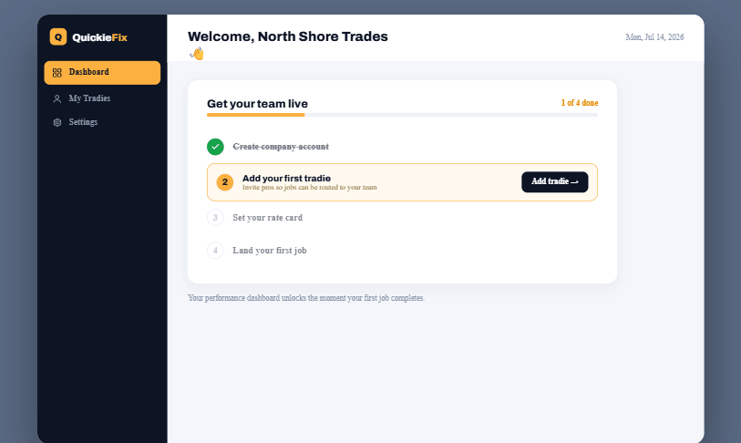
MOCKUP · COMPANY PORTAL
Empty zeros → a path to first value
BEFORE
AFTER
Setup checklist replaces four dead zeros.
One primary action: Add your first tradie.
Dashboard unlocks on first completed job.
Notes:
The portal first-run. Instead of four cold zeros, a company sees a setup checklist with one clear next action — add your first tradie — and a promise that the dashboard unlocks on first completed job.

Slide 19
WHAT TO DO FIRST
Priority roadmap
This week
This quarter
Ongoing
Quick wins · low effort
High-impact bets
Polish & system
Fix nav icons + labels
Unify on amber; drop stray blue
Fix disabled-button state
ETA + price before commit
Phone-OTP sign-in
Portal setup checklist
Trust badges in the flow
Custom trade icon set
Split timing & emergency UX
Consistent spacing scale
Notes:
Sequenced by leverage. Do the quick wins this week, they cost almost nothing and stop the trust leak. Then the high-impact bets that convert on the promise. The rest is ongoing polish.

Slide 20
THE TAKEAWAY
A good product that looks unfinished — and hides its best line.
Close the visual leaks, then put "fast, verified, priced upfront" on the screens where people decide. Same app, far better conversion.
Happy to mock up any of these fixes as clickable Android screens — just say which.
Notes:
The takeaway: the product works, but it looks unfinished and hides its best selling points. Fix the visual leaks, put the promise in the flow, and the same app will convert far better. Happy to mock any of these up.

