Slide 1
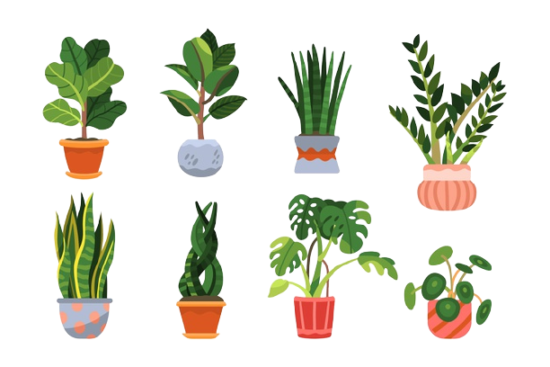

Agro’N’AI

Slide 2

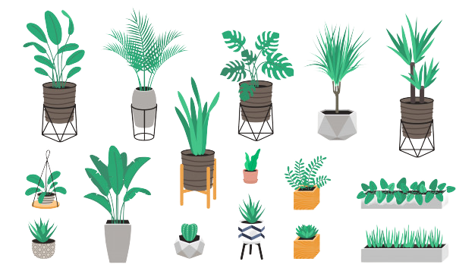
Contents
Contents
INTRODUCTION
LITERATURE
METHODOLOGY
CONCLUSIONS
FUTURE OUTLOOK

Slide 3


INTRODUCTION
AT AGRO’N’AI
OUR MAIN GOAL OF ACHEVEMENT IS TO CARE TO SUSTAIN MANAGEMENT
THE MAIN DIFFERENCE IS THE SERVICE THAT WILL BE BOUGHT.

Slide 4


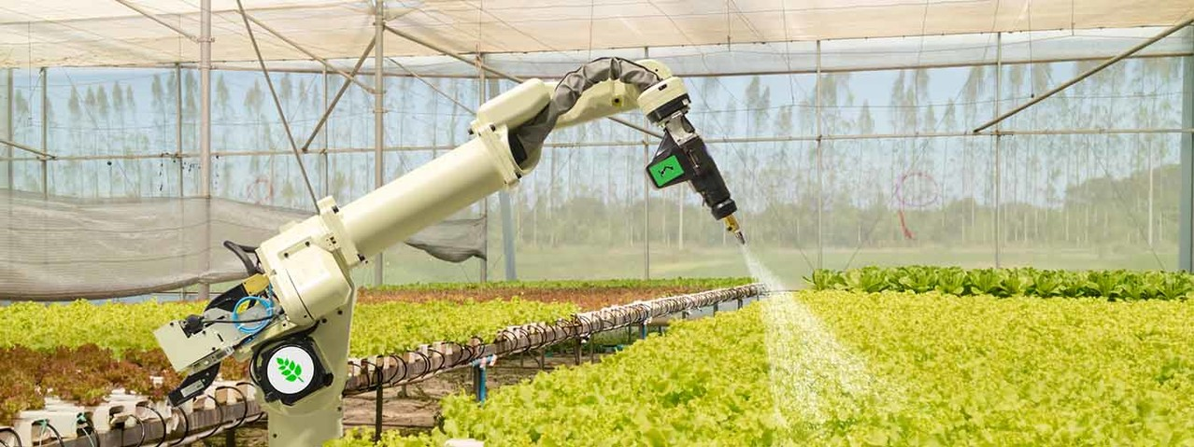
LITERATURE
“FARMING IS NOT MY CUP OF TEA”
FARMING WHICH IS A THOUGHT TO BE A VERY HARD JOB IS NOW MADE EASY AS WE MAKE IT INTERESTING BY NEW UPCOMING TECHNOLOGIES OF THE FARMERS
IN THE COMING YEARS IT WILL B EESSENTIAL TO INCREASE THE CROP PRODUCTIVITY IN DEVELOPING COINTRIES AND FINDING VIABLE SOLUTIONSTO RESEARCH,AGRICULTURAL EXTENSION,RURAL NON FARM EMPLOYEMENT .
THE DETERMINANTS OF GREEN REVOLUTION,ISSUES OF INCOME DIVERSIFICATION BY FARMERS GIVES PROMINANCE TO RURAL DEVELOPMENT
FINALLY INTERNATIONAL TRADE POLICY AND FOOD SECURITY
WHICH ARE AT THE ROOTS OF CRISIS IN AGRICULTURAL COMMODITY IN THE PAST FEW YEARS

Slide 5
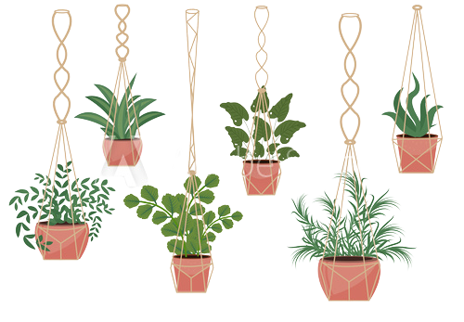
EXISTING RESEARCHES
At present in India, Microsoft Corporation is working in the state of Andhra Pradesh with 175 farmers rendering services and solutions for land preparation, sowing, addition of fertilizers and other nutrient supplements for crop. On an average, a 30% increase in crop yield per HA has already been witnessed in comparison to the previous harvests.
- The hardware solutions like Rowbot (concerning to crops like corn) has already begun pairing software that collect data with robotics to develop the best fertilizer for the cultivation of corns
- Commercial drones makers like Aerialtronics have enforced IBM Watson IoT Platform and the Visual Recognition APIs for eal time image analysis.
- Images of various crops captured under white light and UVA light are to check how ripe the green fruits are.
- Remote sensing (RS) techniques along with hyper spectral imaging and 3D laser scanning are crucial to construct crop metrics over thousands of acres of cultivableland.

Slide 6


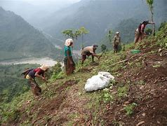
DRAWBACKS
THE MAIN DRAWBACK IN THE INDIAN AGRICULTURAL SYSTEM IS PROPER GUIDANCE AND INSUFECCIENT KNOWLEDGE
THE MAIN PROBLEMS MAY BE FACED DUE TO
TRADITIONAL APPROACH
LAND LIMITATIONS
HIGH PRICES
LACK OF EDUCATION AND QUALIFICATION

Slide 7
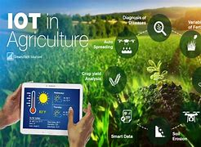
METHODOLOGY
SOPHISICATED IOT
INFO COLLECTION
COLLECTED INFORMATION IS FED INTO DEVICE
DAILY INFORMATION IS COLLECTED AND SENT IT TO MAIN CENTER
THE RECIEVED INFO IS MANIPULATED ACCORDINGLY
THE DATA IS SENT TO THE FARMERS ON DAILY OR WEEKLY BASIS

Slide 8
Conclusions
After many years of continuous growth and technification in agriculture, with more efficient companies, the two main concerns of the sector are focused on production and quality. This is due to the appearance of factors and concerns such as population growth, climate change, and food security. Therefore, the future of the sector involves advances in the application of technology developed in various fields such as computer vision, Big Data, and AI, which engender the development of multiple companies dedicated to precision agriculture
As said above AGRO’n’AI focuses on sustainable farming where technology with the blend of know how’s of farmers and research organizations brings a change in the farming industry will aimed to be brought in the near future.

Slide 9
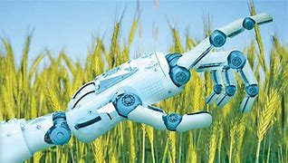
FUTURE OUTLOOK
The global AI in agriculture market size is anticipated to reach at USD 186 billion by 2025. The extended usage of big data, and machine learning technology, along with artificial intelligence and probabilistic logic has paved the way for a greater development of AI in agriculture industry past few years.
AI systems are helping to improve the overall harvest quality and accuracy – known as precision agriculture. AI technology helps in detecting disease in plants, pests and poor nutrition of farms. AI sensors can detect and target weeds and then decide which herbicide to apply within the region.
I

Slide 10
Thank You Everyone!
BY-
ROHAN D
PRAJWAL K
SUHAS KASHYAP
CHANDRU

