Slide 1
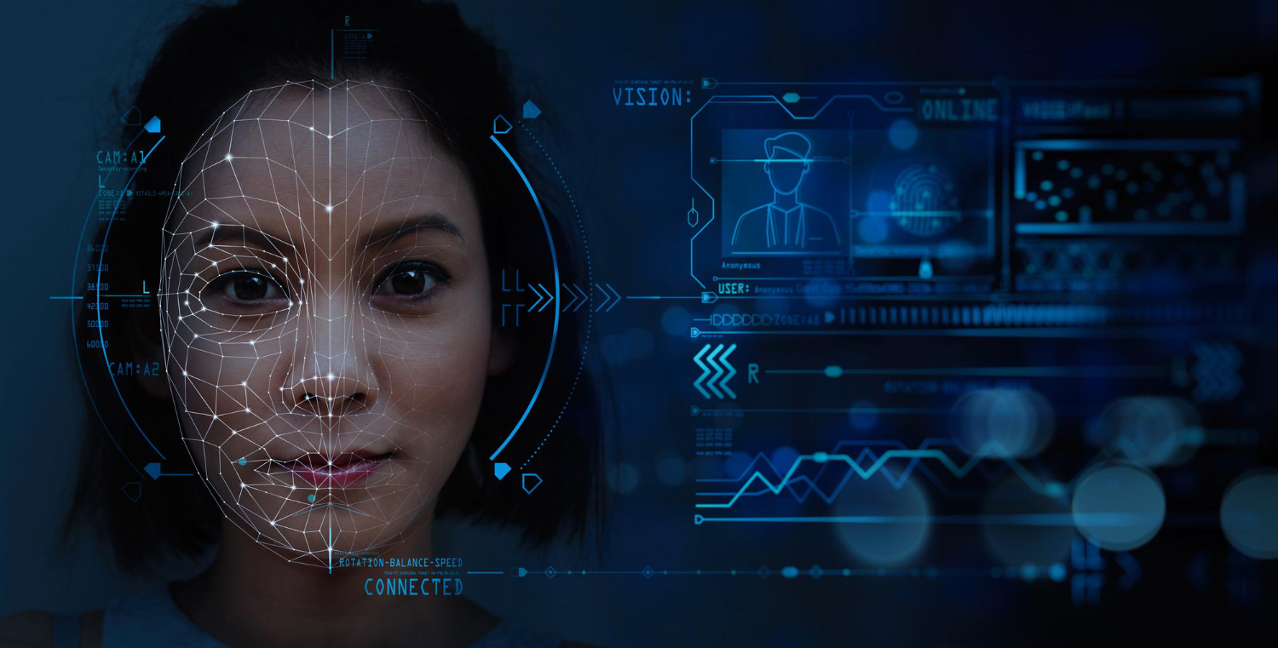
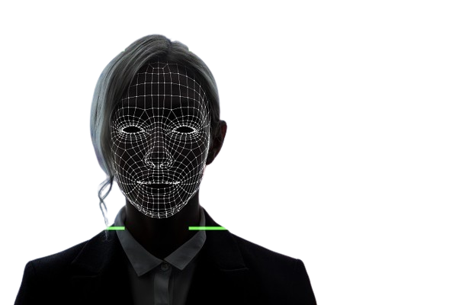

FACE RECODNITION BASED ATTENDANCE SYSTEM
CONTENT

Slide 2
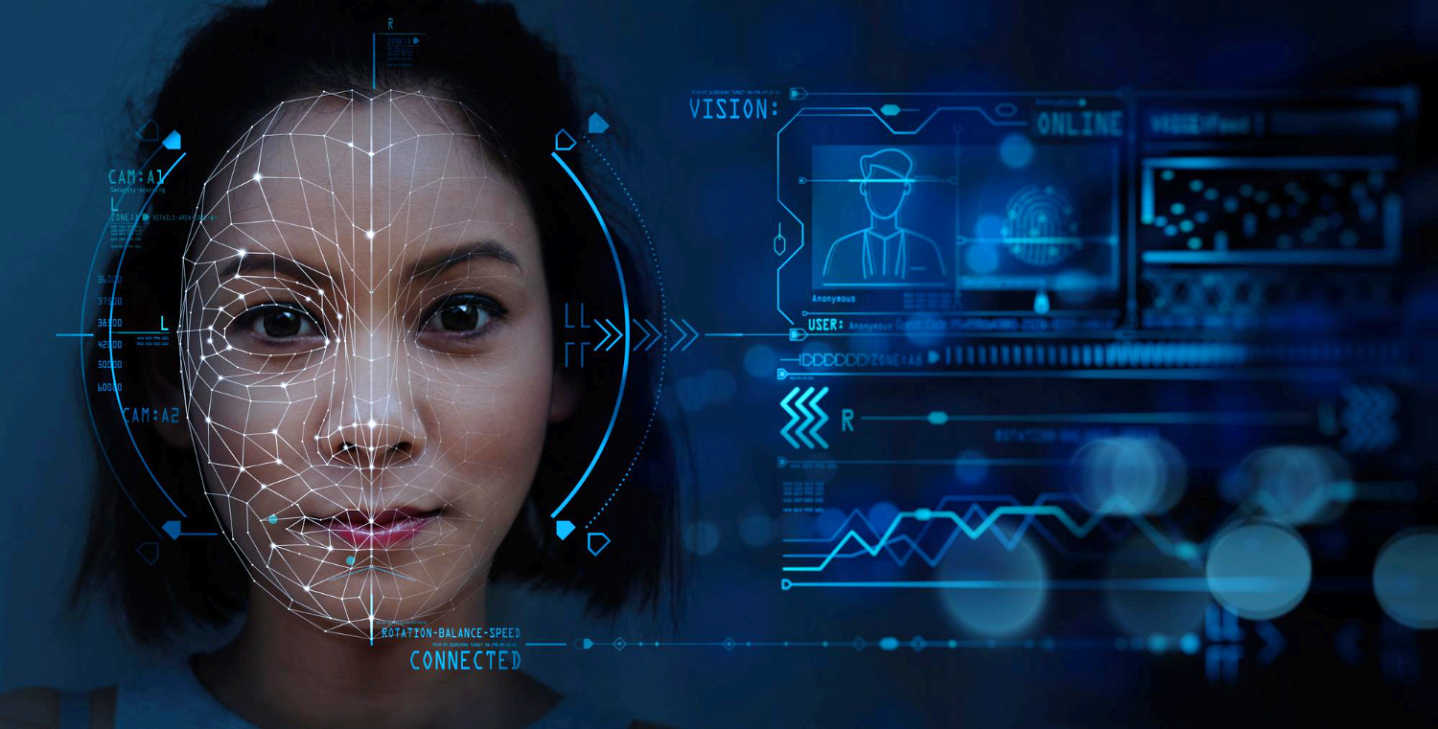


FACE RECODNITION BASED ATTENDANCE SYSTEM
CONTENT
Introduction
Objective
Requirements Tools
Features
Methodology
Flowchart
Snapshots
Conclusion

Slide 3
FACE RECODNITION BASED ATTENDANCE SYSTEM
CONTENT
Introduction
Attendance is prime important for both the teacher and student of an educational organization. So it is very important to keep record of the attendance. The problem arises when we think about the traditional process of taking attendance in class room.
Traditional ways of taking attendance is not only a problem of time consumption but also it needs energy, so an automatic attendance system can solve all above problems.
Currently available automatic attendance systems are :
biometric technique
RFID system
Although it is automatic and a step ahead of traditional method it fails to meet the time constraint. The student has to wait in queue for giving attendance, which is time taking.
This project introduces an involuntary attendance marking system.
The system can be also implemented during exam sessions or in other teaching activities where attendance is highly essential.
This system eliminates classical student identification such as calling name of the student, or checking respective identification cards of the student, which can not only interfere with the ongoing teaching process, but also can be stressful for students during examination sessions.
Objective
Requirements Tools
Features
Block Diagram
Flowchart
Snapshots
Conclusion

Slide 4






FACE RECODNITION BASED ATTENDANCE SYSTEM
CONTENT
Introduction
Objective
HARDWARE
Face recognition Attendance System is developed to facilitate:
To maintain attendance records.
Easier and convenient method than taking attendance manually in classroom.
Using facial recognition technology to identify the person’s facial features and automatically mark attendance.
Less time consuming.
Verry fast than previous methods.
Requirements Tools
Computer(Ryzen 7, 16gb)
Features
Camera
Block Diagram
Flowchart
Snapshots
SSD- 1TB
Conclusion
SOFTWARE
Windows 10
Python, HTML
Visual Studio Code

Slide 5




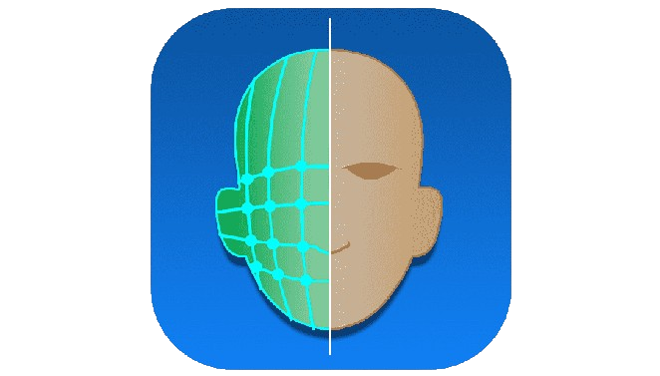

FACE RECODNITION BASED ATTENDANCE SYSTEM
Objective
CONTENT
Introduction
Requirements Tools
Features
HARDWARE
SOFTWARE
Computer(Ryzen 7, 16gb)
Windows 10
Block Diagram
Camera
Python, HTML
Flowchart
Snapshots
SSD- 1TB
Visual Studio Code
Conclusion
True
Camera
Attendance Marked
False
Student
Face Recognition
Unknown Face

Slide 6
SOFTWARE
Windows 10
Requirements Tools
FACE RECODNITION BASED ATTENDANCE SYSTEM
Python, HTML
Objective
CONTENT
Introduction
Visual Studio Code
Features
Facial Enrollment: The system should allow administrators to enroll Students by capturing and storing facial images. This is usually done during the initial setup.
Face Detection: Accurate face detection algorithms are crucial for identifying and isolating facial features in an image or video frame.
Feature Extraction: Extracting unique facial features from the detected face, such as the distance between eyes, nose shape, etc., to create a facial template for comparison.
Matching Algorithm: Utilizes advanced matching algorithms to compare the captured facial features with the stored templates and determine a match.
Real-time Recognition: Capable of performing facial recognition in real-time to ensure timely attendance tracking.
User Management: A user-friendly interface for administrators to manage and update user profiles, access logs, and attendance records.
Attendance Tracking: Recording and storing attendance data, including timestamps, for future analysis and reporting.
Methodology
Block Diagram
Flowchart
Snapshots
Conclusion
HARDWARE
Computer(Ryzen 7, 16gb)
True
Camera
Attendance Marked
Camera
False
Student
SSD- 1TB
Face Recognition
Unknown Face

Slide 7
SOFTWARE
Windows 10
Python, HTML
FACE RECODNITION BASED ATTENDANCE SYSTEM
Visual Studio Code
Objective
CONTENT
Introduction
Features
Requirements Tools
Methodology
Block Diagram
Flowchart
True
Camera
Attendance Marked
False
Student
Face Recognition
Snapshots
Unknown Face
Conclusion
HARDWARE
Computer(Ryzen 7, 16gb)
Camera
SSD- 1TB

Slide 8
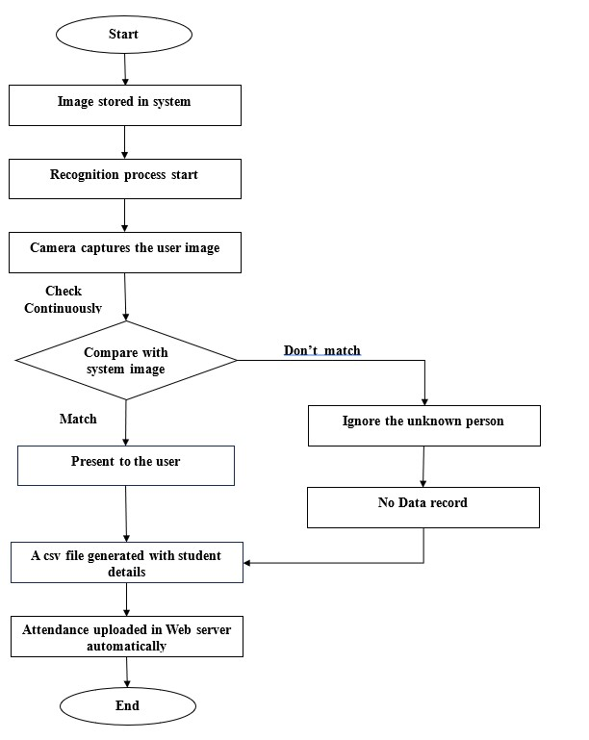
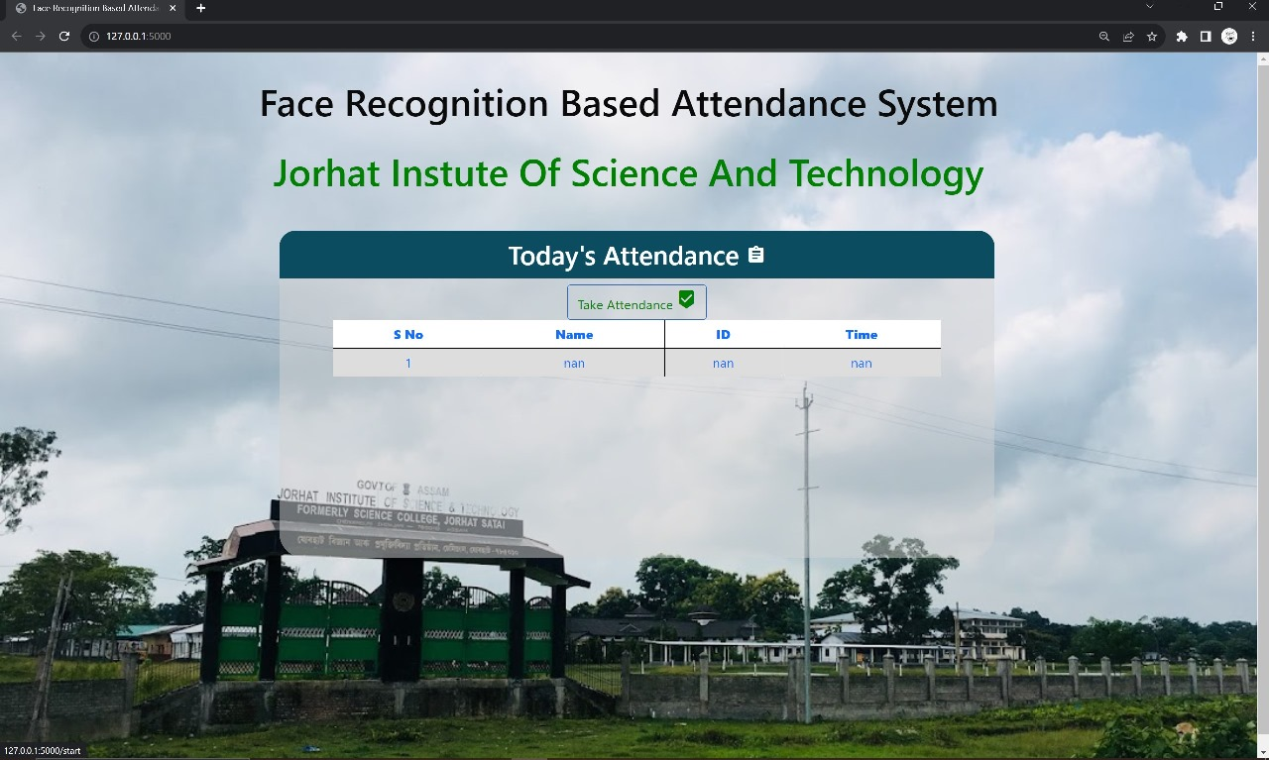
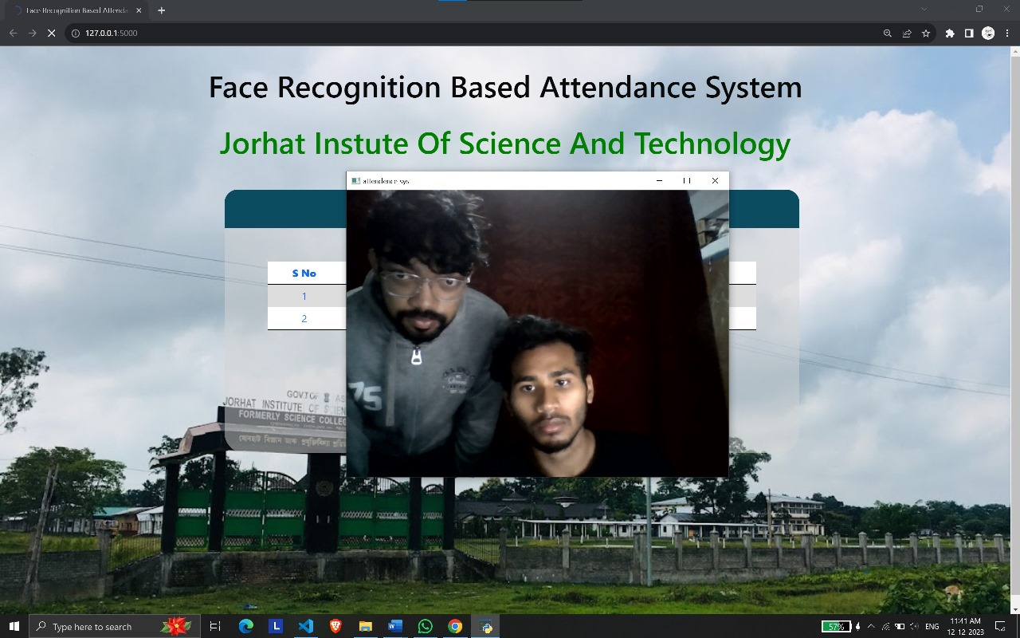
SOFTWARE
Windows 10
Python, HTML
FACE RECODNITION BASED ATTENDANCE SYSTEM
Visual Studio Code
Objective
CONTENT
Introduction
Methodology
Working Process
Requirements Tools
Flowchart
Block Diagram
Snapshots
Conclusion
HARDWARE
Computer(Ryzen 7, 16gb)
True
Camera
Attendance Marked
Camera
False
Student
SSD- 1TB
Face Recognition
Unknown Face

Slide 9
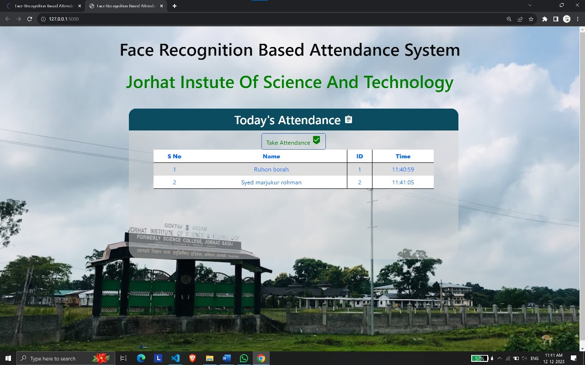
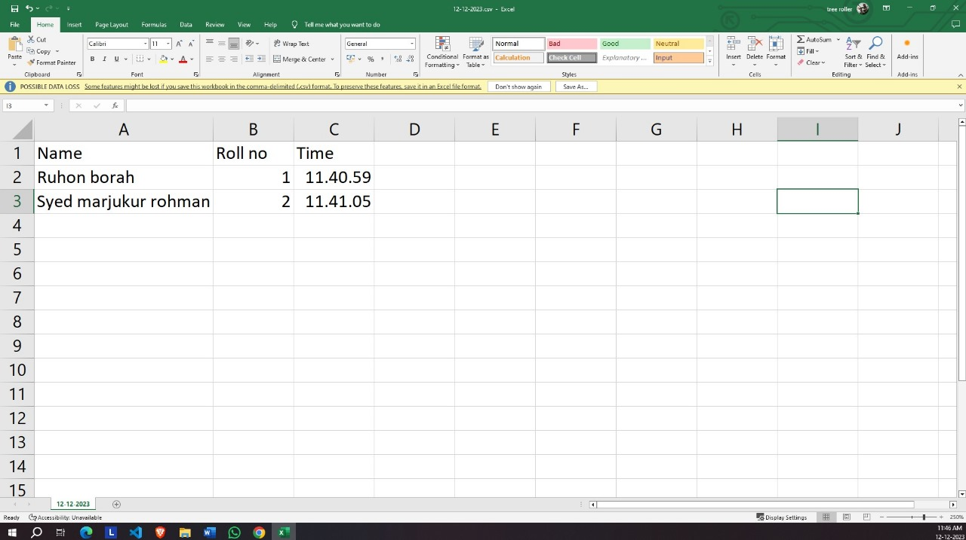
SOFTWARE
Windows 10
Python, HTML
FACE RECODNITION BASED ATTENDANCE SYSTEM
Visual Studio Code
Objective
CONTENT
Introduction
Methodology
Working Process
Flowchart
Requirements Tools
Block Diagram
Snapshots
Conclusion
Taking Video feed
Before attendance
HARDWARE
Computer(Ryzen 7, 16gb)
True
Camera
Camera
Attendance Marked
False
Student
SSD- 1TB
Face Recognition
Unknown Face

Slide 10
SOFTWARE
Windows 10
Python, HTML
FACE RECODNITION BASED ATTENDANCE SYSTEM
Visual Studio Code
Objective
CONTENT
Introduction
Methodology
Working Process
Flowchart
Requirements Tools
Block Diagram
Snapshots
Conclusion
Created CSV file
Attendance marked
HARDWARE
Computer(Ryzen 7, 16gb)
True
Camera
Attendance Marked
Camera
False
Student
Face Recognition
SSD- 1TB
Unknown Face

Slide 11
SOFTWARE
Windows 10
Python, HTML
FACE RECODNITION BASED ATTENDANCE SYSTEM
Visual Studio Code
Objective
CONTENT
Introduction
Snapshots
Methodology
Working Process
Flowchart
Requirements Tools
Block Diagram
Conclusion
offers a modern and efficient solution for tracking attendance in various settings, including schools, businesses, and organizations.
The Automated Classroom Attendance System helps to increase accuracy and speed
Face recognition attendance systems’ appeal is enhanced further by their fast image processing time and ease of integration.
Despite its numerous benefits, it is essential to acknowledge and address potential challenges associated with privacy concerns and ethical considerations.
If your school or college is still using a manual or fingerprint biometric attendance system, it’s time to switch to a facial recognition attendance system.
HARDWARE
Computer(Ryzen 7, 16gb)
True
Camera
Attendance Marked
Camera
False
Student
Face Recognition
SSD- 1TB
Unknown Face

Slide 12
SOFTWARE
Windows 10
Python, HTML
FACE RECODNITION BASED ATTENDANCE SYSTEM
Visual Studio Code
Objective
CONTENT
Introduction
Snapshots
Methodology
Working Process
Flowchart
Requirements Tools
Conclusion
Block Diagram
THANK YOU
HARDWARE
True
Camera
Attendance Marked
Computer(Ryzen 7, 16gb)
False
Student
Face Recognition
Unknown Face
Camera
SSD- 1TB

