Slide 1
Generative or Discriminative?
Revisiting Text Classification in the Era of Transformers
Kasa et al. (Amazon) · EMNLP 2025, Outstanding Paper
CS F429 Paper Presentation · Paper #13 · Group 13
ENC
MLM
AR
AR_pseudo
DIFF
Notes:
Paper #13. The question: when we build a text classifier from a transformer trained from scratch, should it model the label given the text (discriminative) or the text and label together (generative)? Five model families, colour-coded the same way throughout the deck.

Slide 2
Does the classic “two regimes” rule survive transformers?
Generative
Models the text and the label together:
P(X, y) = P(X | y) · P(y)
Classic example: Naive Bayes
Learns fast from few examples
But a higher error once data is plentiful
Discriminative
Models only the label given the text:
P(y | X)
Classic example: logistic regression
Needs more data to get going
But a lower error in the end
Known so far: Ng & Jordan (2001) proved this trade-off for linear models; Yogatama et al. (2017) saw it with LSTMs. Open: does it hold for modern transformer classifiers, and does it depend on model size?
Notes:
Link to the course: Naive Bayes vs logistic regression is the same split. AR in this paper is a neural Naive Bayes: it scores P(X|y)P(y). ENC is the neural logistic regression: a learned feature extractor plus a softmax over labels.

Slide 3
Five ways to turn a transformer into a classifier
Model | What the model sees | Trained to | How it predicts | Passes
ENC | [CLS] text | predict y (cross-entropy) | linear head on [CLS] | 1
MLM | [CLS] text [SEP] The label is y | fill in 15% masked tokens | fill [MASK] in the label slot, label tokens only | 1
AR | y text | predict every next token | pick y with the highest log P(text | y) | one per label
AR_pseudo | text y | predict every next token | next token after the text, label tokens only | 1
DIFF | text [SEP] The label is y | undo random masking (discrete diffusion, SEDD) | denoise the label slot | many steps
Discriminative: ENC. Generative: AR, DIFF. “Pseudo-generative”: MLM and AR_pseudo, which learn a likelihood but read the label off as one prediction.
Notes:
AR is the only true P(X|y) model: it needs one forward pass per label, so cost grows with the number of classes. AR_pseudo puts the label after the text, so it really learns P(y|X) as a next-token prediction: one pass, but not a model of the text given the label. MLM is pseudo-generative because masked-token prediction approximates a pseudo-likelihood (Wang & Cho 2019). DIFF masks the label slot and denoises it.

Slide 4
Why might generative models need fewer examples?
1
More training signal per example
ENC gets one target per example (the label). AR and MLM also predict the text tokens, so one example gives dozens of training targets.
2
Learning the text works like built-in pretraining
Modelling P(X) alongside the label acts as a data-dependent regulariser (Erhan et al., 2010). The paper uses this to explain MLM's strength at high data.
3
But capacity is shared
Modelling the text competes with modelling the label. A small model cannot do both well, so the generative advantage should depend on model size.
4
Calibration should favour ENC
ENC's loss targets P(y | X) directly. The others optimise token likelihoods, so their label probabilities need not be calibrated.
Notes:
This is the 'why it works' part of the rubric. Point 3 is the paper's multi-task argument (Section 2): log P(X, y) = log P(X) + log P(y|X), two tasks sharing one network. Point 4 is from Appendix A: all losses are proper scoring rules, but only ENC's is aligned with the classification task.

Slide 5
The study: 2,835 training runs, all from scratch
5
9
7
3
3
models
datasets (AG News, SST-2, SST-5, IMDb, ...)
training sizes, 128 up to the full set
depths: 1, 6 and 12 layers
random seeds
5 × 9 × 7 × 3 × 3 = 2,835 runs
What they measure
Accuracy: weighted-F1 at every size and depth (Q1)
Robustness: randomly drop or substitute X% of tokens; report the noise level that costs 5%, 10%, ... of F1 (Q2)
Reliability: calibration (ECE, MCE) and ordinality (MAE, MSE, unimodality) of the predicted probabilities (Q3)
Notes:
Training from scratch is deliberate: it removes the effect of pretraining data, so differences come from the modelling approach and size. Section 5.1 adds a pretrained check (BERT vs GPT-2).

Slide 6
Main finding: which approach wins depends on model size
1 layer
6 layers
12 layers
ENC
DIFF
AR
MLM
Only ENC keeps improving with data and wins at high data. No two regimes.
DIFF is best with little data; ENC overtakes it as data grows. The classic two regimes hold.
AR and DIFF win with little data, the gap shrinks with data, and MLM is best at high data.
Also: AR_pseudo is below AR with little data (and noisier). With pretrained models (BERT vs GPT-2), ENC wins at every size: pretraining removes the two-regimes effect.
Notes:
This is the core contribution: the generative/discriminative trade-off is not one rule; it depends on architecture and depth. The 1-layer result is the practical one: small, fast models should be ENC.

Slide 7
Robustness and calibration in the paper
Robustness
Substituting tokens hurts every model more than dropping them
DIFF is the most robust; 12-layer MLM is the least robust to dropping
AR is sensitive to noise
Calibration
ENC is well calibrated at every size
MLM is only as good once data is plentiful
DIFF gives no usable probabilities, so it has no ECE
Source: paper, Table 2 (random token dropping).
Notes:
Their robustness metric is the minimum noise level that degrades F1 by a given percentage relative to the model's peak, averaged over datasets, at full data, for 6 and 12 layers. Ours (later) is a single 30% level at n = 2,048: not the same measurement.

Slide 8
The paper's practical advice
ENC
Fast inference needed
MLM
Plenty of labelled data, offline
Small 1-layer ENC: efficient, robust to noise, well-calibrated and ordinal outputs.
12-layer MLM: best F1, calibration and ordinality. Careful with noisy input.
DIFF
Little labelled data
AR
Calibrated probabilities needed
AR or DIFF. DIFF is more robust to noise and strongest at 6 layers, but slow at inference (20 to 100 times ENC).
Among generative models, AR: better calibrated than AR_pseudo in 7 of 9 datasets at low data.
Notes:
Section 6 and Table 1 of the paper.

Slide 9
Limitations the paper does not state
1. Checkpoints chosen on the test set
In the released code, ENC, MLM and AR are validated on the test split (their comment: “for illustration purposes only”). If the paper's runs did the same, scores are optimistic.
2. Unequal training budgets
Appendix B: ENC 30 epochs, MLM 200, AR up to 100. The code sets 200, 200 and 500. Gaps may partly reflect training budget, not the approach.
3. Paper text and code disagree
MLM template (“The label is” vs “Label:”) and AR scoring (log P(X | y) vs mean loss over label and text, which adds a learned class prior).
4. No significance tests
Three seeds and shaded standard deviations only. Many curves overlap, so several “wins” may be within noise.
5. Narrow evaluation data
Short English texts, mostly sentiment. SST-2 is scored on its 872-sentence dev set. Noise is synthetic, at full data only.
6. Gaps in the comparison
DIFF, recommended for low data, has no calibration numbers. The pretrained check covers only ENC vs AR.
Notes:
Items 1 to 3 come from reading the released code (github.com/amazon-science/Generative-vs-Discriminative-Classifiers; files encoder_mlm/mlm_classif_seed_fixed.py, ar/train_gpt.py, ar_pseudo/train_gpt.py). Say 'the released code does X'; we cannot know whether the paper's numbers were produced by exactly this code.

Slide 10
Open problems and future work
1
Compute-matched comparison
Give every model the same training budget and tuning, then re-ask the question.
2
Real shifts, real noise
Distribution shift, typos and OCR errors instead of random token edits.
3
Pretrained MLM and diffusion classifiers
Does MLM still win at high data when it starts from pretrained weights?
4
Fix AR_pseudo's weak label signal
The label is one token out of dozens in its loss; up-weighting it is a one-line change.
5
Hybrid models and theory
Generative and discriminative heads on one backbone; an explanation for why depth flips the result.

Slide 11
Our reproduction
Four classifiers, one small transformer, trained from scratch on CPU

Slide 12
What we built, and what we cut
 | Paper | Ours
Models | ENC, MLM, AR, AR_pseudo, DIFF | ENC, MLM, AR, AR_pseudo (no DIFF: too slow on CPU)
Size | 1, 6, 12 layers; hidden 64 to 768 | 1 and 4 layers; hidden 128, 4 heads
Tokens | WordPiece / GPT-2 BPE, up to 512 tokens | 3,000 most frequent words, first 40 tokens
Data | 9 datasets; 128 examples up to the full set | AG News and SST-2; n = 128, 512, 2,048
Training | Grid search per model; 30 to 500 epochs; 3 seeds | One learning rate (0.001); 12 to 40 epochs; 2 seeds
Checkpoint | Test split (released code) | 200 held-out training examples; test used once
Noise | Sweep of noise levels, full data, 6 and 12 layers | One level (30%), n = 2,048, 500 test examples
96 runs in about 2 CPU-hours. The mechanisms are faithful; the scale is not.
Notes:
Why these cuts: CPU only, two cores. DIFF needs 200K iterations in the paper. Everything else keeps the mechanism: same four objectives and prediction rules, same weighted-F1, ECE and token-noise definitions.

Slide 13
Where our models differ from the paper and its code
Same as the paper
Different
AR
Matches the paper's text: score log P(text | y), uniform prior.
Differs from the code, which scores label + text with a mean loss. So our AR probabilities are sharper, and our AR ECE is not comparable to theirs.
MLM
Template “the label is [MASK]” as in the paper.
Differs from both: we mask the label slot in every training example; the paper masks it only when it falls in the random 15%. Our MLM gets a stronger label signal.
AR_pseudo
Label after the text, read out over label tokens.
No “label:” cue word before the label (the code has one).
All models
Same backbone and optimiser for every model.
Labels are dedicated vocabulary tokens, not words.
We kept these choices on purpose and report them; changing them would be a separate reproduction.

Slide 14
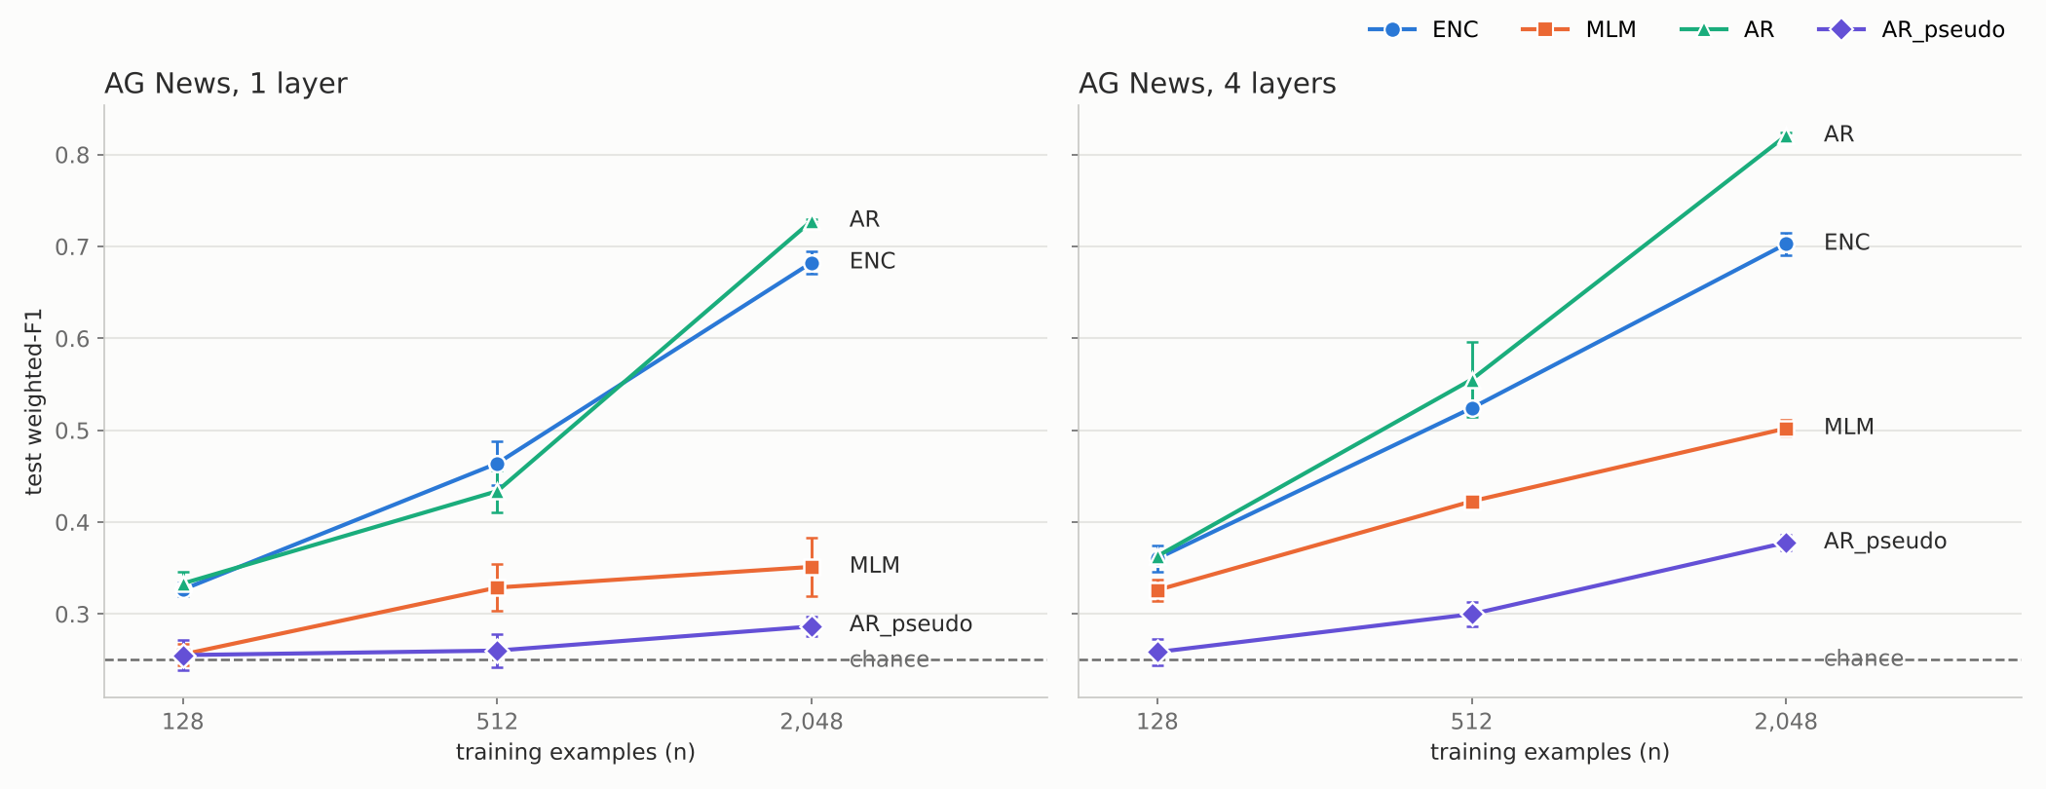
AG News: AR pulls ahead as the data grows
4 layers, n = 2,048: AR 0.821, ENC 0.703, MLM 0.502, AR_pseudo 0.378. At n = 128 AR and ENC are tied (0.363 vs 0.360). Bars show the spread over 2 seeds; chance = 0.25.
Notes:
AR at n = 512 is seed-dependent: seed 0 gives ENC 0.521 vs AR 0.514; seed 1 gives AR the lead. Do not claim AR wins at 512 in every seed.

Slide 15
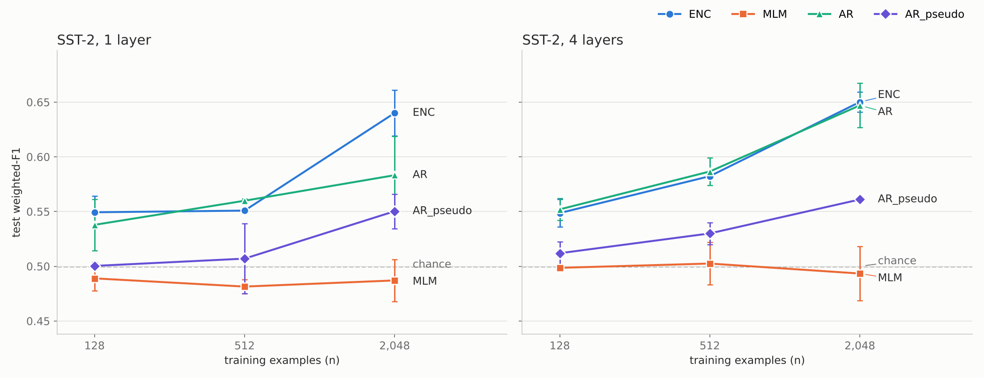
SST-2: a weak signal, and ENC and AR tie
Best result 0.650 (chance 0.5). At 4 layers, n = 2,048: ENC 0.650, AR 0.647; MLM stays at chance. Differences are mostly within seed noise, so SST-2 tells us little at this scale. Scored on the official 1,821-sentence test set.
Notes:
Why so weak: 40 word-level tokens and a 3,000-word vocabulary lose much of the sentiment signal (negation, rare words), and 2,048 examples is small for a from-scratch model. The paper scores SST-2 on the 872-sentence dev set; we use the official test set and keep dev unused.

Slide 16
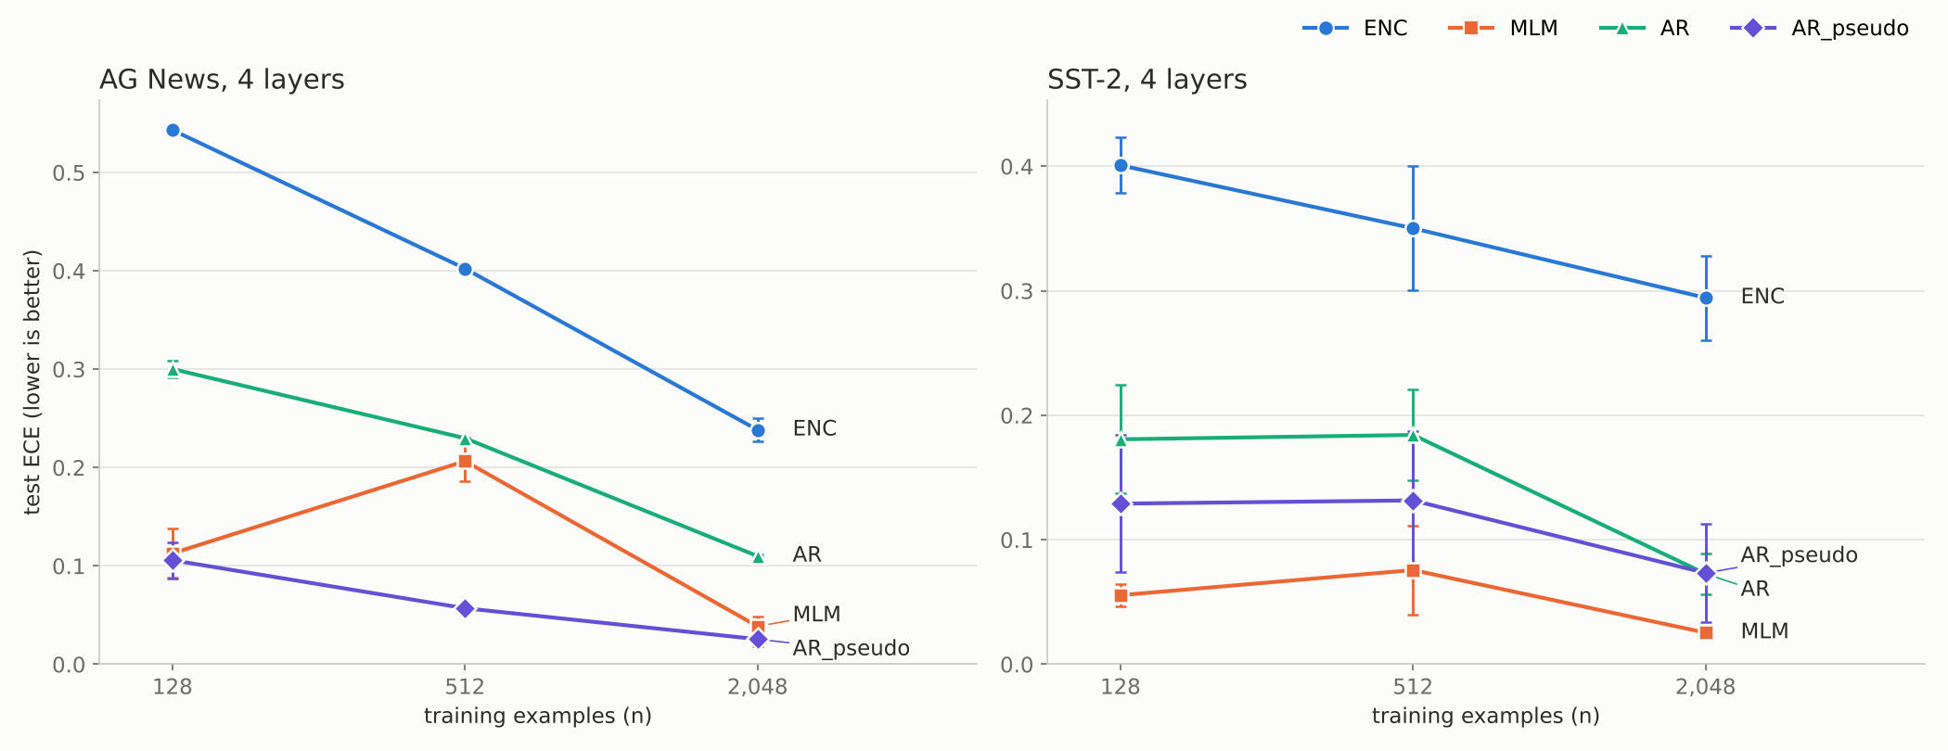
Calibration: our ENC is the worst, unlike the paper's
AG News, 4 layers, n = 2,048 (ECE, lower is better): ENC 0.238, AR 0.110, MLM 0.039, AR_pseudo 0.026. Caution: a model near chance can get a low ECE just by being unsure, as AR_pseudo does here.
Notes:
Likely cause (untested): ENC is over-confident from a high learning rate and many epochs on tiny data. Our AR ECE is not comparable to the paper's because its probabilities come from the sum of log-likelihoods, which is much sharper than the authors' mean-loss scores.

Slide 17
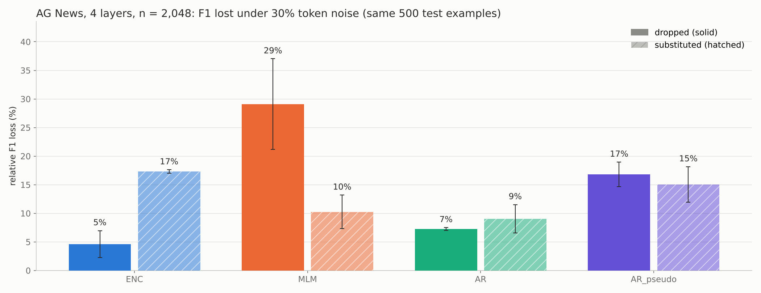
Robustness: dropping tokens hurts our MLM most
F1 lost with 30% of tokens dropped / substituted: ENC 5% / 17%, MLM 29% / 10%, AR 7% / 9%, AR_pseudo 17% / 15%. Clean and noisy F1 on the same 500 test examples.
Notes:
Hypothesis, untested: dropping tokens moves the label slot to an earlier position in the sequence, which MLM and AR_pseudo read the label from; substitution keeps the length. That would explain why they suffer more from dropping than from substitution, the opposite of the paper's finding for all models.

Slide 18
Paper vs us, claim by claim
Paper's claim | Our result (AG News) | Verdict
Generative wins at low data, gap shrinks with data (12 layers) | Tie at n = 128; gap grows to 0.821 vs 0.703 at 2,048 (4 layers) | Not reproduced
1 layer: only ENC keeps improving, best at high data | AR 0.728 vs ENC 0.682 at 2,048; our n stops before “high data” | Can't test
AR_pseudo is weaker than AR with little data | AR_pseudo far below AR at every n (best 0.378 vs AR 0.821) | Reproduced
MLM is best at high data (12 layers) | MLM 0.502, well below AR and ENC | Not reproduced
ENC is well calibrated | ENC has the highest ECE (0.238) | Not reproduced
MLM is least robust to dropped tokens | MLM loses 29%, the most of any model | Reproduced
Substitution hurts more than dropping, all models | True for ENC and AR, not for MLM and AR_pseudo | Partly
AR is sensitive to noise | AR loses 7% / 9% (ENC 5% / 17%); different metric | Not reproduced
Notes:
Most likely reason for the 'not reproduced' rows: our scale (4 layers, n up to 2,048) and our short single-learning-rate training, which probably leaves ENC under-tuned. We have not run an ablation to confirm this, so say 'likely', not 'because'.

Slide 19
Live demo: one cell of the grid, trained live
python repro.py --dataset agnews --layers 4 --sizes 2048 \
--seeds 0 --models ENC AR --out /tmp/demo.jsonl
Expected (deterministic) | weighted-F1 | ECE | 30% dropped | 30% substituted
ENC | 0.715 | 0.226 | 0.663 | 0.587
AR | 0.817 | 0.108 | 0.768 | 0.772
What it shows
AR beats ENC on F1 and is better calibrated, from 2,048 examples
About 7 minutes on one CPU core: start it at the beginning of the talk
Fallback: demo/expected_output_n2048.txt (output of this exact command)
Same code and seed as our stored grid, so the numbers should match to three decimals.

Slide 20
Takeaways
The paper: the generative vs discriminative trade-off depends on model size; there is no single rule.
Our runs: AR is the strongest model on AG News at our scale, but the paper's size-dependent pattern did not reproduce at 1 and 4 layers.
Our caveat: small models, short training and one learning rate; several gaps are within seed noise.
With more compute: 6 and 12 layers, DIFF, subword tokens, per-model tuning, 3 seeds and equal training budgets.

