Slide 1
Bluestock Mutual Fund Analytics
Capstone Project Final Presentation
By Executive Data Team

Slide 2
Problem & Objective
Problem: Fragmented data across 40 schemes leading to poor visibility.
Objective 1: Build a centralized Data Warehouse (Star Schema).
Objective 2: Automate ETL pipelines to ingest live NAV data.
Objective 3: Develop interactive dashboards for executive monitoring.
Objective 4: Compute advanced performance metrics (Sharpe, Alpha, VaR).

Slide 3
Data Sources & Architecture
Internal Data: CSV dumps covering Demographics, Transactions, AUM, and Portfolio Holdings.
External Data: AMFI Public API for live Daily NAV fetching.
ETL Flow: Python/Pandas extraction -> Regex & Type casting -> SQLite Storage.
Schema: Star Schema with Fact (NAV, Performance) and Dimension (Fund, Date) tables.

Slide 4
Architecture Details
Extraction: Concurrent API calls to AMFI
Transformation: Missing value imputation (ffill), Schema enforcement
Loading: SQLite database for lightweight, portable analytical queries
Reporting: Python generated PDFs, PPTX, and BI Dashboard integration

Slide 5
EDA Highlight: AUM Dominance
[Image not found: 2_aum_growth.png]

Slide 6
EDA Highlight: Unstoppable SIP Inflows
[Image not found: 3_sip_inflows.png]

Slide 7
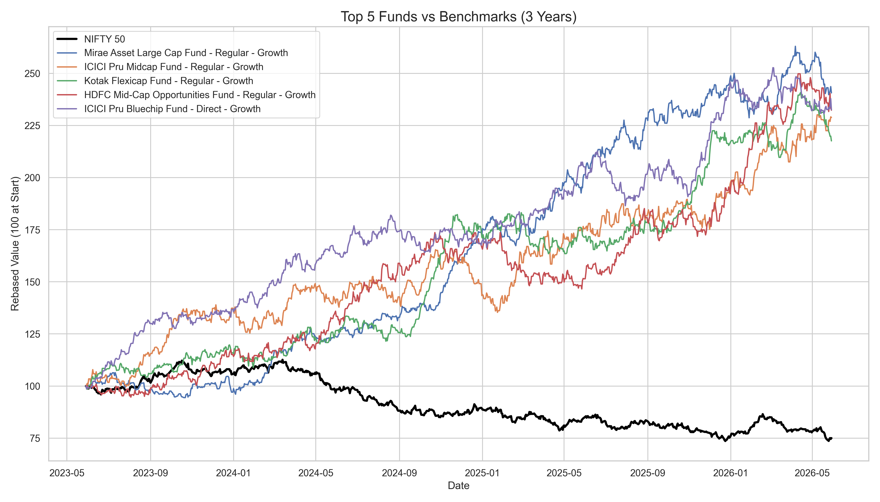
Performance: Benchmark Comparison

Slide 8
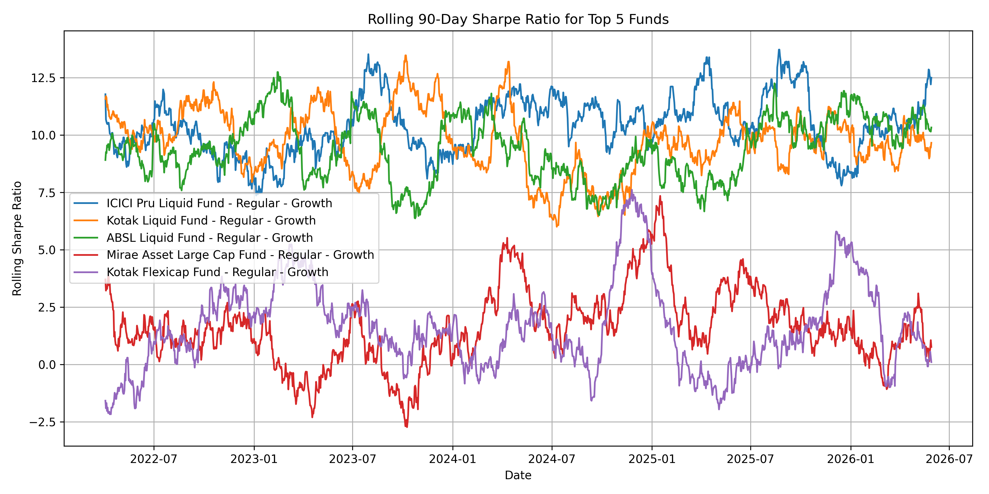
Performance: 30-Day Rolling Sharpe

Slide 9
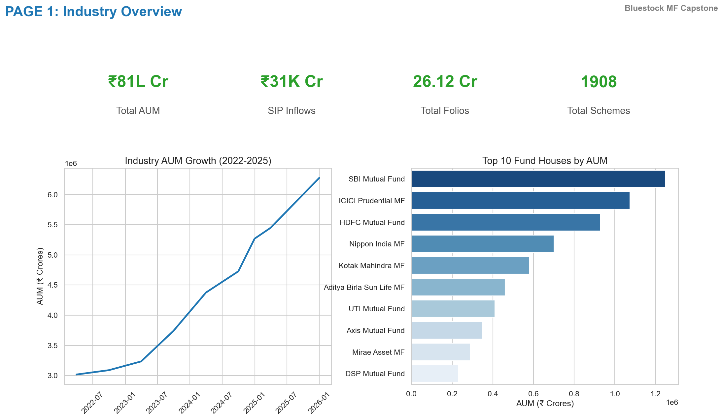
Dashboard: Main Executive View

Slide 10
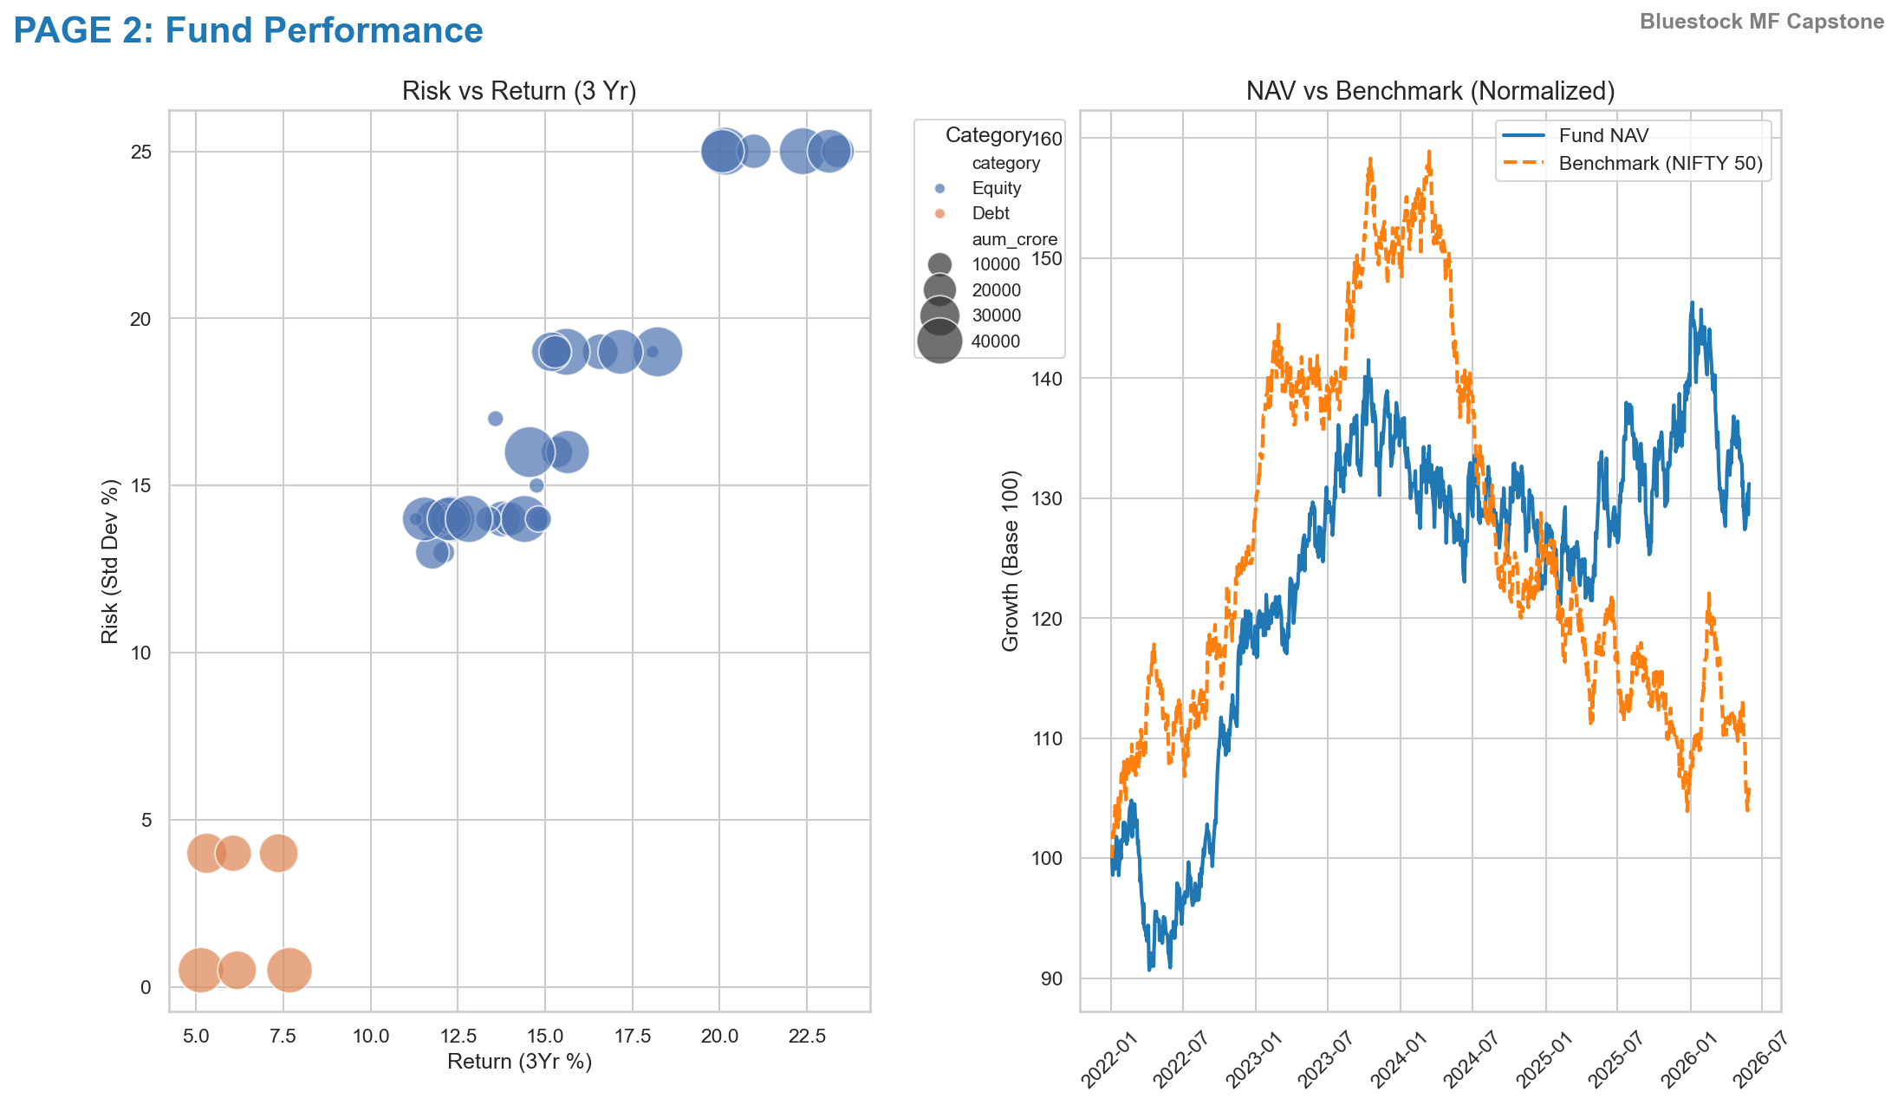
Dashboard: Performance Deep Dive

Slide 11
Key Findings & Recommendations
Finding 1: 2023 Bull run significantly elevated equity fund baselines.
Finding 2: B30 cities represent the highest growth vector.
Rec 1: Target localized marketing campaigns in Tier-2/3 cities.
Rec 2: Implement dynamic hedging for high-beta Small Cap funds.

Slide 12
Thank You
Questions & Answers

