Slide 2
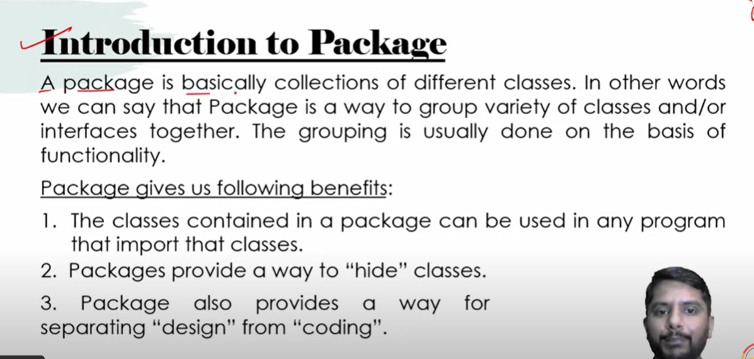

Slide 3
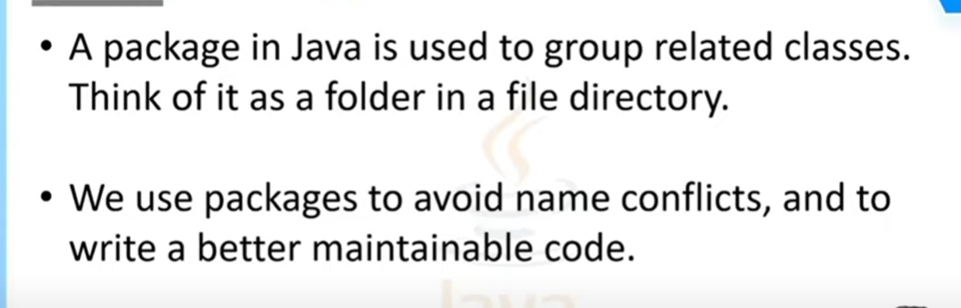
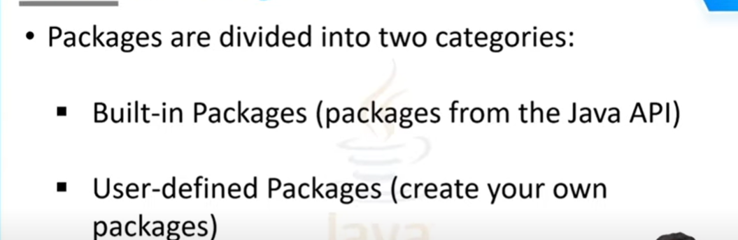

Slide 4
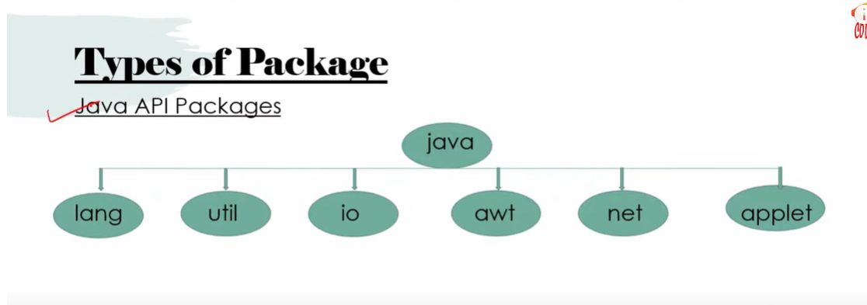

Slide 5
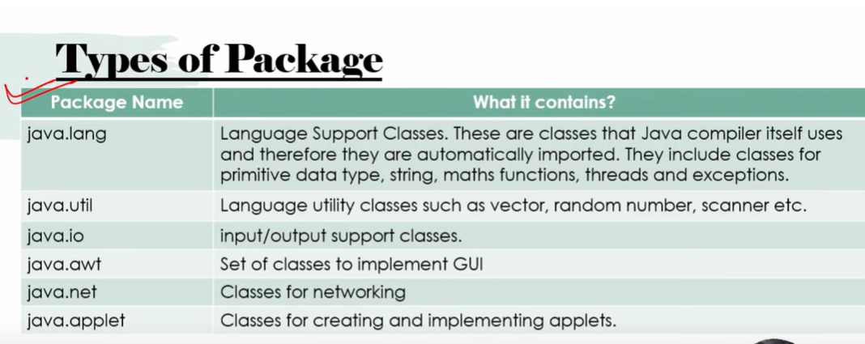

Slide 6
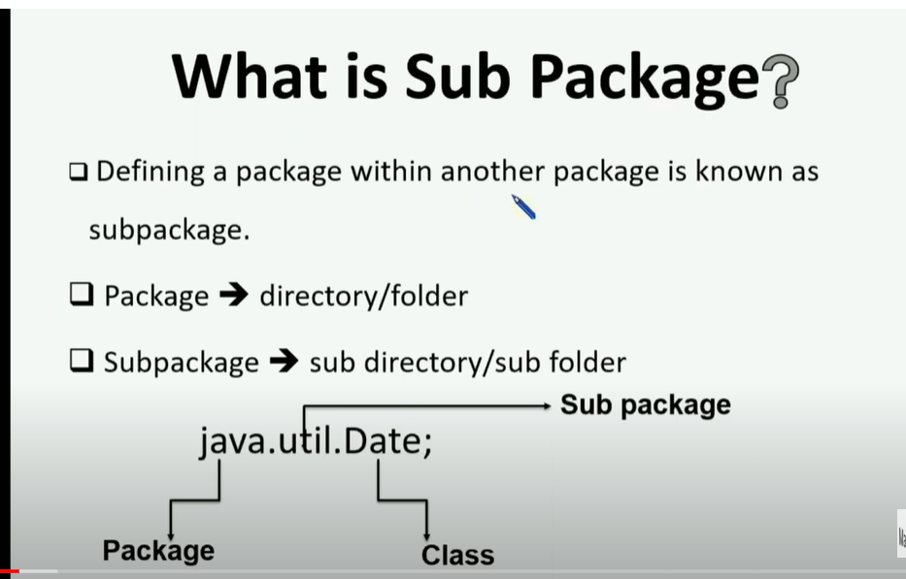

Slide 7
.jar file(java archive)
JAR-Java Archive(It is compressed format of compiled java programs)
It contains .class files + meta data and some other resources.
Direct execution of programs(no need of IDE)
Used to distribute java code/libraries in other projects.

Slide 8
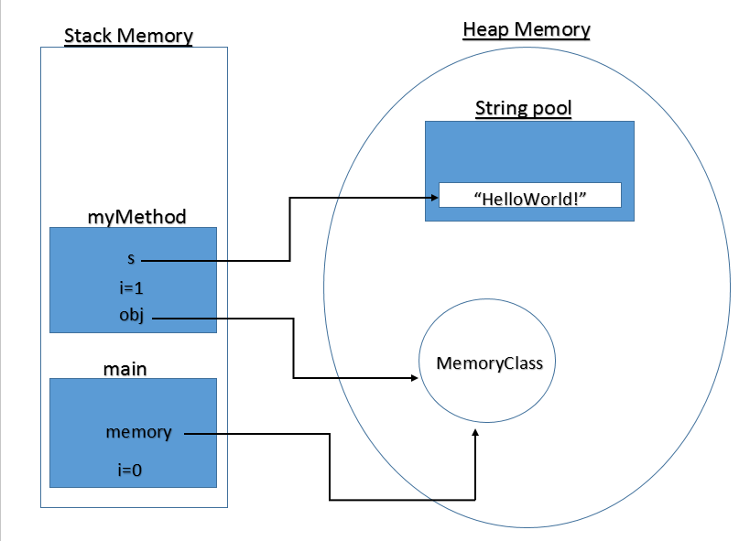
Java Memory Management
Java memory management is done by JVM.

Slide 9
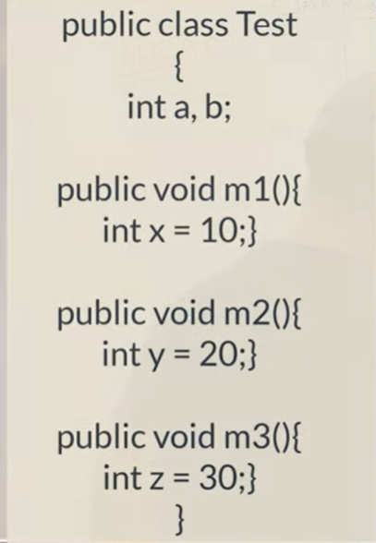
1)Stack(LIFO-Last In First Out)
All Local Variables and method calls gets stored in Stack
x, y, z -local variables
Reference variables
LIFO-allocation first
deallocation last
t
M3=z
M2=y
M1=x
2)Heap memory
Objects are stored in heap memory
Test t=new Test();
t=reference variable in stack
Object in heap
Int a,
int b
Meta space
Stores static…

Slide 10
Static variables and static methods are stored in method area(Meta space.
Method area is part of permanent generation.
Meta-spaces are dynamic in nature.
Meta space is not a part of heap memory
It is dependent on native O.S on which it resides.

Slide 11
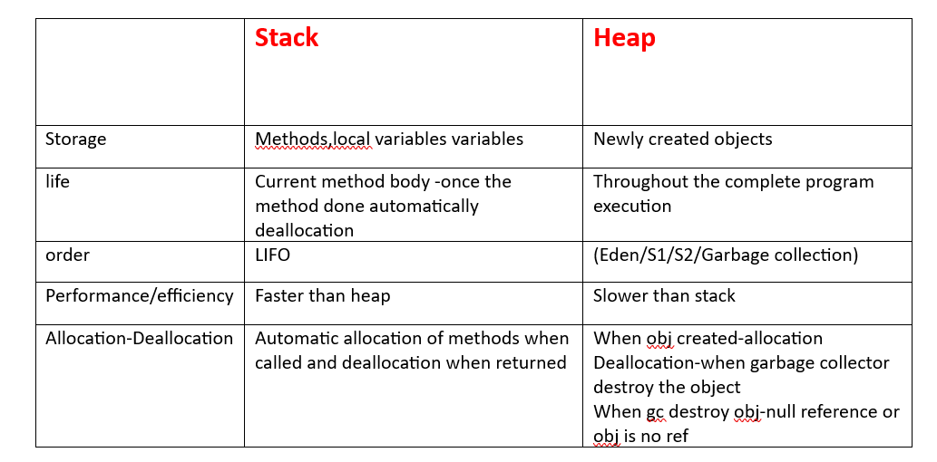
t

Slide 12
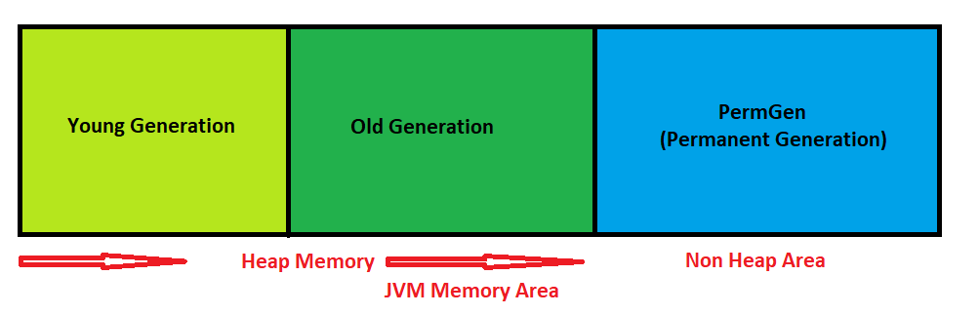
Heap Memory

Slide 13
The heap space is divided into the old and the new generation. The new generation includes the new object space (eden), and two survivor spaces.
The JVM allocates new objects in the eden space, and moves longer lived objects from the new generation to the old generation.
Garbage Collector will automatically called by JVM.

Slide 14
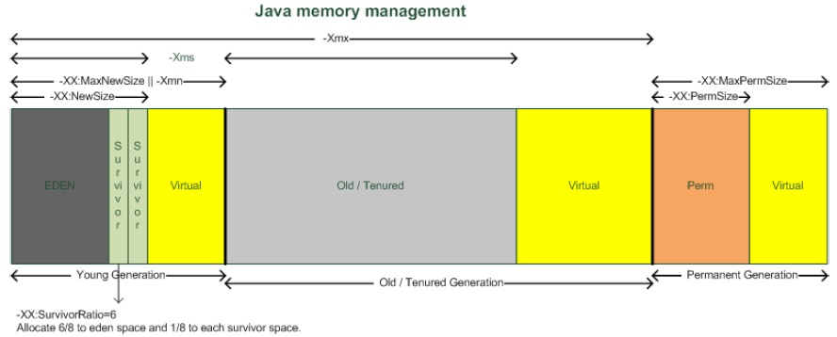

Slide 15
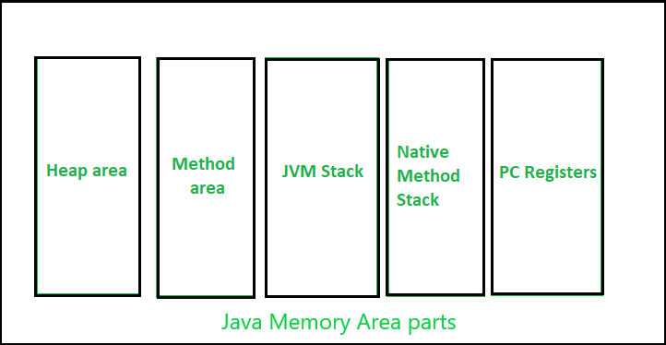
JVM memory area

Slide 16
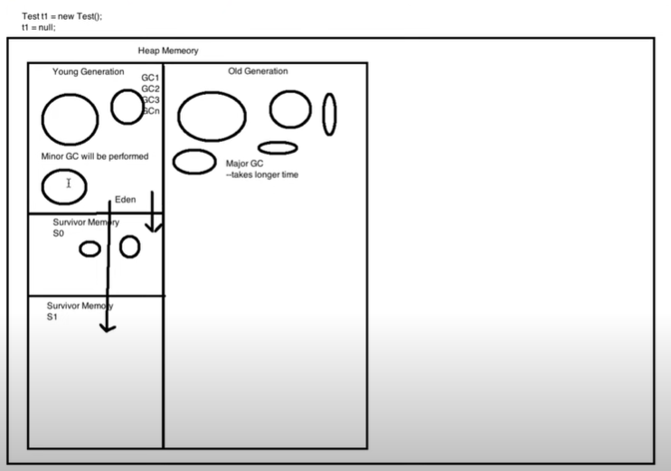

Slide 17
Major gc degrades performance and consumes more time.
Another part ,is permanent generation which contains metadata of classes and methods.
Permanent generation is not a part of heap memory.
Permanent gen memory is created at run time.
One more thing is there in per.gen is method area and Run time constant pool is part of method area.
Method area contains-whole class structure, static variables

Slide 18
Memory pool is part of heap memory.
Memory pool is used to store immutable objects.(String class,strin pools)
Define by JVM at run time.

Slide 19
