Slide 1






Syntax Analysis/Parsing

Slide 2





Slide 3
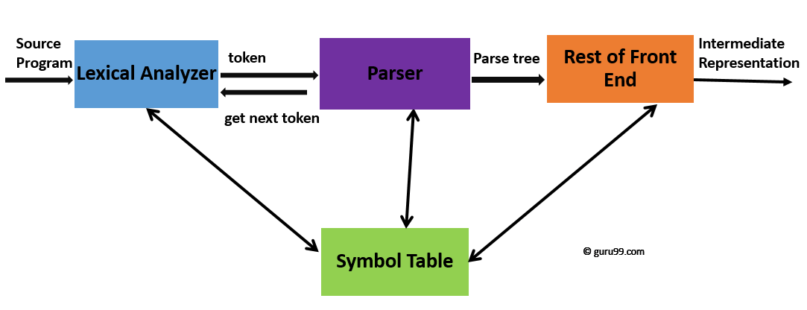
What is Syntax Analysis?
Syntax Analysis is a second phase of the compiler design process in which the given input string is checked for the confirmation of rules and structure of the formal grammar.
It analyses the syntactical structure and checks if the given input is in the correct syntax of the programming language or not.

Slide 4
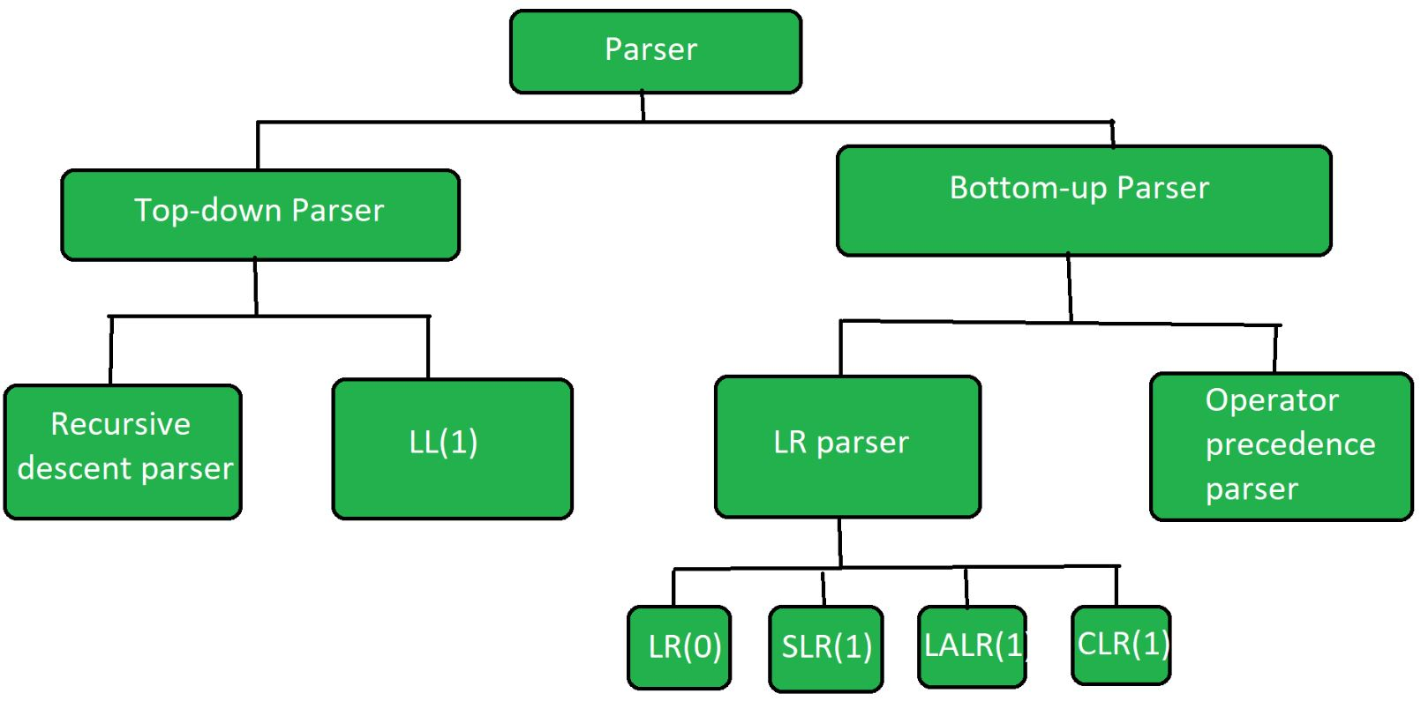
Parsing Techniques

Slide 5
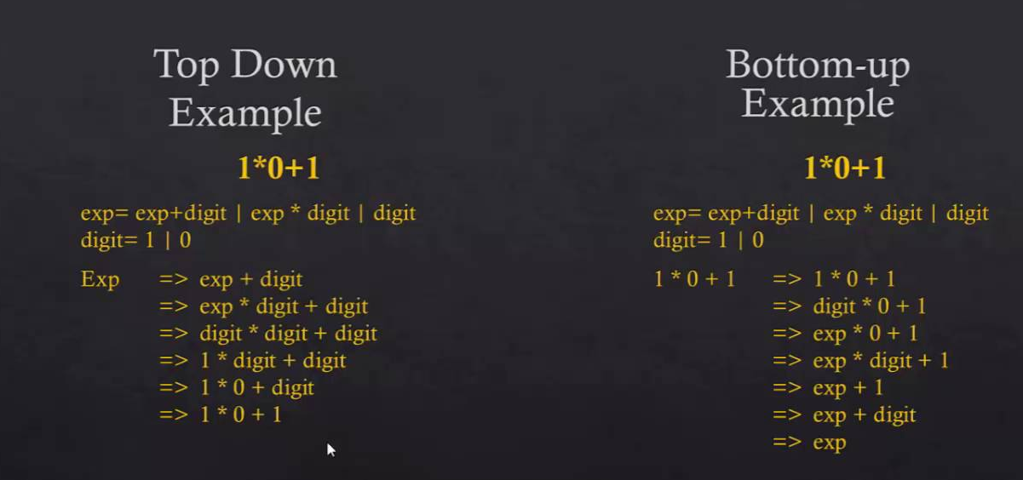

Slide 6
Top Down parsers
A top-down parser builds the parse tree from the top down, starting with the start nonterminal.
As an example, suppose we want to build a parse tree for expression n + n * n using the following grammar.
E → T R
R → ε
R → + E
T → F S
S → ε
S → * T
F → n
F → ( E )

Slide 7
The parser starts by building the top node of the tree from the start nonterminal, E.
E
There is only one production with E on its left-hand side, so that must be the one to use.
E
/ \
T R
Since the parser reads the sequence of tokens from left to right, it builds the tree from left to right too. It is creating a leftmost derivation.
The next step is to expand a little more of the tree beneath the leftmost nonterminal, T. Since there is only one production with T on the left-hand side, we use it.
E
/ \
T R
/ \
F S

Slide 8
There are two productions that have F on the left-hand side, and the parser needs to decide which to use.
Our parsers will make decisions based on a single lookahead token. The lookahead is the next token that has not yet been put into the tree. For expression n + n * n, the initial lookahead is n.
Production F → ( E ) will not work, because the lookahead is not a left parenthesis. We use F → n.
E
/ \
T R
/ \
F S
|
n
Now the leftmost nonterminal is S and the lookahead is +. Production S → * T will not work because * does not match +. The only other possibility is S → ε.
E
/ \
T R
/ \
F S
| |
n ε

Slide 9
Now we need to expand the subtree labeled R.
It is a little less obvious here that production R → ε will not work, but the only one that has a chance of matching the lookahead, +, is R → + E.
E
/ \
/ \
T R
/ \ / \
F S + E
| |
n ε
The parser continues this process. Eventually, it will have built the entire parse tree.
E
/ \
/ \
T R
/ \ / \
F S + E
| | / \
n ε / \
T R
/ \ |
F S ε
| / \
n * T
/ \
F S
| |
n ε

Slide 10
Recursive Descent
General form of top-down parsing which may involve backtracking (making repeated scans of input)
A recursive-descent parser consists of several small functions, one for each non terminal in the grammar.
As we parse a sentence, we call the functions that correspond to the left side non terminal of the productions we are applying.
If these productions are recursive, we end up calling the functions recursively.

Slide 11
A typical procedure for NT
Void A() {
choose an A production A-> X1X2…Xk;
for(i=1 to k){
if ( Xi is a NT )
call procedure Xi();
else if (Xi ==Current input symbol a)
advance the input to the next symbol;
else
error;
}
}

Slide 12
Recursive Descent - Example
S->cAd
A-> ab|a
Input string w=cad
Parse Trees in top-down fashion
S S S
/ | \ / | \ / | \
c A d c A d c A d
/ \ |
a b a
main()
{S();
S()
{ match(c);A();match(d);}

Slide 13
A parsing function N() for nonterminal N will simply contain logic to pick a rule based on the current lookahead, followed by code to match each individual rule.
Its structure will look something like the following:
N() {
if (lookahead can start first rule for N) {
match rule 1 for N
}
else if (lookahead can start second rule for N) {
match rule 2 for N
}
... ...
else if (lookahead can start n'th rule for N) {
match rule n for N
else {
error();
}
}

Slide 14
Example
// Definition of E, as per the given production
E()
{
if (l == 'i') {
match('i');
E'();
}
}
// Definition of E' as per the given production
E'()
{
if (l == '+') {
match('+');
match('i');
E'();
}
else
return ();
}
// Match function
match(char t)
{
if (l == t) {
l = getchar();
//getnexttoken
}
else
printf("Error");
}
Consider the Grammar:
E --> i E’ i+i---E→iE’----E→i+iE’---E→i+i Ɛ→i+i
E' --> + i E' | Ɛ
int main()
{
// E is a start symbol.
//line no. 1// E();
// if lookahead = $, it represents the end of the string
// Here l is lookahead.
//line no. 2 // if (l == '$')
//line no. 3// printf("Parsing Successful");
}

Slide 15
Parsing of a string
Recursive stack is used to parse the input string
i+i $
main( )///stop at line no. 2
E( ) ////stops at line no. 4////l==i///yes
E’ ( )
E’

Slide 16
Example
An Example
Consider the following simple grammar for assignment statements with expressions involving addition or subtraction:
1) stmt: ID ':=' expr
2) expr: expr '+' NUM
3) expr: expr '-' NUM
4) expr: NUM
This grammar allows statements like a:= 1 + 2 - 3. Since the rules for expr are left recursive, we need to transform the grammar to the following:
1) stmt: ID ':=' expr
2) expr: NUM exprRest
3) exprRest: '+' NUM exprRest
4) exprRest: '-' NUM exprRest
5) exprRest: /* empty */

Slide 17
Assuming that the current lookahead is in a global variable tok, we can write the parsing procedures in pseudo-C as follows:
stmt() {
match(ID); match(':='); expr();
}
expr() {
match(NUM); exprRest();
}
exprRest() {
if (tok == '+') { /* rule 3 */
match('+'); match(NUM); exprRest();
}
else if (tok == '-') { /* rule 4 */
match('-'); match(NUM); exprRest();
}
else { /* rule 5 */
}
}
Note that exprRest() chooses rule 5 if the lookahead cannot match any of the other rules for exprRest. It would have also been correct to choose rule 5 only if the current lookahead was a token which can follow exprRest, but the method used above is simpler with the sole disadvantage that errors are detected later.

Slide 18
The match() procedure merely needs to check if the current lookahead in tok matches its argument and advance the input:
match(Token t) {
if (tok == t) {
tok= nextToken();
}
else {
error():
}
}
where we assume that nextToken() is the interface to the scanner and returns the next token from the input stream.

Slide 19
All that remains is to make sure we startup and terminate the parser correctly:
parse() {
tok= nextToken();
stmt();
match('<EOF>');
}
The first line merely primes the global variable used for the lookahead token.
The second line calls the parsing procedure for stmt.
Finally, assuming that '<EOF>' is the token used to represent the end of the input stream,
the last line ensures that no garbage follows a legal stmt.

Slide 20
Problems in Recursive-Descent
Difficult to convert grammars into EBNF
Cannot decide which production to use at each point
Cannot decide when to use Ɛ-production A→ Ɛ
A recursive descent parser cannot be written for a grammar which contains such directly (or indirectly) left recursive rules

